Slide 1
How thick is a leaf? Calibrating and measuring
Notes:
Science and Plants for Schools - www.saps.org.uk Calibrating and measuring in microscopy - a paper-based activity
Resource 6371 – Released 2025
Image of sunflower on this slide by Mollyroselee from Pixabay

Slide 2
How thick is a leaf?
How thick is a sunflower leaf in millimetres (mm)?
What is this thickness in micrometres (μm)?
Notes:
Image of sunflower on this slide by Mollyroselee from Pixabay

Slide 3
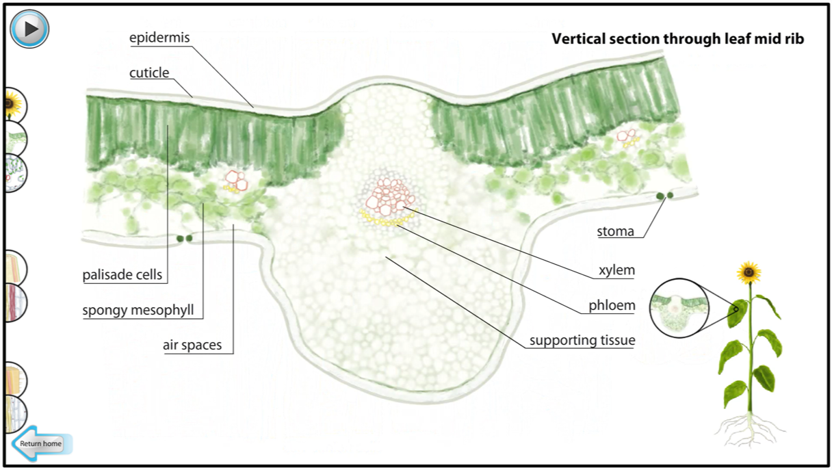
The structure of a leaf
Notes:
Modified screenshot from ‘Transport of water and sugar in plants’ section of the ‘Plant Biology’ animation on the Science and Plants for Schools website

Slide 4
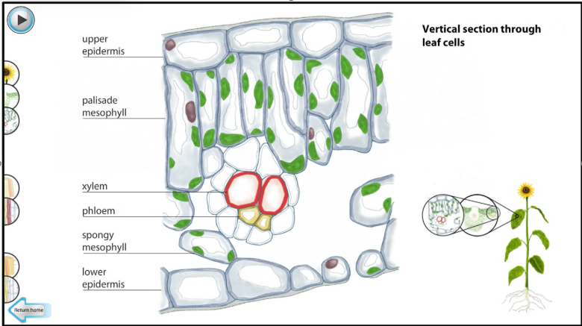
The structure of a leaf
Notes:
Modified screenshot from ‘Transport of water and sugar in plants’ section of the ‘Plant Biology’ animation on the Science and Plants for Schools website

Slide 5
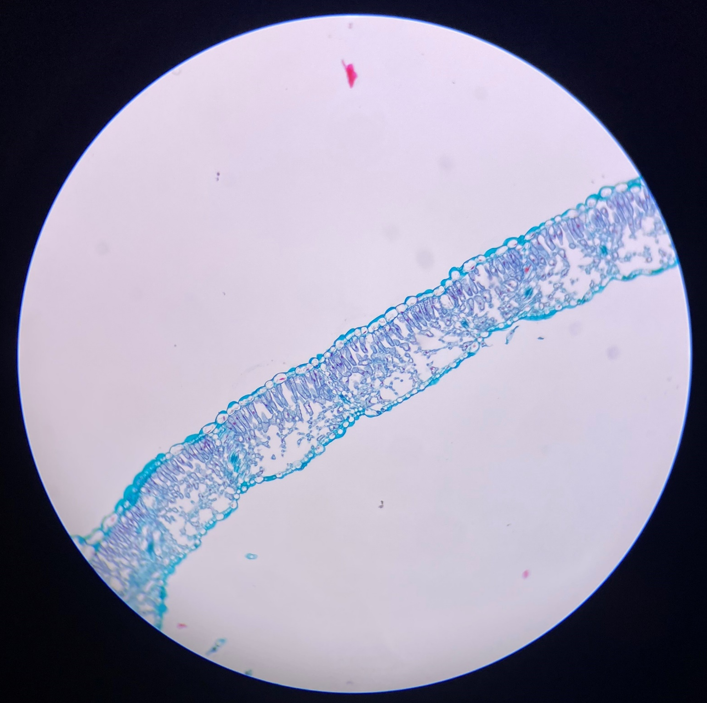
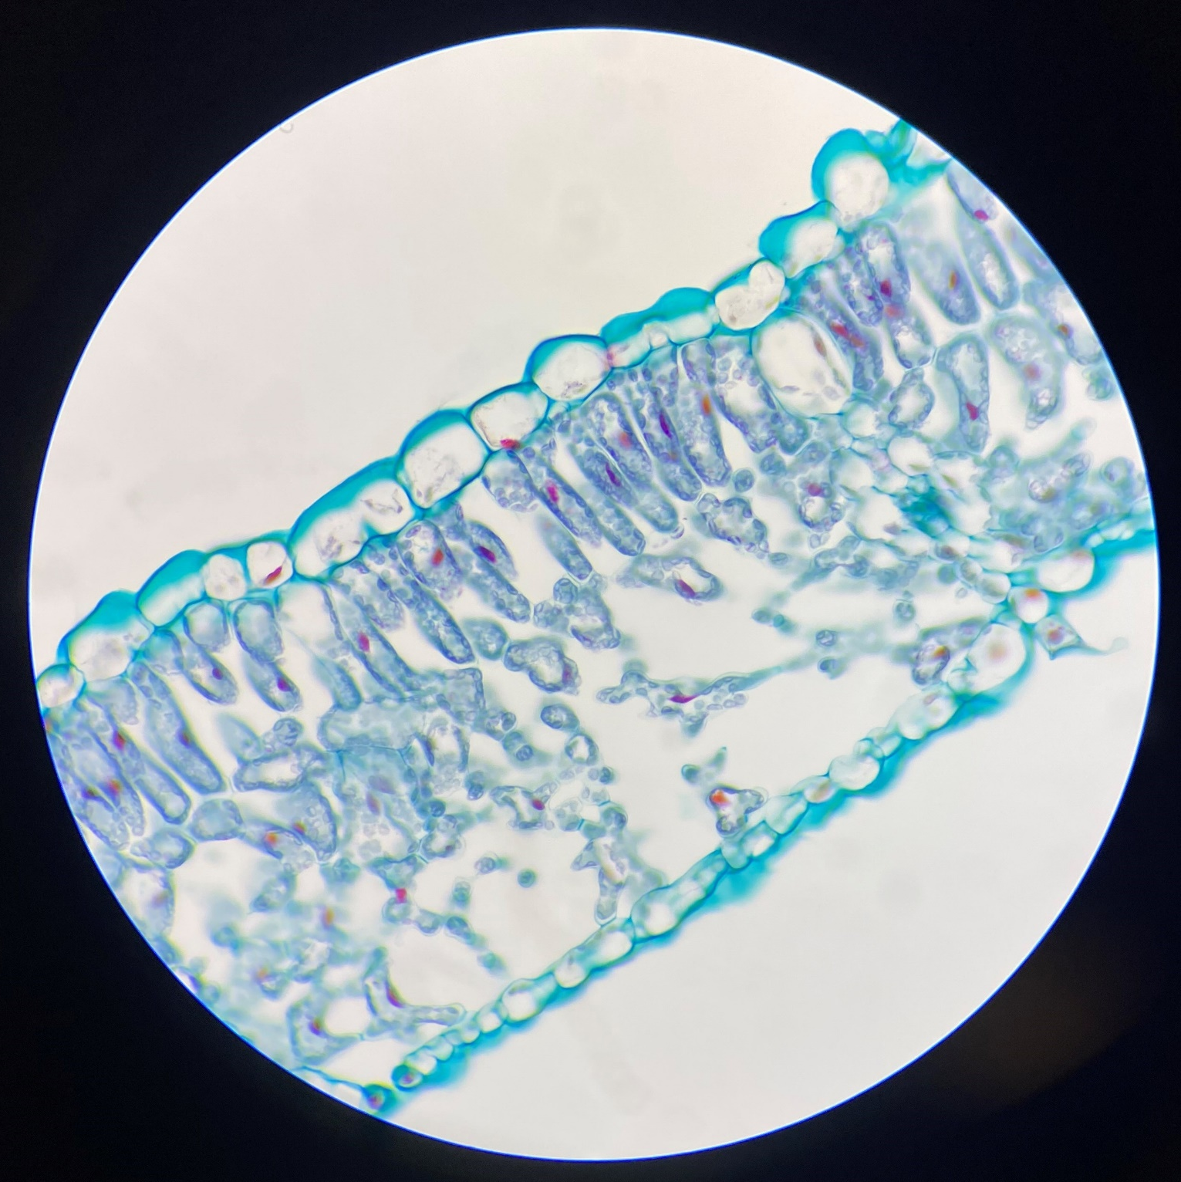
Images of a section through a sunflower leaf
A
A
A
B
B
B
Viewed under a
magnification of x40
Viewed under a
magnification of x100
Viewed under a
magnification of x400

Slide 6
An eyepiece graticule
An eyepiece graticule sits in the microscope’s eyepiece and allows you to measure what you’re viewing under the microscope in eyepiece units (EPUs).

Slide 7
Measuring the thickness of a leaf in EPUs
Line up your image of the eyepiece graticule with the line showing you where to measure the thickness of the leaf (see image).
Measure the thickness of the leaf in EPUs at all 3 magnifications.
Put your results in a table.
Objective lens | Overall magnification with a x10 eyepiece | Thickness of the leaf (EPUs) | Thickness of the leaf (μm)
x4 | x40
x10 | x100
x40 | x400

Slide 8
Calibrating the eyepiece graticule
To calibrate an eyepiece graticule you need a stage micrometer.
You have an image of what a stage micrometer looks like at each magnification.
Use these to calculate how many µm each EPU represents at each magnification.
Put your results in a table.
Objective lens | Overall magnification with a x10 eyepiece | Distance one EPU represents / µm
x4 | x40
x10 | x100
x40 | x400

Slide 9
Calculating the thickness of a leaf in µm
Use your values from measuring leaf thickness in EPUs and those from calibrating the eyepiece graticule to calculate the thickness of the leaf.
You are measuring the same leaf at the same point in all 3 images so the values should be very similar.
Objective lens | Overall magnification with a x10 eyepiece | Thickness of the leaf (EPUs) | Thickness of the leaf (μm)
x4 | x40
x10 | x100
x40 | x400
$$× =$$
Objective lens | Overall magnification with a x10 eyepiece | Distance one EPU represents / µm
x4 | x40
x10 | x100
x40 | x400
Thickness in EPUs x How many µm one EPU represents = Thickness in µm

Slide 10
Example answers
Objective lens | Overall magnification with a x10 eyepiece | Thickness of the leaf (EPUs) | Thickness of the leaf (μm) (3SF)
x4 | x40 | 0.9 | 237
x10 | x100 | 2.3 | 237
x40 | x400 | 9.0 | 239
Objective lens | Overall magnification with a x10 eyepiece | Distance one EPU represents / µm (5SF)
x4 | x40 | 1000/3.8 = 263.16
x10 | x100 | 1000/9.7 = 103.09
x40 | x400 | 350/13.2 = 26.515
Note: values may vary due to slight distortions around the edge of the field of view and decisions made when measurements fall between gradations on the eye piece graticule.

