Slide 1
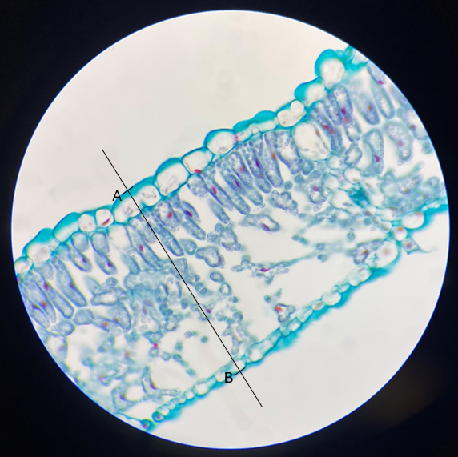
Calibrating and measuring: a paper-based activity
Slides for printing
Notes:
Science and Plants for Schools - www.saps.org.uk
Calibrating and measuring in microscopy - a paper-based activity
Resource 6371 – Released 2025
All images taken by SAPS

Slide 2
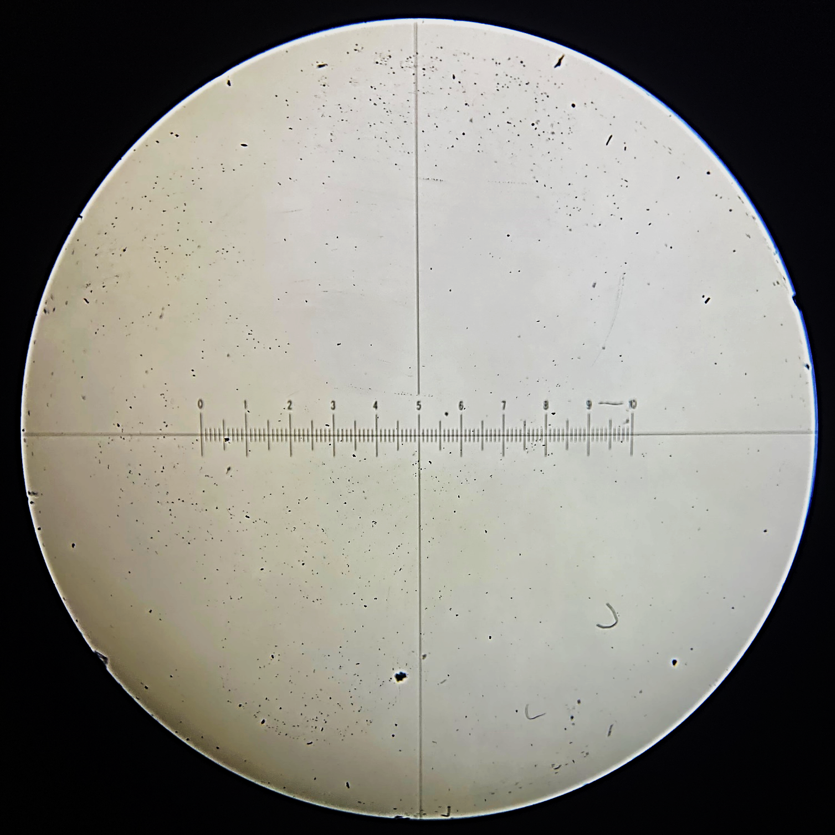
0-10 Eyepiece graticule
Notes:
Print on acetate

Slide 3
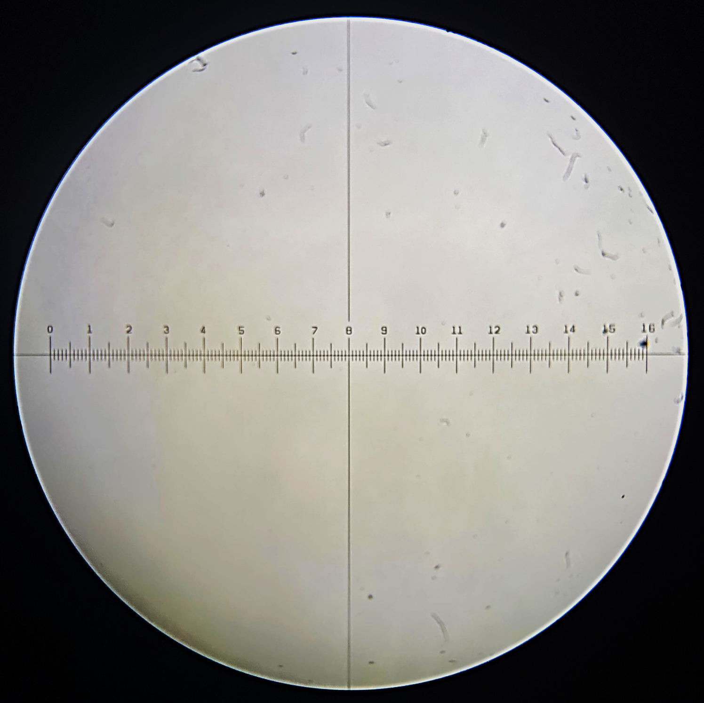
0-16 Eyepiece graticule
Notes:
Print on acetate

Slide 4
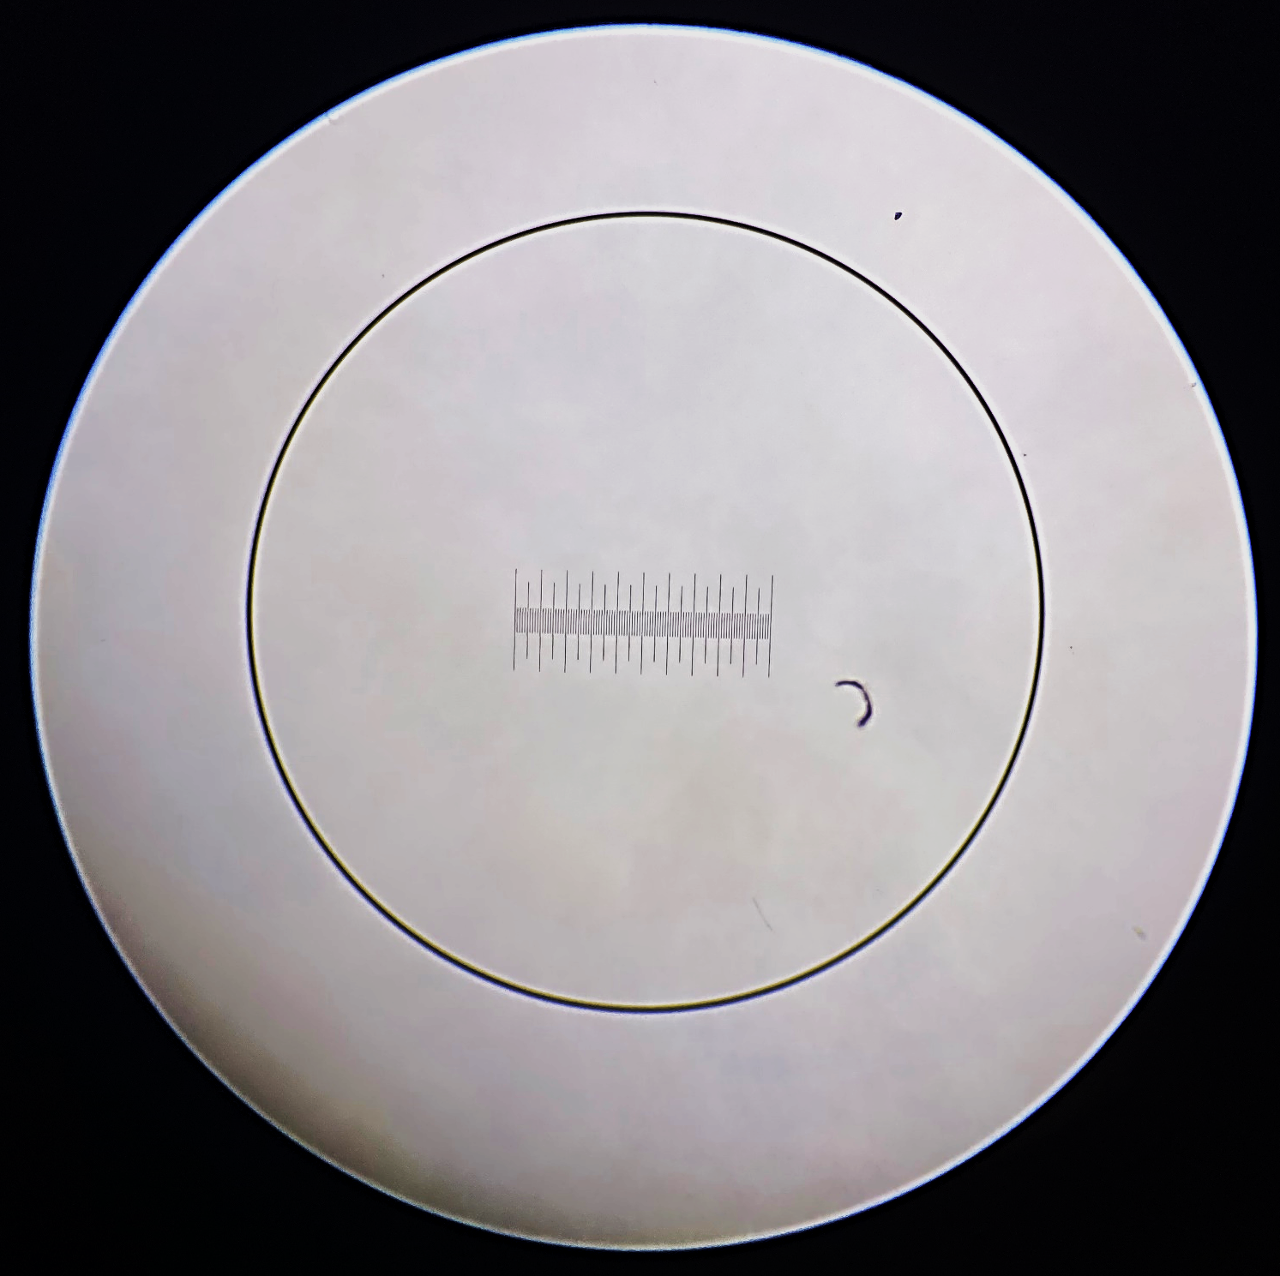
Stage micrometer
1mm long
Smallest division = 10µm
Viewed under a
magnification of x40
Notes:
Print on paper

Slide 5
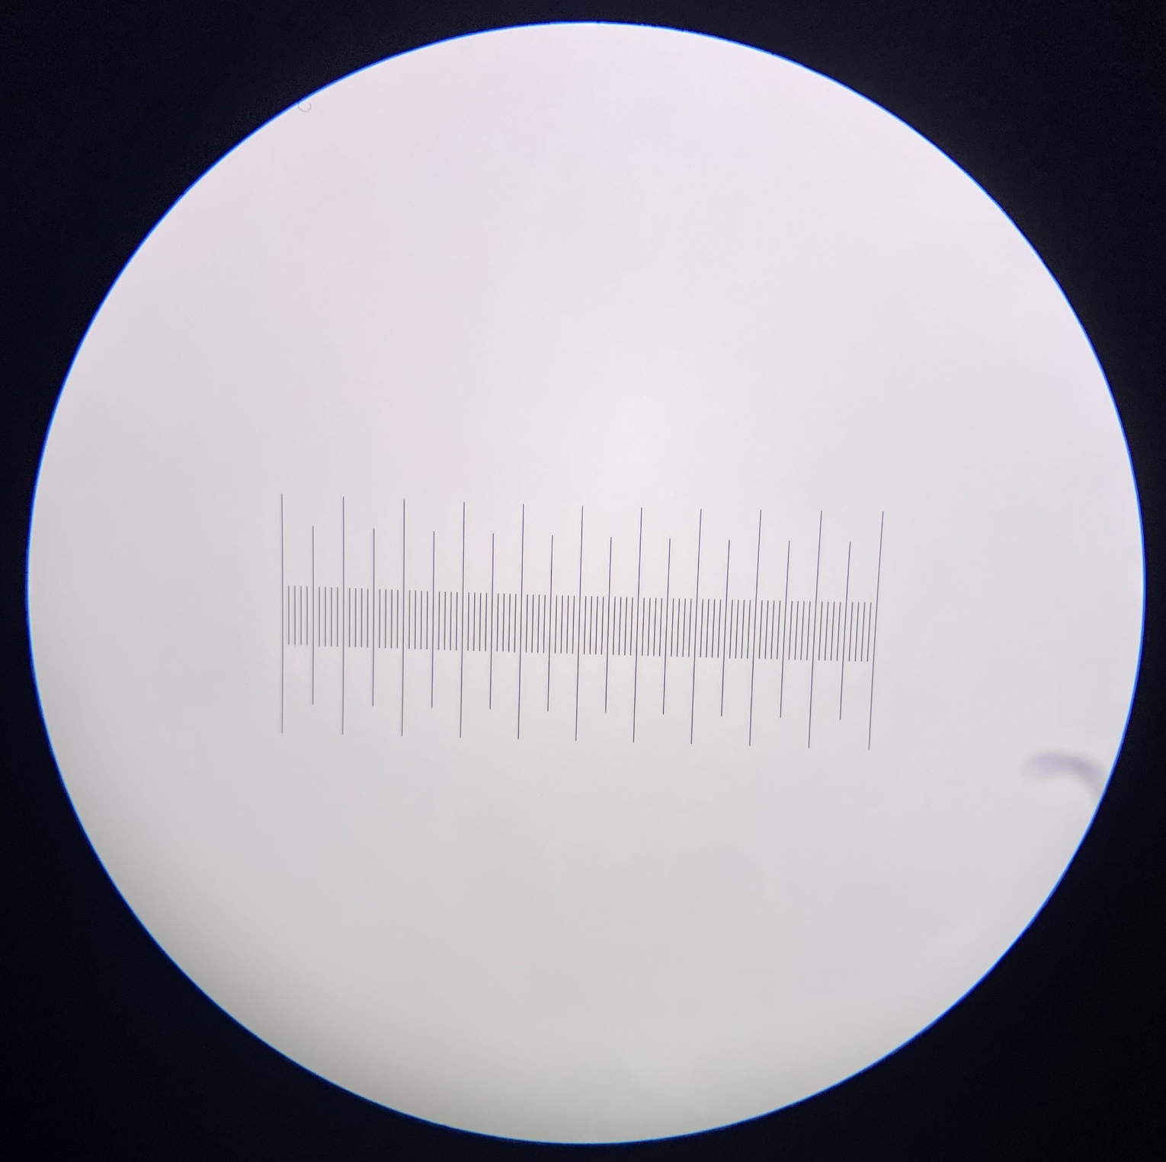
Stage micrometer
1mm long
Smallest division = 10µm
Viewed under a
magnification of x100
Notes:
Print on paper

Slide 6
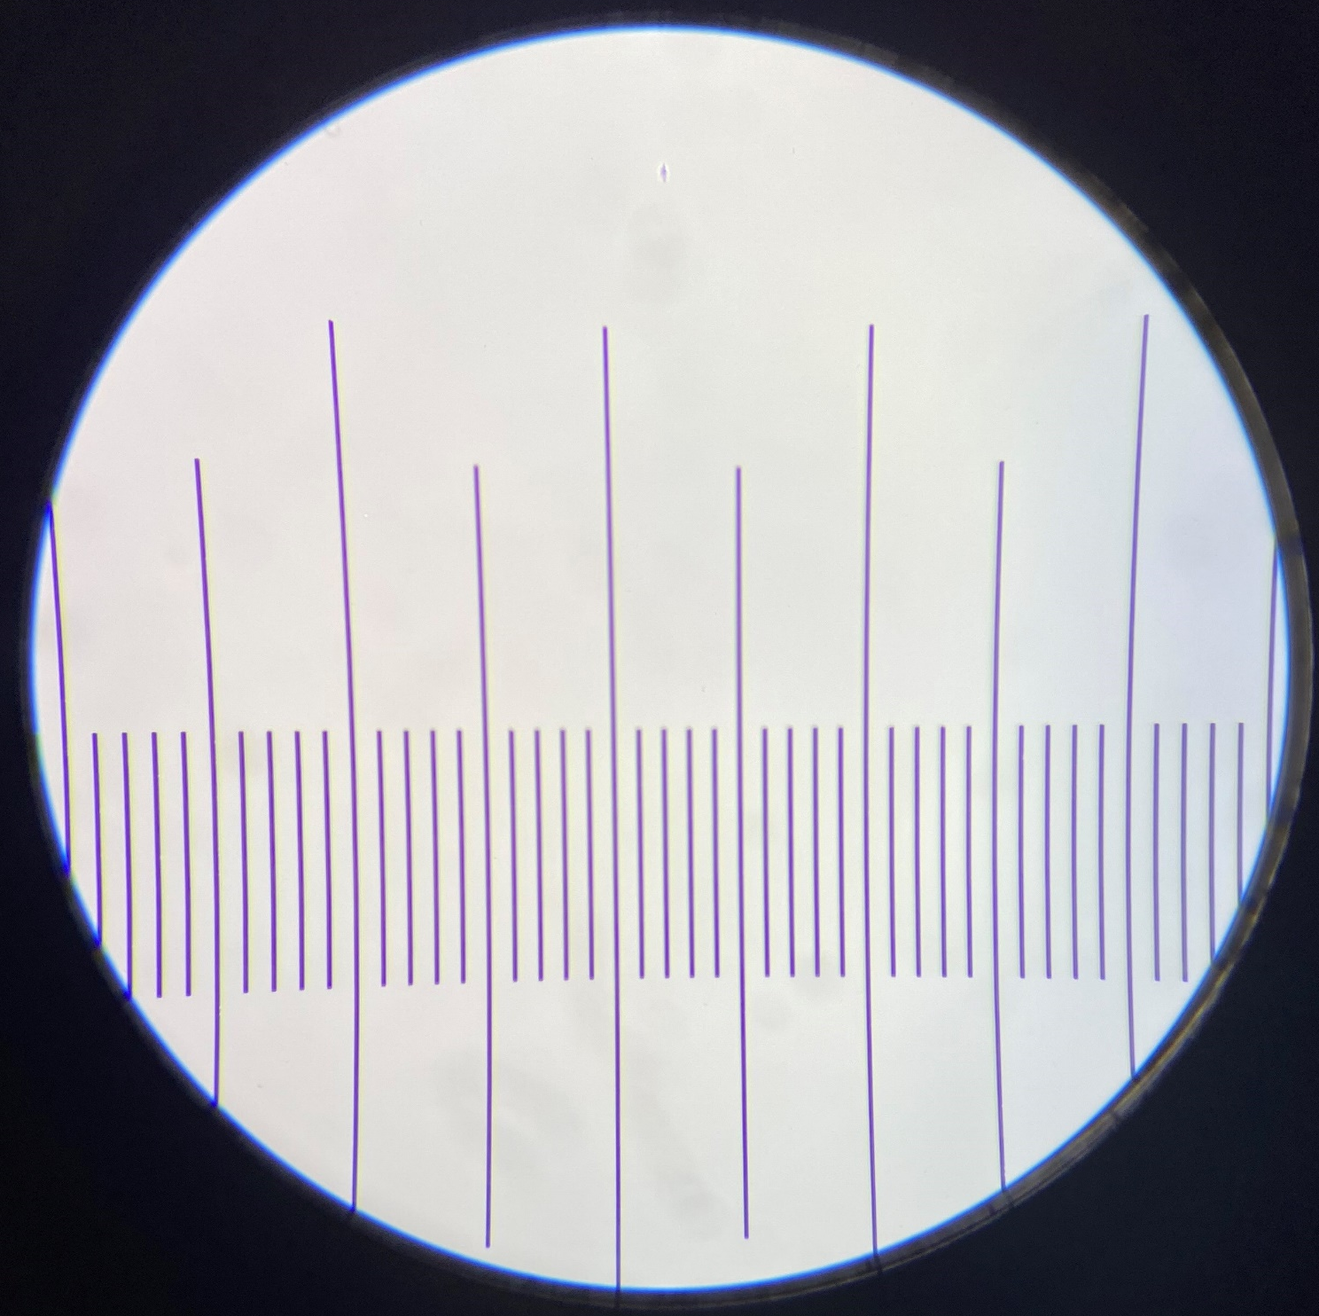
Stage micrometer
1mm long
Smallest division = 10µm
Viewed under a
magnification of x400
Notes:
Print on paper

Slide 7
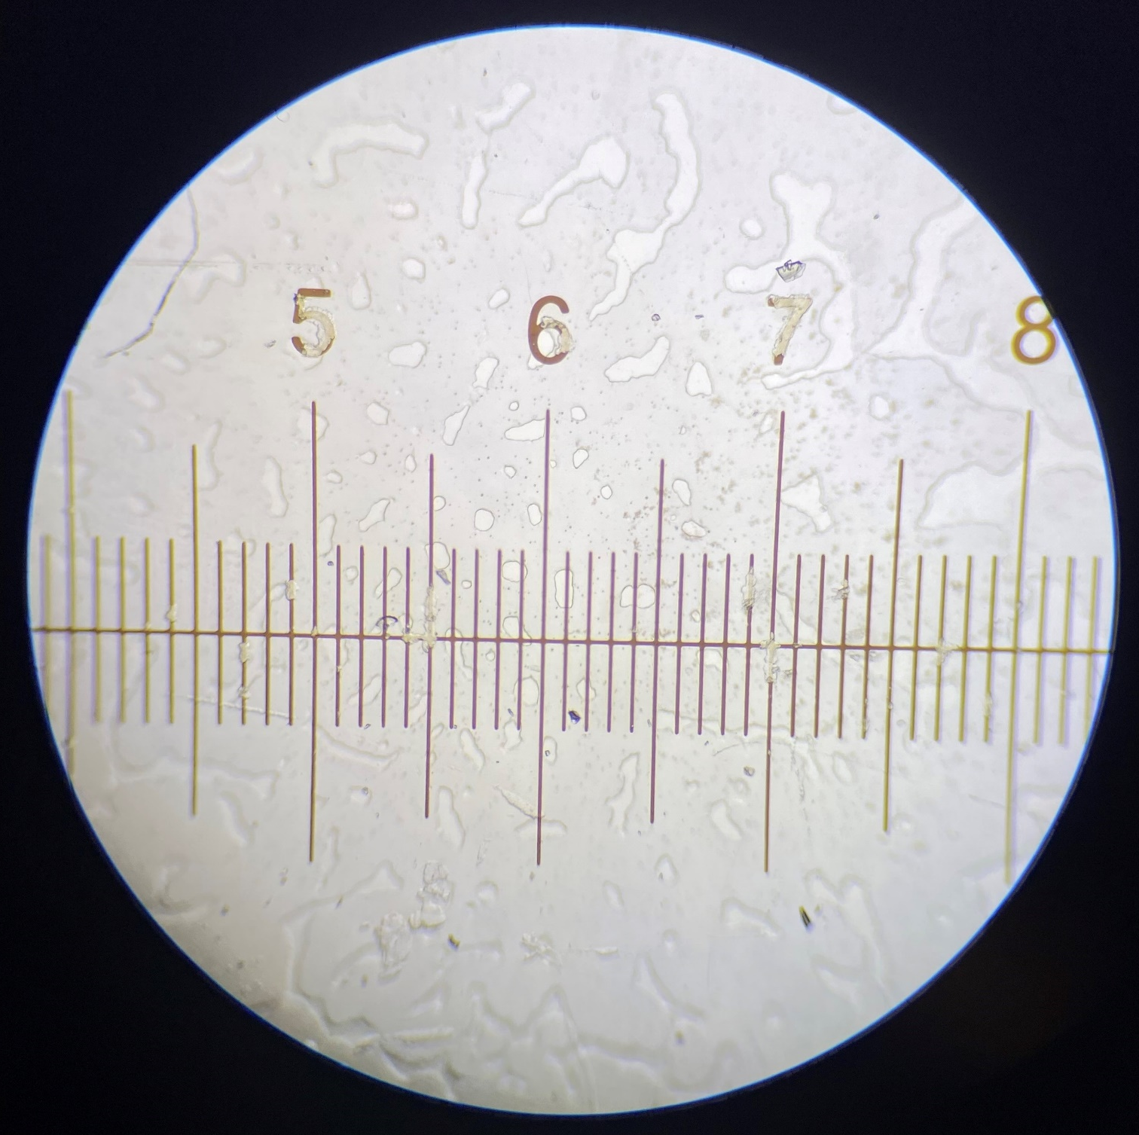
Stage micrometer
1cm long in total
Numbered divisions = 1mm
Smallest division = 100µm
Viewed under a
magnification of x40
Notes:
Print on paper

Slide 8
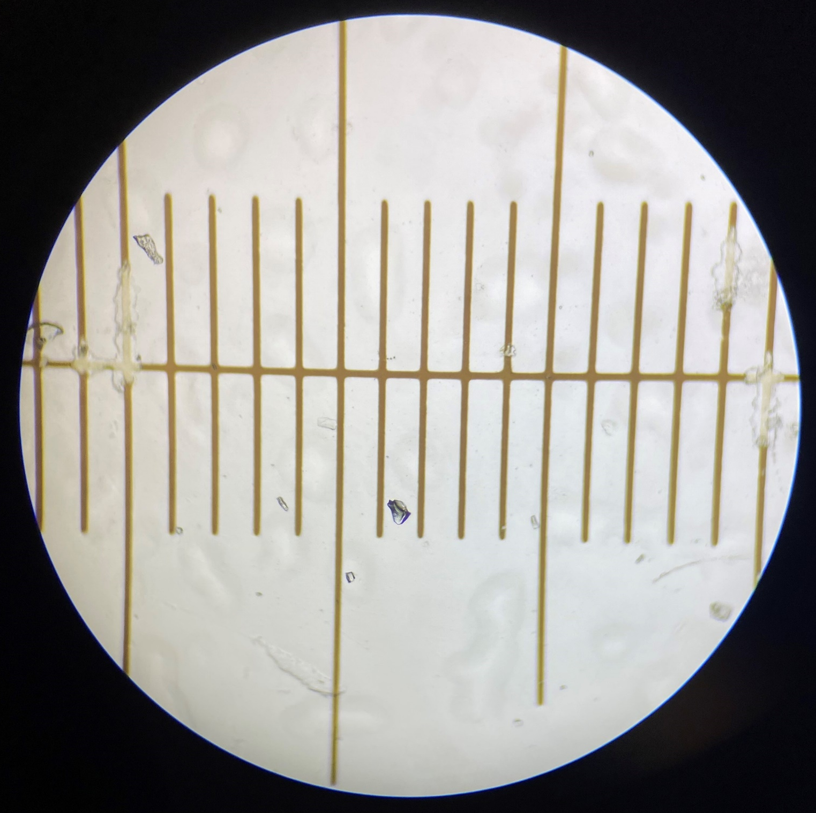
Stage micrometer
1cm long in total
Numbered divisions = 1mm
Smallest division = 100µm
Viewed under a
magnification of x100
Notes:
Print on paper

Slide 9
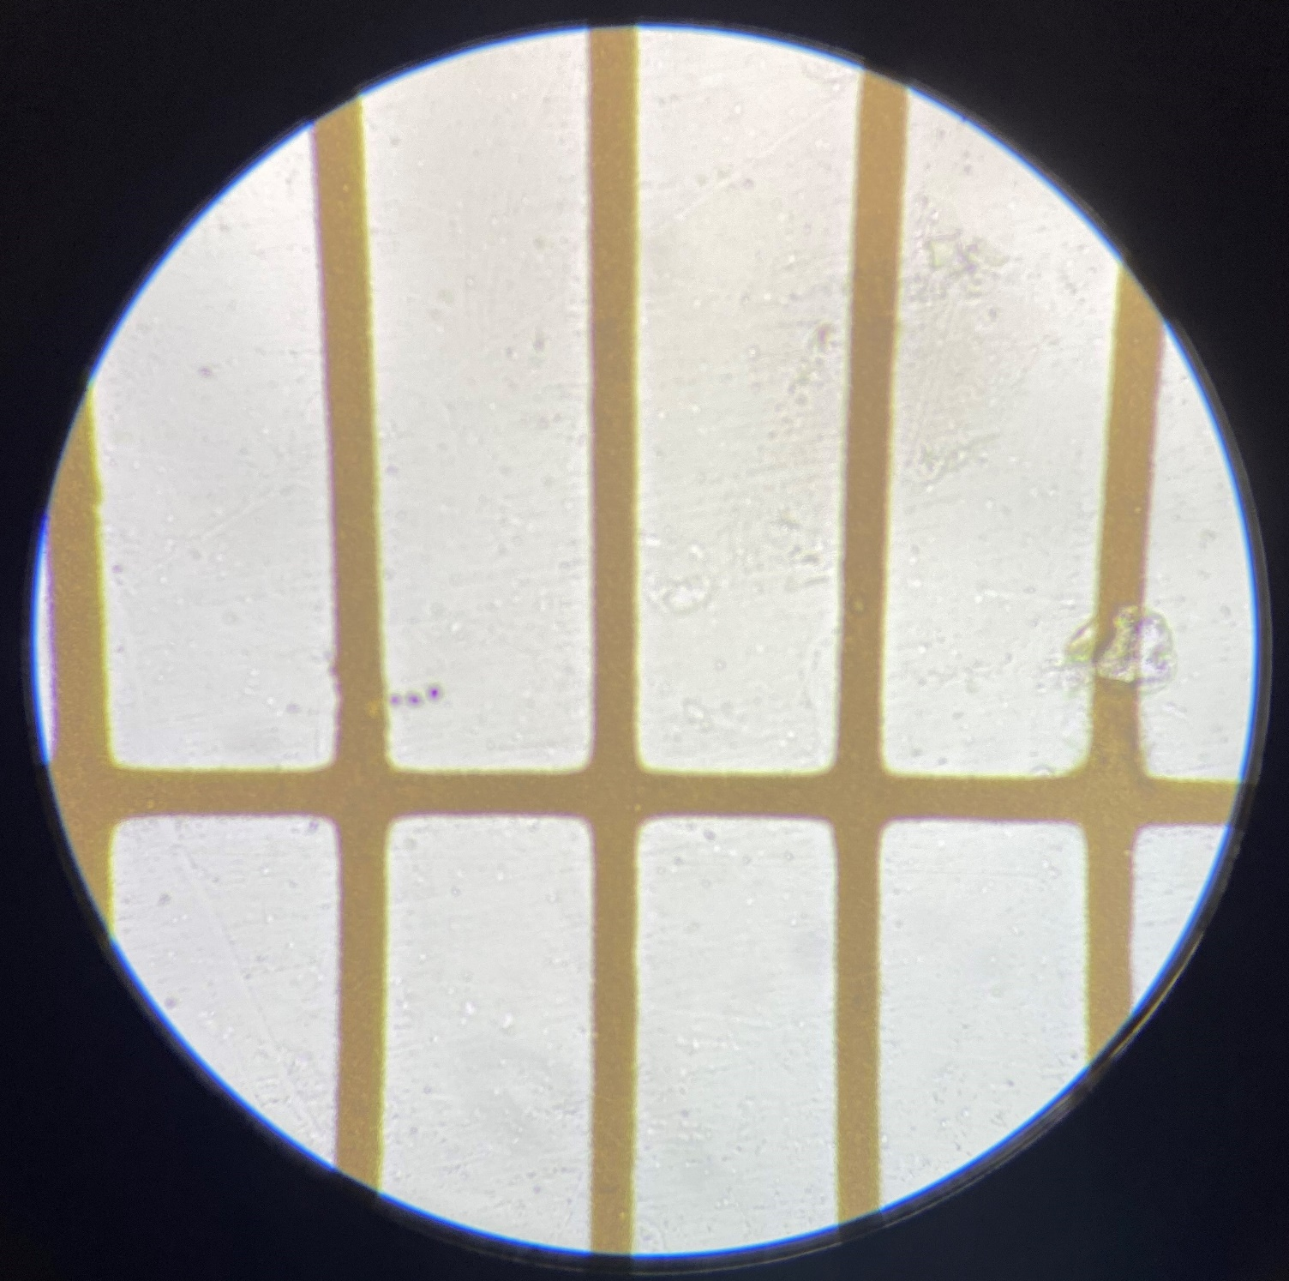
Stage micrometer
1cm long in total
Numbered divisions = 1mm
Smallest division = 100µm
Viewed under a
magnification of x400
Notes:
Print on paper

Slide 10
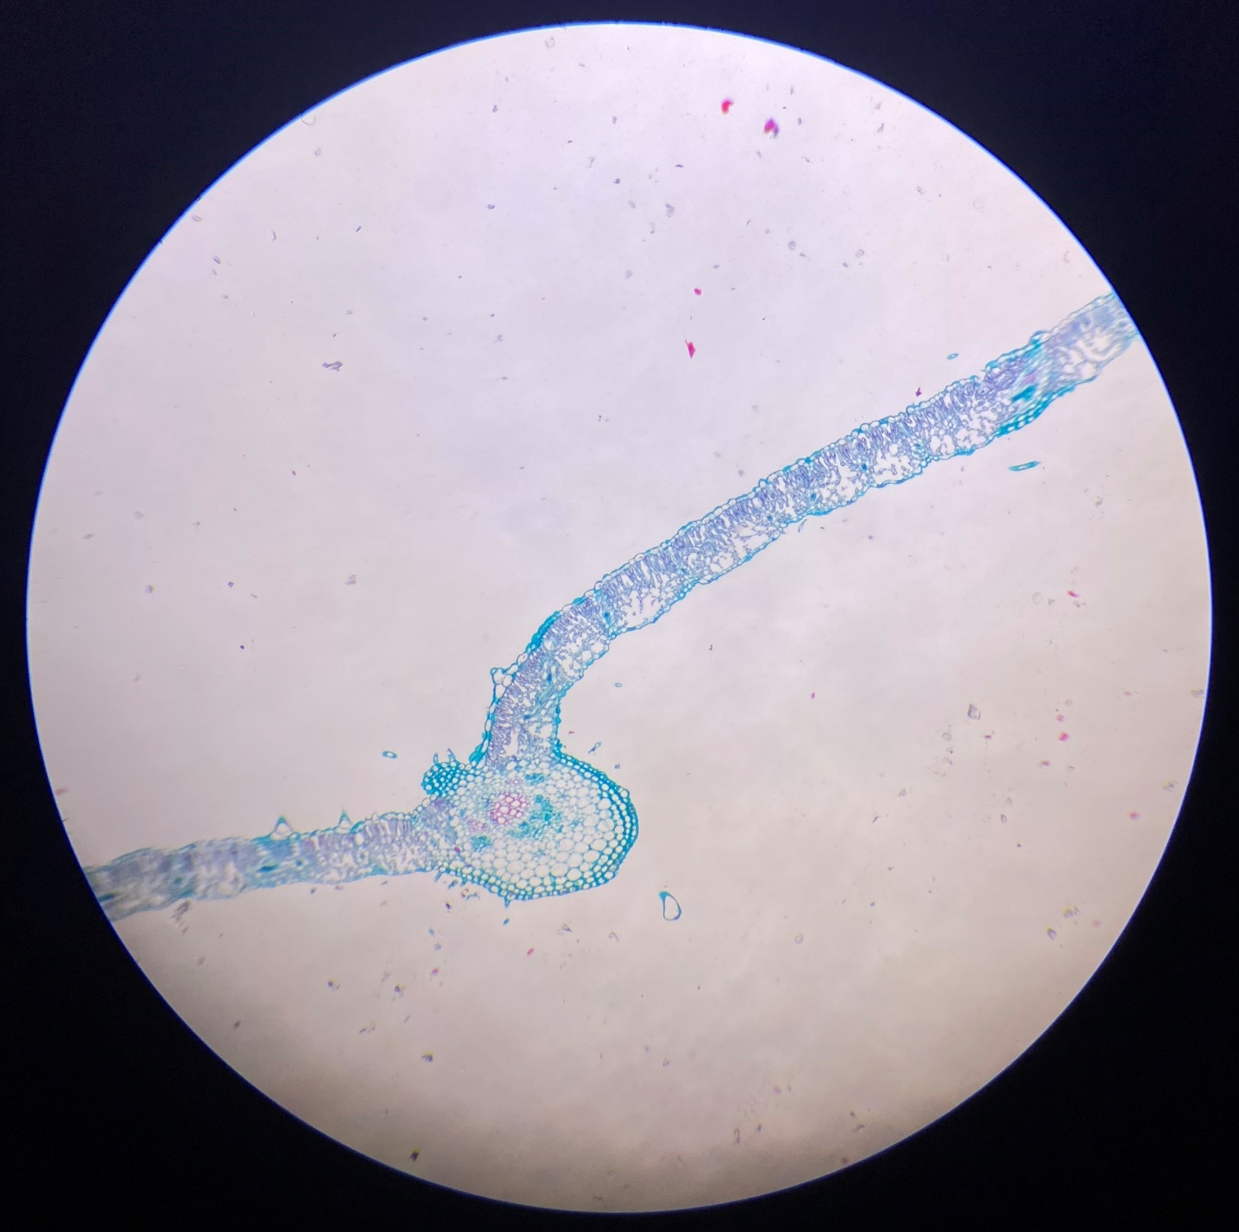
Sunflower leaf
Transverse section
Viewed under a
magnification of x40
A
B
Notes:
Print on paper

Slide 11
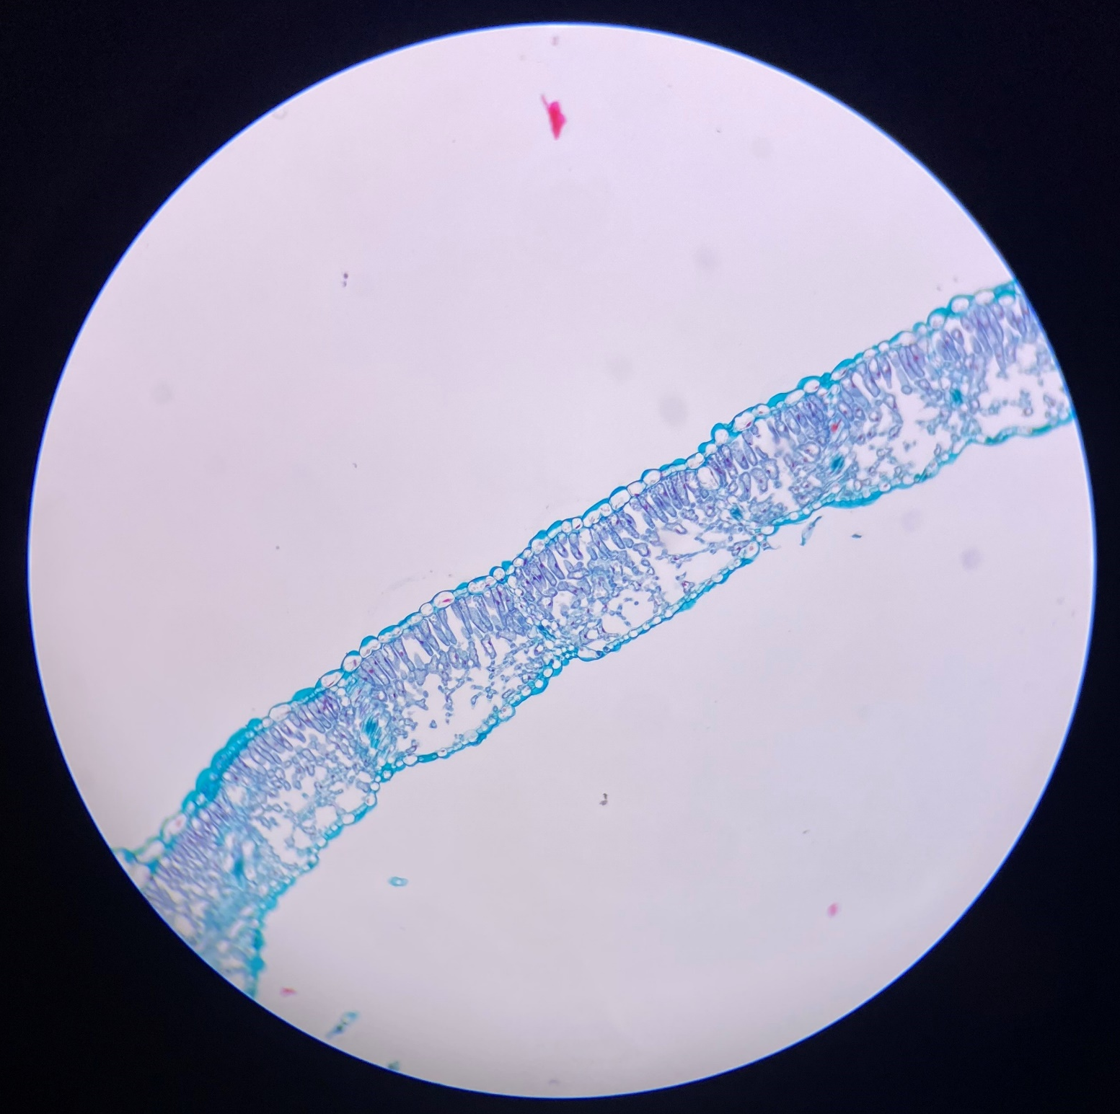
Sunflower leaf
Transverse section
Viewed under a
magnification of x100
A
B
Notes:
Print on paper

Slide 12
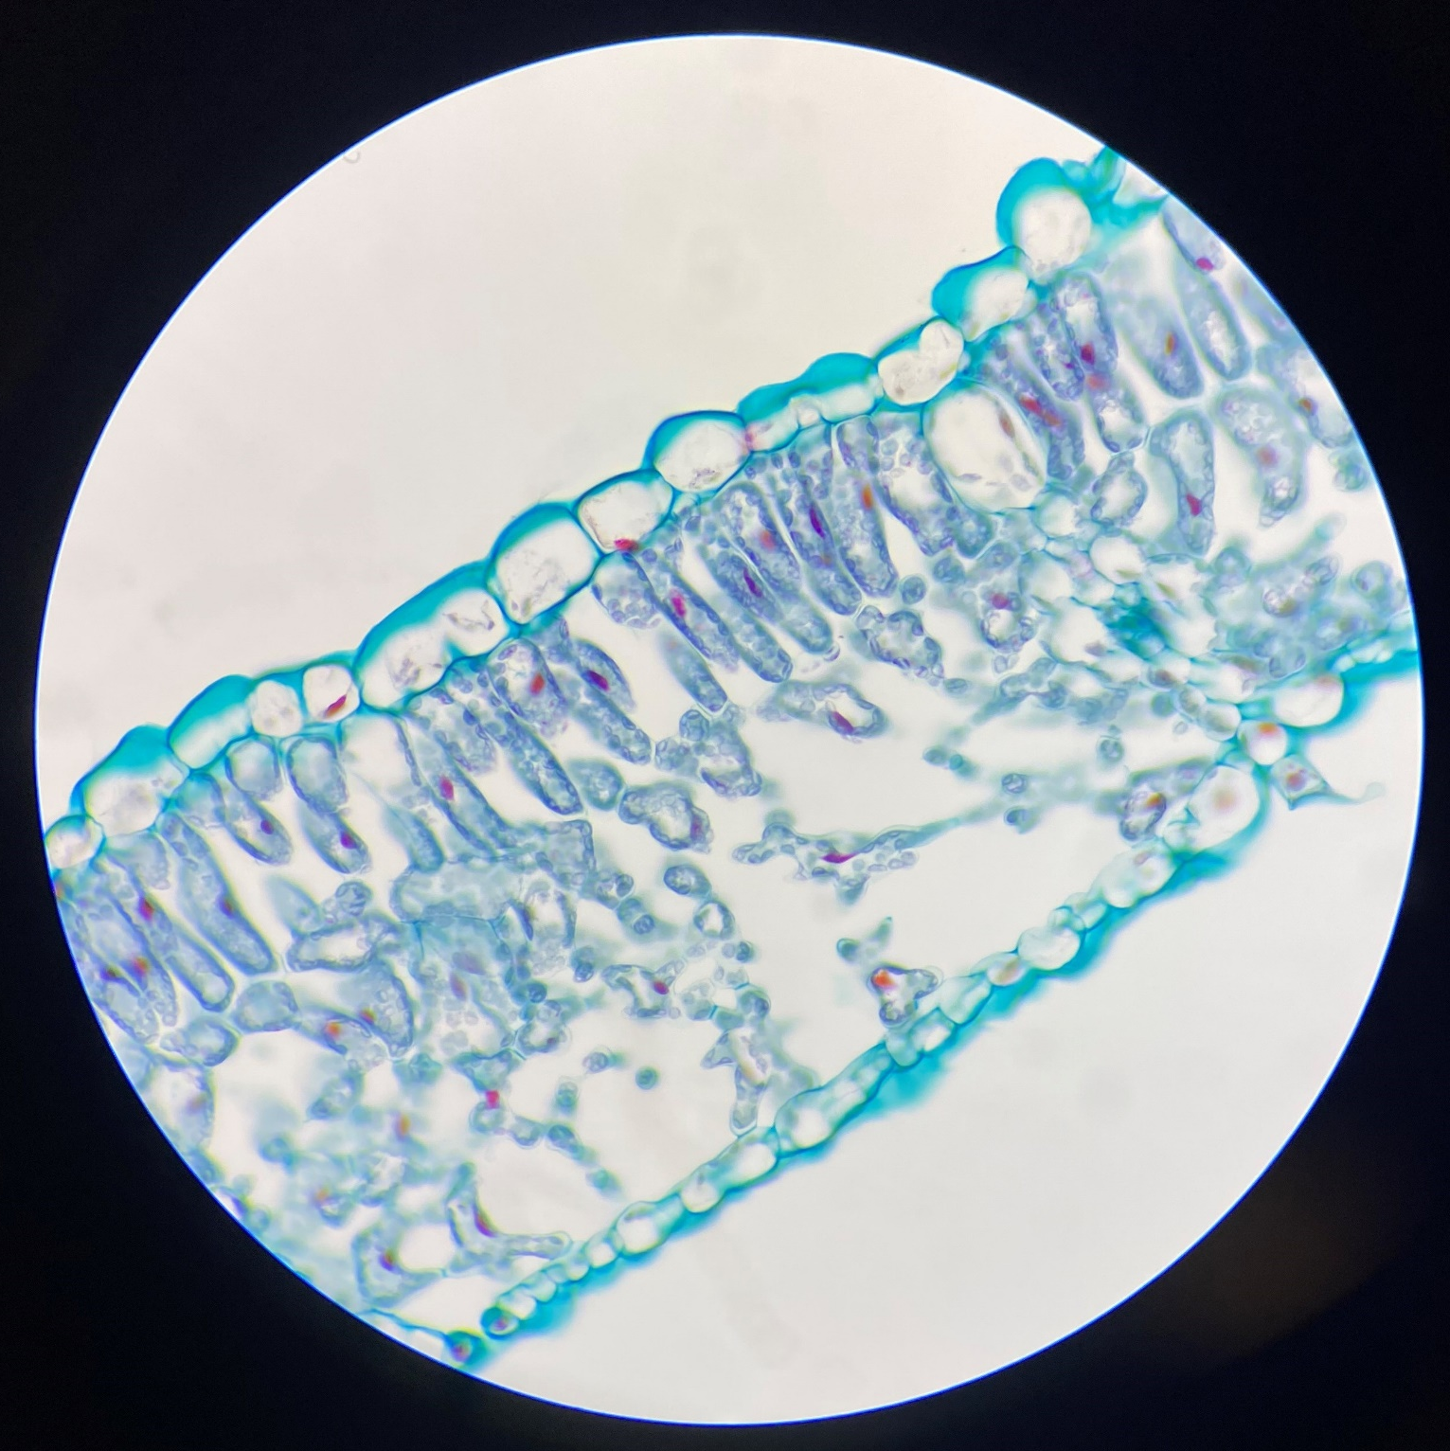
Sunflower leaf
Transverse section
Viewed under a
magnification of x400
A
B
Notes:
Print on paper

