Slide 1
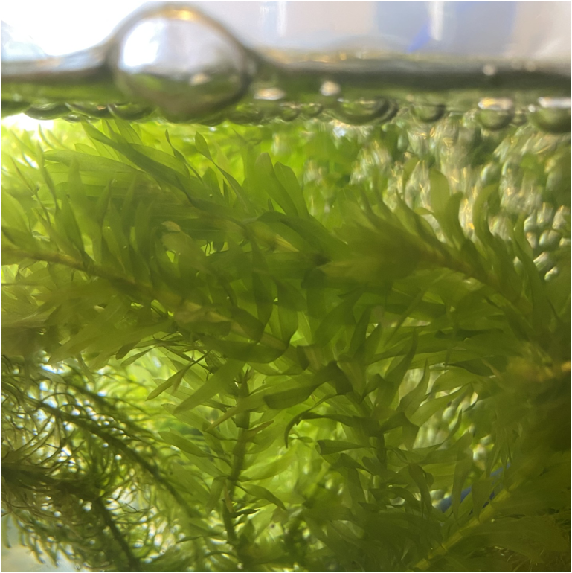
Measuring the rate of chloroplast movement during cytoplasmic streaming
Notes:
Science & Plants for Schools: www.saps.org.uk
Calibrating and Measuring in Microscopy - Measuring Chloroplast Speed
Resource 6425, Version 1.0, Released 2025
All images by SAPS

Slide 2
Cytoplasmic streaming
Cytoplasmic streaming occurs in many plant cells, particularly large ones.
It is thought to increase the rate of transport of molecules and vesicles within these cells and the most obvious visible effect of it in some cells is the movement of chloroplasts.
Another suggested benefit of cytoplasmic streaming is that it increases the rate of photosynthesis of the cell under patchy light conditions due to the redistribution of molecules between areas dominated by respiration and those dominated by photosynthesis.

Slide 3
Viewing the pondweed
Place a leaf of Egeria densa on a microscope slide.
Carefully place one edge of a coverslip to one side of the leaf and slowly lower the slip over the leaf.
Add a drop of water to one edge of the coverslip, to flood the slide.
Insert an eyepiece containing an eyepiece graticule into the microscope.
Observe under the lowest power objective, to find and centre the leaf in the field of view.
Move through progressive lenses to high power and observe; after a few minutes the chloroplasts will start to move around the cells.

Slide 4
Measuring chloroplast movement
Line up the eyepiece graticule with the long edge of a cell containing moving chloroplasts.
Using a stopwatch time how long it takes a chloroplast to move a certain number of eyepiece units (EPUs).
Just from this observation write down how long you think it would take a chloroplast to travel 1m.
Calibrate the eyepiece graticule for the objective lens you have used using a stage micrometer.
Using the time taken, the number of EPUs travelled and the number of µm each EPU is worth, calculate the speed of the chloroplast.
Use the speed of the chloroplast to calculate how long it would take to travel 1m and compare this to your original estimate.

Slide 5
Measuring chloroplast movement: an example
Here are two stills from a video of moving chloroplasts. The arrow identifies the same chloroplast in each image.
The chloroplast moved 2 numbered EPUs in 8.0s (from 9 to 7).
From calibrating the eyepiece graticule for this objective lens each EPU was calculated to be equivalent to 25.6µm.
Speed = distance ÷ time
Distance = 2EPUs x 25.6µm per EPU = 51.2µm
Time = 8.0s
Speed = 51.2µm ÷ 8.0s = 6.4µm/s
It would take this chloroplast over 43 hours to travel 1m.
1m = 1000mm = 1,000,000µm
1,000,000µm ÷ 6.4µm/s = 156,250s
156,250s ÷ 60s/min = 2,604min
2,604 ÷ 60min/hr = 43.4hr
t=0.0s
t=8.0s

