Slide 1
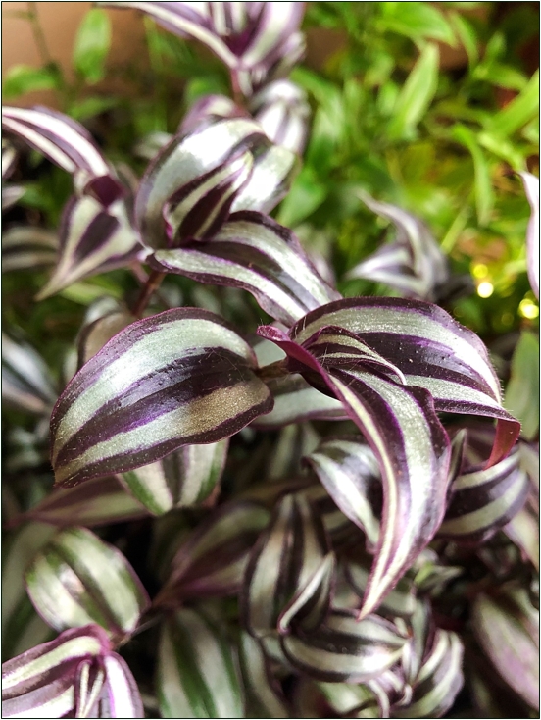
Measuring stomatal density Do plants make more stomata as their leaves grow?
Notes:
Science & Plants for Schools: www.saps.org.uk
Measuring and Calibrating in Microscopy - Measuring Stomatal Density Resource 6407, Version 1.0, Released 2025 Image of Tradescantia zebrina on this slide by Tammarazzi from Pixabay All other images by SAPS

Slide 2
Measure the area of the field of view
Measure the radius of the field of view for each objective lens.
Complete a table of your results
Objective lens | Overall magnification with a x10 eyepiece | Radius of field of view (mm) | Area of field of view (mm²)
x4 | x40
x10 | x100
x40 | x400

Slide 3
Measure the area of the field of view: an example
Use an eyepiece that contains an eyepiece graticule to line up the stage micrometer correctly
The scale on the eyepiece graticule is not important here. Instead, use it to identify the centre of the field of view and line the stage micrometer to measure an accurate radius. (See image)
Measure the radius of the field of view in millimetres (mm)
The stage micrometer in the image is 1mm in length and the longest lines divide the mm into 0.1mm (100μm) sections. In the example image this is 0.9mm
Calculate the area of the field of view (in mm²)
Use πr². In the example image this is 2.54mm².

Slide 4
Large and small leaves
New leaves are made by the plant at the growing tip of shoots. When first produced they are small.
As the plant grows existing leaves grow too. Older leaves are larger than younger leaves.
You have leaf discs from a smaller, younger leaf and a larger, older leaf from the silver inch plant (Tradescantia zebrina)

Slide 5
Slide preparation
Place each leaf disc on a slide with the lower epidermis (the purple side) uppermost.
Press the leaf disc gently onto the slide so that it lies flat and remains in place

Slide 6
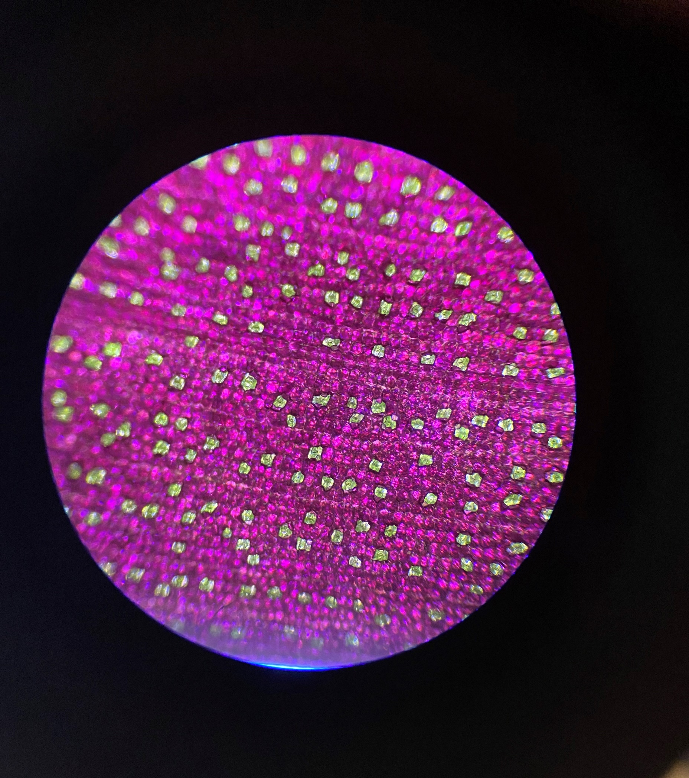
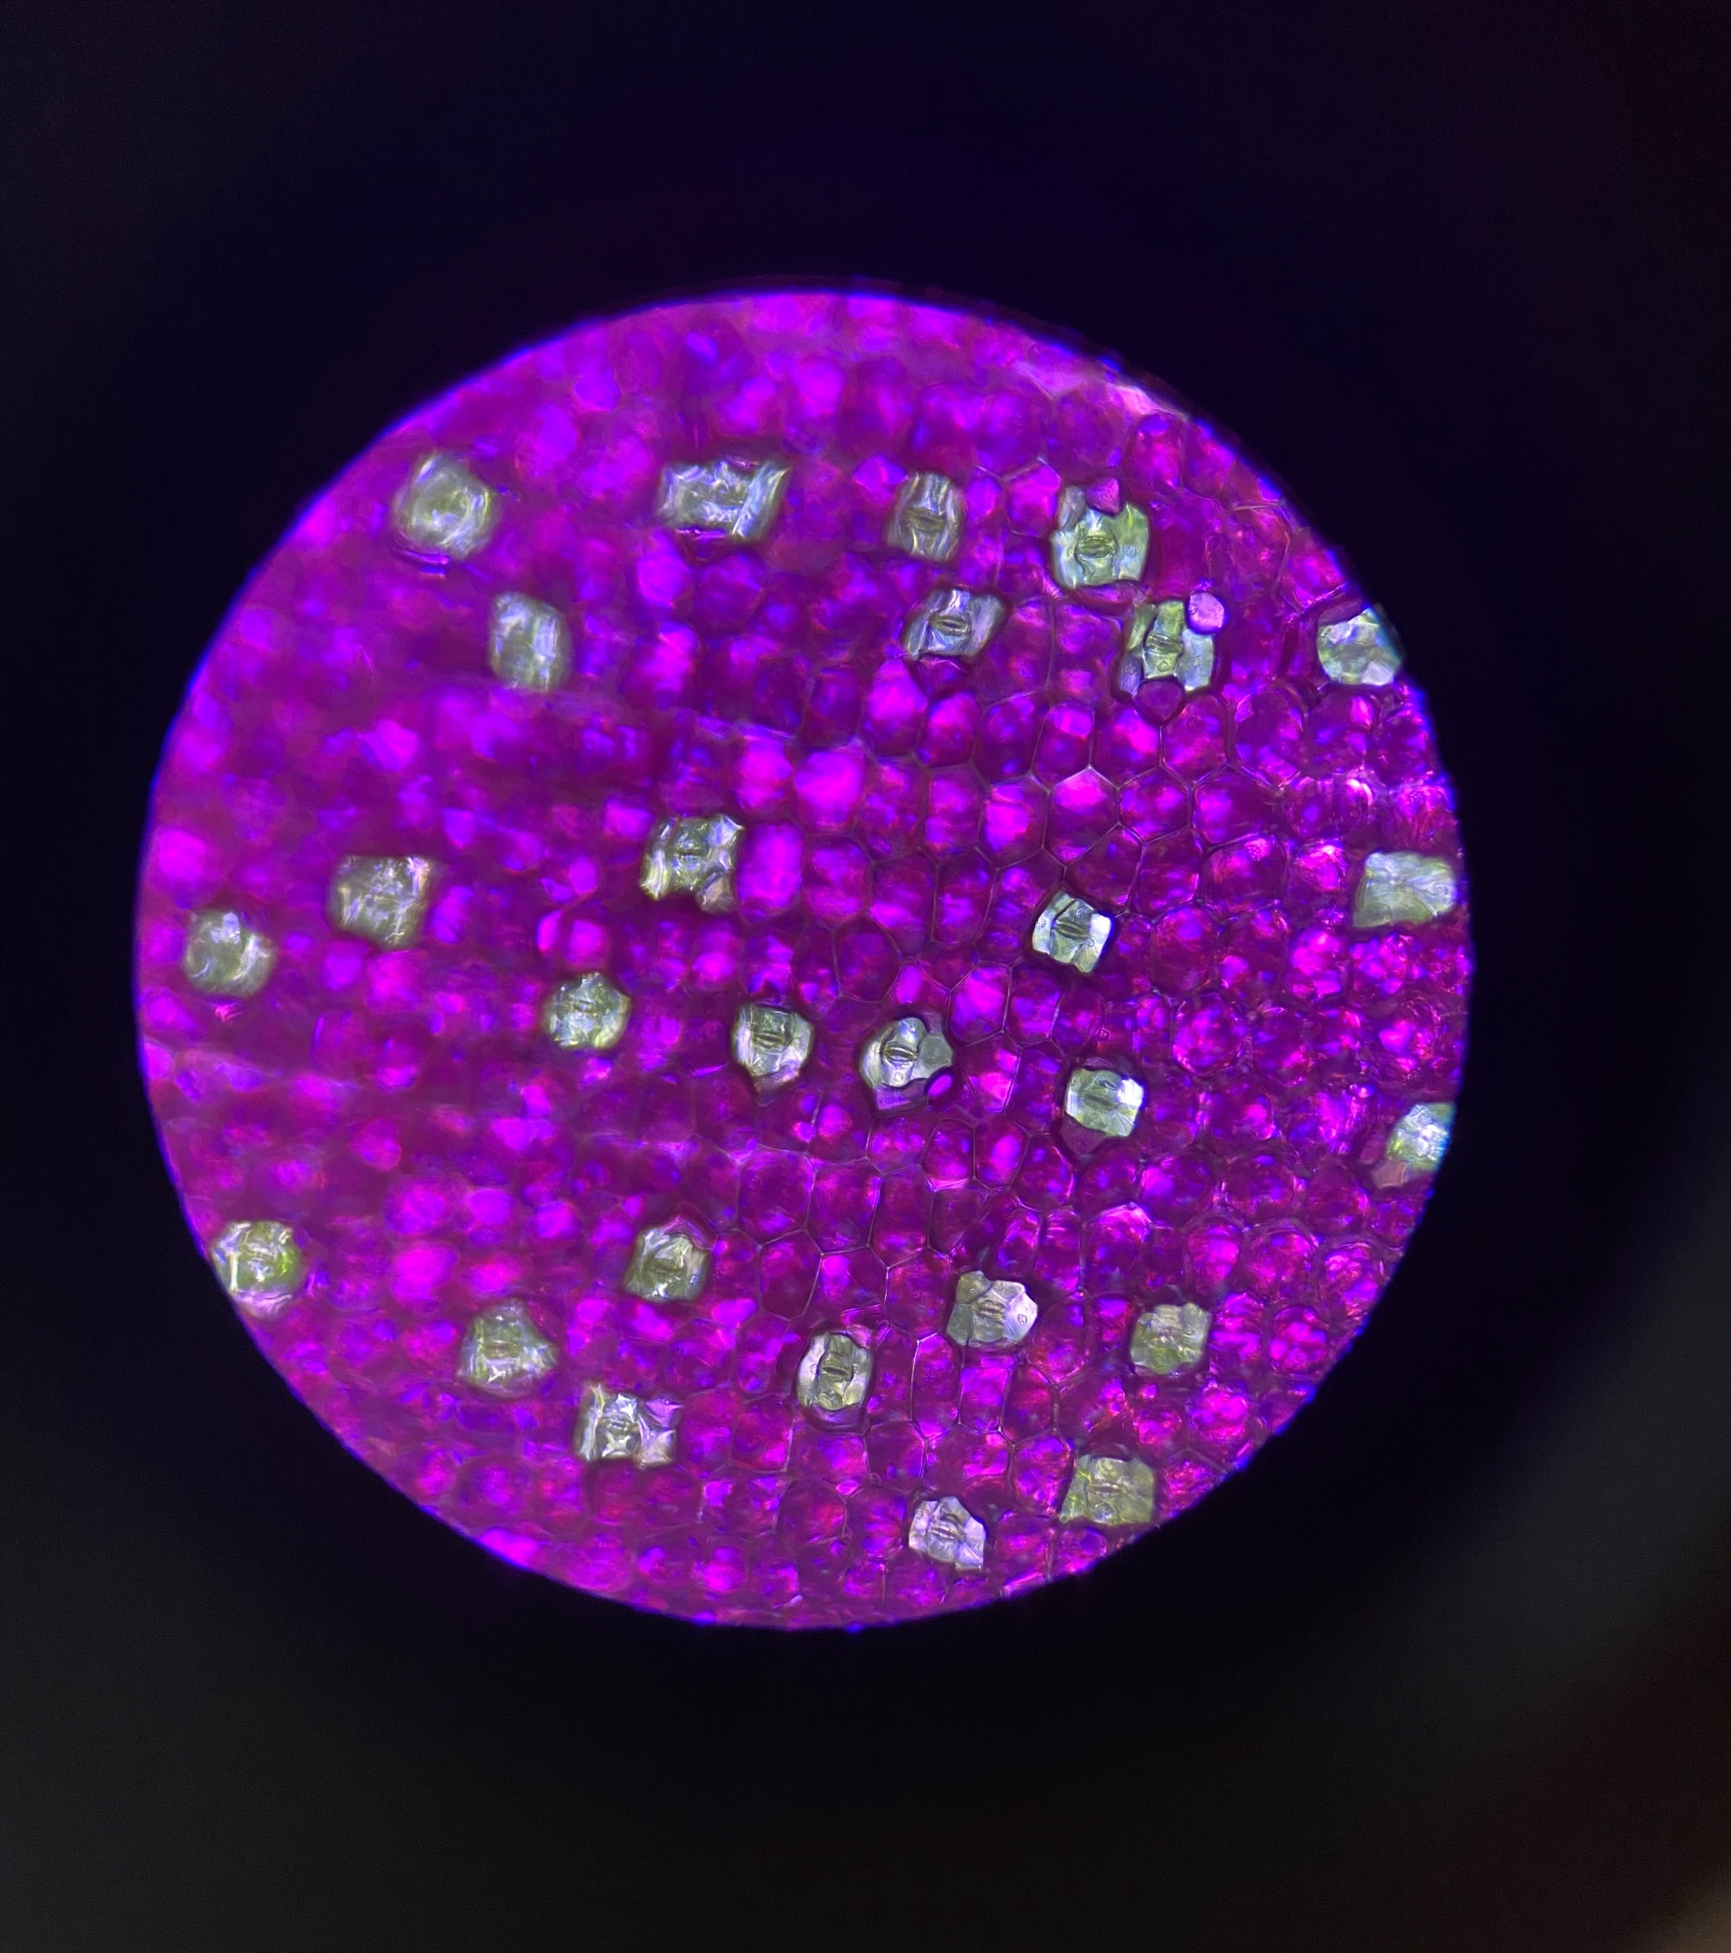
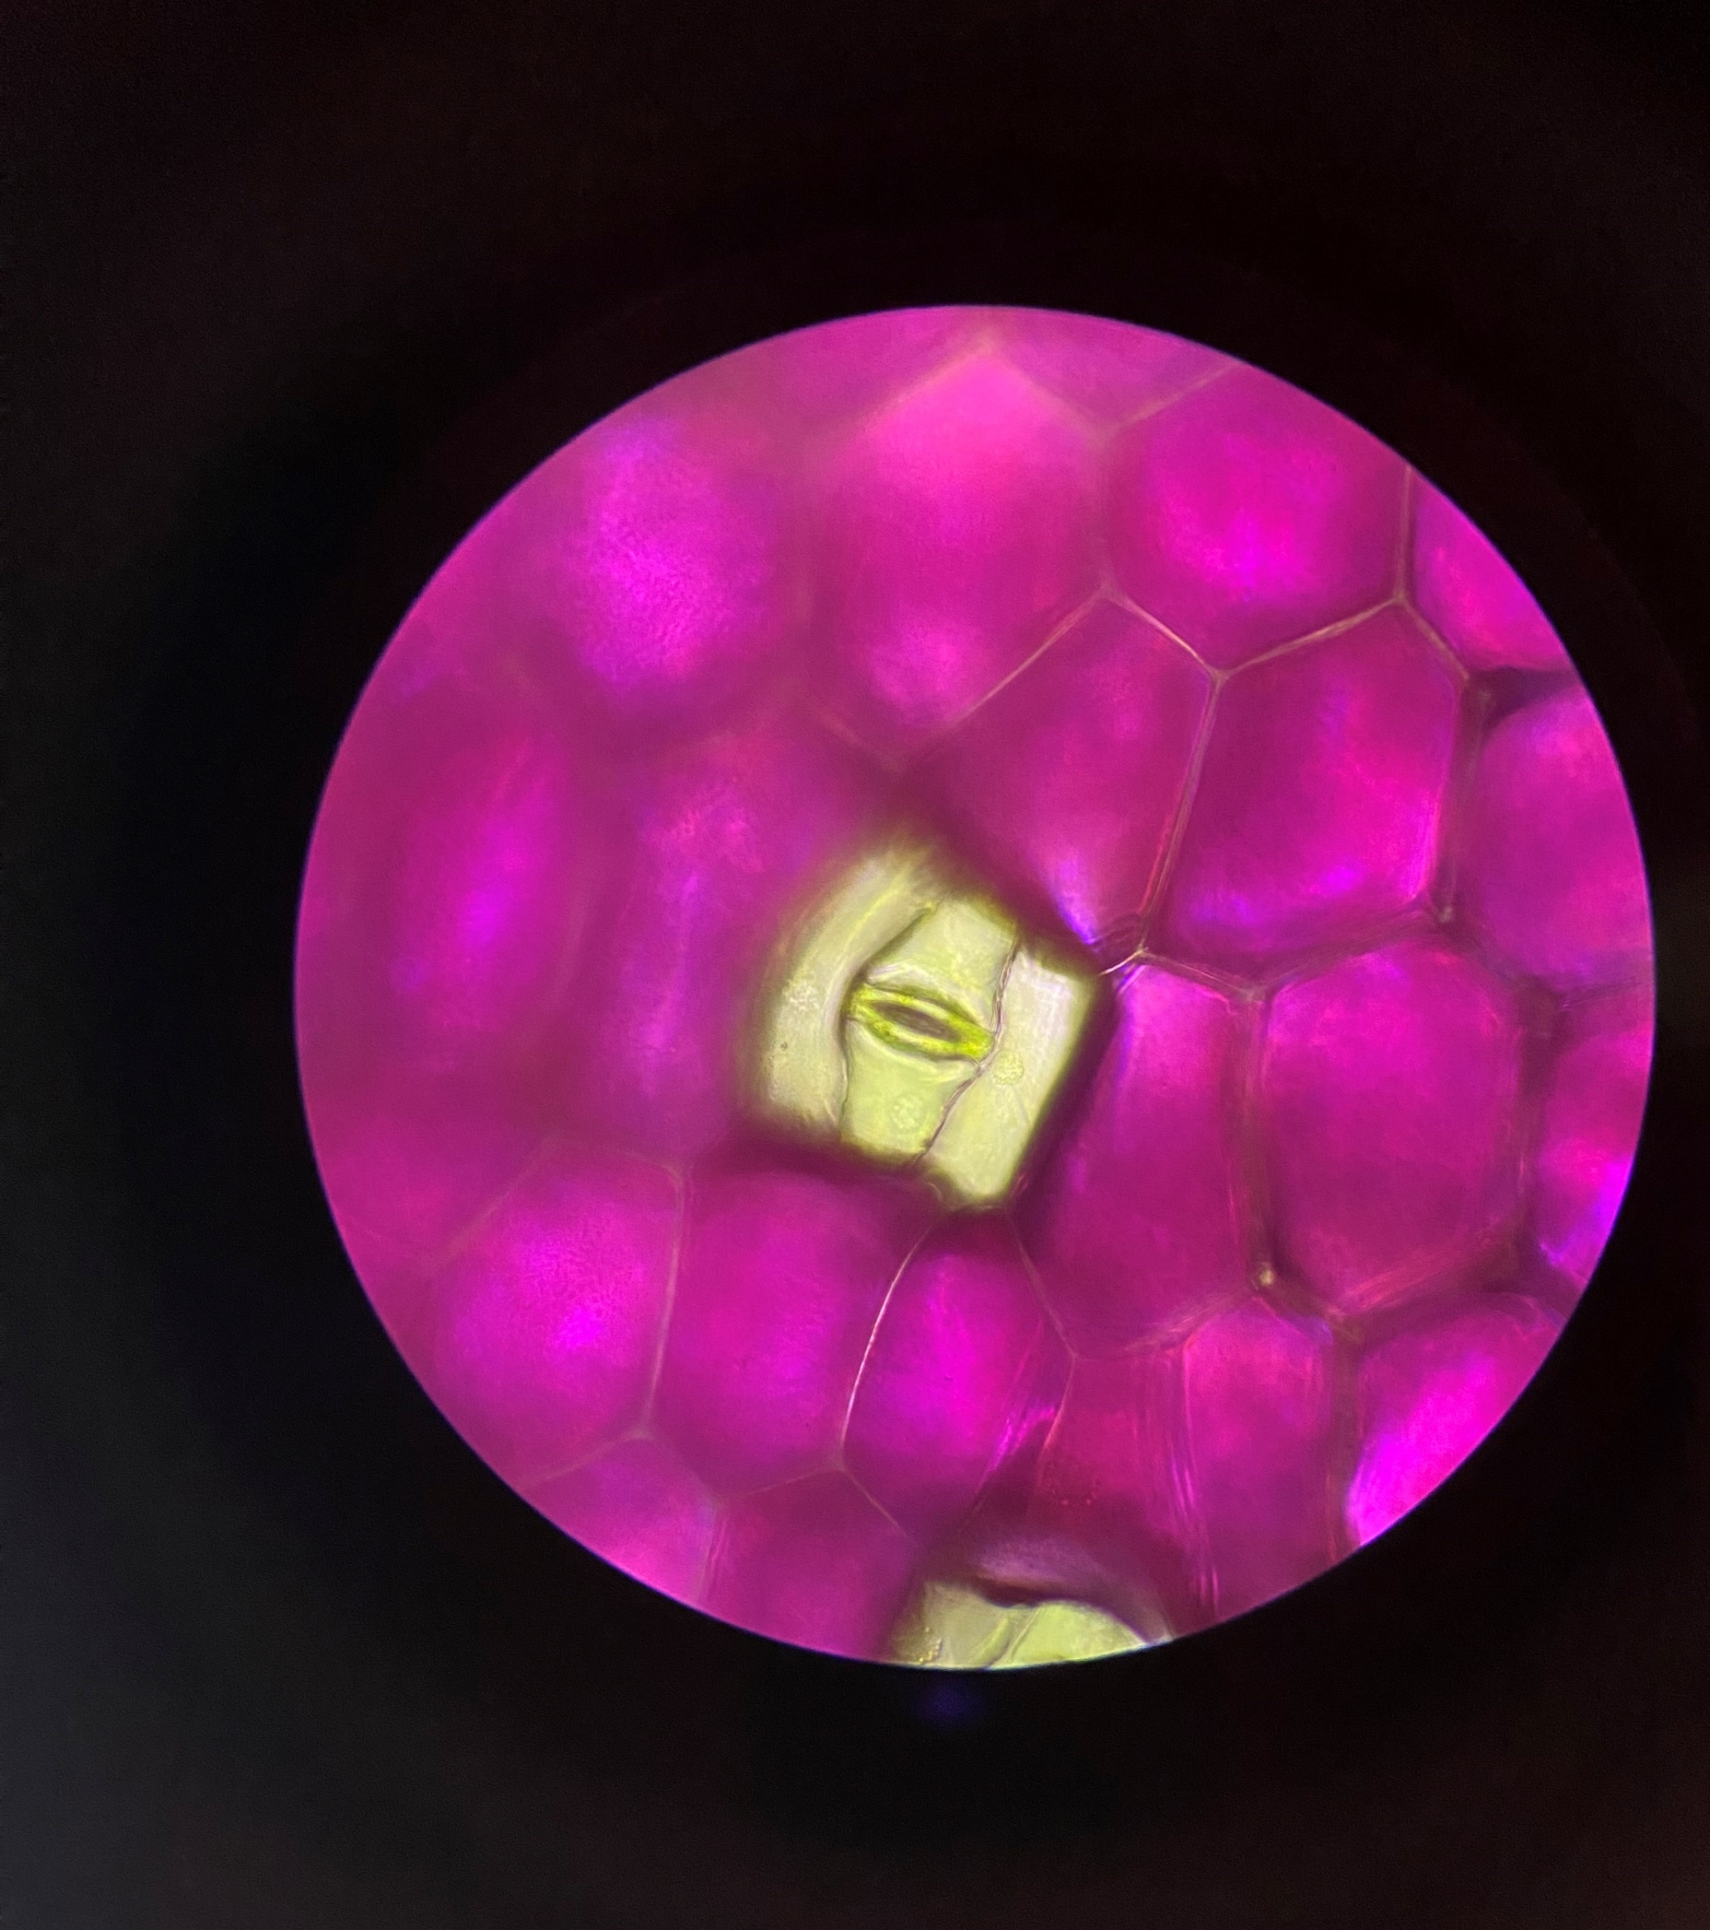
Choosing which magnification to use
Mag = x40
×4 objective lens
Too many stomata to keep track when counting
Mag = x100
×10 objective lens
Not too many stomata to keep track of an enough to accurately calculate stomatal density
Mag = x400
×40 objective lens
Too few stomata to accurately calculate stomatal density

Slide 7
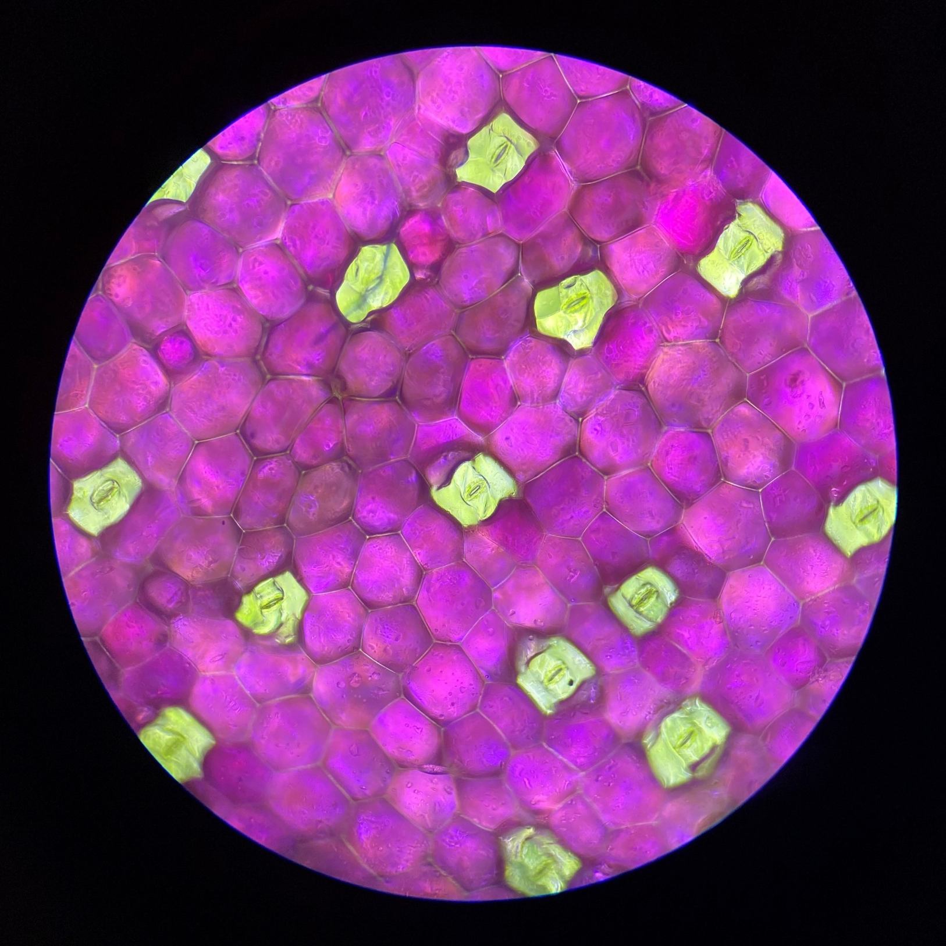
Counting stomata
Choose a magnification where there are a reasonable number of stomata but not too many to make it difficult to keep track during counting.
Count the number of stomata in your field of view for your small leaf and your large leaf samples.
Include ones where the centre of the hole (the stoma) is in the field of view even if some green cells are not (white arrows).
Do not include ones where there are green cells visible but the centre of the stoma is not in the field of view (blue arrow).

Slide 8
Calculating stomatal density
Stomatal density (stomata/mm²) $=\frac{Number of stomata in the field of view}{Area of field of view at the magnification used (mm2)}$
Record the data for your large and your small leaf
Leaf size | Magnification used | Area of field of view (mm²) | Number of stomata counted in the field of view | Stomatal density (stomata/mm²)
Small
Large

Slide 9
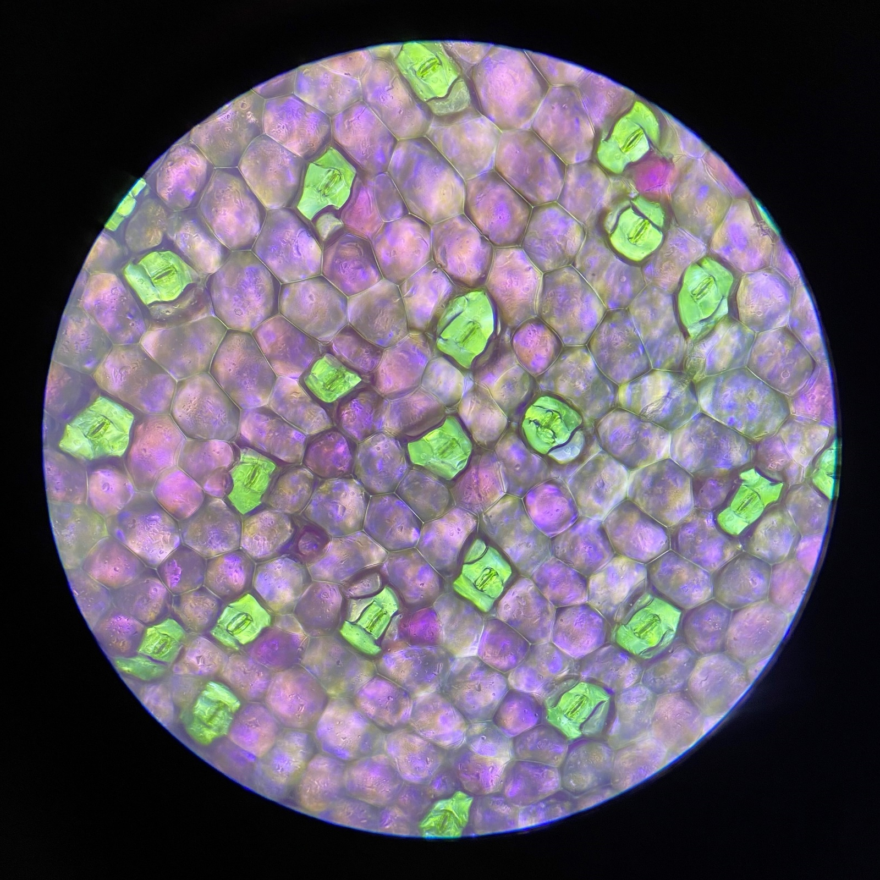
Calculating stomatal density: an example
Mag = x100
FOV = 2.54mm²
Small leaf
21 stomata
Large leaf
13 stomata
Leaf size | Magnification used | Area of field of view (mm²) | Number of stomata counted in the field of view | Stomatal density (stomata/mm²)
Small | x100 | 2.54 | 21 | 8.3
Large | x100 | 2.54 | 13 | 5.1

Slide 10
Do larger and smaller leaves have different stomatal densities?
Collate stomatal density values for both the large and small leaves from the whole class into a table.
Calculate a mean stomatal density for each leaf size.
What statistical test could you use with this dataset to explore whether there is a difference between the means?
Leaf size | Stomatal density (stomata/mm²)
 | Replicate 1 | Replicate 2 | Replicate 3… | Mean
Small
Large

Slide 11
Do leaves make more stomata as they grow?
What is the mean length of a ‘small’ leaf and the mean ‘length’ of a large leaf?
Assuming the leaf proportions stay the same, how many times bigger is the large leaf’s lower epidermal surface area than the small one’s?
If leaves grow from small leaves into large leaves by only making more purple epidermal cells what would the stomatal density of the large leaf be?
Do the leaves make more stomata as they grow?

Slide 12
Do leaves make more stomata as they grow?: an example
What is the mean length of a ‘small’ leaf and the mean ‘length’ of a large leaf?
Small leaf: 35mm Large Leaf: 78mm
Assuming the leaf proportions stay the same, how many times bigger is the large leaf’s lower epidermal surface area than the small one’s?
A large leaf is 2.229 times longer than a small leaf (78/35)
The surface area of the lower epidermis in a large leaf is 4.97 times larger than in a small leaf (2.229²)
If leaves grow from small leaves into large leaves by only making more purple epidermal cells what would the stomatal density of the large leaf be?
The stomatal density of a small leaf is 8.3stomata/mm²
If no more stomata were made a large leaf would have a stomatal density of 1.67stomata/mm² (8.3/4.97)
Do the leaves make more stomata as they grow?
Yes. The stomatal density of a large leaf is 5.1 stomata/mm². This is greater than 1.67stomata/mm² and so more stomata are made as the leaves grow. The leaves produce about 3 times more stomata as they grow (5.1/1.67=3.05)

