Slide 1
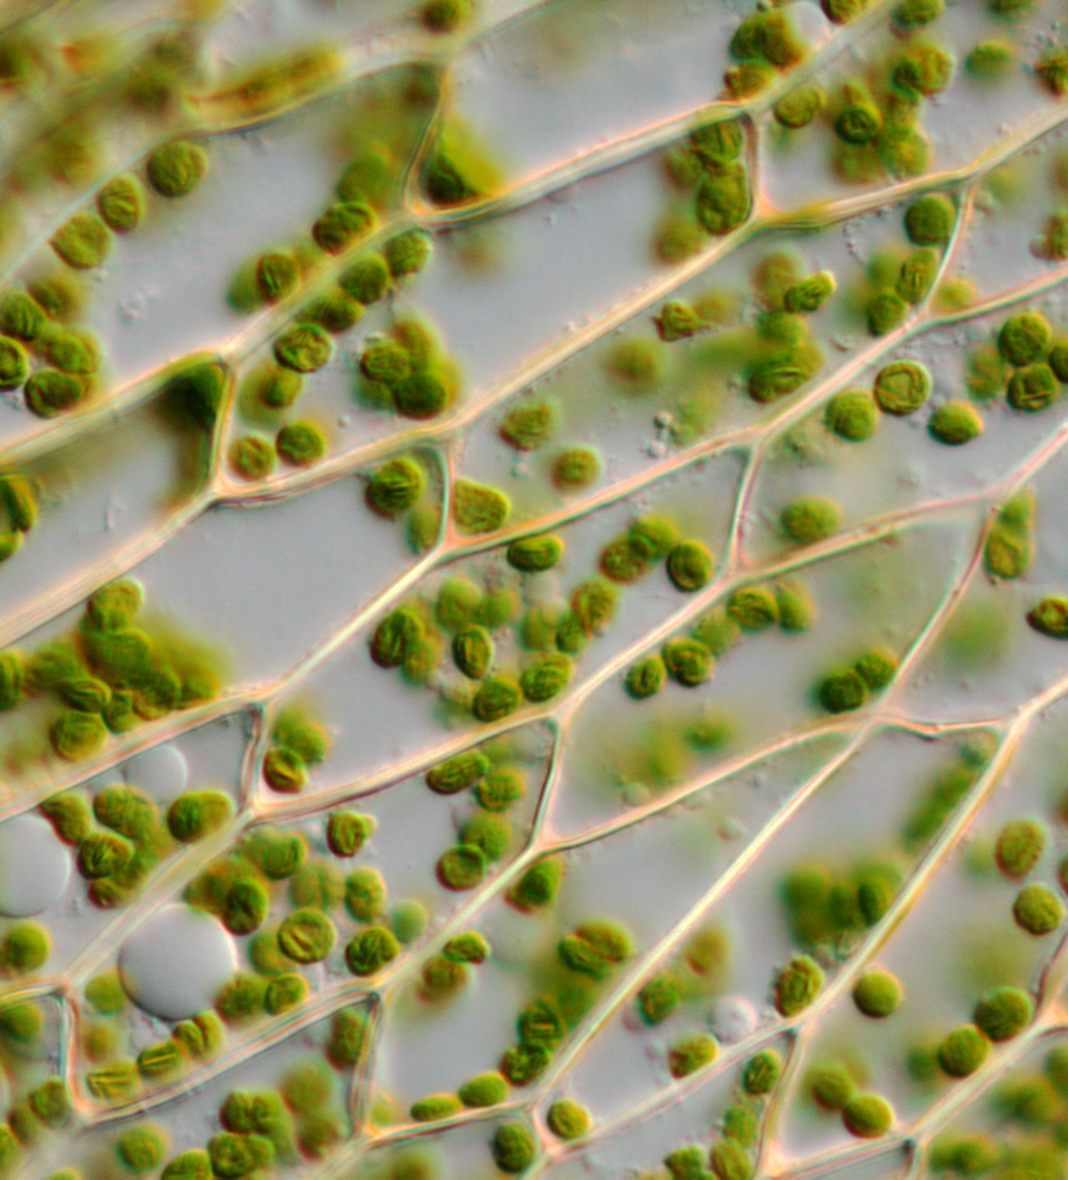
Teaching Biology with Plants 101

Slide 2
A poll!
Have you heard of us?

Slide 3
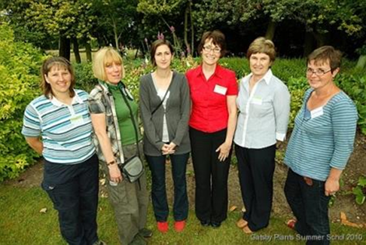
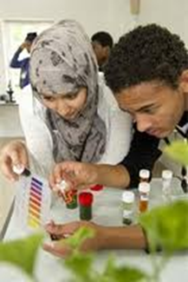
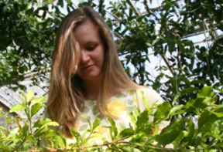
Inspirational plant science teaching
some of whom will become plant scientists.
Enthusiastic teachers will …
engage students …

Slide 4
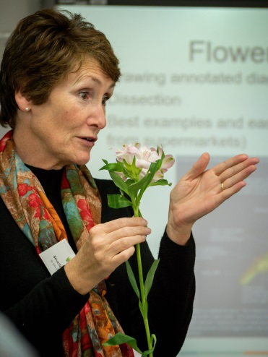
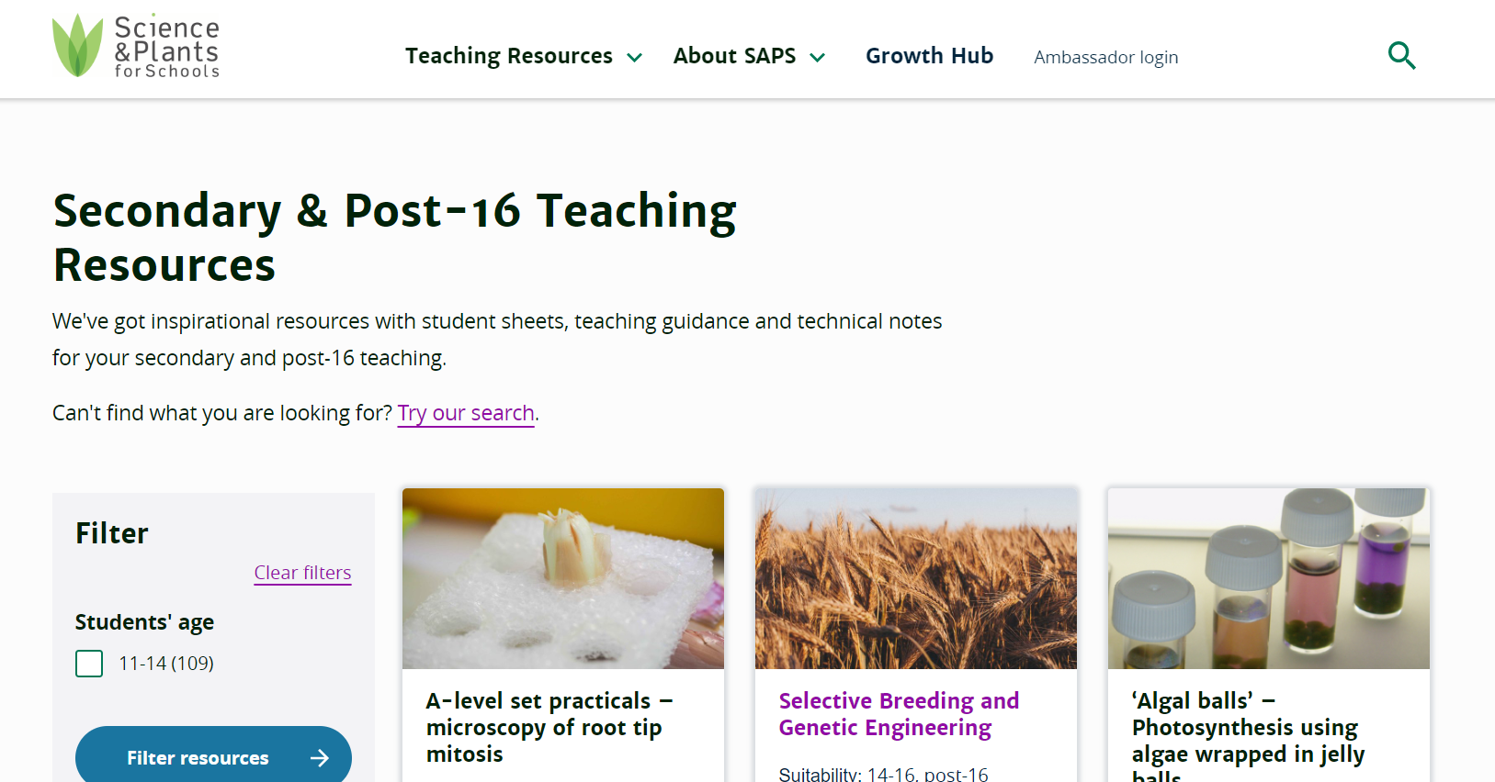
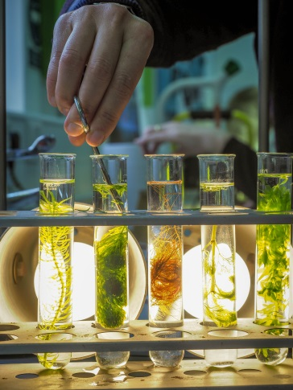
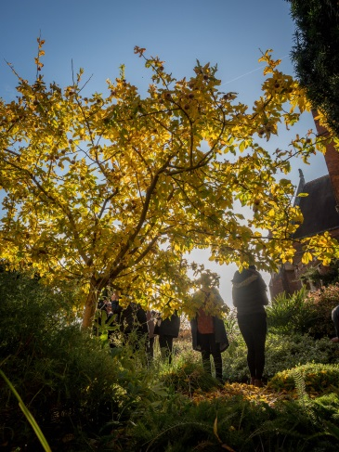
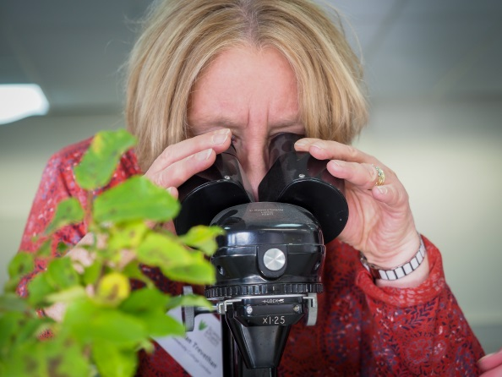
Busy teachers and technicians need …
easy access to resources including …
affordable practicals …
techniques that work, and …
relevant contexts.

Slide 5
They also deserve support and encouragement so we…
Have stands and hold events at teacher and technician conferences
Send half-termly newsletters with new ideas and our latest resources
Run ‘Train the Trainer’ courses
Provide PGCE students and trainees with USB sticks
Have an online ‘Ask the Expert’ service
Run our Ambassador Scheme
Develop CPD
Engage with exam boards and curriculum developers

Slide 6
More polls!
Tell us about yourselves!

Slide 7
This session

Slide 8
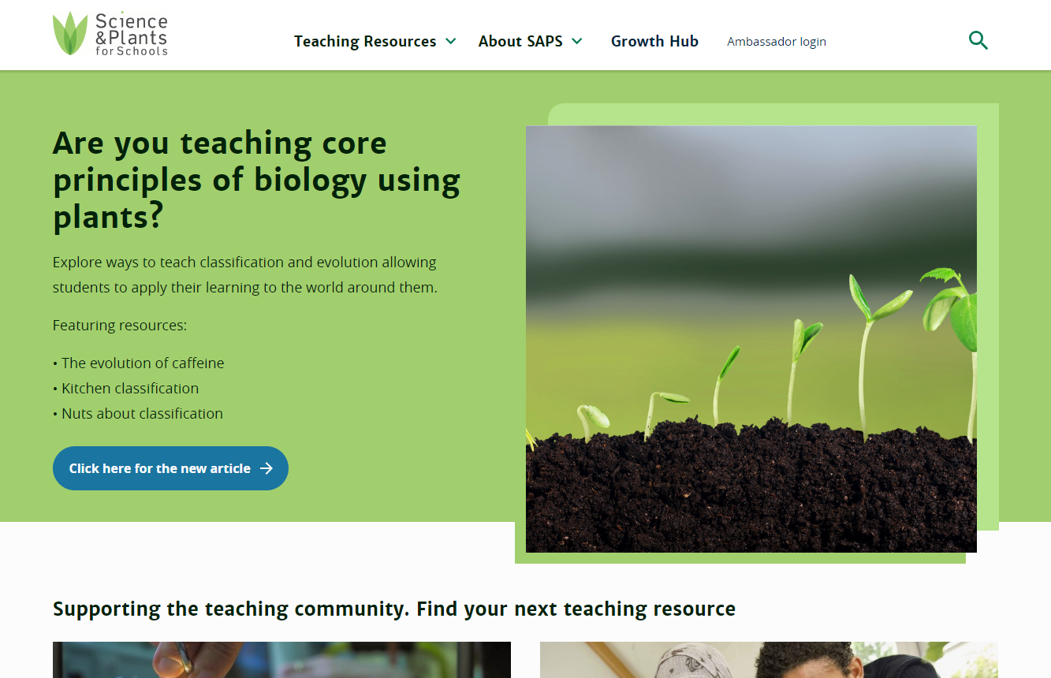
Our website

Slide 9
Bubbling pondweed
Have you done this practical? 👍 / 👎

Slide 10
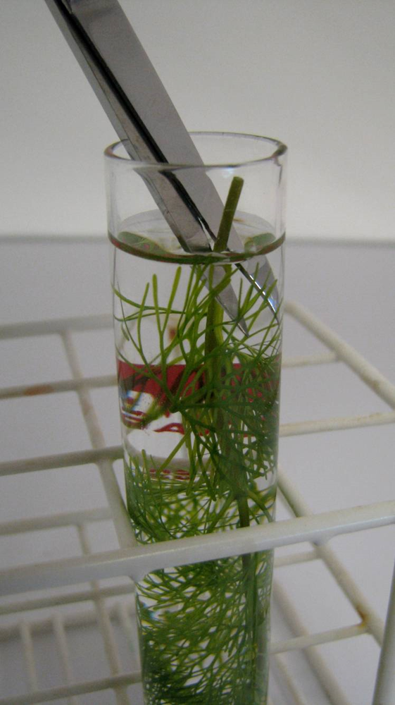
Bubbling pondweed
Investigating the effect of light intensity on the rate of photosynthesis
Piece of pondweed
Place upside down in 1% sodium bicarbonate solution
Cut stem under level of liquid
Place in front of a bright light
Bubbles from the cut stem

Slide 11
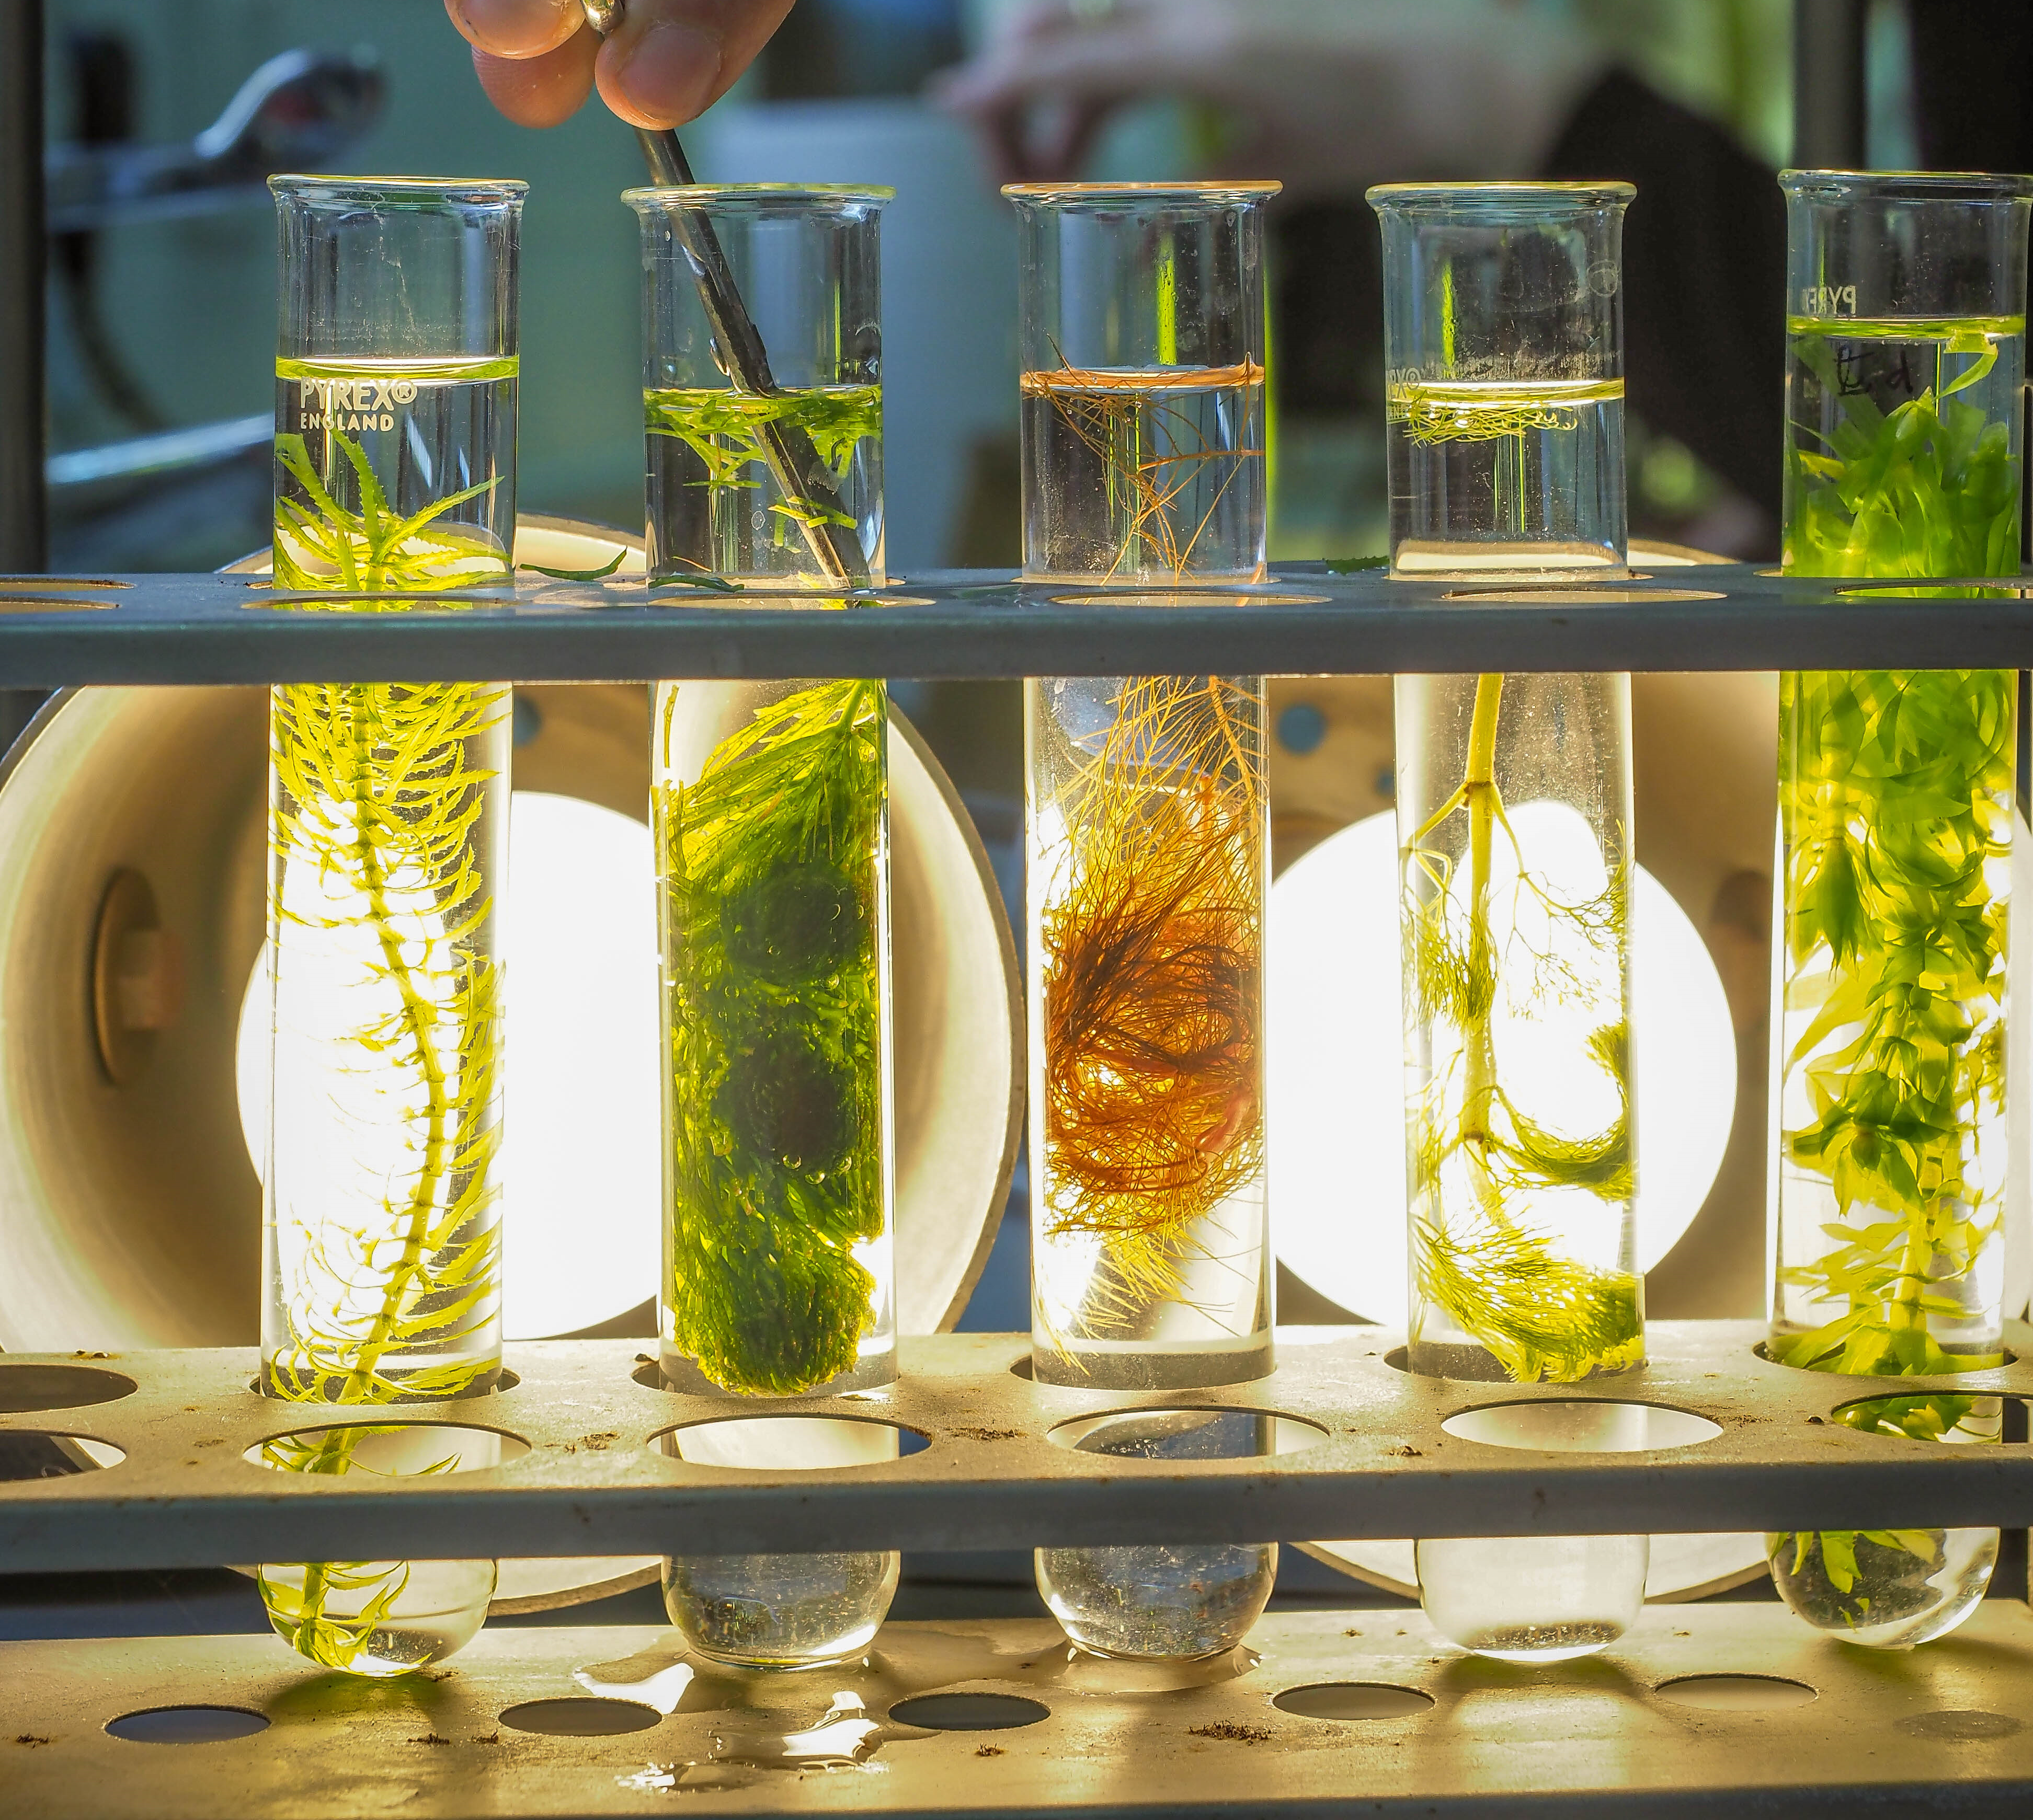

Pondweed species
Egeria najas
Ceratophyllum demersum (hornwort)
Cabomba furcata (red cabomba)
Cabomba aquatica (yellow cabomba)
Egeria/Elodea densa
Myrophyllum scabratum (not pictured)
Notes:
Species listed in order pictured (left to right).
Cabomba aquatica (yellow cabomba) is not as easy to grow as C. caroliniana but in our tests produced either a stream of small bubbles or a slower stream of larger bubbles. Available online and from some pet shops and aquarium suppliers.
Cabomba furcata (red cabomba) produced a good stream of bubbles in our tests. It is available online and from some pet shops and aquarium suppliers.
Ceratophyllum demersum (hornwort) A British native species, suitable for growing in a school pond, or in an indoor tank. This is a robust, fast-growing, easily-propagated plant but may be too woody during winter. Available online.
Egeria densa (formerly Elodea densa). This is a non-native species that can tolerate relatively cold temperatures and low light levels. The short distance of stem between leaf junctions means that it’s harder to cut the stem cleanly. However, we would not recommend growing this in school ponds, as it is an invasive species that can cause harm to invertebrates and fish. Widely available from aquarium suppliers online, and from Blades Biological.
Egeria najas is an easy growing species from South America. It can tolerate relatively cold temperatures and low light levels. However, with high light levels it will grow rapidly. The short distance of stem between leaf junctions means that it’s harder to cut the stem cleanly. Available online and from pet shops and aquarium suppliers.
Elodea species. There are two Elodea species found in the UK, both of which are non-native and potentially invasive: Elodea canadensis and Elodea nuttallii. They are already widespread but should not be introduced to school ponds. They produce large, slow bubbles. Available online.
Myriophyllum scabratum (note – do not use other Myriophyllum species, as these can be invasive). This is a fast growing aquarium plant, which appreciates bright light and an aquarium tank at room temperature. Widely available from aquarium suppliers online, and from Blades Biological.
All plants have the potential to become invasive if released into the environment: please dispose of them appropriately. We support the GB Non-Native Species Secretariat's Be Plant Wise campaign: http://www.nonnativespecies.org/beplantwise/

Slide 12
Tips for happy pondweed
Pondweed is a living thing and needs caring for
Weed from a cold pond in winter is unlikely to be very active
Purchased weed should not be put into very cold water, bring the water up to room temperature.
Constant illumination under bright light (>1200 lumens if possible)
Bubble with an air stone
Cut the stem under water, add Sodium Hydrogen Carbonate to the water (to create a 1% soln.) to ensure CO2 is not limiting in the boiling tube.
Use bright lights during the experiment itself

Slide 13
Immobilised algal balls
Have you done this practical? 👍 / 👎

Slide 14
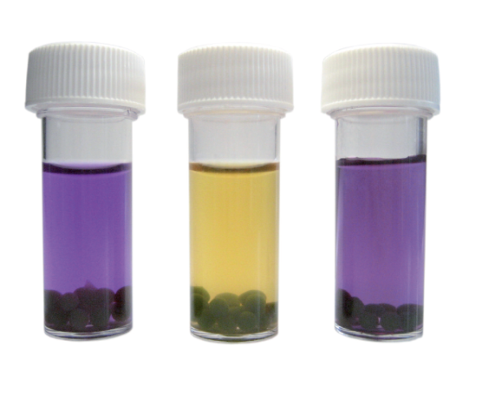
Immobilised algal balls

Slide 15
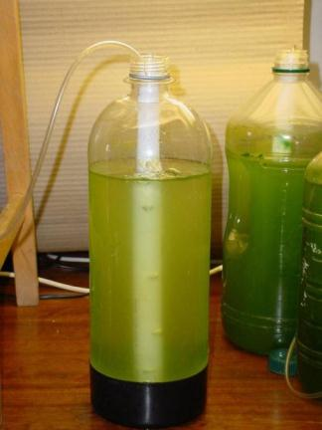
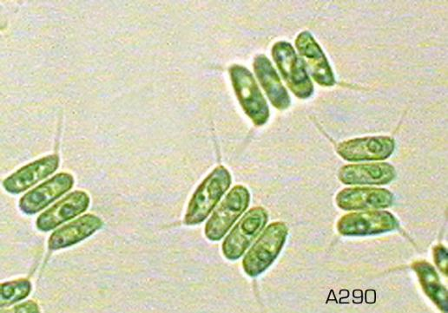
_{Scenedesmus quadricauda}

Slide 16
What’s happening?
Algae suspended in + calcium chloride
Sodium alginate solution
Calcium alginate
(insoluble)

Slide 17
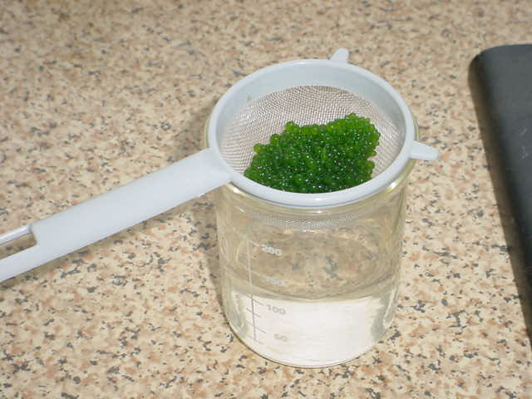

Slide 18
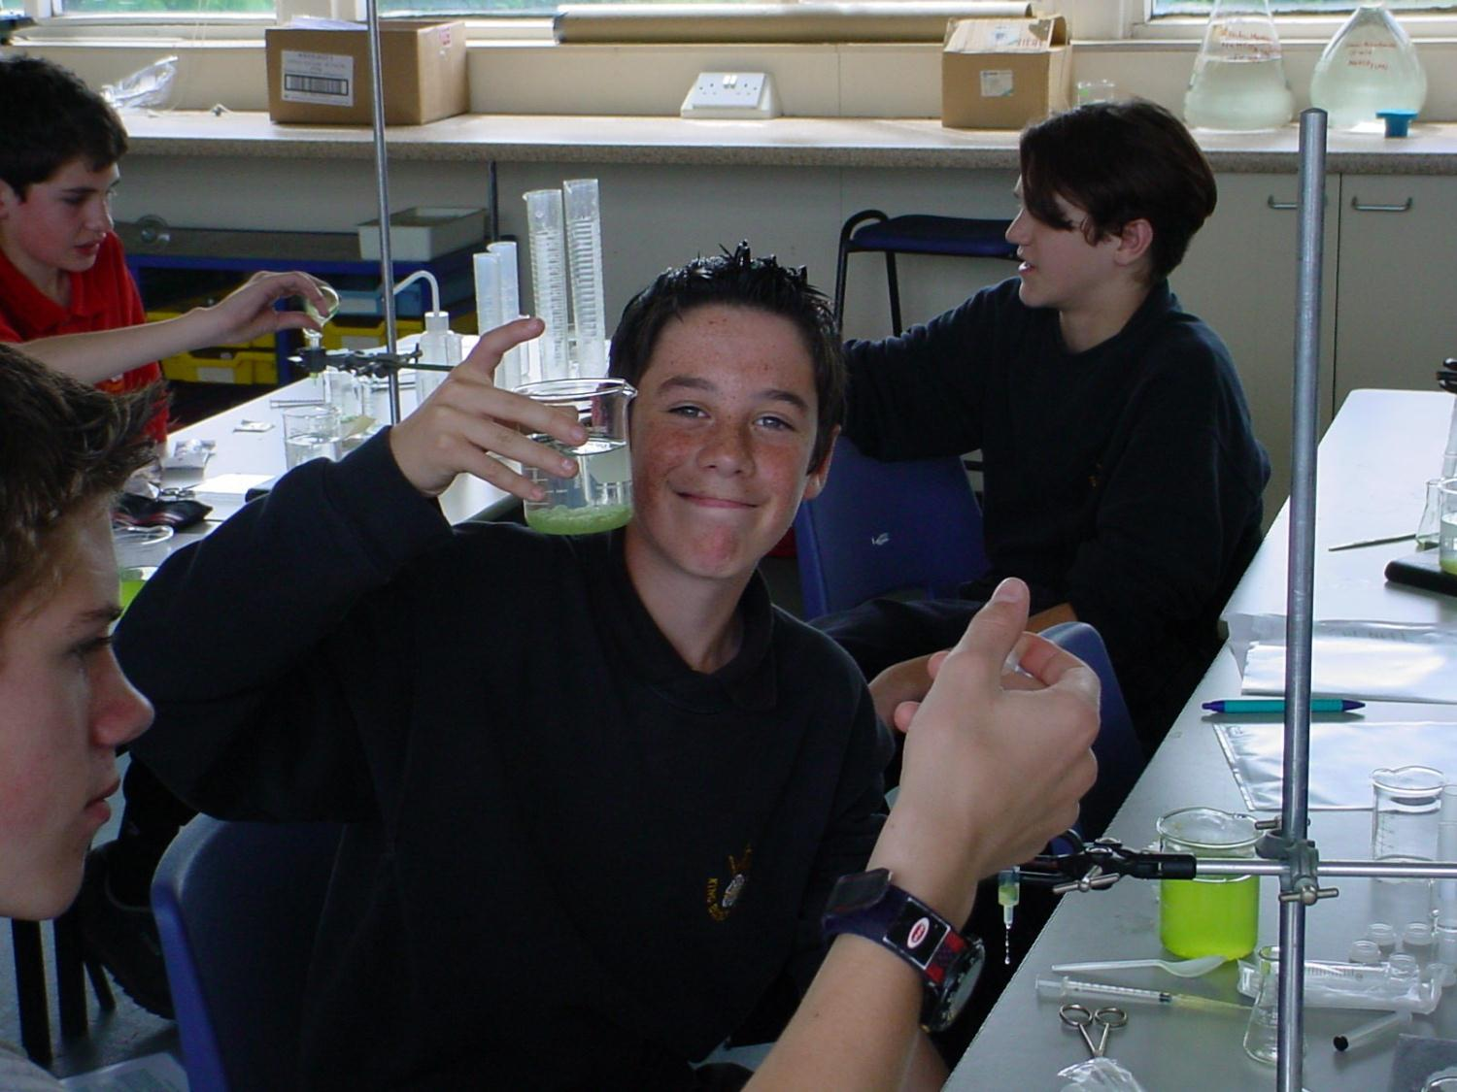

Slide 19
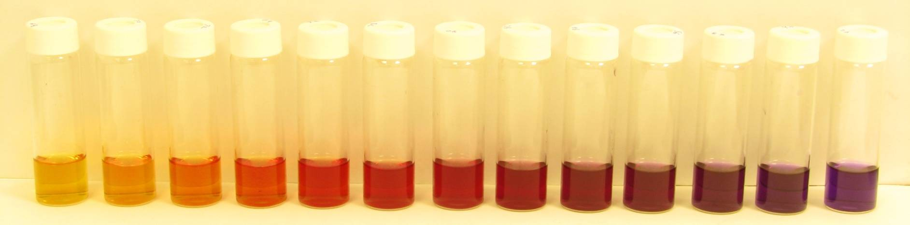
_{Hydrogen carbonate indicator}
pH 6.8 9.2
(in 0.2 increments)
Notes:
₁₉
Buffers 7.6 –9.2

Slide 20
Immobilised algal balls

Slide 21
10 resources in 10 minutes!

Slide 22
Potometer

Slide 23
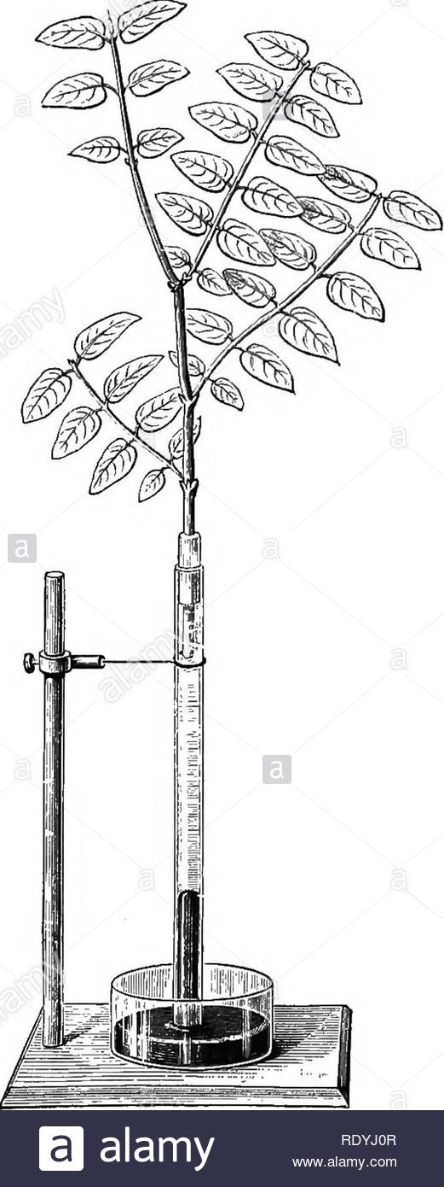
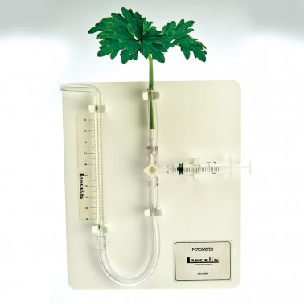
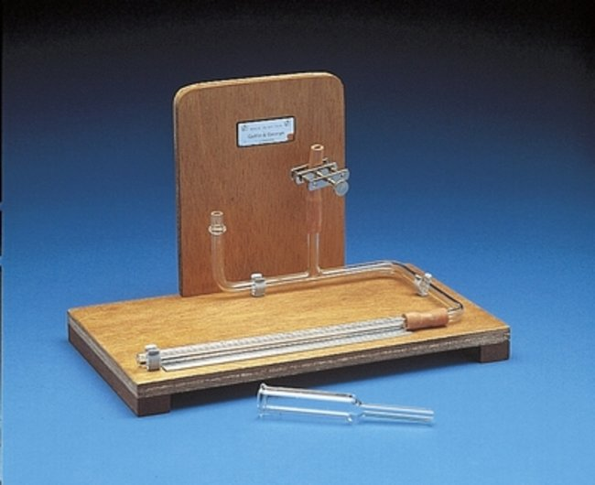
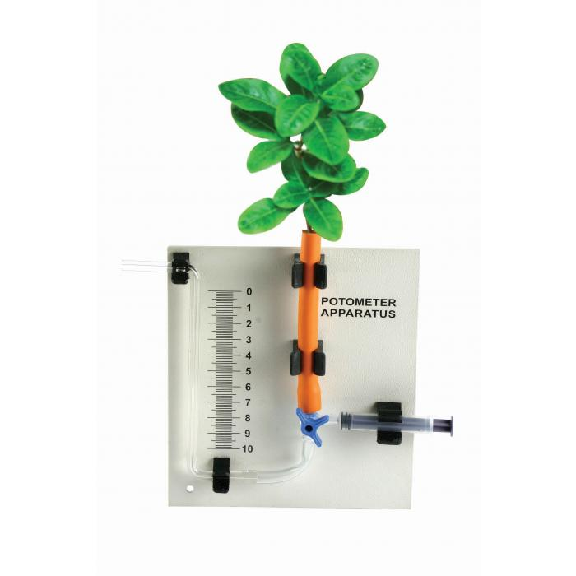
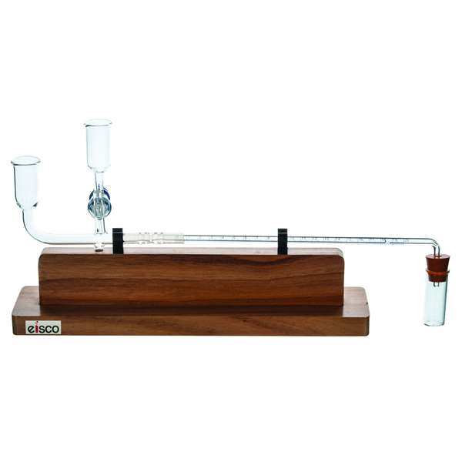
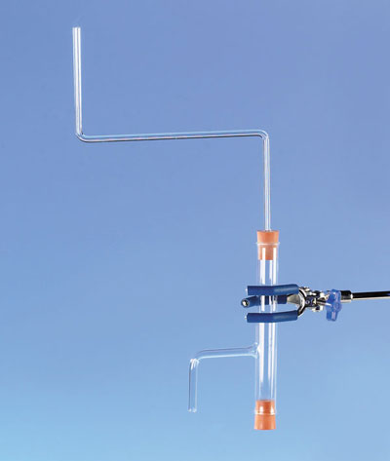
Traditionally one of these…
Something else?

Slide 24
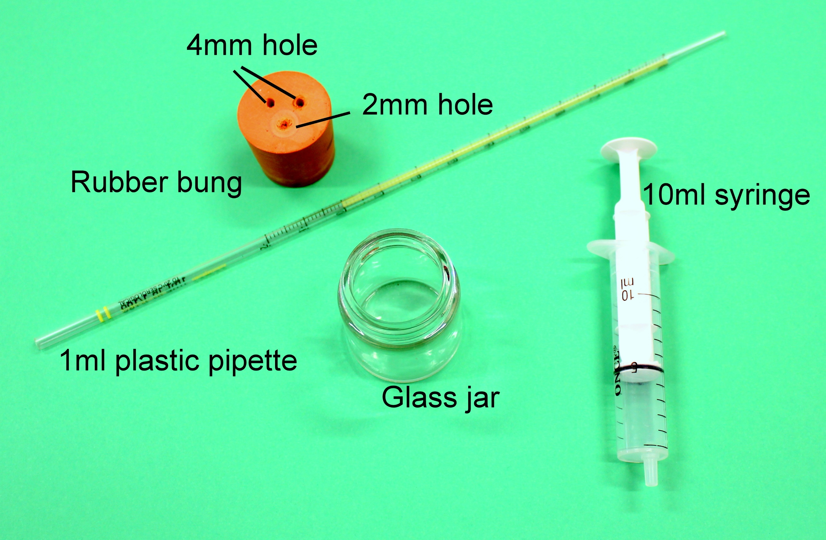
The SAPS potometer

Slide 25
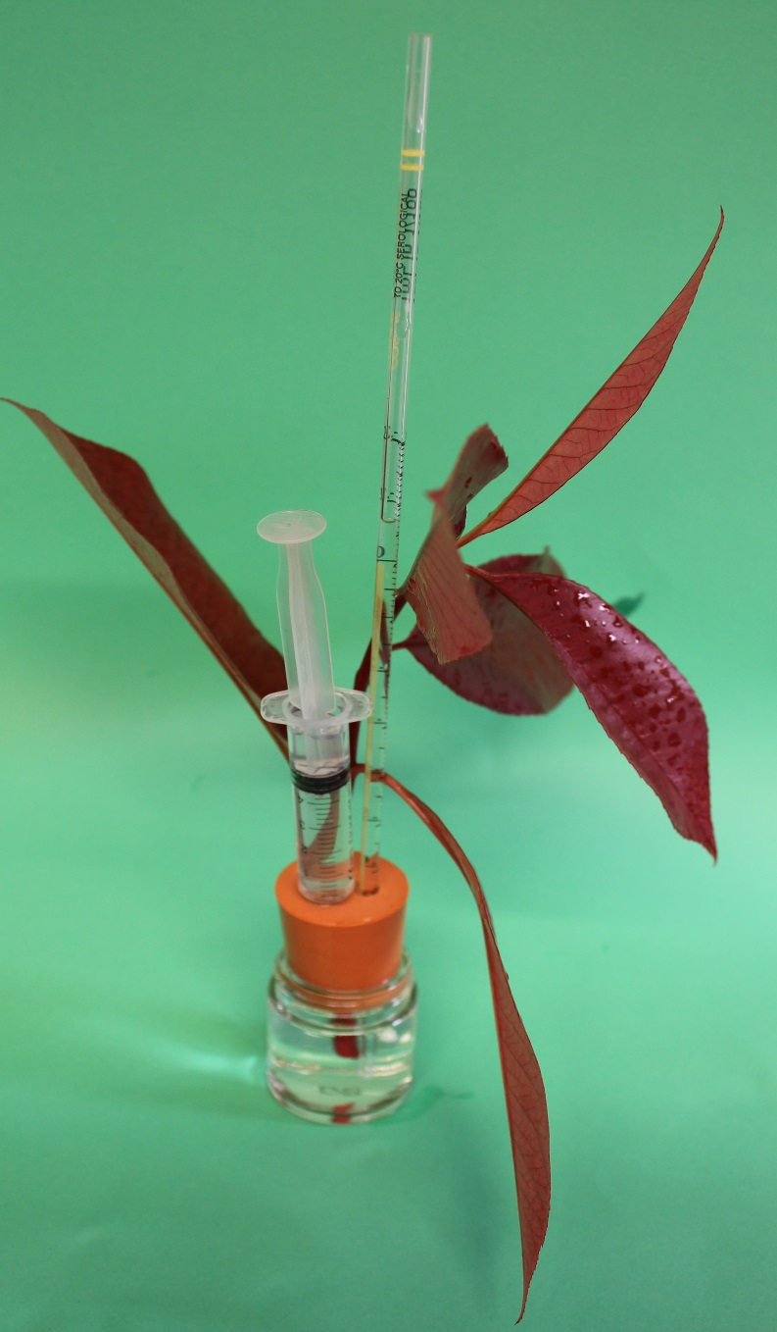
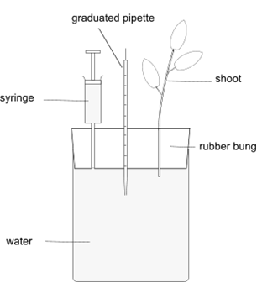

Slide 26
Osmosis in bell pepper

Slide 27
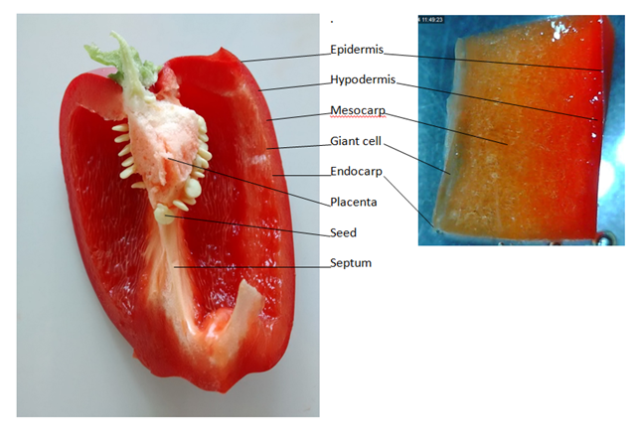
Observing giant cells in bell pepper pericarp

Slide 28
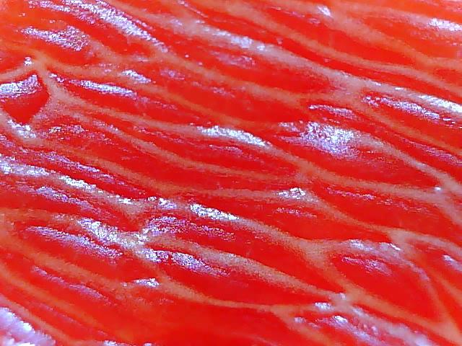

Slide 29
Microscopy of vascular tissue

Slide 30
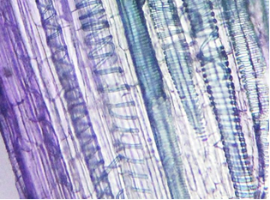
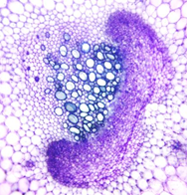
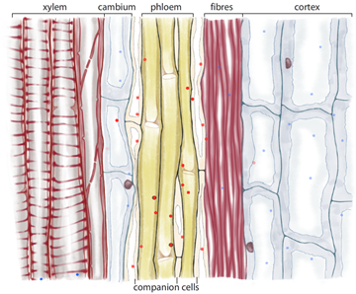
Microscopy of vascular tissue in celery

Slide 31
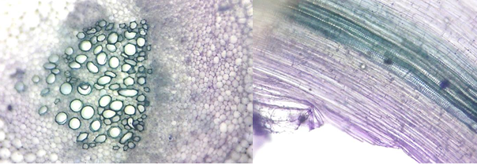
Celery vascular bundles
From plant to microscope in less than 4 mins
Have a go!

Slide 32
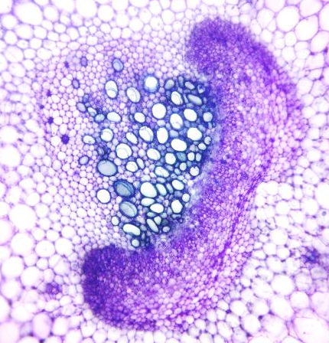
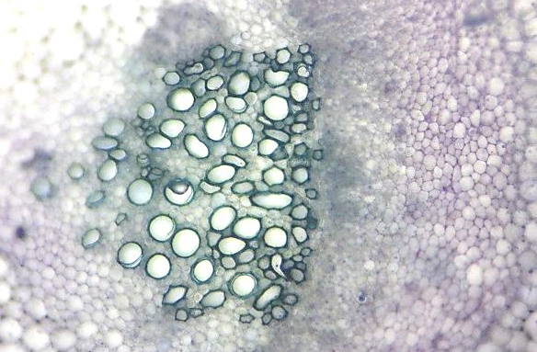
Preparations of celery petioles (leaf stalks) using this method (Apium graveolens var dulce)
Preparations of transverse sections through celery stalks [petioles] (Apium graveolens var dulce)
Phloem
Xylem

Slide 33
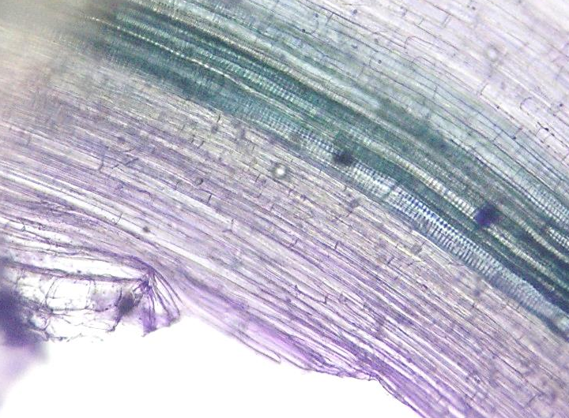
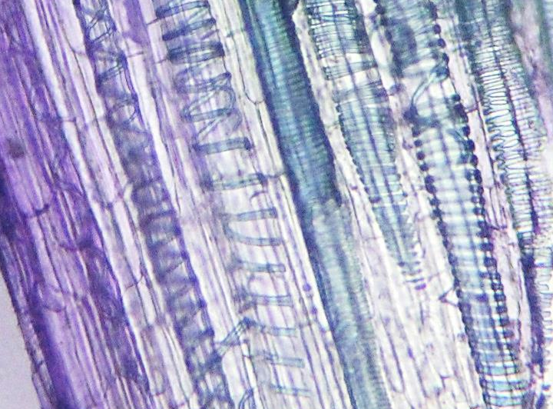
Preparations of longitudinal sections through celery stalks [petioles]
Xylem
Phloem

Slide 34
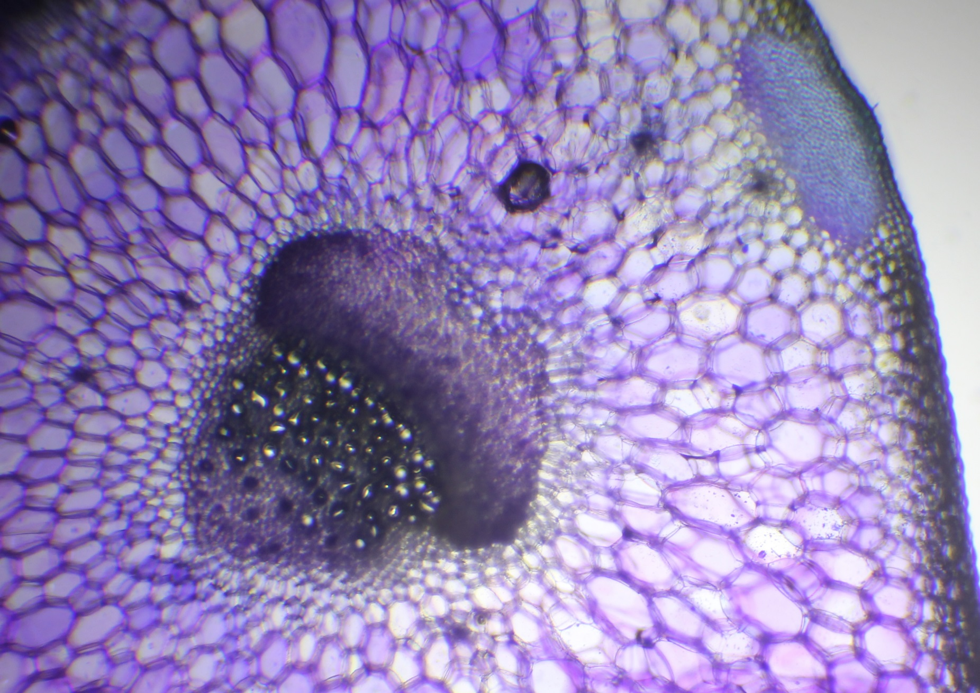

Slide 35
Microscopy of root tip mitosis

Slide 36
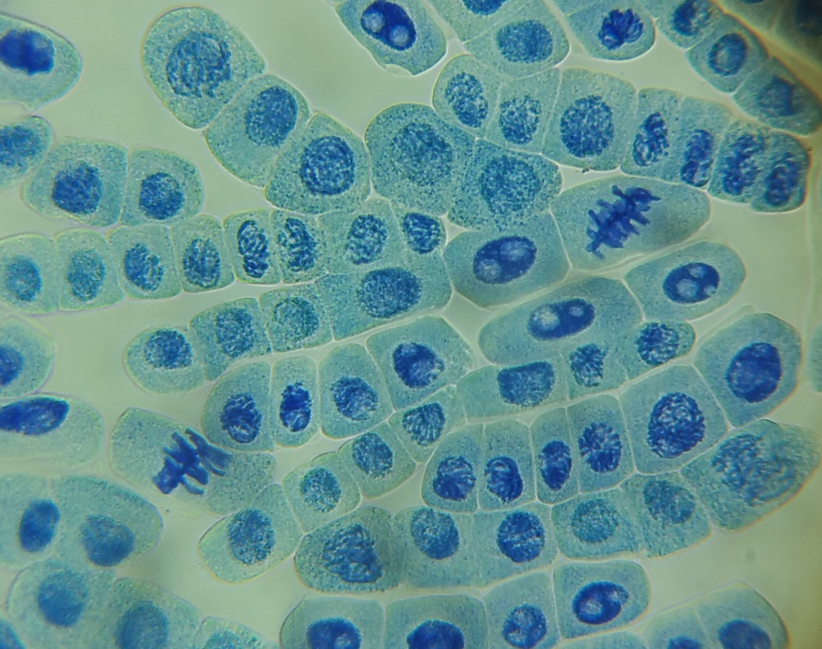

Slide 37
Stages of mitosis
Interphase cell | Prophase cell | Metaphase cell | Anaphase cell | Telophase cell

Slide 39
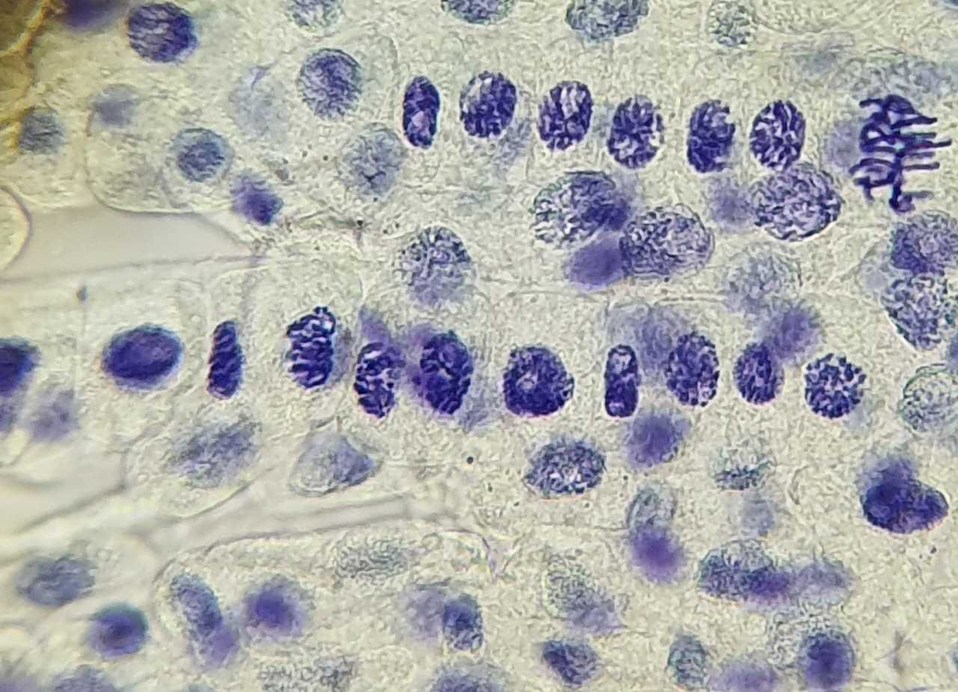

Slide 40
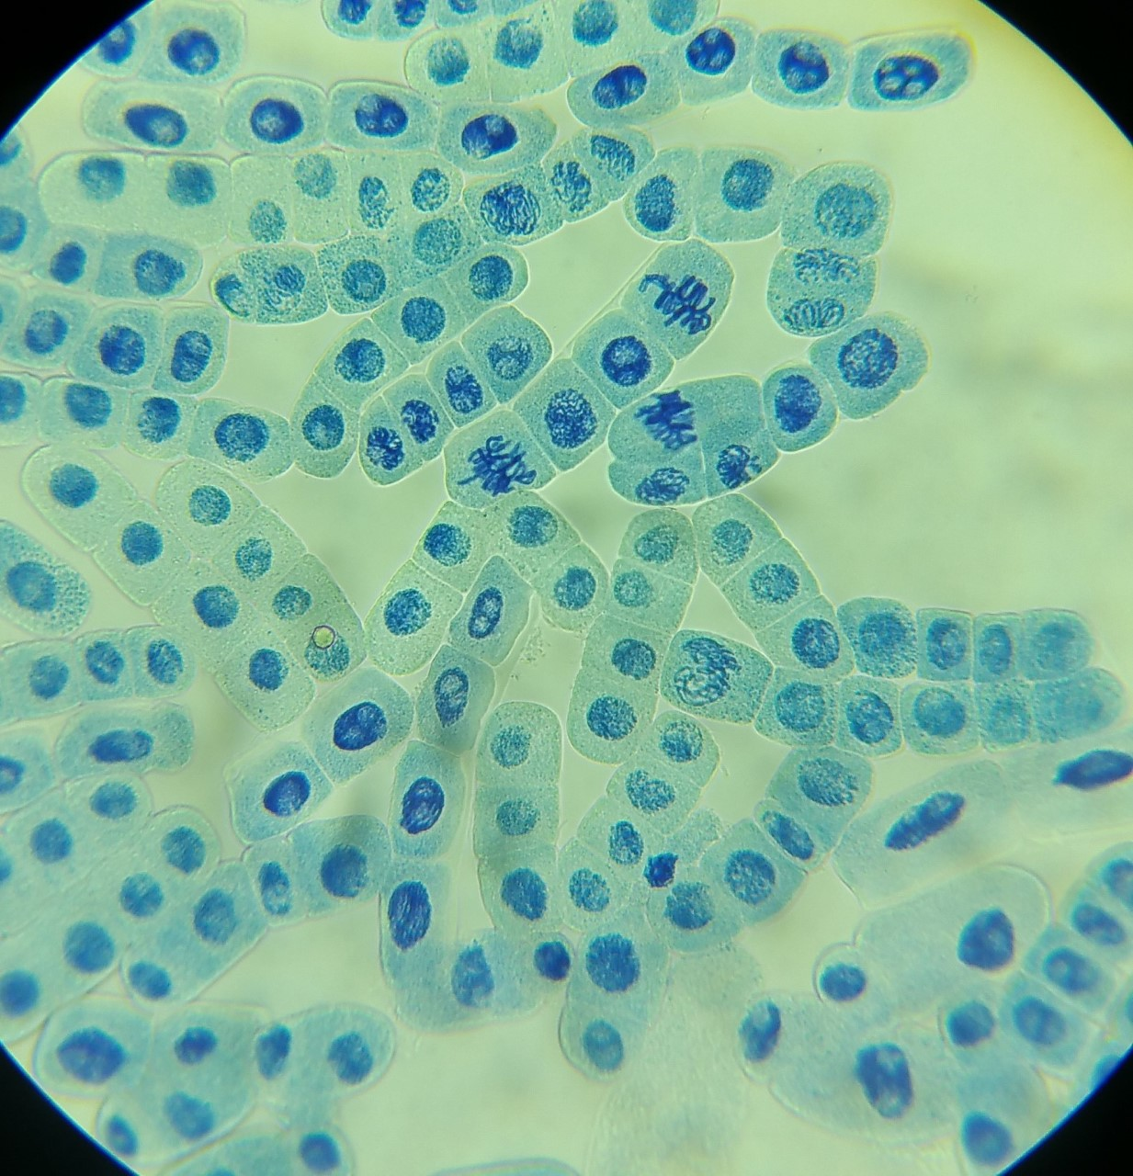

Slide 41
Plant disease

Slide 42
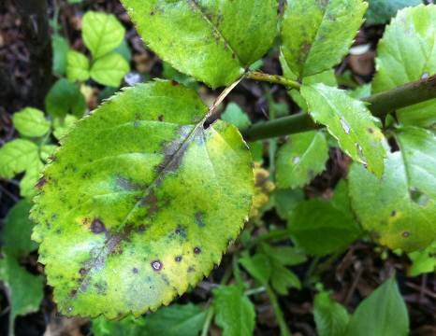
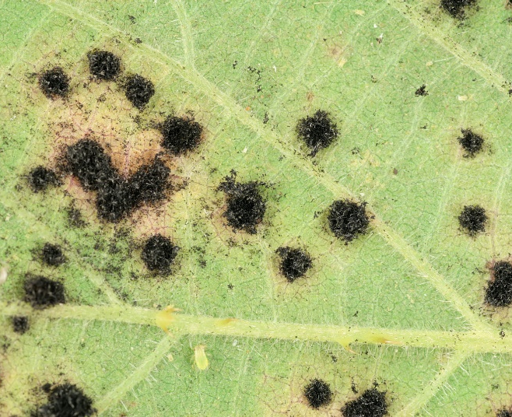
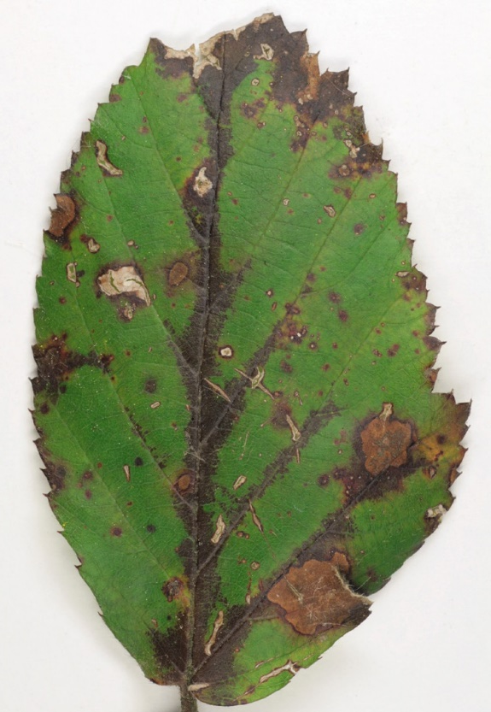
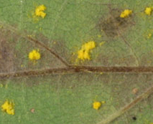
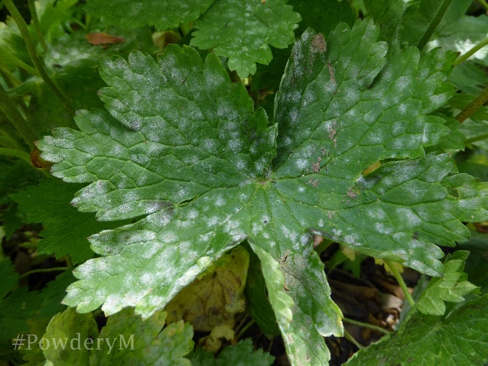
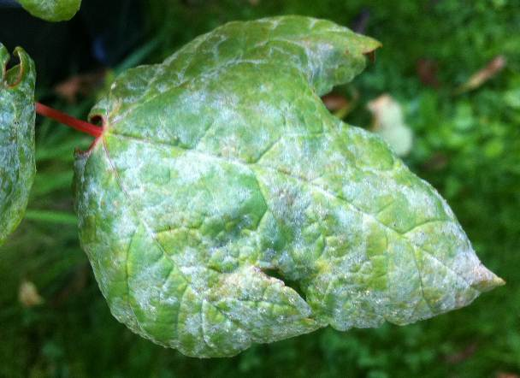
Rose black spot
Violet bramble rust
Powdery mildew

Slide 43
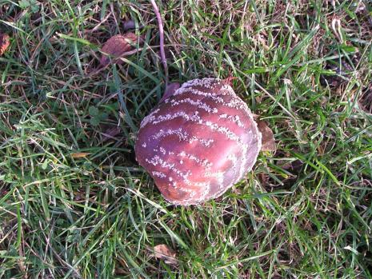
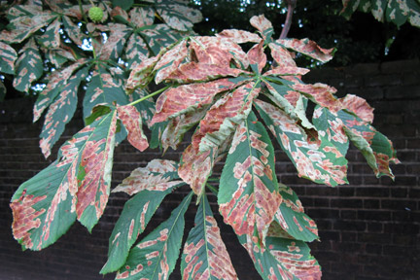
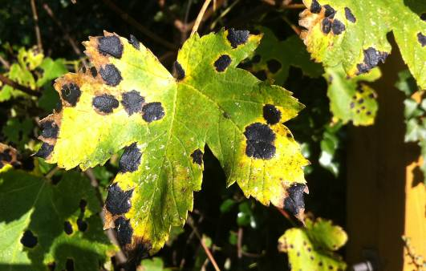
Apple brown rot
Horse chestnut leaf miner
Tar spot on sycamore

Slide 44
Getting plants into different areas of biology

Slide 45
Kitchen Classification

Slide 46

Homework task
Create a Kitchen Classification of at least 6 items similar to the one below

Slide 47
Posters

Slide 48

Awesome, Amazing and Incredible Plants
Inspiring contexts and careers to make students (and teachers) say “wow”

Slide 49


Slide 50

SAPS posters
Accompanying articles
Contemporary topics
C4 rice
Epigenetics
Gene editing
3 x Plant disease (GCSE)
Identification
Control
Plant response

Slide 51
Teaching microscopy using plants

Slide 52








Teaching microscopy using plants: what does a microscope show me?

Slide 53







Teaching microscopy using plants: preparing specimens

Slide 54







Teaching microscopy using plants: calibrating and measuring

Slide 55
Observing stomata in Tradescantia zebrina

Slide 56
Tradescantia zebrina

Slide 57




Plant Science Futures

Slide 58
Coming soon!
Online CPD – Teaching Photosynthesis with Confidence and Enthusiasm
Sessions at ASE Annual Conference 2026
Teaching Microscopy with Plants – ASE online – Summer 2026

Slide 59
Questions for you!
What else do you need?
What biology topics would you like support with?

Slide 60
Next steps
Sign up to our newsletter
Follow us on social media
Email us
Visit the early career teachers page

Slide 61
Evaluation

Slide 62
Thank you Q&A

