Slide 1
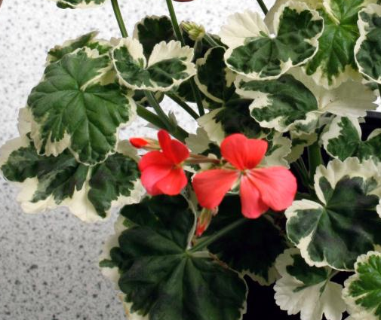
Testing a variegated leaf for starch
Notes:
Science & Plants for Schools: www.saps.org.uk
Testing a variegated leaf for starch
Resource 1222 v2 (Revised 2025)

Slide 2
Initial steps
A variegated leaf has green areas with chlorophyll in them and non-green areas without chlorophyll.
Take a variegated plant which has been in the dark for 24-48 hours and then under bright light for 24-48 hours and remove one of the leaves.
Make a drawing of the leaf showing where the green and non green areas are.
On your drawing mark where you expect to find starch being stored.

Slide 3
Preparing the leaf
Half fill a 250 ml beaker with water from a just boiled kettle
Hold the leaf with forceps and dip it in the boiling water for one - two minutes This gets rid of the waxy coating on the leaf.

Slide 4
Preparing the leaf (continued)
Collect a boiling tube and put the leaf you dipped in the water into the boiling tube.
Add ethanol to the boiling tube so the leaf is covered by the ethanol.
Put the boiling tube with the ethanol and leaf into the beaker of just boiled water.
Leave it for 5-10 minutes and observe what happens.
Tip: if the green chlorophyll does not come out of the leaf, boil the kettle again and change the water in the water bath for hotter water.

Slide 5
Observations
You can expect to see three things:
The ethanol boiling, even though the water was not boiling.
The ethanol turns green, because the chlorophyll is soluble in the ethanol and dissolves into it.
The green parts of the leaf lose their chlorophyll and become paler.

Slide 6
Testing the leaf for starch
Carefully pour the ethanol into a discard bottle that has a screw top lid.
Rinse the leaf in cold water
Put the leaf in a shallow dish, such as a petri dish.
Pipette iodine solution drop by drop onto the surface of the leaf .
Wait for at least one minute

Slide 7
Recording the areas that have stored starch
Make a note of any colour changes. If starch is present the iodine solution will turn from golden brown to blue-black.
Record where the iodine has stayed the same and where it has changed to show starch is present.
Do your results agree with your prediction?

