Slide 1
Your experiences
What do you recall about your own experiences of learning about plants? When did you last get taught some plant science?
How do you feel about teaching about plants?
- The “planty bits”?
- Including plant examples throughout biology

Slide 2
Teaching Biology with SAPS

Slide 3









RSC participant agreement
This session is being recorded.
We agree to…
…foster equal participation
…not tolerate bullying, harassment, or discrimination
…maintain privacy/confidentiality
…respect people’s identities & experiences
…engage with kindness and respect
…keep communication professional
…consider diverse cultural backgrounds
…contribute constructively.
….will not screen-shot or screen-record without the expressed permission from the presenter

Slide 4


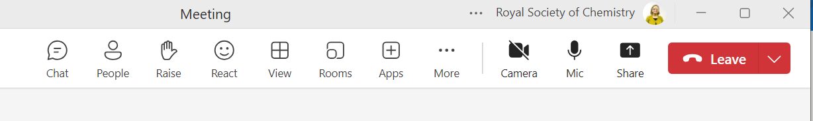
Teams housekeeping
Please mute yourself during the presentation unless you’re directly speaking. This avoids background noise.
  You can mute/unmute by clicking the microphone icon at the top of your screen
  unmute mute
If you have any questions, please type them into the chat. The session co-host will be checking for any questions and asking the host.
  To access the chat, click on the speech bubble icon at the top of the screen
Notes:
Don’t forget to stop annotations when you share screen (“more” at top right when sharing starts)
Mention minimise video thumbs and tiling chat as slides busy

Slide 5
Event support hub
The presentation and links to the resources shown can all be accessed through the event support hub
To have access we will ask you to complete a short survey at the end of the session
You can provide your email address and the link to the event support hub will be emailed to you
Access to the page lasts a month

Slide 6
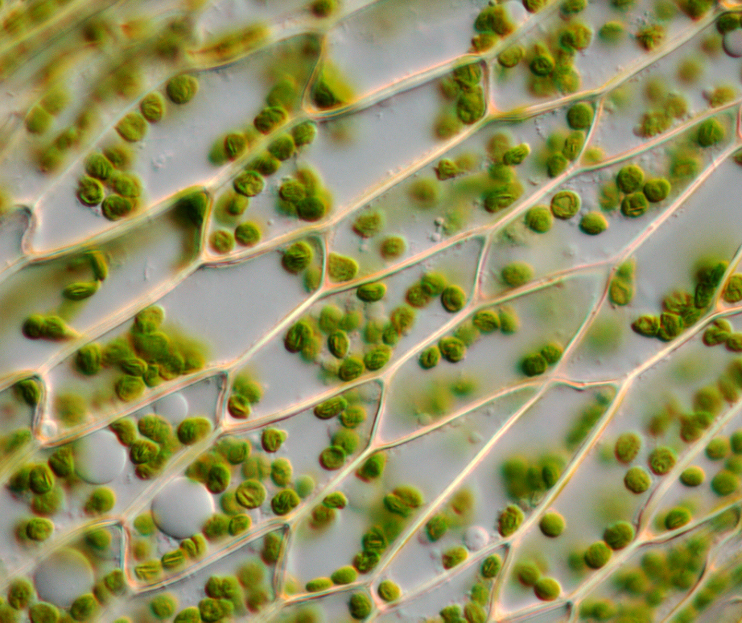
Teaching Biology with Plants 101
Alex Jenkin & Jamie Biggs

Slide 7
A poll!
Have you heard of us?

Slide 8
What we’ll cover
Intro to SAPS
Why teaching plants well is important
Teaching photosynthesis
Teaching microscopy with plants
10 resources in 10 minutes
What next?

Slide 9
The mission of the Gatsby Plant Science Education Programme
Supporting education to build a diverse pipeline of plant scientists, and a plant positive and nature connected society equipped to address global challenges

Slide 10
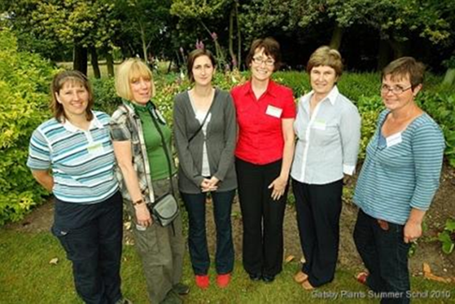
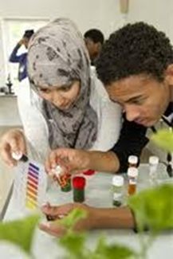
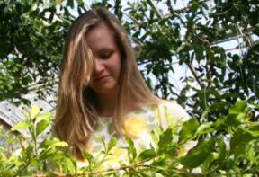
Inspirational plant science teaching
some of whom will become plant scientists.
Enthusiastic teachers will …
engage students …

Slide 11
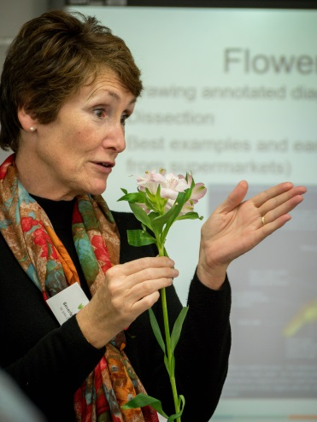
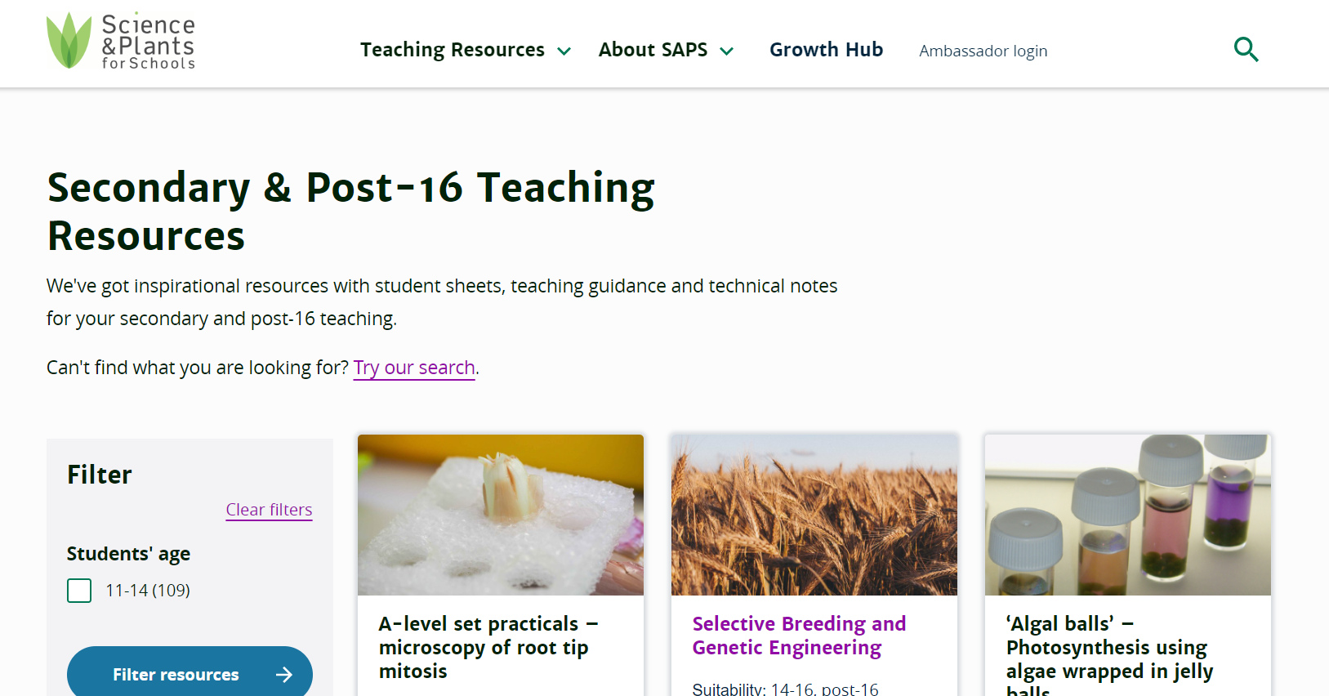
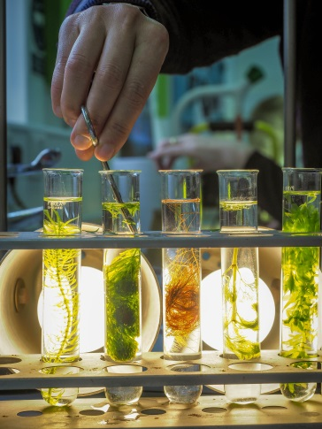
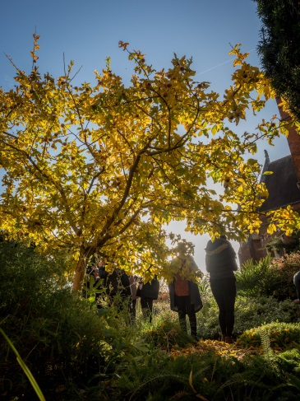
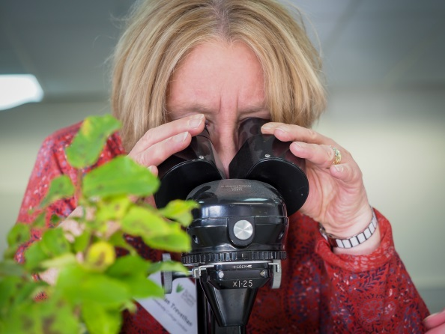
Busy teachers and technicians need …
easy access to CPD and resources including …
affordable practicals …
techniques that work, and …
relevant contexts.

Slide 12
They also deserve support and encouragement so we…
Have stands and hold events at teacher and technician conferences
Send half-termly newsletters with new ideas and our latest resources
Run ‘Train the Trainer’ courses for ITE tutors
Provide PGCE students and trainees with USB sticks
Develop CPD
Engage with exam boards and curriculum developers

Slide 13
More polls!
Tell us about yourselves

Slide 14
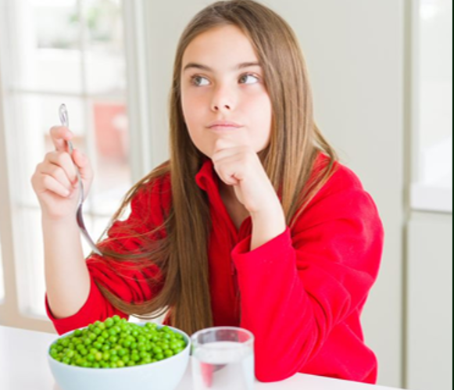
Why effective teaching of plant topics and plant contexts in science education is important

Slide 15
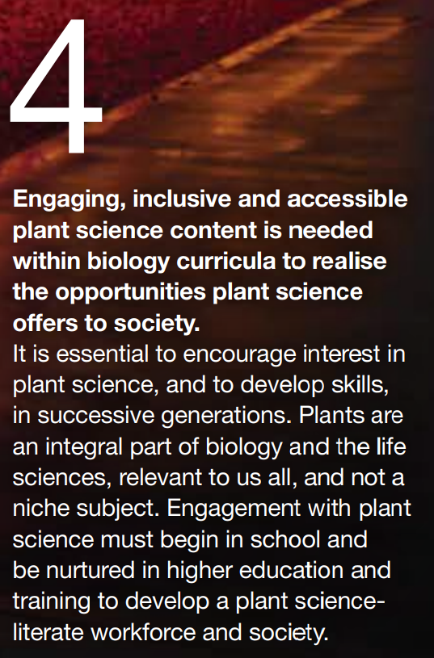
Growing the future. A report by the UK Plant Sciences Federation (January 2019)
Executive summary Conclusion 4
https://www.rsb.org.uk/images/UKPSF_Growing_the_future.pdf

Slide 16
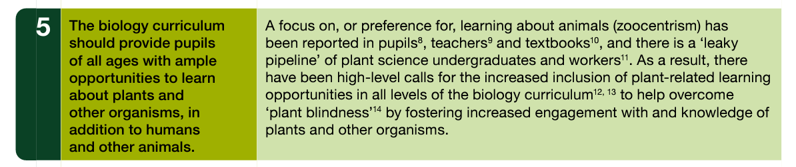
Evolving 5-19 Biology: recommendations and framework for 5-19 biology curricula. Royal Society of Biology (Nov 2021)
Recommendation 5
https://www.rsb.org.uk/policy/education-policy/school-policy/curriculum

Slide 17
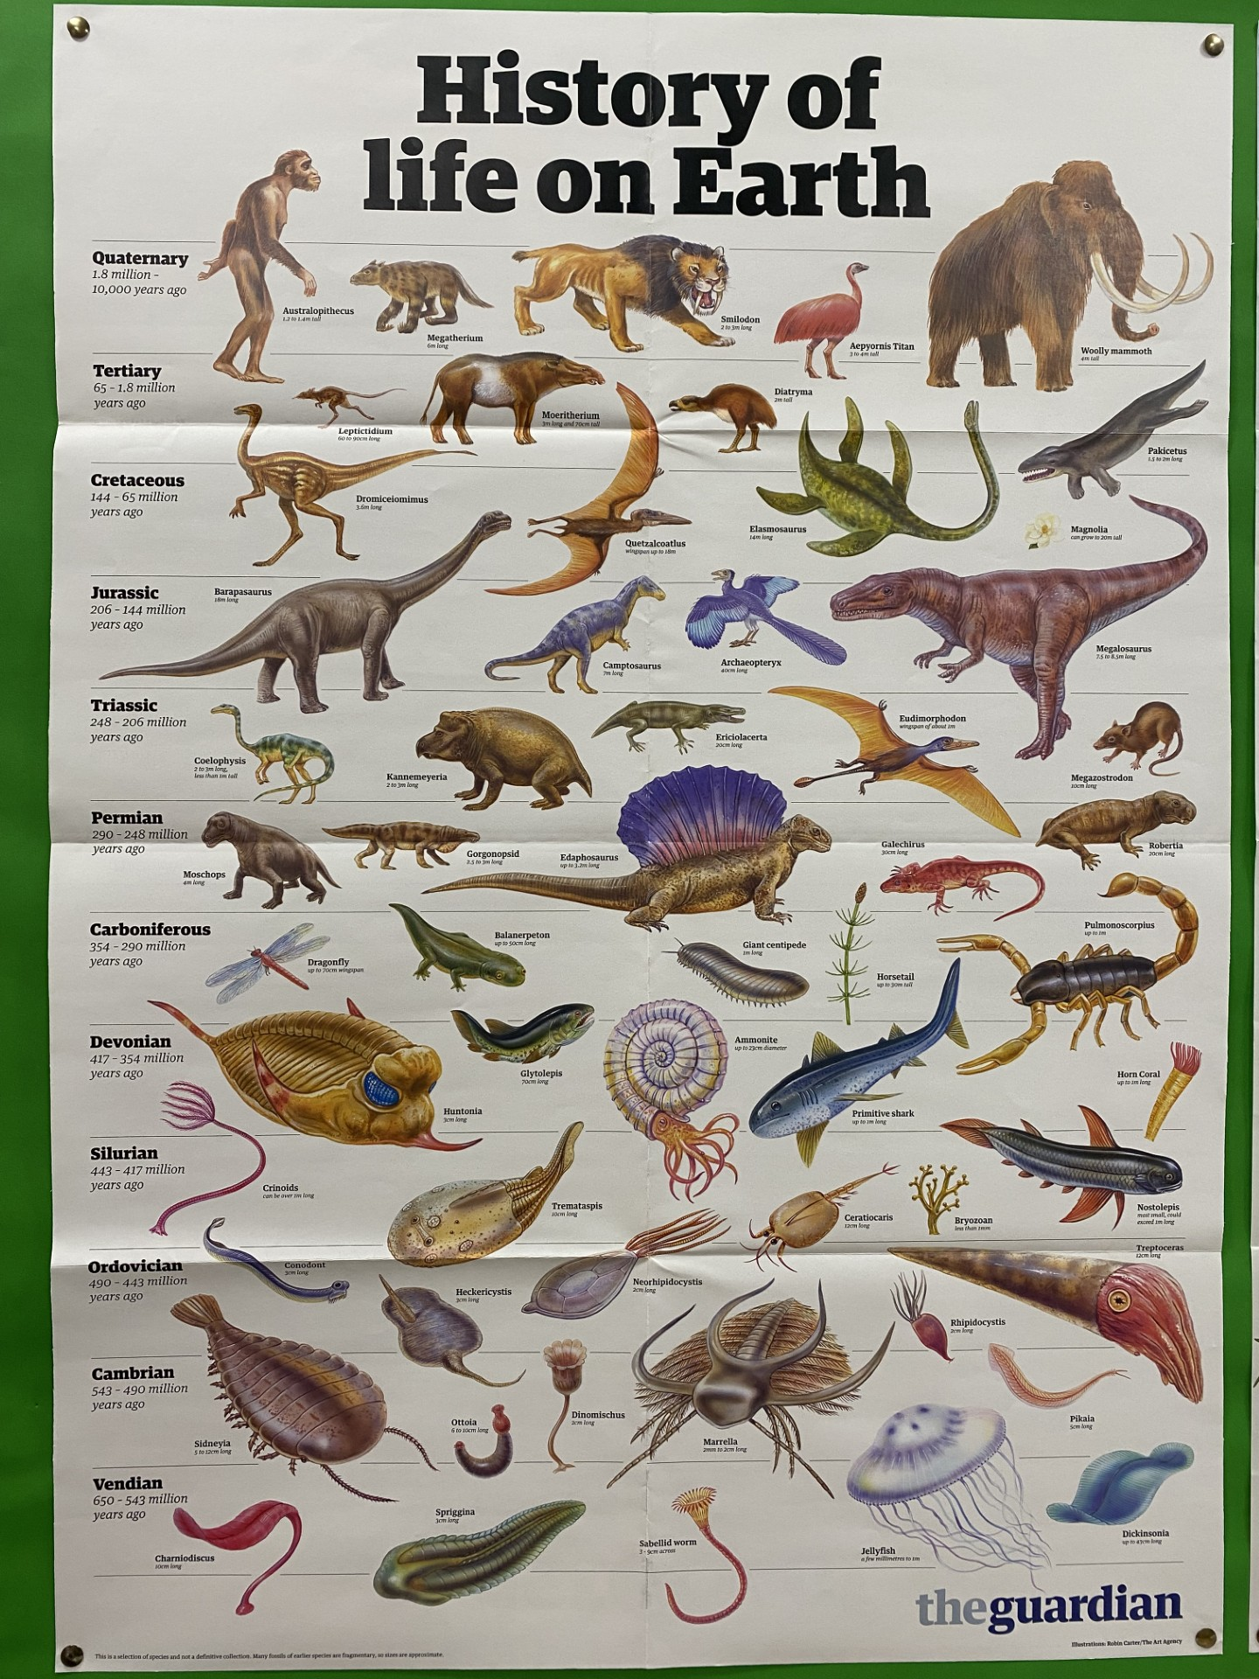
What is plant blindness?
Lack of attention towards plants
Lack of understanding of plants, not seeing the significance or relevance of plants, not feeling a connection with plants, etc.
Plant awareness → Plant positivity
Notes:
Photo by Chris Graham – photo of the Guardian’s ‘History of life on Earth’ poster on a wall at Hills Road Sixth Form College

Slide 18
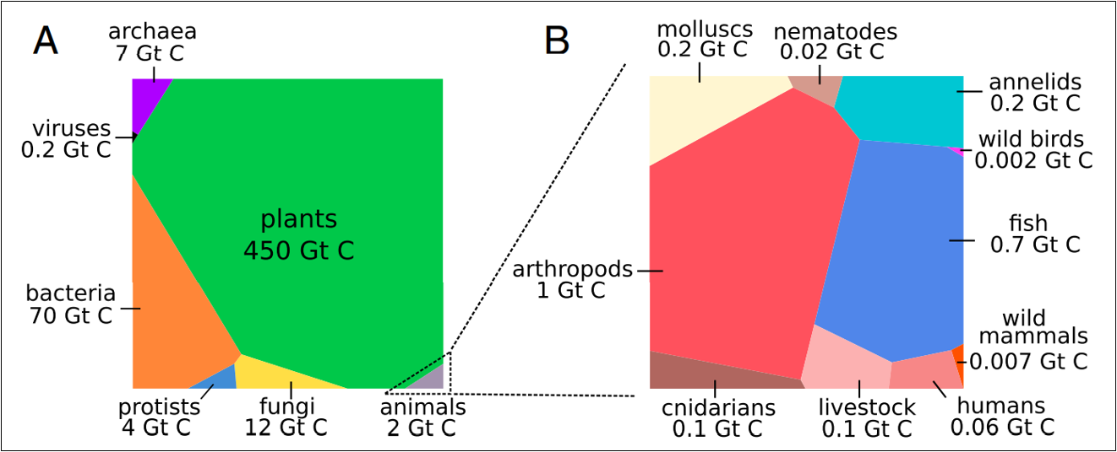
Total carbon in life is about 550Gt
From: Bar-On, Y.M., Phillips, R. and Milo, R. (2018) The biomass distribution on Earth. PNAS 115 (25) pp 6506-6511.
https://www.pnas.org/doi/pdf/10.1073/pnas.1711842115

Slide 20
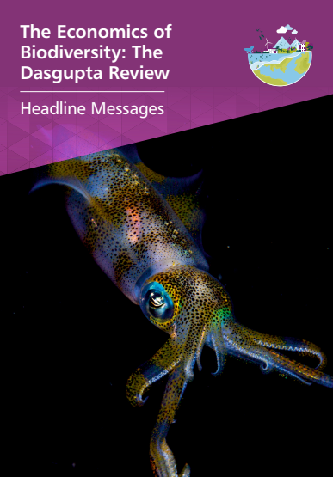
“The discipline to draw on Nature sustainably must, ultimately, be provided by us as individuals. But societal change – particularly growing urbanisation – has meant that many people have grown distant from Nature.”
“Establishing the natural world in education policy is therefore essential.”
p5
Feb 2021
https://assets.publishing.service.gov.uk/media/60182857d3bf7f70c2afe5bb/Dasgupta_Review_-_Headline_Messages.pdf

Slide 21

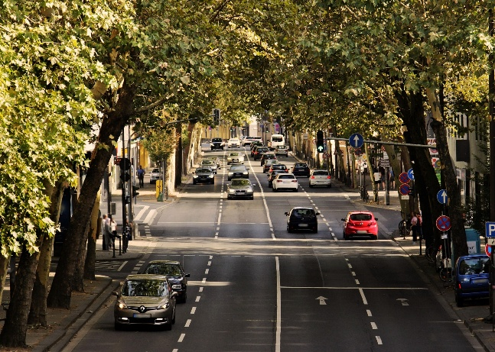
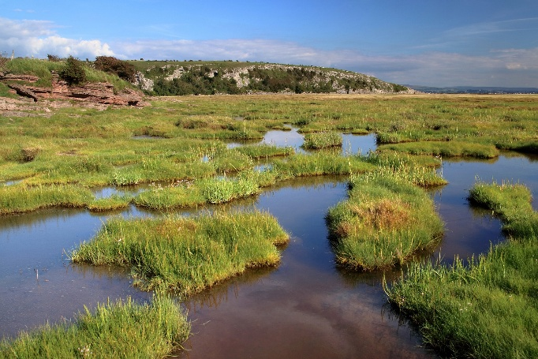
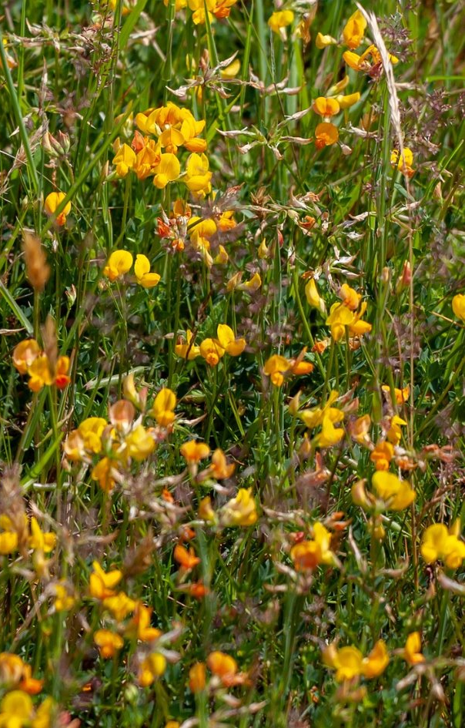
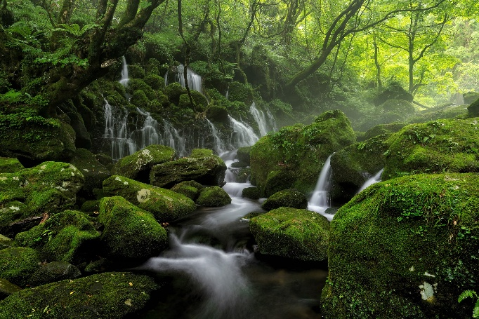
Notes:
Regulate temperature - urban cooling - Image by NoName_13 from Pixabay
Reduce soil erosion - Image by Michael from Pixabay
Water management – flood protection - Image by Kanenori from Pixabay
Reduce coastal erosion - Image by Pete from Pixabay
Resilience of ecosystems / ecosystem services: Image by Kev from Pixabay

Slide 22
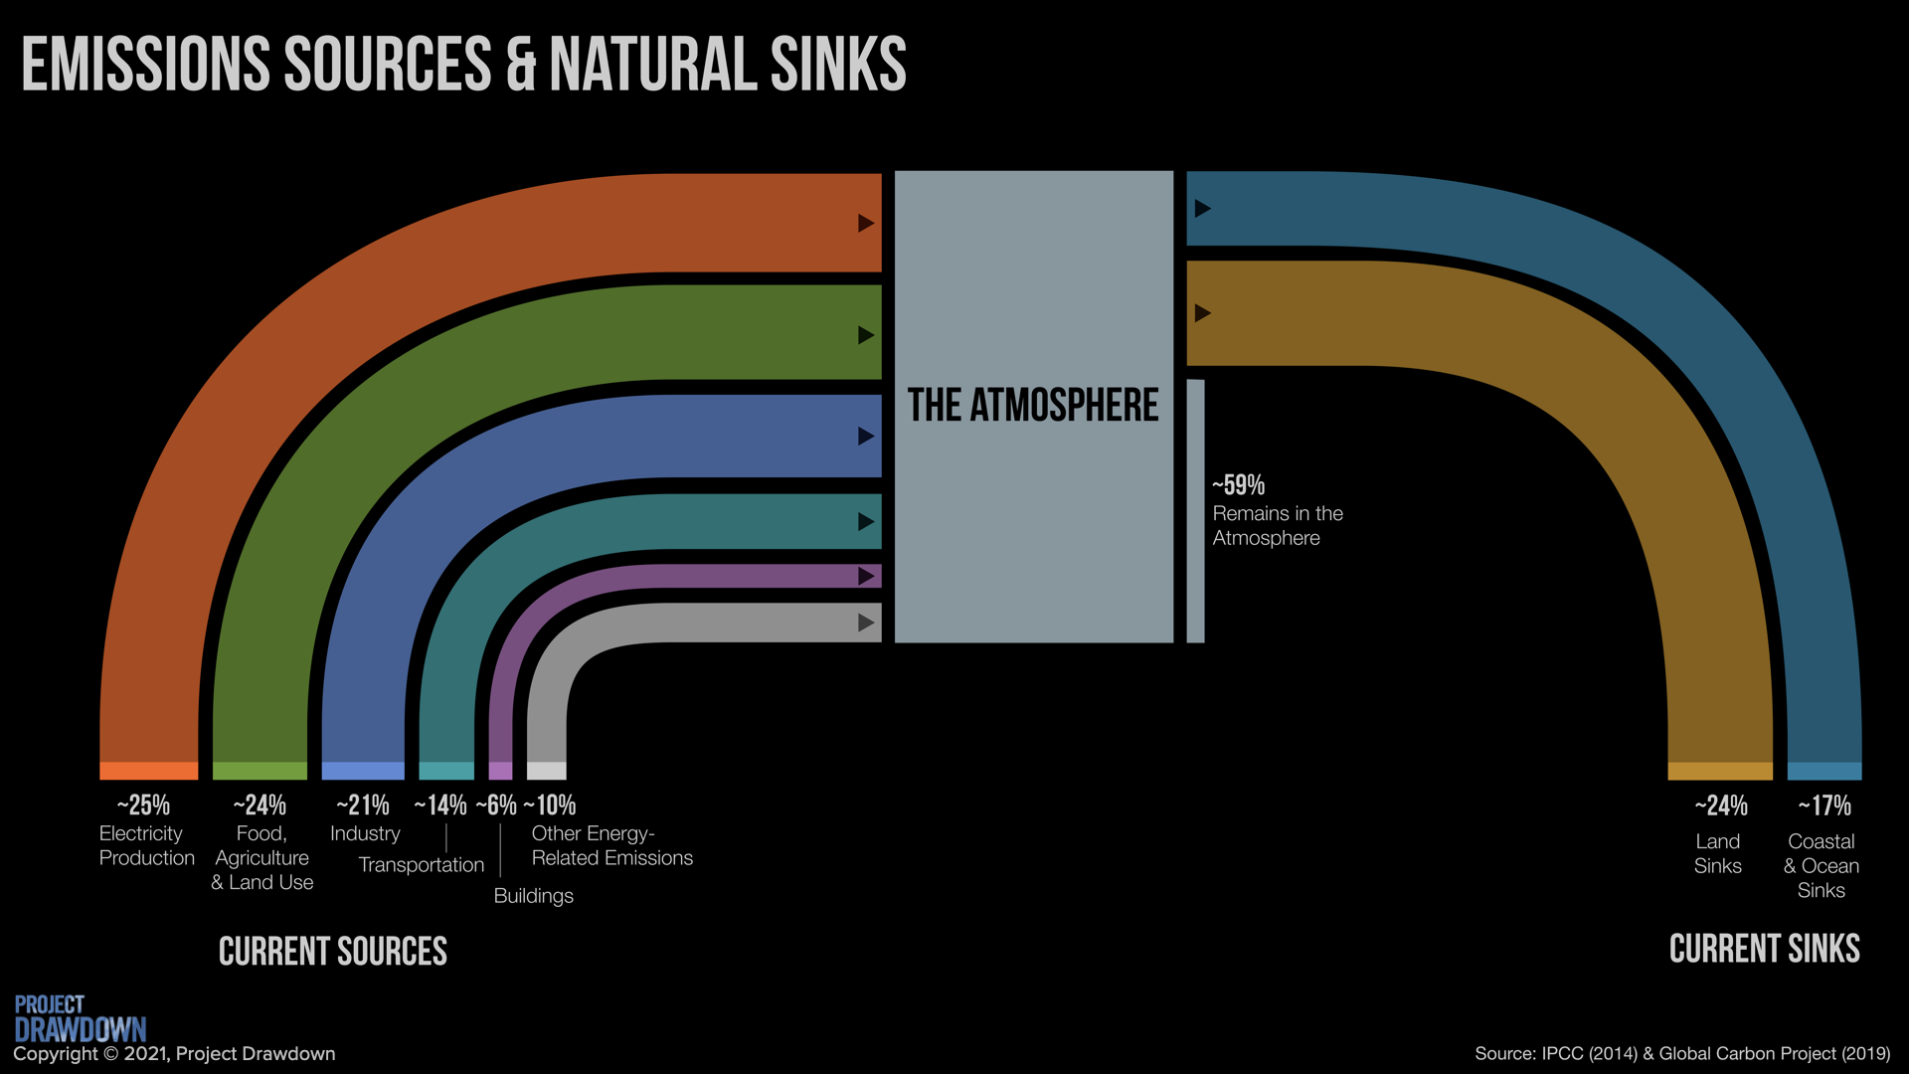
Photosynthesis
Food, Agriculture & Land Use / Industry
https://drawdown.org/climate-solutions-101/unit-2-stopping-climate-change

Slide 23
We need more plant scientists and plant science literate people.
The teaching of plant topics and plant contexts in science teaching at the moment is not meeting the needs of the sector - there tends to be a human and animal bias in biology curricula and in teaching approach.
It would be beneficial to the individual, to society, and to the future of humanity if people were more connected to the natural world.

Slide 24
The educational value of using plants in science education
To take advantage of plant-based examples or contexts where they are the best choice for students’ learning
To reduce the perceived separation of biology into ‘plant’ topics and ‘animal’ topics by students
To highlight general biological principles
To enhance students’ ability to apply their knowledge and understanding across a wide range of contexts
To link learning to what students experience in their lives outside of lessons

Slide 25
Bubbling pondweed

Slide 26
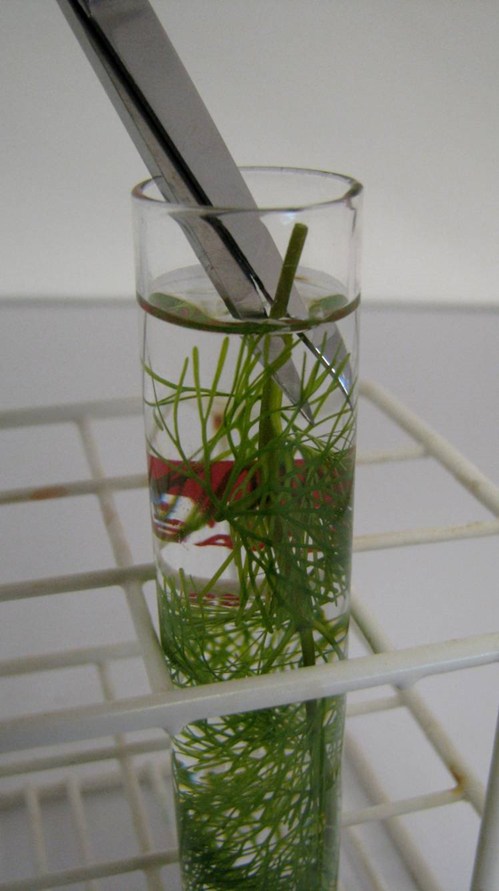
Bubbling pondweed
Investigating the effect of light intensity on the rate of photosynthesis
Piece of pondweed
Place upside down in 1% sodium bicarbonate solution
Cut stem under level of liquid
Place in front of a bright light
Bubbles from the cut stem

Slide 27
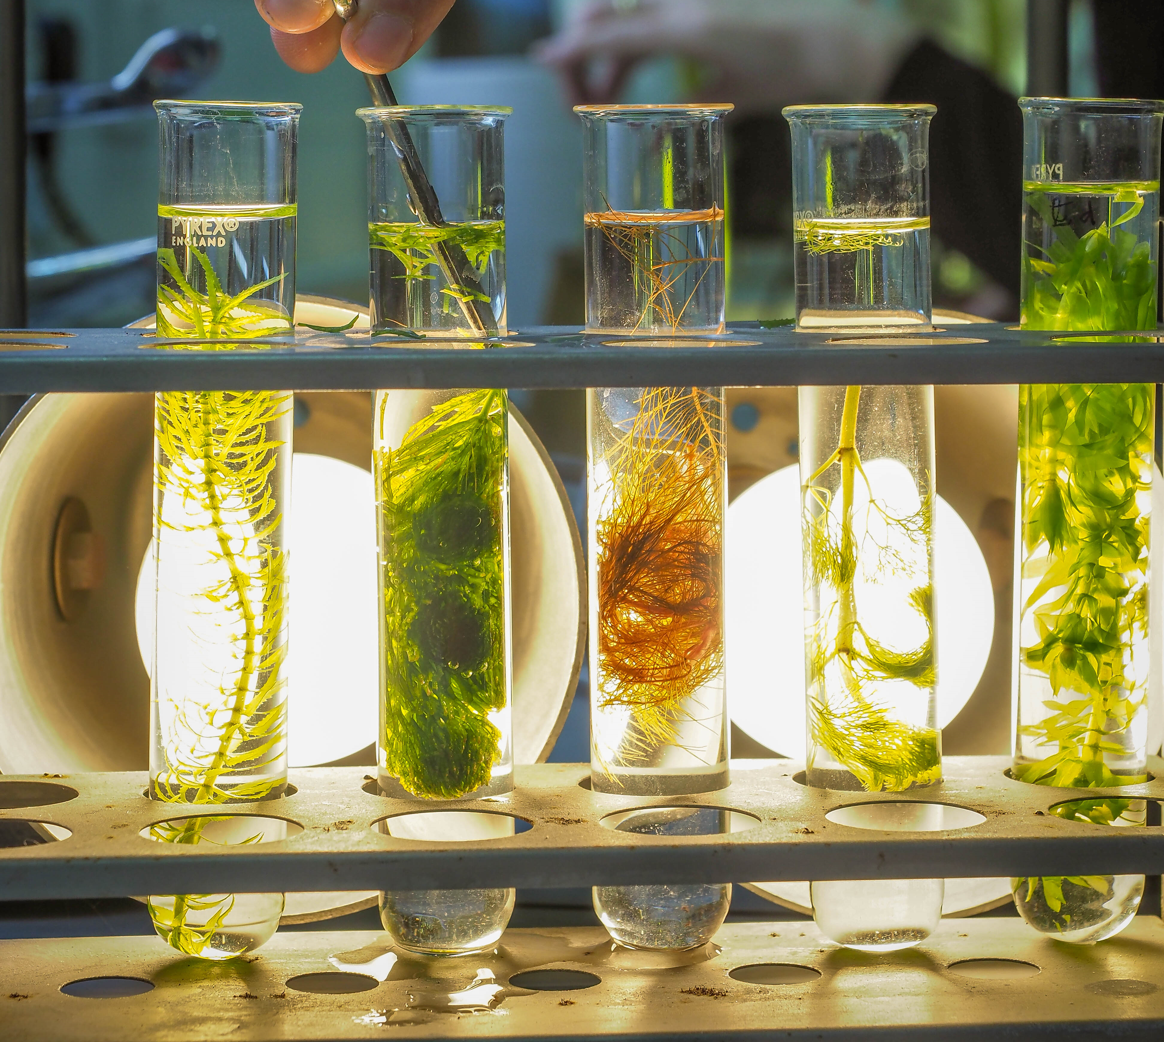

Egeria najas
Ceratophyllum demersum (hornwort)
Cabomba furcata (red cabomba)
Cabomba aquatica (yellow cabomba)
Egeria/Elodea densa
Myrophyllum scabratum (not pictured)

Slide 28
Tips for happy pondweed
Pondweed is a living thing and needs caring for
Weed from a cold pond in winter is unlikely to be very active
Purchased weed should not be put into very cold water, bring the water up to room temperature.
Bubble with an air stone
Constant illumination under bright light (>1200 lumens if possible)
Use bright lights during the experiment itself
Increase the temperature if necessary
Cut the stem under level of the liquid
Add sodium hydrogen carbonate to the water (to create a 1% soln.) to ensure CO2 is not limiting in the boiling tube.

Slide 29
Immobilised algal balls

Slide 30
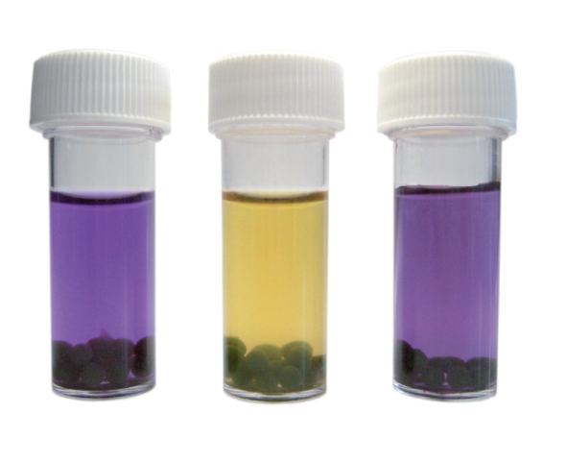
Immobilised algal balls

Slide 31
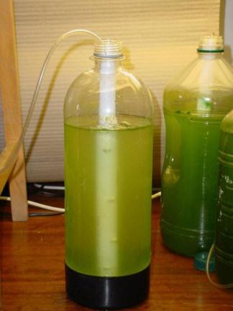
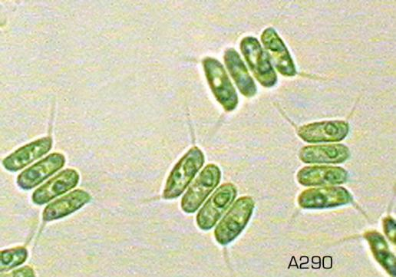
_{Scenedesmus quadricauda}

Slide 32
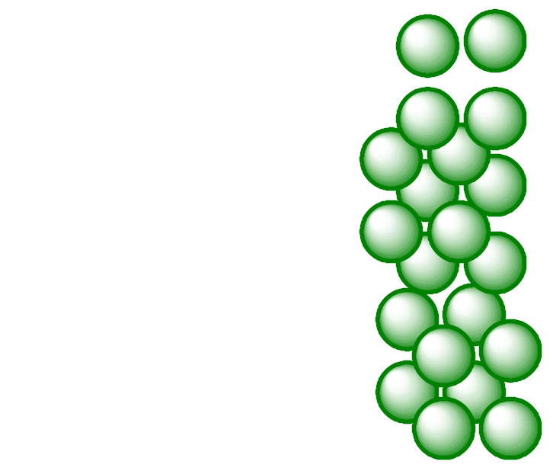
What’s happening?
Algae suspended in + calcium chloride
Sodium alginate solution
Calcium alginate
(insoluble)

Slide 33
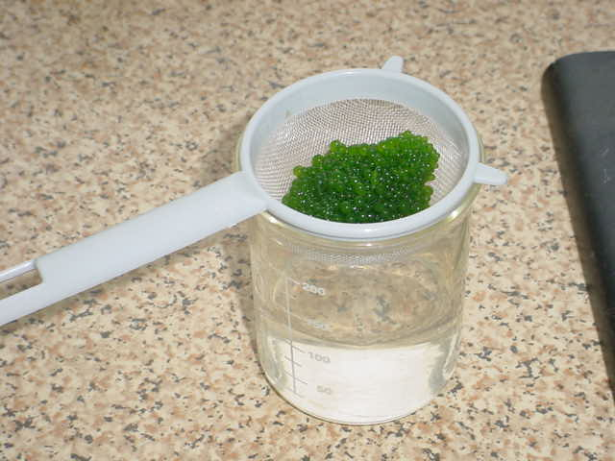

Slide 34
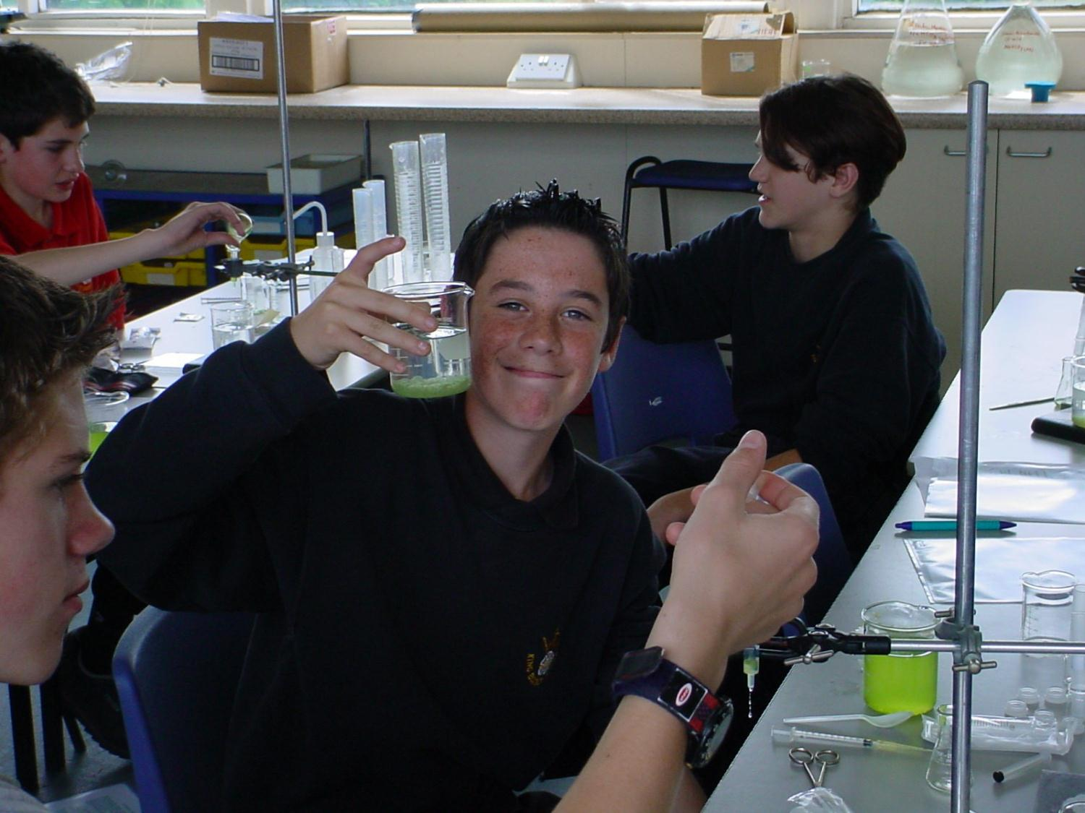

Slide 35
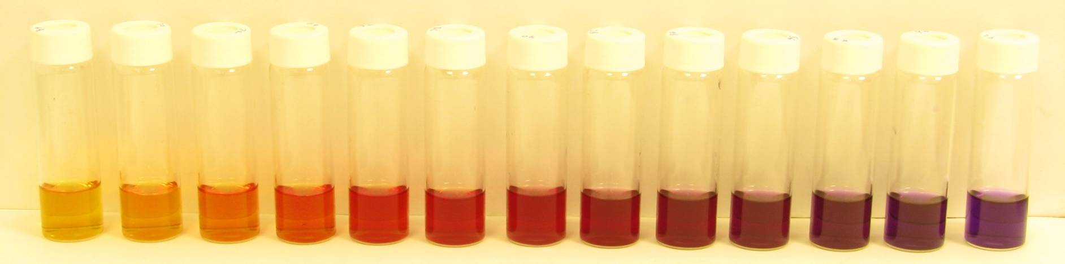
_{Hydrogen carbonate indicator}
pH 6.8 9.2
(in 0.2 increments)
Notes:
₃₅
Buffers 7.6 –9.2

Slide 36
Teaching Photosynthesis with Confidence and Enthusiasm
Free online research-informed CPD on a challenging topic
5 short courses
Misconceptions
Teaching ideas
Content knowledge
Contexts
“a gamechanger” – ECT 2026

Slide 37
10 resources in 10 minutes!

Slide 38
Potometer

Slide 39
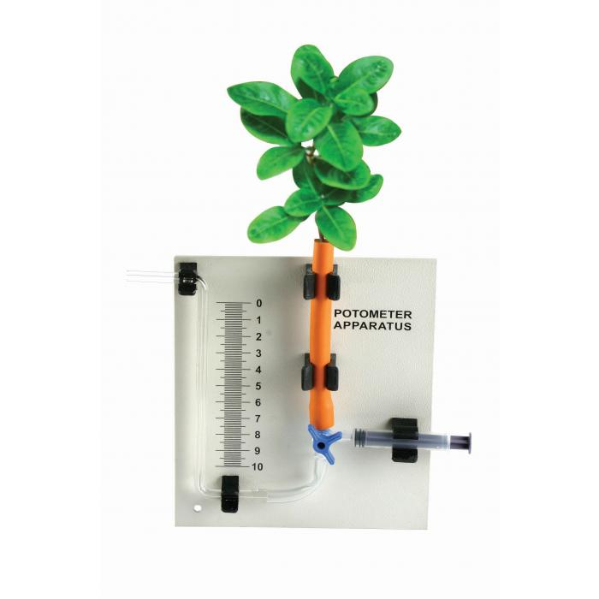
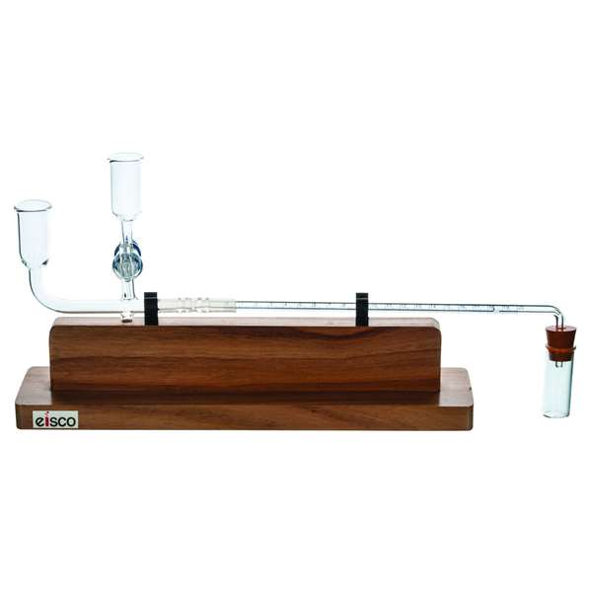
Traditionally one of these…
Something else?

Slide 40
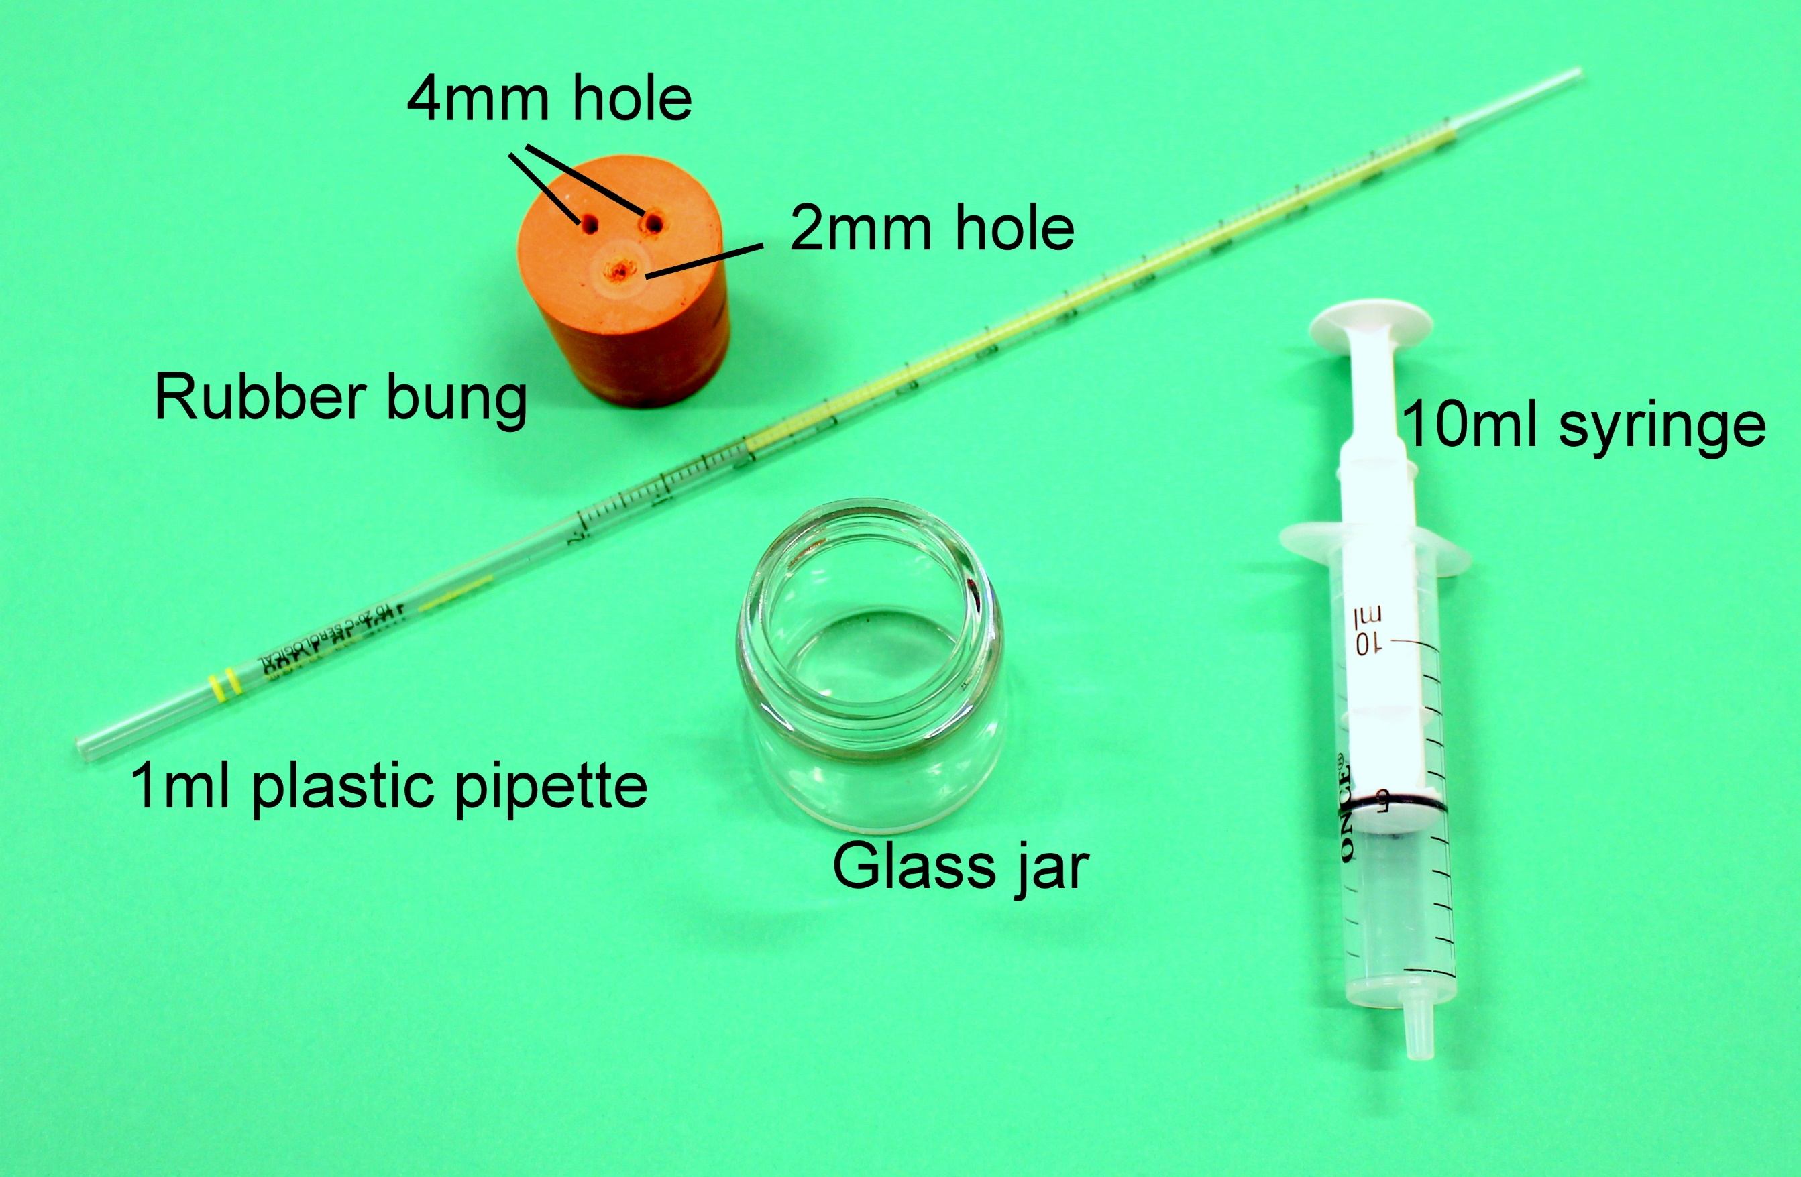
The SAPS potometer

Slide 41
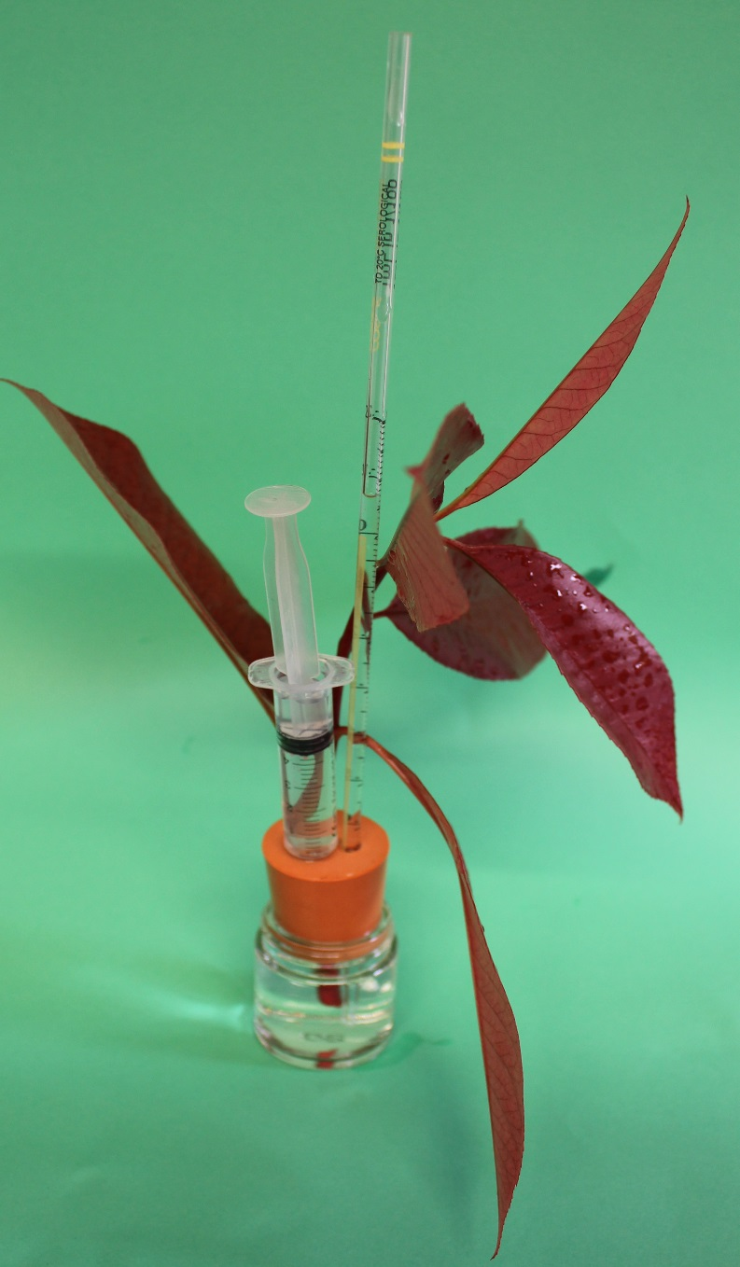

Slide 42
Osmosis in bell pepper

Slide 43
Observing giant cells in bell pepper pericarp

Slide 45
Microscopy of vascular tissue

Slide 46
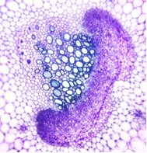
Celery vascular bundles
From plant to microscope in less than 4 mins

Slide 47
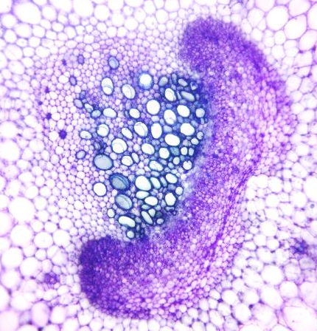
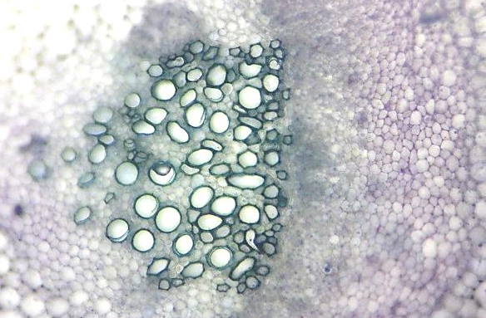
Preparations of celery petioles (leaf stalks)
Preparations of transverse sections through celery stalks [petioles] (Apium graveolens var dulce)
Phloem
Xylem

Slide 48
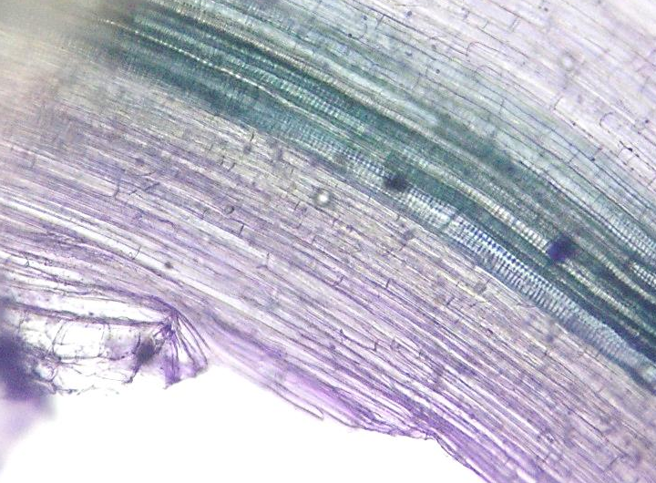
Preparations of celery petioles (leaf stalks)
Preparations of longitudinal sections through celery stalks [petioles]
Xylem
Phloem

Slide 49
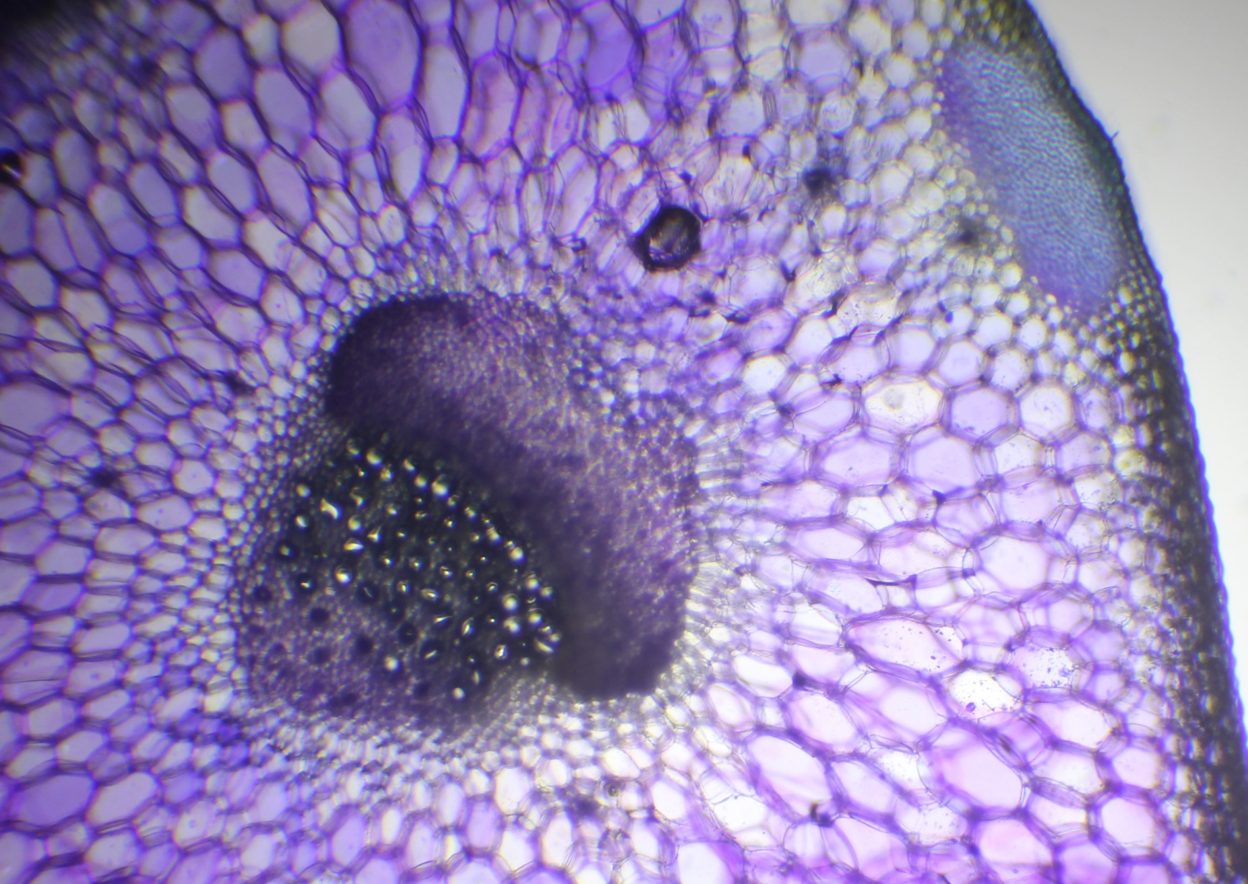

Slide 50
Microscopy of mitosis in garlic root tips

Slide 51
Root tip mitosis

Slide 52
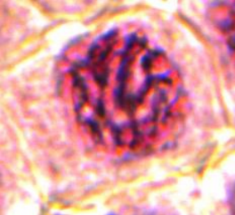
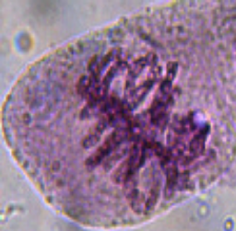
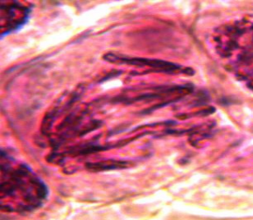
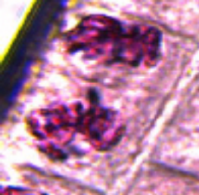
Stages of mitosis
Interphase cell | Prophase cell | Metaphase cell | Anaphase cell | Telophase cell

Slide 53
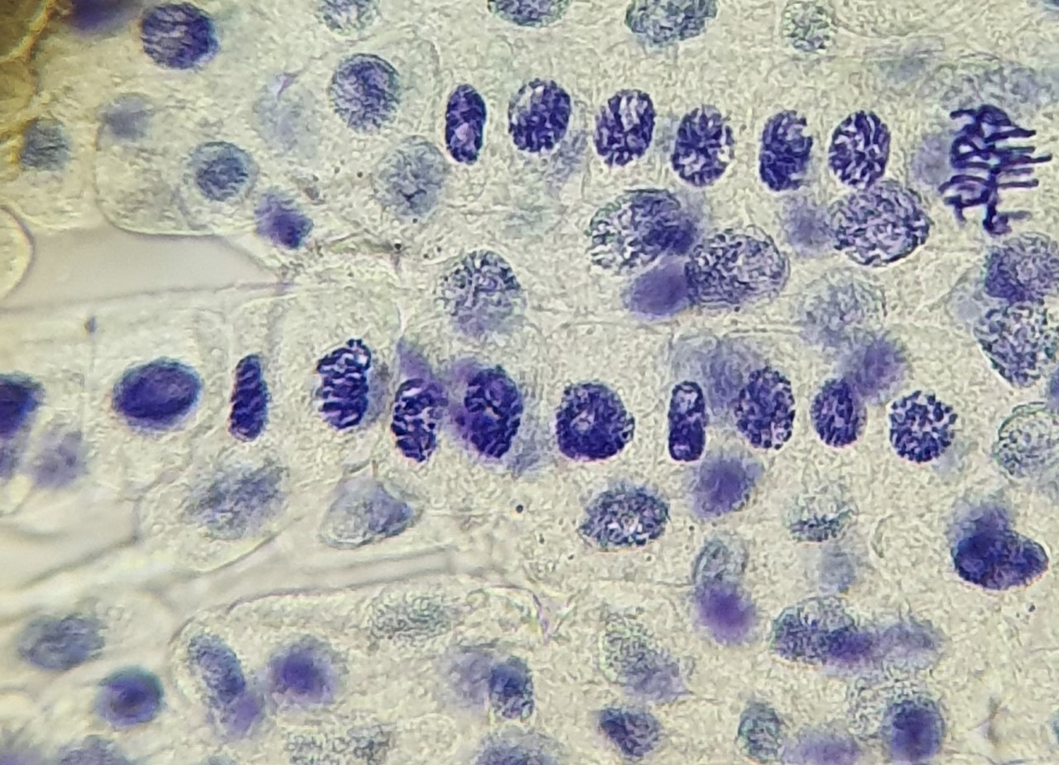

Slide 54
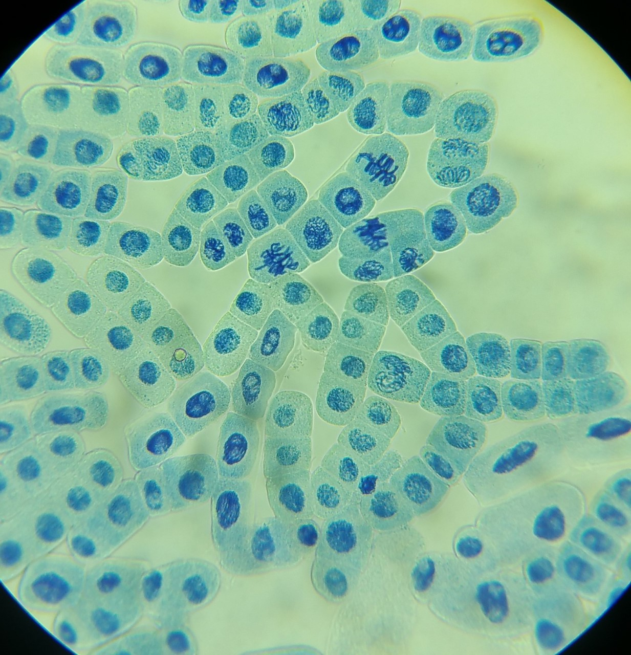

Slide 55
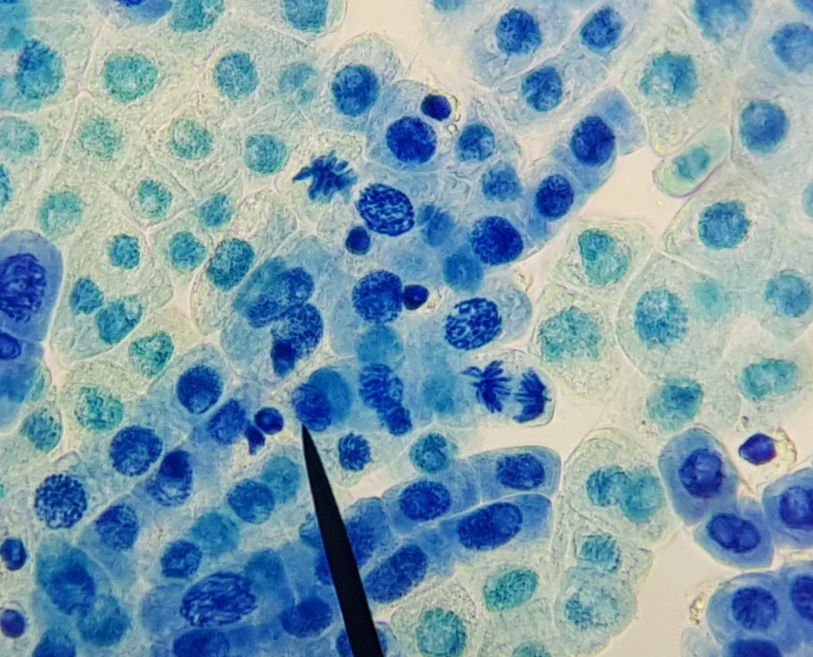

Slide 56
Plant disease

Slide 57
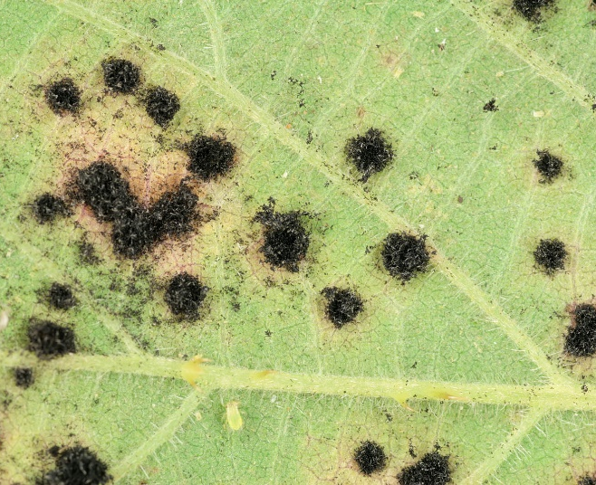
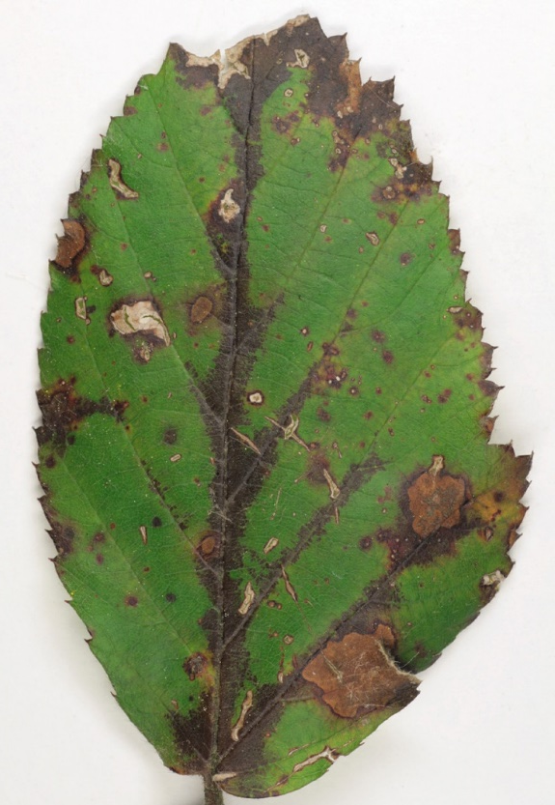
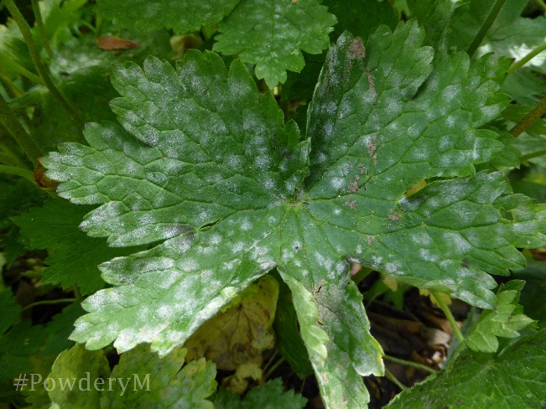
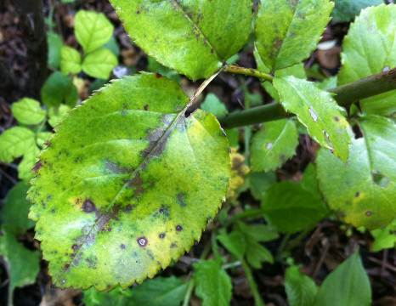


Rose black spot
Violet bramble rust
Powdery mildew

Slide 58



Apple brown rot
Horse chestnut leaf miner
Tar spot on sycamore

Slide 59
Getting plants into different areas of biology

Slide 60
Kitchen Classification

Slide 61

Homework task
Create a Kitchen Classification of at least 6 items similar to the one below

Slide 62
Posters

Slide 63

Awesome, Amazing and Incredible Plants
Inspiring contexts and careers to make students (and teachers) say “wow”

Slide 64


Slide 65

SAPS posters
Accompanying articles
Contemporary topics
  C4 rice
  Epigenetics
  Gene editing
  3 x Plant disease (GCSE)
    Identification
    Control
    Plant response

Slide 66

Teaching microscopy using plants
Notes:
Photo by Chris Graham

Slide 67








Teaching microscopy using plants: what does a microscope show me?

Slide 68







Teaching microscopy using plants: preparing specimens

Slide 69







Teaching microscopy using plants: calibrating and measuring

Slide 70
Observing stomata in Tradescantia zebrina

Slide 71
Tradescantia zebrina

Slide 72




Plant Science Futures

Slide 73


Talk to us!
Sign up to our newsletter
Email us, call us
Follow us on social media
RSC New Teacher Series
Visit us at the ASE Annual Conference
Visit the early career teachers page

Slide 74

Thank you
Q&A

Slide 75
Questions for you!
What else do you need?
What biology topics would you like support with?

Slide 76









One-hour sessions designed to support you with new ideas and resources for teaching
Live, online and fully funded
Teacher support sessions | Live online PD | RSC Education
New teacher
programme
Notes:
Reminder we still have more New teacher support sessions, alongside some others, do make sure you sign up for these

Slide 77




Courses cover practical skills, subject knowledge, teaching strategies and more.
Sustained professional development courses | Live online PD | RSC Education
Notes:
https://edu.rsc.org/teacher-pd/live-online-courses/sustained-professional-development
Highlight mentioned self-led PD and also online teacher support sessions, but is also SPD. One specific for early career teacher strategies

Slide 78

How do I access the information you have shared?
The presentation and links to the resources can be accessed through our event support hub
When you complete the survey, you will be redirected to the event support hub where you can download all the resources
If you provide your email address, the link will also be emailed to you
Access to the page lasts a month
Insert QR code
& SmartSurvey
weblink here
https://forms.cloud.microsoft/e/T2eshnv9Yu

Slide 79
Thank you

