Slide 1


Skills Champions Grant

Slide 2
What is the Skills Champion programme
Building on the successes of the Multiply Champions
This Skills Champion programme will focus on the three Essential Skills.
Literacy
Numeracy
Digital Skills
This programme is for employees or individuals in the local community and to improve access to, and increase participation in Adult Learning in Lincolnshire.
Champions are focused on improving confidence in everyday skills through a range of innovative activities and recognise that delivery in the community is key to improving adult skills.
This means practical activities rather than direct classroom learning.

Slide 3
Lincolnshire County Council is offering the opportunity for community groups and local businesses (with five or more employees or volunteers) the chance to apply for a £1,000 grant from its UK Shared Prosperity Fund and become a Lincolnshire Skills Champion.
Organisations can apply for up to 4 champions.
Each Champion can focus on 1 or more of the 3 essential skills specified.

Slide 4
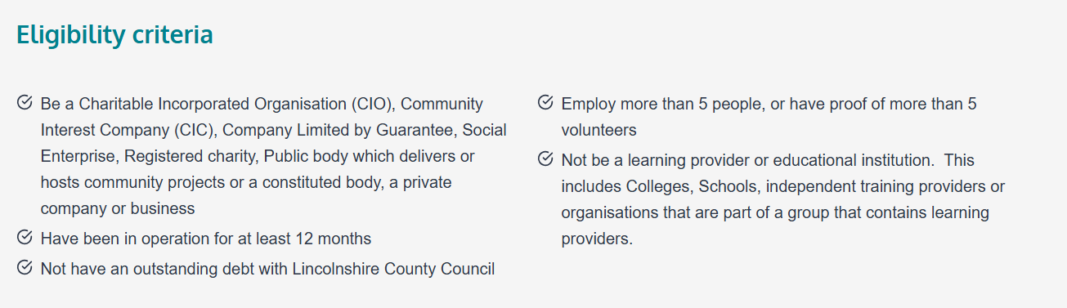

Slide 5
About the Champions
Organisations can apply for up to 4 champions (max funding £4000)
Each Champion will be awarded £10000 and can focus on 1 or more of the 3 essential skills specified.
We will hold regular LinknLearn networking workshops over Teams throughout the year which we strongly expect Champions to attend. These offer an opportunity to collaborate and share innovative ideas with other Champions to take away and implement.
The LinknLearn network meetings will be on:
8 October 2025
21 January 2026
18 March 2026.

Slide 6

Ideas for how to use the funding
Numeracy-Focused Activity Ideas
Teach participants how to measure ingredients, calculate cooking times, and adjust recipe quantities. This could include budgeting exercises for meal planning.
Simulate real-life shopping scenarios to practice budgeting, comparing prices, and calculating discounts possibly even use local markets or supermarkets for hands-on learning.
Plan garden layout focusing on area and volume calculations. Track growth and costs of plants to integrate numeracy with sustainability.
Literacy-Focused Activities
Community Book Clubs
Host themed reading sessions, book swaps, or storytelling events.
Encourage discussions to build comprehension and confidence this could include grammar and vocabulary games.
Word games.
Creative Writing Workshops
Focus on writing short stories, poems, or community newsletters.
Recipe reading combined with cooking workshops to teach how to follow written instructions and understand food labels.
Digital Skills Activity Ideas
Teach how to use email, browse safely online, and navigate websites.
Include sessions on accessing public services online.
Microsoft 365 Skills Sessions
Introduce tools like Word, Excel, PowerPoint, Planner, Loop, and Sway.
Create mini-projects like newsletters or task planners.
Use apps like Sway to create interactive presentations.
Encourage participants to share personal or community stories digitally.

Slide 7
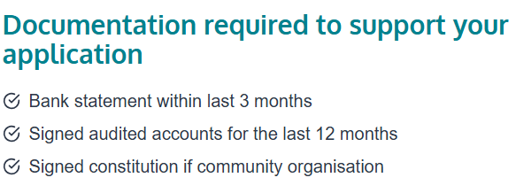
How to Apply?
Funded through the UKSPF, the grant operates over a one stage application process by the submission of a full application.
Organisations must operate within the administrative area of Lincolnshire County Council.
(Rather than Greater Lincolnshire)
Applications are now open and the application form can be accessed on the Lincolnshire County Council website.
Applications will close on Sunday 14th September at 5pm, with funding decisions communicated in late September.

Slide 8
