Slide 1

Guide to Successful Virtual Meetings:
Benefits and Successful Approaches to
Virtual/Remote Meetings
Dr. Peter Arnfalk, Lund University & REMM
Pontus Grönvall, Stormen Communication & REMM
Notes:
This presentation is based on research findings and experiences from the REMM project.
REMM involves more than 80 public agencies in Sweden.
It started in 2011 with the mission to support public agencies in their effort to develop better digital meeting cultures.
The project is run by the Swedish transport administration.
This presentation was developed for a UN training session in Geneva in November 2018.

Slide 2

We want you to:
get a better insight into
how to plan and manage good
collaborative projects at a distance
get some practical tips on what
to do and not do in virtual
meetings
feel inspired, less afraid and
encouraged to develop good
virtual collaboration projects
Notes:
…
In other words, after this presentation, you will have inspiration, arguments and tools.
You will be eager to learn more and to start the transition to more virtual meetings in you organization.

Slide 3

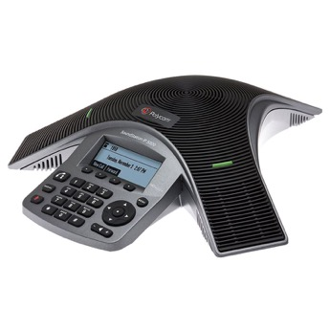
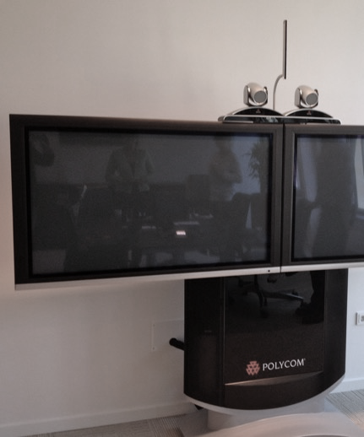
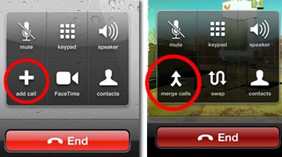
What is a virtual meeting?
Notes:
Virtual meetings is a collective term for real time meetings, held at a distance, with the aid of digital technology.
This means, a virtual meeting can be everything, from a conference call with three colleagues, to lectures and conferences with hundreds of participants.
Conference calls are in fact still the most common virtual meeting.
Simple to initiate, uncomplicated to set up, and maybe easier to accept for new users.
Having said that, we do recommend using web cameras when possible.
When you see your fellow participants, the meeting works more like a meeting IRL (in real life). Also, facial expressions and body language play a major part in our communication.
Web meetings are more and more common, when technology becomes more available.
You can use your computer, smart phone or iPad … or other tablet, of course
There are several affordable and user-friendly programs available, such as Skype for Business, WebEx or GoToMeeting
Here, I want to remind you that Skype for Business is NOT the same as the ordinary Skype
The professional programs have several useful functions such as:
Screen sharing and whiteboards
Chat function
Polling function
Recording

Slide 4
Essential meeting components
On-site meeting – IRL
Virtual meeting
Location
Room:
– chairs
– tables
– ventilation
– projector
Practical:
– pens
– paper
– post-it
– etc.
Invitation
Agenda
Objectives and expectations
Meeting
– Finish in time
– Productivity
– Inclusiveness
– Enthusiasm
Documentation
etc.
Connection
Sound & video
Meeting tool:
– virtual room
– accessibility
Know-how/skills:
– Tech: tools, equipment
– Virtual meetings
management
Notes:
Let’s have a look at two types of meetings: a traditional IRL meeting on one hand, and a web meeting on the other.
What’s unique for each one and what do they have in common.
Components that are specific for an on-site meeting, and which someone has to prepare, are for example:
A meeting room with equipment, coffee, lunch, dinner, accommodation, security. The participants also need travel tickets, connections from the airport or train station, and so on.
As a preparation of a virtual meeting,
The host has to make sure a digital meeting room is ready and that all participants know what technology they need.
The participants need to download software, make sure they have sufficient bandwidth, maybe update firewalls or make other security considerations.
Access to technical support might be a good idea.
Both IRL meetings and virtual meetings require specific preparations.
But in fact, most of the components that make up a good meeting, they have in common.
Sometimes, you might consider arranging a hybrid meeting, that is a mixed IRL and virtual meeting.
Then, you will need to make both types of preparations and you will need both kinds of support.
Thus, it is often easier to arrange an all-virtual meeting instead of a hybrid meeting, even if some of the participants are in the same building.
An all-virtual meeting also gives all participants the same conditions and experience, which may be positive from a fairness perspective.

Slide 5
Planning and preparing for a business meeting – IRL
Family
Sync calendars
Inviting host
Sync calendars
Meeting
Invitee
Sync calendars
Plan trip
Fill in form
Travel
Meeting
Travel
Expenses report
Boss/ manager
OK trip
OK expenses
Travel admin
Order trip
Send info
Pers.
admin
Control & registr.
Notes:
So, why should we switch to more virtual meetings? Why go through the hassle of learning how to handle all these digital tools?
Let’s review the effort it takes to arrange and participate in an ordinary project meeting, IRL.
Also, when looking at the price of a business trip, we tend to sum up costs for tickets, hotels and transfer.
But if we include the travel time, and the effort it takes to plan, prepare, and administrate the trip, the cost will double, according to the Swedish Business Travel Association.

Slide 6
Planning and preparing for a business meeting – virtual meeting
Sync calendars
Family
❌
Inviting host
Sync calendars
Meeting
Sync calendars
Plan trip
❌
❌
Meeting
Travel
Expenses report
Invitee
❌
Fill in form
Travel
❌
❌
Boss/ manager
❌
OK trip
OK expenses
❌
Travel admin
Order trip
Send info
❌
❌
Pers.
admin
Control & registr.
❌
Notes:
When we we arrange a virtual meeting, we can avoid several steps of preparation and administration.
We of course have to make technical arrangements for a virtual meeting.
But when the routines are in place and we know how to use the meeting tools, the time and effort will be a lot less, compared to arranging an IRL meeting.
This means, we will save a considerable amount of time.

Slide 7





Eight Potential Benefits of Virtual Meetings
Collaboration
Productivity and economy
Environment and climate impact
Work/life
balance
Notes:
The use of virtual meetings can have many beneficial effects.
Improved collaboration.
• It’s easier to involve key competences. It doesn’t matter where they are located.
• It’s easier to find time for a project meeting, and
• When collaborating virtually, you can have more frequent, short meetings. When needed instead of when scheduled.
• Also, you might find it easier to involve and cooperate with other organisations.
Productivity and economy.
• In many organizations, business travel is the second or third largest controllable cost. More virtual meetings is an effective way of
cutting expenses without reducing productivity. You might actually see an improved productivity instead.
• The time saved can be used to run more projects. For example, BMW was able to cut the “time-to-market” by half when producing
one of their car models, through streamlining the collaboration process and using one common digital communication platform.
• Virtual meetings tend to be shorter and more productive. Project leaders and managers spend about one third of their work time
in meetings. Making their meeting time more efficient, the whole organization will benefit.
Environment and climate.
• This is a very important aspect. Preventing the need for travel is by far the most cost-effective way to reduce the organisation’s environmental impact.
• Swedish public agencies in the REMM project, have cut CO2 from business travel with 25 % since 2011. During the same period,
they have expanded their scope of work and number of employees.
• The Swedish telecom company Telia cut 61% of the flights per employee and year, between 2001 and 2015, by introducing a better
digital meeting culture. Similar numbers also apply to the use of business cars and taxi.
Work-life balance.
• Virtual meetings can improve the balance between work and leisure. It can reduce stress and provide a more flexible work schedule for the employees.
• More virtual meetings can also help developing and maintaining good relationships, between colleagues and partners.
• 77% of the employees in the REMM-organizations experienced reduced stress, and
• 83% of the employees claimed the transition to more virtual meetings made the workplace more attractive.

Slide 8

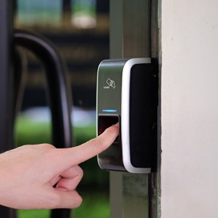


Eight Potential Benefits of Virtual Meetings
Equality
Accessibility
Regional development
Emergency preparedness
Notes:
Gender Equality.
Virtual meetings can increase gender equality, as it has proven to increase women's participation, in project meetings and collaboration.
Business travelling is still primarily a ”male activity”, regardless of family situation.
Women account for about a quarter of the business trips by air (27 % in Sweden, 2008)
In virtual meetings, the participation tend to be evenly distributed between women and men.
Women may sometimes be disadvantaged in business contexts, due to prejudice. However, in virtual meetings, gender tends to be of less importance.
Accessibility
Parents can attend virtual meetings without losing time travelling. Instead, they can spend this valuable time with their kids.
People with physical disabilities don’t have to make difficult journeys, or access badly adapted offices, in order to attend a virtual meeting.
In Sweden, doctors offer consultations in virtual rooms. This is especially of interest for people living in remote areas.
Swedish residents can also see an administrator at the Social Insurance Agency (Försäkringskassan) and at the Employment Agency (Arbetsförmedlingen) in a web meeting.
Regional development
Virtual meetings can strengthen regional development, as they:
allow people in remote areas to attend meetings in major cities.
facilitate the establishment of business offices and agencies, outside major cities. Swedish authorities with headquarters outside the capital, are also some of the most advanced users, of digital meeting technology.
Emergency preparedness
Virtual meetings offer a better opportunity to manage accidents and crises from a distance due to natural disasters, extreme weather conditions, terrorist attacks or war.
The use of video conferencing more than doubled after the eruption of a volcano in Iceland in 2010, when lots of flights were cancelled, due to the volcanic ash.

Slide 9

If virtual meetings are so beneficial
– why do you need to promote them?
Unwilling to change their way of working
Technology focus
Connection problems
Counteracting incentives
Notes:
Bear in mind that some employees may be worried, or even suspicious, at the beginning. Why? They may, e.g.:
be afraid that all of their travel will be replaced with virtual meetings, which is not recommended and rarely the case. In most organizations only some 20 - 30 % of the business travel is reduced due to an increased use of virtual meetings, and then it is commonly least important and fruitful trips that are avoided in the first place;
not feel at ease when using the virtual meeting tool, due to lack of knowledge and training in virtual meeting skills. This can be prevented with the help of information, education, training and practicing;
be afraid that virtual meetings are not as good and efficient as face-to-face meetings. They are right in the sense that face-to-face has a higher social presence and faster and easier can build trust and understanding. However, a meeting culture in which virtual meetings are well integrated optimises the combination of different types of meetings and a vast majority of employees experience not only an improved productivity, but also an improved quality of the collaboration.
For a successful transition to more virtual meetings, it’s important to work systematically and with all aspects of the organization, and not only the IT-department. This includes looking into the monetary incentives for travelling, and allocating sufficient time for education and training in the virtual meeting tools.

Slide 10



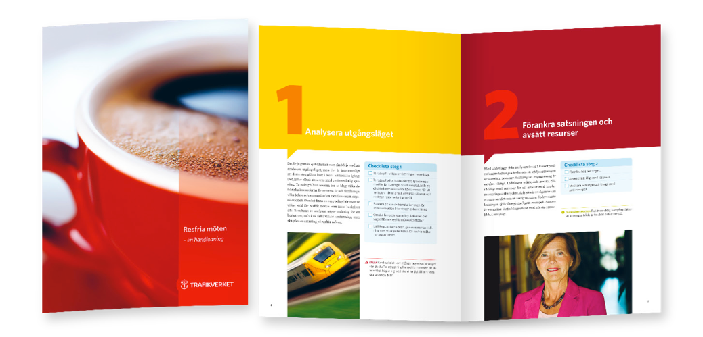







REMM methodology – ten steps
Notes:
The REMM project has developed a ten-steps methodology as a way of supporting the efforts to implement and develop the use of virtual meetings in an organization.
It is recommended to progress in the numbered order of the steps, but it’s not a requirement. As most organizations have made some progress in several of the steps, these ten steps can be used as a sort of check-list to identify where work still remains to be done. In short – it’s a way to make sure it’s not only managed as a IT-issue.
Let’s review the different steps.

Slide 11
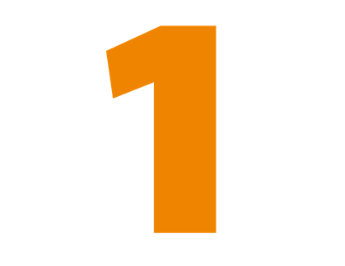

Analyze the starting point; travel costs, use of and interest in virtual meetings.
Notes:
An obvious starting point is investigating the extent of business travelling in your organization.
Who will use the virtual alternatives?
What opportunities and new ways of collaboration can it lead to?
Have a look at the total costs of business trips, and the major collaboration requirements, between different sites, units and projects.
Review the travel policy. Does it promote virtual alternatives?
This initial analysis is typically used for convincing the top management in the organisation to set aside sufficient funding to coordinate and engage the work and the people working with developing their virtual meeting culture and technique.

Slide 12
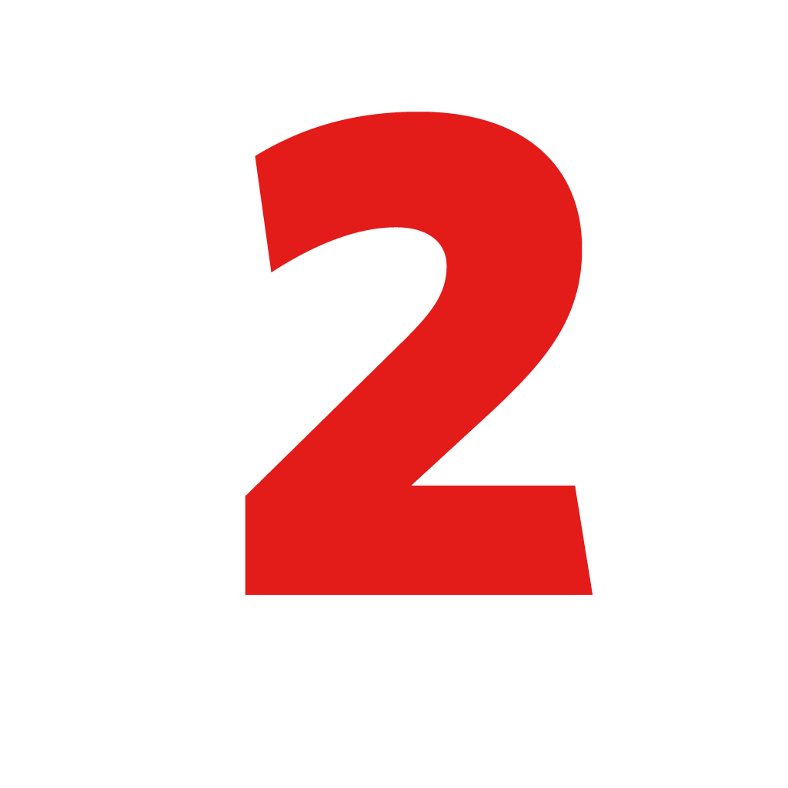
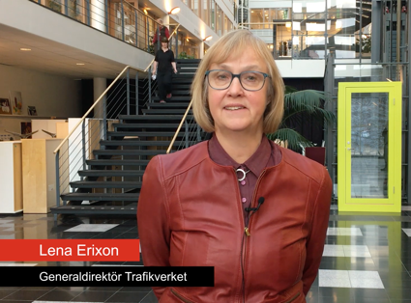
Get top management commitment and sufficient resources allocated for the implementation.
Notes:
Based on the information collected in step 1, the management should be able to make a decision to support the initiative and allocate resources.
It’s important to have to management on board. If they are enthusiastic and willing to lead by example, they will inspire the whole organization.

Slide 13
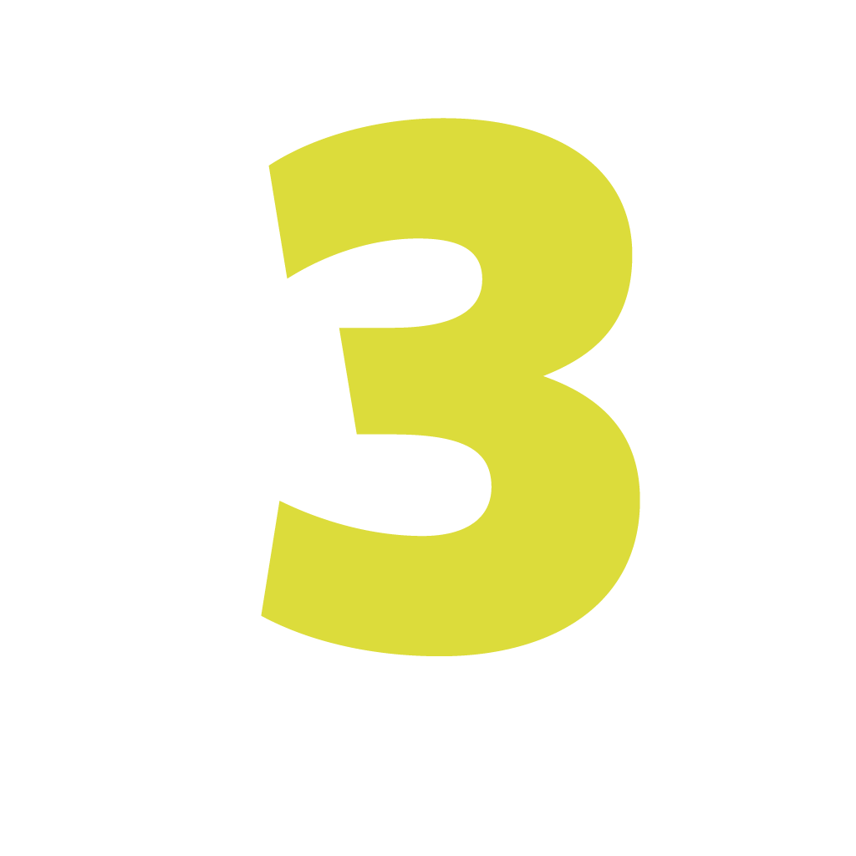

Establish a multidisciplinary working group in the organization.
Notes:
When you engage people from all over the organization, the chances of a successful promotion is increased.
The workgroup may include people from management, Human Resources, IT, technical support, administration and super users.
Remember that in general, it’s not a good idea to ask the person who is most technically interested to be the group leader.
Too much focus on technology can take focus from the wide approach needed, when changing a meeting culture.
That said, the technical issues are also very important.

Slide 14


Analyze the organization’s meetings, communication and collaboration.
Notes:
With the working group in place, and the top management committed and ready for a change, it’s time for a more thorough and detailed analysis:
map out the reasons for, and types of travel
analyse which colleagues should be offered virtual meetings as an alternative
review which types of communication is needed
consider which goals the organization should aim for.
It is also important to find out how the colleagues feel about changing their meeting habits.

Slide 15


Map out the organization’s existing technical infrastructure.
Notes:
You need an inventory of your organizations current technical equipment, service subscriptions, security issues and available in-house support.
It’s also advisable to review the technical maturity level of the organizations you plan to collaborate with.

Slide 16

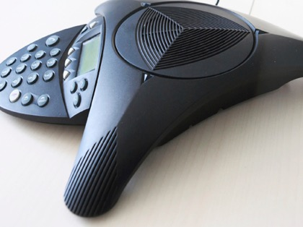
Select and acquire appropriate equipment /services.
Notes:
A successful transition to virtual meetings depend on user-friendly technical equipment, easy enough to understand with little or no instructions.
Think twice before before trying to save money, by choosing the cheaper option.
Badly working equipment can hit back with unhappy users. You don’t want that.

Slide 17

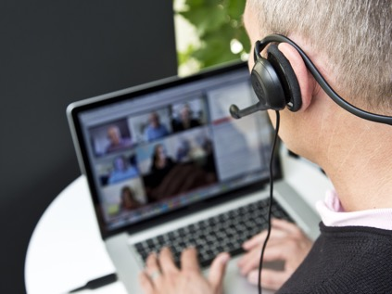
Establish routines and procedures.
Notes:
Clear routines and procedures are high priority, when you are ready to introduce virtual meetings in your organization:
For example, a travel policy is an important document that can be combined with virtual meeting policy – a meeting and travel policy.
Or, a meeting policy can have a travel policy included, as one of many ways of meeting with counterparts.
The meeting policy defines and must must be complemented with clear guidelines on how and when to use virtual meetings.

Slide 18

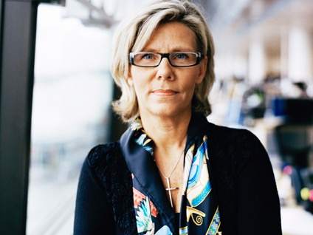
Designate staff responsible for the operation, booking, support, training and monitoring.
Notes:
It does not take many technical snags before you lose a new user’s patience.
All aspects must work perfectly and a technical support organization must be ready.
Regarding larger videoconferencing systems, it is advisable to have the connections up and running prior to the meeting to save time.
Participants will trust the system and feel confident.

Slide 19


Inform and organize teaser and testing events.
Notes:
People who often arrange meetings need clear recommendations on when to choose a virtual option.
Invite the colleagues to take part in test sessions. Let them experience a virtual meeting, use the chat function, the polling system, try sharing documents, etcetera.
Point out the obvious human incentives, such as better work-life balance, reduction of our carbon footprint, and so on.
I would recommend you to not focus on economic incentives. Such arguments might backfire and be seen as yet another way to cut costs.

Slide 20


Follow up and communicate use, progress and savings.
Notes:
A change project like this must be followed up, to make sure the new routines continue.
Share positive user stories and measure progress, such as
Number of travel days per full-time employee, now and before
Travel expenses per full-time employee, now and before
Reduction in emissions due to not travelling per full-time employee
Inform the organization on the progress. You might also consider sharing interesting findings externally. It can strengthen the organization’s ethical and environmental statement.

Slide 21
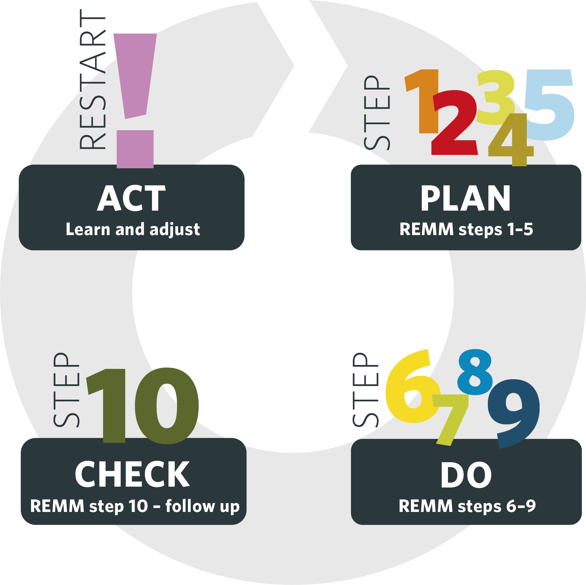

Continuous
improvement
Notes:
The REMM methodology can easily be integrated with other management systems.
Here, we can see how the ten steps fit into the PDCA wheel, the process of continual improvement and learning.

