Slide 1



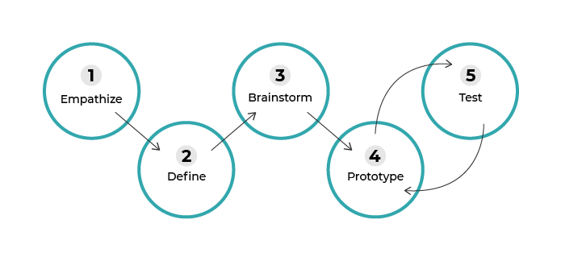







Course Summary Sheet: Learn About Design Thinking
Design
Adopt an empathetic approach to understand the needs of your project's potential users: observe, ask questions and try not to let ego get in the way.
Brainstorm to generate as many ideas as possible for your project. At the end of your brainstorming session, select the most promising solution.
Have users test the prototype and take their feedback into account to improve it. Repeat steps 4 and 5 until you arrive at your final product.
Definitions
Design Thinking
A methodology developed by designers that can be applied to projects in a diverse range of fields. As it is structured in stages and people-centered, it allows projects to be led in new and innovative ways.
Divergent thinking
An intellectual exercise consisting of going beyond your initial presuppositions and functional fixedness, and looking at a problem from a new or unusual angle to come up with original ideas and/or solutions
Iteration
A basic principle of repetition to advance by qualitative leaps in the development of a project. This is achieved by going through a prototype-test loop as many times as needed to achieve the final product, with improvements made in each loop.
Organize the information you have collected into broad categories so that you can then sum up the problem in one sentence.
Develop the your first prototype, with the goal of improving it progressively in every iteration.
Best Practices
Common Pitfalls
Keep an eye out for any “design anomalies” around you.
Consider any obstacles you may encounter as opportunities for improvement.
Listen actively to others and take into account their expectations and constraints in the context of your project.
Look at a problem from all sides using divergent thinking.
Sketch out your first prototype with pencil and paper.
Do your best to be as impartial as possible in your interactions with users, particularly during interviews and user testing sessions.
Only trusting your initial presuppositions in the first steps of defining an innovation project.
Asking closed-ended questions or talking over users during interviews.
Dismissing ideas too quickly as unfeasible when brainstorming.
Perfectionism: trying to design a finalized prototype on your first attempt.
Developing an A-Z solution without consulting any potential users.
Taking critical feedback a personal attack.

