Slide 1
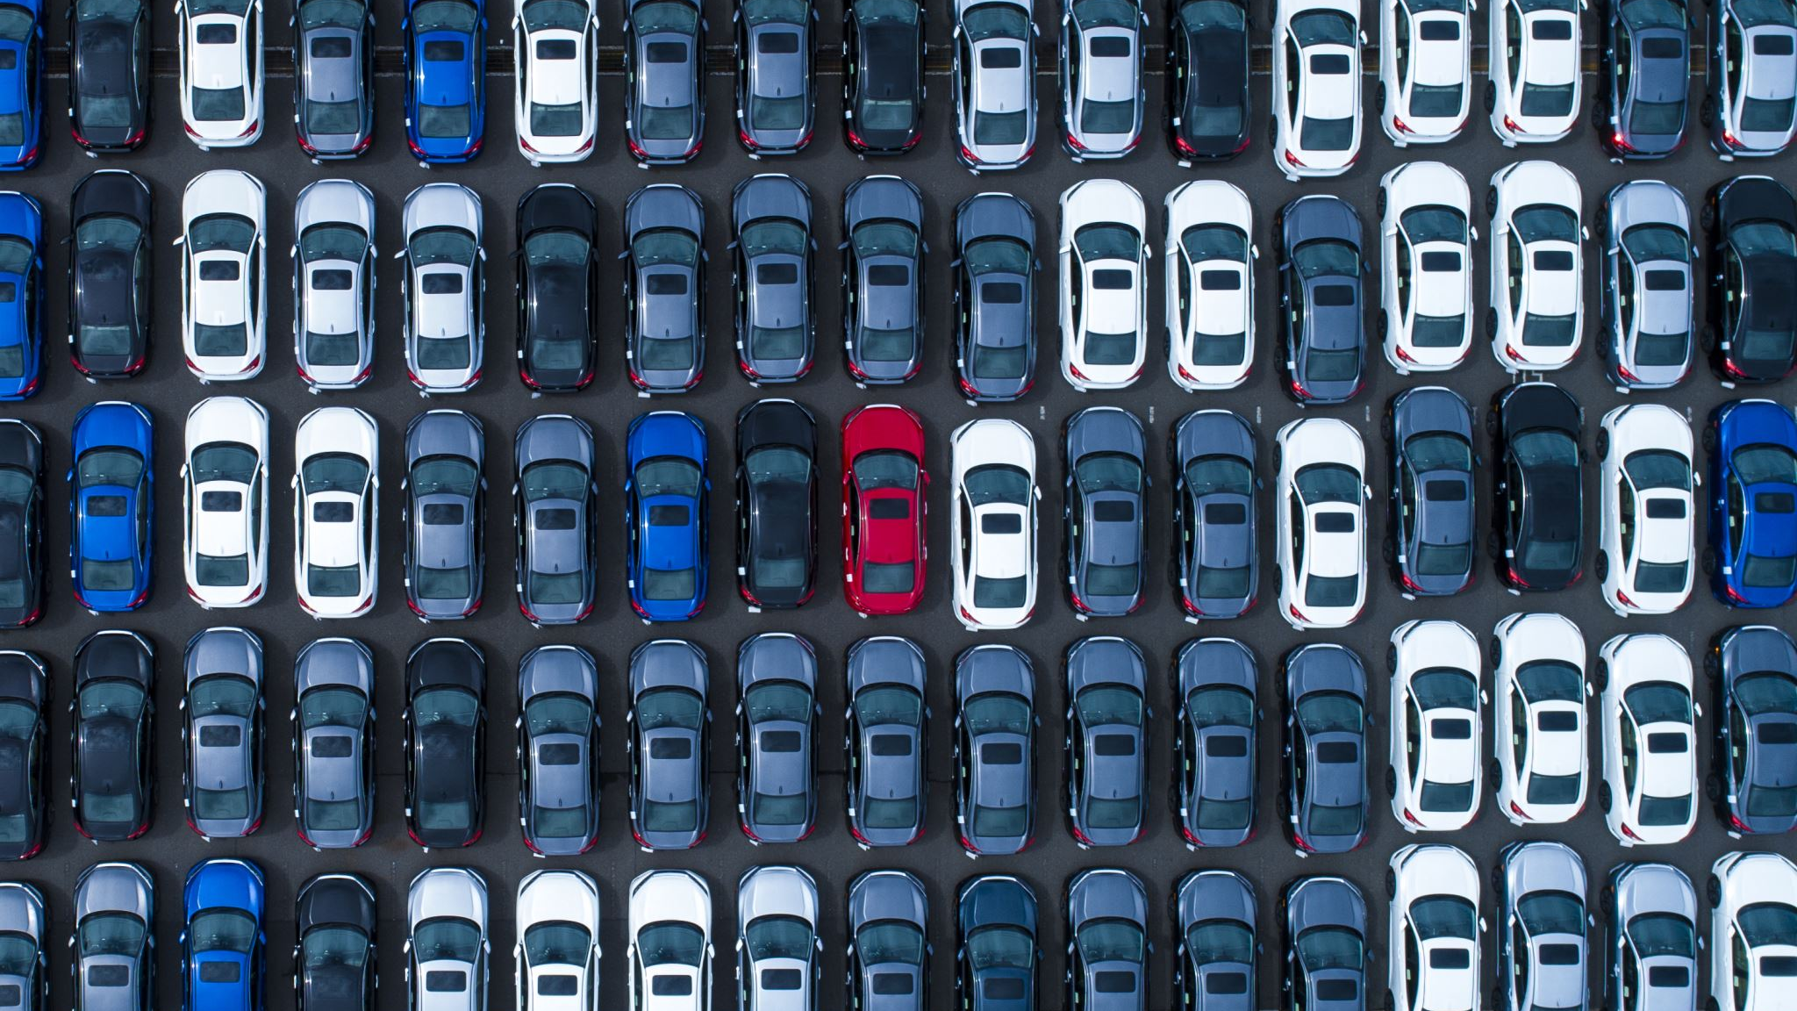
Types of vehicles

Slide 2
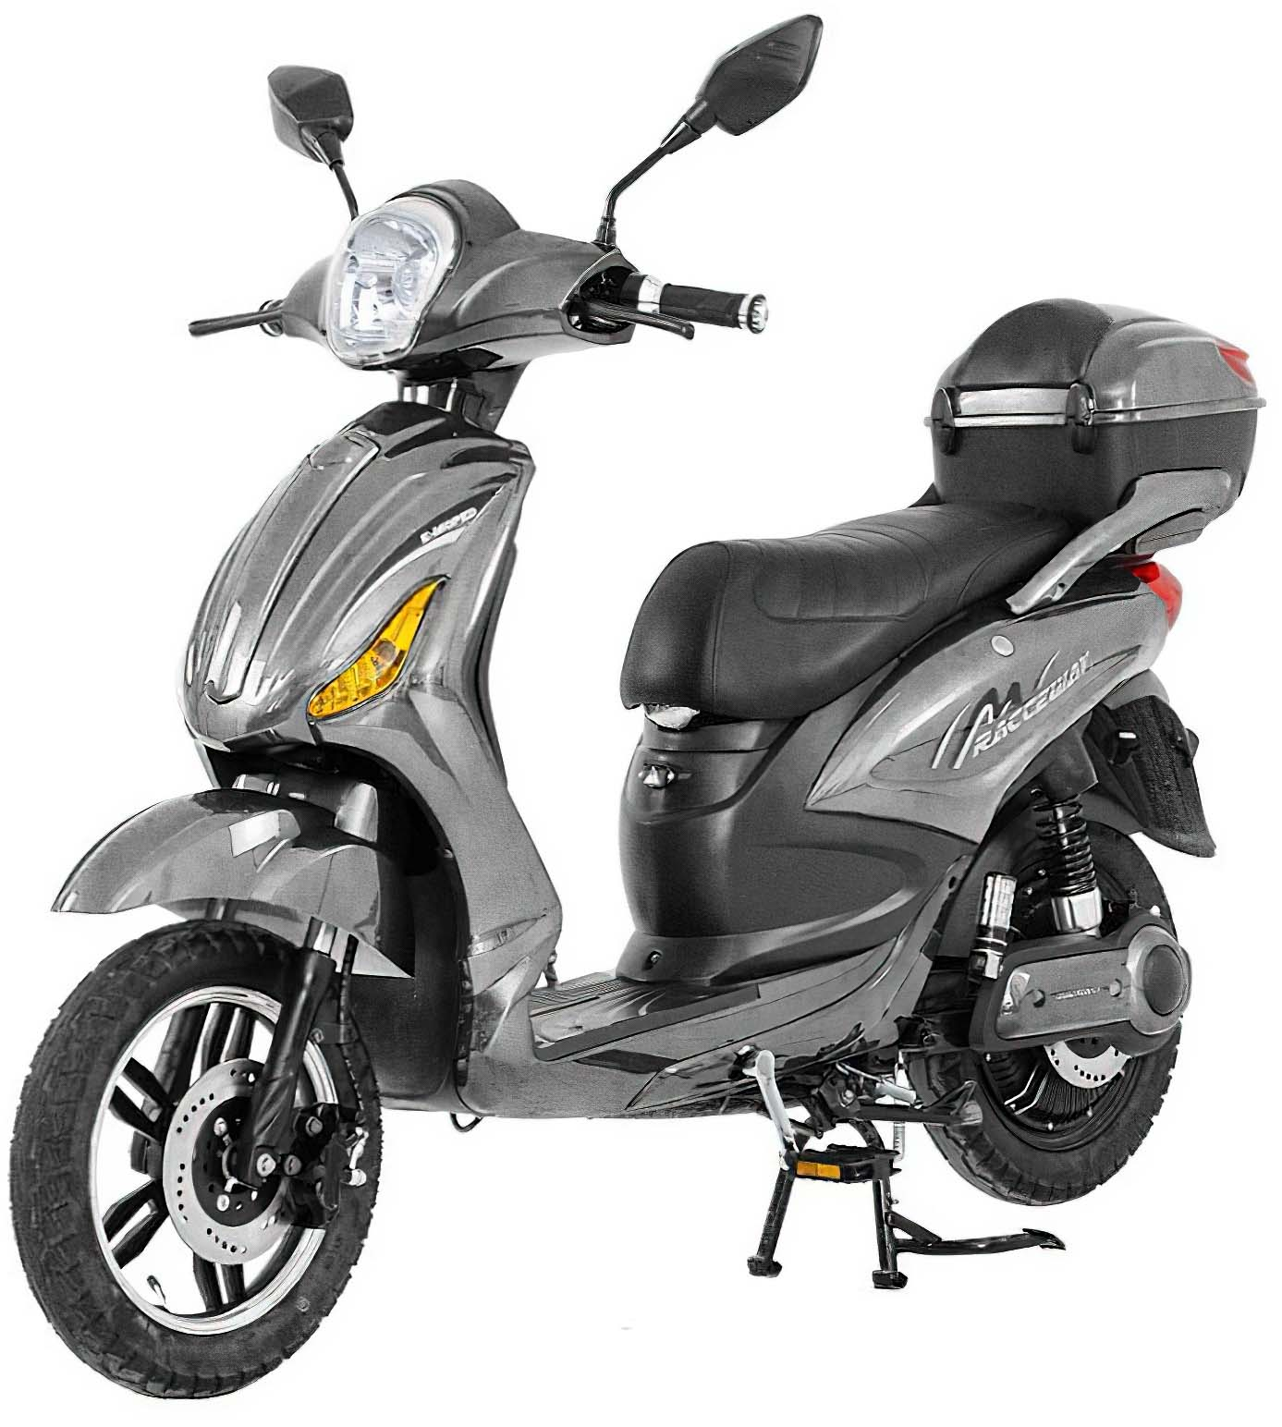
MOPED
A moped is a combination of a motorcycle and bicycle.

Slide 3
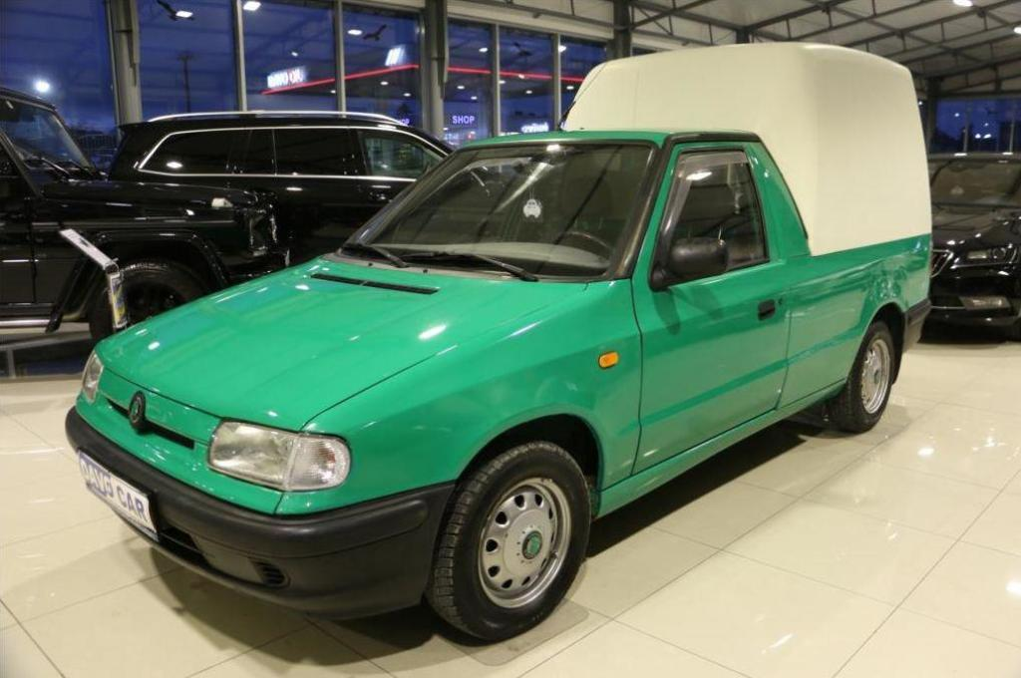
2) PICK UP
These cars are used to transport cargo.

Slide 4
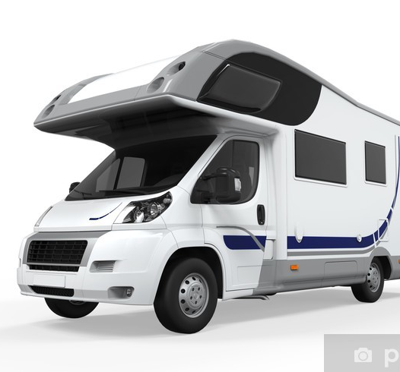
3) CAMPER
It is a self-propelled vehicle that provides both transportation and sleeping.

Slide 5
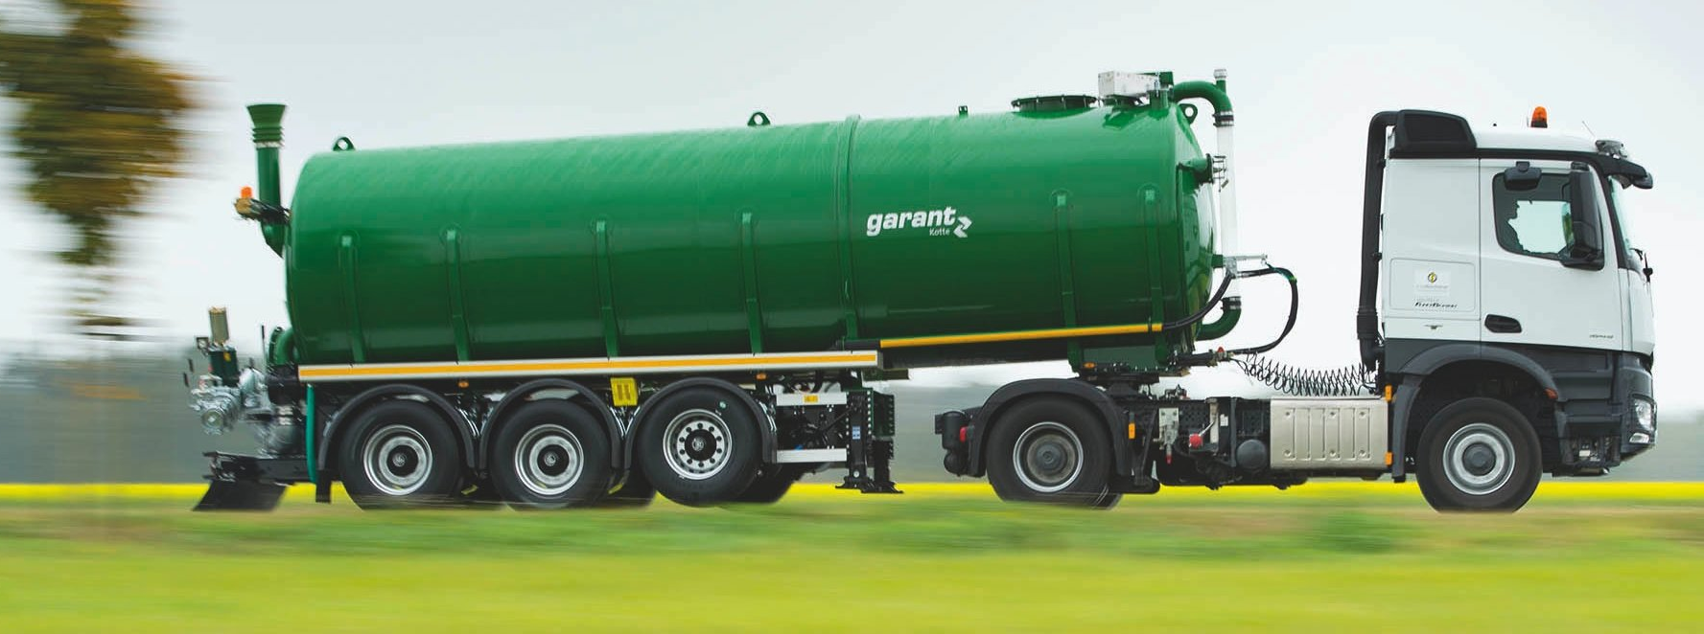
4) TANK
A tank is a stable tank for liquid or bulk substances that is placed on a road vehicle.

Slide 6
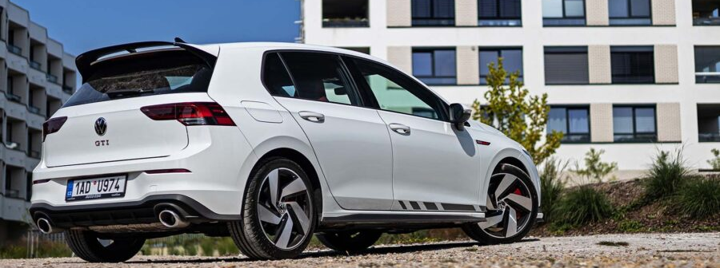
5) HATCHBACK
The first car with this body was the Citroën in 1938.The first car with this body was the Citroën in 1938.

Slide 7
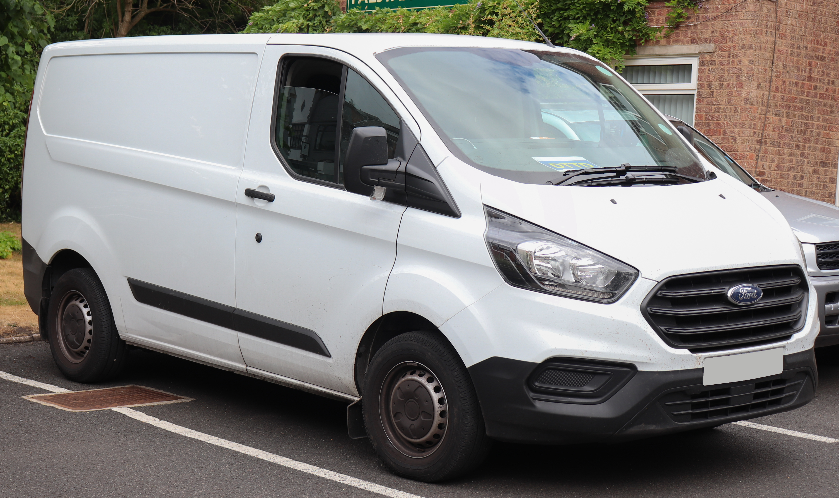
6) VAN
These cars have larger dimensions, 5 or more seats and a large luggage compartment.

Slide 8
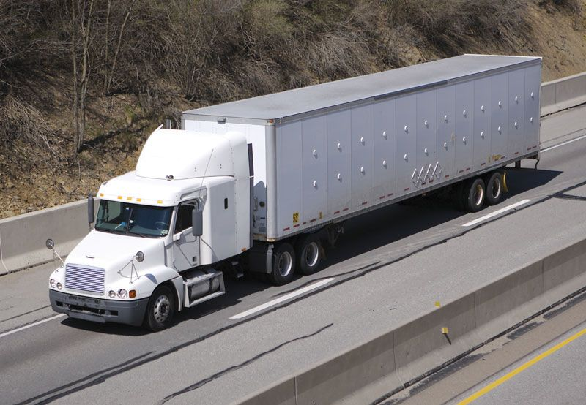
7) TRUCK
A truck is a motor vehicle designed to transport cargo. Trucks vary greatly in size and performance.

Slide 9
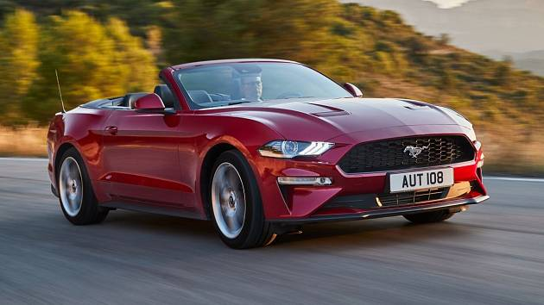
8) CONVERTIBLE
It is a type of car that can be driven with or without the roof.

Slide 10
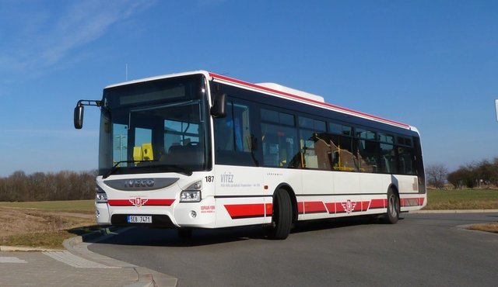
9) BUS
Is a vehicle designed to transport a large number of people on the road. The first bus with an internal combustion engine was introduced by Karl Benz in 1895.

Slide 11
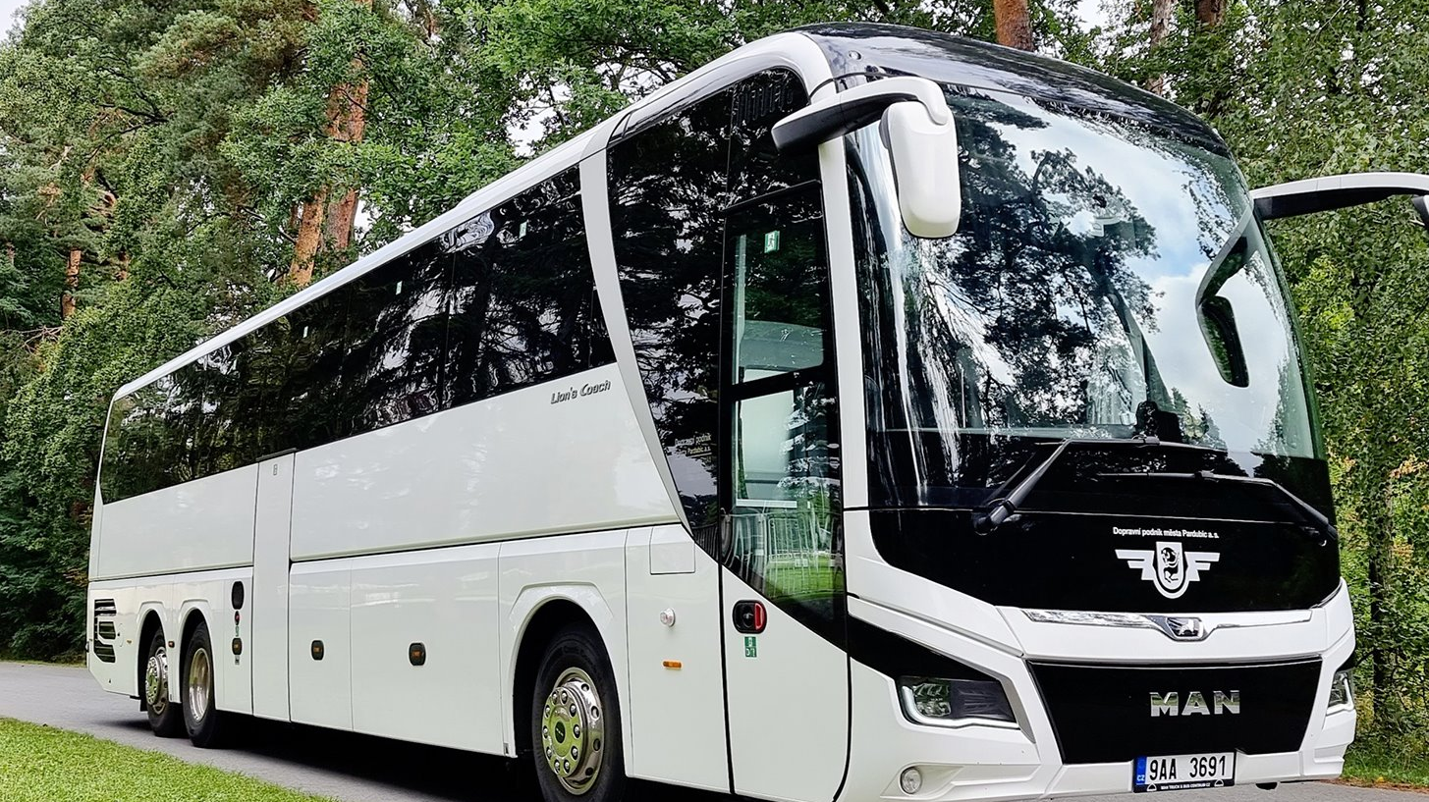
10) COACH
Is a type of bus designed for long-distance transport.

Slide 12

11) LORRY
It is used to transport cargo.

Slide 13
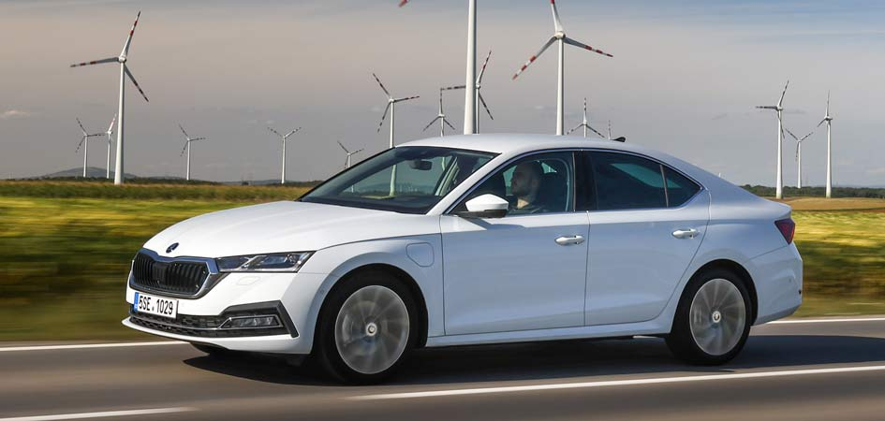
12) SALOON
This is a conventional type, which is characterized by the separation of the luggage compartment from the passenger compartment.

Slide 14
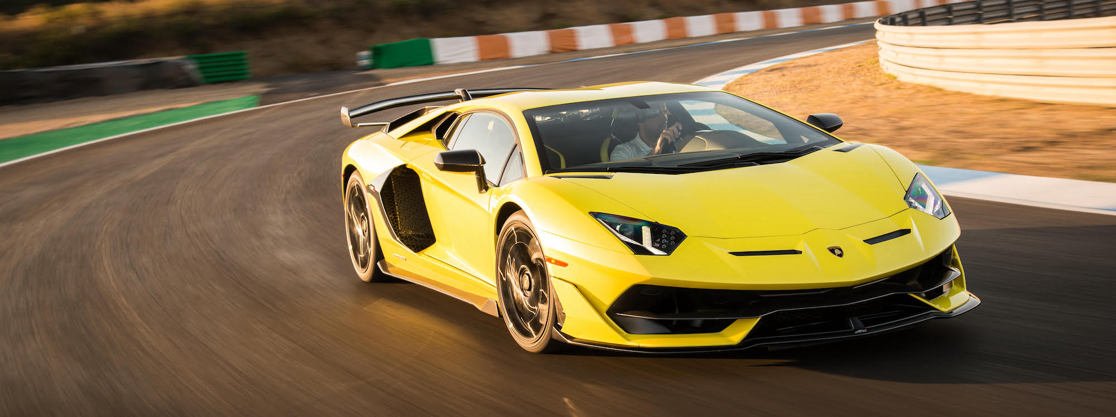
13) SPORTS CAR
Sports cars originated in Europe in the early 1910s and are currently produced by many manufacturers around the world.

Slide 15
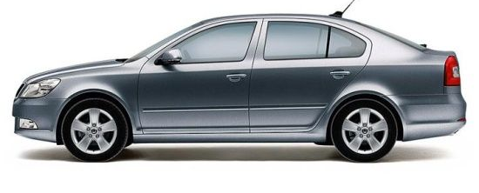
14) LIFT BACK
Compared to a hatchback, the rear of the car slopes at a gentler angle and is longer.

Slide 16
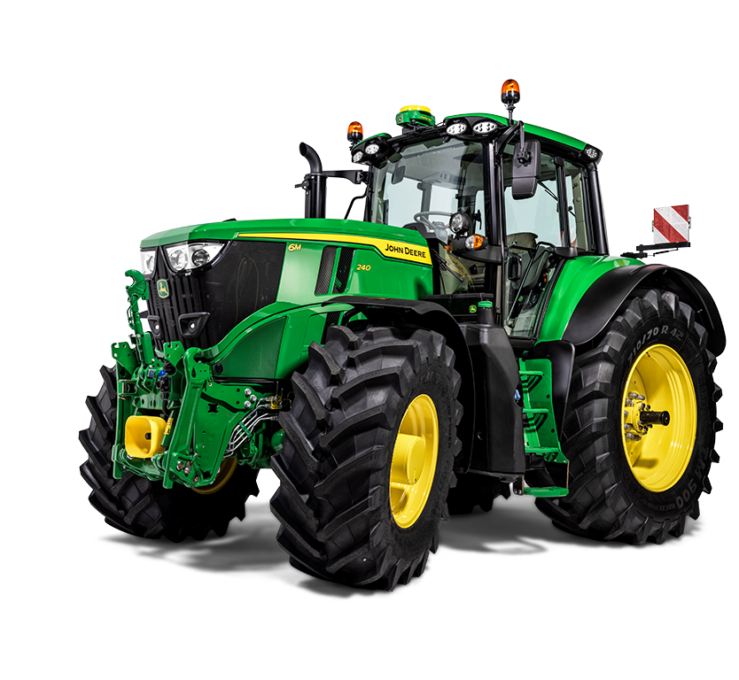
15) TRACTOR
It is used primarily to pull carts and various agricultural machinery.

Slide 17
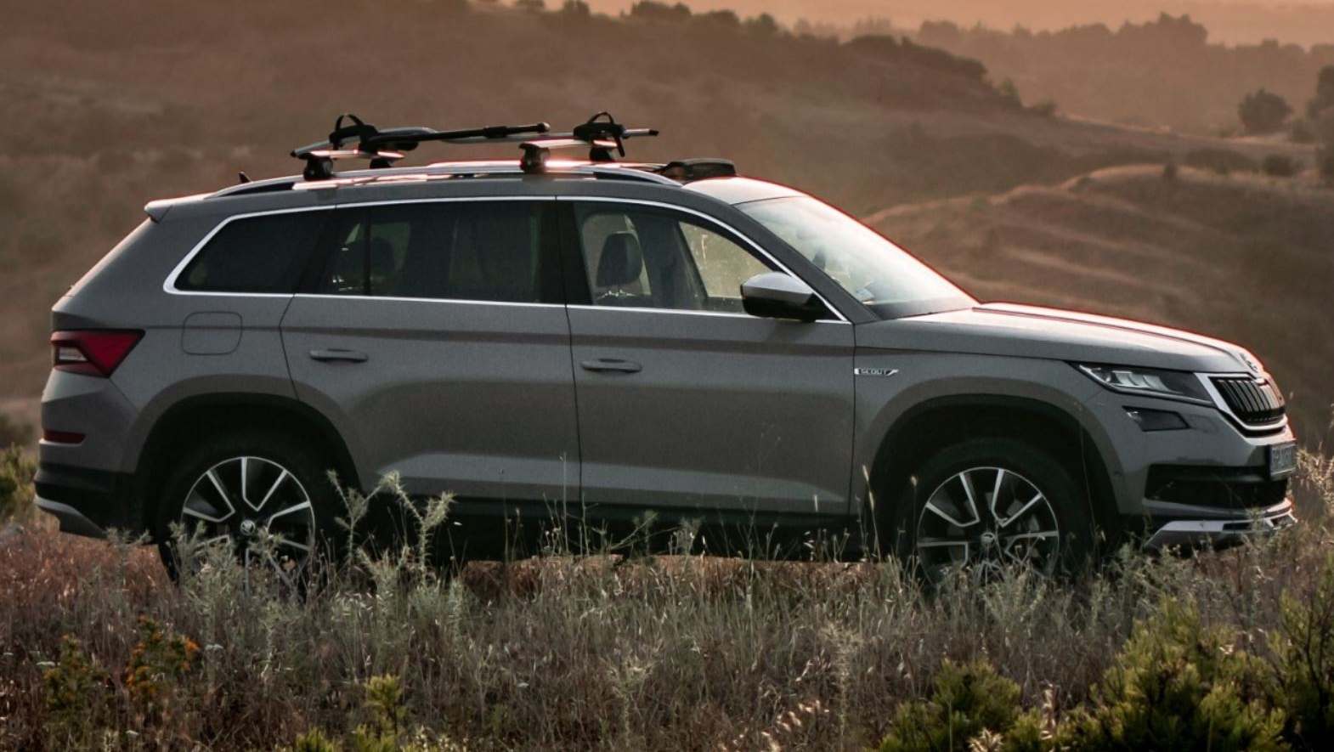
16) SUV (sport utility vehicle)
These are cars that combine the advantages of off-road vehicles.

Slide 18
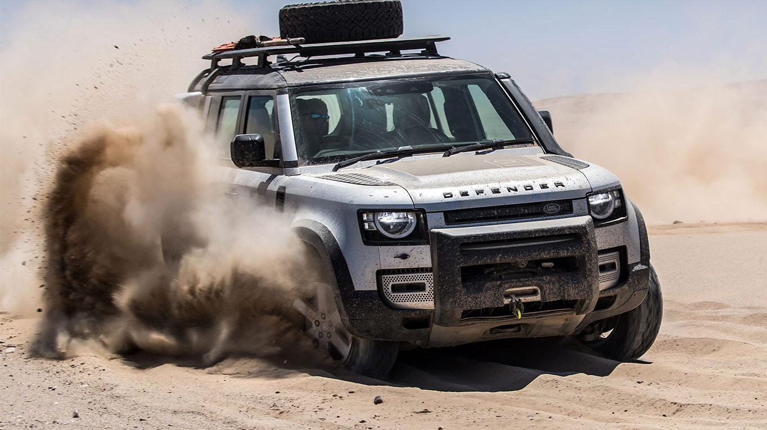
17) OFF-ROAD
Is a vehicle equipped to drive on unpaved surfaces.

Slide 19
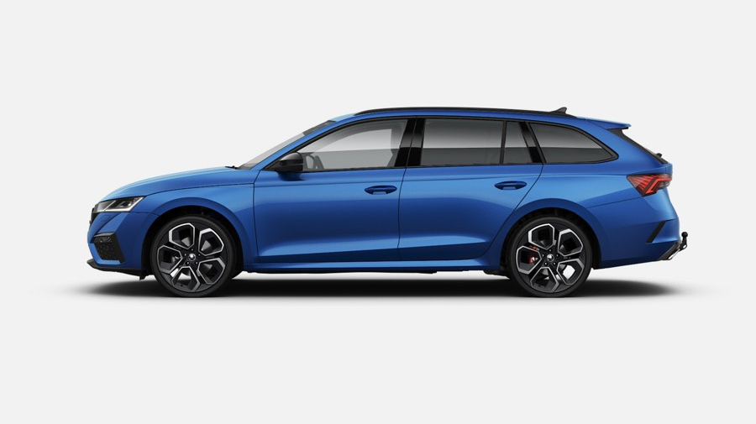
18) ESTATE CAR
It is a type of passenger car body with a large luggage compartment.

Slide 20
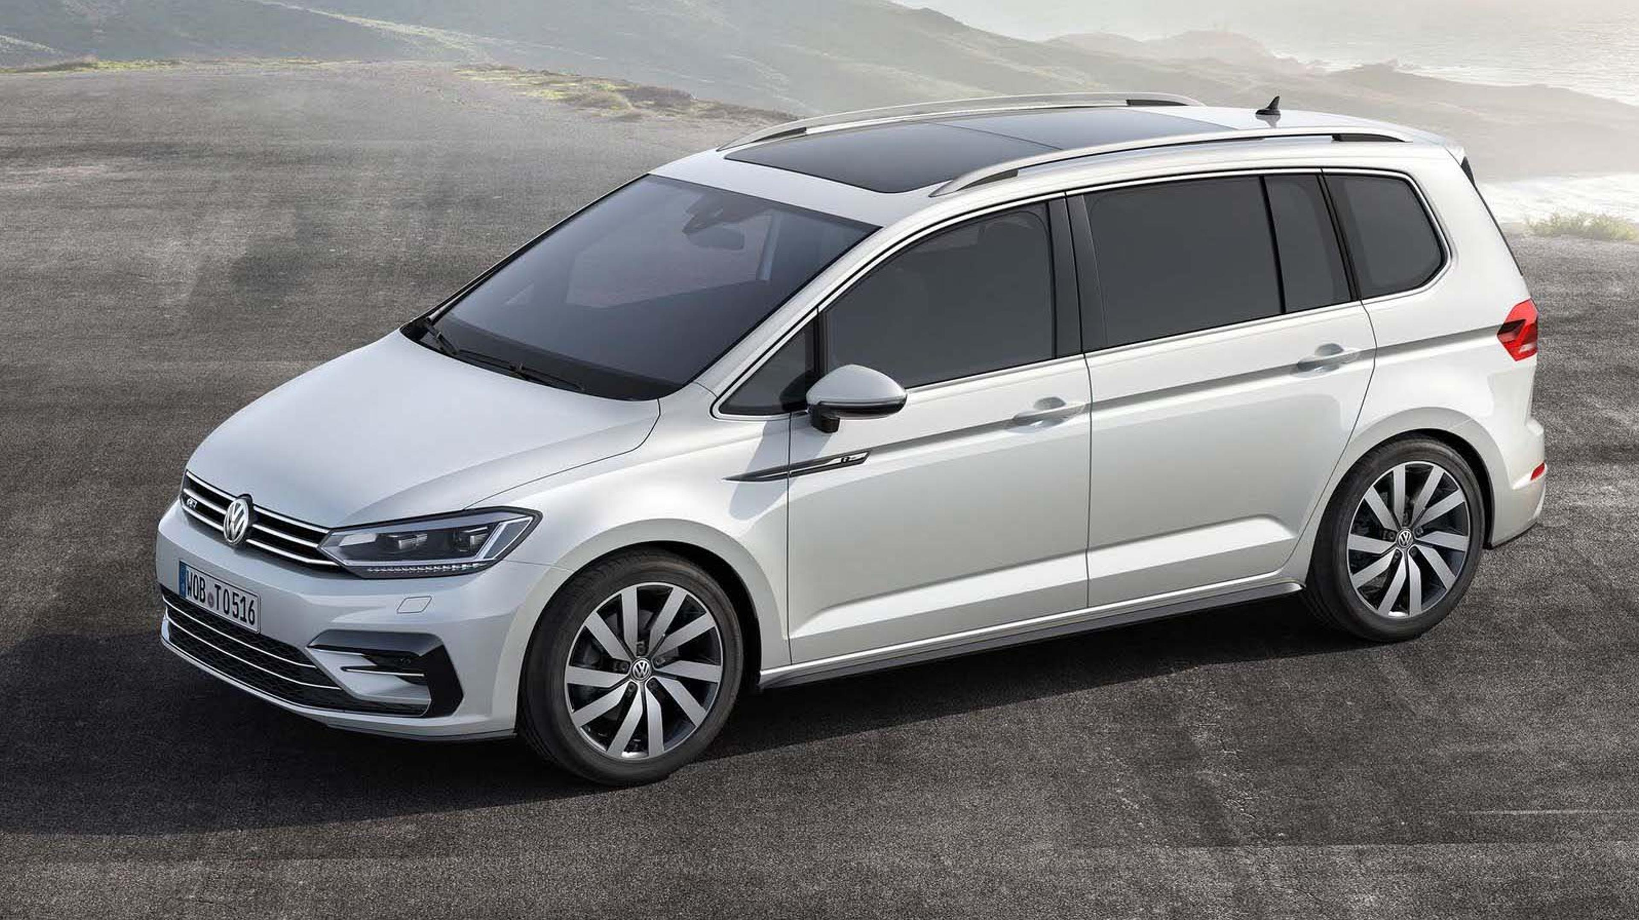
19) MPV (multipurpose vehicle)
This is a type of car that resembles a van in shape, but is designed to transport people.

Slide 21
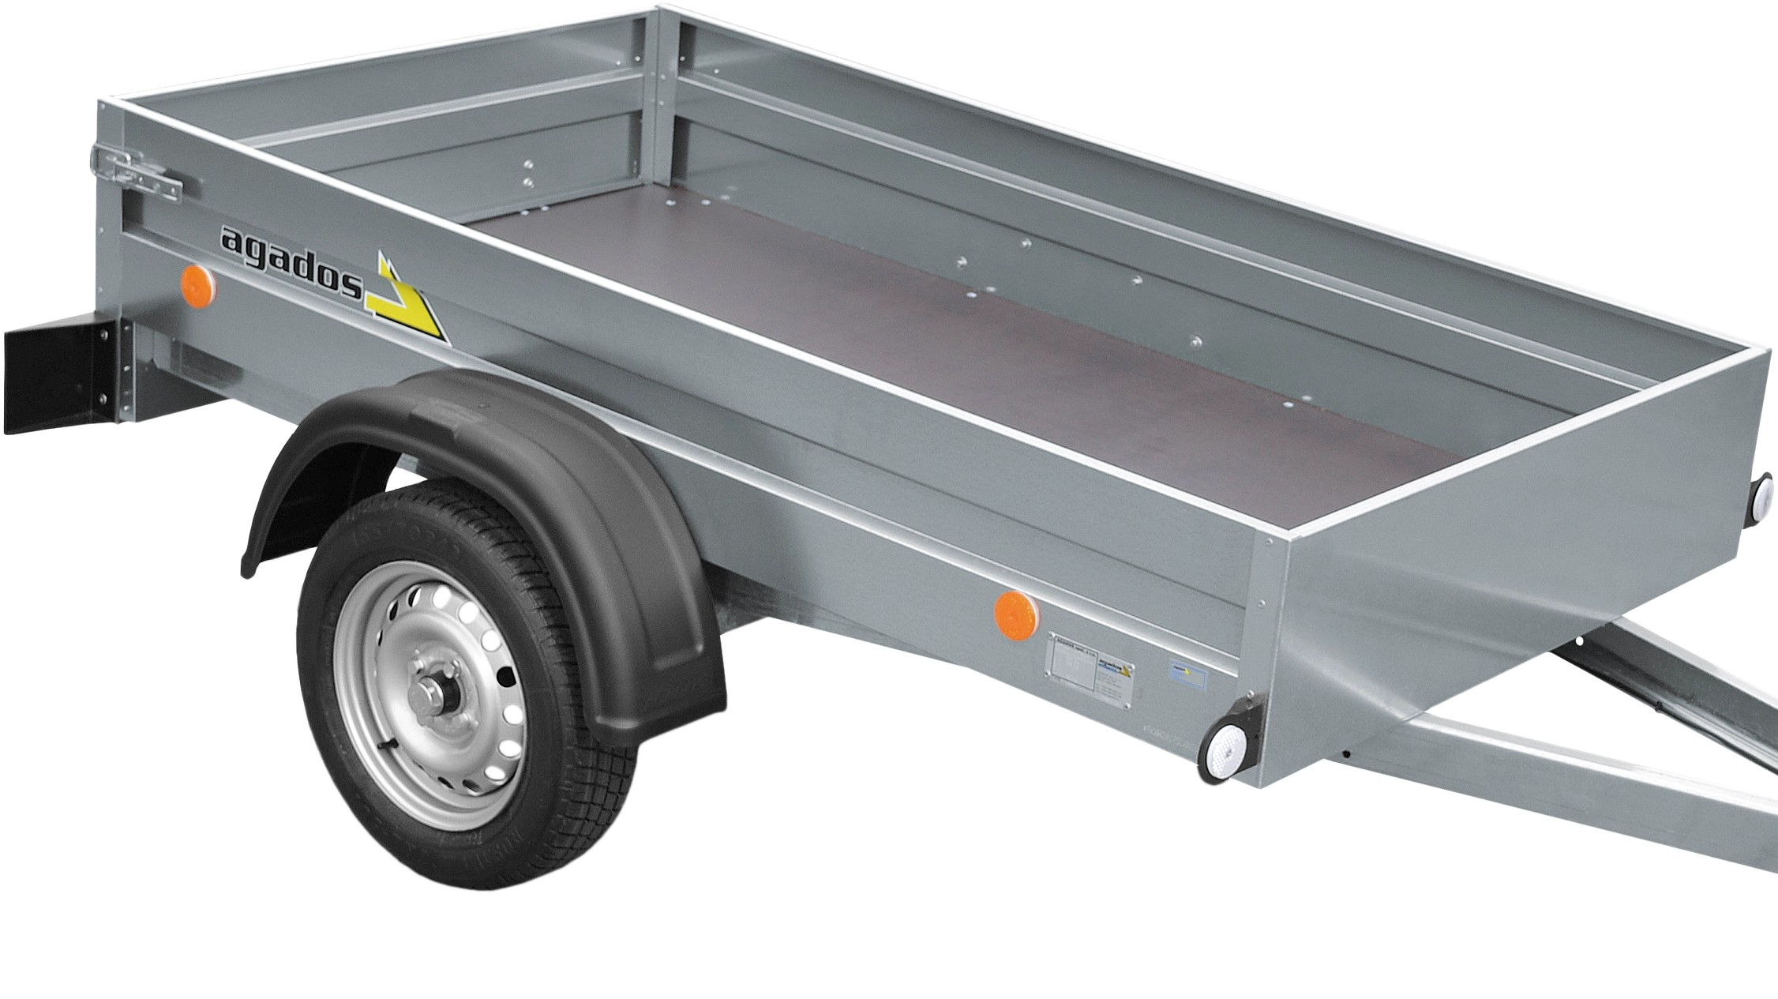
20) BOX TRAILER
A box trailer is usually towed by a motor vehicle, we use the box trailer to transport cargo.

