Slide 1


Chiesa Avventista del Settimo Giorno Storia dei
Ministeri Femminili
1995-2015
General Conference of Seventh-day Adventists Women’s Ministries Department
www.adventistwomensministries.org

Slide 2
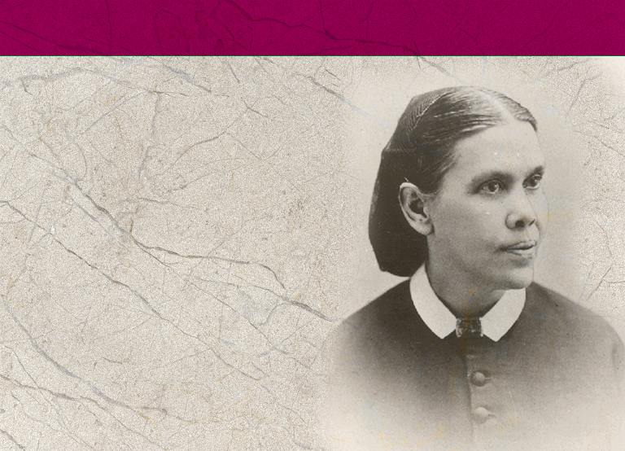
Cronistoria
1844
Ellen Harmon ha la prima visione
Notes:
B. Women’s Ministries Time Line
Note to the Presenter: Give everyone the Time Line Handout (found in Appendix 4). Below is a list of important dates to go over with the class.
1844 - In December Ellen Harmon receives her first vision.

Slide 3

1874
La prima società Dorcas nasce a Battle Creek, Michigan, grazie alla sig.a Henry Gardner.
La sig.a S. M. I. Henry diventa
una speaker nazionale dell’Unione
delle Donne per la Temperanza Cristiana.
1896
… diventa avventista dopo essere stata curata nel sanatorio di Battle Creek.
Notes:
1874 - First Dorcas Society formed in Battle Creek, Michigan, by Mrs. Henry Gardner in October.
- Mrs. S. M. I. Henry becomes a national evangelist for the Women’s Christian Temperance Union.
1896 - Mrs. S. M. I. Henry joins the Seventh-day Adventist Church after attending Battle Creek Sanitarium for treatment.

Slide 4

1898
La sig.a Henry intrattiene una corrispondenza con Ellen G. White e delinea “il ministero della donna”; Ellen White la incoraggia.
Il 30 marzo la sig.a Henry ottiene una credenziale dalla Conferenza Generale.
Scrive un supplemento di quattro pagine sulla Review and Herald del 6 dicembre 1898
Notes:
1898 - Mrs. Henry corresponds with Ellen G. White and outlines “woman ministry”; Ellen White encourages her.
- March 30, Mrs. Henry given a ministerial license by the General Conference.
- SMI Henry wrote a four page supplement to the December 6, 1898, Review and Herald.

Slide 5
1899
La sig.a Henry cura una rubrica settimanale della Review intitolata “Women’s Gospel Work” (l’opera evangelistica delle donne). Viaggia intensamente promuovendo i Ministeri Femminili.
1900
La sig.a Henry muore. Un comitato di nove membri lavora ancora per un po’, ma poi i Ministeri Femminili smettono lentamente la loro attività.
Notes:
1899 - Mrs. Henry produced a weekly page in the Review called “Women’s Gospel Work.” She traveled extensively promoting Women’s Ministries.
1900 - Mrs. Henry dies. Nine member committee continues a short while, then disbands.
Organized work of Women’s Ministries stops.

Slide 6
1913
La società Dorcas entra a far parte del Dipartimento “Home Missionary”, in seguito chiamato Attività Laiche e quindi Dipartimento dei Ministeri Personali. L’attività è incentrata sull’aiuto ai poveri.
1915
Il 16 luglio muore Ellen White.
Notes:
1913 - Dorcas Society becomes part of the Home Missionary Department, later the Lay Activities, and then the Personal Ministries Department. It focuses on helping the poor.
1915 - July 16, Ellen White dies.

Slide 7

1973
Il primo comitato denominato “Role of Women in the Church” (il ruolo delle donne nella chiesa) ha luogo a Camp Mohaven, Ohio.
1980
Durante la Sessione della CG a Dallas, il Presidente Neil C. Wilson chiede alla chiesa di individuare i modi per organizzare e utilizzare il vasto potenziale dei talenti delle donne.
Notes:
1973 - First “Role of Women in the Church” committee meets at Camp Mohaven, Ohio.
1980 - Dallas General Conference Session, President Neil C. Wilson calls for church to find ways to organize and use the vast potential represented by women’s talents.

Slide 8
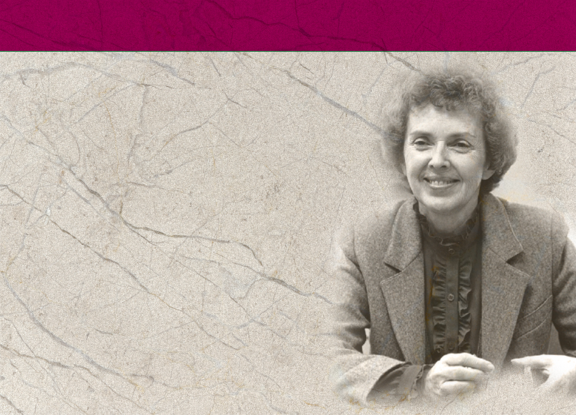
1985
Marzo: si riunisce la Commissione che discute sul Ruolo delle Donne. Vi sono inclusi delegati da tutto il mondo.
Il Consiglio Annuale istituisce il Comitato Consultivo dei Ministeri Femminili. Betty Holbrook ne è la presidente.
Notes:
1985 - March: Commission on the Role of Women meets. Includes delegates from world field. Recommend an affirmative action plan be developed to improve women’s involvement in the church.
- July: The General Conference Session in New Orleans votes “affirmative action” for the involvement of women in the work of the church be a priority plan with church leadership, and to request leaders use their executive influence to open to women all aspects of ministry in the church that do not require ordination.
- Annual Council establishes a Women’s Ministries Advisory Committee. Betty Holbrook is appointed chair person.

Slide 9
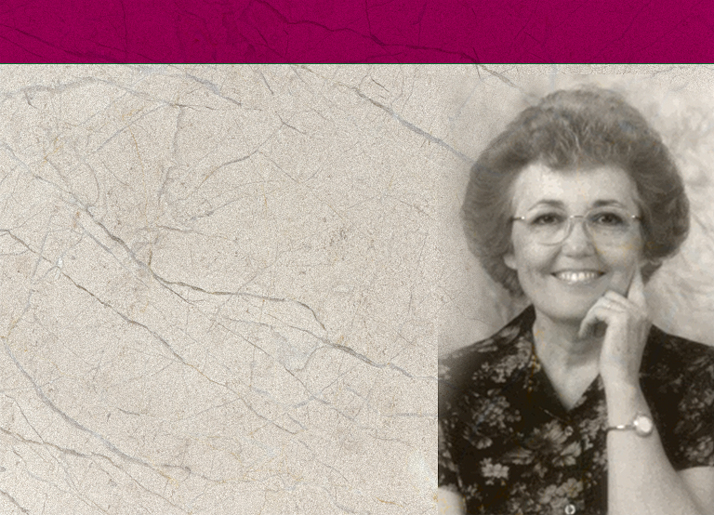
1988
Karen Flowers diventa presidente del Comitato Consultivo dei Ministeri Femminili. E’ formulata la dichiarazione di missione dei MF, tuttora in vigore.
Il Comitato Consultivo dei MF redige una proposta da sottoporre al presidente Neal Wilson evidenziando la necessità di una direttrice dei MF a tempo pieno.
Notes:
1988 - Karen Flowers becomes head of the Women’s Ministries Advisory Committee.
They formulate a mission statement for Women’s Ministries, the same one now in use by the Women’s Ministries Department.
- The GC Women’s Ministries Advisory drafts proposal for President Neal Wilson outlining full-time position for a Women’s Ministries director.

Slide 10
1989
In una commissione sul Ruolo delle Donne, a Cohutta Springs, Karen Flowers presenta uno studio sulle donne in posizione di leadership nel campo mondiale. In quell’occasione è espressa la raccomandazione che la CG apra un ufficio dei Ministeri Femminili con una direttrice a tempo pieno.
Notes:
1989 - March 16, “Forgotten Heritage,” and editorial in the Adventist Review summarizes the work of SMI Henry and calls for re-establishment of Women’s Ministries.
- Karen Flowers presented a study on women in leadership in the world field to a Commission on the Role of Women at Cohutta Springs, Georgia.
The meeting recommended that the General Conference open an office of Women’s Ministries with a full-time director for Women’s Ministries.

Slide 11
1990
Durante la Sessione della Conferenza Generale di Indianapolis è esposto un arazzo raffigurante donne avventiste che, in ogni Divisione, sono al servizio di Cristo. Attualmente è in mostra presso la sede della Conferenza Generale.
Notes:
1990 - A fabric wall-hanging depicting Adventist women serving Christ in every division of the world is displayed at the General Conference Session in Indianapolis.
It is now on display in the General Conference building.

Slide 12
1990
35 donne in rappresentanza di vari gruppi chiedono alla Chiesa di nominare un Direttore dei Ministeri Femminili a tempo pieno, a tutti i livelli. Le loro raccomandazioni includono quali dovrebbero essere i doveri del Direttore:
Identificare, valutare e sviluppare strategie per soddisfare i bisogni delle donne
Produrre e divulgare informazioni accurate sul ruolo delle donne nella chiesa
Sponsorizzare ritiri con lo scopo di nutrire spiritualmente
Promuovere attività che informino le donne sulla governance e le politiche della chiesa
Notes:
1990 - A group of 35 women representing various groups asks the church to appoint a full-time Director of Women’s Ministries at all levels. Their recommendations said the Director’s duties should include:
Identifying, assessing and developing strategies to meet women’s needs
Generating and disseminating accurate information concerning the role of women in the church
Sponsoring retreats for the purpose of spiritual nourishment
Directing activities to educate women regarding church governance and policies

Slide 13
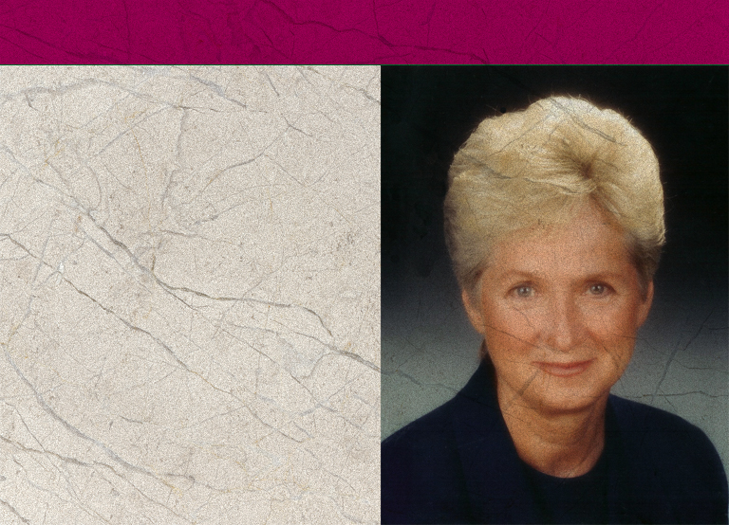
1990
Il Consiglio Annuale del 4 ottobre vota di aprire un ufficio dei Ministeri Femminili. Rose Otis è nominata direttore dei MF.
Notes:
1990 - Annual Council, October 4, voted to open an Office of Women’ Ministries. Rose Otis, elected the director of Women’s Ministries.
(Note: The fact that it was the Office of Women’s Ministries meant that it was under the direction of the President; it was not a separate department of the church as yet.)

Slide 14
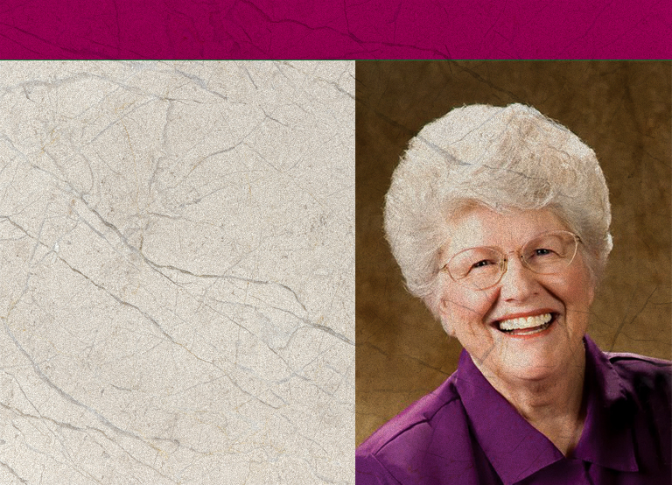
1995
Il 1995 è dichiarato Anno della Donna Avventista.
Durante la Sessione della Conferenza Generale a Utrecht, i MF assumono il pieno status di dipartimento.
Ardis Stenbakken è nominata Direttore Aggiunto.
Notes:
1995 - 1995 was declared the Year of the Adventist Woman
- Women’s Ministries given full departmental status at the General Conference Session in Utrecht.
- Ardis Stenbakken is elected as Associate Director.

Slide 15
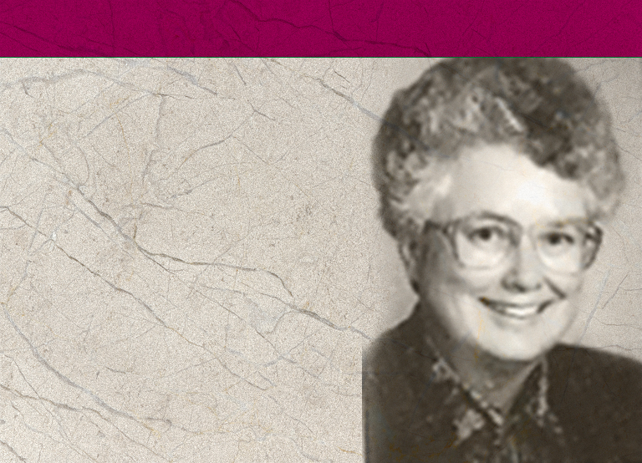
1996
EAD, EUD, and IAD istituiscono un Dipartimento dei Ministeri Femminili.
La prima Consulta (Advisory) Mondiale ha luogo in marzo.
Dorothy Eaton Watts sostituisce Rose Otis che si era dimessa per assumere l’incarico di vice presidente della Divisione Nord Americana.
Notes:
1996 - First Women’s Ministries World Advisory held in March. These sessions involve all the Division Women’s Ministries Directors and lays plans for Women’s Ministries for the next five years and adopts policies and initiatives such as the Abuse Prevention Day.
- Dorothy Eaton Watts elected to replace Rose Otis, who resigned to become a Vice-President for the North American Division.

Slide 16
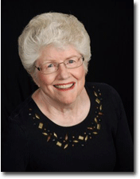
1997
Durante il Consiglio Annuale Ardis Stenbakken è chiamata a sostituire Dorothy Watts che si era dimessa dall’incarico quando il marito diventa presidente della Divisione Asia del Sud.
Lynnetta Siagian Hamstra è nominata Direttore Associato del Dip. dei MF presso la Conferenza Generale.
Notes:
1997 - At Annual Council Ardis Stenbakken was chosen to replace Dorothy Watts who resigned when her husband became president of Southern Asia Division.
- Lynnetta Siagian Hamstra elected as Associate Director of General Conference Department of Women’s Ministries.

Slide 17
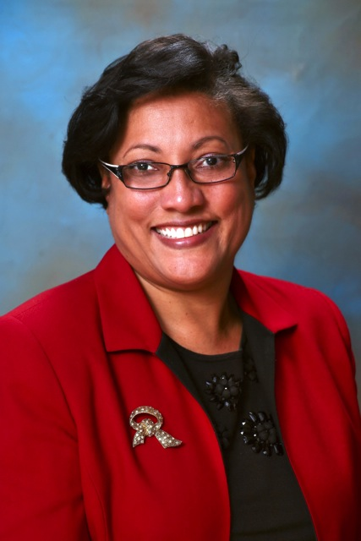
2004
Ardis Stenbakken va in pensione alla fine dell’anno.
2005
Heather-Dawn Small è eletta Direttore dei Ministeri Femminili.
Notes:
2004 - Ardis Stenbakken retires at the end of 2004
- Heather-Dawn Small is elected Director of Women’s Ministries.
2005 - Raquel Queiroz da Costa Arrais elected as Associate Director

Slide 18
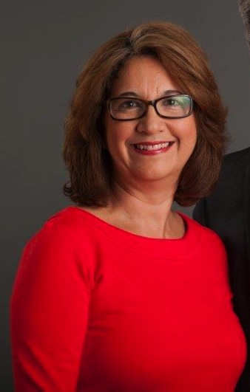
2005
Raquel Queiroz da Costa Arrais è nominata Direttore Aggiunto.
Notes:
Conclusion
Women’s Ministries has been a blessing to individual women and to the local church and community right from the first. And with your support, it will continue to be. The programs, Bible studies, and other spiritual activities will nurture your soul. The leadership training can empower and help you be prepared to fully partake in the mission of the church. As you and other women work together to meet the needs of your church and community, and mentoring other women, you too will be fulfilling the outreach mission of the church. Further, you will be fulfilling the task presented in Titus 2:3-5 by finding and helping to meet the needs of your church and community.
Likewise, teach the older women to be reverent in the way they live, not to be slanderers or addicted to much wine, but to teach what is good. Then they can urge the younger women to love their husbands and children, to be self-controlled and pure, to be busy at home, to be kind, and to be subject to their husbands, so that no one will malign the word of God.

Slide 19

Dichiarazione di Missione
Nutrimento:
elevare le donne in quanto persone di inestimabile valore poiché sono state create e redente
mettere in grado le donne di approfondire la loro fede e la loro esperienza di crescita e di rinnovamento spirituale
Notes:
The first section of the mission statement is under Nurture:
elevate women as persons of inestimable worth because they have been created and redeemed
enable women to deepen their faith and experience spiritual growth and renewal

Slide 20
Dichiarazione di Missione
Nutrimento:
costruire una rete di collegamenti tra le donne nella chiesa mondiale per incoraggiare i vincoli di fratellanza e di aiuto reciproco nonché favorire lo scambio creativo d’idee e informazioni
sostenere le giovani incoraggiando il loro coinvolgimento e creando per loro spazi alfine di raggiungere le loro potenzialità in Cristo
Notes:
build networks among women in the world church to encourage bonds of friendship and mutual support and the creative exchange of ideas and information
mentor young Adventist women, encouraging their involvement, and creating paths for them as they reach for their potential in Christ.

Slide 21

Dichiarazione di Missione
Potenziale:
cercare spazio per un servizio cristiano dinamico per le donne
introdurre la particolare prospettiva femminile su vari argomenti che la chiesa mondiale affronta
Notes:
The next section is grouped under the Empower heading:
seek expanding avenues of dynamic Christ service for women
challenge each Adventist woman with her potential to complement the gifts given to other women and men as they work side by side to further the global mission of the Seventh-day Adventist Church
bring women’s unique perspectives to the issues facing the world church

Slide 22
Dichiarazione di Missione
Potenziale:
sfidare ogni donna avventista con il suo potenziale ad essere di complemento ai doni delle altre sorelle e dei fratelli mentre lavorano fianco a fianco per portare avanti la missione globale della Chiesa Avventista del Settimo Giorno
Notes:
challenge each Adventist woman with her potential to complement the gifts given to other women and men as they work side by side to further the global mission of the Seventh-day Adventist Church

Slide 23

Dichiarazione di Missione
Testimonianza:
ricercare metodi dinamici di servizio cristiano affinché tramite la pienezza
che le donne hanno personalmente trovato in Gesù Cristo, possano acquisire potenza nel condividere la buona novella nelle famiglie, con i membri di chiesa e con coloro che ancora non conoscono l’evangelo della salvezza
Notes:
The last section of the Mission Statement concerns Outreach:
seek expanding avenues of dynamic Christian service for women that out of the fullness we as women have personally found in Jesus Christ, we may be empowered to share the good news within our families, among our fellow believers, and in ever expanding circles in the unsaved world.

Slide 24
Dichiarazione di Missione
Una delle forze dei Ministeri Femminili…
E’ importante che le leader dei MF e i comitati considerino attentamente questa dichiarazione di missione affinché sia studiato ogni suo punto e siano elaborati dei piani per coprire quante più aree e bisogni particolari.
Notes:
One of the strengths of Women’s Ministries from the start has been that it is a ministry that seeks to ascertain and meet needs. Thus, Women’s Ministries does not always look the same from place to place, but these ministries should all reflect back on the Mission Statement.
It is important that all Women’s Ministries leaders and committees look at this mission statement carefully to see that all sections of the Mission Statement are studied and plans developed to cover as many of these areas as possible according to the needs of the particular area. As you can see from the Mission Statement, Women’s Ministries is much for than retreats and entertainment programs.

Slide 25
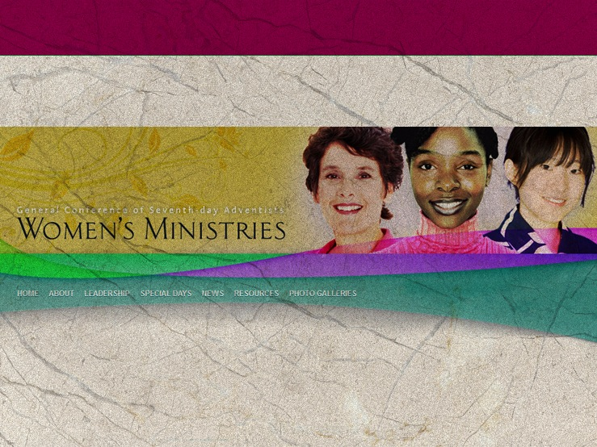
Panoramica dei Ministeri Femminili e delle Risorse
GC Women’s Ministries website: adventistwomensministries.org
Ministeri Femminili UICCA:
www.avventisti.it/ministerifemminili
www.avventisti.it/ministerifemminili
Notes:
Overview of Women’s Ministries Programs and Resources
Based on the Mission Statement, the General Conference Women’s Ministries has developed a number of programs and resources. They are constantly developing seminars, brochures, and other resources for use at all levels. Many of the seminars, sermons, and other materials can be down-loaded from the GC Women’s MInistries web site: http://adventistwomensministries.org/.
Others can be obtained from the Adventist Book Center or AdventSource, and even directly from the Review and Herald Publishing Association. It is important to check with your local Division to see which they can make available; Many Divisions have also generated resources which will be important to your territory. Here is an overview of some of the things available.

Slide 26

“Molte donne si sono comportate da virtuose, ma tu le superi tutte. La grazia è ingannevole e la bellezza è cosa vana; ma la donna che teme il Signore è quella che sarà lodata. Datele del frutto delle sue mani, e le opere sue la lodino alle porte della città."
Proverbi 31:29-31
Notes:
Paul wrote to the culture of his day; If he were writing today, he would undoubtedly urge women to be involved in their community, making a difference. He would encourage mothers to be the best mothers they can be, and professional women to reflect Christ in the marketplace, and all women to forward the mission of the church, working with other women and men locally and globally according to the God-given gifts she possesses.
“Many women do noble things,
but you surpass them all.”
Charm is deceptive, and beauty is fleeting;
but a woman who fears the Lord is to be praised.
Honor her for all that her hands have done,
and let her works bring her praise at the city gate.
Proverbs 31:29-31

