Slide 1
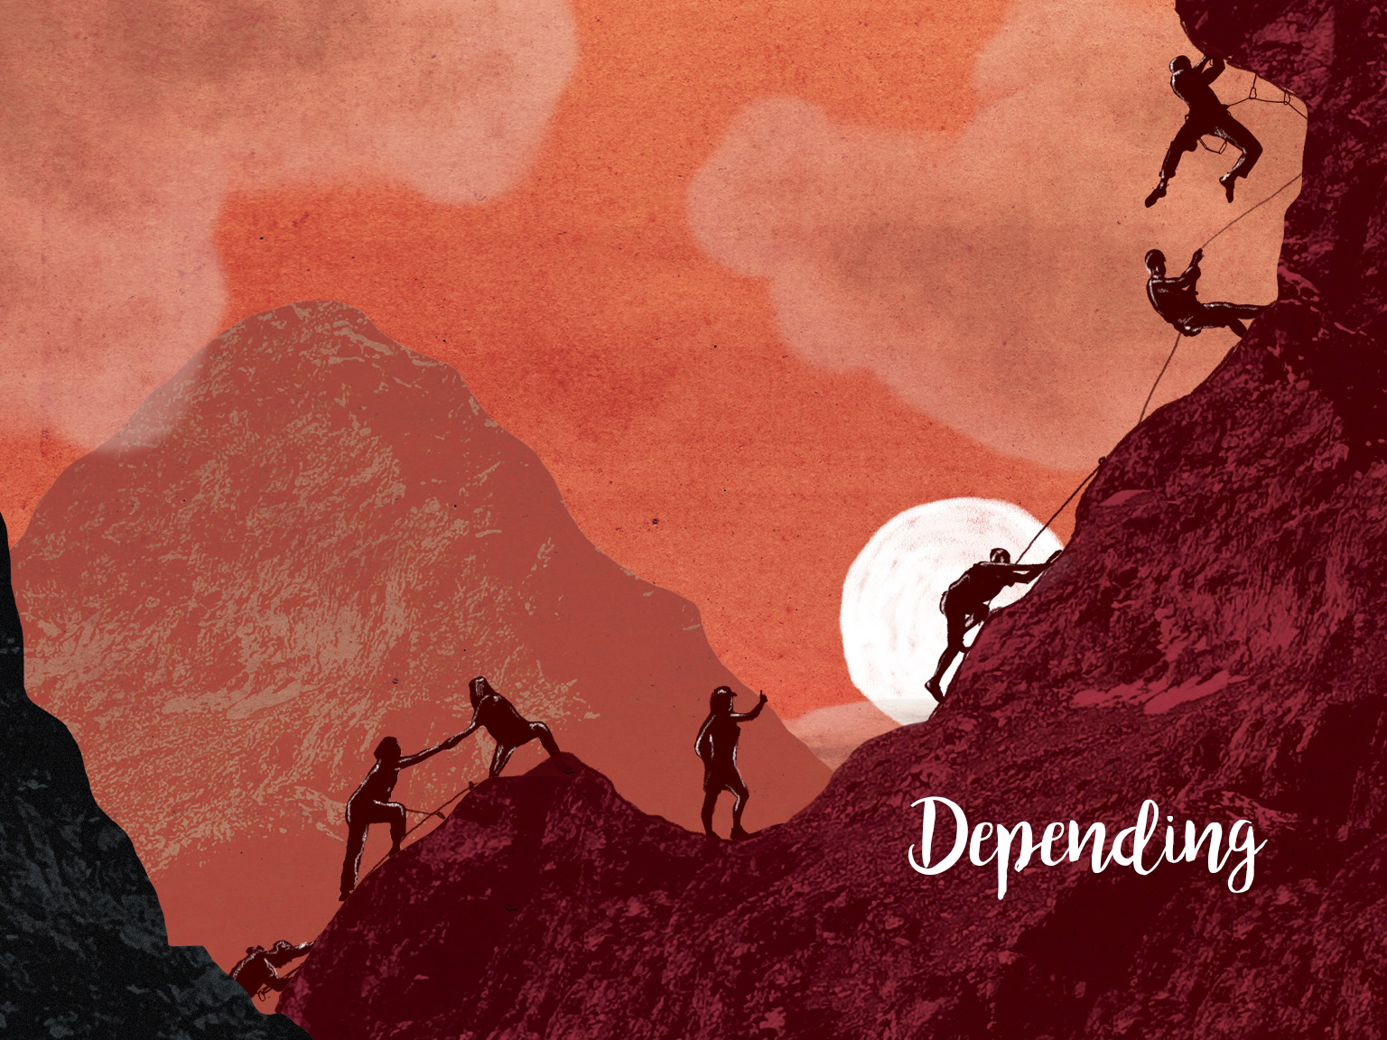

Slide 2

But he said to me, “My grace is sufficient for you, my power is made perfect in weakness.” Therefore I will boast all the more gladly about my weaknesses, so that Christ’s power may rest on me.
2 Corinthians 12:9

Slide 3
Pray for increasing dependence on God’s sufficient grace – Ask that God would help us trust him to provide for everything he wants our congregation to do.

Slide 4
Pray for increasing acknowledgement of weaknesses – Ask God to help us honestly address areas of church life that are not strong.

Slide 5
Pray for decreasing dependence on our own strength – Ask God to help our congregation not to trust in its own gifts, skills, talents and abilities when serving Christ.

Slide 6
Pray for growing experience of Christ’s power at work as we increasingly depend on him – Ask God for growing confidence that he is at work despite our weaknesses and frustrations.

