Slide 1
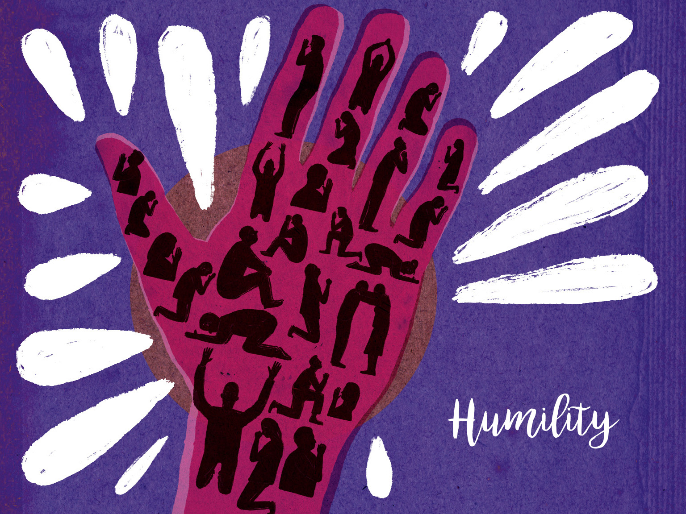

Slide 2

All of you, clothe yourselves with humility toward one another, because, ‘God opposes the proud but shows favour to the humble.’ Humble yourselves, therefore, under God’s mighty hand, that he may lift you up in due time.
1 Peter 5:5-6

Slide 3
Pray for all who come together to make up our congregation –
Ask God to bless children, young people, young adults, the middle-aged, senior citizens, men and women, married and single.

Slide 4
Pray for humility in relationships with one another – Ask that God would help us listen well to one another and respect different preferences.

Slide 5
Pray for freedom from pride –
Ask that God would free us from anything that deflects attention from focusing on him.

Slide 6
Pray for humility that waits upon God’s timing – Ask that God would give strength and grace to wait upon his perfect timing.

