Slide 1


Slide 2
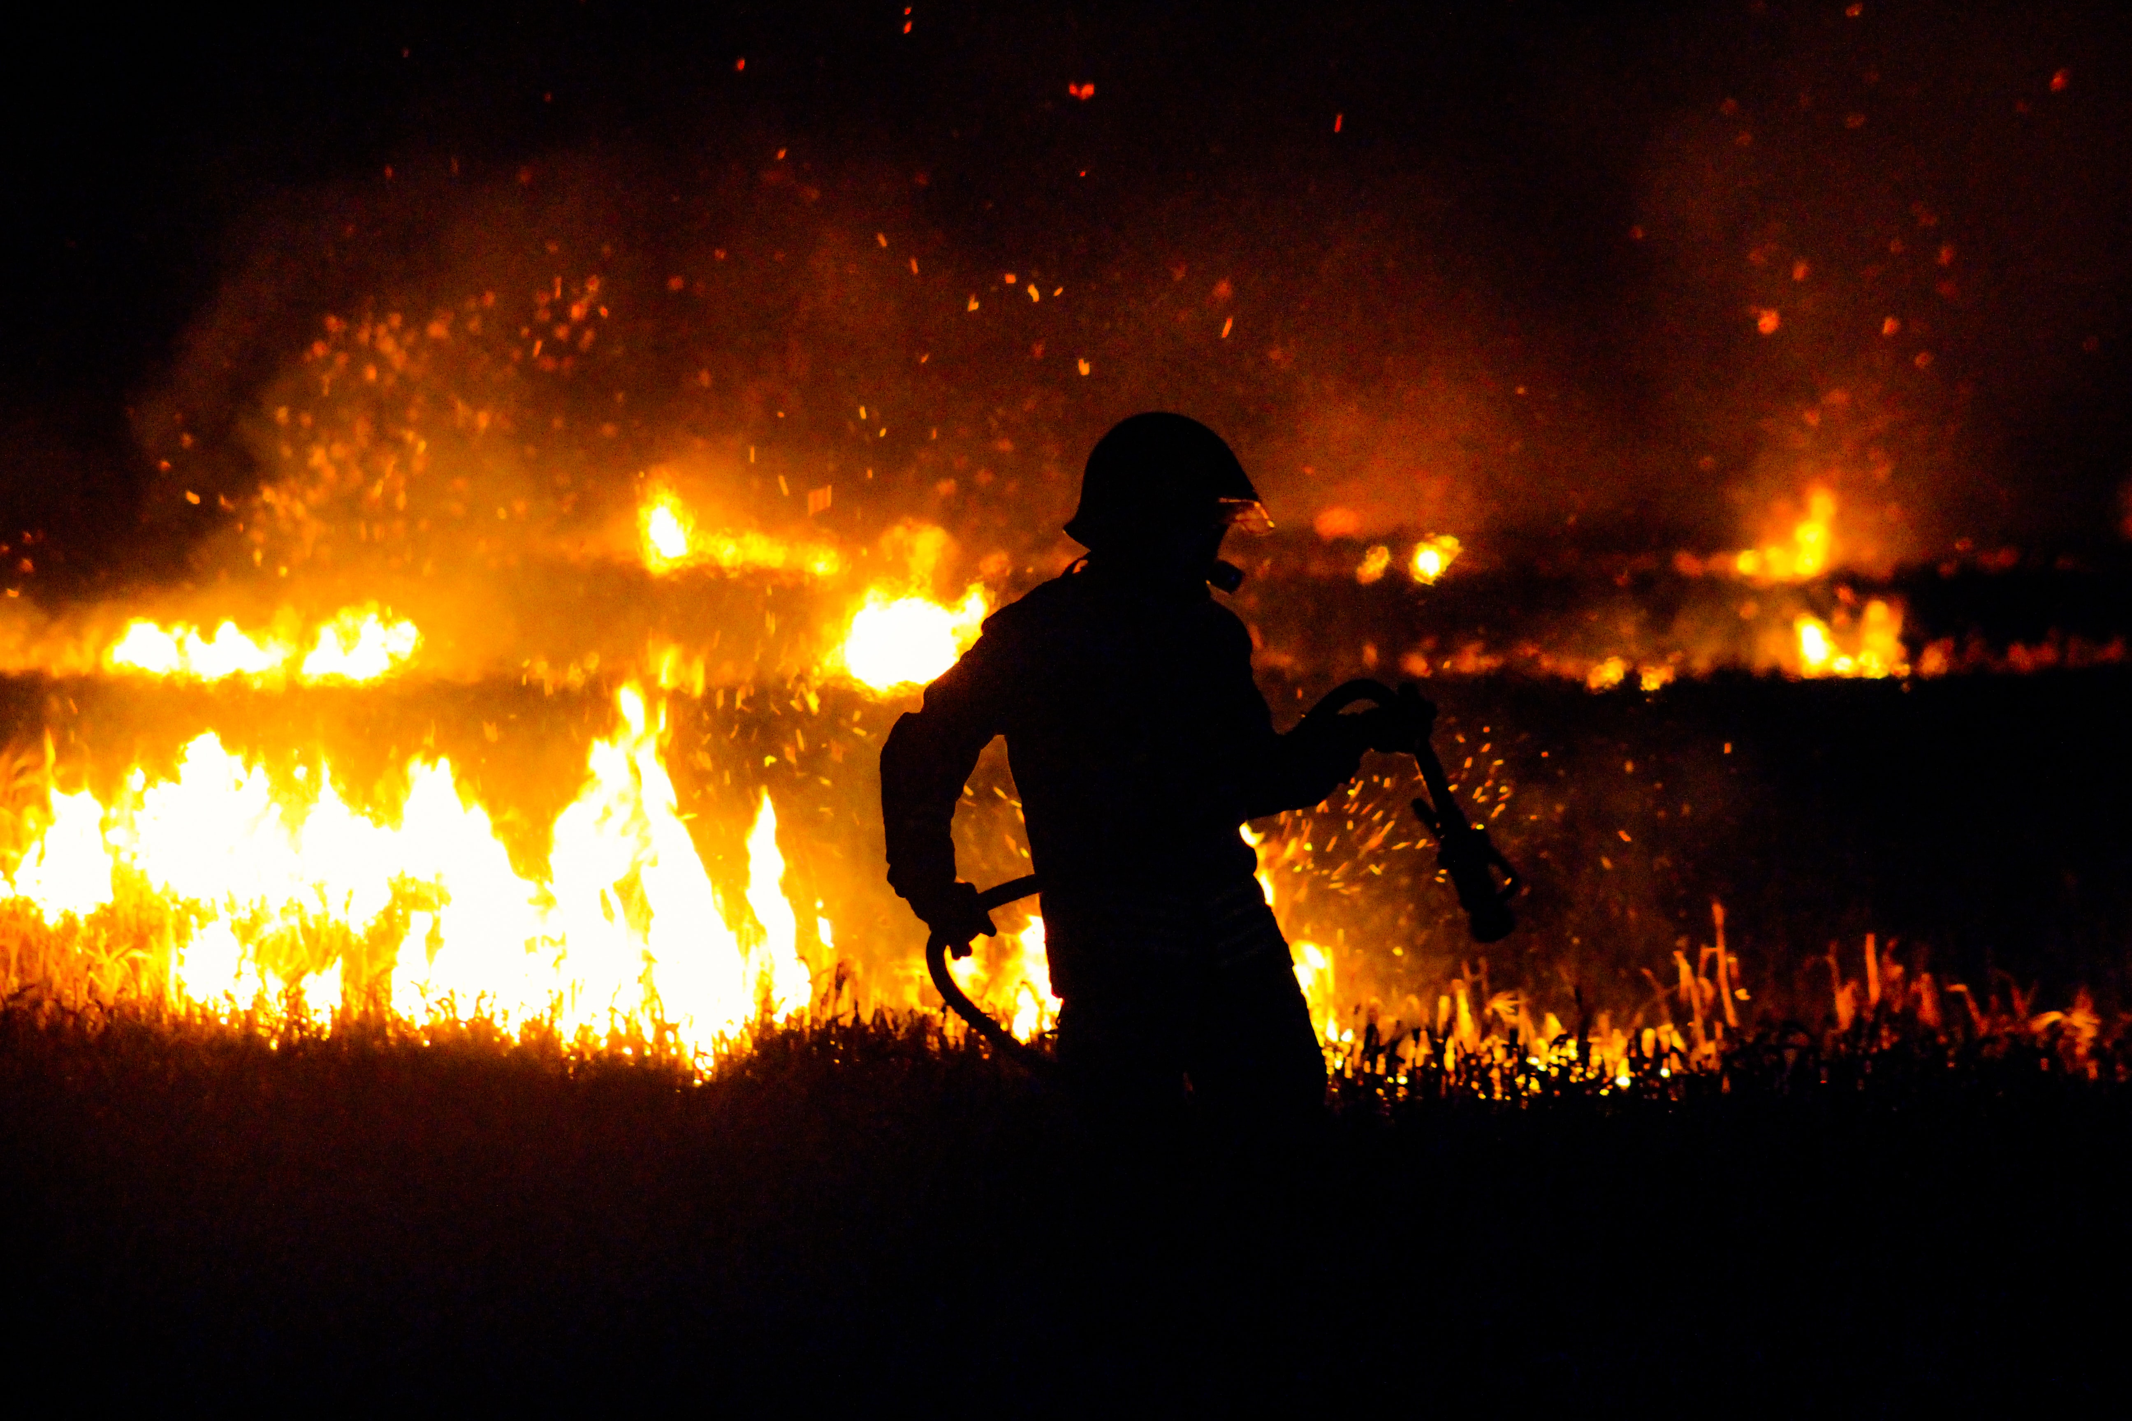
Notes:
Climate report is “Code red for humanity” was the BBC headline in August 2021 quoting the comments of the UN Secretary-General, António Guterres on the Intergovernmental Report on Climate change published on the 9th August 2021. The document states: "it is unequivocal that human influence has warmed the atmosphere, oceans and land".
The authors say that since 1970, global surface temperatures have risen faster than in any other 50-year period over the past 2,000 years. This warming is "already affecting many weather and climate extremes in every region across the globe". Whether it's heatwaves like the ones recently experienced in Greece and western North America, or floods like those in Germany and China, "their attribution to human influence has strengthened" over the past decade.
We have seen it ourselves with the highest confirmed temperature this summer recorded in Castlederg at 31.3. According to Armagh observatory and Planetarium the highest since their records began in 1794.

Slide 3
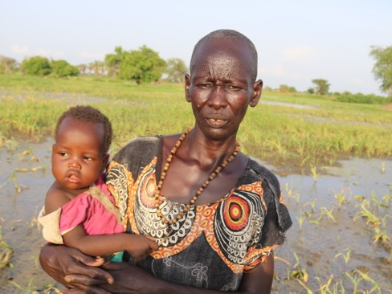
A farmer and mum of six from Northern Bahr El Ghazal, South Sudan, Asunta's crops were destroyed by flooding. Now, there's little left to eat. Image courtesy of Christian Aid
Notes:
The impact of these climate changes have been felt across the globe this summer but the hardest hit countries are those in the global south – many of our partners in global mission experience its devastating effect in failed harvests, frequent droughts and increased flooding.
To quote Katherine Hayhoe – a world renowned climate scientist who is also a committed Christian – “Climate change is not only an environmental issue. Climate change is a poverty issue. It’s a hunger issue. It’s an issue of inequality and injustice. It’s a human issue. And that’s why we care.’ (Tearfund: Christianity and Climate Change”
South Sudan is one very obvious example where alongside many other challenges - 2.4 million people are presently at risk of falling into famine.

Slide 4
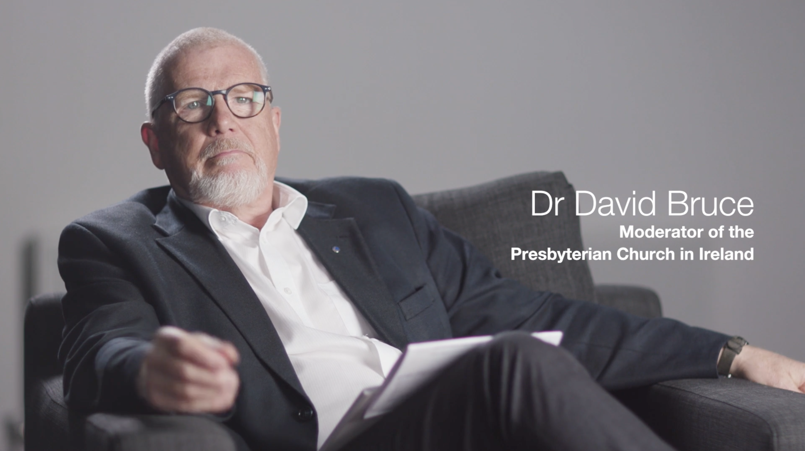
Notes:
There are Scriptural grounds for action
We know from Genesis 1:31 that what God created, He declared to be ‘very good’ and through Adam, we were asked ‘to take care of it’ (2:15).
The Psalmist also explains that “The highest heavens belong to the Lord; but the earth he has given to humanity” (Psalm 115:16.) In effect God remains the landlord, for ‘The earth is the Lord’s and everything in it’ (Psalm 24:1).
While there may still be some debate regarding the degree of climate change and its causes, as Christians we can agree on this: God does not change, and neither does His word. God has given us the privilege and responsibility to use and to care for His creation.

Slide 5
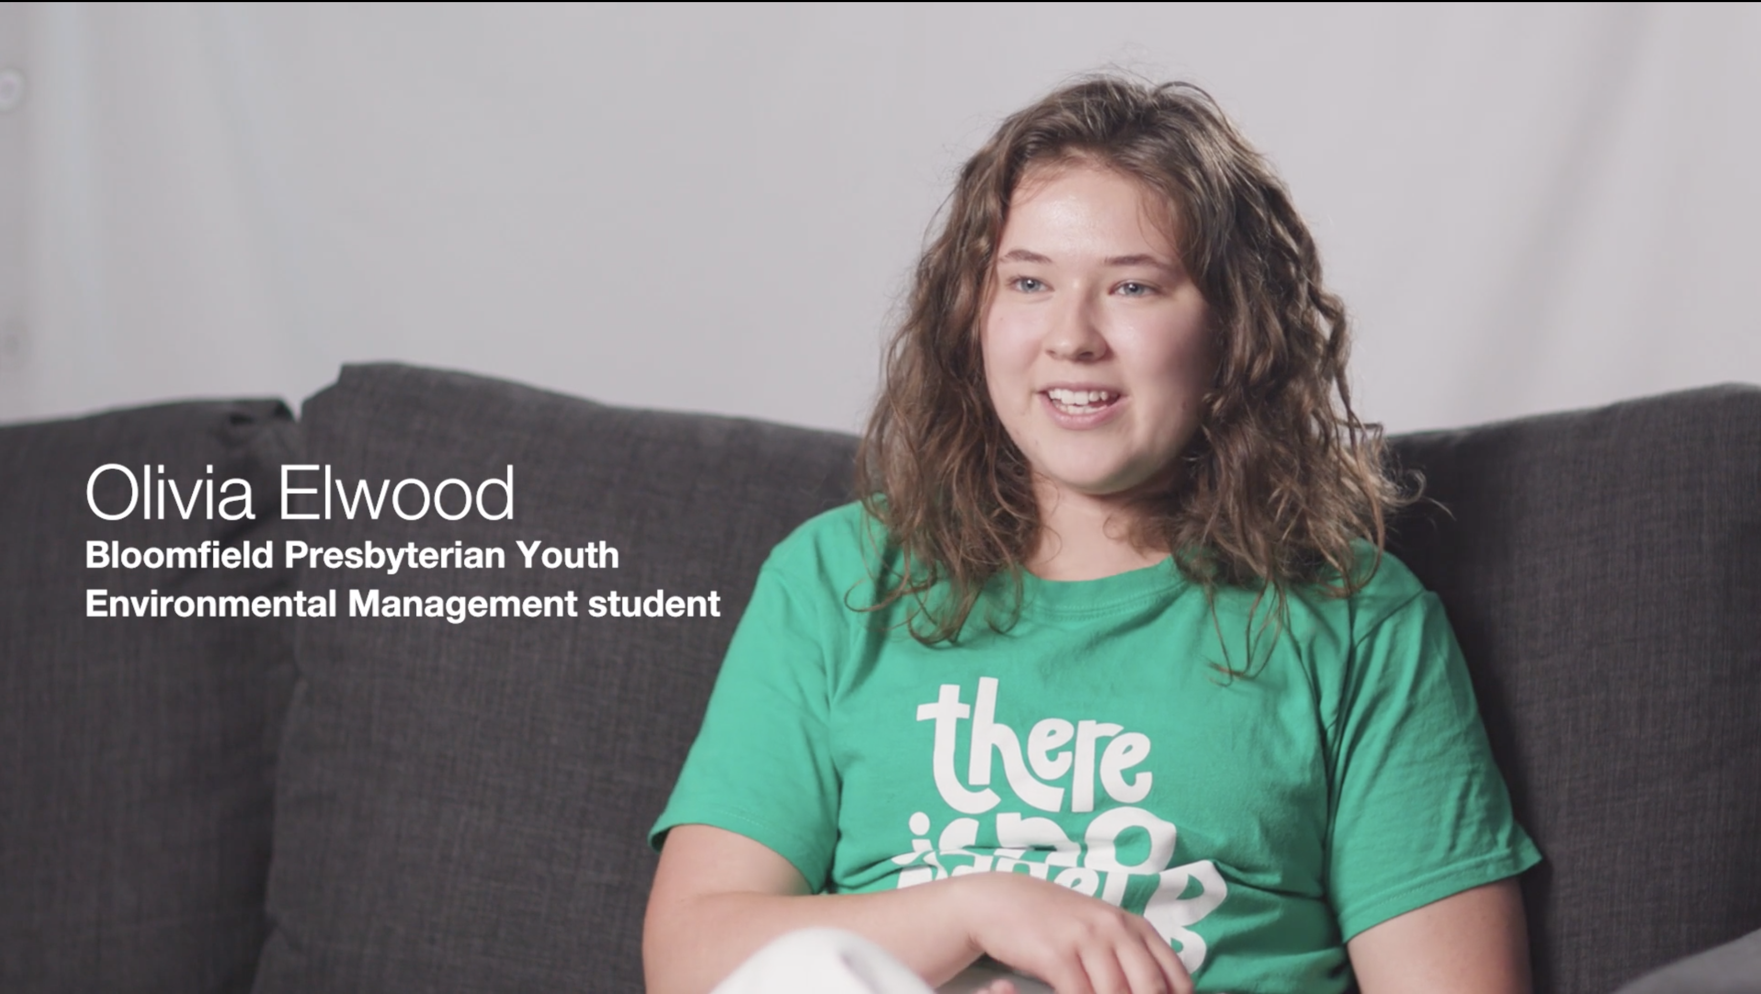
Notes:
It’s an intergenerational issue
It’s great to hear young Presbyterians speak up about this issue.
Olivia Elwood, an Environmental Management student and member of Bloomfield Presbyterian church in Belfast says “she'd love to see the church take the environment issue and see it as a form of worship to look after the environment. That it's not something that's separate from the church or something to be dealt with outside of it, but actually it can be part of our giving back to God and showing our love for him to look after this gift of a planet he's given us.”
In 2020 We Are Tearfund and Youthscape surveyed 630 young Christians from the UK. They asked 14-19 year olds about their thoughts on the climate, the church and their faith. The report entitled “Burning the house down” found that nine out of ten Christian young people are concerned about the climate crisis, and only one out of ten thinks their church is doing enough about it.

Slide 6
What can we do?
Worship Give thanks
Confess
Preach and teach
Pray
Notes:
What can we do?
We can worship: Give thanks for God’s creation
Confess our failure to care
Preach and teach about our responsibility as followers of Jesus to care for God’s world.
Pray for those suffering most because of Climate change

Slide 7
What can we do?
Worship Give thanks
Confess
Preach and teach
Pray
Commit Take personal and congregational responsibility
Notes:
We can commit: As an act of Christian discipleship commit to take personal and congregational responsibility
– see ten tips document

Slide 8
What can we do?
Worship Give thanks
Confess
Preach and teach
Pray
Commit Take personal and congregational responsibility
Speak up Talk about climate change and what we need to do
Encourage your political representatives
Notes:
We can speak up: Take every opportunity in everyday life to talk about climate change and what we need to do
Encourage your local councillors, MLAs, TDs and MPs to do the same and pray for them.
Pray for COP26.

Slide 9
For more information please visit,
www.presbyterianireland.org/stewardshipofcreation
Notes:
Please visit the PCI website ‘/stewardship of creation’ for more information, and where you can also find a short film of the Moderator Dr David Bruce in conversation with Olivia talking more about these issues recorded in the run-up to COP26 in 2021.

