Slide 1

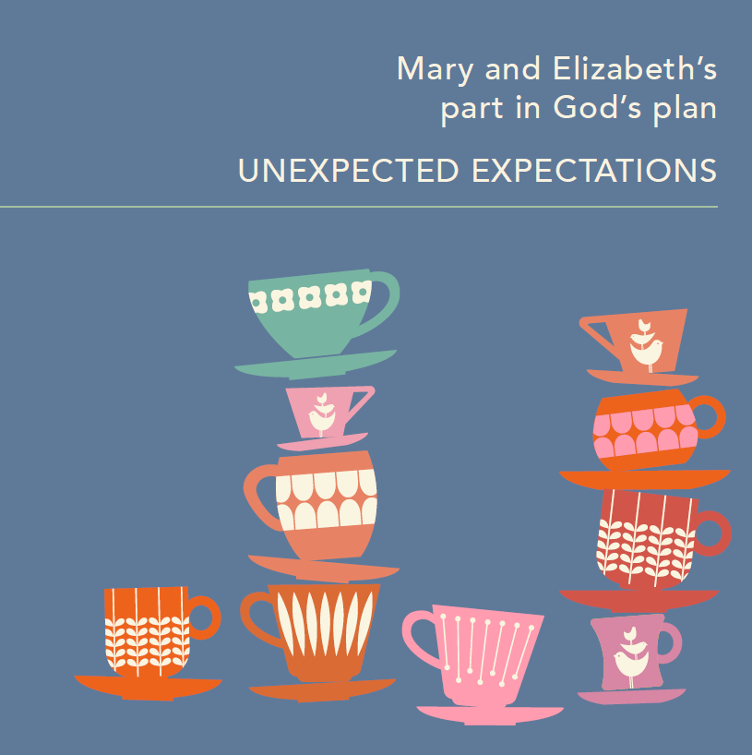
Mary & Elizabeth’s part in God’s plan
UNEXPECTED EXPECTATIONS

Slide 2


Icebreaker - who is my mother?
Who is Claudia Winkleman’s mother?

Slide 3
Icebreaker - who is my mother?
Who is Claudia Winkleman’s mother?
Answer: Eve Pollard

Slide 4
Who is Princess Anne’s mother?

Slide 5
Who is Princess Anne’s mother?
Answer: Queen Elizabeth II

Slide 6
Who is Kate Hudson’s mother?

Slide 7
Who is Kate Hudson’s mother?
Answer: Goldie Hawn

Slide 8
Who is Liza Minnelli’s mother?

Slide 9
Who is Liza Minnelli’s mother?
Answer: Judy Garland

Slide 10
Who is Carrie Fisher’s mother?

Slide 11
Who is Carrie Fisher’s mother?
Answer: Debbie Reynolds

Slide 12
Who was Ruth’s mother-in-law?

Slide 13
Who was Ruth’s mother-in-law?
Answer: Naomi

Slide 14
Who is Princess Charlotte’s mother?

Slide 15
Who is Princess Charlotte’s mother?
Answer: Princess of Wales

Slide 16
Who is Queen Elizabeth I mother?

Slide 17
Who is Queen Elizabeth I mother?
Answer: Anne Boleyn

Slide 18
Who is Sophie Ellis-Bextor’s mother?

Slide 19
Who is Sophie Ellis-Bextor’s mother?
Answer: Janet Ellis (Blue Peter)

Slide 20
Who is Gail Platt’s mother?

Slide 21
Who is Gail Platt’s mother?
Answer: Audrey Roberts
(Coronation Street)

Slide 22
FEAR | Luke 1:30 | The angel told Mary not to be afraid. Her desire to serve God was greater than her fears.
SURRENDER | Luke 1:38 | Mary surrendered to God’s will. If she had tried to control God’s plan for Jesus, we would have a very different story.
DESIRE | Luke 1:38 | "I am the Lord’s servant. May your word to be me be fulfilled.” These words show Mary’s desire to surrender and serve her Lord.
TRUST | Luke 1:38 | In surrendering, Mary had to trust God, place herself before him and trust him.
PRAISE | Luke 1:46-55 | In Mary’s Song, we hear Mary praising, glorifying and rejoicing in her Lord.
SUFFERING | John 19:25-27 | We don’t hear too much about Mary during Jesus’ ministry but, at the crucifixion, John records her being present. How must she have felt, witnessing his death?

