Slide 1

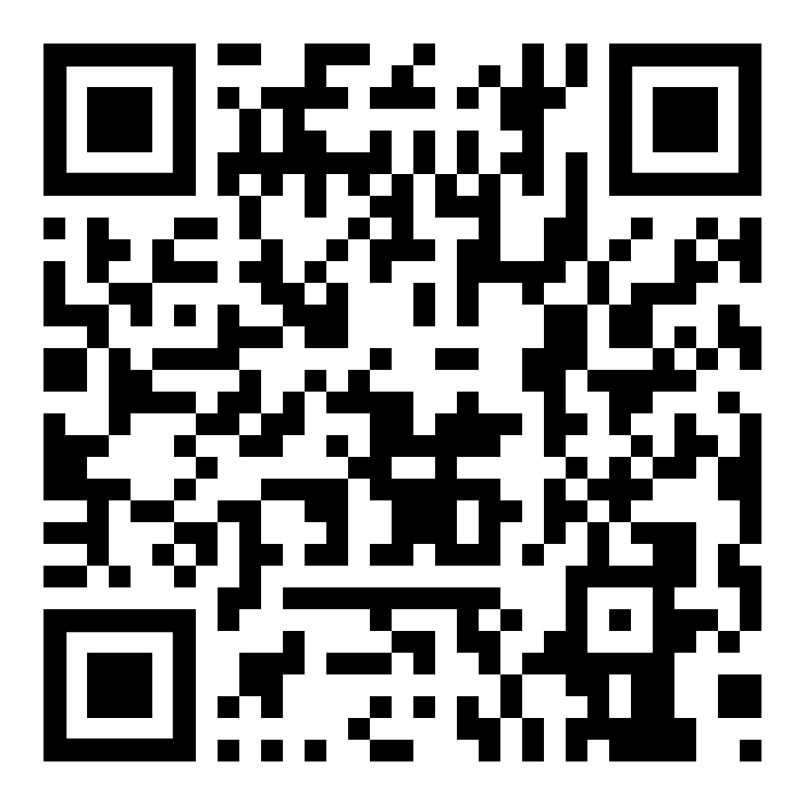
The INEQE Safeguarding Group is an independent company
of safeguarding professionals.
We have been asked to carry out an independent safeguarding review to ensure the Presbyterian Church in Ireland is doing all they can to create an environment where everyone feels safe, valued and respected.
Listening to and learning from individuals involved in the life and work of the Presbyterian Church in Ireland is an important part of the Review.
You can help us
If you have any information, concerns or worries about something that happened in or is related to the Presbyterian Church in Ireland, you can contact us via this webpage.
ineqe.com/presbyterian-church-in-ireland
Tell us your views!
Closing date is 21st September 2026
Your participation is critically important and you can help by taking part in an anonymous and confidential survey.
We encourage you to be open and honest. We will only share information if what you tell us indicates a serious risk of harm.
Don’t forget - If you or someone you know is in immediate danger, it is important that you quickly get the right help – call the police on 999 or if you are calling from the Republic of Ireland phone 112
ineqe.com/presbyterian-church-in-ireland
NSPCC Helpline
Helpline - 080 8800 5000
Email - help@NSPCC.org.uk
ISPCC
Helpline – 01 522 4300
Email – parentingsupport@ispcc.ie
Childline UK
Helpline – 0800 1111
Web – childline.org.uk
Childline ROI
Helpline – 1800 66 66 66
Web – ispcc.ie/childline/
Samaritans UK and ROI
Helpline – Call 116 123
Visit in person to your local branch during their opening hours
© Ineqe Group Ltd 2026
© Ineqe Group Ltd 2026
Access the webpage by scanning the QR code
ineqe.com/presbyterian-church-in-ireland

Slide 2
The INEQE Safeguarding Group is an independent company
of safeguarding professionals.
We have been asked to carry out an independent safeguarding review to ensure the Presbyterian Church in Ireland is doing all they can to create an environment where everyone feels safe, valued and respected.
Listening to and learning from individuals involved in the life and work of the Presbyterian Church in Ireland is an important part of the Review.
You can help us
If you have any information, concerns or worries about something that happened in or is related to the Presbyterian Church in Ireland, you can contact us via this webpage.
ineqe.com/presbyterian-church-in-ireland
Tell us your views!
Closing date is 21st September 2026
Your participation is critically important and you can help by taking part in an anonymous and confidential survey.
We encourage you to be open and honest. We will only share information if what you tell us indicates a serious risk of harm.
Don’t forget - If you or someone you know is in immediate danger, it is important that you quickly get the right help – call the police on 999 or if you are calling from the Republic of Ireland phone 112
ineqe.com/presbyterian-church-in-ireland
NSPCC Helpline
Helpline - 080 8800 5000
Email - help@NSPCC.org.uk
ISPCC
Helpline – 01 522 4300
Email – parentingsupport@ispcc.ie
Childline UK
Helpline – 0800 1111
Web – childline.org.uk
Access the webpage by scanning the QR code
Childline ROI
Helpline – 1800 66 66 66
Web – ispcc.ie/childline/
Samaritans UK and ROI
Helpline – Call 116 123
Visit in person to your local branch during their opening hours
ineqe.com/presbyterian-church-in-ireland
© Ineqe Group Ltd 2026

