Slide 1
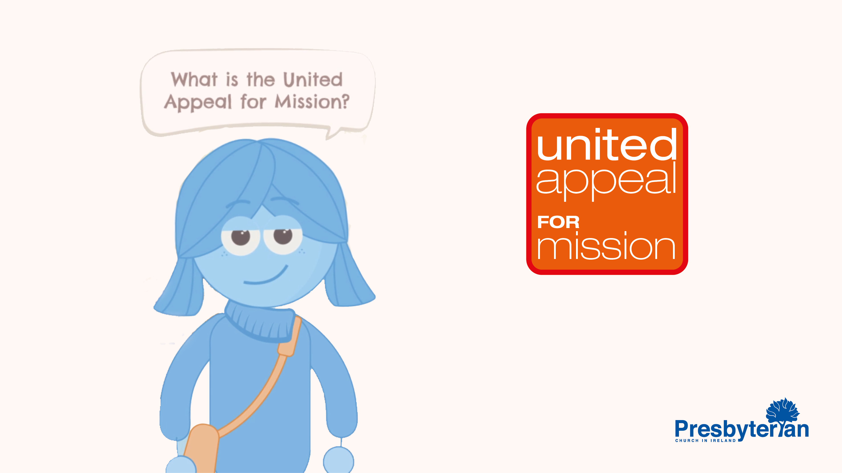
Notes:
Doing things together, is at the very heart of being a Presbyterian.
And the United Appeal for Mission is one of the ways we do things together...
But maybe sometimes we ask.., ‘what is the United Appeal for Mission?’
Well in brief...
It’s about the power of team work!

Slide 2
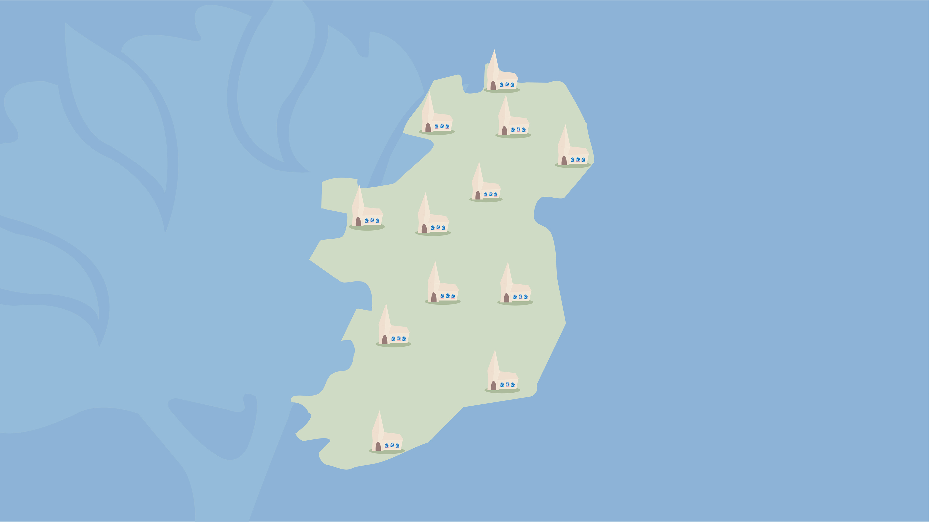
Notes:
Our denomination is made up of over 500 congregations.
Of all different sizes, – in cities, towns and countryside, – from Castlerock to Cork.
All doing great things for God’s mission.
But sometimes there’s things that we want to do as a denomination, that we can’t do as individual congregations...
and that’s why we have the United Appeal for Mission.

Slide 3

Notes:
As acting as part of a team - each congregation contributes a share, dependant on their size,
– and by combining these resources together, – we are able to do so much more.
Not only just to the benefit members of our congregations, but also, the wider community.

Slide 4

Notes:
And through global mission workers and partners, benefitting people around the world too.
Through ministry and mission, at home and abroad, areas such as:
– church planting, community outreach
– Bible study resources, training and leadership development courses,
– children and youth events, and theological training.

Slide 5

Notes:
The Bible teaches us that it’s better to do things together –
Together as one body, with different parts of all shapes and sizes.
But one in heart and mind.
And together we work as a team – creating opportunities to share the good news of Jesus, both in word and in action.

Slide 6
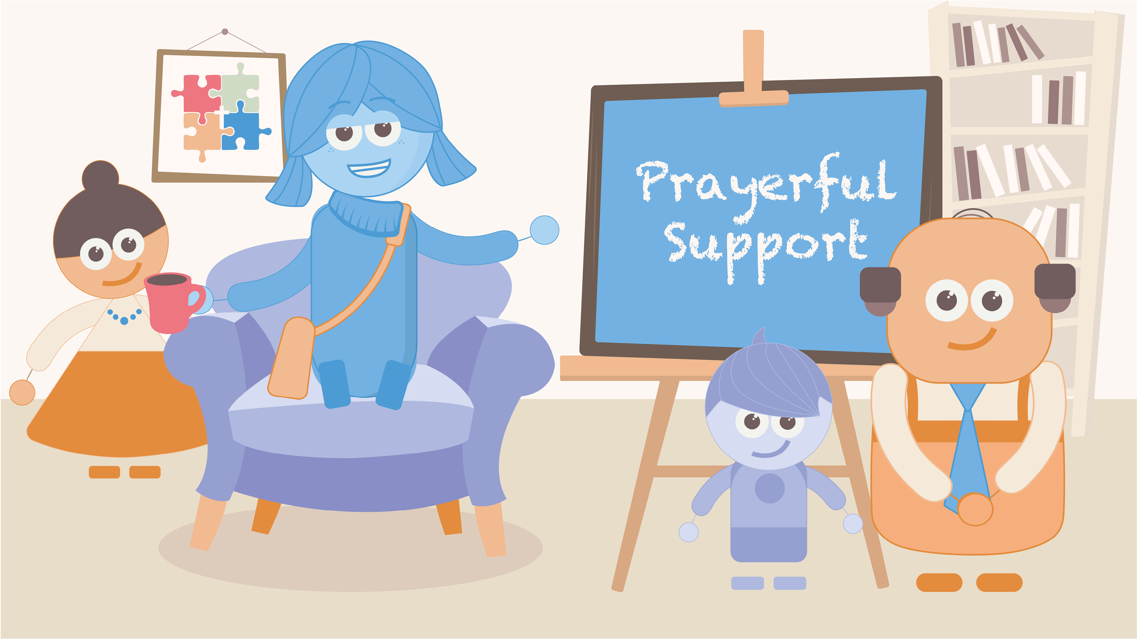
Notes:
As a church family we thank you, not just for your financial giving, but also for the prayerful support you offer to the people and projects that benefit from the United Appeal.
Please be encouraged – in working together – your giving and prayers are making a difference.
Together we are doing much more than we can do on our own.

Slide 7

Notes:
As part of the United Appeal team, you play a vital role in helping support and grow the ministry and mission of the church.

