Slide 1
Informing Choice for Safer Building:
A Protocol for Developing & Disseminating Shelter and Settlement related Information, Education, Communication (IEC) Resources

Slide 2
Background
In post-crisis contexts, humanitarian shelter programming should address the shelter needs with solutions that provide protection from weather and unwanted intrusion, healthy and dignified living conditions, a minimum of safety against natural hazards and are appropriate to the context and acceptable and feasible for people.
How to know what solutions is most suitable and fits peoples needs?
What locally used building practices can to be improved to ensure better safety and security?
How can people best learn what improvements can make their shelter/house more resilient and also provide a healthier living environment.
→ Global Shelter Cluster Working Group on Promoting Safer Building Practices, co-chaired by CARE and CRAterre has developed different tools to find answers to these questions.

Slide 3
Why a are technical IEC so important?
Shelter Clusters are expected to produce IEC materials to support shelter response
Coordinated messaging clearly is more effective.
With growing multipurpose cash programs, technical information and assistance is critical how to ensure quality shelter outcomes
→ Support self recovery /Extend our Impact: The large majority of people who self-recovery without humanitarian assistance will greatly benefit from technical information that helps them to make informed choices about how to build back safer.

Slide 4
What is this Protocol?
A process to identify the relevant messages as well as the best communications channels for disseminating them.
https://www.sheltercluster.org/promoting-safer-building-working-group/protocol-informing-choice-better-shelter
The protocol can be used to develop technical information in immediate emergency in post-disaster contexts, but also to develop relevant information for preparedness and building greater resilience.

Slide 5
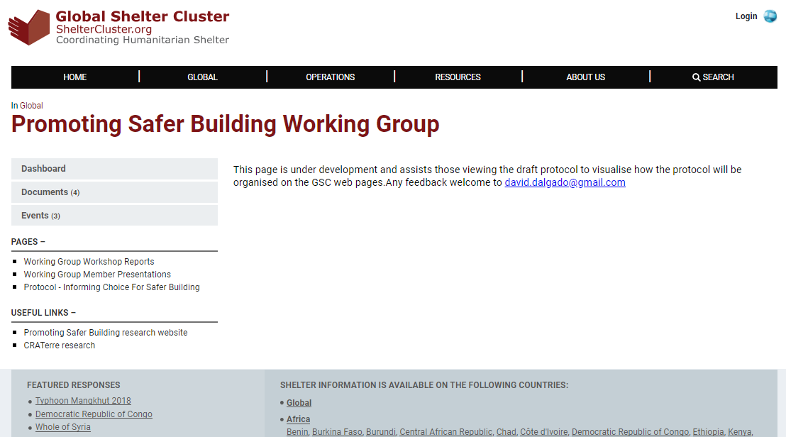
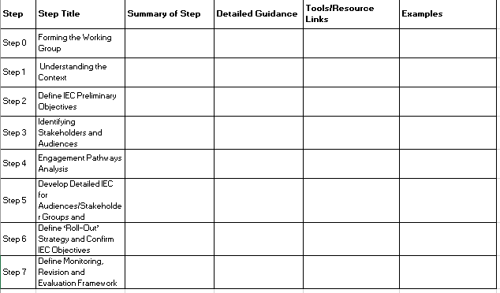
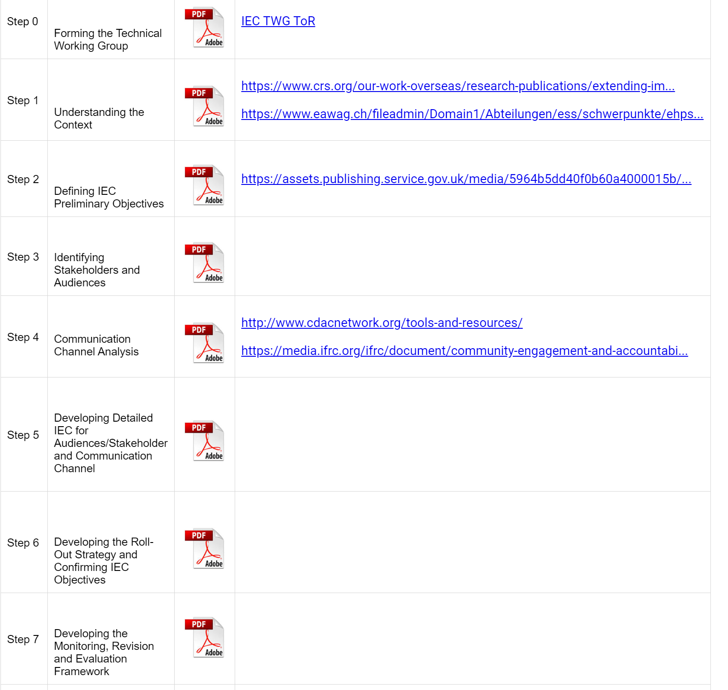

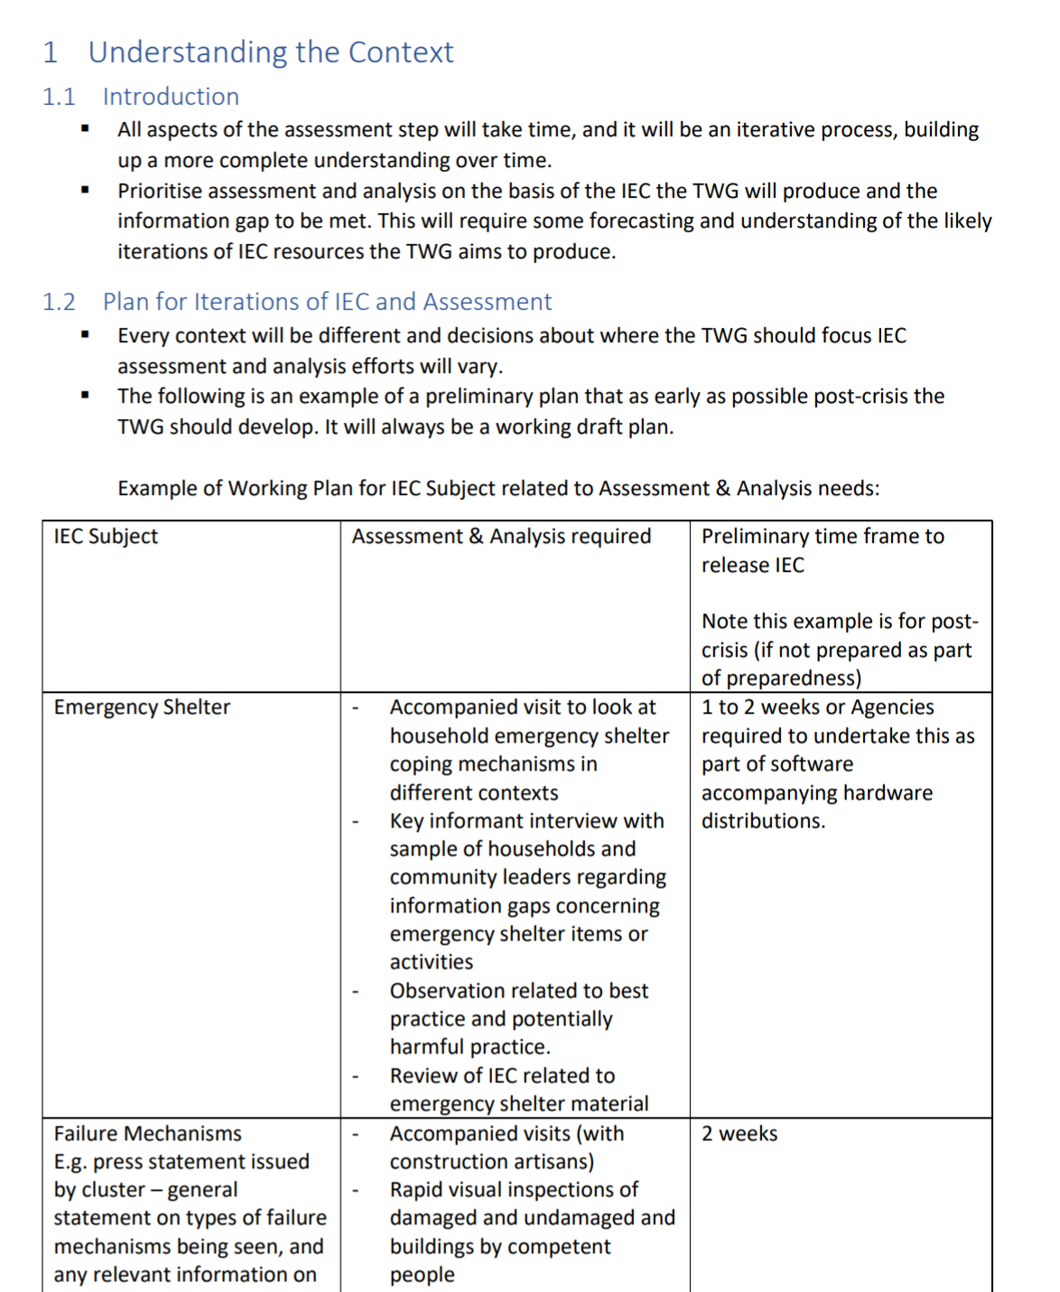

Slide 6
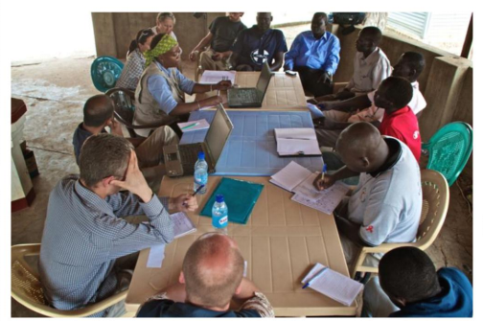
Step 0: Forming the Working Group
Identify and include the most relevant stakeholders with relevant competencies:
Authorities
Technical competencies
Communication experts (CWC)
Competencies on the local context

Slide 7
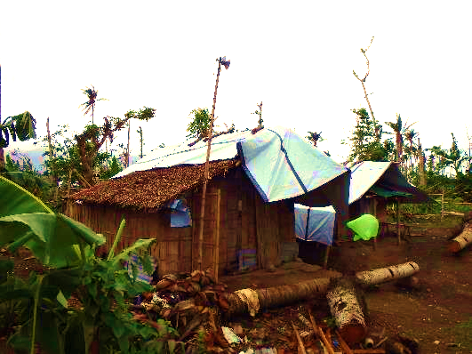
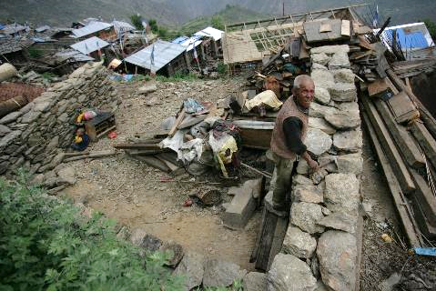
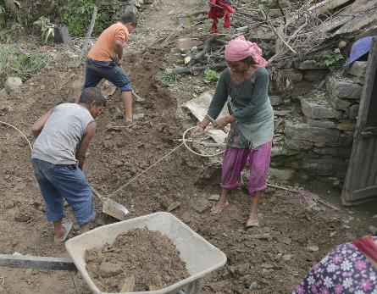
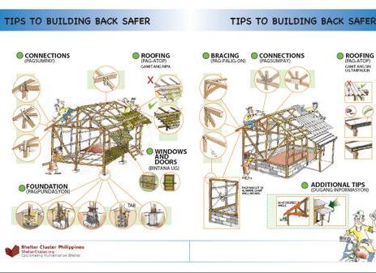
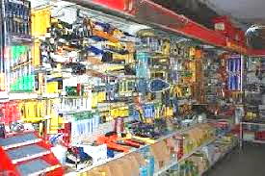
Step 1: Understanding the Context
How are people coping
What failure mechanisms can be seen on buildings?
What IEC already exists?
In what quality?
What tools and materials are available locally?
How do people build?

Slide 8
Step 2: Defining IEC Preliminary Objectives
“WHAT”
What is the information gap and how to fill it?
OBJECTIVE: House constructed stronger and able to resist higher levels of flooding
People use lime plaster or cement to stabilize mud walls
Households build a raised floor or plinth
IEC: Radio broadcast to promote
flood-resistant construction
People use cross bracing when constructing their house or roof
IEC on how to make a mud-block house more flood resistant
IEC: Information leaflets promoting raised floors or plinths
IEC: Workshops to demonstrate cross bracing
Distributions construction tools
Cash for reconstruction

Slide 9
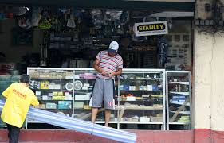
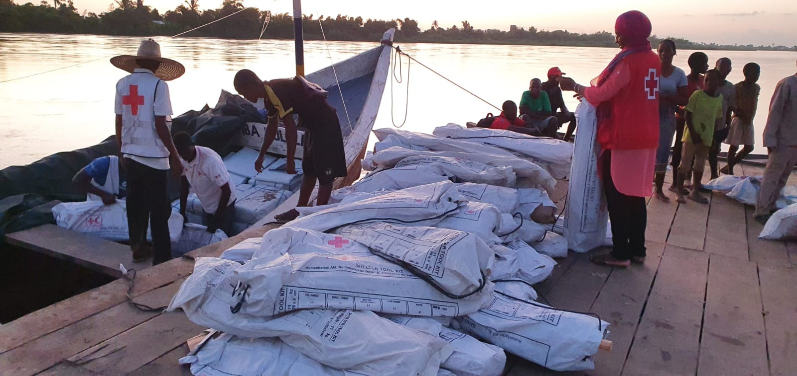
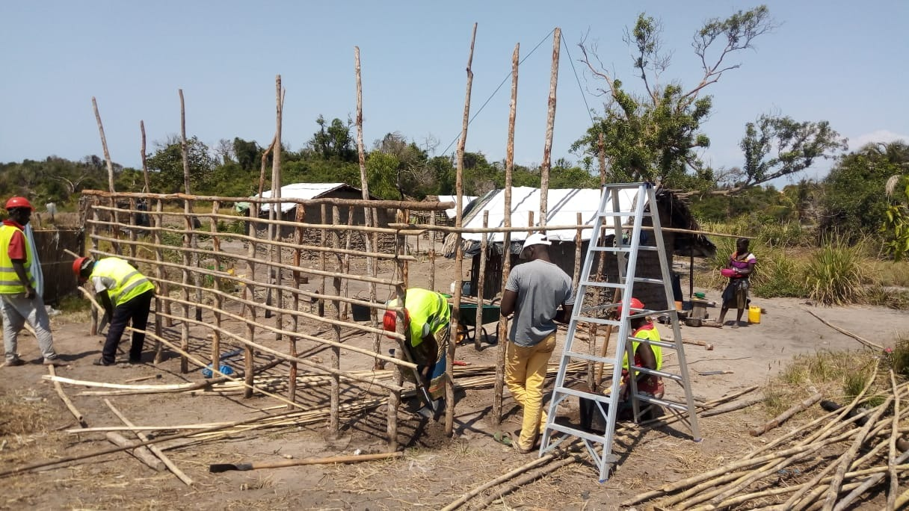

Step 3: Identifying Stakeholders & Audiences
“WHO”
Who are the most relevant target groups for which messages?

Slide 10
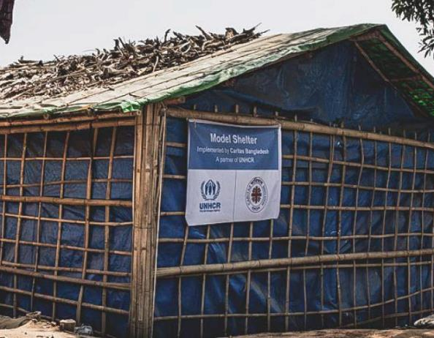
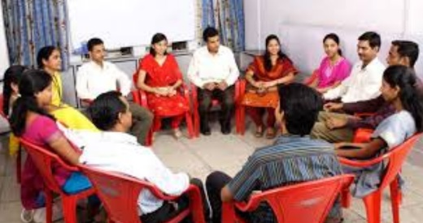
Step 4: Analysing Engagement pathways
(communication media analysis)
“HOW”
What type of communication works best for each of the different target groups?

Slide 11
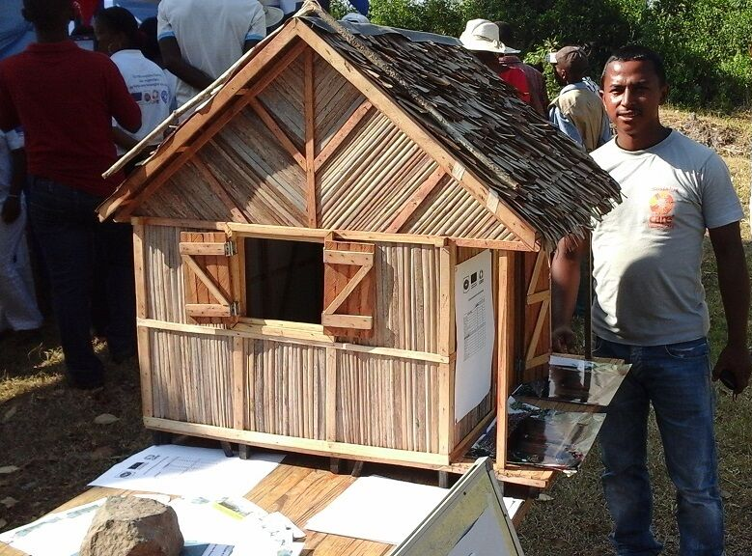
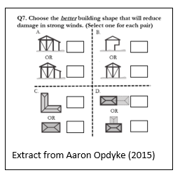
Step 5: Developing Detailed Messaging for different Audiences/Stakeholders and Engagement Pathways
Bring the “What”, “Who”, “How” together

Slide 12
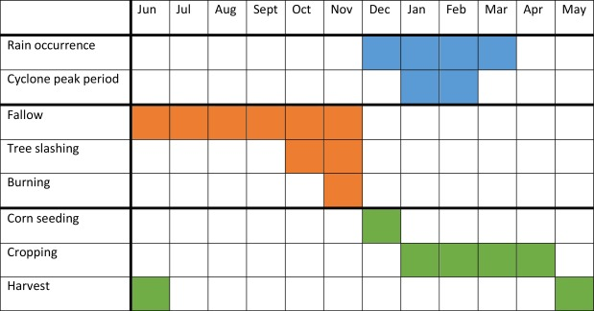
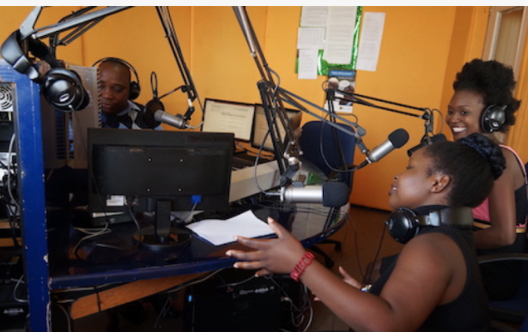
Step 6: Defining Roll-Out Strategy and confirming IEC objectives
“WHEN”what messages need to be communicated when?

Slide 13
Example of communications timeline– Post Crisis.

Slide 14
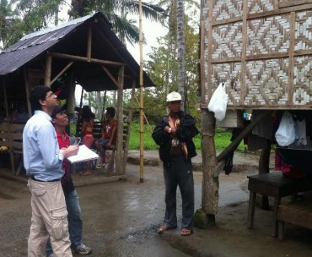

Step 7: Defining M&E Framework and process of revision

Slide 15
Step 0: Forming the Working Group
Step 1: Understanding the Context (KAP analysis, building practices, construction failure mechanisms, coping strategies, available materials, etc.
Step 2: Define IEC Preliminary Objectives
Step 3: Identifying Stakeholders & Audiences
DOESN´T HAVE TO BE A CONTINUUM – SOME STEPS CAN BE DONE IN PARALEL AND FEEDBACK OTHER STEPS
Step 4: Engagement pathways analysis
(communication media analysis)
Step 5: Develop Detailed Messaging for Audience/ Stakeholders and Engagement Pathways
Step 6: Define Roll-Out Strategy and confirm IEC objectives
Step 7: Define Monitoring, Revision and Evaluation
Framework

