Slide 1
17 September 2020
Urban Settlements Working Group
USWG
Urban
Settlements
Working Group

Slide 2
AGENDA
Topic | Speaker
Start-up | USGW co-chairs
1. Urban Housing Recovery- Case studies from Nepal and beyond (20 mins) Presentation Q&A | Housing Reconstruction and Recovery Platform (HRRP) Nepal – Urban working group chair Sneha Malani / Minar Thapa Magar
2. Beirut blast update (20 mins) Presentation Q&A | Shelter Sector Coordination Team – Maha Al Ayoubi Islamic Social Welfare Association – Tarek Bizri
3. Settlement approach guidance (5 mins) Brief Update Virtual workshop | USWG co-chairs
4. Any Other Business (10 mins) World Habitat Day Others | All
USWG
Urban
Settlements
Working Group

Slide 3
Housing Reconstruction Recovery Platform HRRP Nepal
URBAN HOUSING RECOVERY
Compilation of Case Studies from Nepal and Beyond
USWG
Urban
Settlements
Working Group

Slide 4
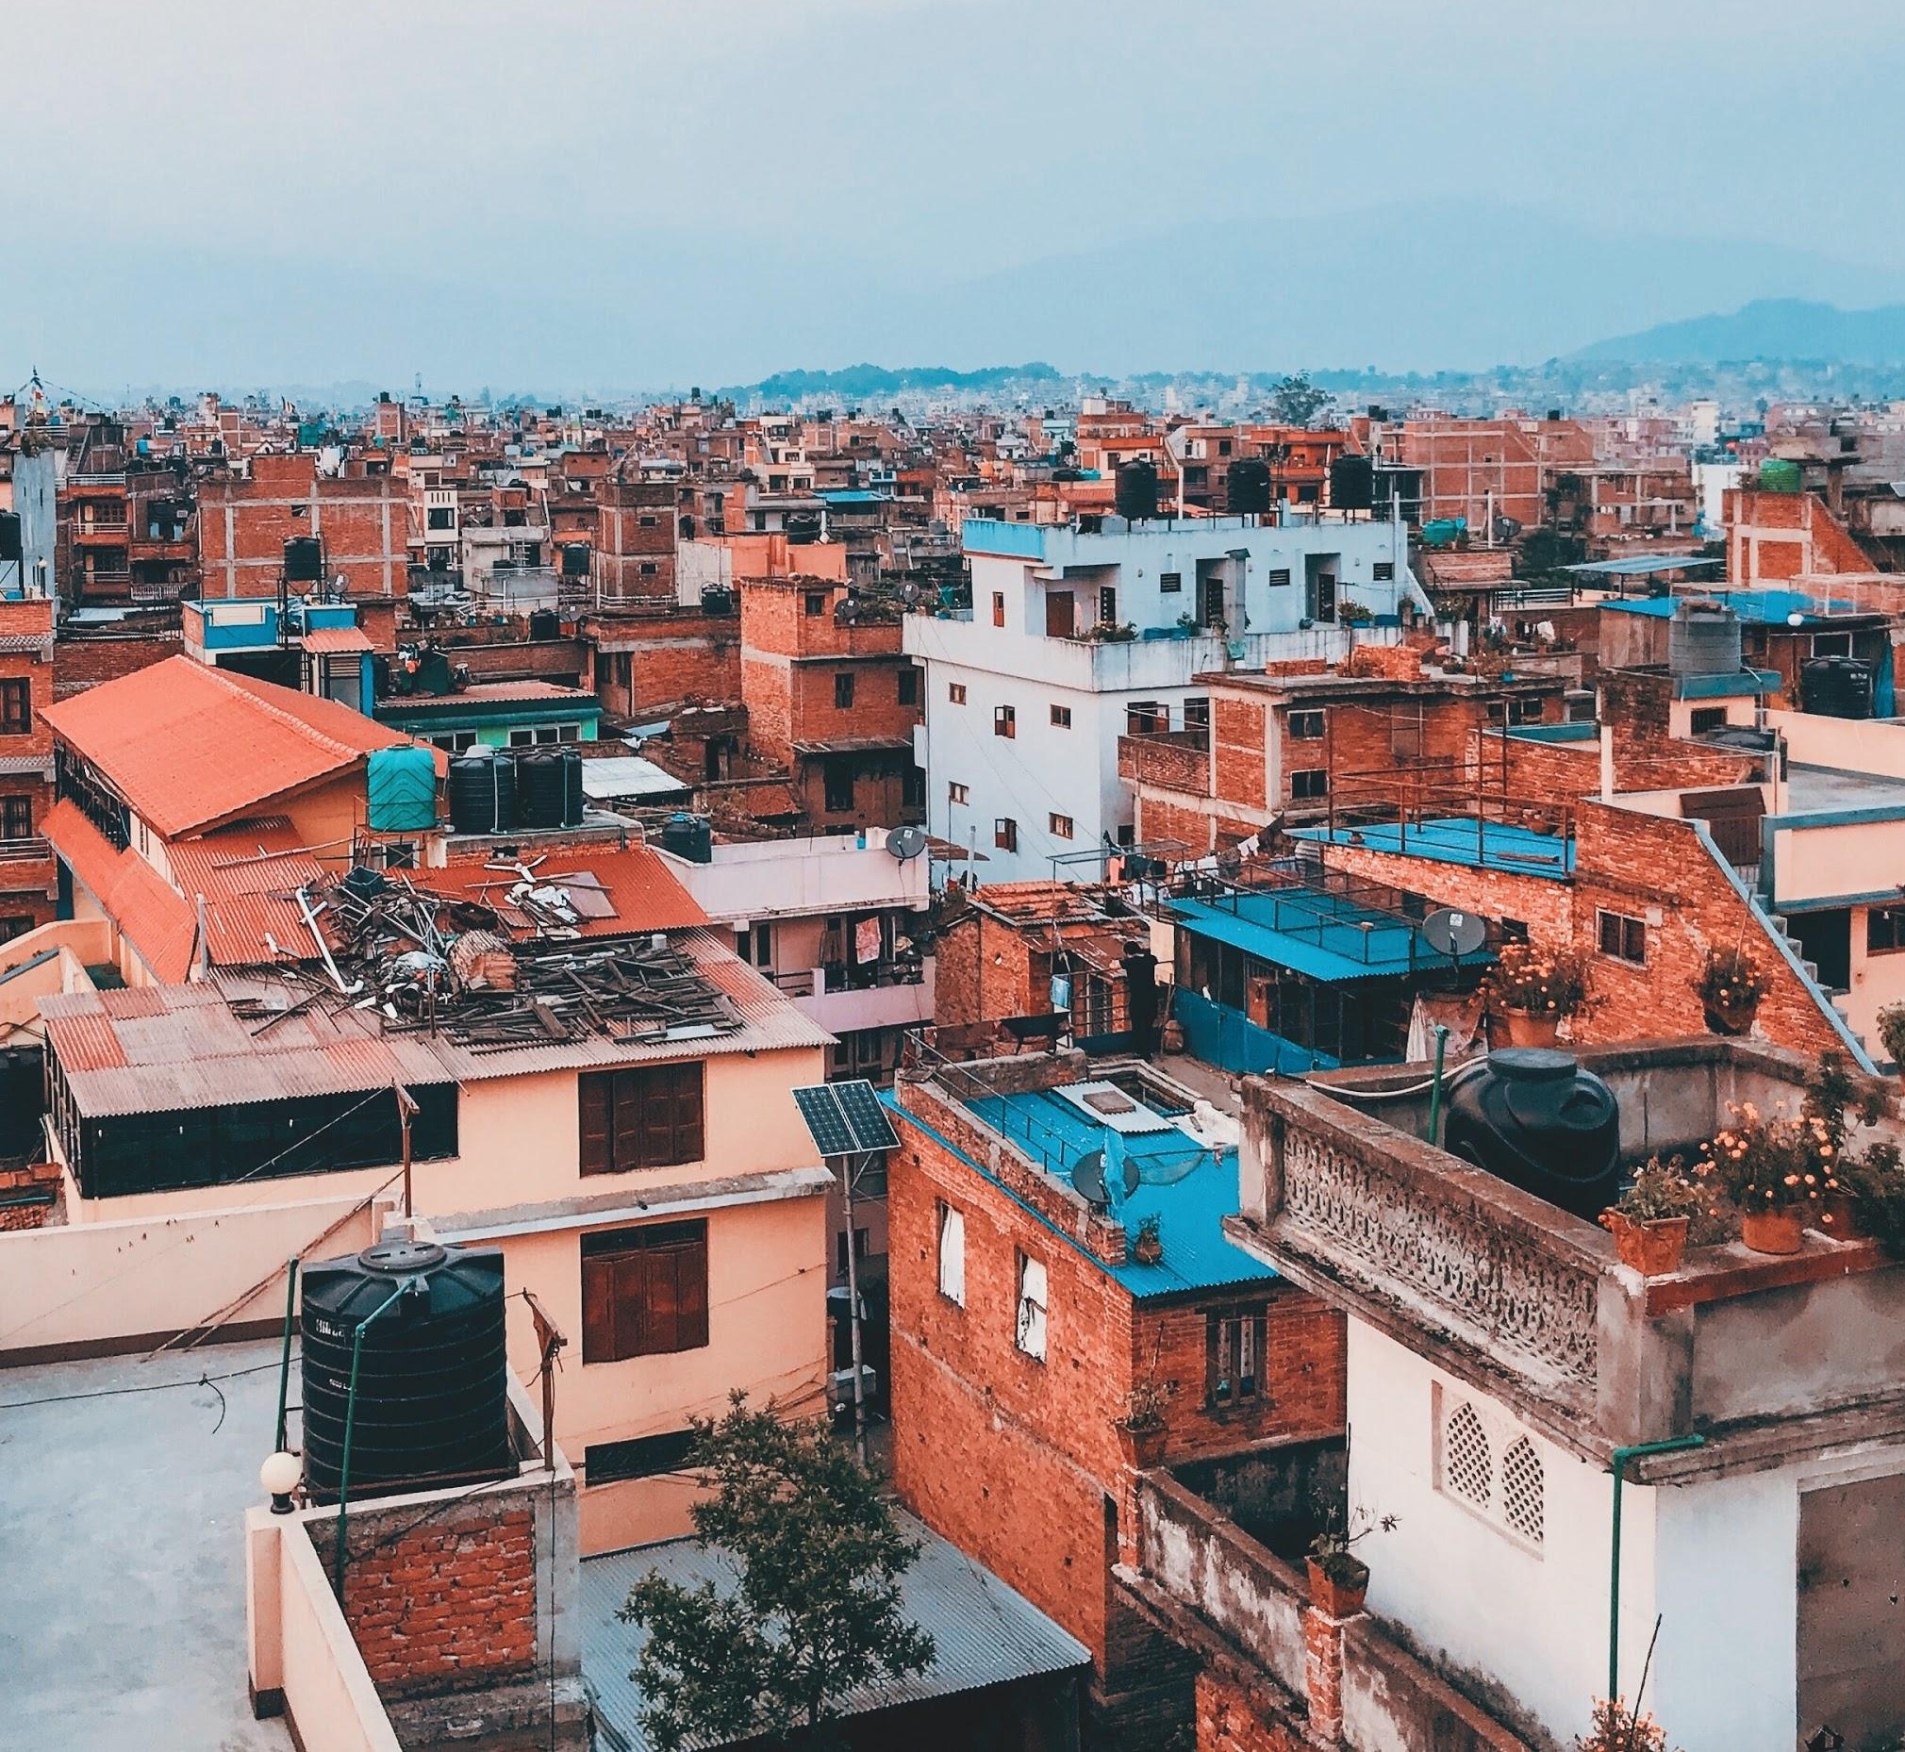

URBAN HOUSING RECOVERY
Compilation of Case Studies from Nepal and Beyond
CONTEXT
URBAN RECOVERY ISSUES
CASE STUDIES
1. FINANCIAL MECHANISMS
2. LAND AND HERITAGE
3. SOCIO-TECHNICAL ASSISTANCE
STRUCTURE OF COMPILATION
WAY FORWARD
Source: Unsplash
USWG
Urban
Settlements
Working Group
USWG
Urban
Settlements
Working Group

Slide 5
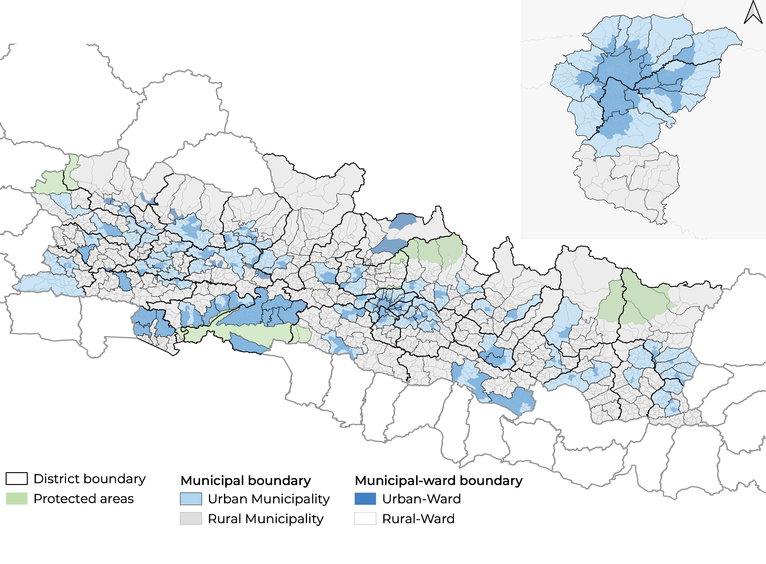
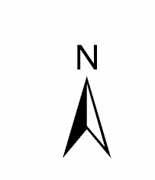
CONTEXT: THE GORKHA EARTHQUAKE 2015
Nepal is 80% rural (2018), fast urbanizing
Damage to over half a million homes.
30% damage in urban areas
NRA set up to lead recovery, cash grant and STA for recovery
Urban Recovery is slower than rural; 75% rural recovery complete compared to 60% urban
Urban Wards in Urban and Rural municipalities of Nepal
Source: HRRP 2020
USWG
Urban
Settlements
Working Group
USWG
Urban
Settlements
Working Group
Notes:
276 urban municipalities, and 460 rural municipalities
Nepal is 80% rural (2018), fast urbanizing
Damage to over half a million homes. 30% damage to urban areas
NRA set up to lead recovery
NRA cash grant for recovery
3,00,000 NPR (2500 USD) for reconstruction;
1,00,000 NPR (850 USD) for retrofitting
Urban Recovery slower than rural

Slide 6
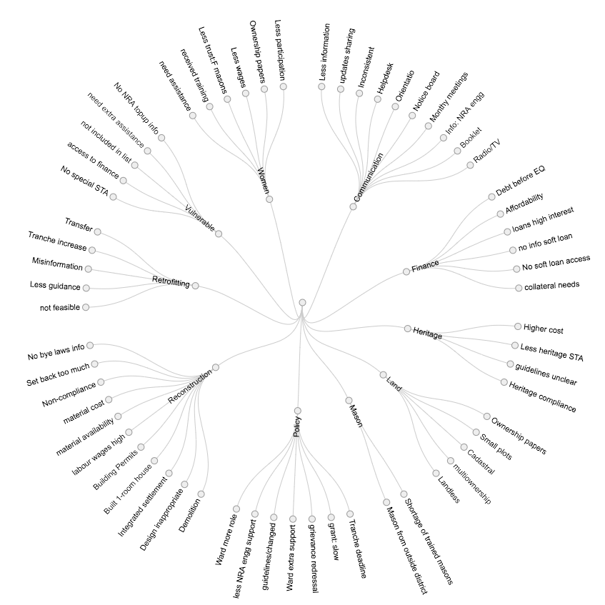
URBAN RECOVERY ISSUES
The Urban Technical Working Group’s Qualitative Study: identification and prioritization of urban recovery issues.
Source: HRRP 2020
USWG
Urban
Settlements
Working Group

Slide 7
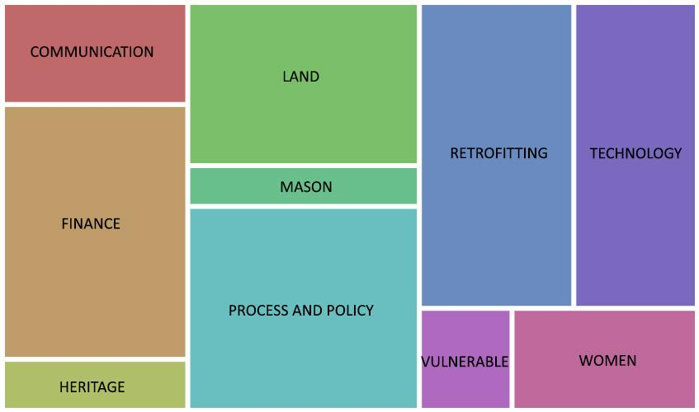
URBAN RECOVERY ISSUES
Finance, Land, Process and Policy, Retrofitting, and Technology categories consist of the highest number of prioritized sub-issues
Source: HRRP 2020
USWG
Urban
Settlements
Working Group

Slide 8
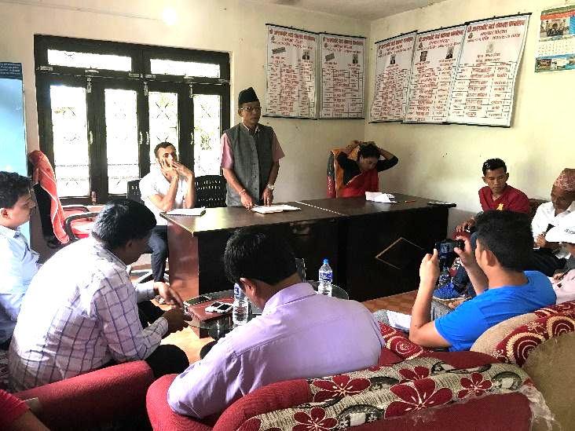
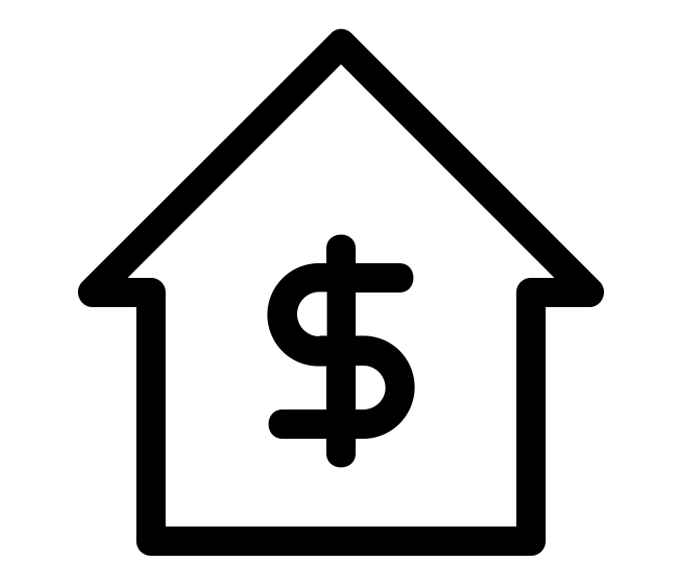


HOUSING RECOVERY FINANCE
Municipal level coordination meeting for revolving loan fund
High cost of reconstruction
Less access to soft loans
Private loans at high interest
Arughat Municipality Revolving Loan, Nepal
Lumanti’s Community Lending Model, Nepal
Women for the World’s Savings Model, Myanmar
Source: The Noun Project by Arthur Shlain; Daniel Grohotolski; Thuy Nguyen
Source: HRRP 2018
USWG
Urban
Settlements
Working Group

Slide 9
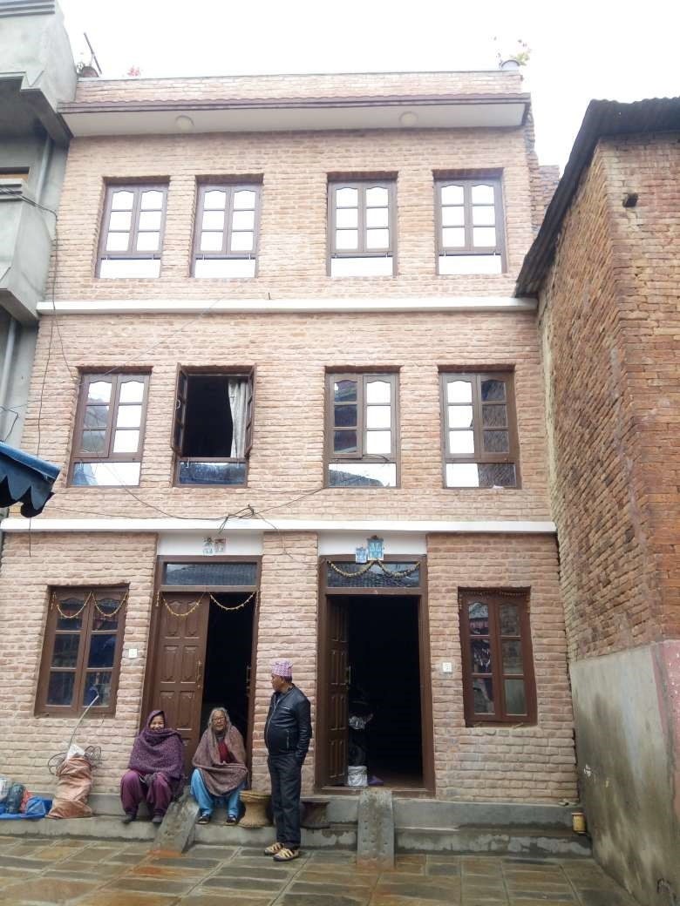
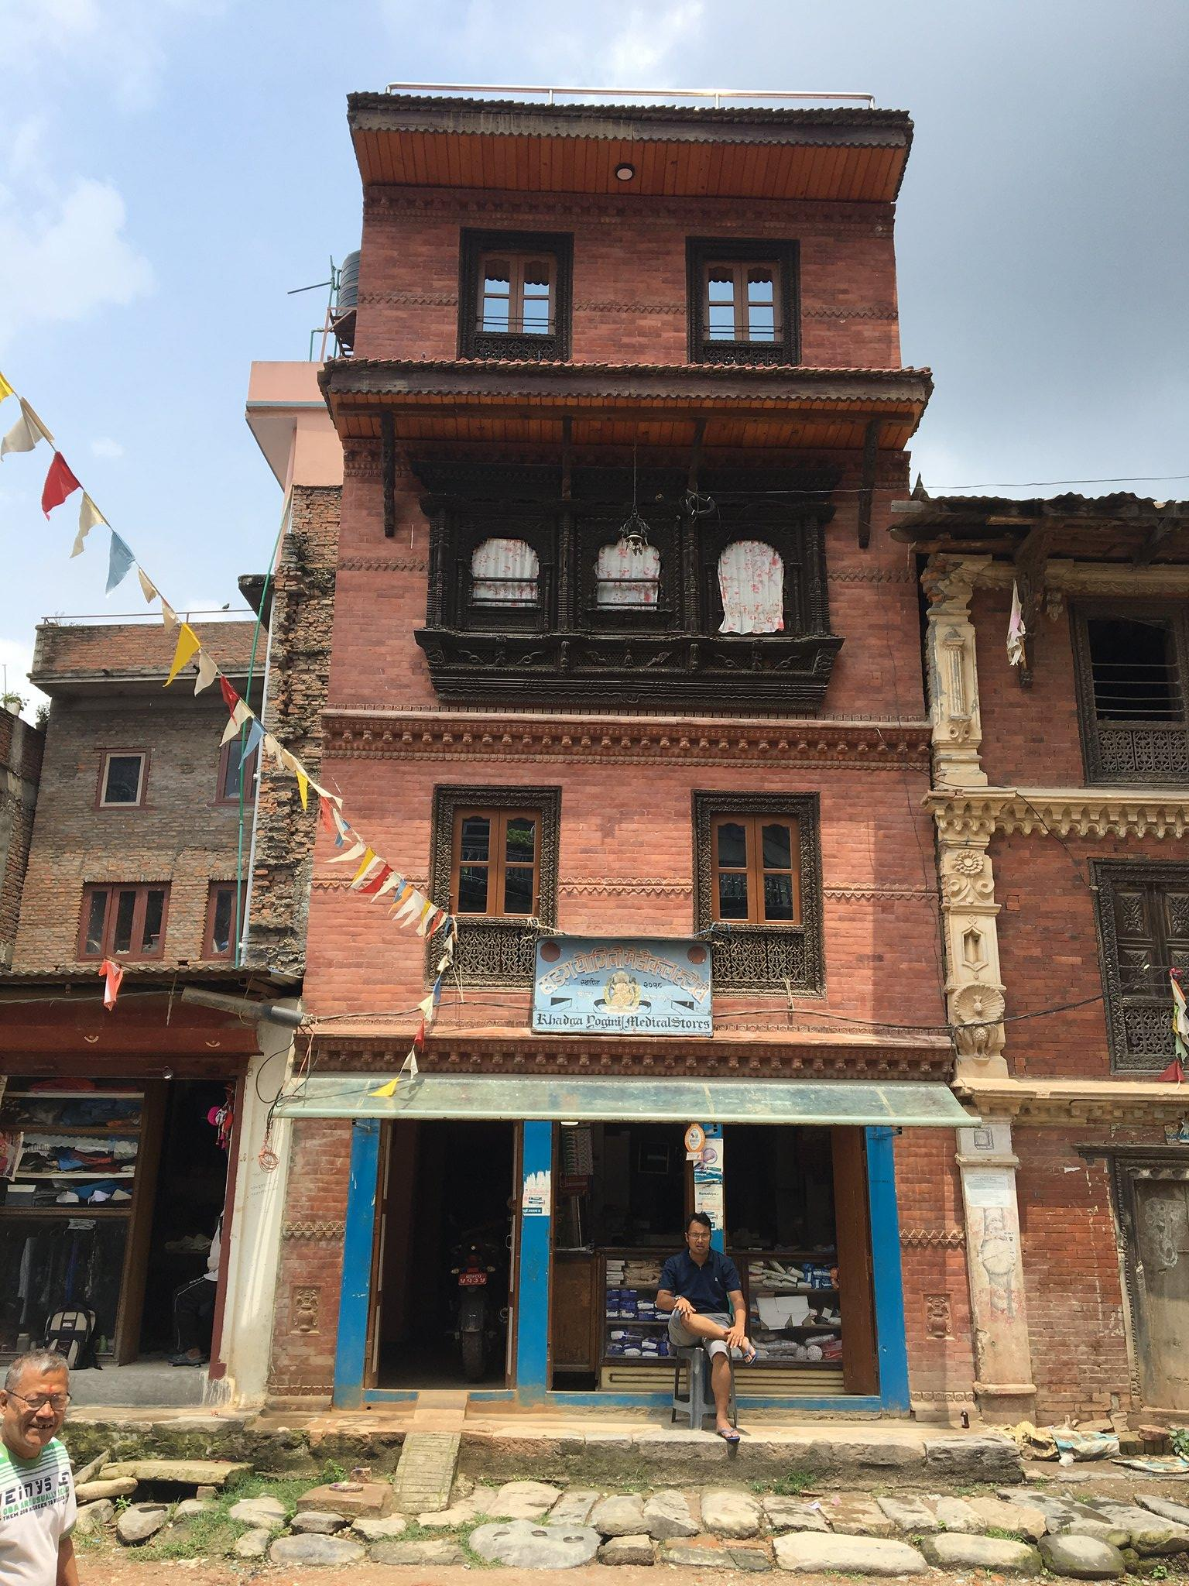




LAND & HERITAGE
Lack of land ownership papers
multiple ownership disputes
Left: Multiple ownership grant, Nepal
Right: Heritage compliance top-up grant, Nepal
Small plots
below threshold
Challenges in Heritage Compliance
Source: The Noun Project by Alfredo; Gan Khoon Lay; Icon Fair; Eucalyp
Source: HRRP, 2018
USWG
Urban
Settlements
Working Group

Slide 10

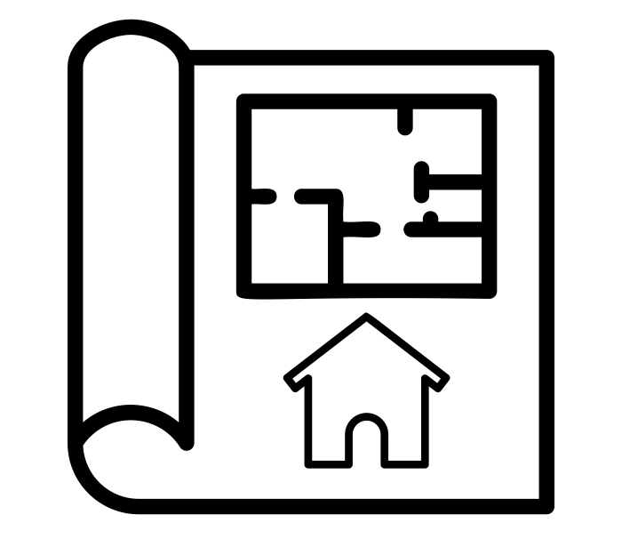
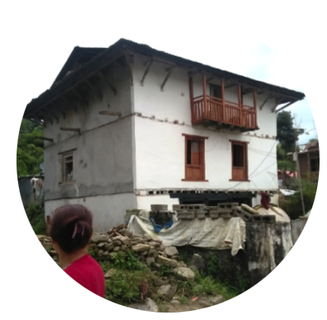
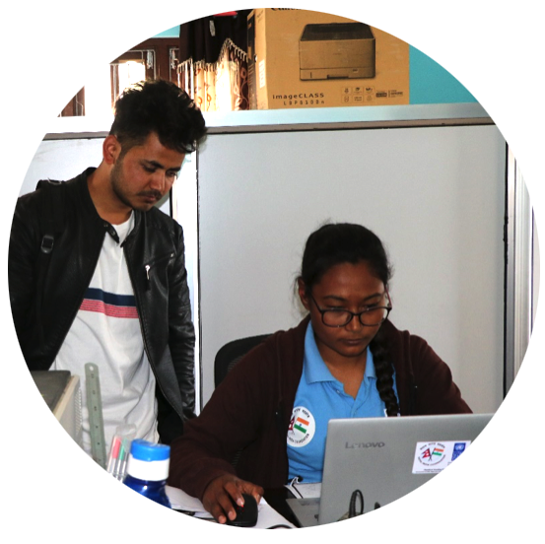
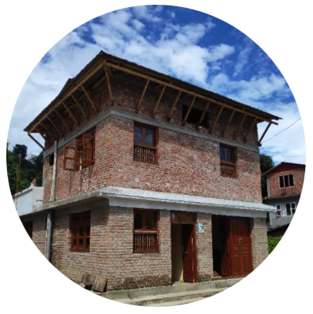
SOCIO-TECHNICAL ASSISTANCE (STA)
Retrofitting STA by NSET
(National Society for Earthquake Technology)
Building Permit Studios
UNDP
Long process, requirements unknown
Structural engineers and architects
no cost consultation, design and drawings
benefitted 3200 households
retrofitting training : masons, local authorities
Information through TV program; model houses
technical supervision
Source: NSET
Source: The Noun Project by Gregor Cresnar; Vectors Point
Source: UNDP
USWG
Urban
Settlements
Working Group

Slide 11
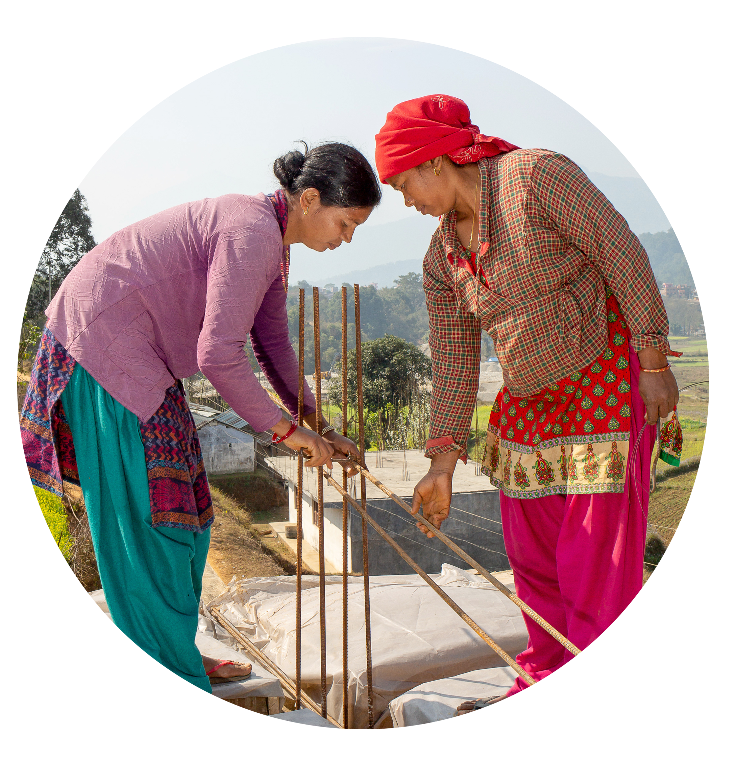
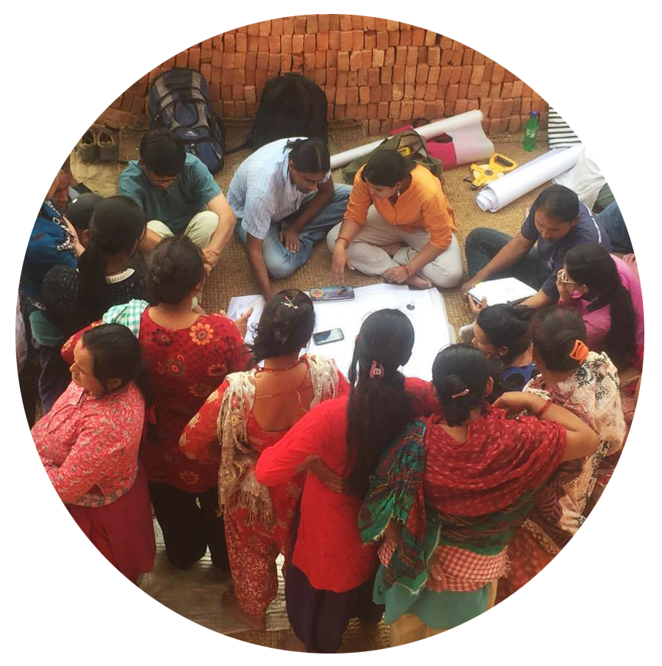
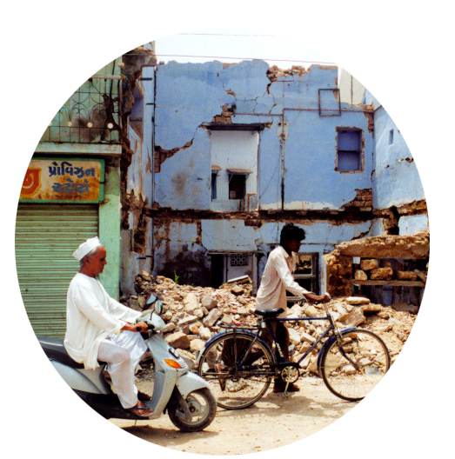
URBAN HOUSING
RECOVERY COMPILATION
1) HOUSEHOLDS’ PERSPECTIVES
KEYWORDS
mason training, gender gap, heritage reconstruction, NRA guidelines, land ownership, retrofitting, urban STA, documentation, governance, housing compliance, recovery finance
Source: CR/Jennifer Hardy
Compilation as a tool
Evidence-based advocacy
Short & long-term solutions
2) PARTNER ORGANIZATIONS
Lumanti, NSET, UNDP, The Asia Foundation, Arughat Municipality
Source:
Lumanti
3) GLOBAL
Philippines, Haiti, India, Chile, Afghanistan, Turkey, Myanmar,
Source:
Unsplash
USWG
Urban
Settlements
Working Group

Slide 12
WAY FORWARD
STAKEHOLDER ENGAGEMENT
KEY MESSAGES
Reconstruction Authority: Influencing The Urban Housing Recovery Strategy and Policy Reforms
Urban Ministry + Municipalities: Bridging the longer term urban resilience and Development
CRS: Urban Pilot. Urban STA Guidelines (Menus of solutions that can be adopted, scaled and replicated)
UR-TWG: Urban Recovery joint research and advocacy
Scaling community financing models
Capacity Building at municipality level
Link recovery program with development framework
Potential of retrofitting in urban areas
USWG
Urban
Settlements
Working Group

Slide 13

THANK YOU
Urban Housing Recovery
Compilation of Case Studies from Nepal and Beyond here
To know more about HRRP’s work and publications, visit https://www.hrrpnepal.org/
Source: Unsplash
USWG
Urban
Settlements
Working Group

Slide 14
Beirut Blast response
Shelter Sector coordination
USWG
Urban
Settlements
Working Group

Slide 15

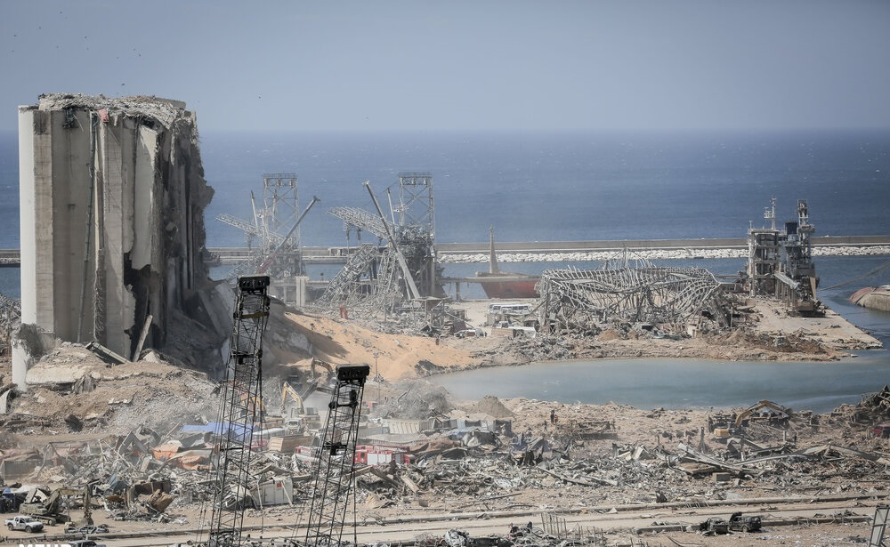
Beirut Port Explosions:
Shelter Sector Overview
Photo: Mehr News Agency

Slide 16
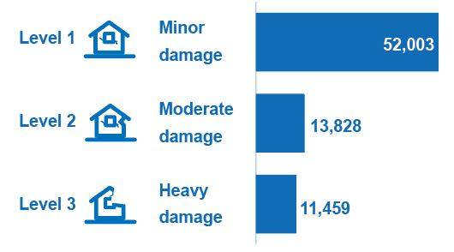

Overview of needs (based on 4 Sept. MSNA data)
MSNA coverage to date:
  2,833 buildings assessed
    21% of total in affected area
  12,305 apartments assessed
    12% of total in affected area
77K
Estimated damaged apartments (total)
291K
People in need
171K
People targeted

Slide 17
Overview of response strategy
Outcomes | Outputs | Activities
1: Response to immediate shelter needs of most vulnerable HHs. | 1.1: Access to safe and liveable residential units is increased through temporary shelter assistance | 1.1.1: Emergency weatherproofing of damaged residential buildings
 |  | 1.1.2: Provision of temporary shelter to displaced individuals
 |  | 1.1.3: Provision of conditional cash for rent to displaced individuals
2: Contribute to longer term repair or rehabilitation and occupancy of damaged buildings | 2.1: Access to adequate residential/ non-residential units for affected populations is increased | 2.1.1. Minor repair of residential / non-residential units
 |  | 2.1.2. Rehabilitation of residential shelters
 |  | 2.1.3. Rehabilitation of common areas within residential units
 |  | 2.1.4. Rehabilitation of structural damages within residential buildings
3: Support multi-sectoral approaches to rehabilitate affected areas | 3.1: Affected community assets and spaces reconstructed for enhanced safety and resilience | 3.1.1: Implementation of community support projects in affected areas
 |  | 3.1.2: Capacity building of national institutions and organizations on shelter response
 |  | 3.1.3: Prod. of assessment studies that are made accessible and widely disseminated

Slide 18
Coordination of shelter actors
Beirut Blast response leads: UNHCR, NRC, UN-Habitat
49 shelter agencies involved in the BB response (28 in FA)
Temporary Technical Committees providing guidance on:
  Cash for Rent
  Rehabilitation/Minor Repairs
  Housing, Land and Property (intersectorial TTC:Protection and Shelter)
Coordination with the Forward Emergency Room is ongoing
Inter-sectoral coordination inside and outside the EOC
Notes:
Coordination of partners by geographical area, capacity + activity over affected area
Capacity assessment of partners
Socio-economic categorization of operational zones
Assignment of partners to zones for assessments, emergency distributions, repairs/rehabilitation
Technical guidance
TTCs are subject determined time bound towards provision of technical guidance
Temporary Technical Committees for each of minor repairs and rehabilitation, cash for rent and HLP
New guidelines for HLP will come out soon; response to structurally unsound buildings pending further assessments and coordination with other actors.
Coordination ongoing with the Forward Emergency Room managed by LAF designated to mange the operation from the government side.
While the OCHA managed EOC provide inert sectoral coordination, additional bilateral coordination also takes place specifically with protection and WASH sectors.

Slide 19
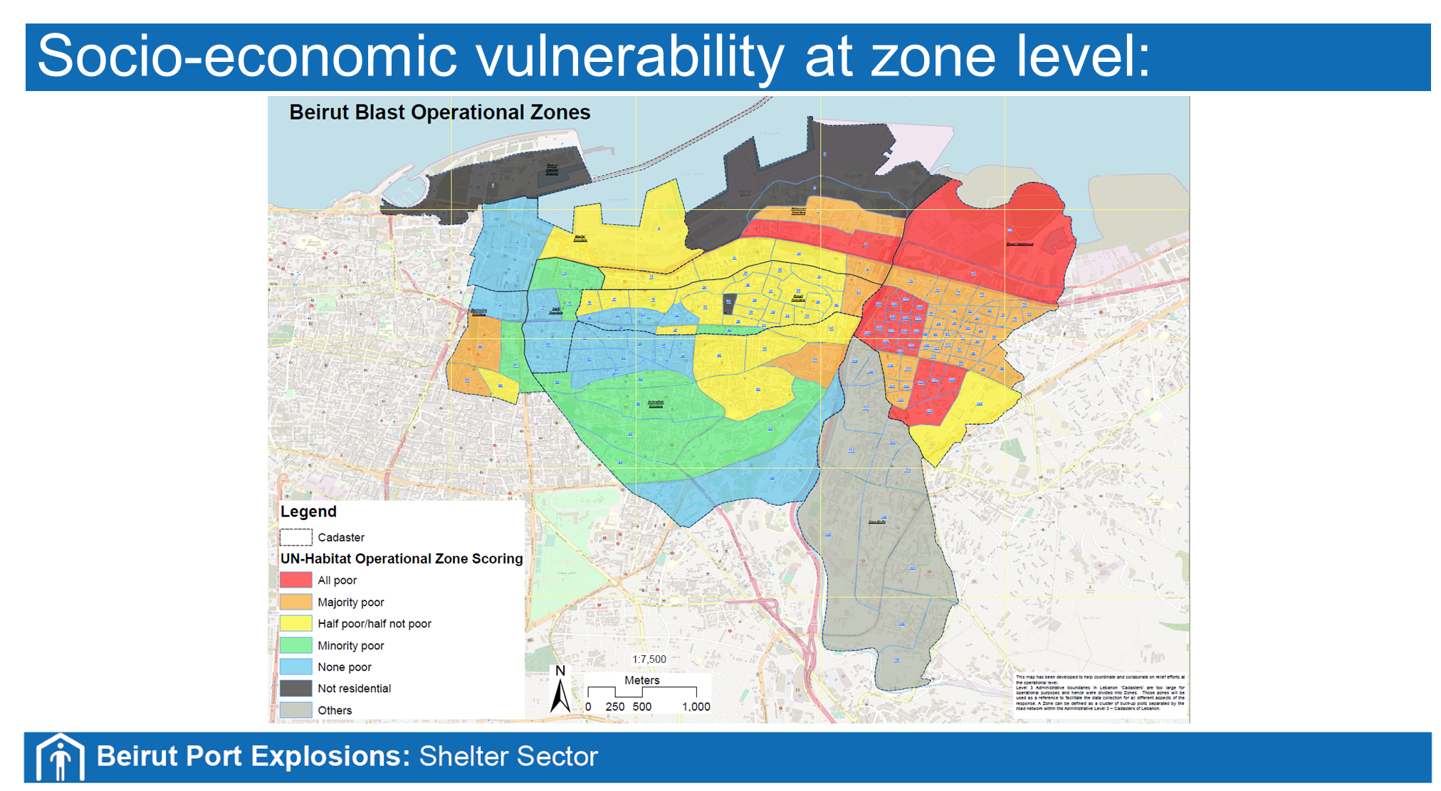

Slide 20
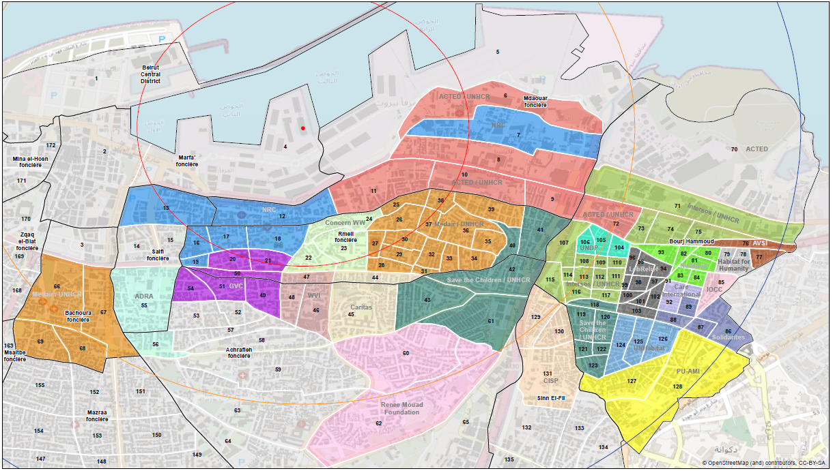
Shelter response to date - geosplit

Slide 21
Overview of gaps and challenges
 | Minor repairs | Residential rehabilitation
Estimated need | 52,000 (100%) | 14,000 (100%)
Existing immediate capacity | 8,576 (16%) | 1,911 (14%)
Projected capacity | 10,130 (19%) | 4,140 (30%)
Immediate + projected capacity | 18,706 (36%) | 6,051 (43%)
GAP

Slide 22
Overview of gaps and challenges
Scale of damage
Shelter agencies present immediate capacity
Coordination on the ground
Vulnerability
Currency devaluation
Funding
Balancing physical reconstruction with tenure security approach
Community participation
Advance housing agenda in Lebanon
Notes:
Scale of damage
Vast areas of damage, at various levels, requiring extensive damage surveying to inform detailed Shelter response (both immediate humanitarian + early recovery)
Sector immediate capacity
Shelter sector progressively underfunded for several consecutive years; immediate capacity on ground limited; funding to urban response historically weaker than to informal (tented) settlements response; BML least partner coverage of all regions
Structural unsoundness of buildings is a feature of this incident; responding to unsound buildings is included in appeal but is new ground for sector
Coordination
Presence of numerous non-traditional local shelter actors working outside - or newly introduced to - coordination mechanisms, humanitarian and local sector standards.
The emerging role of LAF as an official coordinator from GoL side as opposed to the previous role of Ministries.
Cross-sectoral local coordination does not feed into top-down coordination and is not sufficiently paralleled by an inter-agency communication between sectors.
Internally, there is space for more systematic coordination across sectors (Protection and Shelter as an example).
Externally, harmonisation of coordination mechanisms with LAF, possibly also municipalities, ensuring adequate protection of personal data for beneficiaries.
Vulnerability
Emerging vulnerabilities of non-refugee populations (Lebanese and Migrants) with no long-standing understanding of their specific vulnerabilities.
Currency devaluation
Most of materials needed are imported; response is exposed to lira devaluation
Tenure security
Funding
Minor repairs and residential rehabilitation (secured + pipeline) are, respectively, 64% and 57% underfunded relative to est. needs (in terms of residential unit count)
Balancing physical reconstruction with tenure security approach
Mainstreaming of HLP, Gender and PSEA among all actors, including governmental and official actors.
Complex HLP issues at household, but also at neighbourhood, levels in some instances (Urban informalities)
Community participation
Enhancing community engagement while ensuring proper navigation of governance structures especially with non-state actors.
Advance housing agenda in Lebanon
Shelter sector's leading role, including via 3RF housing sector, in fostering an enabling environment for more inclusive housing market, + construction markets that contribute to the local economy.

Slide 23
Lebanon 3RF – proposed pillars (draft)
Improving Governance & Accountability
EU & WB
Basic Services
Health
Education
Infrastructure
Transport & Port
Jobs & Economic Opportunities
WB
Strengthening social cohesion & resilience
UN
Improving Services & Infrastructure
WB & UN
Productive and Financial Sectors
Social Protection
Social Sustainability and Inclusion
Energy
Environment
Municipal Services
Commerce & Industry
Financial Sector
Tourism
Macro-Economic Stabilization
Housing
Public Financial Management
Accountability & Transparency
Private Sector Enabling Environment
Culture
Governance
Water Supply and Sanitation

Slide 24
Beirut Blast response
Islamic Social Welfare Association
USWG
Urban
Settlements
Working Group

Slide 25




^{ISWA}
is a charitable non-profit organization, established in 1985, aiming at supporting orphans and children with special needs, individuals suffering from addiction, helping the society in overcoming daily burdens and assisting civil society organizations in various relief, welfare and sustainable development works.

Slide 26

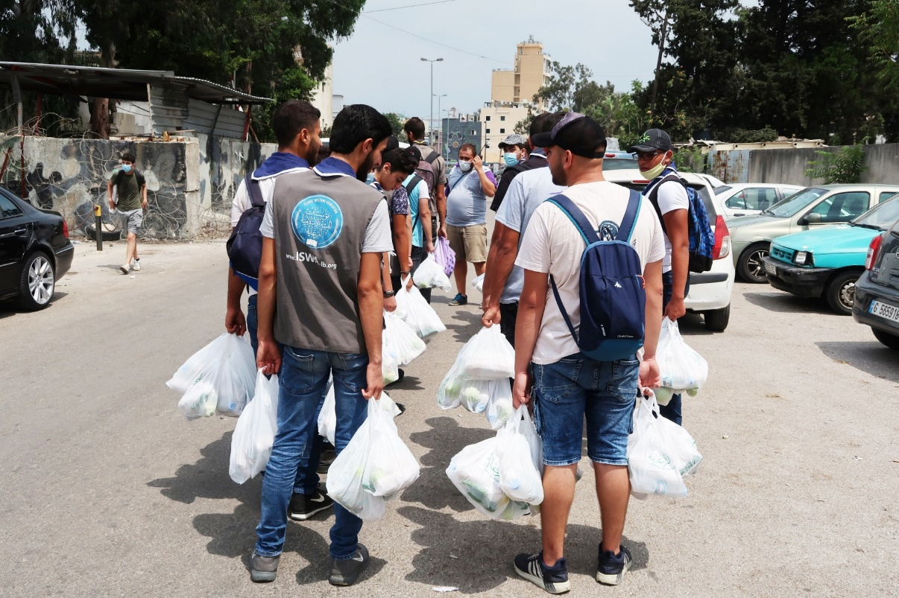
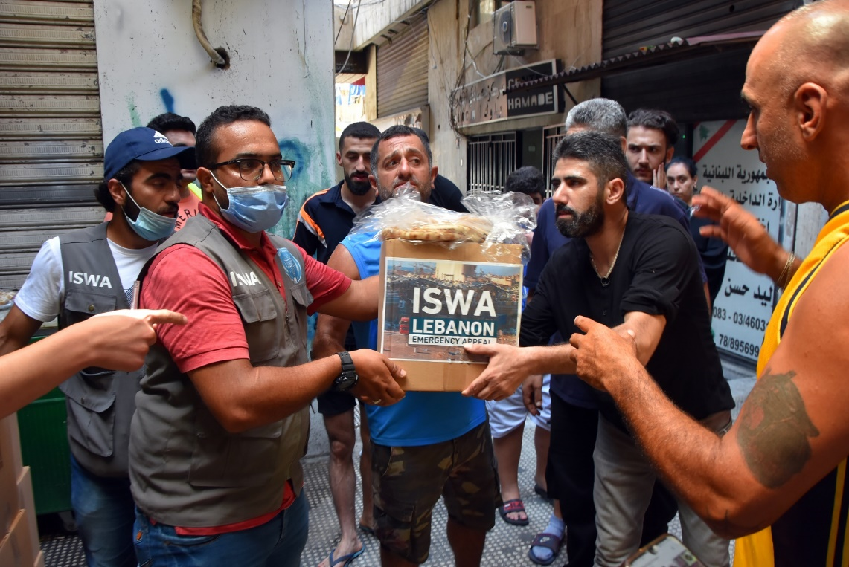
Since August 6th, our relief team is on the ground to provide emergency assistance to those affected by the blast. The team set up in two severely impacted locations in Beirut: Karantina and in Al Roum hospital area.
On August 10th, in collaboration with the municipality of Saida and the Union of NGOs in Saida, a convoy of cars, trucks, ambulances, mobile clinic and fire truck was deployed. Vehicles were loaded with food packs, cold meals, clothes, water (non-drinkable and drinkable), to be distributed to families in the target areas, in Beirut. A total of 250 volunteers and personal from ISWA, the Municipality of Saida and local organisations help during the distribution work. Nurses and doctors were providing first aid and medical check-ups to those in need.

Slide 27
The main challenge:
Lack of effective coordination between all the actors in the field.
The large number of organisations in the field makes it very difficult to coordinate the work. It comes out of the challenges in terms of:
  Risk of duplication,
  Loss of time (after almost 1,5 month, a lot of persons live in their houses without windows),
  Risk of leaving person/family behind.
Ex. At the beginning of the intervention, we had to cancel a house repair because the families was already supported by another organisation. From now on, we take further measures to avoid such event.
  The large size of Beirut makes these challenges harder to mitigate. Some houses have been damaged even though they are located more than 9 km from the port.

Slide 28
Other challenges:
Threat of Rain
Lack of funds

Slide 29
The strengths:
The timeline for each house being rehabilitating is short (maximum of 5 days)
4 teams present on the field
Strong relationship with the target communities
Regular coordination with local NGOs

Slide 30
The Shelter program
Target population: Nationals and Non-nationalities
Target locations: Achrafieh, Mar Mikhael, Karantina, Burj Hammoud, Getawi.
Main activities:
  Assessments of needs per household;
  Clearing up rubble and glass from the streets;
  Repair damage houses and provide logistics support: clearing, windows and doors replacement, painting, electric wiring, telephone network, sanitary, etc
  Refer families to other services when needed

Slide 31
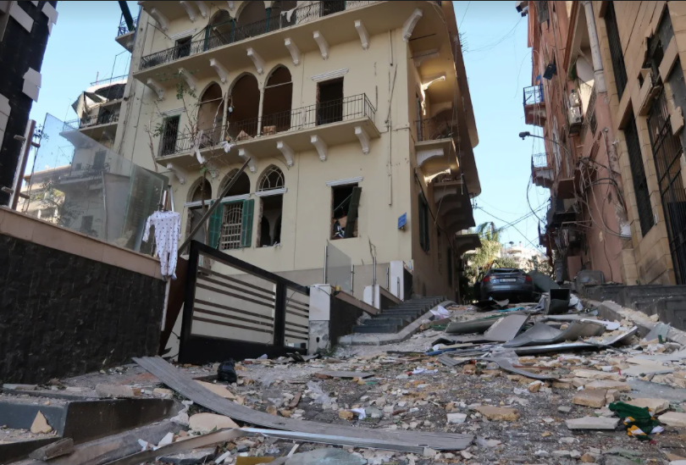
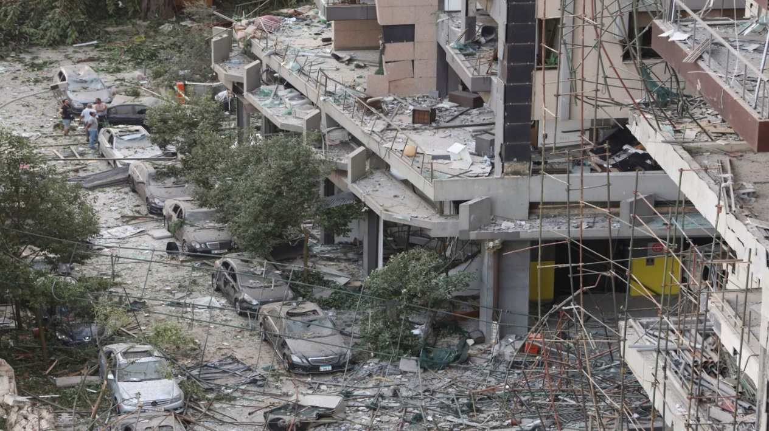
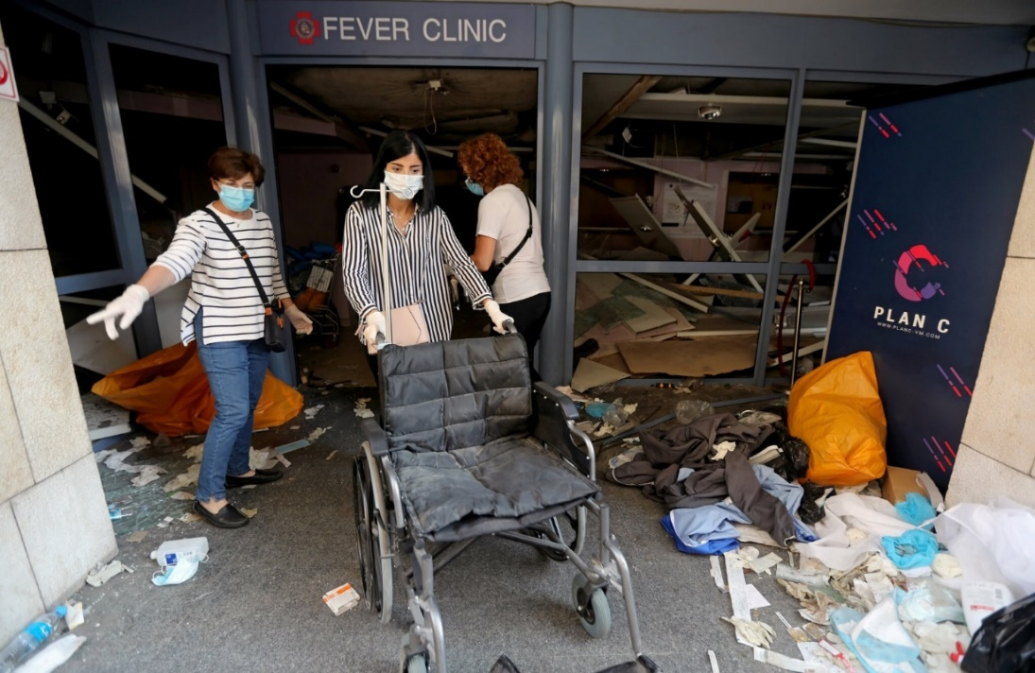
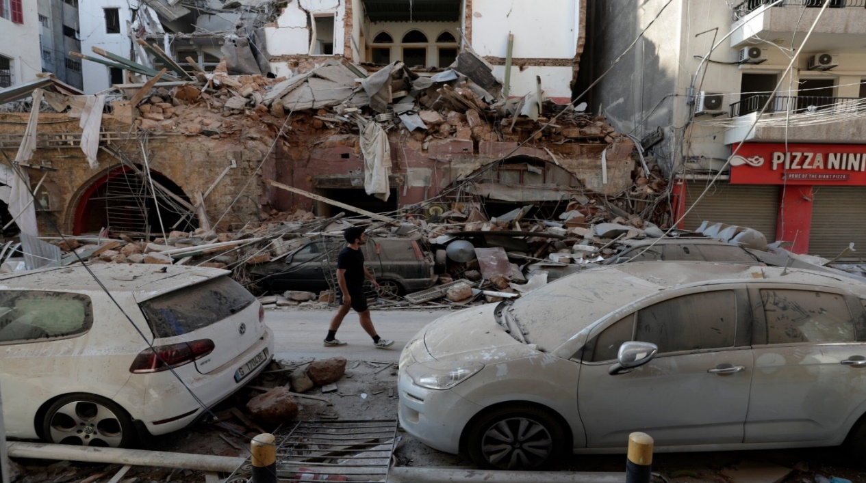

Slide 32
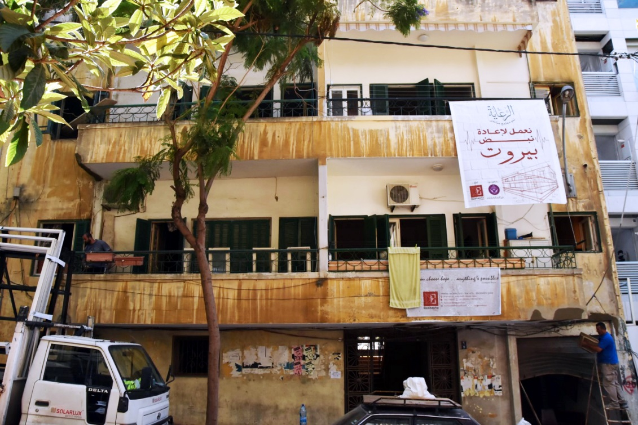
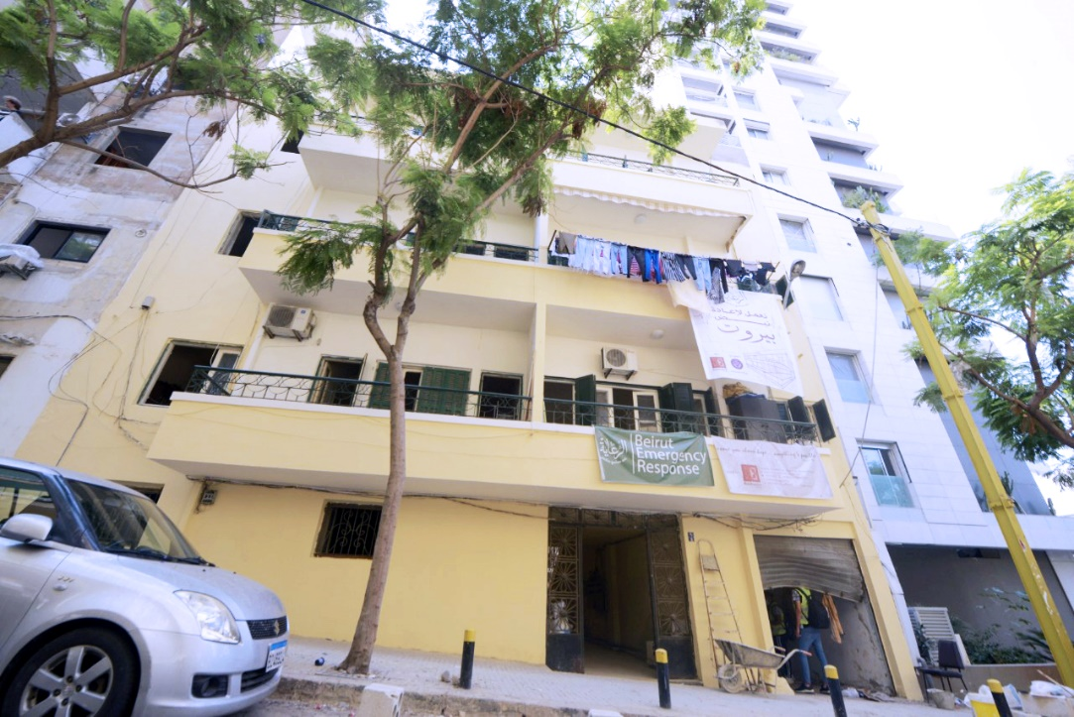
Before
After

Slide 33
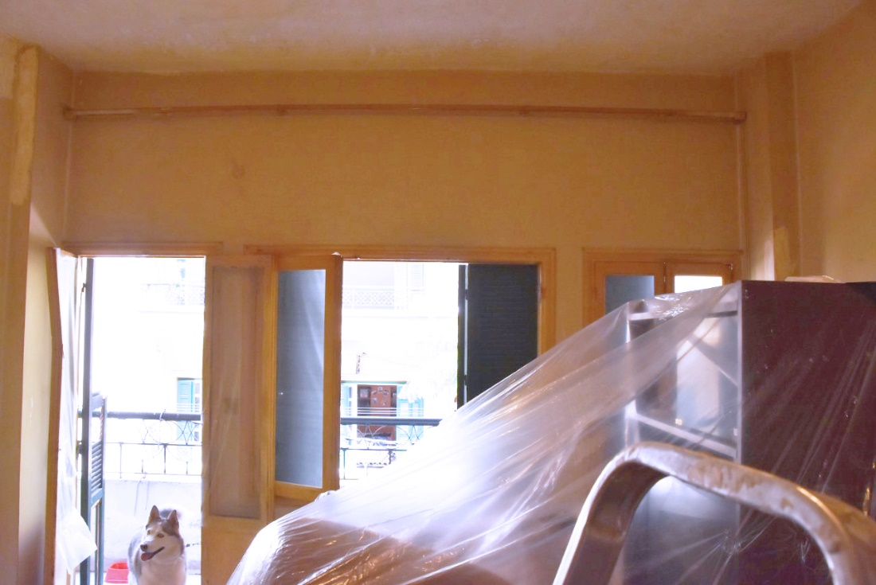
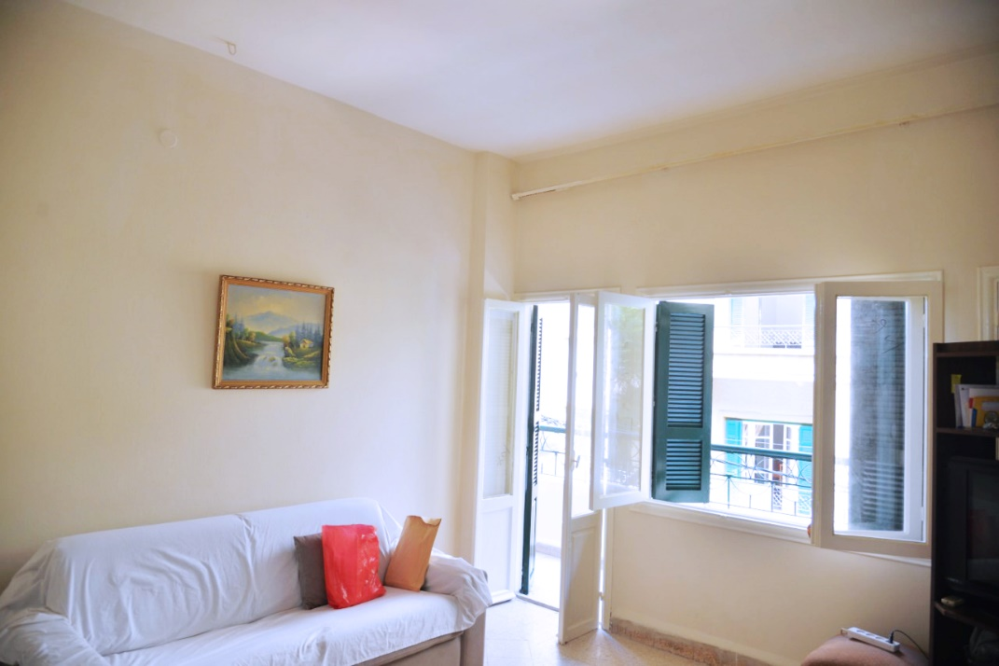
Before
After

Slide 34
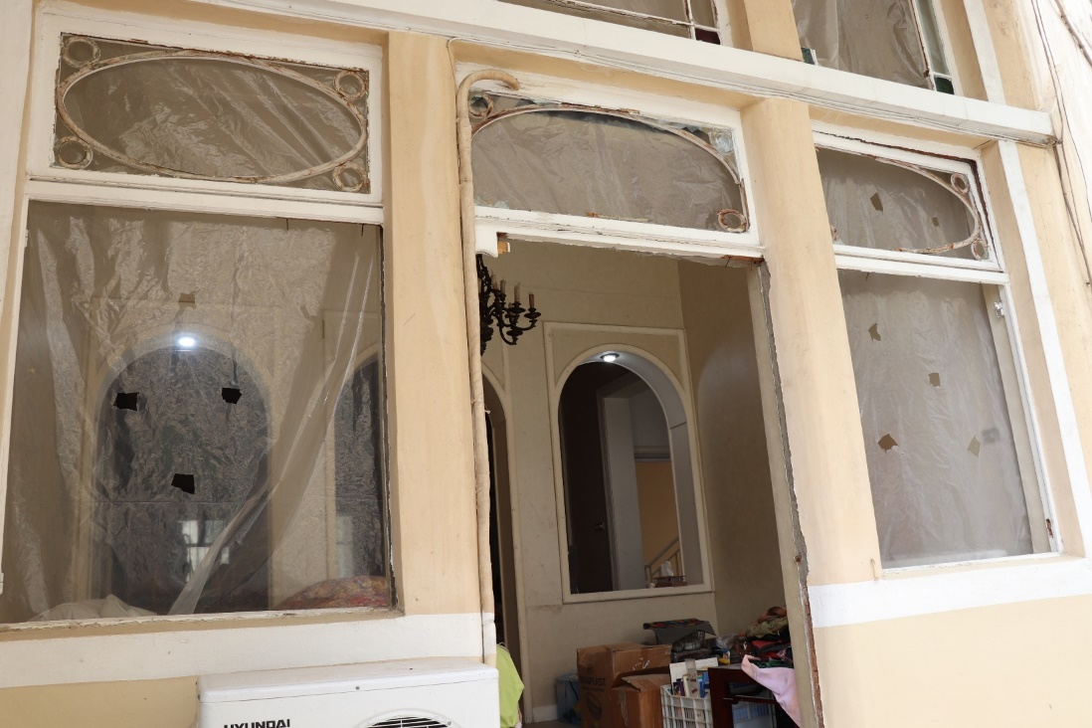
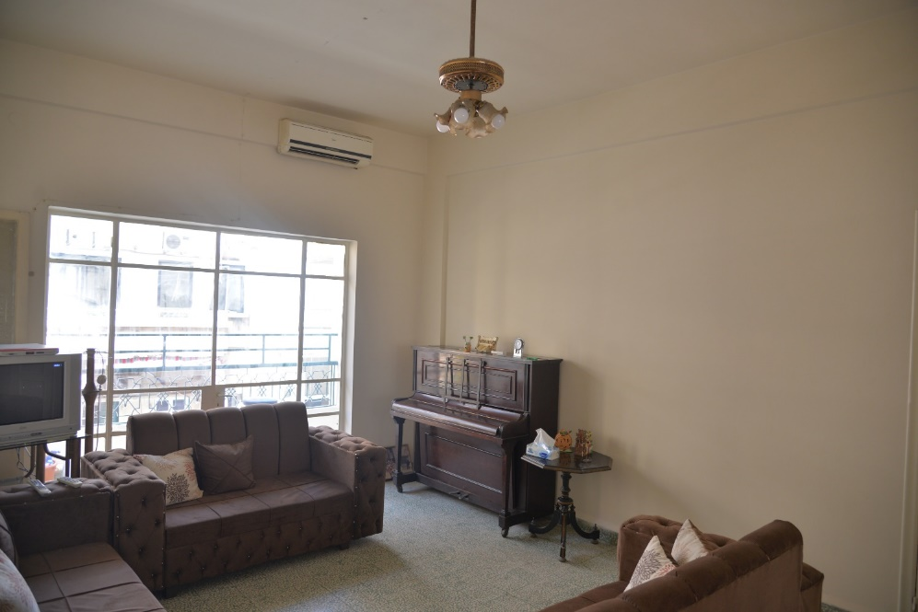
Before
After

Slide 35
Questions?
USWG
Urban
Settlements
Working Group

Slide 36
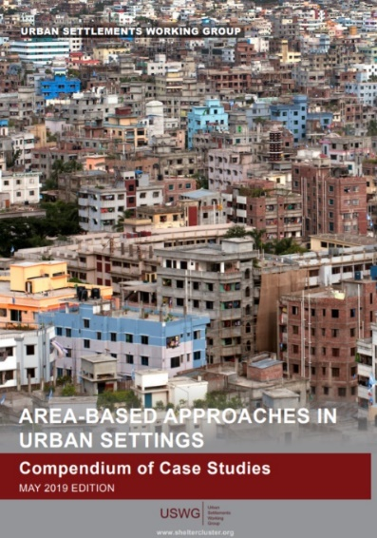
Settlement Approach Guidance
Drafting process
Starting point of guidance being the learning from practice ie. Case studies. Funded under GSC ECHO grant
- Regional / global consultations
  Geneva, Lombok, BKK, Jordan, Philippines
-Field visits
  Iraq / Tacloban
- Structure created for the drafting process, steering group, peer reviewers, authors and secretariat.
Timeline;
  - Draft 1 created by thematic expert authors,
  - Peer reviewed / check in with OFDA (BHA)
  Editing – Kate Murphy
  Draft 2 issued to Authors to re-work (Aug)
  Final Edits (now)
  Virtual workshop – (share with WG members)
  Finalisation
USWG
Urban
Settlements
Working Group

Slide 37
Thanks to
Authors and Peer reviewers
Chapter Authors | Peer Reviewers
Eva Suarez Gareth Lewis Harriette Purchas Fiona Kelling Laura Heykoop Tom Bamforth Jim Kennedy Giovanna Federici Anna Hirsch-Holland James Schell | ECHO, CCCM, UNDP, OCHA, ACTED, AECOM, JIPS, OFDA (BHA)
Editor; Kate Murphy
USWG
Urban
Settlements
Working Group

Slide 38
Title 1
Guidance Note Table of Contents
Introduction to the settlements approach
Characteristics of the settlements approach
Implementing the settlements approach
USWG
Urban
Settlements
Working Group

Slide 39
Chapter 1
Introduction to the settlements approach
1 Introduction to the settlements approach
1.1 What is the settlements approach?
1.2 Why use the settlements approach?
1.3 Key benefits of the settlements approach
1.4 When is the settlements approach appropriate?
1.5 How does the settlements approach complement existing approaches?
1.1 What is the settlements approach?
1.2 Why use the settlements approach?
1.3 Key benefits of the settlements approach
1.4 When is the settlements approach appropriate?
1.5 How does the settlements approach complement existing approaches?
USWG
Urban
Settlements
Working Group

Slide 40
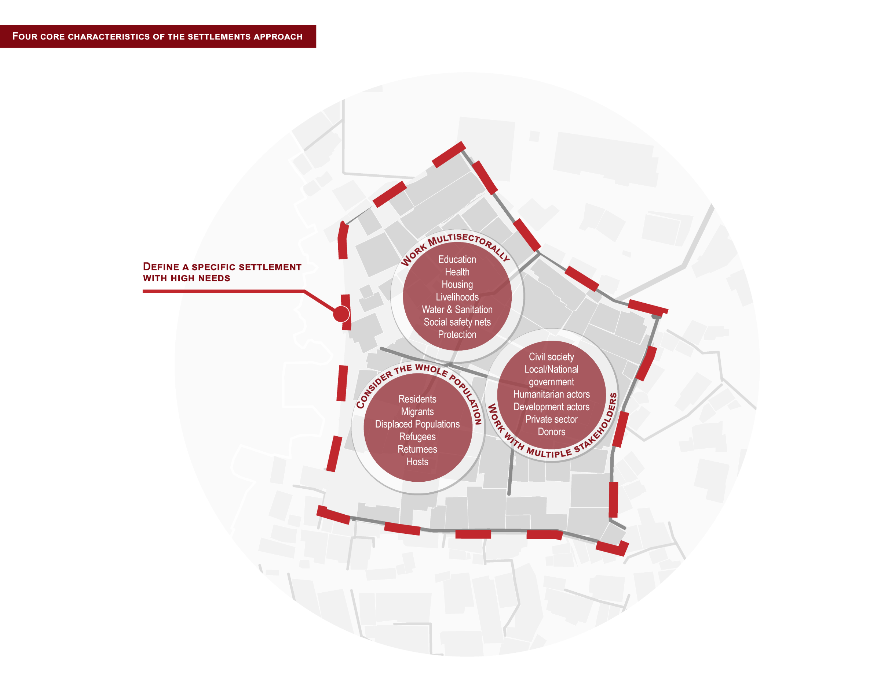
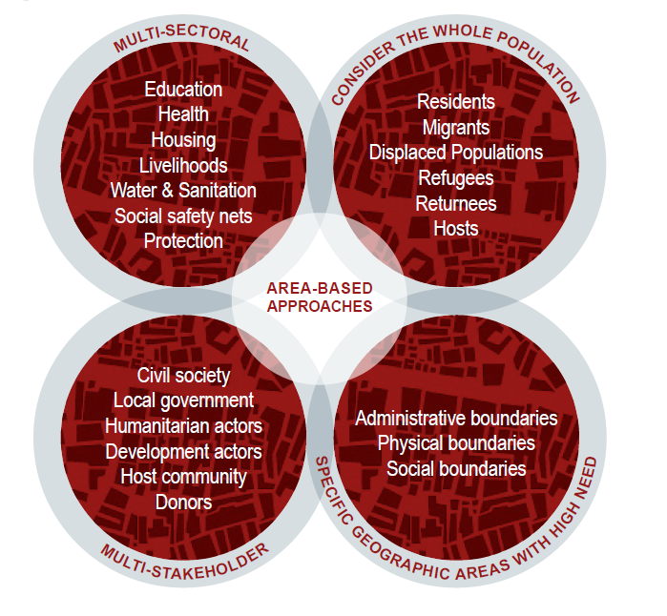
Characteristics of the settlements approach
Settlement approach
Previous diagram
New diagram
USWG
Urban
Settlements
Working Group

Slide 41
Chapter 2
Characteristics of the settlements approach
- Key principles
1 Introduction to the settlements approach
1.1 What is the settlements approach?
1.2 Why use the settlements approach?
1.3 Key benefits of the settlements approach
1.4 When is the settlements approach appropriate?
1.5 How does the settlements approach complement existing approaches?
2.1 It recognizes that a settlement is defined by both physical and socio-cultural factors
The scale of the settlement-level intervention should consider local context, socio-cultural factors, and response capacity
Different types of settlement boundaries can define a settlement
Needs in a given settlement are interconnected and influenced by other factors
2.2 It relies on multisectoral engagement and input
A multisectoral approach requires ongoing discussion and collaboration to meet the community’s needs efficiently
An understanding of potential barriers to multisectoral collaboration is the first step in removing them
Streamlining collaboration throughout the program cycle ensures a comprehensive, cohesive response
2.3 It involves working with multiple stakeholders
A range of stakeholders should represent various segments of the community or specialised sectors
Different local stakeholders have different engagement needs
Existing structures for local stakeholder engagement are often the most effective platforms
2.4. It considers the needs of the whole population
Knowledge about the diverse population and key components for community engagement is essential
A joint community engagement strategy, backed by settlement-level representative and/or community structures, promotes an inclusive, participatory approach
Key Principle 2.4.3. Protection and do-no-harm principles are relevant throughout the program cycle to ensure that no marginalised or vulnerable groups are left behind

Slide 42
Chapter 3
Implementing the settlements approach
- Key Actions
1 Introduction to the settlements approach
1.1 What is the settlements approach?
1.2 Why use the settlements approach?
1.3 Key benefits of the settlements approach
1.4 When is the settlements approach appropriate?
1.5 How does the settlements approach complement existing approaches?
3.1 Identifying and delineating target settlements
3.2 Applying the settlements approach to context analysis and needs assessment
3.3 Applying the settlements approach to strategic response planning
3.4 Applying the settlements approach to collaborative implementation and monitoring
USWG
Urban
Settlements
Working Group

Slide 43
Next steps
  Final Edits (now) (share with WG members)
  Virtual workshop (end Oct)
  Finalisation (end Nov)
  Other related work
  Global shelter cluster month (Oct) USWG session
  Group in the GCCG is drafting an ABA paper
USWG
Urban
Settlements
Working Group

Slide 44

Any other business
World Habitat Day 5th October 2020
Housing For All: A Better Urban Future.
Media Campaign contact; MHilmi@INTERACTION.ORG
USWG
Urban
Settlements
Working Group

Slide 45
17 September 2020
Thank you!
Urban Settlements Working Group
USWG
Urban
Settlements
Working Group

