Slide 1
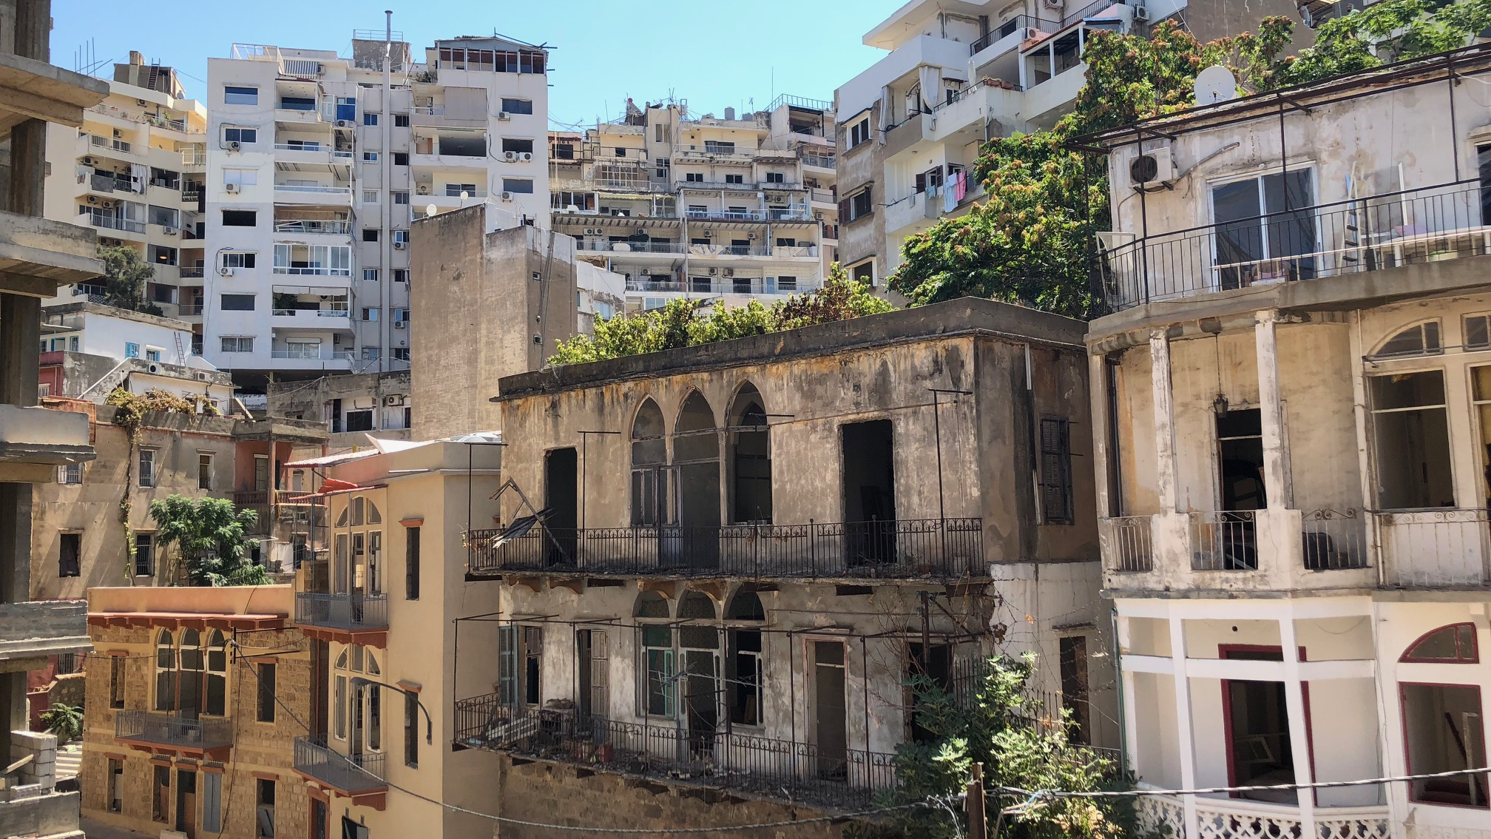

Beirut Port Explosions:
Shelter Sector IM Overview
29/9/20
Notes:
On August 4th, a warehouse at the Beirut Port exploded, causing widespread casualties and material damage. It is estimated that the explosions directly impacted around 300,000 individuals living in an estimated 77,000 apartments located across 10,000 buildings within three kilometres of the epicentre. This has led to the displacement of households to areas within and outside of the immediately impacted area. However, a majority of affected households continue to reside within their damaged buildings.

Slide 2
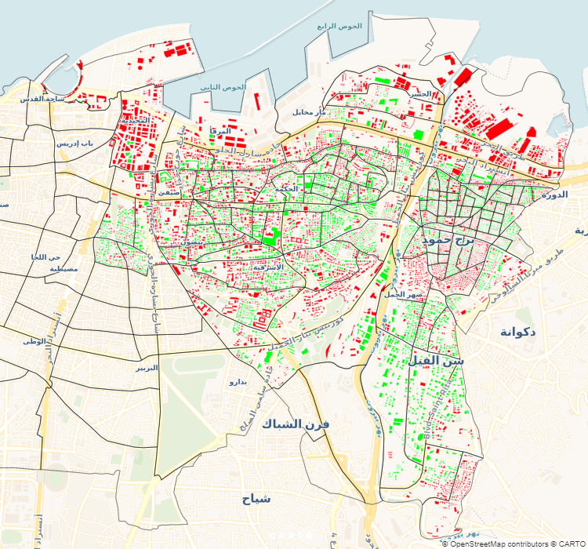

Overview of needs
Level 3 admin boundaries are too large for operational purposes and hence were divided into 188 zones.
The zones are used to facilitate assessments and coordination.
MSNA started by LRC day after explosions, currently 19 partners are collecting data.
The aim of MSNA is to visit all apartments in the 3KM prioritized area
Notes:
A zone can be defined as a cluster of built-up plots separated by the road network within the cadasters.
There are around 15 cadasters in the 3 KM prioritized area compared to 139 zones
Based on 17 September data:
16,913 apartments assessed to date (16% of total in affected area)
5,436 buildings assessed to date (41% of total in affected area)
Currently more than 50% of the buildings have been assessed
Online dashboard is being created in Power BI to make new results available faster
Updating formulas in a spreadsheet with ~20,000 rows of data is slow and not fun ☺

Slide 3
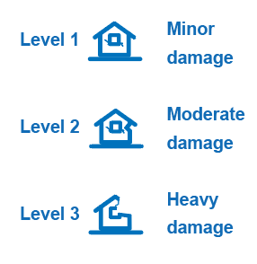
Overview of needs
82K
Estimated damaged apartments
Apartments in Level 1 have minor damages to property such as broken glass, doors, locks, collapse of false ceiling.
Apartments in Level 2 have moderate damage to property, but no apparent structural damage.
Apartments and buildings within level 3 have heavy damages of structural (load-bearing) and/or architectural elements.
247K
Estimated affected individuals
Notes:
For Level 3 damage, the multiple choice question “damages observed” is used to determine where collapsed beams or columns have been recorded
For Level 2 damage, there should be collapsed / damaged balconies or fallen ceiling (also from damages observed question) in combination with door damage, window damage, and toilet damage (all separate questions)
For Level 1 damage, there should be at least one recording of door damage, window damage or toilet damage

Slide 4
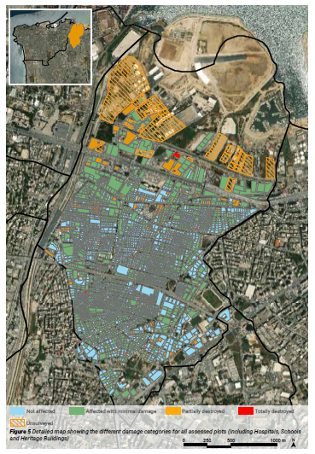
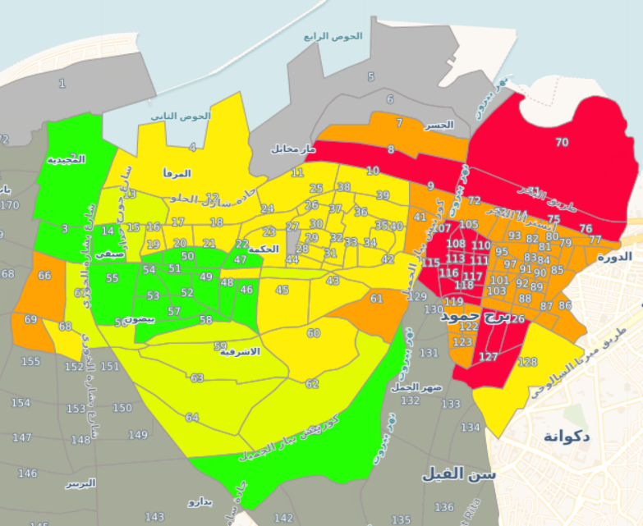
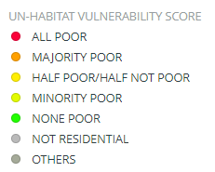
Overview of needs
Notes:
Socio-economic categorisation of operational zones to guide targeting. Shelter agencies will ascertain the following parameters to determine HH vulnerability:
Ability to afford costs
HH socio-economic evaluation
Individual vulnerabilities: elderly person alone, female headed household, PwD, GBV, etc.
Municipality Building-level Rapid Damage Assessments in Beirut and Bourj Hammoud (UN-Habitat), to be released soon. Cross-checked data with damage assessment from the Order of Engineers and Architects.

Slide 5
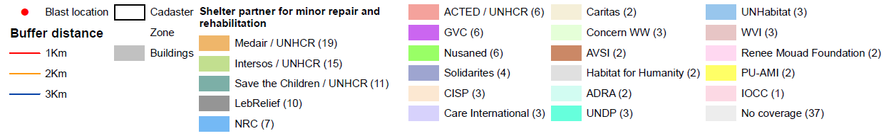
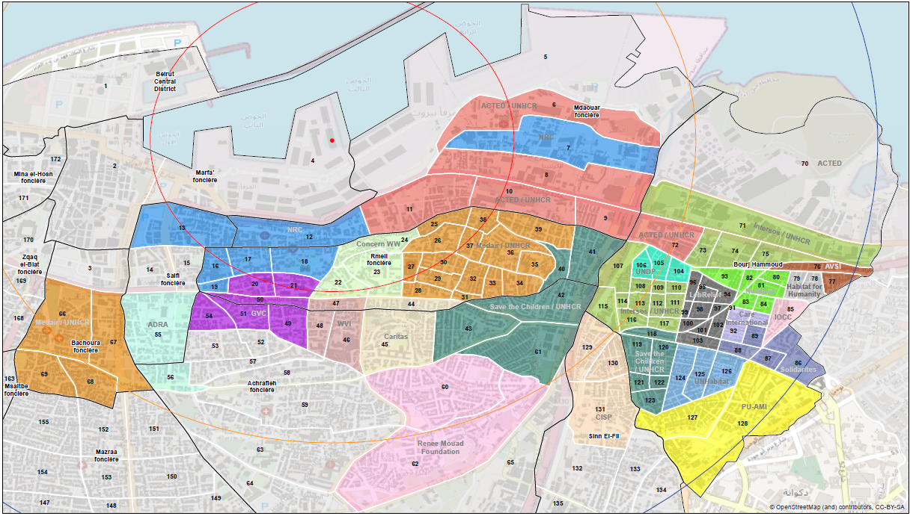
Coordination of response
Notes:
Coordination of partners by geographical area, capacity + activity over affected area
Capacity assessment of partners
Socio-economic categorization of operational zones
Assignment of partners to zones for assessments, emergency distributions, repairs/rehabilitation

Slide 6
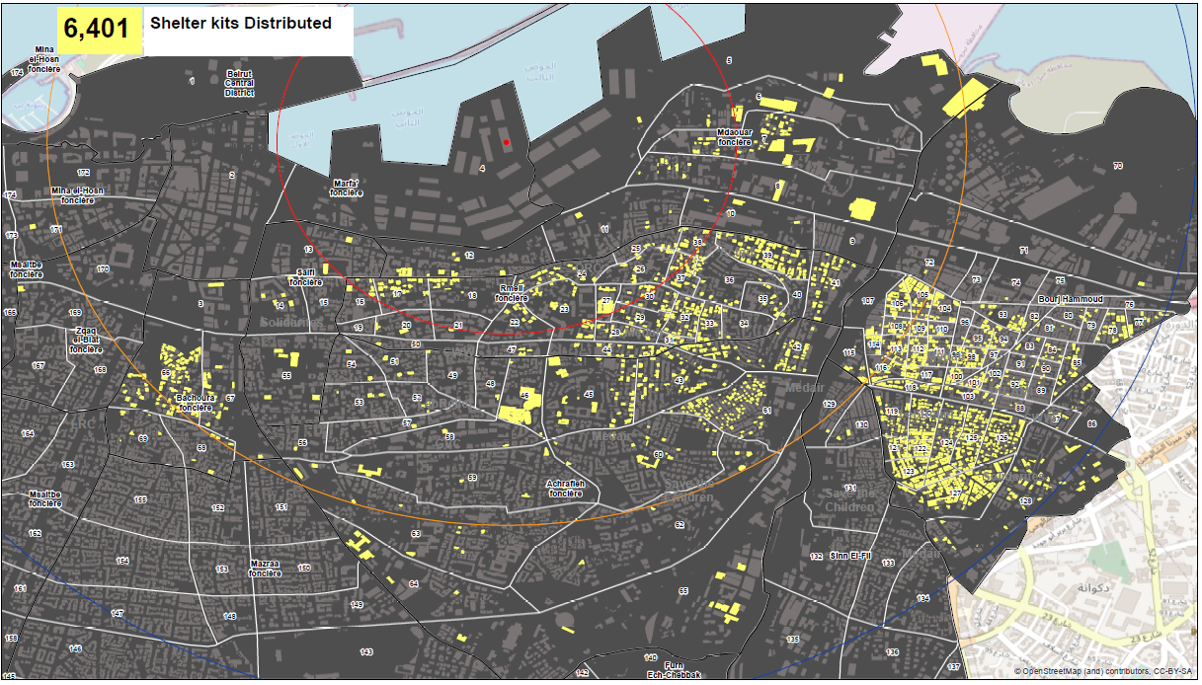
Coordination of response
7,062 kits distributed
Notes:
In the first month of the response, weatherproofing kits were distributed as an immediate response. This happened alongside the data collection for the MSNA to avoid delays, it was therefore possible to track the distribution of kits at building level.
The yellow dots present the locations where shelter kits were distributed, with clear concentration in Achrafieh, worst hit area and in Borj Hammoud, which was also badly affected, though with increased vulnerability and reduced capacity of affected families to take immediate action on their own.

Slide 7
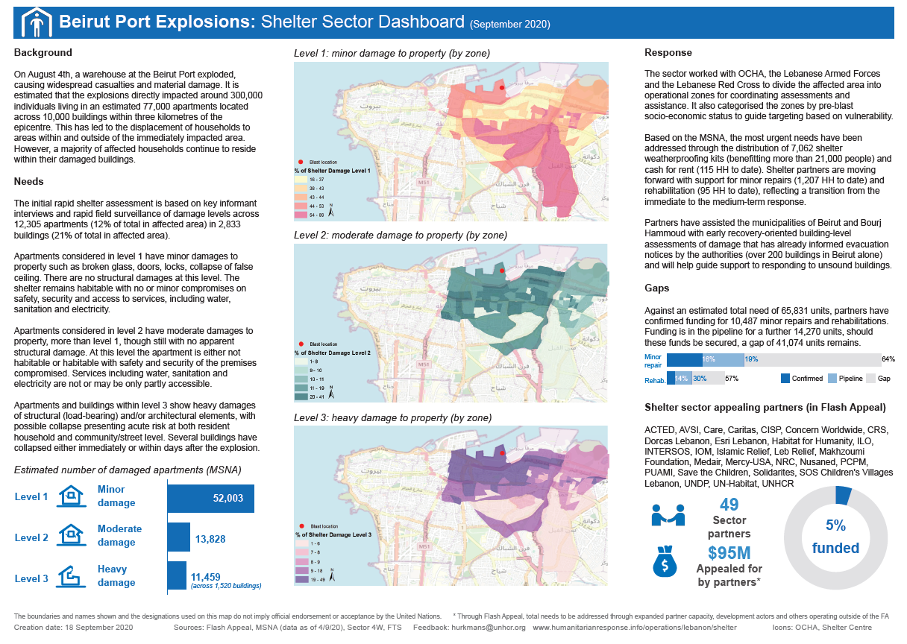
Sector dashboard
Notes:
The dashboard contains information about the needs, response, gaps and partners in the Beirut Port Explosions Shelter Sector.
These maps are based on MSNA data and show the percentage of apartments by damage level and zone as per the earlier mentioned calculations.
It is clear to see that majority of structural damage is in close proximity to the location of the explosion and lighter damage is further away.
If anyone has better icons to shelter damage in apartments, please do share, Shelter Centre is credited given the use of Shelter After Disaster icons ☺
The product is made in Illustrator, follows the OCHA dashboard template and will be updated twice a month. Next version will focus on response more.

Slide 8
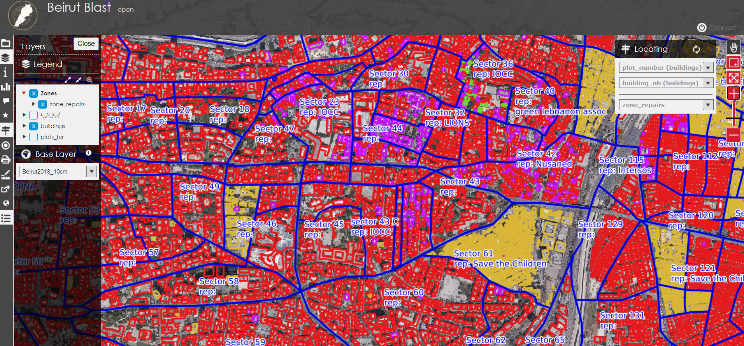
Challenges and next steps
Damage levels and activities do not always link up, this affects gap analysis level
Align damage results of various assessments (LAF, UN-Habitat, MSNA etc.)
Need to track assessments and interventions at apartment or at least building level
Merging of coordination structure with different responses (LCRP, COVID-19)
 | Minor Works | Rehabilitation Works
L1 | Yes | No
L2 | Yes | Yes
L3 | No | Yes (excl. structural repairs)
Notes:
The number of damaged apartments by level is based on MSNA data and used for a rough approximation of needs at zone level
Technical assessments are used to establish the exact type of response needed per apartment, response type and damage level are not fixed
Reporting by partners in ActivityInfo is at zone level and by response type, not by damage level
Given the above, it will not be possible to match achievements reported through ActivityInfo with the needs by damage level
The only way around this will be to go one level higher in our analysis, we should still be able to directly compare estimated damaged apartments with the number of units repaired or rehabilitated.

Slide 9


Please visit:
HumanitarianResponse.info
/operations/lebanon/shelter for all sector documents and infographics
Please visit:
IALebanon.UNHCR.org
/#ContactHub to sign-up to our mailing list
(choose “Beirut Port Explosions” as
Area of Interest and “Shelter” as Sector)

