Slide 1
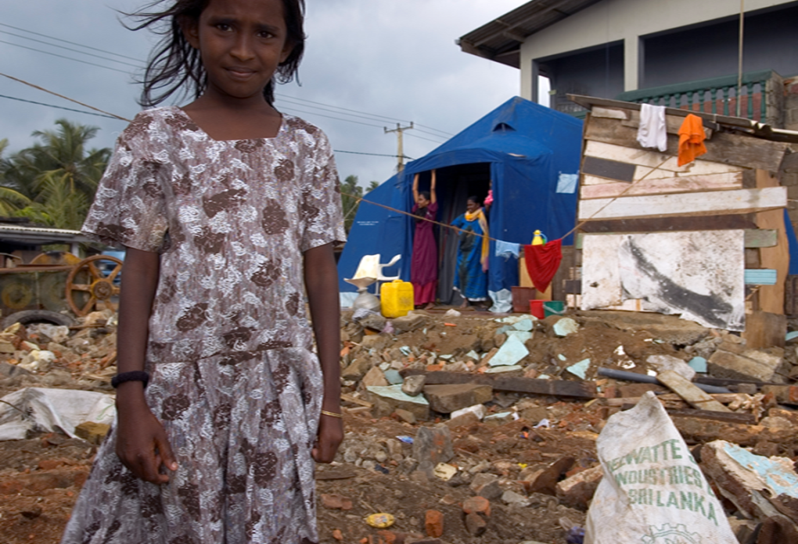


CASH WORKING GROUP
UPDATE OF CWG ACTIVITIES
WEBSITE IMPROVEMENTS – YOUR IDEAS
NATIONAL LEVEL CASH WORKING GROUPS – ARE THEY WORKING FOR YOU?

Slide 2
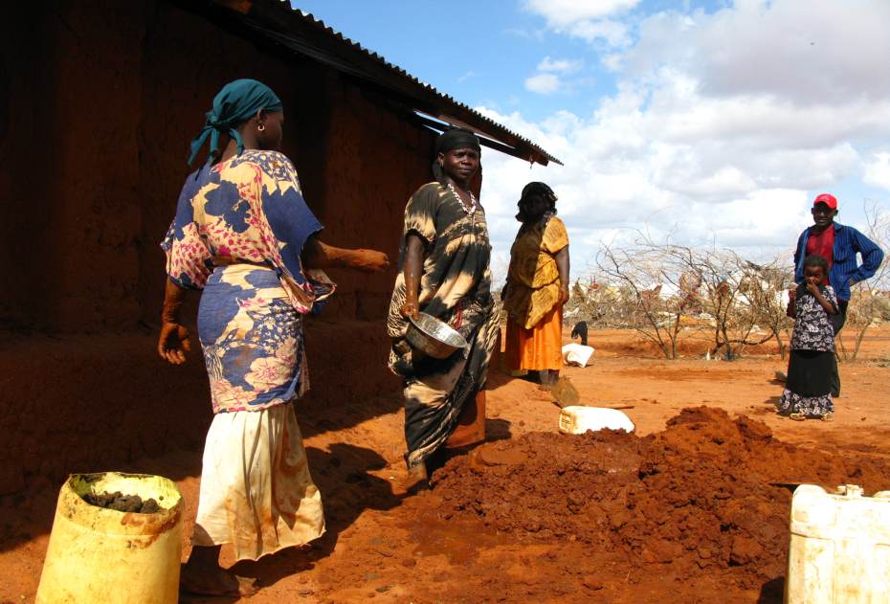

Areas of Focus
- Development of cash/shelter guidance
- Capacity building/development
- Market assessment – capacity/guidance
- Advocacy around shelter/cash
- Improving external understanding of the shelter sectors needs and issues around cash

Slide 3
What we are doing
Position and Advocacy papers, Literature review, sector specific reports and evaluations
Involvement in a range of relevant discussions (CaLP, Grand Bargain etc)
Technical contributions/evidence collection at agency and cluster levels
‘Cash Champions’ supported by ECHO grant to the GSC
Save = working on training package and construction labour market mapping tool/approach
CRS = deployable markets expertise
HFH = sector expertise to support global level policy/technical discussion and coordination

Slide 4
CONTEXT IS EVERYTHING!
Understanding what the ‘right’ tools to use to meet a specific objective requires detailed analysis of all of the options and variables.
Cash is a tool
In kind material distribution is a tool
Technical Advice is a tool
Credit is a tool
Markets dictate which of these ‘tools’ are available locally and which need to be provided
But who decides what ‘tool’ will work best?
We think this should be the context and not donors or reform agendas…..

Slide 5
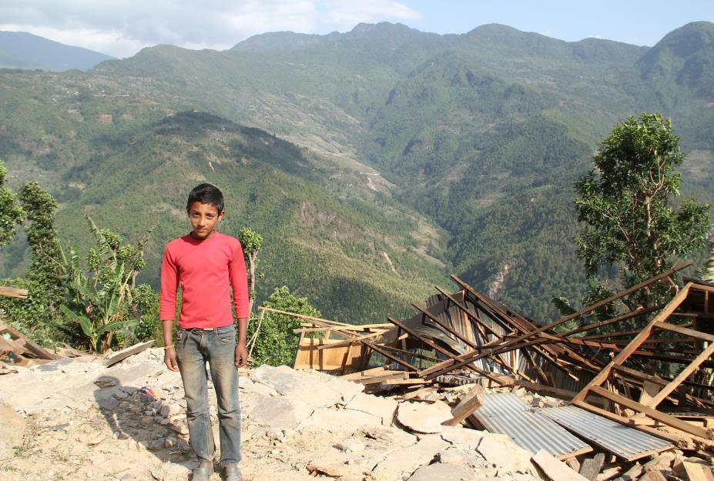

Shelter Cluster engagement in National Level Cash Working Group's.

Slide 6
- Significant efforts made over the past year to improve the predictability and efficiency of national level CWGs.
- Includes work on coordination guidance, the development of standard CWG ToR.
- Work on the cash champions deployments has highlighted that all SC’s we have engaged with expressed the national CWGs were unable to assist them with their specific issues.
- We want to know why so that solutions can be identified or proposed to donors and relevant actors

Slide 7
Cash working groups globally 2017-2018
Active Country Based Cash Working Group |  | Regional Cash Working Groups
Afghanistan Bangladesh Burkina Faso Burundi Cameroon CAR Chad Colombia DRC Ethiopia Fiji Haiti Iraq Jordan Lebanon Liberia Libya Kenya Madagascar Mali Mauritania | 22. Myanmar 23. Nepal 24. Niger 25. Nigeria 26. Pakistan 27. oPt 28. Philippines 29. Sierra Leone 30. Somalia South Sudan Sudan Syria/Damascus Tanzania Turkey (Syria)/ Turkey (Refugees in Turkey) Uganda Ukraine Yemen Pacific Regional Working Group (under PHT) | Kenya Senegal Thailand Jordan

Slide 8
Links with coordination architecture
Representation or engagement at a strategic level (HCT) | Seat at the ICCG / Linkage reflected in the CWG TOR | Ad-hoc reporting through attendees with an HCT/ Inter-Cluster seat
1. Pakistan 2. Yemen 3. Lebanon* | Afghanistan Burundi Cameroon CAR Chad Colombia Ethiopia Haiti Iraq** Libya Mali Myanmar Niger Nigeria Philippines S. Sudan Syria/Damascus Turkey Lebanon* Ukraine | oPt Somalia Sudan

Slide 9
Sectoral vs. Multi-Sectoral CWGs
 | Independent / Multi-Sectoral (within humanitarian architecture) | Under a Cluster/Sector
 | Afghanistan 13. Myanmar 2. Burundi 14. Niger 3. Cameroon 15. Nigeria 4. CAR 16. Pakistan 5. Chad 17. Philippines 6. Colombia 18. Somalia 7. Ethiopia 19. South Sudan 8. Haiti 20. Sudan 9. Iraq 21. Turkey 10. Lebanon 22. Ukraine 11. Libya 23. Yemen 12. Mali | 1. oPt – Food Security 2. Syria/Damascus – Food Security 3. Lebanon* - Food Security and BN

Slide 10
CWG Leadership
UN | UN + Intl NGO | NGO
1. CAR: OCHA (chair) 2. Myanmar: WFP (chair) 3. Niger: OCHA (chair) 4. Pakistan: FAO (chair) + WFP (co-chair) 5. Sudan: WFP + UNHCR 6. Lebanon*: WFP Food Sec/ Basic Needs UNHCR | 1. Afghanistan: NRC (chair) + WFP 2. Cameroon: WFP (chair) + IRC 3. Ethiopia: WFP + Oxfam (co-leads) + OCHA 4. Iraq: UNHCR (chair) + Mercy Corps 5. Libya: UNHCR (chair) + Mercy Corps 6. Nigeria: OCHA (chair) + INGO forum 7. South Sudan: WFP (chair) + Dan Church Aid 8. Syria (Damascus): UNRWA (chair) + pending nomination 9. Yemen: Oxfam (chair) + OCHA | 1. Chad: Oxfam (chair) + CRS 2. Ukraine: Moving to I/NGO chair + OCHA

Slide 11
CWG Leadership Contd.
Local Govt Involved in Leadership | UN + Local NGO | Rotating
1. Burundi: Ministry for Human Rights & Social Welfare (chair) + WFP 2. Colombia: See rotating → 3. Mali: Oxfam (chair) + Direction Nationale de la Protection Sociale et de L’Economie Solidaire) + WFP | 1. Somalia: WFP (chair) + ADESO 2. Colombia: See rotating → | 1. Philippines: 4 month rotation, all organizations 2. Colombia: Presidential Agency for Intl Cooperation (APC) + Colombian Red Cross + WFP 3. Turkey: Rotating amongst steering committee Intl NGOs as of Feb 2018

Slide 12

Discussion around SC engagement in National Level CWGS.
If one exists in your country how does the SC and shelter sector participate and engage?
How does the CWG support SC or shelter sector activities and needs?
If yes how?
If no why not?
How could CWG’s better support the SC and facilitate the use of cash for shelter outcomes?
Is the CWG open and supportive of sector concerns, issues or capacity gaps?
Does the CWG offer opportunities for more coordinated response?

