Slide 1


Slide 2
RAPID ASSESSMENT FINDINGS & RECOMMENDATIONS
SHELTER & NFI
21-23 OCT 2020
Floods in Central Viet Nam

Slide 3
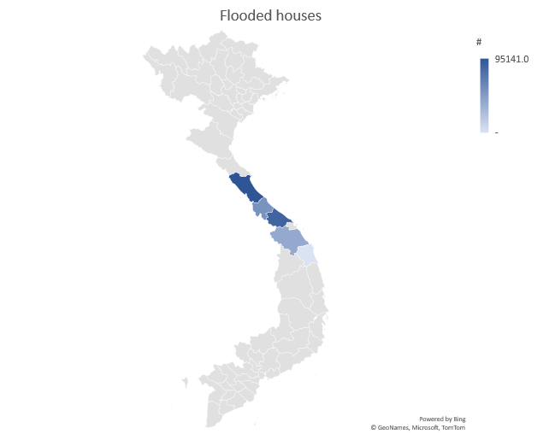
Impact on housing – Flooded households
Province | # of HH
Quảng Bình | 95,141
Quảng Trị | 53,759
Thừa Thiên-Huế | 84,963
Quảng Nam | 39,129
Quảng Ngãi | -
Total | 272,992
Source: Report of CCNDPC– 24 Oct 2020

Slide 4

Impact on housing – Evacuated households
Province (except Ha Tinh, Nghe An) | # of HH
Quảng Bình | 29,793
Quảng Trị | 15,011
Thừa Thiên-Huế | 12,075
Quảng Nam
Quảng Ngãi | -
Total | 56,879
People evacuated to temporarily evacuation shelters which are not designed as evac centers
Source: Report of CCNDPC– 24 Oct 2020

Slide 5
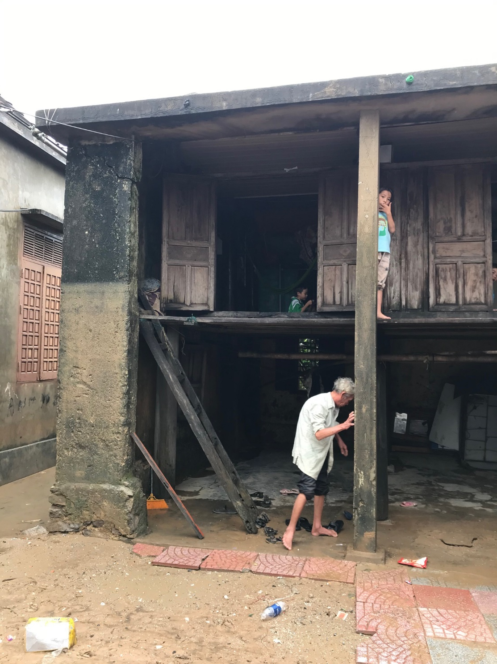
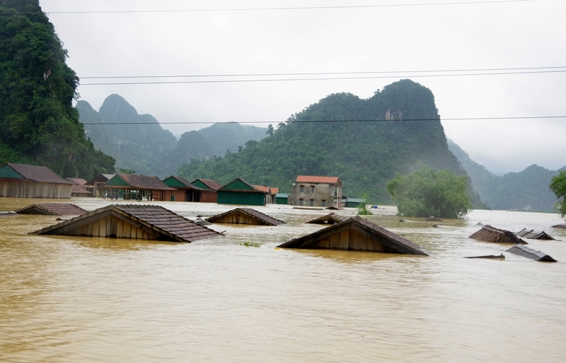
Historical levels of floods
Families were evacuated from their rooftops in Quang Binh Province
Flood levels over the traditionally designed mezzanine levels

Slide 6
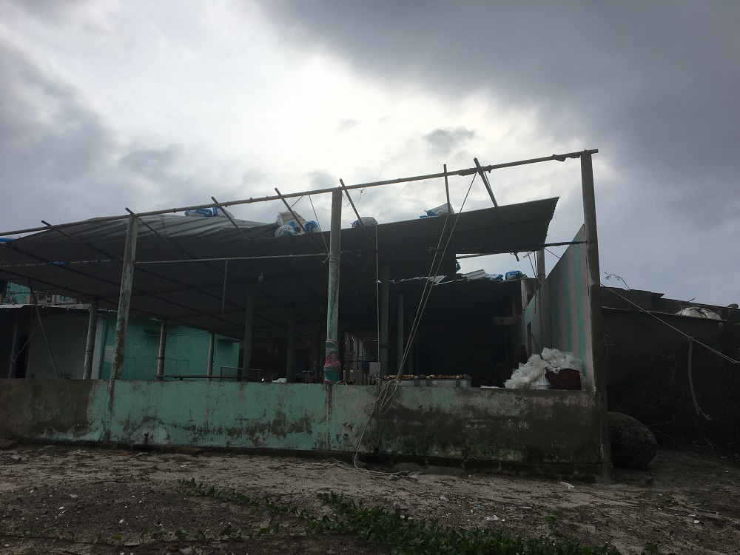
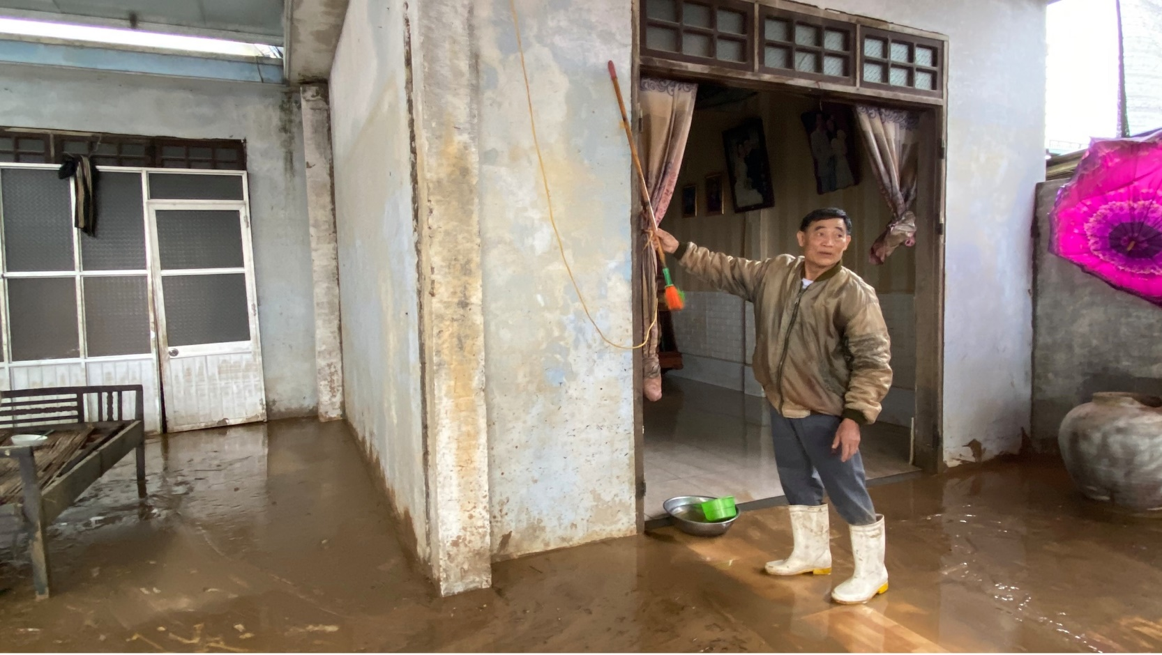
What was damaged and swept away?
Total number of houses damaged (various level): 37,524

Slide 7
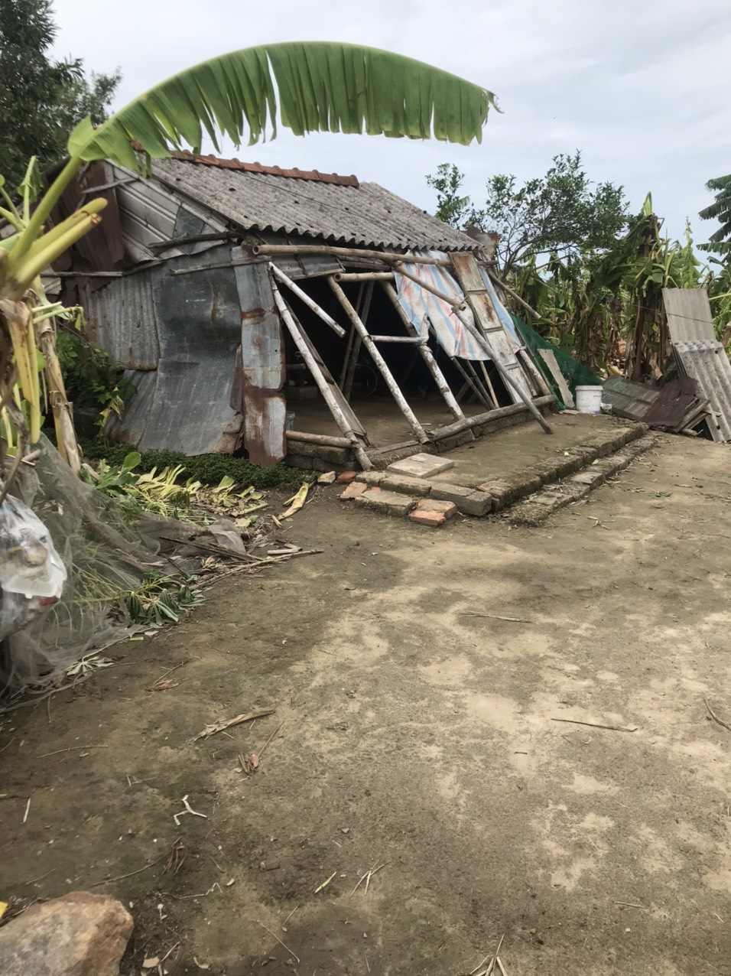
What was damaged and swept away?
Damaged houses: totally collapsed, partial damage (cracks, damage to walls, windows, foundation and structure)
  unstable houses will degrade quickly due to extended exposure to flood waters

Slide 8
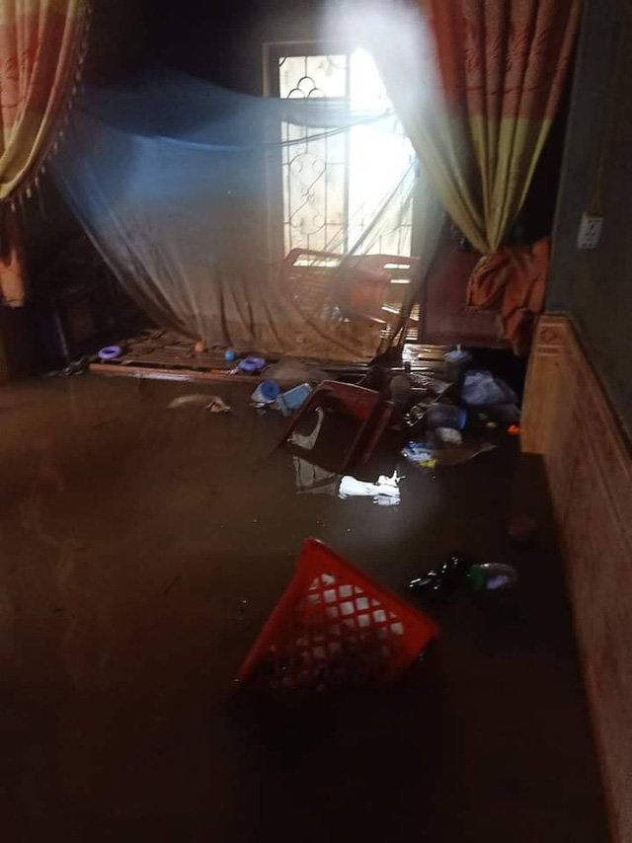
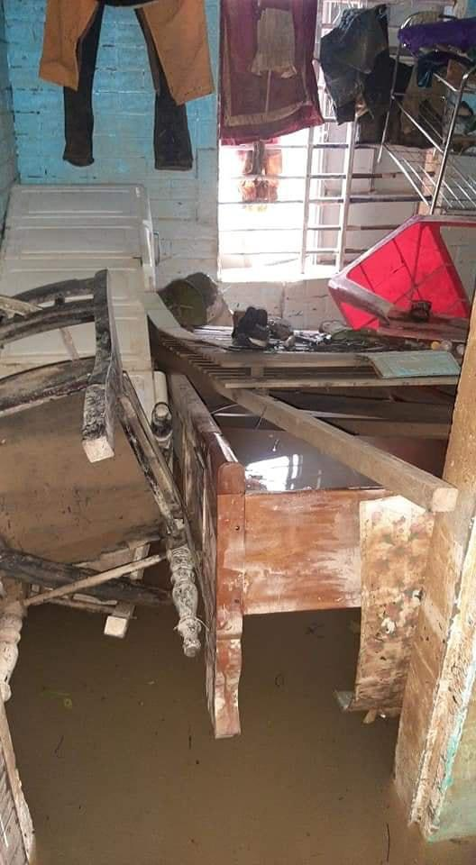
What was damaged and swept away?
Loss of household items: swept away by strong currents
Damage to blankets, mosquito nets, household & kitchen utensils

Slide 9
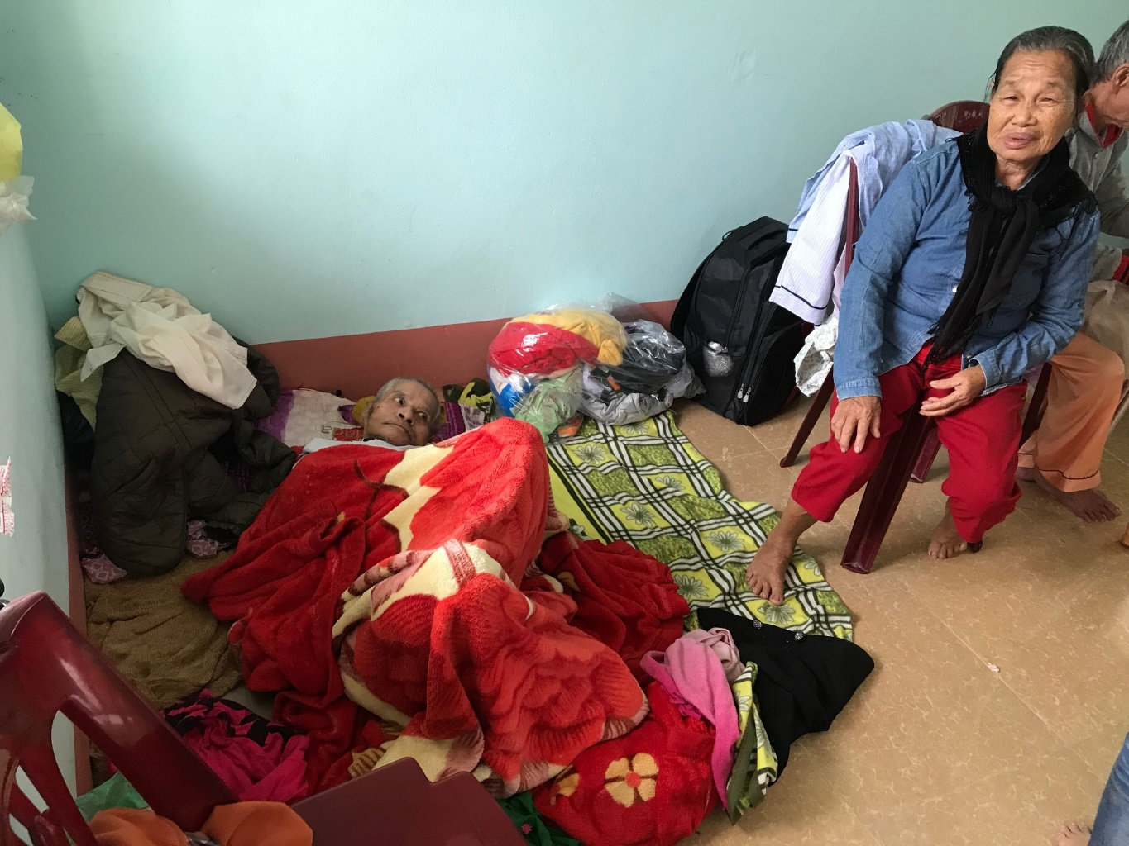
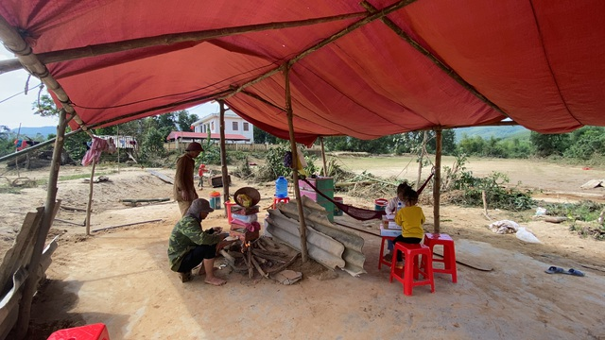
Observation: In which conditions are affected people living?
Living in temporary shelter & evac. centers (not designed for these purposes)
Living in vulnerable structures
Immobile and sick elderly housed at Tân Ninh Commune People Committee Office, requiring medical attention
Quảng Ninh District, Quang Binh Province

Slide 10
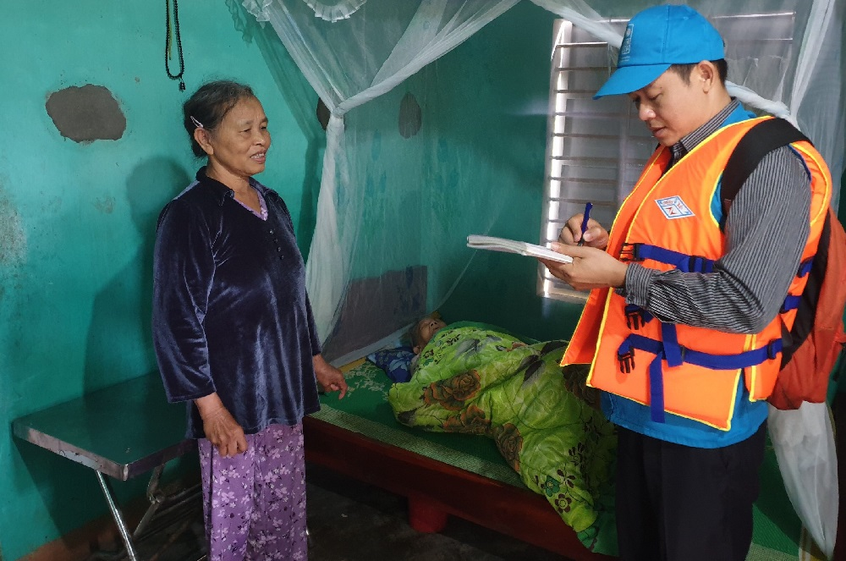
Observation: In which conditions are affected people living?
Ms. Le Thi Phuong in Phong Hai commune, Phong Dien district, Thua Thien Hue province (70 years old) is taking care of her mother (99 years old). She is also living with two grandsons (with her son and daughter in law).
They returned and could only salvage the remaining household items

Slide 11
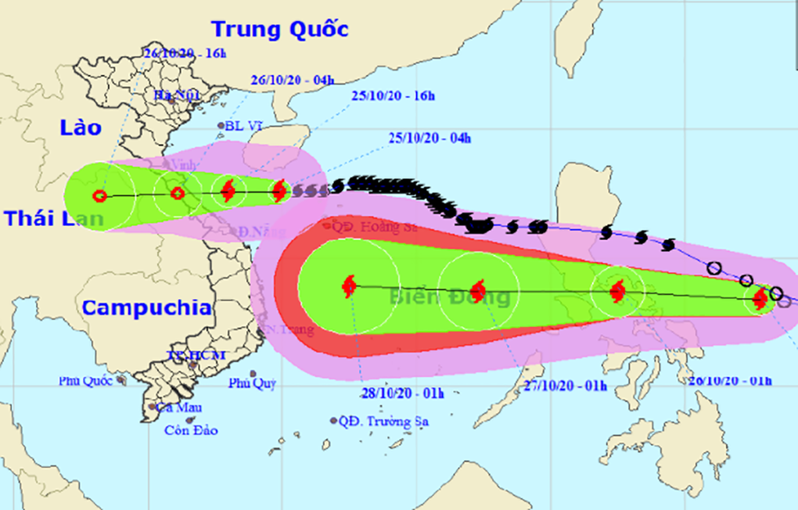
How will the situation deteriorate?
Damaged and submerged houses and loss of household items will not be able to fully re-function in next 3-5 weeks → expected to deteriorate quickly since poor and near-poor households have also lost everything and will not be able to invest in house repairs, new purchases.
Two more storms/tropical depressions expected until end of Oct → additionally pushing the poor to the tipping point.
Confirmed by provincial DOLISA that although there is a policy to provide immediate financial assistance to repair/reconstruct damaged houses, provincial budget has been empty due to COVID-19 impact (less income, more expenditure).→ Gov will prioritize food and seeds

Slide 12
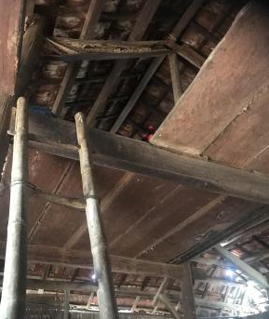
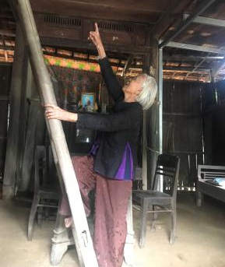
Exacerbated risks
Prolong rainfall causing land-slides resulting in severe damage for houses
Preliminary damage accounted for only VND 11 bn. The potential risks are unpredictable (land-slides threaten houses, community health centers and schools)
Local people build mezzanine in accordance with historical flood levels
Loud-speaker system does not fully cover the commune, which is a risk to PwD, OPs
One house visited by the team in Ha Vi village, Dai Hong commune, Dai Loc district which is now even more dangerous due to potential flood and storm hazards;
Most houses collapsed and damaged belong to poor and near-poor households.

Slide 13
Timeline
Critical Live-threatening Easing impacts Recovering
IMPACTS as a result of house damages
Spend more, debts
Physical health
Mental health
School dropout
Water/sanitation
Nutrition
Etc.
Nov - Dec Dec - Jan Feb - March April - May

Slide 14
Needs and gaps: Prioritized needs
1. Evacuation Centers, House repair and rebuild:
Address the shelter needs of those evacuated: establish proper evacuation centers – to enhance preparedness for upcoming storms/floods
For fully damaged/collapsed houses: urgently repair and rebuild a total of 100 houses for 5 provinces
For damaged/submerged houses for long duration: 37,524 houses for 5 provinces
On-going and committed assistance:
Unclear commitment or assistance provided in terms of

Slide 15
Needs and gaps: Prioritized needs
2). Provide Non-food items
Blankets: damaged and swept away
Mosquito nets (preventing dengue fever – various reported cases have already occurred). Stagnant water will be breeding sites
Household items: cooking sets (basket, pans, bucket, chopstick, bowls, etc.)
2). On-going and committed assistance
Unclear commitment or assistance provided in terms of NFIs

Slide 16
Needs and gaps: Prioritized needs
3). Provide employment for the poor & near-poor households:
Repair houses, strengthen/retrofit houses
Remove debris
Clean-up of streets & environment
Clear sluice and irrigation system
Rehabilitate farming land
Repair commune roads
Construct village roads
Repair flood marker systems
Make cloth masks (masks will be distributed to avoid COVID-19)
Work for agricultural cooperatives (cooperatives get free labor, workers get paid).
3). On-going and committed assistance
Unclear commitment or assistance provided to improve employment

Slide 17
Needs and gaps: Medium & Longer-term needs
4). Needs for medium & longer terms (3-6, 6-12 months):
Retrofit using build-back-better principle for private houses, public facilities
Awareness of the public on importance of resilient houses
Awareness raising on preparedness in low-lying areas of flooding risks
Establish proper evacuation centers (with COVID-19 prevention plan)
Carry out flood risk assessment to inform flood risk planning
4. Recommendations
Replicate successful housing models to coastal provinces
Introduce and share info/lessons learnt from Gov housing program (program 48).
Implement flood risk planning linked with preparedness at inter-provincial scale
Capacity building for local authorities on houses strengthening retrofitting techniques
Conduct training to Commune Task forces on strengthening, retrofitting techniques to support the community prior to the disaster season
Integrate flood risk reduction into SEDPs at commune, district and provincial levels (2021-2025)

Slide 18
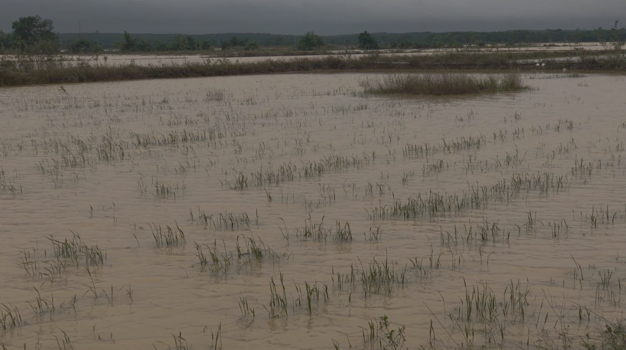
FOOD SECURITY
&
LIVELIHOOD SECTOR

Slide 19
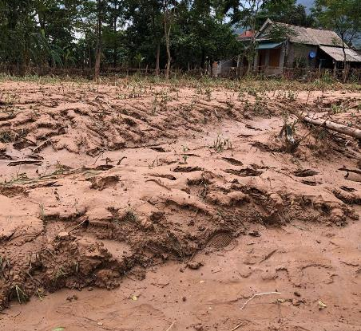
DAMAGES REPORTED SO FAR BY PROVINCES*
Over 54,809MT of food stock and 687MT of seeds;
1,032ha of paddy rice and 7,735ha of cash crop;
4,363ha of aquaculture (without Quang Binh report);
6,662 cattle and 760,411 poultry;
331ha of perennial trees and 636ha of fruit tree;
ESTIMATION OF DAMAGES TO FOOD SECURITY AND LIVELIHOOD SECTOR
90K MT
Food stock and seeds
30K Ha
Agriculture land
2.06M Heads
Livestock

Slide 20
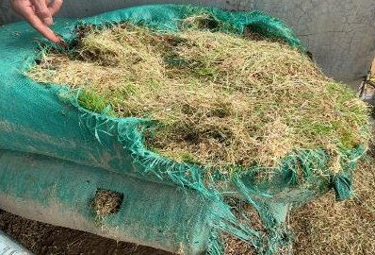
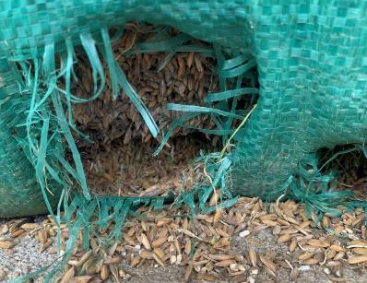
KEY FIELD OBSERVATIONS & FINDINGS:
Most of assets and food stock (harvested rice) have been damaged, especially in Quang Binh, Quang Tri and Thua Thien Hue provinces;
Large volume of harvested rice got wet and can only be used as chicken feed;
Food aid (mostly rice, instant noodles and dry provisions) is main food source of affected vulnerable households;
Vulnerable households are negatively coping by reduction of meals, saving foods for children, eating non-nutritious foods;

Slide 21
KEY FIELD OBSERVATIONS & FINDINGS:
Damages to cash crop (mostly vegetables) take away not only income but also food source from families; and vegetable farming provides significant income to women;
Flood-induced sedimentation on agricultural land and damages to rice field embankment will require higher investment;
Large number of cattle and poultry are killed due to floods;
Livestock production constitutes not only additional source of income but also animal protein intake of smallholder farmers;
In Vietnam, smallholder farmers own 40% of cattle stock and 75% of poultry population;

Slide 22
KEY FIELD OBSERVATIONS & FINDINGS
Aquaculture could have been mostly harvested before floods if COVID-19 did not impact on prices;
Damages to aquaculture farming pose a loss of labor opportunities of vulnerable households (poor, near poor and landless);
Fishing tools are badly damaged and;
Due to COVID-19 impact, people are worrying that the government will not be able to provide sufficient assistance on food security and restoration of agriculture production;
Where floods receded, local markets are seen to be in function; foods and basic items are available; and no considerable increase of prices are except vegetables are in shortage and;

Slide 23
IMPACTS:
Affected vulnerable people will not die hunger, but they will suffer from food insecurity;
High threat of food insecurity of poor and near-poor households in next 6 months (lean season);
Higher investment will be required to restore agriculture land and to resume the winter-spring crop that will start in 2 months;
Without assistance, vulnerable households will have to implement negative coping activities, e.g., selling productive assets, taking loans;

Slide 24
NEEDS:
At least 150,000 people will urgently need food assistance for 5-6 months (lean season)
110,000 vulnerable people will require assistance to restore their livelihood activities in agriculture production (rice cultivation, cash crop, poultry production, fishing, etc.)
Restoration of agriculture production by rehabilitation of agriculture land, irrigation, pump and provision of agriculture inputs;
Restoration of livestock production, especially recovery of poultry together with provision of extension and vet services;
Provision of fishing tools (fishing nets, fishing gears, other tools);
Debt reschedule is also requested by affected farm owners;

Slide 25
RECOMMENDATIONS:
Given the conducive environment for cash transfer programme, emergency operations should consider to use cash to deliver supports to affected communities;
The on-going distribution of rice and in-kind food would only cover 10-20% of food need (MEB) per month of household to ensure food security;
Where feasible, it is recommended to consider cash-for-work for rehabilitation works (clearing debris, restoration of agriculture land and irrigation, etc.) that could provide additional income to local vulnerable households

Slide 26
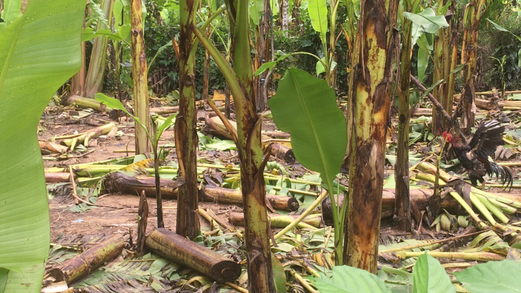
Health and Nutrition

Slide 27
Population affected (Nutrition)
 | Team 3 (QN, QNG) | Team 2 (HUE) | Team 1 (QB, QT) | Total
Total affected number | 482.000 | 1.283.000 | 1.586.000 | 3.351.000
Pregnant women | 12.000 | 32.075 | 38.000 | 82.075
Children under 5 | 12.000 | 21.700* | 112.000 | 145.700
Children under 2 | 12.000 | 30.792 | 38.064 | 80.856

Slide 28
Food Damage* mapping
Information source: Report from 5 assessed provinces - consolidated by the FAO - Focal point officer for Nutrition Food security in this assessment

Slide 29
Key Findings
Household food shortage or hunger was not yet an issue for QN and QNG; but the poor and severe affected households (more than 200.000 household estimated will face with food insecurity in a short and medium term, especially in Quang Binh and Quang Tri
Child feeding practices have been disturbed especially quality of complementary feeding for young children in the flooded locations. Donation of Infant formula are not found yet, and not reported.
In QN and QNG, about 100 pregnant women are protected by multiple micronutrient supplementation; High coverage rate of children under 5 was protected by the VAS (Vitamin A Supplementation) in previous VAS campaign (June /2020)
Lack of communication activities that guides, and promote good practices in health nutrition and wash, and DRR also
None nutrition emergency supplies for used in emergency response … existed in the store of CHC, District and provincial CDC (Vitamin A high dose capsules, sprinkles/BIBOMIX, RUFT/HEBI SAM/IECD material ..)
There was no a provincial contingency plan for emergency nutrition under overall DOHs contingency plan existed
Lack of training for health staffs at all level on sector nutrition response in emergency

Slide 30
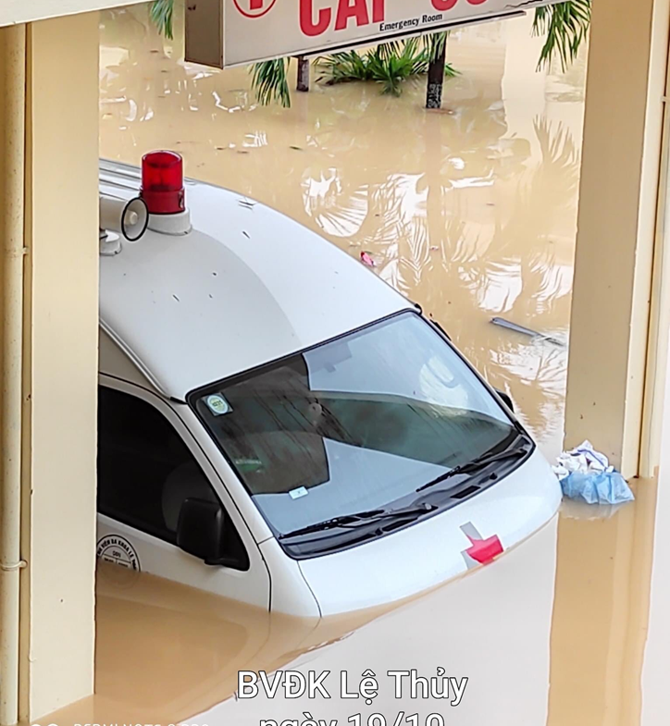
Nutrition and health services interrupted
  61 commune health stations was partly damaged
  Limited services including ANC & nutrition provision inside and outside the CHS due to lack of personnel and no transportation mean in flood areas
  Reduced significant healthcare workforce due to family situation
  Limited functions (maintaining only on first aid, emergency, normal childbirth and referral)
  Affected quality of services (no electricity, no testing, low light, very poor sterility, lack of clean water)
  Patients hardly access and faced high risk of accident, drowning due to boat flipping
  High risk of water born disease outbreaks. Diphtheria outbreak is ongoing in Quang Nam & Quang Tri. Skin disease commonly reported in all provinces.

Slide 31
Recommendation for nutrition
Short term:
Medium and longer term:
Need to support local DOHs to implement integrated communication activities on good health, nutrition and hygiene sanitation practices, DRR, and health outbreak prevention and control (Covid 19 & Diphtheritic, others)
Need to support local DOHs’ procurement of essential nutrition supplies for intervention in affected locations
Need to closely track nutritional status of women and children in affected areas with soon carry out a specific nutrition survey to assess further on impacts
Nutrition care for the first 1000 days,
PTSD support
Services for people living with NCD and mental health, HIV and using Methadone, Disabilities. Especially vaccination for young children and pregnant women.
Need to build capacity for health staff on development of annual preparedness Plan
Need to train responsible health staffs in emergency response intervention

Slide 32
Needs & Recommendations
Recover recommendations (3 – 12 months)
Support implementation of sanitation activities for prevention of water born and other disease outbreaks (especially the Covid 19; Diphtheritic and Dengue fevers)
Support a quick maintaining of essential health care services for women and children, especially for the 61 CHS damaged and flooded
Training, supporting healthcare sectors at different levels to develop practical emergency responding plans, planning transportation means for their emergency in floods.
Building reserved water tank and providing power generators, ventilators, chargeable lights, life vests for commune health stations
Maintaining the workforce of village health workers to connect health sectors with community and facilitate health services access.

Slide 33
Gaps for supporting
Intervention | Targeted number
Support implementation of integrated communication program on good health, nutrition practices under the dual emergency (Covid 19 & Flooding), and DRR in affected provinces | 5 provinces
Procurement of the multiple micro-nutrient for protection of about 100,000 young children under 2 from micro-nutrient deficiencies in affected locations | 80,000
Procurement of the multiple micro-nutrient for protection of about 100.000 pregnant women in 3 severely affected provinces (Hue, Quag Binh, Quang Tri) | 80,000
SUPPORT to carry out a specific nutrition survey to assess further detail of the impacts in 3 provinces for interventions | 3 provinces
Training for capacity building on nutrition emergency response | 5 provinces

Slide 34
WASH
Key Observations
Summary of WASH Impacts (from government reports & mission findings)
Overall Sector Needs and Recommendations (from government reports & mission findings)

Slide 35
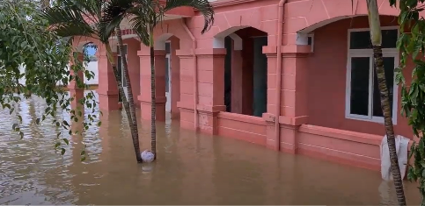
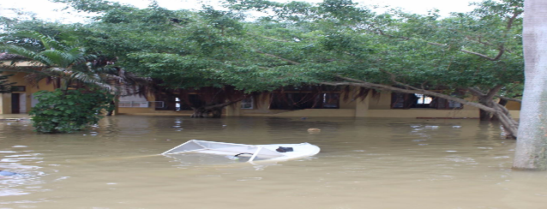
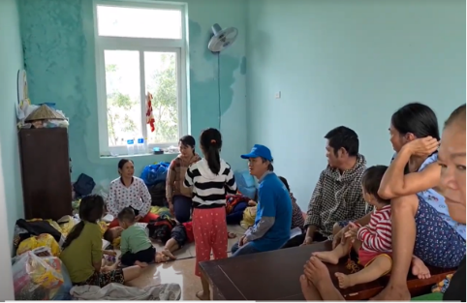
OBSERVATION: Evacuation center - Tân Ninh Commune People Committee Office, Quảng Ninh District, Quang Binh Province
Evacuated at CPC office for a week
150 people, with the majority were women, children, and elderly
One latrine only on the first floor submerged under water
Put the human waste into a piece of paper and throw it into the water nearby.
Minimize their kids’ meal sizes to avoid the toilet time
No water for personal hygiene
No privacy for women and girls.

Slide 36
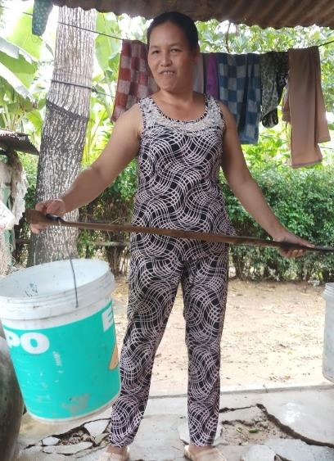
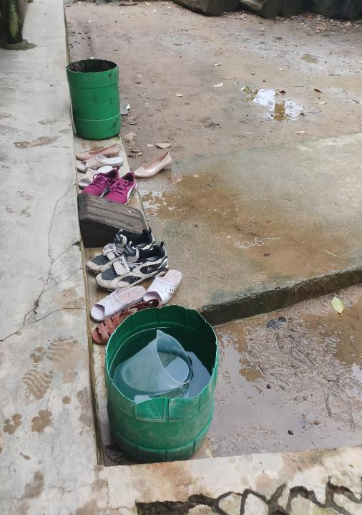
OBSERVATION: Clean Water
Nguyễn Đức Hường, Đông Phước village, Dien Hong commune, Dai Loc district, Quang Nam province
The house was flooded 1m height within 3 days
Use rain water, river water or get tap water from another HH, 5 kms away from her house, 1 hour per day for water collection
She is the main water collector

Slide 37
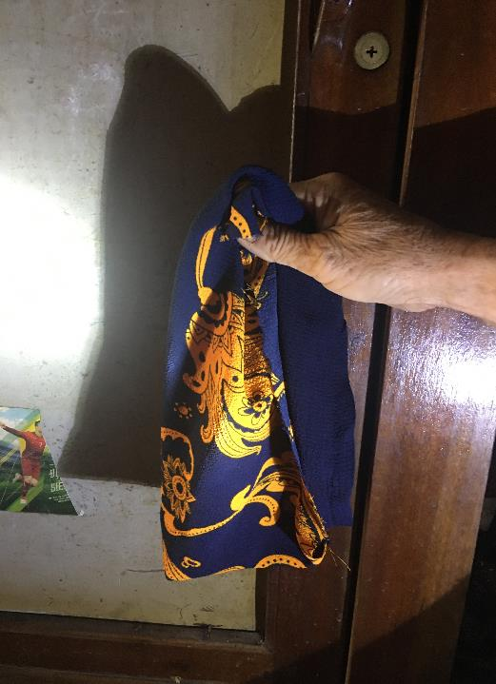
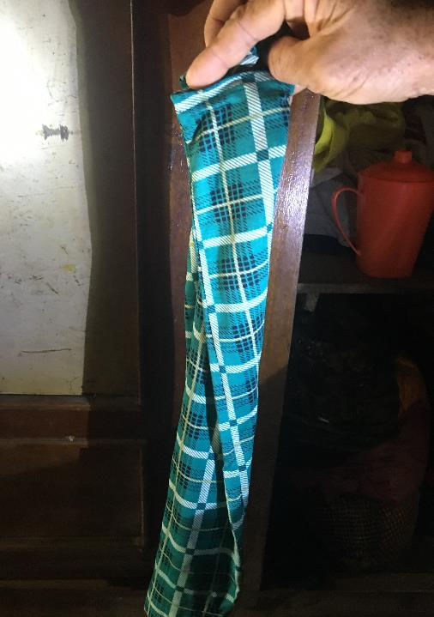
OBSERVATION:
Personal Hygiene
Ms. Pham Thi L., 53 years old in Nghi Xuan village, Quang Phu commune, Quang Dien district, Thua Thien Hue province. She and her daughter had monthly period when flood came:
No sanitation kit
No clean water
No soap/detergents
Use pants as sanitary napkins

Slide 38
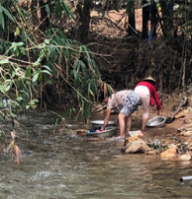
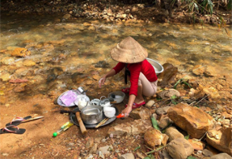
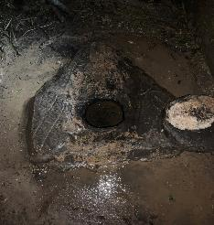
Are they single cases? Not at all
Are these single cases? Not at all
SUMMARY OF IMPACTS
Quang Binh
•105,509 HHs flooded
•29,793 HHs evacuated from 3-7 days to designated shelters
•WASH facility in 303 schools affected
•WASH facility for 58 health stations broken
•46 water piped schemes broken, degraded: pipe system, treatment station
Quang Tri
11 water piped scheme damaged, could not provide clean water
Lack of clean water for drinking and cooking, domestic use
Mountainous areas: Most of Van Kieu ethnic minority do not have latrine and usually defecate outside
Thua Thien Hue
7,477 people evacuated
Pipe systems and chemical treatment stations of 12 pipe water schemes have been damaged
Roughly 10,000 HHs could not access clean water for 2-4 days because the tap was deeply submerged in water
Data sources: Provincial report, NCERWASS data, observation

Slide 39
SUMMARY OF WASH IMPACTS (Cont.)
Quang Nam
09 domestic scale water systems impaired;
02 water systems of 2 commune health centers not functioning (Bhalee commune– 100% damaged and Tali commune – partly)
The water tanks at the flooding-prevention house (Quang Nam) are too small - has just enough water for about 1 day
Data on WASH at schools, health station and HH lever could not be collected yet
Quang Ngai
5 domestic scale water systems have been damaged and already fixed by the local agency
45 digging wells have been flooding up to the well-background, not affecting the water quality (Binh Minh commune).
Ha Tinh
64 communes of 6 districts (Ky Anh, Huong Khe, Cam Xuyen, Loc Ha, Thach Ha and Duc Tho) are flooding,
128 WASH facilities in 128 schools have been devasted.
6 piped schemes have been broken and pumping system did not function well.
Roughly 8,000 HHs could not use dug well water- the main water source for domestic use
Data sources: provincial reports, NCERWASS data

Slide 40
URGENT NEED AND RECOMMENDATIONS
MARD to recommend PPC for water tariff subsidy for impacted HHs (2m3/person/month) in Thua Thien Hue, Quang Nam, Quang Ngai;
Full data on HH sanitation and WASH facilities at public places are expected urgently; MARD/DARD and MoH/DoH to guide district and communes in WASH treatment pre, during and after flooding
10,000,000 Aquatab tablets and 200kg of Chloramine B for Quang Nam, Quang Ngai, Quang Tri
300 RO water filters for 300 schools and health stations in Quang Binh,Quang Tri, Ha Tinh and Thua Thien Hue, priority for kindergartens for boarding children
10, 000 water tanks with 1000 m3 for HHs in Ha Tinh, Quang Binh, Quang Tri, Thua Thien Hue
50,000 Ceramic Water Filters for HHs in Ha Tinh, Quang Binh, Quang Tri
100,000 Sanitation kits for women and girls are strongly recommended for Ha Tinh, Quang Binh, Quang Tri and Thua Thien Hue
100,000 Soap and liquid sanitizer for heath staff in commune health station
WASH Behavior change communication (BCC) for community and schools are critical for disaster prevention and response, particularly personal/menstrual hygiene improvement during and after flooding.

Slide 41
LONG-TERM NEED AND RECOMMENDATIONS
Upgrade broken piped water schemes particularly in Ha Tinh, Quang Binh, Quang Tri
Improve/upgrade WASH facilities for health station and schools
Develop simple guidance tools and guide health staff and community in water treatment and store for flood and storm response
Design mobile latrine for designated shelters and flooding regions
WASH BCC campaign, particularly handwashing for all and menstrual hygiene management for women and girls

Slide 42
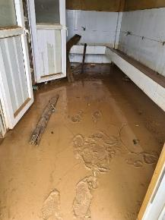
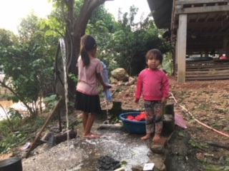
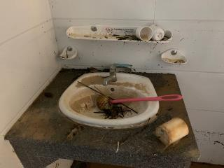
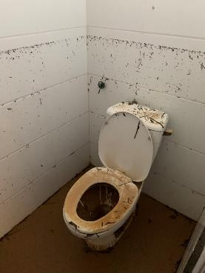
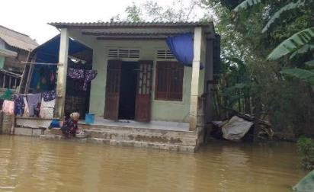
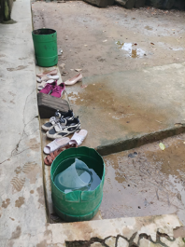
Some more pictures from the trip
Toilet
In a healthcare center in Quang Binh
No water. Not functioning
Van Kieu Children, Quang Tri province
Con Se primary school, Quang Binh
Washing cloths in Quang Phu, Quang Dien, Thua Thien Hue
Water store in Dien Hong, Quang Loc, Quang Nam

Slide 43
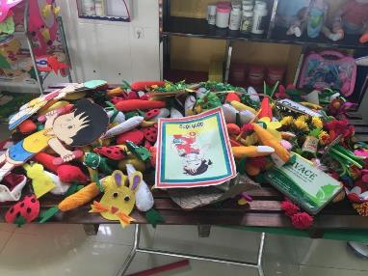

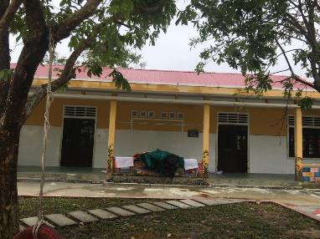
Education – Key observations
Overall: Children’s right to learning is now disrupted
An unknown number of schools, potentially more satellite schools, were damaged, including education equipment, books and WASH facilities. Also many children whose houses were flooded lost education materials.
Schools were closed, varying from just 3 days, to more than 2 weeks and some till further notice in different provinces.
For those schools which re-opened, some had to relocate to other further locations due to damages in school infrastructure and students -especially children with disabilities- faced difficulties commuting to schools.
For schools that are still closed, no temporary school locations have been identified yet to continue their education and restore sense of normalcy.
The teams did not observe alternative learning solutions in -any form- being offered to students to ensure continuity of learning during school closure. For distance learning (Online, TV, Radio), absence of electricity, limited and/or unaffordable connectivity and damaged devices were observed as main barriers.
Some children and families, especially of poorer households and children with disabilities, are not benefitting from school communications and (early) warning information due to limited mobile connectivity and/or language barriers.
Notes:
*In Hue, school closure lasts from 12-16 days, even now 151 schools out of 569 schools have been still closed (26.5%), particularly all kindergarten, primary schools, and secondary schools in Phu Vang district due to unsecured roads to schools.
*In Quang Nam, All classrooms back into normal. All students back in class after the flood after school closure for Middle school for 7.5 days and kindergarten for 3 days
*In Quang Ngai, 34 school campuses were affected with 2-3 days disrupted but return normal now.
*In Quang Binh, Quang Tri, Thua Thien Hue, Many schools in flooded areas were closed for more than a week. Some schools have closed for two weeks.

Slide 44
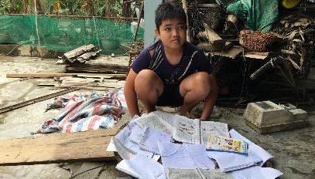
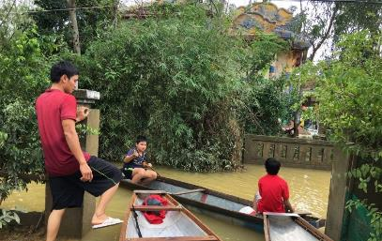
Education - Impacts
A total of 362 school buildings are reported to be damaged
Estimated 2,747 schools in the affected provinces are/or have been closed, interrupting the learning of an estimated 1,2 million students (of which there are 590,000 girls, 5,700 children with disabilities and 101,000 ethnic minority children)
1
2
1
Viet Nam: Floods, Landslides and Storms, Office of the UN Resident Coordinator, Flash Update No.3 as of 22 October 2020.
Statistic provided by the Office of MOET for the Academic Year of 2019-2020.
2

Slide 45
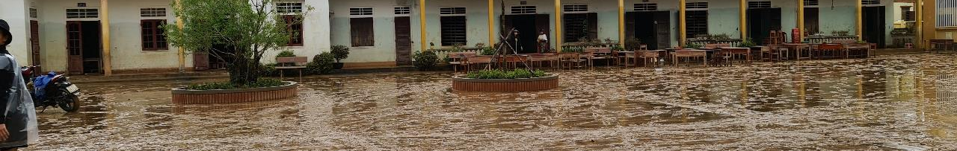
Education – Overall Needs
Priority: An urgent need to ensure continuity of education which include:
  Providing alternative learning solutions reaching every student such as distance learning when schools are closed, when/wherever possible.
  Ensuring a safe learning environment in which physical safety and psycho-social wellbeing of students are ensured and supported. This includes communication to parents to warn when commuting to school is challenging, incl in ethnic minority languages and sign language.
  Equipping children with knowledge and skills on handwashing, nutrition, child protection, disaster adaptation and psychosocial support and well-being.

Slide 46
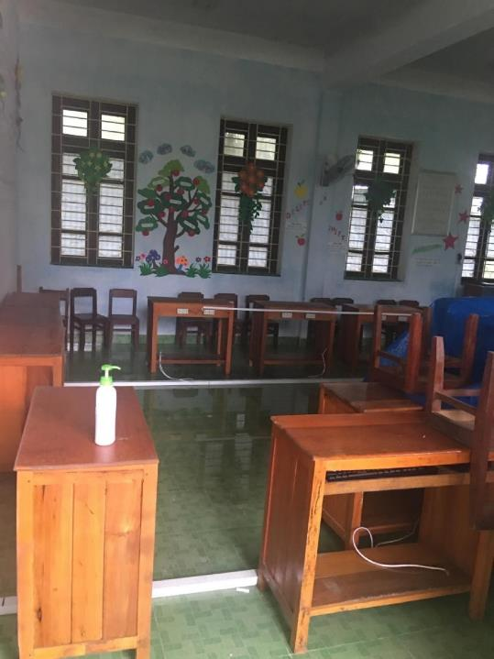
Education – Current Gaps
Major gap: to ensure continuity of education during school closures.
No alternative learning solutions being offered to students to ensure continuity of learning during school closures.
The safety of the learning environment is not ensured – school infrastructure in some cases damaged and commuting to schools in many cases still dangerous.
There is a data gap on psychosocial and mental health status of children, but typically there is an urgent need during and after natural disasters to provide psychological support to in/out of school children and their families.
There is a gap in ensuring messages including early warnings, especially targeting children with disabilities, and messages from school in reaching families especially when connectivity and electricity are not available needs to be addressed.
A specific response targeting children with disabilities is lacking.

Slide 47

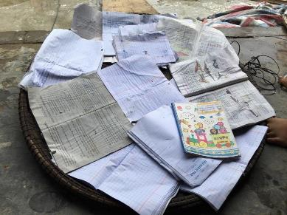
Education - Recommendations
Immediate responses
Ensure the continued learning of affected students through supporting the Ministry of Education and Training (MOET) with the provision of distance and online learning opportunities.
Providing emergency education supplies to affected provinces especially for children whose houses and/or schools were flooded.
Ensure a safe learning environment by assessing current and future school safety and damage to educational facilities.
Disseminating communication messages on handwashing, nutrition, child protection, psychosocial support and well-being, including in ethnic minority languages and sign language, reaching the most vulnerable children and families.
Ensure children and their parents are provided with opportunities for immediate psycho-social support in schools.

Slide 48
Education - Recommendations
Recovery
Implement Safe back to school Protocols, special consideration for gender and protection issues.
Preparedness
Strengthen the capacity of the education system on more effective preparedness and response interventions, and more attention to narrow the digital divide for the most marginalized and vulnerable children .
Update hazard maps at provincial, district and commune levels and take into account student exposure to hazards along commute routes and locations of (satellite) schools.
Awareness raising and conduct of skills trainings to build capacities for children on what they should and/or shouldn’t do before, during and after disasters to prevent injuries and drowning.
Improve early warning systems that are relevant also for children with disabilities and ethnic minority children to provide real time information at the local levels to inform localized decision making and avoid unnecessary disruption in education services in unaffected areas.

Slide 49
Gender and Protection
Joint Need Assessment
Floods in Quang Binh, Quang Tri, Thua Thien Hue, Quang Nam and Quang Ngai
21-23 October 2020
Inputs from Gender and Protection Group member:
UN Women, CRS, UNICEF, Save the Children, UNFPA
Notes:
- Key issue faces by women and the most vulnerable people
- Safety and security of women and children

Slide 50
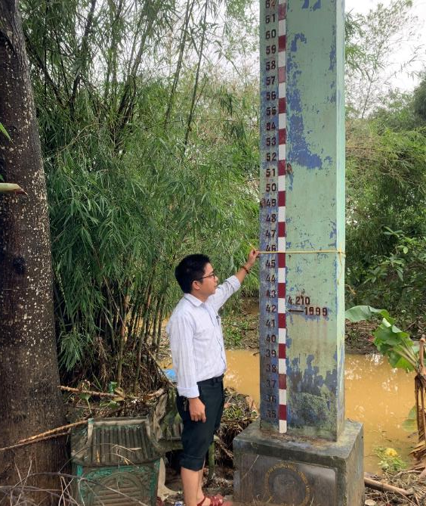
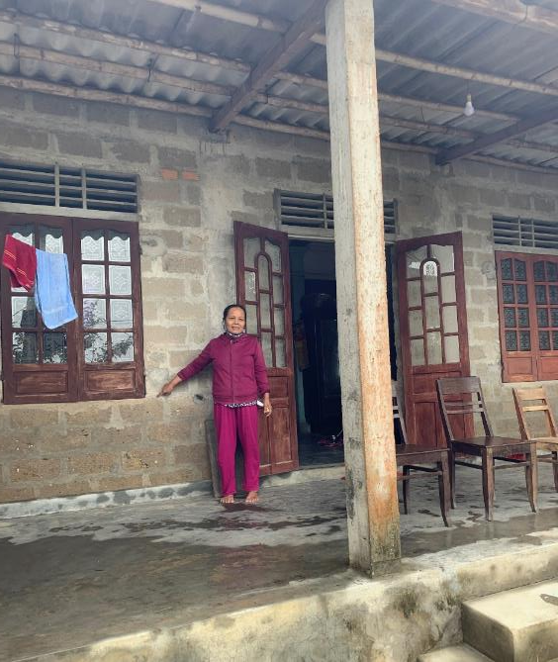
Loss of non-food items (clothes, blankets, kitchen items)
16/123 deaths are women
13/123 deaths are children
The most affected are the most vulnerable people (poor, near poor, single or female headed HH, disable people, old people) as they live in low areas, their houses are not concrete enough, they do not have stored foods, they did not receive timely warnings for evacuation, or they underestimated warnings. Most of them were not prepared for the floods.
Most of HH items were swept away or soaked into water for many days, which no longer can be used.
Negative impacts on the most vulnerable as they do not have money to buy new items and the winter is coming.

Slide 51
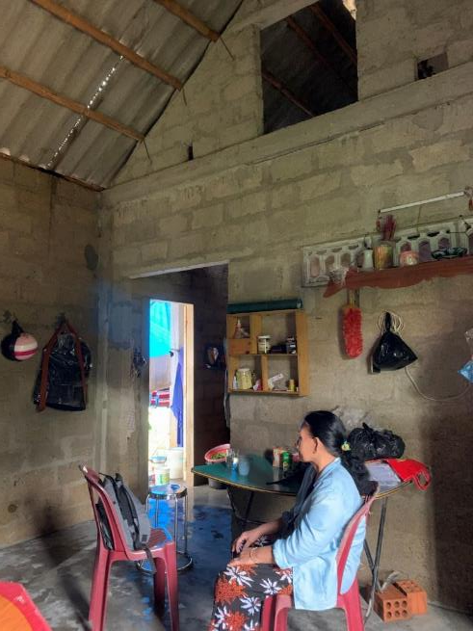
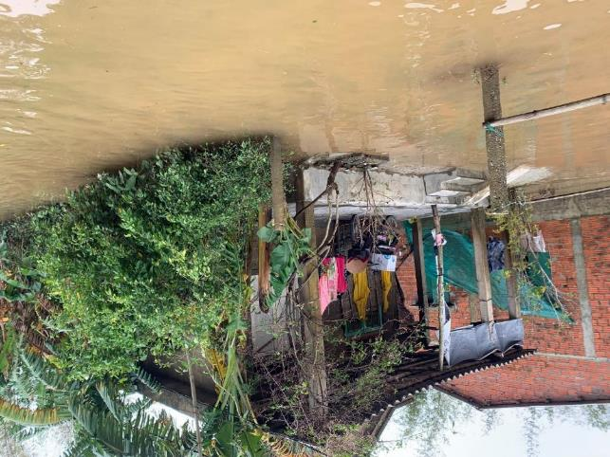
Ms. Le Thi Cam – 63 years old, a widow, poor HH, in Quang Phu, Quang Dien.
Her clothes and household items were swept away or dipped in the flood. Her roof were broken during the storm. Midnight of the 6th Oct, she and her daughter had to evacuate to a nearby worship house as the water rose so quickly. They stayed there with anther widow for 5 nights without electricity, battery or phone. They slept on a table and ate instant noodles provided by the commune rescue team. It was very frightening for them.

Slide 52
Safety and security in evacuation sites
Thousand people had to evacuate to safe places (Hue: 15,147 HH; Quang Binh: 29,793 HH; Quang Tri: 15,372 HH) for a least 3 days to 2 weeks.
Evacuation sites are often public places (community houses or commune PC offices) or neighbor's houses. These locations often did not have sleeping areas separated by gender. They usually end up sharing overcrowded space with both family and non-relatives which limits their privacy and can lead to conflicts between families, general harassment and intimidation, increase risk of violence, sexual harassment to women and girls and boys.

Slide 53
Safety and security in evacuation sites
No electricity, no flashlight, phone were out of battery, women, especially single/widow women did not feel comfortable/safe to stay in these places. They tried to go back to their houses as soon as they could, even there was still water flooded.
Women in ethnic minority groups (Pako/Vân Kiều) in Quang Tri, due to their culture, they only evacuate to their family houses, or neighbor’s houses if both husband and wife go.
Evacuation sites are not accessible for people with disabilities. They do not have basic health care for evacuated people.
No bathrooms and toilets at all, or no separate bathrooms and toilets in the evacuation sites.
More information is required about sexual violence/cases of violence in their community during flood time. But the women interviewed share feeling safe sheltering in community flood evacuation house. Ms. Pham Thi Mui, 59 years old, village Tan Phuoc Dong, Binh Minh Commune, Binh Son District
Notes:
More information is required about sexual violence/cases of violence in their community during flood time. But the women interviewed share feeling safe sheltering in community flood evacuation house.Ms. Pham Thi Mui, 59 years old, village Tan Phuoc Dong, Binh Minh Commune, Binh Son District

Slide 54
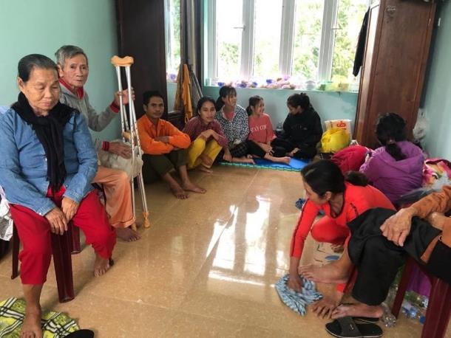
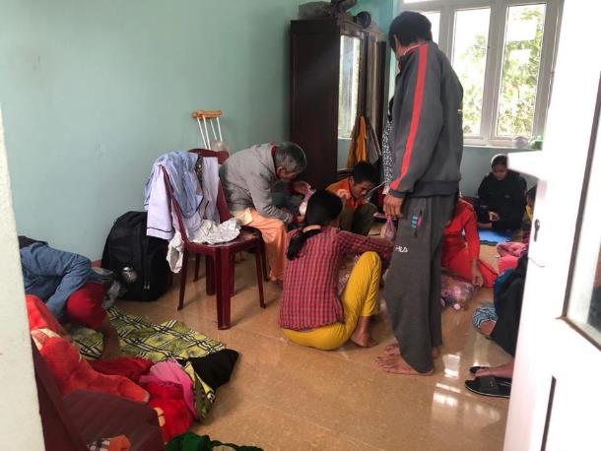
150 people was staying in the Commune PC Office in Tan Ninh commune, Quang Ninh, Quang Binh since 18/10

Slide 55
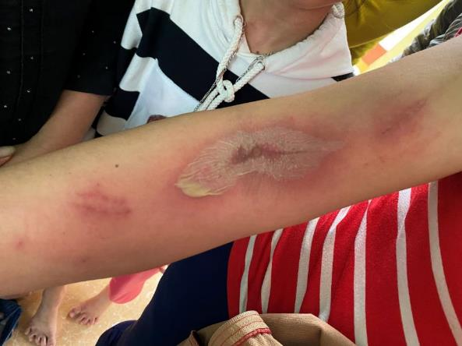
Negative impact on women and vulnerable people’s health
Many pregnant women, breast feeding women are facing food insecurity and under nutrition, related illnesses, while a lack of access to healthcare and other stresses, raised the risk of miscarriage for pregnant women and cause a long-term impact on health of women and children.
Many women reported getting gynecologic infections, sick and other skin diseases from soaking in water for many days, lack of clean water for bathing, lack of clean clothing, and personal hygiene items.
Pregnant women, mothers, and older persons are at risk if they could not be timely referral to higher level for health care if the affected areas are isolated due to flooding.
Notes:
- There was one woman who slipped and fell into the water and suffocated while cleaning after the flood; 03 children drowned while using the boat to get away from the flood.
- 05 women were injured/ had their arms broken/ had back pain when cleaning after the flood; 01 child slipped and had his head injured

Slide 56


Increased burden of domestic work and care work for women after the flood
Women play primary roles in doing domestic work and care work in the family
During the floods, women took care of children, elderly and sick people.
After the flood, women clean muds, cleaning houses, clothes, kitchen items, drying rice…
Not only for their houses, but also for community
Take a lot of their time and impacts on their long-term health
Notes:
Have had to spend additional time to get water for the family and for livestock raised due to women’s primary responsibility in managing water for domestic use in the family (e.g. drinking, cooking, bathing for children, taking care of family members). For example, in Quang Nam, interview with household found that woman has to collect water for domestic use and for 4 cows raised as there was no electricity provided which mean additional at least 2 hours a day.
Pregnant women, mothers, and older persons are at risk if they could not be timely referred to higher level for health care if the affected areas are isolated due to flooding.

Slide 57


Women cleaning their houses

Slide 58


Loss of jobs and livelihoods of women
The flood causes further negative impacts on incomes/livelihoods of the most vulnerable women – who do informal jobs and rely on daily wages such as in aquaculture farming. Many of them are already affected by the COVID-19.
Many women loss their main livelihoods due to the flood. Vegetables and livestock are the main incomes for women during these months until the next rice crop. In Hue 332 ha crops were destroyed and 57,357 livestock were killed.

Slide 59

Interview a women
Ms. Nguyen Thi Hanh, 52 years old, Nam Truong village, Giang Hai commune, Phu Loc district, Thua Thien Hue.
Her 1,500m2 of morning glory were all destroyed by the flood last week in Hue. This is the main income for her family from now until the next rice crop which will be in January next year.
She has 4 children and 3 of them are still going to school. Her husband working as an informal construction worker and he did not have much work this year due to the COVID-19.
If the vegetable were not flooded, she could earn around 150.000-200.000 VND per day which she could buy food for the family and pay for school for children.
She said she will need to borrow money for living and for recovering her vegetable.
In her villages, around 50 women was growing vegetable and are in the same situation as her.

Slide 60


Ms Phạm Thị Nở (50 years old) and her daughter Phạm Thị Hoa (7 years old) at Con Se village, Quang Loc commune, Ba Don town
Her income (1,500,000 VND/month) was from weaving nets and collecting bottles. Her house got flooded in the early morning of October 18, 2020. She asked neighbors to help her evacuate to a tall building nearby.
In the afternoon of October 20th she come back home to clean the house. She said : I had two buckets to store rainwater for drinking, but now one bucket has been swept away. Clean water has not yet been restored, so I am trying to collect rainwater for drinking and cooking. There is not enough for bathing and washing”. She and her daughter got skin diseases.
Clothes, household items, pots and pans were washed away or wet. One week before the flood, she bought 01 oats of rice, but it is also wet now. The remaining amount of rice will only be enough for her family to eat with fish sauce for 2-3 days. She has no job and no income now. She plans to borrow rice until she can collect bottles or weave net and earn money again.

Slide 61
Child protection
Although no reported case on children neglected, in affected districts, schools was closed from at least 1 week, to 3 weeks and children has been staying at home with their grandparent or mother.
Risk of stress/trauma/mental health to children due to hearing/experience classmate loss the lives in disaster and could not talk to teacher or parent (Quang Ngai)
Relocated 41 high school students, who were not part of the boarding program, incurring meals and living expenses but not supported to campuses contain risks of child protection
Risks of getting drown: the percentage of children learning to swim and how to swim increased from less than 30% in 2016 to more than 35% in 2019 (Still very low) in Quang Nam. During the flood in Quang Nam, two children drown. In Quang Ngai there are 15 swimming pool that provide training to only 300 pupils.
Majority of parents go working outsides leaving children stay with grandparents and that may lead to risk of child-protection issues (being neglected, sex abuse…)

Slide 62
Immediate needs
Targeting the most vulnerable:
  Reliefs activities (food, nutrition, WASH, health, shelter…) to target the most vulnerable people: poor, near poor, disability, female headed HHs, old people, based on their specific needs
Protection:
  Ensure separate sleeping areas by gender and safety measures for women and girls in evacuation sites, evacuation plan should take into account gender and culture sensitiveness and disability.
  Mobilize fund to build the road for PWD/OPs to get to sheltering area in second floor of Community flood sheltering house
  Provide mental health and psychosocial support (MHPSS) for children and women after disaster
  Implement case management for women and children affected or at risk
  Provide information in GBV in emergencies, and hotlines on GBV supporting services for women and girls
WASH:
  Hygiene/dignity kits for women and adolescent girls (with water purification in areas that clean water is not yet available)
Shelter:
  Household items for family (kitchen items, blanket, mosquito net, clothes, flashlight and back up battery, life vest).
Livelihood:
  Cash for work programme for women who rely on daily wages
  Support new seeds and livestock to recover agriculture livelihoods for women.

Slide 63
More long-term recommendations
Child protection:
  Raise awareness on child injuries including drowning, risks of violence against children (VAC) and measures to prevent VAC and inform hotline/helpline numbers
  Conduct communication activities to raise awareness of community on injury risks and measures to prevent children from injuries including drowning
Strengthen coordination on GBV interventions in emergencies at central and local levels.
Mobilize fund support the swimming course training with swimming pools, particularly for women, children and vulnerable groups, poor people.
  Support swimming pool for school in flood area
Strengthen Women Union role in Committee of Natural Disaster Prevention and Control
  Specific program to support role of Women at local level through communication on DRR, health and in livelihood sector with standard material
  Capacity building so that they provide meaningful contribution.
  Communication activities on women’s role in DRR and gender sensitive DRR plans
  Monitoring and evaluating integration gender into NDPC plan.
Notes:
Lack of infrastructure for swim training, particularly for women, children and vulnerable groups: Risks of getting drown: 1 women was drowned in Quang nam
2.Limited communication material on DRR for communication activities/integrated activities for Union/Women Union at local level
3.Lack communication activities on women’s health and disaster risks
4.Limited integration gender into NDPC plan with M&E the implementational

Slide 64
More long-term recommendations
Provide training course of CADRE (Community Action for disaster response) for commune in flooding area
Invite Labor, Social Affair and Invalid representative into committee of NDPC
Enabling environment for PwD, OPs in technical support group (TSG) for CBDRM at different level
Awareness raising/training/capacity building to local authorities, NDPC on inclusive integration to NDPC and
Support for timely referred to higher level for health care for the vulnerable group once the affected areas isolated

Slide 65


















