Slide 1
Word cloud
Metimeter; Q. As a global shelter cluster member, practitioner, coordinators and academics. What has COVID meant to you?
Notes:
Seki

Slide 2

Global Shelter Cluster annual meeting
Thematic session COVID and Shelter 08.10.2020
Notes:
Seki

Slide 3
Topic | Speaker
Welcome (5 mins) | Seki Hirano GSC SAG (CRS)
2. Global HRP for Covid-19 response and the role of shelter in it (5 mins) | Cecilia Schmoelzer (IFRC) Angel Pascual (UNHCR)
Reflecting on Covid -19 Shelter and health infrastructure interventions/ coordination (20 min) Distributions Adequate shelter Adequate settlement Reducing over crowdedness Quarantine facilities Health infrastructure Ventilation | Cecilia Schmoelzer (IFRC) Claire O’Reilly (ARUPS)
4. Discussions Reflection on the type of S+S programming in response to COVID How are you preparing for the future? (25 mins) AOB - announcements | All Emma Weinstein-Sheffield (CARE/ Oxford Brookes) Indonesia Shelter Cluster
Notes:
Seki

Slide 4
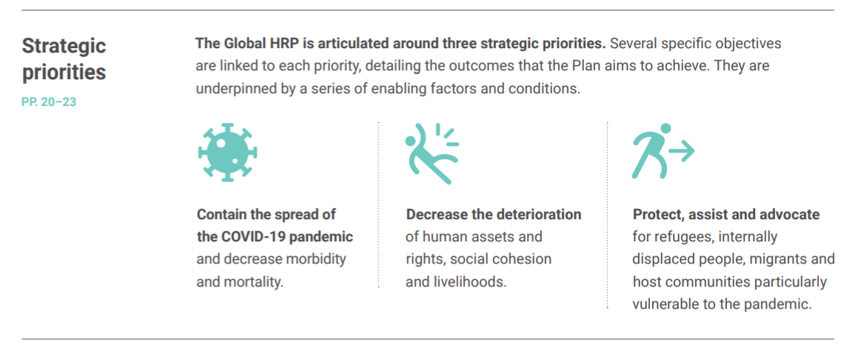
Global HRP for Covid-19
Notes:
Cecilia 3mins

Slide 5
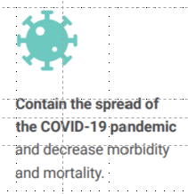
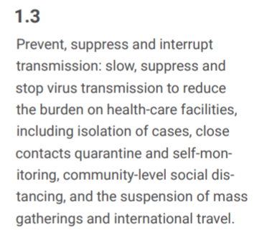
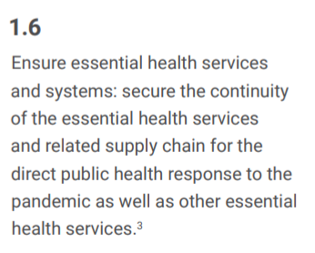
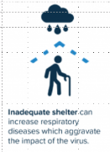
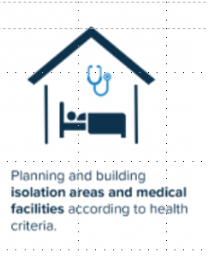
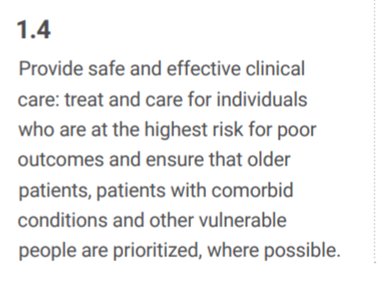
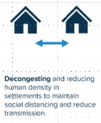
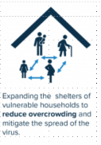
Shelter & Settlement related activities suggested by the appealing agencies:
- “Activities will be implemented to improve living conditions of displaced populations to minimize the risks related to the spread of COVID-19 disease, including improvement of camps and camp-like settings, provision of WASH services, and shelter assistance to support density reduction and isolation.”
- “…reinforce and improve shelters including for isolation purposes; stockpile and provide core relief items, particularly for distribution in congested urban and camp settings. “

Slide 6
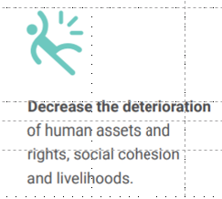
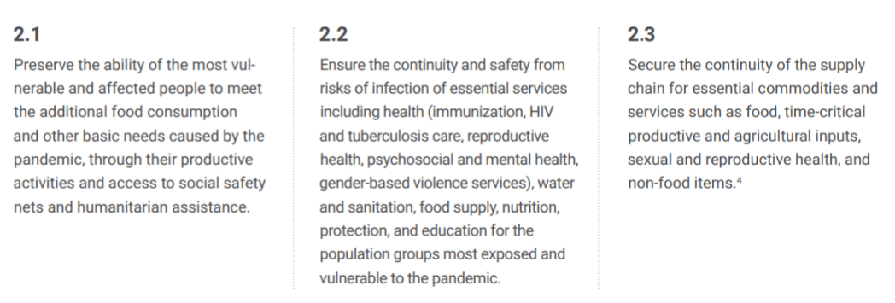
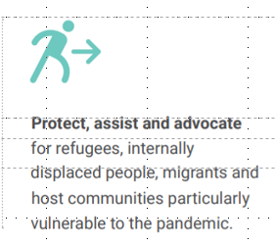
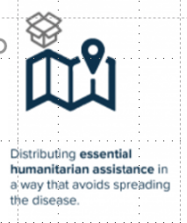
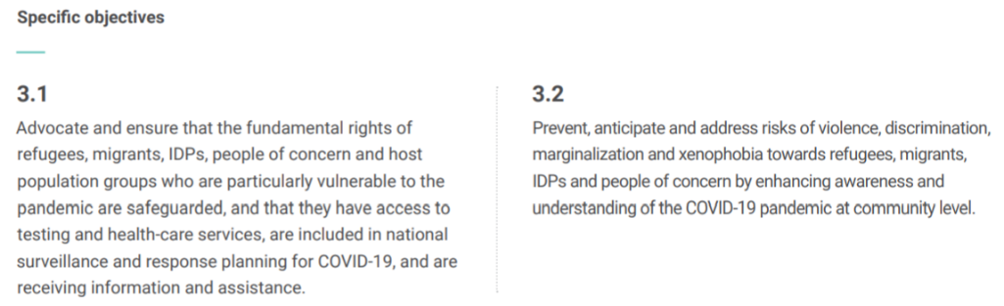

Slide 7
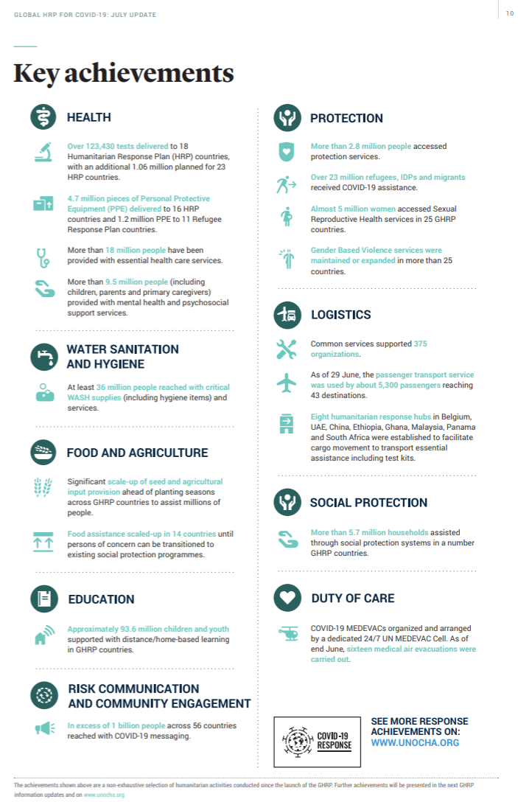


#+
GLOBAL HRP FOR COVID-19, JULY 2020 UPDATE
Find the missing sector…
What happened to the
Distribution of essential humanitarian assistance (NFI) while following preventive measures?
Measures to decongest, reduce overcrowding, improve shelter quality to reduce transmission, stabilize mental health, reduce GBV risk, etc.?
Construction of Isolation wards and temporary medical facilities?
🡪 Does this reflect the reality on the ground?
Notes:
Cecilia
Now the first results of the global HRP we can see in the key achievement published in July this year. 🡪 🡪
What happened to the
Distribution of essential humanitarian assistance (NFI) while following preventive measures?
Measures to decongest, reduce overcrowding, improve shelter quality to reduce transmission, stabilize mental health, reduce GBV risk, etc.?
Construction of Isolation wards, quarantine spaces and temporary medical facilities? They are not reported under the health achievements!
Knowing that a lot is actually being done and we will see that in the presentations shortly I wonder why we don’t see it here in the HRP update?

Slide 8
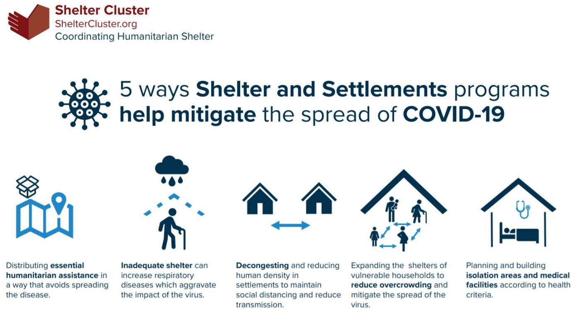
Shelter response framework for Covid-19 mitigation
NFI distribution / Construction site safety
Adequate shelter
In terms of thermal comfort, ventilation etc.
Adequate settlements,
space and basic facilities
Adequate shelter
in terms of space, possibility to separate
Adequate emergency health infrastructure
Notes:
Seki 1 mins
summary of 5 key concepts how shelter response can support the fight against the spread of Covid 19.
Produced by GSC

Slide 9

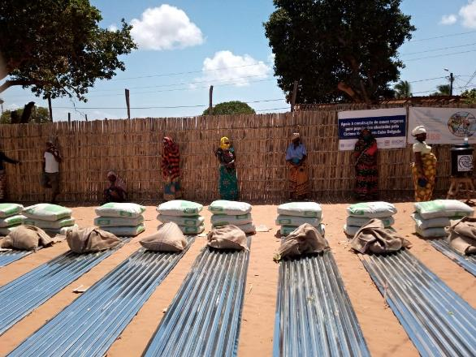
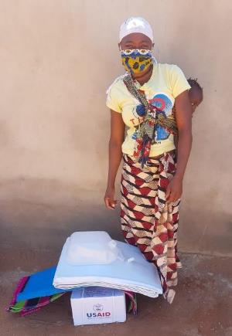
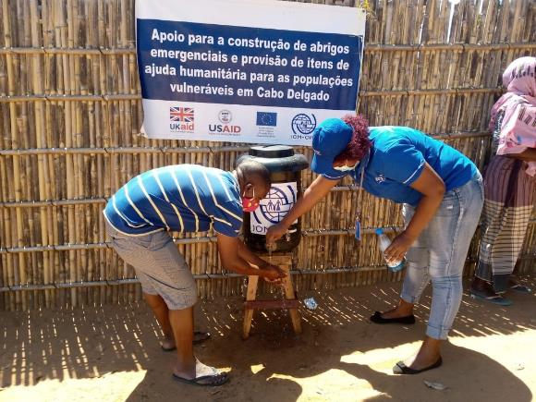

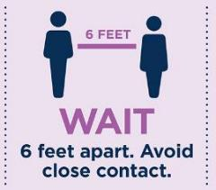

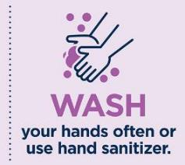




Distributing essential humanitarian assistance
NFI Distributions (Mozambique, IOM)
Fotos: Clara Gomez, IOM)
Gloves if you are staff
- At all moment -
EVERYONE and at all moment
and use hand sanitizer regularly
EVERYONE and Regularly
INFORM
(Information, Education and Communication)
Notes:
Cecilia 1 mins
Shelter & NFI response all over the world has adapted to the Covid-19 restrictions. - Reorganising distributions in a way that implements social distancing rules and avoids people crowding or queuing at distributions points
Sometimes Kits have been adapted to include additional items such as face masks or gloves, or additional hygiene articles
Handwashing stations are installed and used for demonstration purposes during the distribution
Distributions are used for information and awareness raising
Staff also follows very strict hygiene protocols

Slide 10
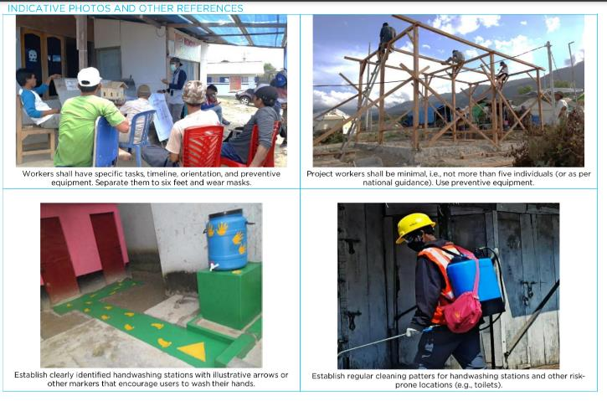



Construction site safety – for COVID
Main underlying approaches:
Reduce access to site
Adapt work plan and activities to reduce close contact
Increase overall level of hygiene of the site
Prioritize health and safety of staff, workers and their surrounding communities
Increase awareness of the workforce
Notes:
Seki 1 mins

Slide 11
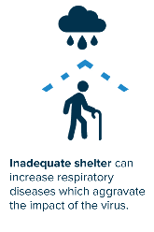
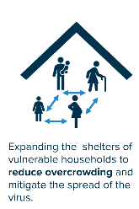
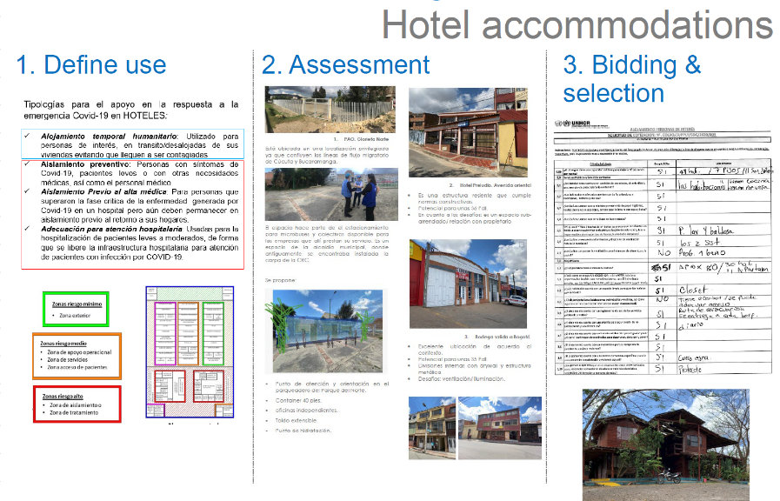
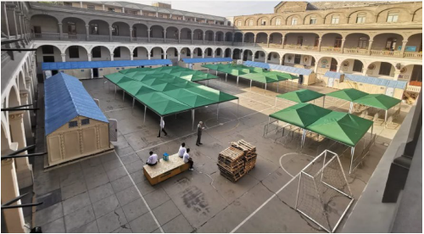
Providing Adequate Shelter
Setting up and running adequate temporary shelter arrangements (collective shelters) including Covid-19 prevention measures.
Providing cash-based support for rental assistance and hotel accommodation to prevent eviction or not finding accommodation.
UNHCR, Americas: CBI for shelter
UNHCR, Peru: New collective shelters

Slide 12

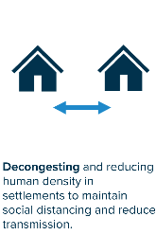
Decongest and reduce overcrowding
Reorganizing and expanding temporary shelter arrangements (collective shelters, camps) ensuring social distancing measures and better hygiene and health protocols can be followed
UNHCR Colombia: Adapting/expanding existing collective shelters

Slide 13

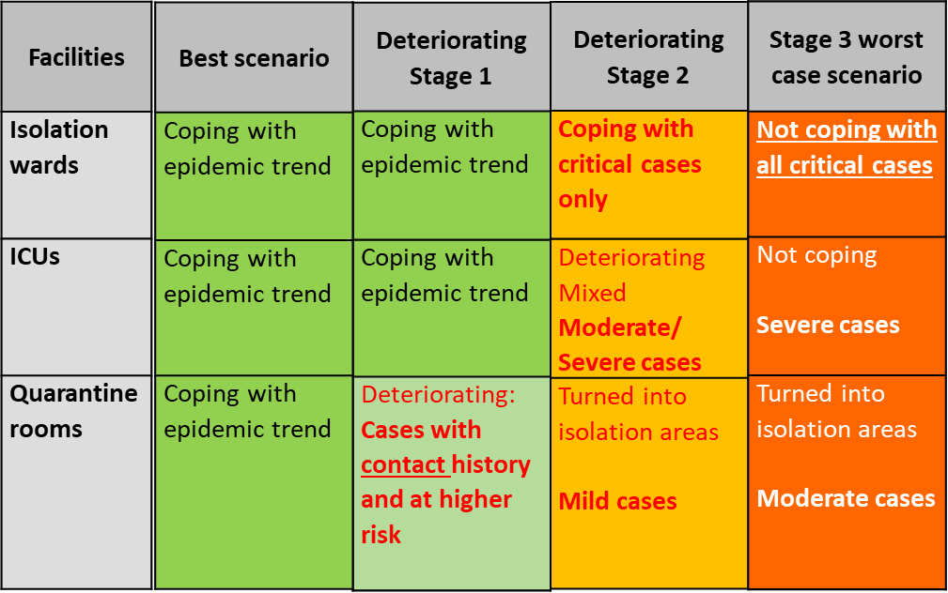
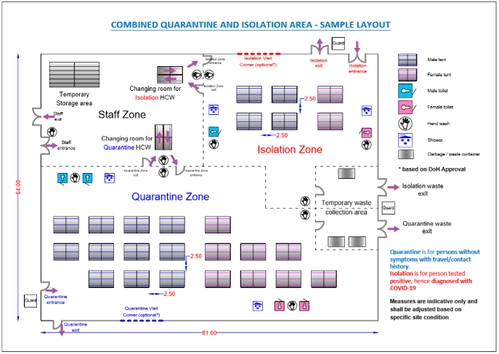
Setting up Quarantine and Isolation areas
Collaboration between Health and Iraq Shelter Cluster (UNHCR, WHO):
Scenario planning for deterioration of health care system
Development of guidance for planning and setting up quarantine and isolation spaces in camps, including SOPs on Home Quarantine/Isolation as last resort.
https://www.sheltercluster.org/response/iraq

Slide 14

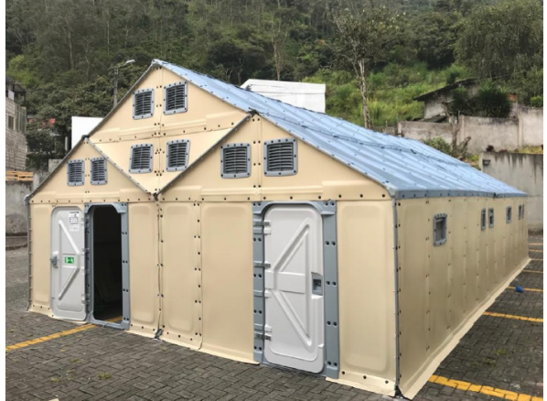
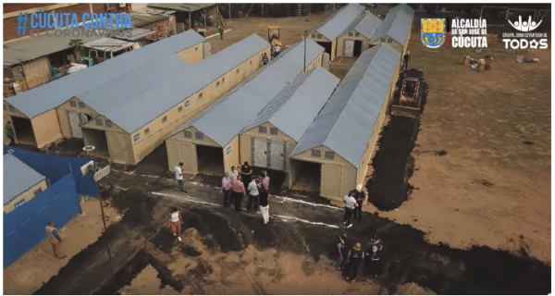
Expanding/ building Health Care facilities
Isolation and Quarantine centres with focus on IDPs and returnees who have to be quarantined when arriving back in their country (e.g. Venzuela, Colombia, Ecuador, Panama, etc.)
Setting up or temporary health facilities to support the treatment of Covid-19 patients (Brazil, Colombia, Ecuador, Peru, etc.)
UNHCR Ecuador: Expansion of health infrastructure using RHUs

Slide 15


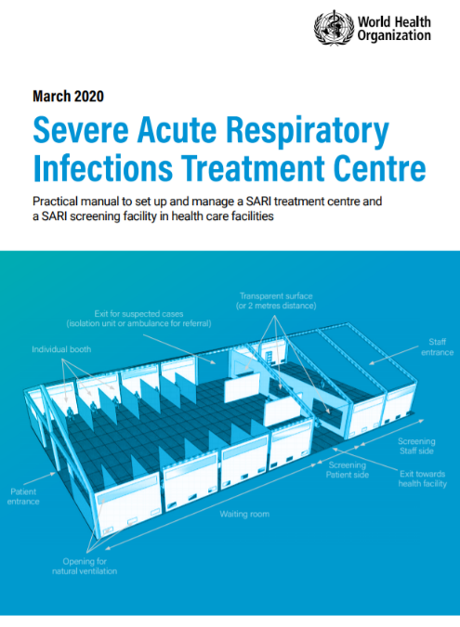
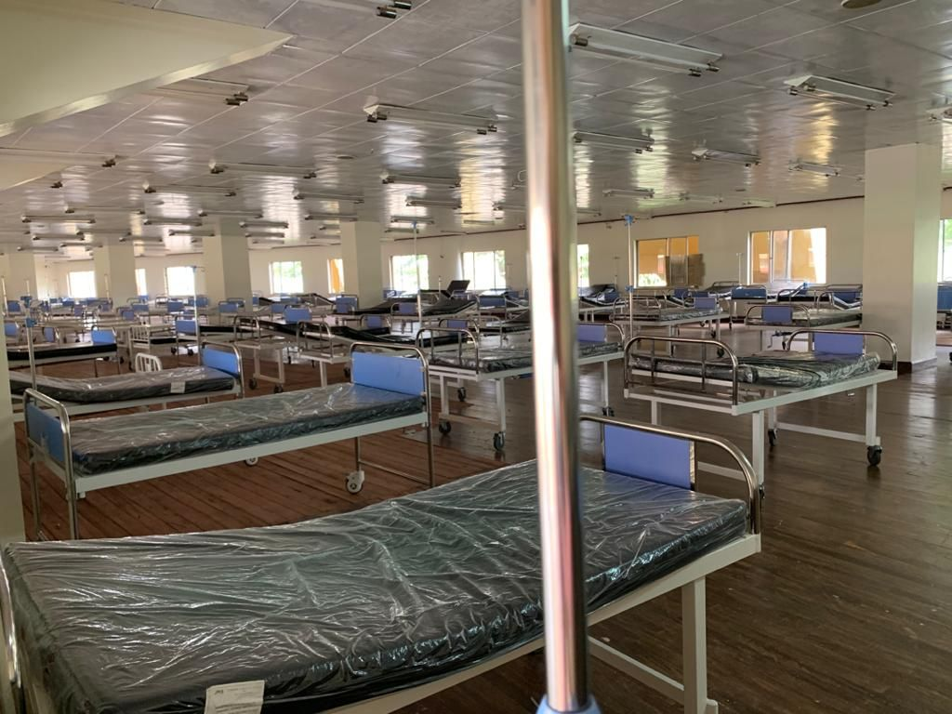
https://www.who.int/publications/i/item/10665-331603
Notes:
Seki

Slide 16
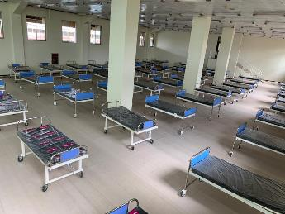
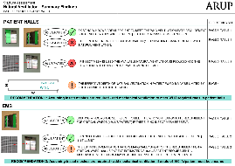
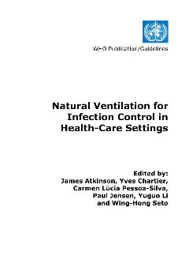
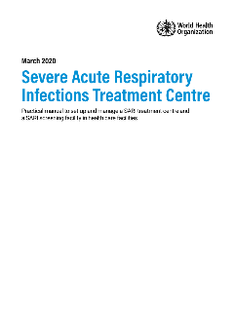
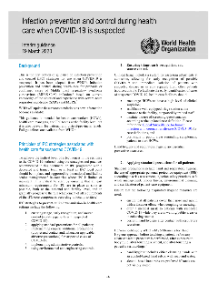
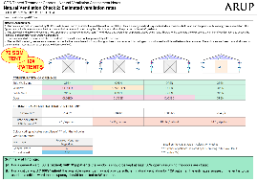
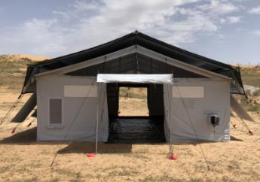
Ventilation and Covid-19
From emerging technical guidance
To practical application in the field
https://www.alpinter.com/product/xpert-tent-24/

Slide 17
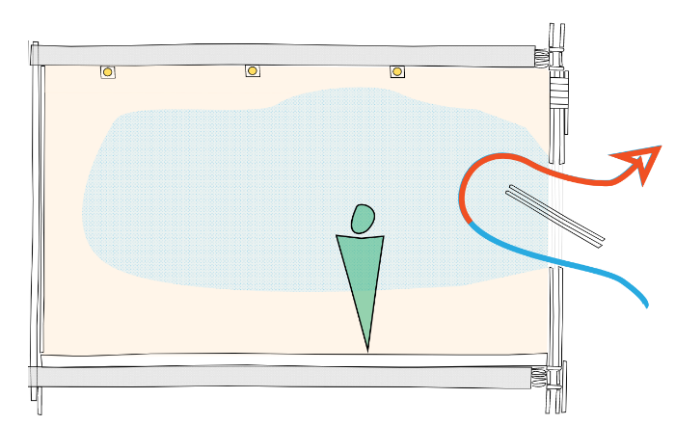
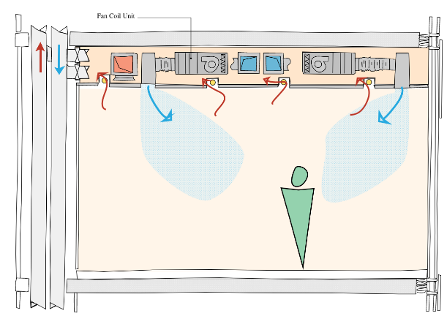
Ventilation and Transmission of Covid-19
Natural Ventilation
Mechanical Ventilation
Supply air
Return air
Airflow through openings to external air – e.g. windows
Airflow driven by fan through ductwork
May be part of a Heating Ventilation and Air Conditioning System (HVAC)
Can involve some of the air from the room being recirculated

Slide 18
Natural Ventilation considerations
How much ventilation is available?
How much ventilation do you need?

Slide 19
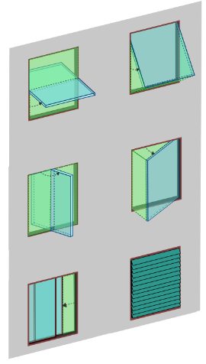

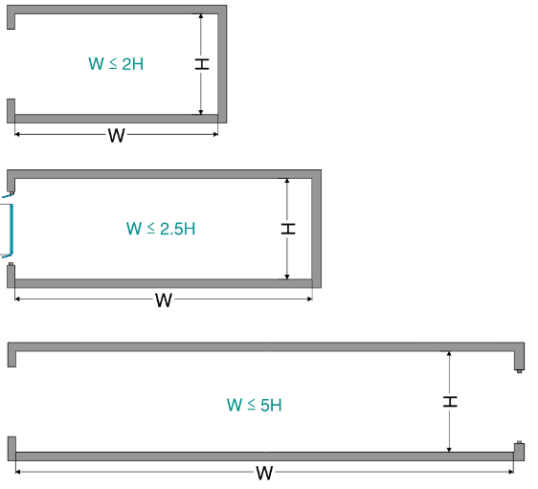




Natural Ventilation considerations
How much ventilation is available?
Configuration
Size of openings
Single Sided
open
closed
Double sided - “Cross ventilation”
Free area: Area of window less the frame and other obstructions like insect mesh
It’s only an opening if it’s open

Slide 20
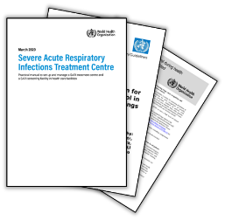
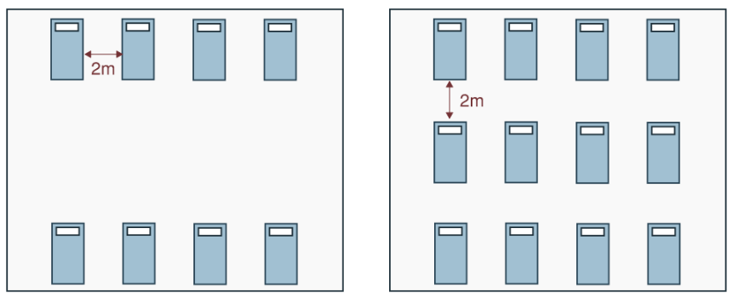
Natural Ventilation considerations
How much ventilation do you need?
For general ward rooms: 60 l/s/patient
More patients → more ventilation required
For airborne precaution rooms (‘critical ward’):
160 l/s/patient
You may have space for more patients but do you have enough ventilation?

Slide 21
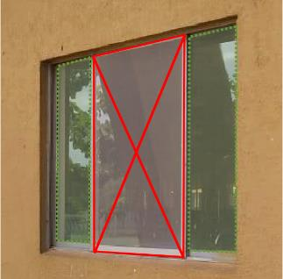
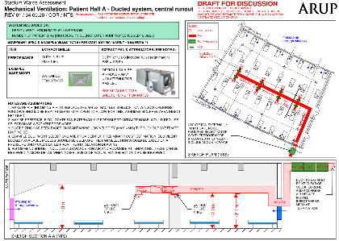

Natural Ventilation considerations
What if available ≠ required?
1. Increase what is available
2. Reduce requirement
Increase area of opening
b. Add mechanical ventilation
Limit the number of patients based on ventilation
Simple (?)
Cheap (?)
Able to return to original use?
Design required
Expensive (?)
Operate/maintain
Space for ducts & equipment

Slide 22
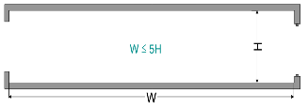


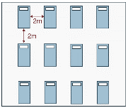

Natural Ventilation – key points
Look at the “current” guidance
A space that appears to have plenty of ventilation may be deceptive!
Will air be effectively distributed
How much open area is there? And will it be kept open?
The number of patients that fit might exceed the number you can provide with ventilation
claire.oreilly@arup.com

Slide 23
Shelter response framework for Covid-19 mitigation
NFI distribution / Construction site safety
Adequate shelter
In terms of thermal comfort, ventilation etc.
Adequate settlements,
space and basic facilities
Adequate shelter
in terms of space, possibility to separate
Adequate emergency health infrastructure
Notes:
Seki

Slide 24
Metimeter; multiple choice.
Which type of programming has your organization implemented to tackle COVID- 19 related issues?

Slide 25
Challenges and Consequences of COVID-19
Particularly for NFI distributions:
breaks and delays in pipelines for international procurement and depletion of local market stocks for items in high demand
Social distancing regulations and other measures such as movement restrictions (lockdown) etc. add considerably to time and effort for distributions.
Reduced coverage of HHs per day slows down provision of essential support and amounts to at least triplicating operational costs!
Coordination between sectors, especially Health and Wash but also Food security is absolutely critical for scenario planning as well as implementation. However collaboration with other sectors has proven to be challenging also with various other actors such as with health authorities. Partially because of limited capacity being overwhelmed with the challenges of the response but also because of lack of appreciation for the importance of adequate shelter for health and more holistic approaches.
Support to health care facilities not necessarily reported as shelter intervention.
→ Very little or NO funding for shelter received through the Covid-19 HRP.

Slide 26
How are you preparing for the future?
Are there opportunity to update Shelter COVID strategy – Evictions, Infection Prevention Control at home.
Is it a game changer? Is it asking us to change our practice forever?
Will it put better living conditions higher onto the agenda?
Are we learning new and better ways of serving people affected by crisis?

Slide 27

#WorldHabitatDay
https://twitter.com/antonioguterres/status/1312907101342056448

Slide 28








Guidance, Information and tools
Notes:
An amazing number of resources has been produced, various guidelines, recommendations, information sheets, messaging, even a “chatbot” to inform about Covid-19
However, the resources to actually implement shelter related activities remain very limited around the world.

Slide 29

Shelter and Health Multi-sectoral Learning Day 14th May 2020
Learning Day in brief
20 presentations and 8 breakout groups
Representatives from Health, WaSH, Shelter
Humanitarian and development researchers and practitioners
Physical and mental health conditions linked to homes and settlements
‘Towards Healthier Homes’ report at CARE Insights
Notes:
We organised the Shelter and Health multi-sectoral Learning Day in May. Many of you attended. The key idea was that the workshop included both development and humanitarian actors: academics and practitioners. People with Shelter, Health and WaSH backgrounds. In other words, groups that don’t normally meet!
Workshop planned pre-COVID19, but the pandemic has made the topic even more relevant. Still, there are so many health issues other than viruses that can be mitigated by better, less crowded shelter.
There were 20 presentations with opportunities for further discussion in breakout groups. Not enough time for discussion, but happily there have been many follow-up conversations and there are many more to come.
One important point to make though is that we are aware that one group was missing from the conversation, as so often, the affected populations – the ‘home-makers’ themselves.
Following the presentations and the surrounding discussion plus feedback forms, we divided the main findings from the day into three themes - Shelter realities and practice, Research and evidence-building, Advocacy and policy. You can read the detail in the report.
https://insights.careinternational.org.uk/publications/towards-healthier-homes-in-humanitarian-settings

Slide 30

Tracking the recommendations...
Notes:
5 recommendations made. We’re now tracking progress on these and welcome further ideas and collaborations to make them happen.

Slide 31

Environmental Health lens: how do we ‘mainstream’ health in shelter and leverage the co-benefits of healthier homes?
Continue to gather emerging research evidence from varied sources
Roadmap for Research (InterAction) chapter: need for evidence synthesis and first steps in field research to evidence connections between shelter and health
Health questions being built into GCRF project activities e.g. in Malawi
Collaborative research with Health partners - we need their expertise
Notes:
New research all the time, - humanitarian and development settings. Lots of new research prompted by COVID e.g. ventilation, shelter design, air quality, transmission of viruses. See EvidenceAid resources
Collaborative chapter for Interaction’s Roadmap for Research publication (currently a draft) - setting out how to develop a wider ‘Environmental Health lens’ in practice
Health in CRAterre’s local scale ‘contextualised analysis of local construction’ pilot as part of testing and refining Step 1 of the Protocol. Planned research on health outcomes alongside CRS’ Extending Impacts studies
We need to start somewhere… barrier of evidence is currently holding back action and donor acceptance. Clear advocacy needed with donors and other sectors.

Slide 32
AOB
Anyone would like to share any events links etc.….?
Feed back form on the session – leave message on anything you would like to follow up with.
https://ee.humanitarianresponse.info/x/sv6oXV96
Take care.

Slide 33

Ideas for further Covid-19 or other health related responses:
Establish a good collaboration with Health Cluster/health actors
Advocate for shelter to play a more important role in the prevention of diseases. Adequate shelter means good health and wellbeing…
Collect evidence that adequate shelter interventions have a high impact on health outcomes.
Image from: WB, 2020, GPURL Online Learning Series: „Cities and Contagion Rapid Deployment Tool to Identify COVID-19 Exposure Hotspots“
Notes:
One thing we can do already is of course, to specifically report all the covid related activities. I know, we all love reporting and have nothing else to do, but in the end if we don’t report shelter will not get the visibility or the funding it deserves.
Link to the COVID-19 reporting template: https://ee.humanitarianresponse.info/x/9LsRBIfT

Slide 34

Funding for global COVID-19 appeal
https://fts.unocha.org/donors/8523/summary/2020
construction of temporary isolation facilities is often taken on by Shelter Clusters not Health Cluster hence not in the Health Cluster budget
Health Cluster received 22.5% of the global COVID-19 appeal funding. Protection (including child protection and GBV mitigation) received app. 16%, Shelter about 2%
~2%?
Notes:
The same is reflected in the funding recorded on FTS.
Of course, the health sector needs to be prioritized in a pandemic, but the construction of temporary health facilities and quarantine spaces is not part of the health cluster interventions.
And in a pandemic where people with potential infections are supposed to self-quarantine and lockdowns are enforced by governments it seems obvious that interventions improving shelter would be given much more attention.
I wonder, does this all reflect the reality in the field? I doubt it
🡪 the question is, how can we advocate better for the importance of shelter in this response, but also in general for preventing spread of disease and ensuring better health and wellbeing?
I think key is to start collect more evidence for the impact that good shelter has on health ad wellbeing. And for that we need to reach out to health actors, the health cluster on global and on national levels.
I know the global shelter cluster coordinators have already reached out the global health cluster in this respect.

