Slide 1
Data Fearing - The Politics of Data Cyclone Dorian response in the Bahamas
Global Shelter Cluster Coordination Workshop 2020
29/09/2020

Slide 2
Politics of Data… new trend(s)?

Slide 3
Still no official figures on scope of housing damages
Cyclone category 5
Date 1 September 2019
Casualties at least 75
Affected people less than 30 000
Houses destroyed or damaged ???
Damages estimated 7 billions (USD)
Coordination No cluster activation but request to support coordination… (challenge to build our legitimacy with the government to demand data to be released)

Slide 4
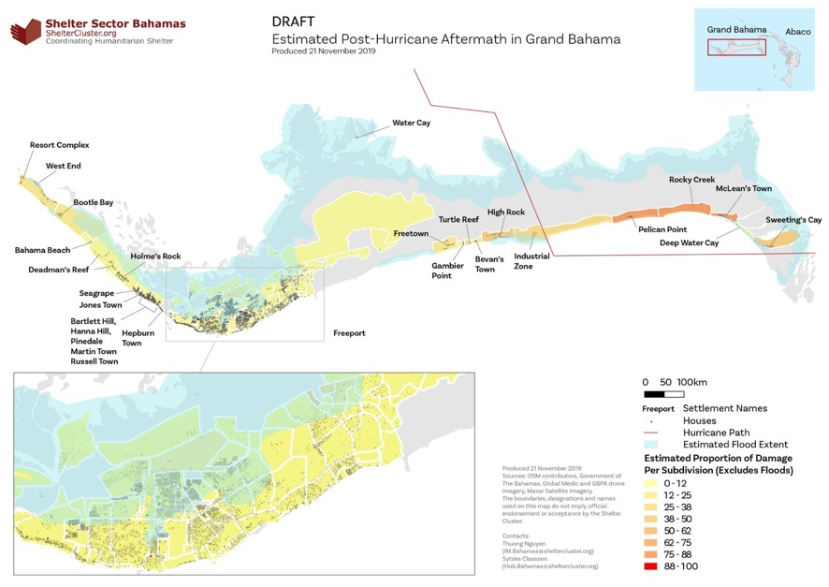
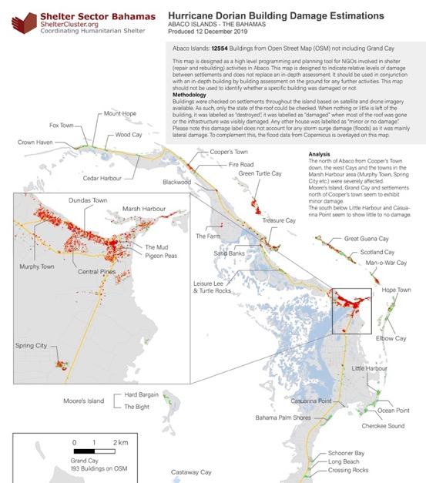
Processing data with no public release of products

Slide 5
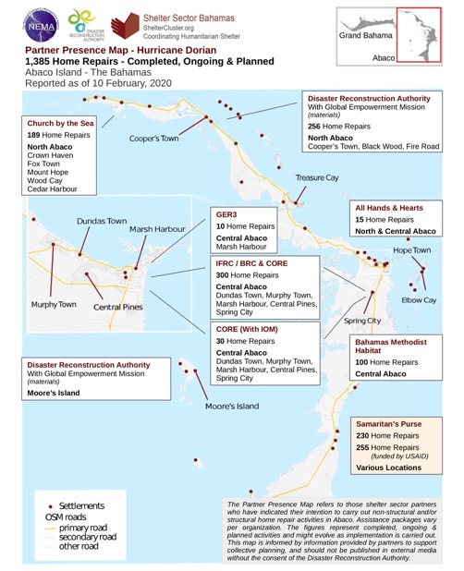
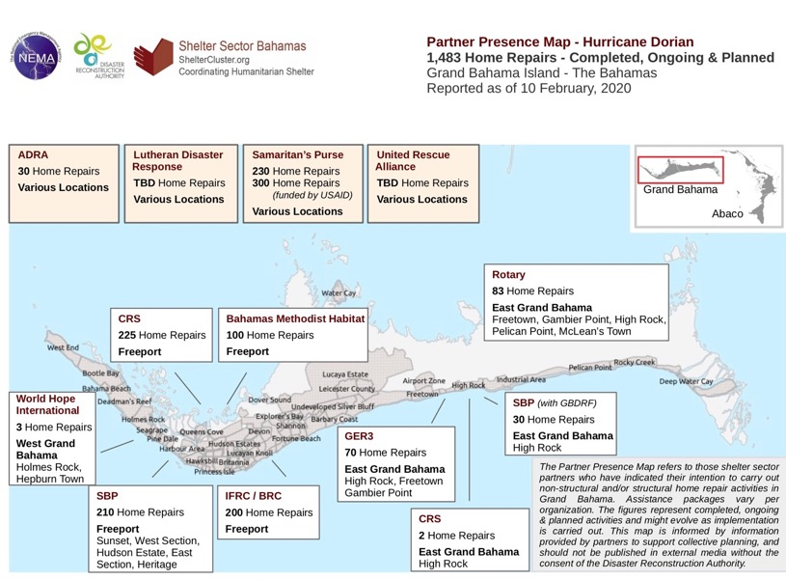
Mapping response against unknown needs

Slide 6
Mapping the risks associated with publishing certain types of data
Data Quoted out of context

Slide 7
Using media monitoring to balance politics and information sources

Slide 8
Navigating the social media planet
X15

Slide 9
Key topics/Issues for discussion
The perception of “data” by organisations which do not often use data
The distinction/confusion between data and information
Different type of risks (reputational/political/etc) associated with owning/publishing/sharing different types of “information” and how to mitigate them
Why organisations/governments might collect data but not share it (they often think that they need to share “data” while what we need can be “aggregated information” or “top level numbers”, not individual names

Slide 10
For more information
on the response to cyclone Dorian in the Bahamas,
please join us on the GSC annual meeting
Session Tuesday 6/10, 4 to 5PM

