Slide 1
Shelter, Housing and Data
4 years of lessons learned
Shelter Coordination in Conflict Settings
Virtual Coordination Workshop 2020

Slide 2
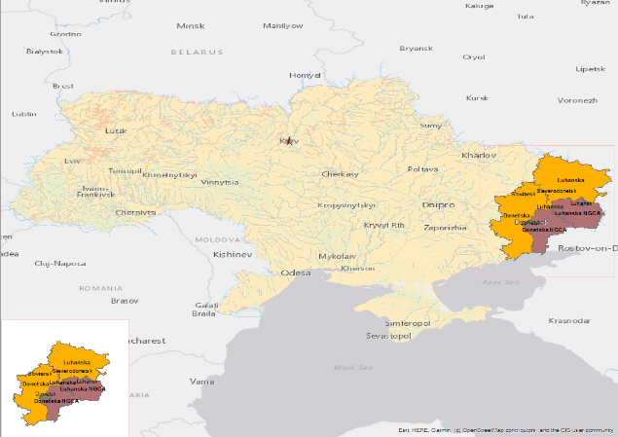
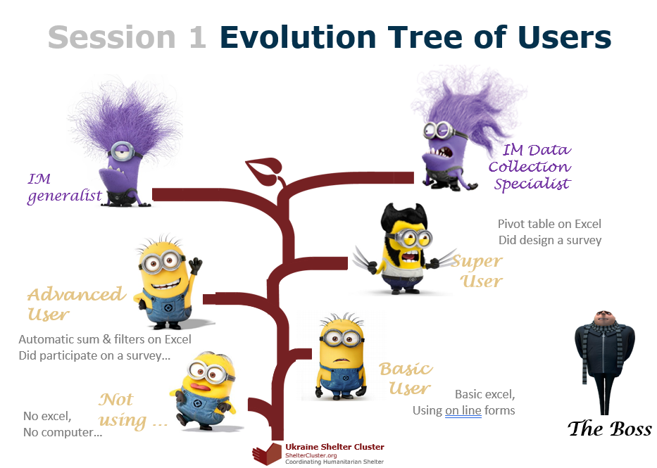
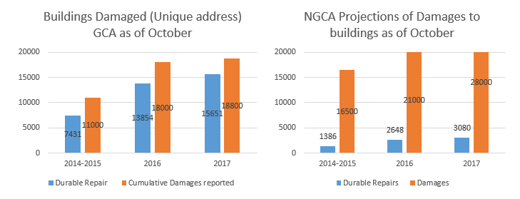


Ukraine: Protracted Crisis

Slide 3
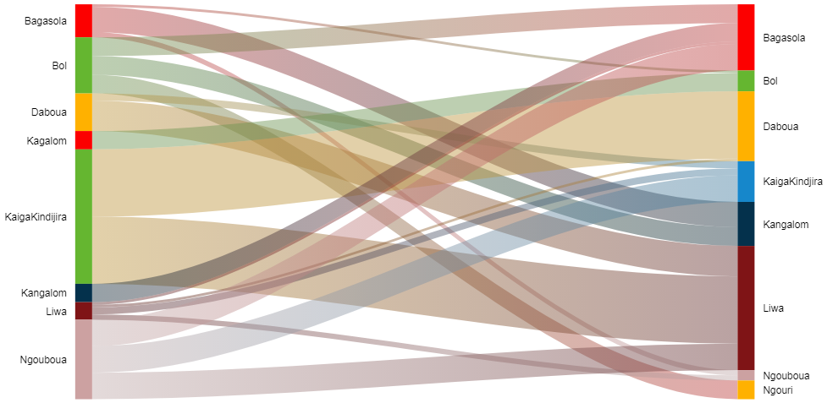
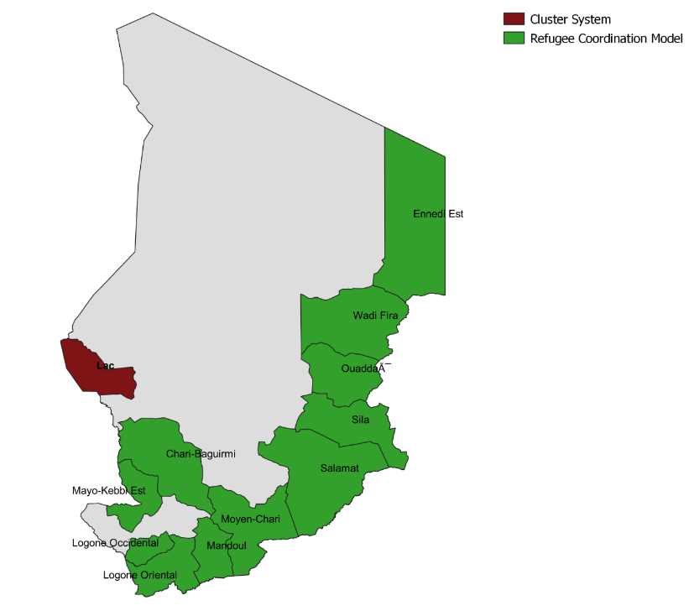
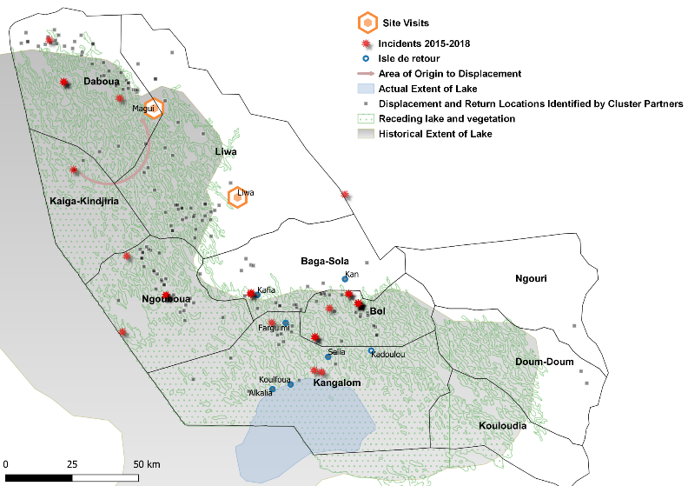
Chad: IM and analysis in Context of Merged Clusters

Slide 4
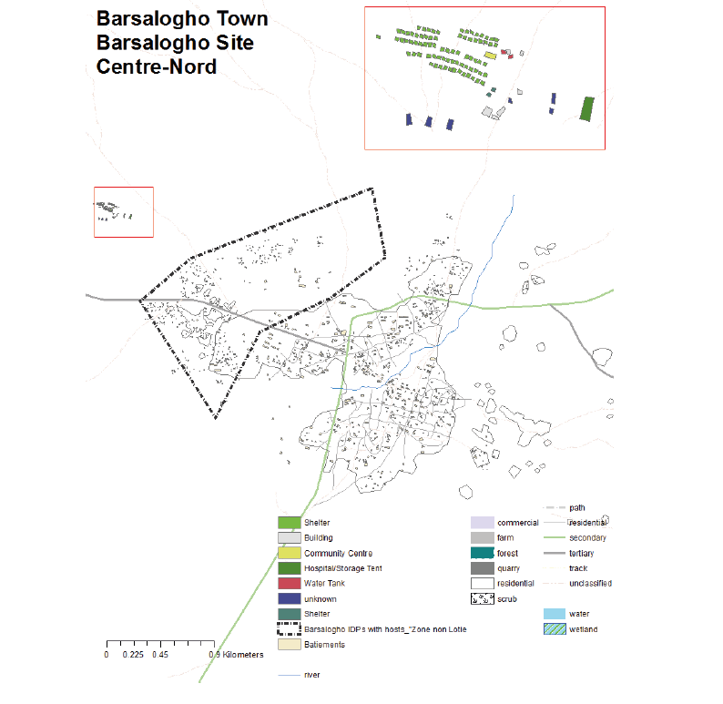
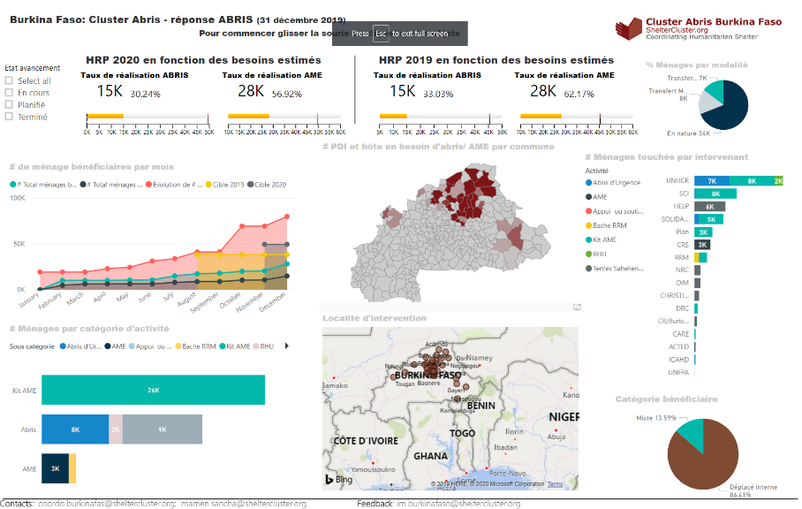
Burkina Faso: Setting up the Shelter Cluster
Activity Matrix
Shelter Cluster Strategy
Define Essential Components of 5W
Identify the right team

Slide 5
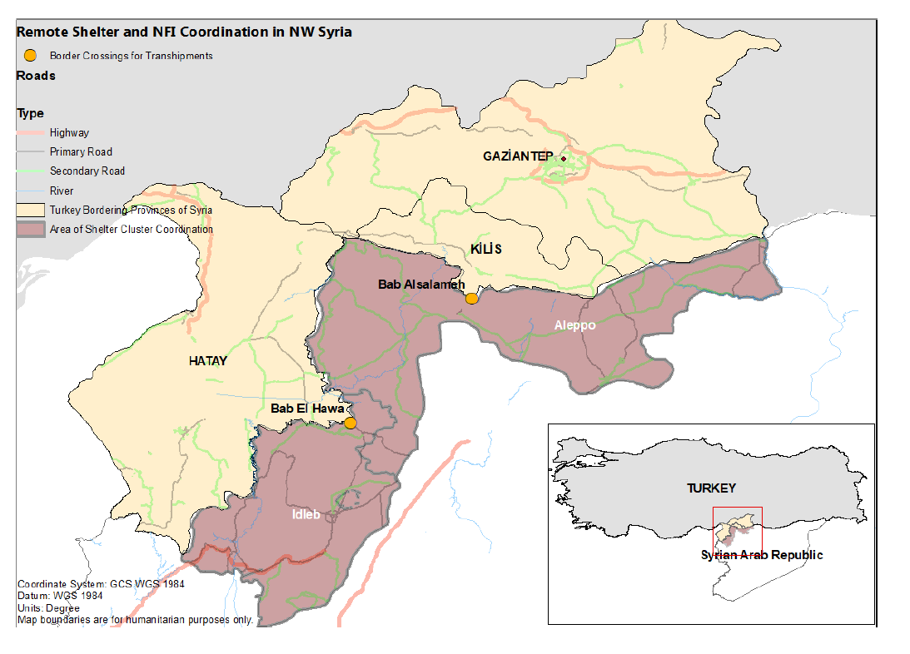

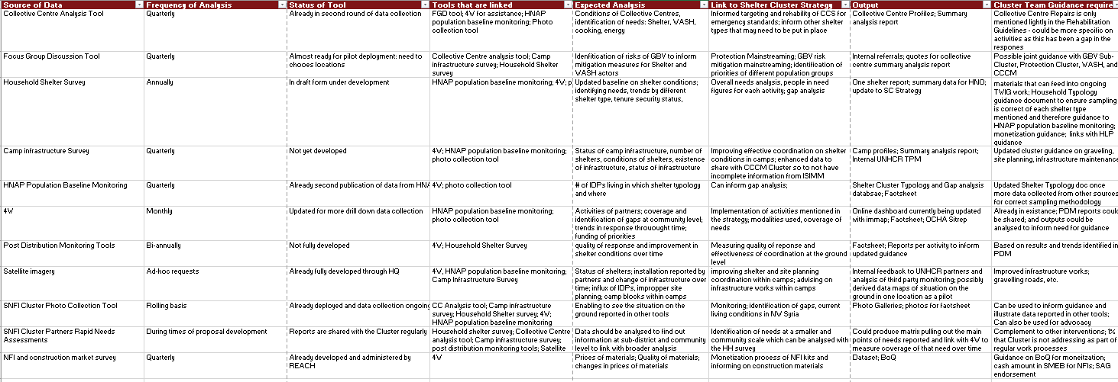
NW Syria: Remote Coordination and Data as Currency

Slide 6
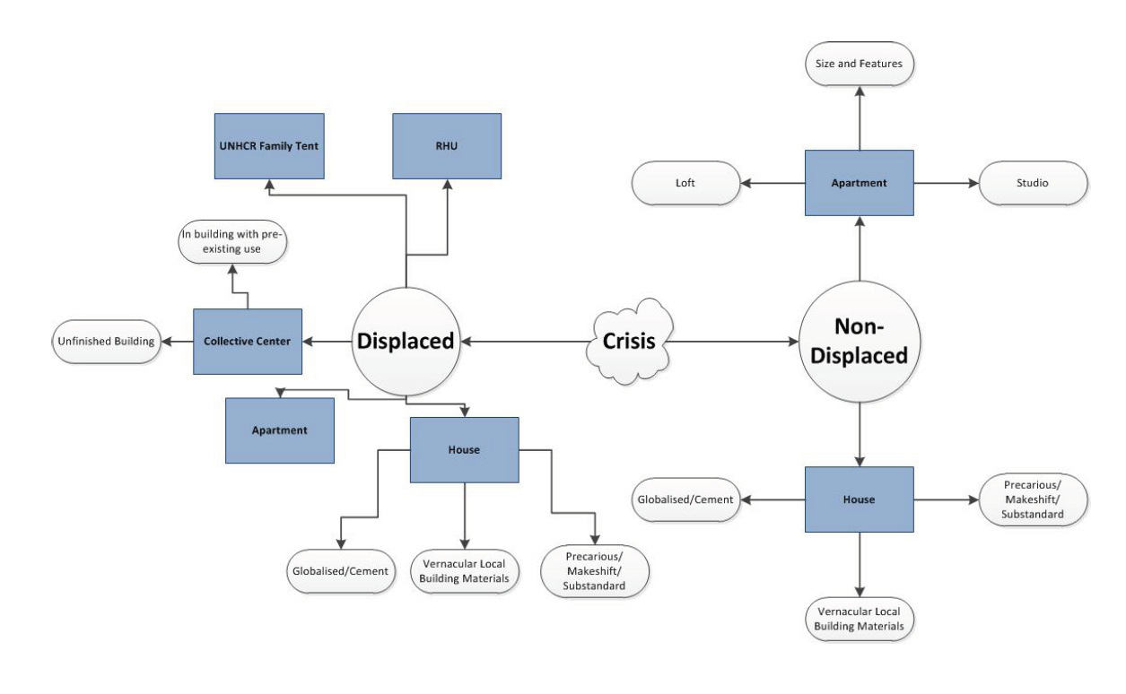
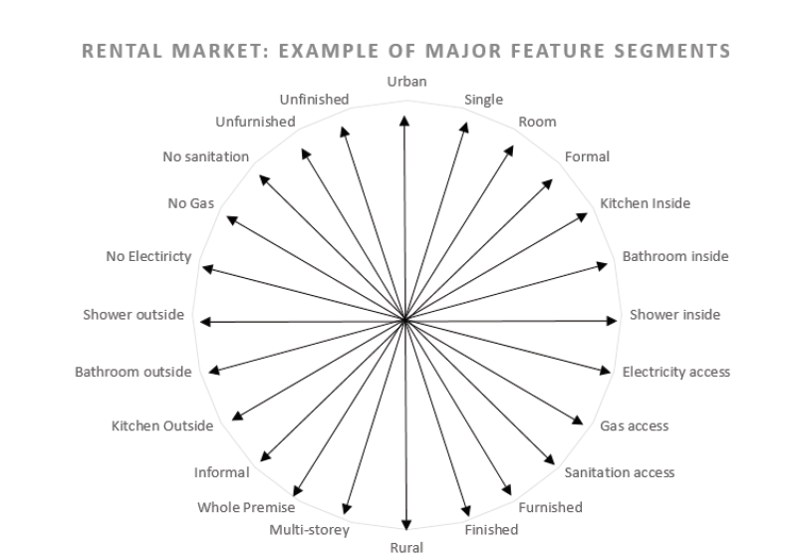
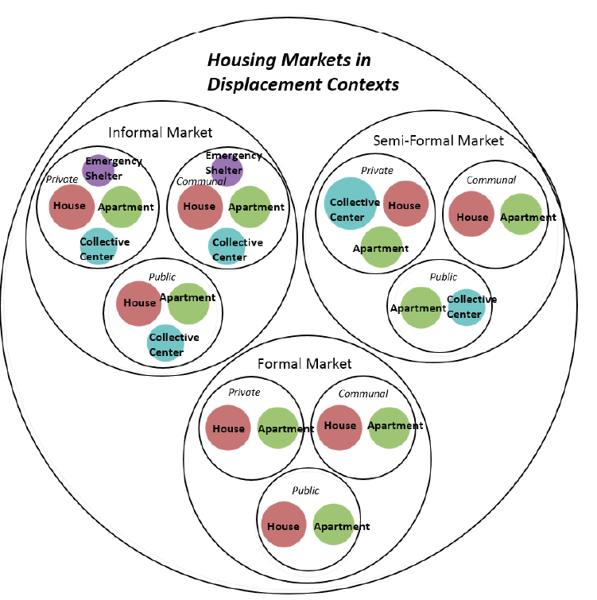
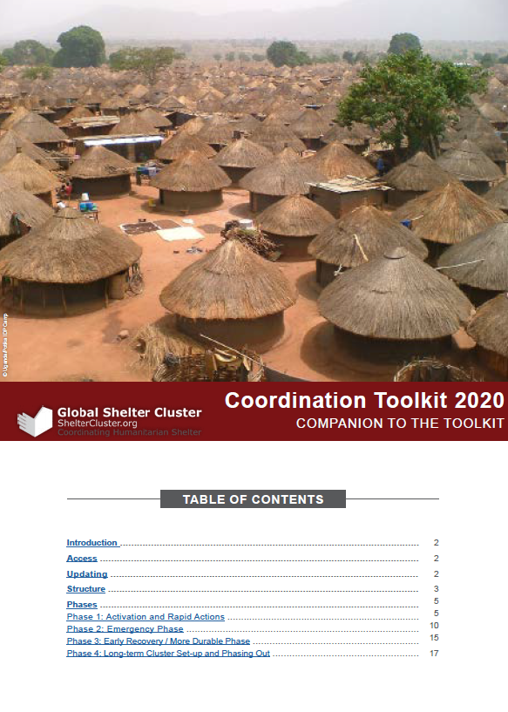
Recommendations

