Slide 1
Shelter Working Group Meeting
Disaster Risk Reduction
Friday 4 August, 10AM
World Vision

Slide 2
Agenda
Introductions/ Agenda
IM update
District focal point updates
Community DRR
AOB

Slide 3
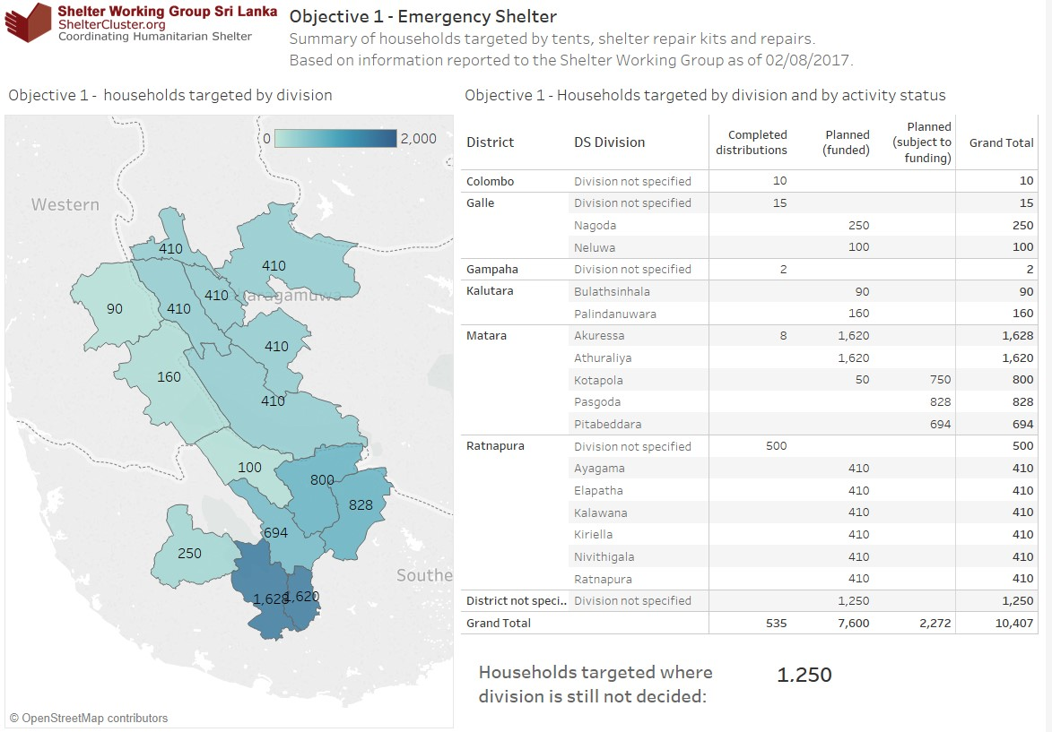
Shelter & NFI - progress to date

Slide 4
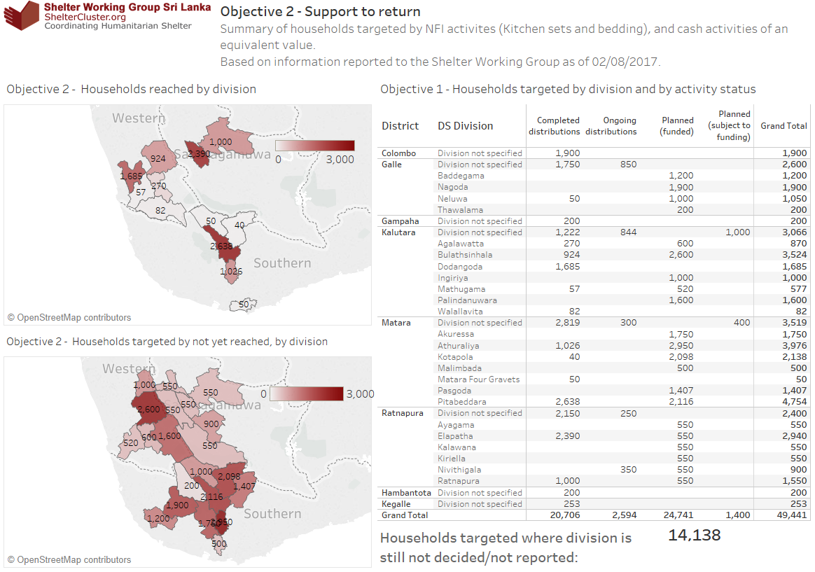
Shelter & NFI - progress to date

Slide 5
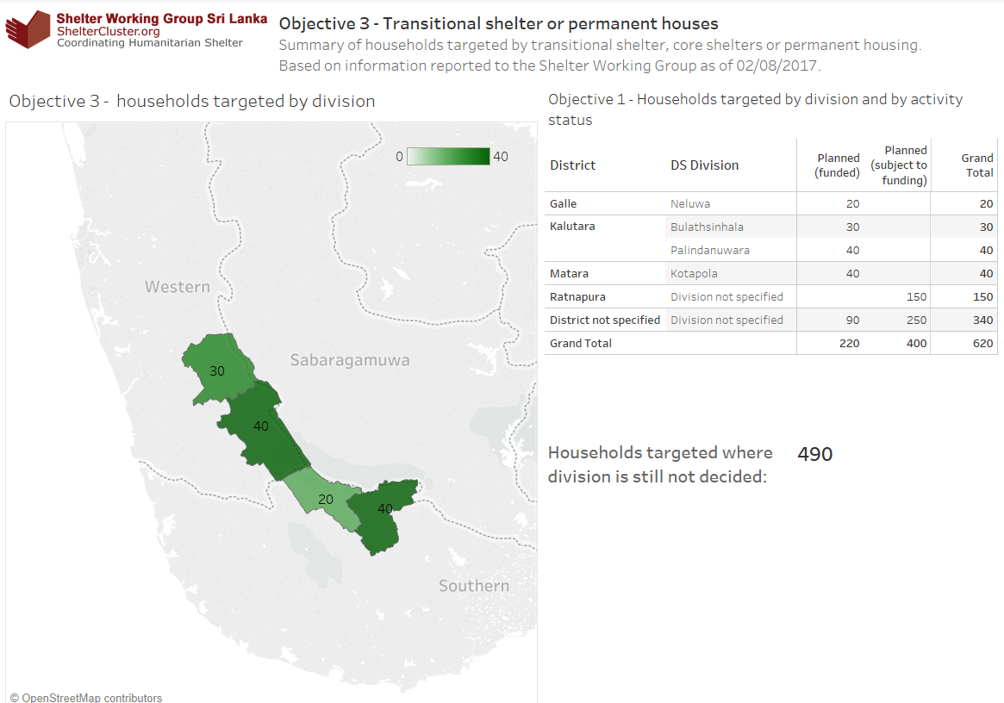
Shelter & NFI - progress to date

Slide 6
District updates
World Vision: Ratnapura
UN Habitat: Galle & Kalutara
Save the Children: Matara
* Ensure coordination with other sectors! *

Slide 7
Disaster Risk Reduction
knowledge sharing
how to improve resilience
  improve infrastructure
  quick cash access
preparedness, early warning
mapping good practices

Slide 8
Disaster Risk Reduction
Need to be prepared for next disaster
DS and communities requested support on:
  community-based DRR
  first responder training
  emergency response preparedness & early warning training
  establishing village Disaster Management Committees
  establishing safety centers
  adequate stock of boats, life jackets and other rescue equipment

Slide 9
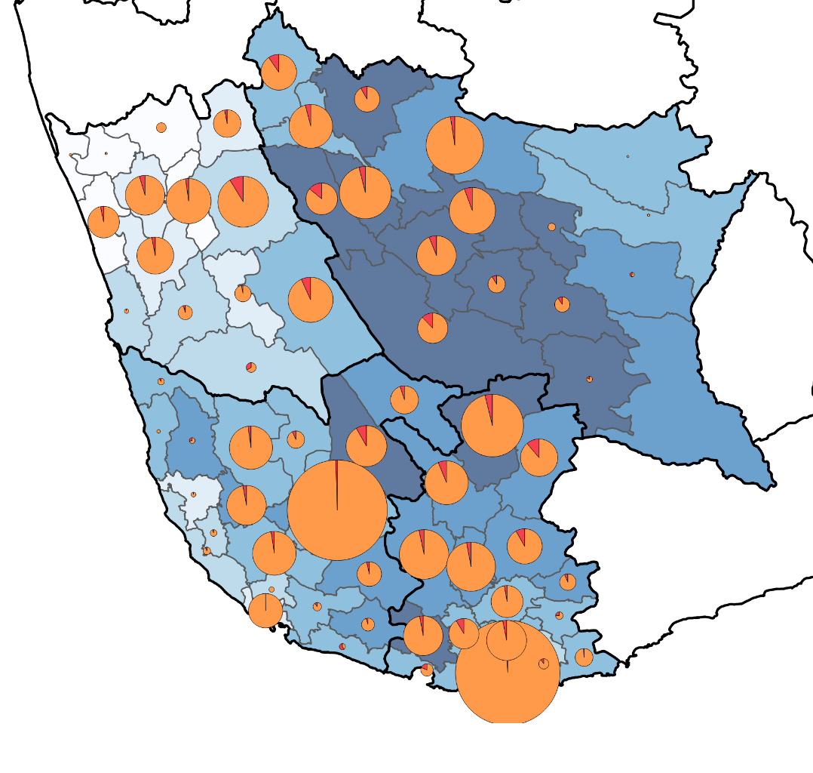

Community resilience: Disaster Risk Reduction (DRR)
  + Climate Change Adaptation (CCA)
  + Poverty reduction
District damage data
Fully damaged
Partially damaged
Percentage living below the poverty line (2012 census/HIES)

Slide 10
Disaster Risk Reduction
Local context: socio-economic, environmental
Risk of disaster: future/ previous disasters, climate change
Design and construction practices
  codes and enforcement
  building systems and materials
  local design and construction practice
  skills, techniques, tools

Slide 11
Community DRR
Participatory hazard, vulnerability, capacity and risk assessment of individuals, families and communities;
IEC materials (involve community)
Training (vocational training centers, school curricula)

Slide 12
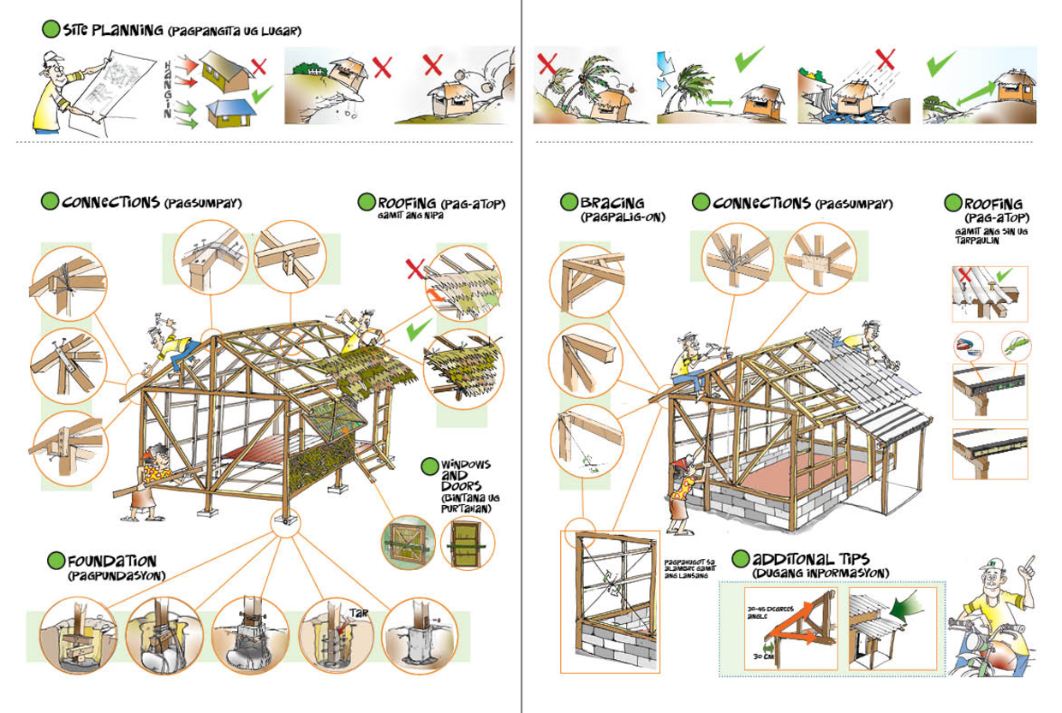
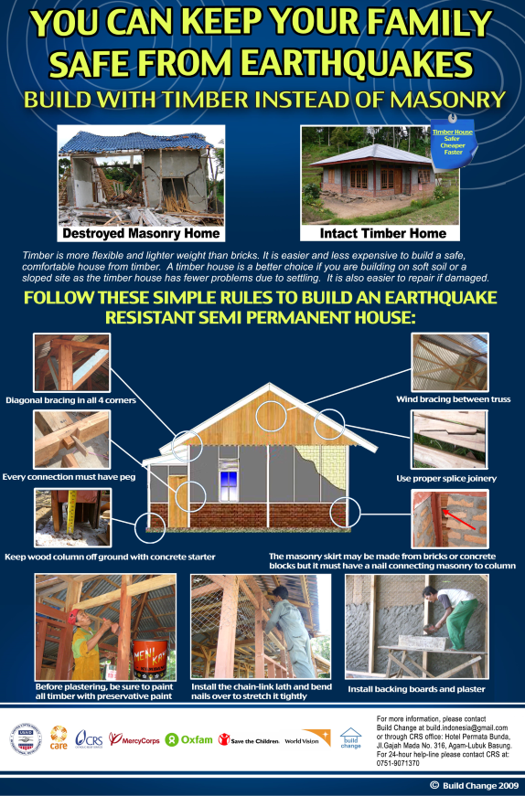
Shelter Cluster

Slide 13
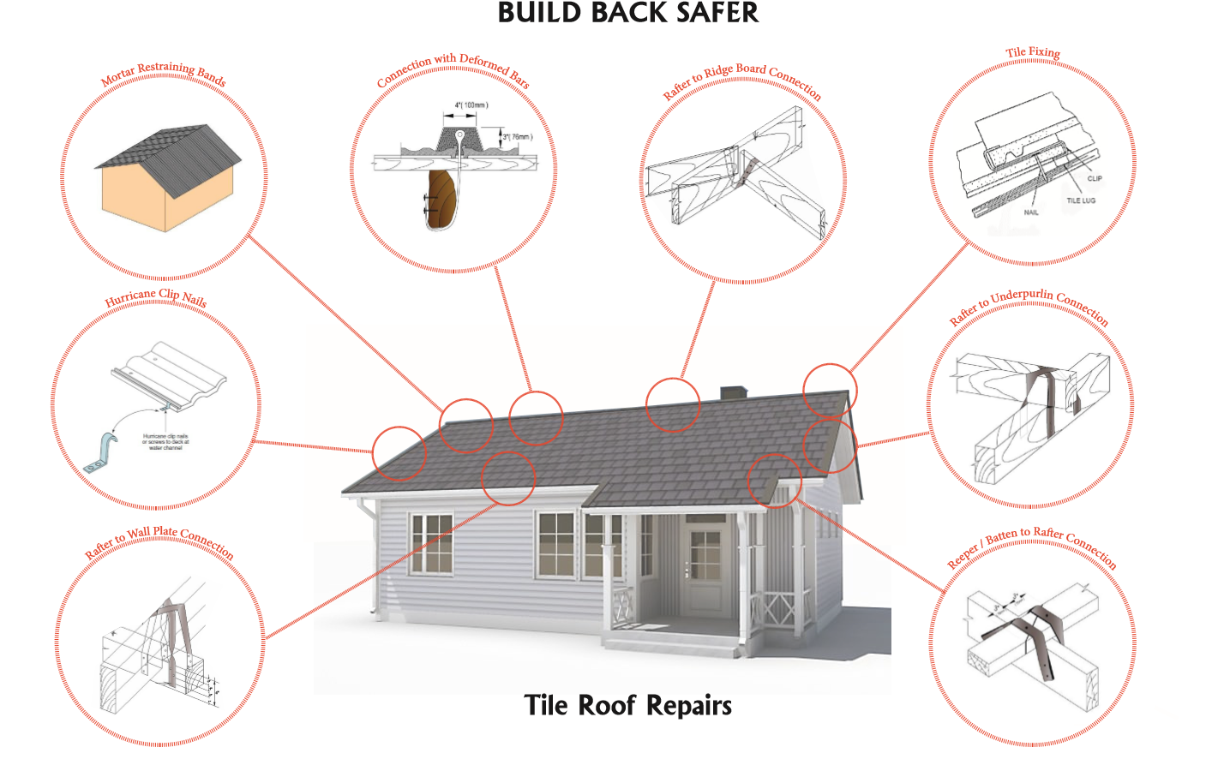
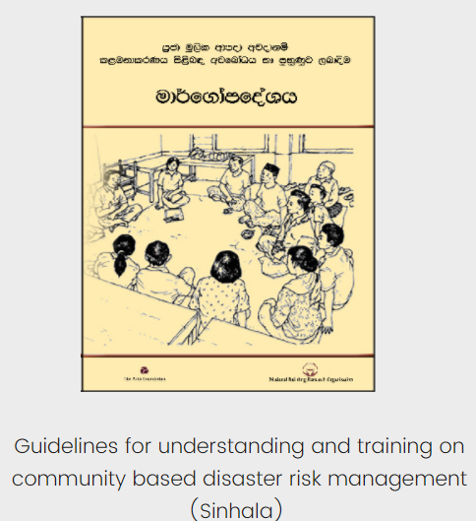
NBRO materials

Slide 14
Web Details
www.sheltercluster.org
https://www.sheltercluster.org/response/sri-lanka-floods-2017
https://www.sheltercluster.org/sri-lanka-floods-2017/documents/21062017-nbro-presentation
https://www.sheltercluster.org/response/sri-lanka-floods-2017/documents?sort=date&sort_direction=DESC

