Slide 1
Shelter Working Group Meeting
Thursday 6 July, 10AM
Consortium of Humanitarian Actors Office

Slide 2
Agenda
Introductions
Information Management
District Focal Point Update
Protection & Shelter
NBRO Drone assessment
Strategy update
AOB and Next Meeting

Slide 3
Overview of planned response (4 districts)
Transitional Shelter | 90
Permanent House | 250
Unmarked District for the Response Plan
Partially Damaged Houses | 20439
Fully Damaged Houses | 2967
Item | Total # of HH
Household NFIs Kits/ Cash | 26635
Shelter Repair kits/Cash | 5700
Repairing | 58
Community Based Shelter Programme | 400
Permanent House | 290
Transitional Shelter | 540
Items | Total Response Needed | Response Plan | Gap
Cash/ Shelter Repair Kits | 20439 | 6158 | 14281
Cash/ Household NFI Kits | 23406 | 26635 | (3229)
Permanent House/Transitional Shelter | 2967 | 830 | 2137

Slide 4
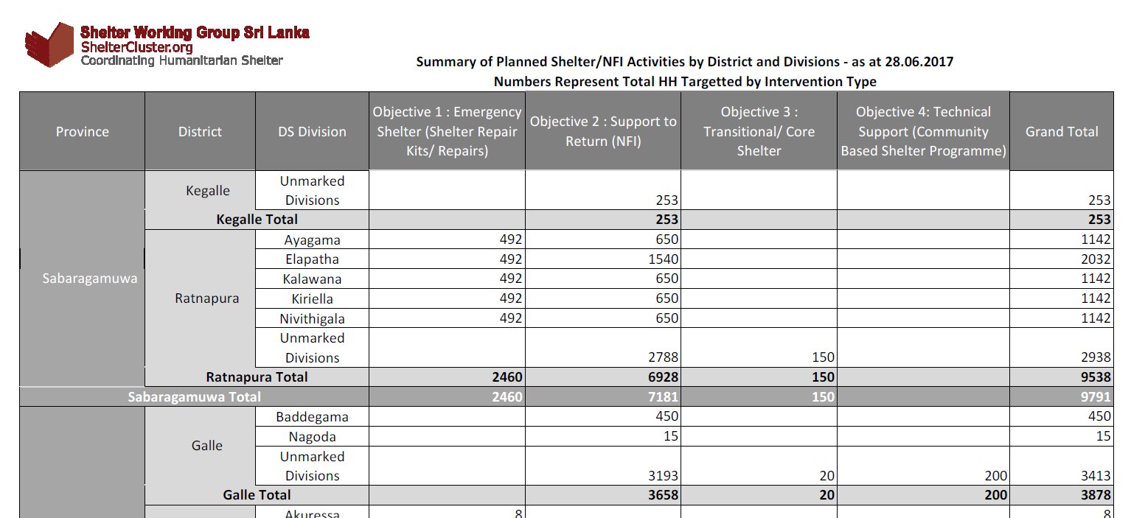
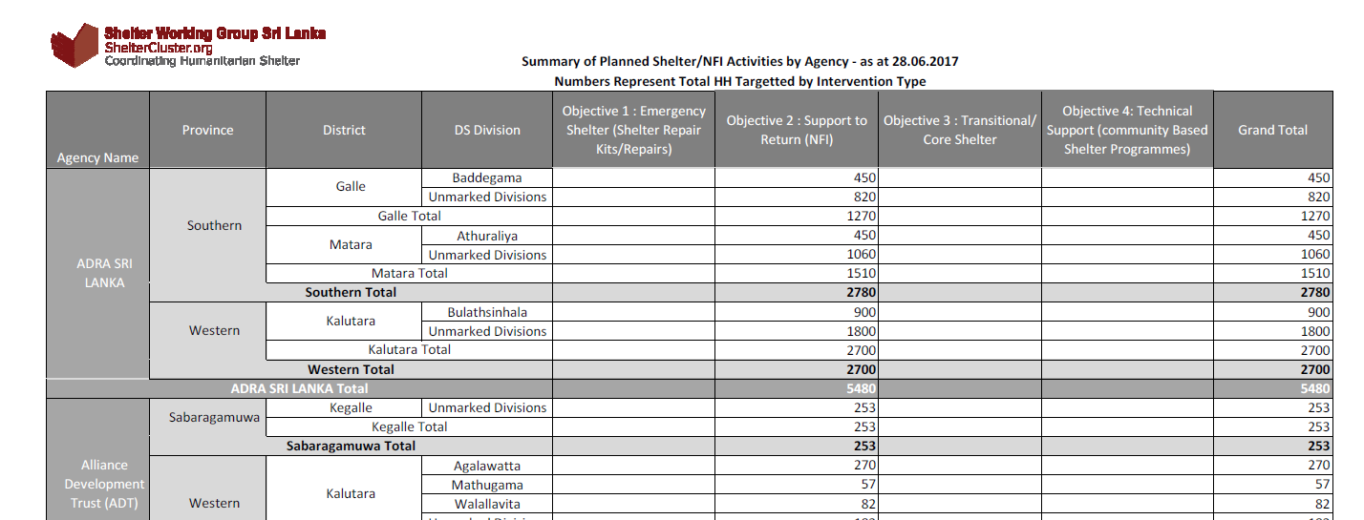
New reports
- by District and DS Division
- by Agency, then District and DS Division
Please check your agency’s information and send us updates

Slide 5
Gaps in planned coverage – by district

Slide 6
Gaps in planned coverage – by district

Slide 7
Gaps in planned coverage – by district

Slide 8
Progress to date

Slide 9
Web Details
www.sheltercluster.org
https://www.sheltercluster.org/response/sri-lanka-floods-2017
https://www.sheltercluster.org/sri-lanka-floods-2017/documents/21062017-nbro-presentation
https://www.sheltercluster.org/response/sri-lanka-floods-2017/documents?sort=date&sort_direction=DESC

Slide 10
Affected – 630,000 PP
(126,000 HH)
May Displaced HH
~ 75,000
Damaged HH - 24,742
Partially - 21,616
Fully
3,126

Slide 11




Shelter Recovery
Self- Recovery
Assistance (need based)

Slide 12
Goal
The goal of the Shelter Sector is to provide people affected by the floods with the means to live in a safe, dignified and appropriate shelter. The Sector will support owner-driven recovery, prioritise the most vulnerable people, families and communities, and invest in DRR.
Objectives
Objective 1: Emergency shelter
  Provision of emergency shelter items contributing to self-recovery such as shelter kits (including tools and CGI) or their cash equivalent, supported by appropriate training, community mobilisation and IEC material.
Objective 2: Support to return
  Support the most vulnerable households to return through the provision of NFI kits (including kitchen sets, solar lights), or their cash equivalent along with appropriate IEC material.
Objective 3: Transitional/Core
  Provision of transitional shelter options for vulnerable households with fully damaged houses, or in identified high risk zones where a longer term permanent housing solution will need to be found.
Objective 4: Technical support
  Provide education information and communication on safer construction principles, and community-based hazard awareness, preparedness and DRR, during all phases of the response.

Slide 13







Emergency Shelter
Damage Category 1 - 4
Emergency shelter support options
No Damage
Impact
Protection Support | Tents | Tool Kits | NFI | Technical support | Financial
X |  |  | X |  | X
X |  |  | X | X | X
X |  | X | X | X | X
X | X |  | X |  | X
Minor damage requires little or no assistance
Up to 30% damaged, can be repaired
Displaced
Host Family / Rental
Greater than 30% damaged, can be repaired
Non-Displaced
NFI (light daamge)
Destroyed or damaged beyond repair
Non-Displaced
Repair Kit (Major damage)
Displaced
Collective Centres

Slide 14
Transitional shelter options are required for households that do not have the resources, or where there are other constraints, that delay recovery. Ideally investment in transitional solutions should promote and contribute toward recovery, such as materials, tools, and technical training and information.
Safe Site ?
No
Yes
To provide SPHERE minimum shelter and protection standards
  Access and Protection
  Safe
  Durable – Sufficient for the period until full recovery is achieved
  Dignified
  Sufficient to meet social / cultural / and livelihood needs
Fully Damaged
Partially Damaged
Undamaged
Relocate
Emergency/Transitional Period
Transitional/core shelter
Transitional /core shelter
Shelter
Repair Kit
Technical support

