Slide 1
Shelter Cluster Donors and Heads of Agencies Strategic Meeting 17:00, Nov 21st, 2013

Slide 2
Outline of contents
Coordination arrangements for shelter
Introduce Shelter strategy
Funding levels low for the scale of emergency
-why?
-what capacity do we as a sector have to scale up?

Slide 3
Current Appeal
46 million of which 14 million funded (30%)
Scale has increased to 1.1 million houses appeal figures will increase

Slide 4
Shifting priorities
Priority
Food and water
Shelter relief
Shelter recovery
4,200
Time

Slide 5
Impact on population
Houses destroyed about 520,000
Houses damaged about 500,000.
Displaced population - 4.4 million.
-
Evolving situation figures need to revised continuously

Slide 6
Response Strategy and Progress
Emergency Distribution
4000 shelter kits delivered
300,000 in the pipeline – subject to funding
Emergency Self recovery Support
88,500 in the pipeline
Core, Transitional shelter and rental support
20,000 in the pipeline
Support to collective centres – no information
Support permanent Housing and tenure security

Slide 7
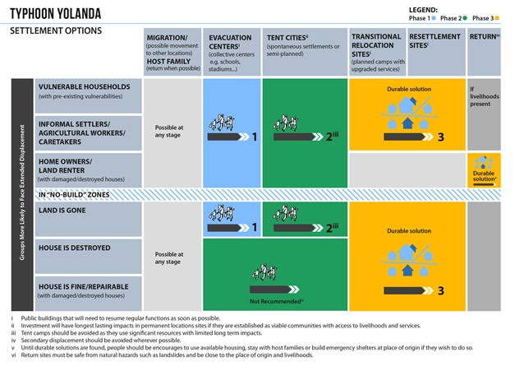

Slide 8
Key factors to take into account
Prioritisation = Poverty index + number affected + severity of damage (typhoon or typhoon and surge wave)
Logistics
Capacity of markets to meet the demand
Capacity of local government and civil society
Land policy – relocations, tenure security

Slide 9
Current strategic gap capacity analysis
Repair - reconstruction for 1.1 million houses
Shelter cluster capacity to address the shelter needs of 400,000 hhs
Civil society, self recovery
International community
Government
Scale of funding
Scale of implementation capacity

Slide 10
Supply pipeline gap analysis
28,000 CGI sheets/week in affected area
National supply of CGI and other materials being investigated
We predict a massive shortfall particularly in roofing and framing materials

Slide 11
Urgent Shelter Needs
Item | Urgent assistance requested from Donor
Roofing materials 26 gauge CGI sheets (10 sheets per hh) Local procurement international procurement | International procurement of CGI and fixings 3 million sheets
Framing materials Timber Coco lumber Steel | Local Salvage of Coco lumber – mobilising capacity for industrial scale processing TWIG on cocolumber

Slide 12
Other supply chain considerations
Debris removal: Making available safe areas for reconstruction
Build back safer: Skilled, trained labour
Relocations: minimising multiple relocations, services and ensuring tenure security

