Slide 1
Shelter Cluster Meeting 17:00, Dec 2, 2013

Slide 2
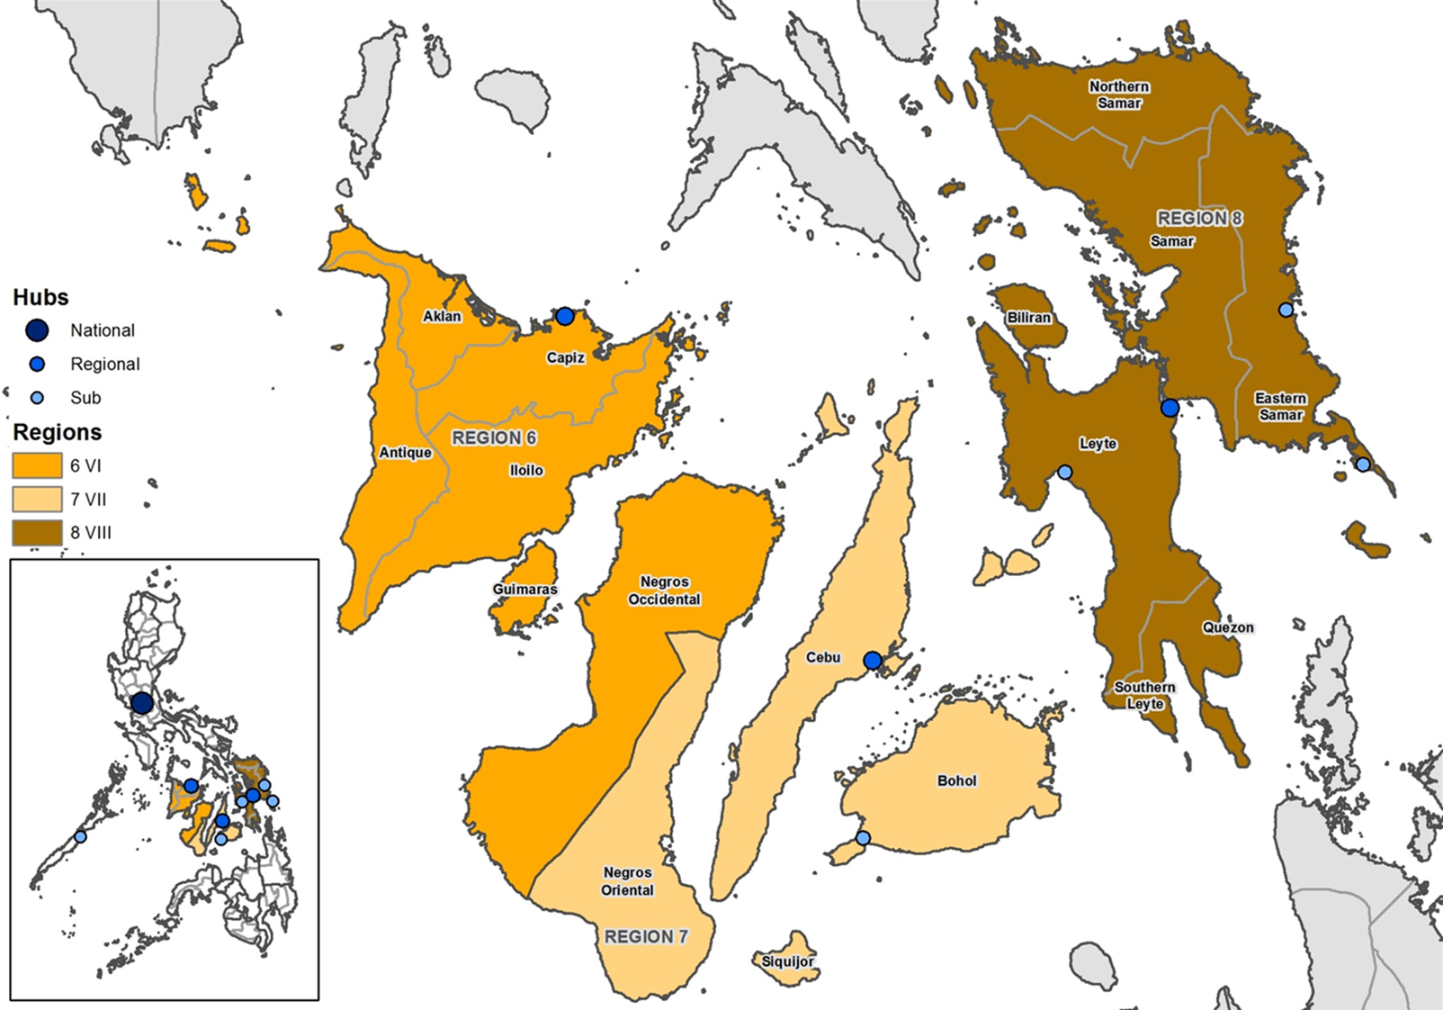

Coordination Structure 29/11 – 2/12/2013
Borongan (PLAN)
Christopher Cushing
0908 4014375
Chris.Cushing@plan-uk.org
Roxas
(DSWD)
Josephine Degala
0910 375 8512
(IFRC)
Tim Stats – im2
09297957369
Gustavo Domato – coord4
0915 946 8721
Britt Christiaens – tech3
Helen Wood – data
Tacloban
(DSWD)
Chi Redja (although alternating)
(IFRC)
Richard Luff – coord3
09054400048
David Dalgado – tech
Matt Hewett – im3
Irwin Lopez – UN-Habitat
Ormoc :
(IFRC)
Wan Sophonpanich – tech2
Guiuan (IOM)
Andrew Lind – alind@iom.int
09186572802
Philippines
Cebu
(DSWD)
Grace Subong
09177120024
(IFRC – inter regional)
Xavier Genot – coord2
Manila
(DSWD)
Assistant Secretary Gudmalin
(IFRC)
Victoria Stodart– coord
Emese Csete - im
Neil Bauman
neilbauman@sheltercluster.org
Manila
Bohol (IFRC)
Birgit Vaes
coord.bohol@sheltercluster.org
09183438466
REACH
Vincent Anonni
vincent.annoni@impact-initiatives.org
Joshua Kirton
Mitch Levine
To email Shelter Cluster staff
place .phil@sheltercluster.org
after their designation. E.g.
coord.phil@sheltercluster.org

Slide 3
Coordination Meetings
Manila: Mon 17.00
Tacloban: Tues & Thurs 17:30
Roxas: Mon, Weds, Fri 19:30
Cebu: Mon 9:00
Ormoc : Fri 17:00
Guiuan: Mon 8:00am

Slide 4
Update on meeting with Sec DSWD
‘Moving forwards’ plan:
Phase 1: Critical needs to be met (by march 2014)
Phase 2: Early recovery/rehabilitation/ reconstruction
Throughout - ensuring build back better
Priority areas: Yolanda corridor – 50km

Slide 5
Update on meeting with Sec DSWD
No build zones:
No build zones: 40m for all coastal towns
Relocation by National Housing Authority & Dept for Public Works & Highways
Targeting
Relocated from no build zones relocation 120,000 PSD
Totally damaged 30,000 PSD
Partially damaged 10,000 PSD
Piloting in Guiuan

Slide 6
Appeal
Original appeal: 46 million of which 29,139,831 funded (36.2%)
Revision: 203,648,553 USD
27 projects
CURRENT TOTAL ALL SECTORS: 946,840,490
Target approx 800,000 households- 300,000 emergency shelter, 500,000 recovery
Appeal heavy focus on Recovery

Slide 8
Next steps with appeal
Launch by Valerie Amos on 9 December
OPS closed
Next week: HQ and OCHA review and gender markering
Small edits can be made: contact anna.pont@ifrc.org
SRP finalised next week

Slide 9
SAG
Chair DSWD Assistant Secretary Gudmalin
NHA
HUDCC (Urban)
IFRC
IOM
CRS
HFH
UN-HABITAT
DILG (Dept of Interior and Local government)
Gawad Kalinga (GK) local NGO

Slide 10
Strategic objectives of HCT
Strategic objective 2: People with destroyed or damaged homes (displaced and non displaced) attain protective and sustainable shelter solutions
Indicators:
- Number of families that sustained house damage from the Typhoon that are currently living in a habitable house/dwelling
- Number of households that sustained house damage that are satisfied with assistance

Slide 11
Shelter Objectives
Cluster objective 1A:
Shelter Cluster partners will provide immediate emergency shelter and NFI solutions for households in order to minimize the risk of GBV and decrease the rates of morbidity and mortality.
Outcome-level indicators and targets
Number/% of households that sustained house damage from the typhoon that are currently living in safe, habitable emergency shelter (300,000)
Number/% of households that are satisfied with the emergency shelter support and assistance that they received from humanitarian agencies

Slide 12
Cluster objective 2A:
Shelter Cluster partners will provide support for household self-recovery through incremental housing solutions using consultative, participatory processes that respects diversity and the different needs of women and men of different ages, and prioritizing the poorest households.
Outcome-level indicators and targets
Number/% of households that sustained house damage from the typhoon that are currently living in safe, habitable dwellings resulting from assistance from humanitarian partners
Number/% of households that are satisfied with the recovery solutions and assistance that they received from humanitarian agencies

Slide 13
Cluster objective 2A:
Shelter Cluster partners will provide support to build community-level capacity to rebuild or repair housing damaged by the typhoon including alternative supplies of materials, increasing labor supply, and ensuring appropriate access to building areas is available.
Outcome-level indicators and targets
A skilled labour force for reconstruction is nurtured and developed (reword as indicator)
Usable reclaimed material is made available for reconstruction and repair efforts (reword as indicator)

Slide 14
Outcome Indicators
Number/% of households that sustained house damage from the Typhoon that are currently living in a habitable house/dwelling
Number/% of households that sustained house damage that are satisfied with assistance

Slide 15
Response Progress
Emergency Shelter
34,000 emergency shelter delivered
Total planned = 484,000 HH
Emergency Self recovery Support
Almost 30,000 HH supported
94,000 funded / in the pipeline

Slide 16
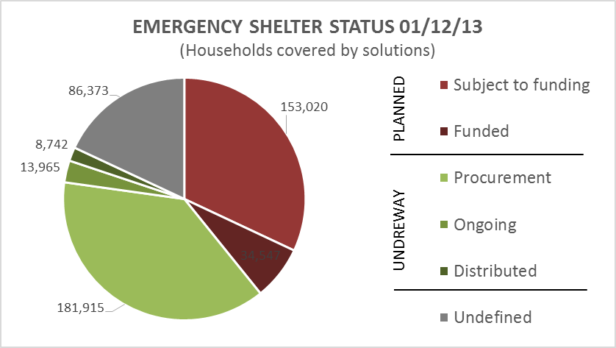
FUNDED VS UNFUNDED

Slide 17
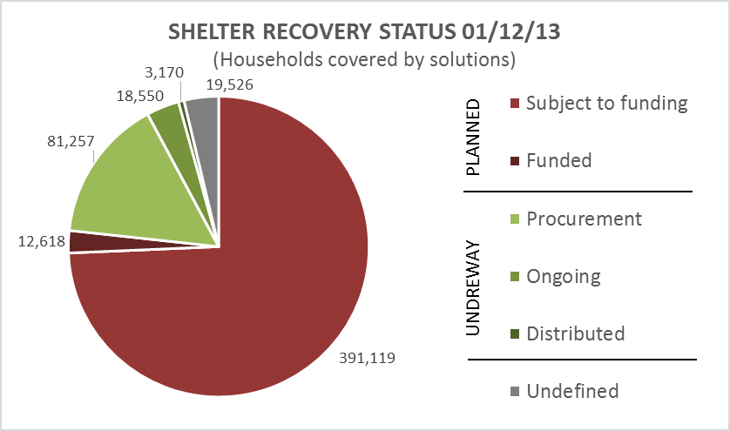
FUNDED VS UNFUNDED

Slide 18
REPORTING
Reports to reporting.phil@sheltercluster.org
Shelter cluster reporting template can be found on the shelter cluster Philipinnes website

Slide 19
TWIGS
HLP with the protection cluster – Tenure security, land ownership, relocations, NBZs
Reconstruction and recovery: chairs UN-HABITAT and DSWD Ass Sec Gudmalin: How to operationalise reconstruction process
TWiG at field level: Early recovery, relocation sites WG, Debris & salvage

Slide 20
Advocacy
Bunkhouses
Resettlement
HLP
Cash
Build back safer

Slide 21
Update : other clusters
CASH WG: EMMA (Market Analysis) shelter materials being tracked
WASH: requests shelter partners to ensure that they partner with WASH capacity to ensure sanitation facilities are established
ER: coordination on salvage of material (coco lumber) and debris removal – ER actors will salvage and provide to shelter actors

Slide 22
AOB

