Slide 1
Shelter and WASH Working Group Meeting
Thursday 13 July, 10AM
Asia Pacific Alliance for Disaster Management

Slide 2
Agenda
Introductions & Agenda
Information management
Environmental concerns – WWF
IEC materials for DRR - NBRO
District Updates
AOB

Slide 3
Overview of planned response (4 districts)
Transitional Shelter | 90
Permanent House | 250
Unmarked District for the Response Plan
Partially Damaged Houses | 20439
Fully Damaged Houses | 2967
Item | Total # of HH
Household NFIs Kits/ Cash | 26635
Shelter Repair kits/Cash | 5700
Repairing | 658
Permanent House | 290
Transitional Shelter | 540
Items | Total Response Needed | Response Plan | Gap
Cash/ Shelter Repair Kits/repair | 20439 | 6358 | 14081
Cash/ Household NFI Kits | 23406 | 26635 | (3229)
Permanent House/Transitional Shelter | 2967 | 830 | 2137

Slide 4
Progress to date

Slide 5
WASH sector coverage
 | Type of Activity
1 | Distribution of Water bottles
2 | Provision of 1000L water tank to camp
3 | Repairing community rural water supply
4 | Jerry cans (20 liters)
5 | Disinfection kits
6 | Hygiene kit
7 | Water Trucking
8 | Well cleaning
9 | Field water quality testing equipment and consumable support to MoH for day to day support kit
10 | Capacity building to Government officers on well cleaning
11 | Dengue awareness program
12 | Public Health Awarnes Program
13 | Construction of SP Latrines
14 | Hand-Washing Facilities (Water-Tank with Washing Consumables)
15 | Provision of Washing and Bathing Facility including Water Connection
16 | Rehabilitation of school WASH facilities, provision of school cleaning kits
17 | Water purification Tablets
18 | Diesel driver Submersible water pumps
19 | Water Pump(3HP)
Target beneficiaries: 550,000
Total number of people reached – 214,953
Planned to reach – 116,700
Gap– 218,347
1 | Alliance Development Trust (ADT)
2 | A-PAD
3 | Habitat for Humanity Sri Lanka
4 | LEADS
5 | Oxfam
6 | Plan International Sri Lanka
7 | Save the Children
8 | Sri Lanka Red Cross
9 | Team Rubicon UK
10 | UNICEF
11 | World Vision Lanka
12 | ADRA

Slide 6
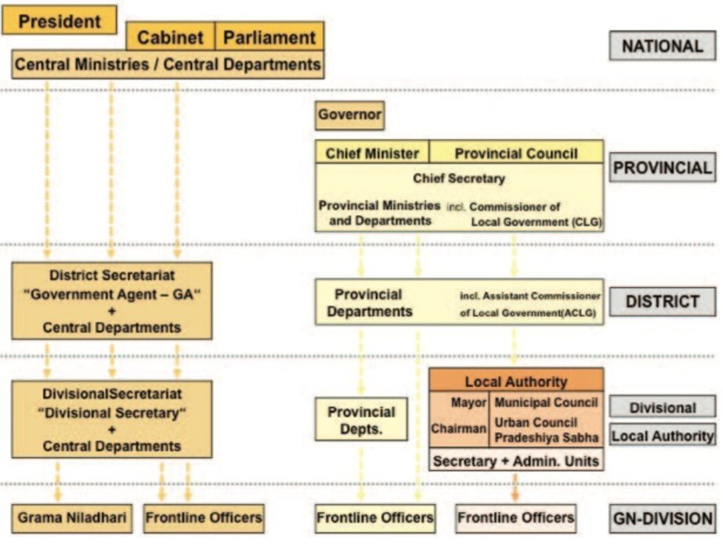
District Updates

Slide 7
District Updates
ToR
Coordination district
Regular update GA
How to capture activities local CBO/ CSO

Slide 8
District Updates
Focal points
WASH update
World Vision – Kaluthra
LEADS – Ratnapura and Matara
Oxfam – Galle
Shelter update
World Vision: Ratnapura
UN Habitat: Galle & Kalutara
Save the Children: Matara

Slide 9
Major challenges and needs identified in Kalutara district
Key challenges:
Disaster preparedness
Inadequacy of the early warning dissemination
Contamination of drinking water sources due to flooding
Damages to toilets in Bulathsinhala is high in Kalutara
Damages:
Bulathsinhala:
54 GNs affected
07 Landslide location
15,098 families affected
39 Dead, 38 Missing
11 Injured
214 Houses fully damaged
667 Partially damaged houses
1556 Wells contaminated
> 400 toilets requires repair
Palindhunuwara:
>200 toilets to be repaired
Needs:
Improving and support for effective disaster preparedness plan
Improving the early warning dissemination mechanism
Cleaning of wells and other key water sources
Construction and repair of toilets
Support for hygiene awareness campaigns, dengue eradication, etc

Slide 10
Validation of agency data
Few changes received in the last 2 weeks - please update:
Distributions which were previously ‘ongoing’ which are not complete
Activities which were indicated as ‘planned’ may now be ‘ongoing
Activities may have been allocated to a district but not yet a division – have your plans developed?
NFI – we would like to verify kit contents, to ensure that we are not double-counting.
Will be contacting you to validate our information

Slide 11
Web Details
www.sheltercluster.org
https://www.sheltercluster.org/response/sri-lanka-floods-2017
https://www.sheltercluster.org/sri-lanka-floods-2017/documents/21062017-nbro-presentation
https://www.sheltercluster.org/response/sri-lanka-floods-2017/documents?sort=date&sort_direction=DESC

