Slide 1

Nepal Earthquake – Shelter Cluster Meeting
Kathmandu 29th April 2015
Government of Nepal
Ministry of Urban Development
Department of Urban Development and Building Construction
Shelter Cluster Nepal
ShelterCluster.org
Coordinating Humanitarian Shelter

Slide 2
Agenda
Update of response
Partner Updates
Technical Standards – Market Mapping
Flash Appeal & Strategy

Slide 3
Update
Nepal Red Cross has started their initial rapid assessment in 12 districts, anticipated to be completed within 15 days.
Over 5,000 people have died and 10,000 injured, to date
There will be no MIRA until week 3 or 4
CERF allocation of USD15m, of which 3.5m is for shelter
Flash Appeal – ball park figures provided by clusters, appeal will be launched on Wednesday
OPS/FTS is currently closed to projects, will be opened in approx. 5/7 days time once more information has been obtained.
Stockpile update – DFID, IOM

Slide 4
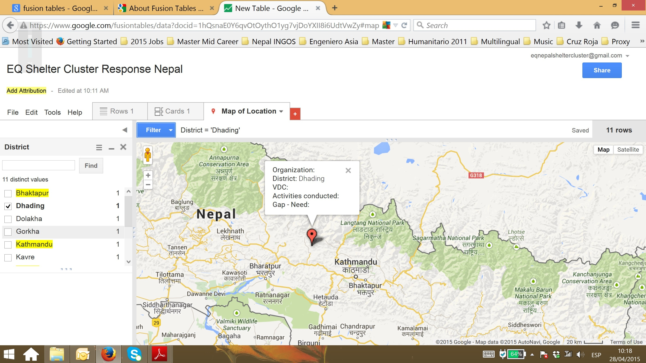

Slide 5
Assessments
Feedback on initial assessments
Simple format on gathering information to share with cluster
We will gather, triangulate, collate and inform
Market mapping – 5 main products, tarps, CGI, rope, wire – ?????

Slide 6
Technical Standards
Technical Working Group
Emergency phase - Shelter Kits, Specifications, Build Back Safer Messages
Recovery Shelter Programmes
Information, Education and Communication (IEC) Materials:
Tarpaulins, Tents and CGI Sheeting
Other working groups – cash?

Slide 7
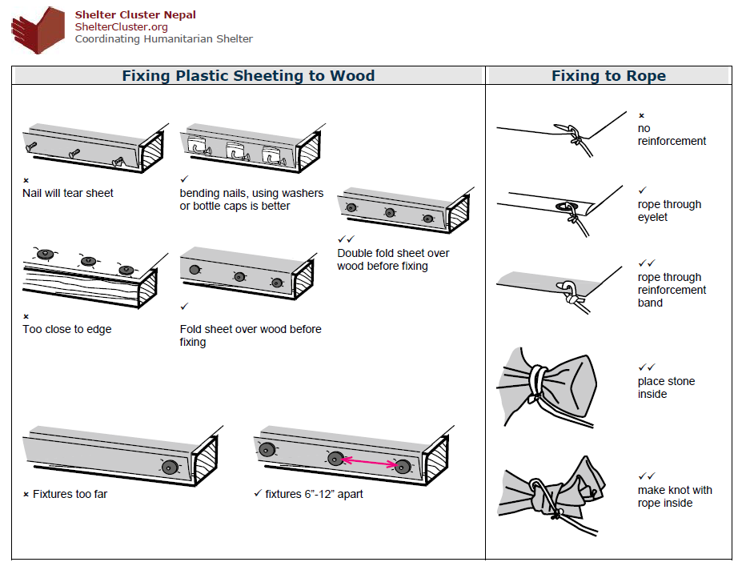

Slide 8
Strategy
Strategic objective relating to shelter (for first 3 months):
“Families with destroyed or damaged homes, including the displaced population, attain basic and protective shelter solutions”
Immediate life-saving shelter interventions such as tarpaulins, basic tools and fixings for damaged homes for displaced people, along with the provision of appropriate non-food items.
Provision of emergency cash assistance to address urgent needs of the most vulnerable households and host families, including rental subsidies in urban or semi-urban areas.
Support to municipalities and districts to ensure safe housing checks prior to movement of people.
Provision of information, education, and communication (IEC) materials on appropriate, safe, building standards are provided to affected populations and implementing agencies.
Coordination support for the development and implementation of emergency and durable shelter and settlement solutions.

Slide 9
Thank you
Meeting tomorrow at 9am
www.sheltercluster.org/Nepal
Sanjeev Hada (Coordinator): 985 102 7783, sanjeev.hada@ifrc.org
Victoria Stodart (Coordinator) – victoria.stodart@ifrc.org : 986 098 2132

