Slide 1
National Shelter Cluster Meeting
Kathmandu – DUDBC
20th May 11am
To be added to the contact list please email
coord3.nepal@sheltercluster.org

Slide 2
Updates
Government update:
  Tarp Distribution: the Government has ordered 622,709 of which 230,569 have been distributed
  Humanitarian Partners – 192,094 distributed, with 509,547 in pipeline/to be distributed.
  Overall total – 528,400 distributed

Slide 3
Updates
Flash Appeal – 26% funded at USD20,035,189
To be relaunched on Friday 29th May
To be extended from 3 months to 5 months
Currently no plan to increase amount overall
But needs to include response for second earthquake and contingency planning
Process and documentation to be provided by OCHA COB today.
If 100% funded then we would be able to support 350,000HHs with emergency shelter and approx. 150,000HHs with support to self recovery

Slide 4
Strategic Goal
To deliver a shelter response that supports appropriate, flexible, progressive solutions to affected, vulnerable populations that contributes to their own self recovery to provide a safer, more resilient and durable shelter.
With the following options based on addressing humanitarian needs:
Shelter interventions which support short and long term self-recovery approaches
Capacity building through different means of trainings appropriate to the recipient
Key messaging promoting more resilient shelter

Slide 5
Short- term objective
Short-term objective: 350,000 affected and most vulnerable households, are reached with a life saving shelter solution; prioritizing at risk groups (in hard to reach areas) by the end of July.
Outcome Indicator:
% of households whose homes have been destroyed or damaged that attain a basic, lifesaving shelter solution.

Slide 6
Long-Term Objective
Long-term objective: XXX,XXX affected and most vulnerable households receive shelter solutions that progressively contribute and promote appropriate long-term self recovery. This should build upon the short term objective caseload
Outcome Indicators:
% of households whose homes have been destroyed or damaged that have a rigid roof
% of households that will keep more than 50% of their dwelling structure over the next two years

Slide 7
Technical Guidelines
The Shelter technical and Implementation guidance in consultation with the six technical working groups identified by Shelter Cluster Partners
The Technical and Implementation Guidance Document will seek to outline for each response option:
    Intervention Purpose
    Outline the recommended Package as best practice
    Recommend Minimum Materials Specifications
    Implementation Modalities for Shelter
    Implementation Support
      Technical Training
      Capacity Building
      Ensuring Accountability to Beneficiaries

Slide 8
Technical Guidelines
PART 1 Strategic Objective 1- SHORT TERM SOLUTIONS - Emergency/Relief Sheltering
Timeframe UP TO 3 MONTHS - Two potential ‘crises points’ (Monsoon/Winter)
  Targeting Households
  Specific Objective
  Key Principles: Best Practice
  Strengths and Challenges of the intervention

Slide 9
Technical Guidelines
PART 1 - SHORT TERM SOLUTIONS - Emergency/Relief Sheltering
  Household kit Package ($100 – 10,000 NRup)

Slide 10
Technical Guidelines
PART 1 - SHORT TERM SOLUTIONS - Emergency/Relief Sheltering
  Household kit Package ($100 – 10,000 NRup)
    Tarpaulin Specifications
    Tents Specifications
    Rope Specifications
    Blanket/ Mat Specifications
    Tools Specifications

Slide 11
Technical Guidelines
PART 1 - SHORT TERM SOLUTIONS - Emergency/Relief Sheltering
  Implementation Support
    Emergency Shelter Kit Training
    Support Capacity Building and Training
    Emergency Information, Education and Communications (on shelter cluster website)
  Emergency Shelter Accountability Recommendations
    Shelter Post Distribution Monitoring and Assessment (for support to self-recovery)

Slide 12
Technical Guidelines
PART 2 - Strategic Objective 2 – LONG TERM- SUPPORTING SELF RECOVERY Timeframe
Timeframe From 2 MONTHS onwards, Self- Recovery building to permanent reconstruction
    Earthquake Response Programming
      Intermediate/Temporary shelter provision for most vulnerable families
      Material inclusion in self-recovery and reconstruction plans
    Crises point 1:Monsoon Contingency (Intermediate solutions)
    Crises point 2: Winter Contingency

Slide 13
Technical Guidelines
Support to Self- Recovery- Earthquake response Programming

Slide 14
Technical Guidelines
Temporary Shelter Package
Repairs
    CGI Specifications
    Fixings Specifications
    Timber/ Bamboo –Other Materials
    Tools specifications
  Delivery Modality
    Materials Distribution
    CASH/Voucher Conditional/Unconditional

Slide 15
Technical Working Groups
6 Technical Working Groups
  Capacity Building Training
  Key Messages
  Shelter Interventions
  Cash Modalities
  Contingency Planning (mosoon and winter)
  Accountability to Beneficiaries
Technical Advisory Group, 1 meeting per week

Slide 16
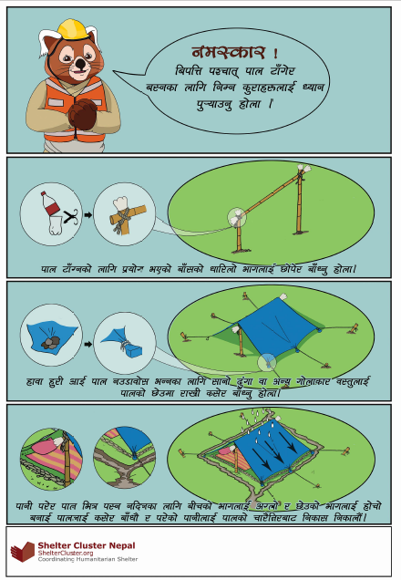
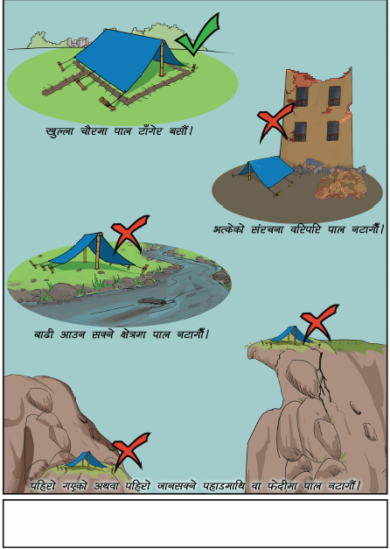

Slide 17
Shelter Assessment
Shelter assessment – completed in Kathmandu, Bhaktapur, Lalitpur, Gorkha, currently underway in Dolahka
Govt agreed to assessment of 8 other priority districts: Sindhuli, Sindhupalchok, Rasuwa, Okhaldhunga, Dhading, Makawanpur, Kabre, Nuwakot, Ramechhap
Support to carry out the assessment – transport and enumerators – training etc will be provided

Slide 18
Top Figures

Slide 21
East Hub

Slide 28
West Hub

Slide 33
Central Hub

Slide 38
Any other business
      Move meeting to once a week? On a Sunday?
      Next meeting – Sunday 11am DUDBC

Slide 39
Thank you very much
First Name | Last Name | Role | email address | Mobile
Victoria | Stodart | Lead Coordinator | coord1.nepal@sheltercluster.org | 9810120909
Saanjeev | Hada | Operations Coordinator | Sanjeev.hada@ifrc.org | 9851027783
Seki | Hirano | Field Coordinator | coord2.nepal@sheltercluster.org | 9813149666
Lise Anne | Pierce | Assistant Coordinator | coord3.nepal@sheltercluster.org | 9810120923
Raul | Ecay | Information Manager | IM2.nepal@sheltercluster.org | 9810152591
Alisha | Ghimire | Information Manager | IM4.nepal@sheltercluster.org | 9851216004
Eve | Leonard | Technical Coordinator | tech1.nepal@sheltercluster.org | 9808429143
Siobhan | Kennedy | Technical Coordinator | tech2.nepal@sheltercluster.org | 9818414269
Robert | Trigwell | Assessment Coordinator | robert.trigwell@reach-initiative.org | 9813031024

