Slide 1
TWiG - shelter&cash
Kathmandu –Soaltee Hotel
16th June 04:00pm

Slide 2
Agenda
Welcome
“Shelter perspective on cash”, Jim Kennedy (IOM)
Cash mapping at the districts (Shelter – cash mapping at DC level)
Open discussion
Cash distributions methods for shelter (challenges)
Cash distribution methods being tested by agencies so far (comparison of transaction costs, appropriateness for remote areas etc.)
Plans for monitoring cash related shelter interventions (relief, temporary)
- (Lessons learnt from using cash and vouchers)
- (Reports from the field)
Other issues (CGI fixing, Bricks…)
AOB

Slide 3
Reports from the field:
Remittance agencies are not running
Mobile coverage is not everywhere
Traders are used to deal with cash
Retailers need incentives to work
Duplications of beneficiaries / ID only by government
Banks: 2400 agents (many closed)
A Bank cannot transfer to B/C/D bank

Slide 4
Mainly B/C/D level
Liquidity is not known
Recommendation: not too much money in the account
Banks are not at the VDC level
Money transfer – NGO must be registered with SWC
Government wants to issue “short term ID”
Small banks – system may be stressed

Slide 5
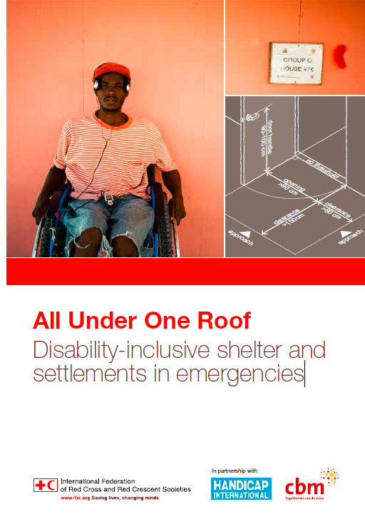
Other
CGI fixings and safety
Bricks
All Under One Roof - Disability-inclusive shelter and settlements in emergencies

Slide 6
AOB
Future meetings: SC meeting, Wednesday, 17th June 11:00am
Next meeting – has to be decided
Friendly reminders:
Check for updates on the website
Send in your reports for SC tracking
Register yourself on the mailing list
New Shelter Cluster Email for general correspondence: nepal@sheltercluster.org
https://www.sheltercluster.org/response/nepal-earthquake-2015

