Slide 1
Dahuk Shelter & NFI Cluster Coordination Meeting
Agenda
Introductions
Previous meeting action points
Mosul response camp populations
Mosul response camp summerisation
Needs in camps
Newly retaken areas and out of camp response inside Pesh lines
Rehabilitation
Key updates by partners
Updates from national level
AOB KRI
Newly retaken areas and out of camp response in GoI areas
AOB GoI
Tuesday, 1st Aug 2017
http://sheltercluster.org/response/iraq

Slide 2


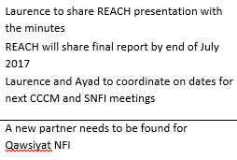








Update on Previous Action Points
http://sheltercluster.org/response/iraq

Slide 3
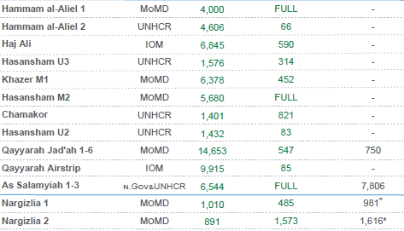
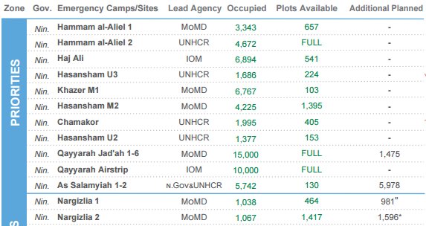
Mosul Response Camp Populations
27th July
{
22nd June
Nargazilia decreases, Erbil camps increase, but big decrease for M2.

Slide 4
Mosul Response Camp Gaps
Summerisation
Jerry cans in Qaymara
MoMD distribution of AWC to new arrivals in Mosul response camps and 2014 caseload?
Lead Agency | Site Name | Clothing | Shoes | Jerry can | Cool box | Fan | Shading | AWC | Additional items
MoMD | Nargizlia 1 | MoDM + PWJ | PWJ | Mission East | Fridge - PWJ | N/a | Mission East | MoDM | N/a
MoMD | Nargizlia 2 | MoDM + PWJ | PWJ | Mission East | Fridge - PWJ | N/a | Mission East | MoDM | N/a
UNHCR | Qaymawa (former Zelikan) | MoDM + PWJ | PWJ | Gap | Fridge – PWJ + Coolbox UNICEF | N/a | UNHCR | MoDM | N/a

Slide 5
Needs in existing camps
Prioritisation
The prioritization spreadsheet was updated and will be re-shared through the mailing list.
UNHCR have based their mid year review around the listed projects.
Have partners reviewed? Are any able to support?
Needs for Dahuk camps will shortly be merged with the needs of all KRI camps creating a single place for reference to SNFI in camps.
The SNFI cluster requested guidance from the global technical unit on the life expectancy of UNHCR tents which was stated as two cold winters or hot summers. As such the SNFI cluster conducted KRI wide analysis and is advocating to UNHCR for the replacement of all tents over this threshold before winter.
Fire Prevention
CCCM – please can you give an update on the method and pilot?

Slide 6
Needs in existing camps
Distributions in Nargazilia
Distributions have been disorganized and resulted in violence.
Guidelines have been written and will be sent out with the minutes. They are in addition to the normal agency guidelines, are very simple, specifying roles and responsibilities and created as a check list for Camp Management.
  There are some key changes around scheduling, staffing and community mobilization.
Guidelines are for all partners (NGO, WFP, BCF, MoMD, UN etc) when distributing.
Guidelines have been created with SC, BRHA, Camp Management, CCCM, Protection, UNHCR and NGOs all able to contribute. Partners are welcome to make further comments.
Following finalization of the document it will be translated into Kurdish.
Camp Management will establish a calendar and BRHA and SC will provide monitoring and support.

Slide 7
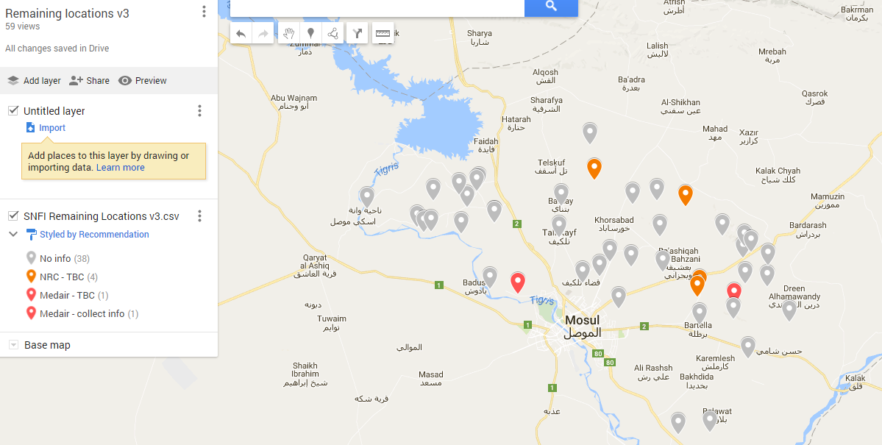
Newly Retaken Areas & Out of Camp Response in Pesh Areas
Remaining areas mapping
From 60 now at 38 without info.
Big thanks to NRC, Medair and Mission East
Link to map - https://drive.google.com/open?id=19LJmQ1PtJuMZ3RV3h0ITs3i4T0I

Slide 8
Newly Retaken Areas & Out of Camp Response in Pesh Areas
Assessments and responses since the last meeting:
Can partners respond to more villages?
Area | Responders
Ayadiya Sub District | WHH
Remaining villages + future plans | NRC
Remaining villages | Medair
Khazna | Mission East
Khorsebad | DORCAS

Slide 9
Newly Retaken Areas & Out of Camp Response in Pesh Areas
Upcoming partner assessments and responses?
Are partners planning assessments?
Do partners have ongoing responses or are planning responses?

Slide 10
Newly Retaken Areas & Out of Camp Response in Pesh Areas
Barima
Location still paused for SNFI activities
ICCG mission was organized for the 28th July and a report published.
OCHA, are there next steps?

Slide 11
Rehabilitation
New topic for discussion!
Various partners have been involved in rehabilitation of private households. Some such as NRC and UNHabitat are advanced and others are just starting. Around Dahuk we have:
  UNHabitat
  IOM
  UNDP
  NRC
  CRS
  ACTED
In other locations or with potential projects we have DRC, PWJ and Samaritans Purse.
Are there other partners with projects?
Cluster has a global technical advisor in country to complete guidelines. First discussion during TWiG - Thursday 2pm, UNHCR Erbil.
Bashiqa
Without coordination we already have five partners working in village…meeting to discuss Wednesday 2pm, UNHCR Erbil.

Slide 12
Key Updates by Partners
General notifications:
Programmatic updates all are required to be informed of?
Change in staffing?
Change in area of operation?
Projects:
Have you signed new funding recently?
Is a closing project creating a geographic gap?
Do you have an active SNFI project and have not had a “project check” email from me?
Security and access:
Problems inside Pesh lines?

Slide 13
Updates from national cluster and any other business in KRI?
What multi lateral issues have we not covered?
Updates from the national level
  Mosul coordination Skype group reactivated https://join.skype.com/ewCYhkuQZN9o
  Winterisation will be discussed during August and will update the 2016 kerosene position paper and 2015 guidelines
  The Erbil SNFI cluster has restarted and will hold it’s third meeting next week. Focus has been developing the list of camp issues and summerisation. Secondary topics will be out of camps, demining etc
Alignment of admin to match other SNFI clusters:
Agenda – requests for agenda to be in writing to Laurence the week before the meeting
Meeting minutes:
  To be sent to Laurence within 48 hours of the meeting
Meeting minutes are open for comment:
  Within 48 hours of the minutes being sent out
  Submitted on email
  To Laurence

Slide 14
Part two - GoI

Slide 15
Newly Retaken Areas & Out of Camp Response in GoI Areas
Assessments and responses since the last meeting:
Area | Responders
Alamuk, Janek and surrounding towns | ACF?

Slide 16
Security & Any Other Business
Security updates:
Have medium or major incidents occurred during the previous two weeks?
  When, where and why?
Updates from those working in forward or high risk areas
What multi lateral issues have we not covered?
Thanks for attending!

Slide 17





1. Cluster Team Structure
Laurent de Valensart - UNHCR National Cluster Coordinator +964 (0) 771 994 5694 coord.iraq@sheltercluster.org Michel Tia - IOM National IOM +964 (0) 750 021 1720 im2.iraq@sheltercluster.org Abdoulaye Dieye - NORCAP Assistant National IMO +964 (0) 771 488 2672 im2.iraq@sheltercluster.org Ali Rasul – UNHCR Senior Cluster Associate +964 (0) 750 445 4684 snrnatassot.iraq@sheltercluster.org | Andrea Quaden - NRC National Co-Coordinator +964 (0) 7517 407 635 coord2.iraq@sheltercluster.org Laurence West - UNHCR Sub National Coordinator – KRI + 964 771 911 0574 coord3.iraq@sheltercluster.org Tonja Klansek - ACTED Roving Coordinator - Mosul +964 (0) 773 725 80 92 coordroving.iraq@sheltercluster.org Cornelius Weira - IOM Sub National Coordinator - Centre and South +964 (0) 751 234 2548 coord4.iraq@sheltercluster.org

