Slide 1
Dahuk Shelter & NFI Cluster Coordination Meeting
Agenda
Introductions
Previous meeting action points
Mosul response camp populations
Winterisation
Rehabilitation
Arab returns in Zummar and Rabea
Other responses out of camps inside Pesh lines
Summary of outstanding needs
Key updates by partners
Updates from national level
AOB KRI
Tuesday, 12th Sept 2017
http://sheltercluster.org/response/iraq

Slide 2


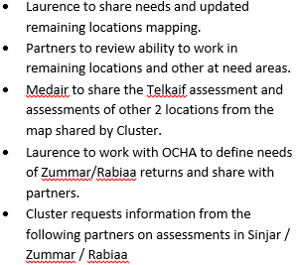



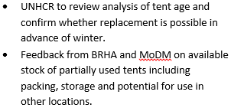
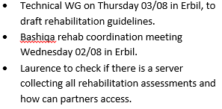

Update on Previous Action Points
http://sheltercluster.org/response/iraq

Slide 3
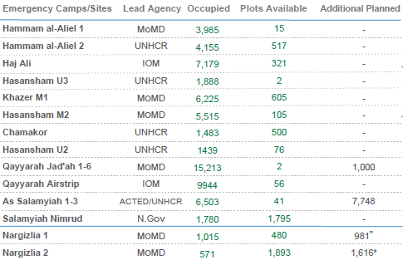
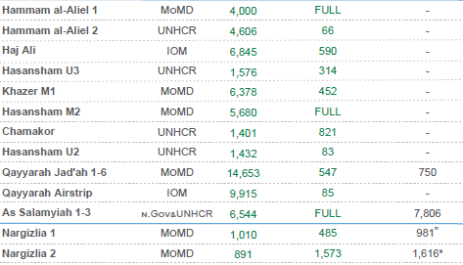
Mosul Response Camp Populations
10th Sept
27th July
Camps are filling again due to Tel Afar and waiting lists

Slide 4
Winterisation
Lessons learnt
What did partners learn from last year?
Some ideas to get us started:
Camps
Shelter – tents, bases, prefabs, plastic sheeting
NFI – items (heater, clothing, insulation etc), quantity, quality
Kerosene – 400L, four months, distribution
Infrastructure – power, drainage, roads
Out my camps
Critical shelter
MCNA 4 - 18% of IDP in UAB, containers or damaged buildings. Majority in unfinished buildings around Sumel
Provision of NFI and kerosene
Beneficiary selection

Slide 5
Winterisation
Need
What do partners see as the most acute needs?
Camps
Out of camps
Geographic areas
Types of interventions
Categories of people

Slide 6
Winterisation
Funding
Who has or is applying for funding?
Confirmed
Applied for
Considering to apply
Will not undertake winterisation

Slide 7
Winterisation
Other information
Cluster guidance on Climatisation Guidelines and the Kerosene Position Paper is under review and will be circulated to all sub national clusters for comment in the very near future.
To our knowledge local government is not able to provide details of confirmed activities at this point. The cluster continues to work at a senior level in KRI and Baghdad to resolve.
UNHCR is planning a project covering a number of camps and potentially out of camps, the details of which are being worked out. The cluster is supporting this process and UNHCR can provide details as soon as available.
To the best of our knowledge at this point:
The Climatisation Guidelines will provide the order of interventions based upon IASC Guidelines, the SNFI SAG and lessons learnt
Potentially the bulk of remaining activities for NGO partners will be out of camps
UNHCR tent replacement has been analyzed KRI wide, agreed and all qualifying will be completed pre winter
Specific planning needs to be made for the three non standard camps
Specific planning needs to be made for caravan camps
Camp projects should include infrastructure
Planning should be divided not by Mosul and Old caseload camps but whether a family arrived after the winter distribution of the previous year
Winter is a high priority and the above will be resolved ASAP

Slide 8
Summerisation
Request for support
Can any partner support MoMD and BRHA to transport remaining AWC to Nargazilia?
BRHA can provide details or this and other related work

Slide 9
Rehabilitation
Info to date
The following partners have funded projects:
UNHabitat
ACTED
NRC
CRS
UNDP FFIS
UNDP ICRRP
Samaritan's Purse
Zaka Khan Foundation
Arch Diocese of Erbil
Knights of Columbus
Does anyone other organization have confirmed funding? Do you know of other organisations with confirmed funding?
IOM has just closed a round of applications for an approx. 3,000 house project and other donors are seeking to fund. Shelter cluster worked with two partners during proposal development stage and recommended them to IOM as clear to work.
Many organisations have participated in the TWiG and the following documents have been created:
Minimum standards (Final and released)
War damaged buildings categorization (Final and released)
Guidelines and costs per category (draft, completed soon)
With operations being undertaken in:
Bashiqa
Qaraqosh
Bartella
Telescof
Baqofah
Karmles
Khorsebad
Omar Qapchi.

Slide 10
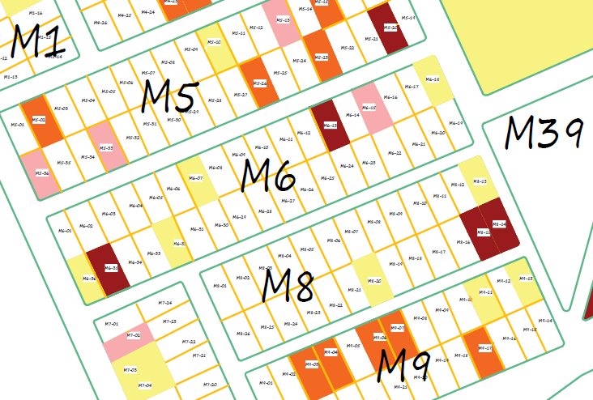
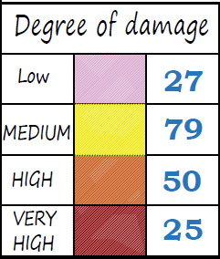

Slide 11
Rehabilitation
Next steps
Bashiqa is being used as a test case. UNDP undertook an assessment of all houses in the village and will under take the same in Bartella. We are aiming to designate an NGO at house level to avoid duplication and communicate residual need.
For the larger towns with multiple partners, the cluster is aiming to work in the similar way to Bashiqa, if successful.
For smaller villages the cluster is aiming for an individual partner to lead and communicate any gaps for other partners to support, in a similar fashion to the village cluster system.
A rough database of need exists and is being updated with all assessments partners are able to provide. When this progresses a little more it will become a public tool for all to use.
There is a lot of think about beyond guidelines – one question is beneficiary selection of most vulnerable, including in camps
Currently the bulk of implement is occurring within Bashiqa, Bartella and Qaraqosh. ACTED have declared for Khorsebad and Omar Qapchi and two Christian organisations for Telescof, Baqofah and Karmles. We have been working to gather information from UNDP and the Christian organisations on these projects with the aim to create a sharable map and needs database as soon as possible.
If you are applying for funding please contact the cluster at
proposal development stage to discuss geography

Slide 12
Arab Returns
First villages
Who can support for ESK/SOK?
Village | GPS | Current/Pre HH | Need | Partner | Response
Qahera | 36.90048 42.20054 | 10/100 | NFI SOK/ESK (40 destroyed, 13 partial, 8 rehab) | NRC | BNFI 23
Saudia | 36.86945 42.22698 | 179/300 | NFI SOK/ESK (10 destroyed, 5 partial, 150 rehab) | NRC | BNFI 141
Kharab Tibin | 36.747216 42.469764 | 24/220 | NFI SOK/ESK (3 destroyed and 200 rehab) | NRC ACTED | BNFI 23 SOK/ESK – 14/09/17
Ain Zala | 36.71707 42.55725 | 54/120 | NFI SOK/ESK (2 destroyed, 2 partial, 50 rehab) | NRC | BNFI 8

Slide 13
Arab Returns
Further villages
Who can support with assessments leading to BNFI and ESK/SOK?
Village | GPS | Current/Pre HH | Need | Partner | Response
Khirbet Al-A'ashiq | 36.75488 42.45644 | 225/??? | NRC to share assessment | NRC ACTED | BNFI 218 ESK/SOK – 14/09/17
Esfiya (Sufiya) | N 36°51'48" E 42°17'19" | 48/150 | Assessment required
Barzan | N 36°46'18.25" E 42°32'46.05" | ???/300 | Conflicting info between OCHA and NRC on number of returns – circa 170?
Shahir | Unknown |  | Assessment required
Ain Mana | N 36°35'33.03" E 42°42'16.72" | 6/150 | Assessment required
Al Qahiraa | N 36°54'41.14" E 42°12'31.75" | 15/75 | Assessment required
Asqof | 36.388328 43.450457 | 46/??? | NRC to share assessment | NRC | 48 BNFI
Rekabah | 36.568052 43.234751 | 10/??? | Assessment required

Slide 14
Rapid Needs Assessment Training
Aid efficiency
When a village is first accessed it is efficient to have a standardized multi sector needs assessment creating clear and comparable information which can be shared with all clusters to determine a go / no go position.
This reduces the number of assessments, reduces cost, is quicker and more equitable
SNFI Cluster, in conjunction with Protection Cluster, through OCHA and the ICCG, is organizing a training by REACH for all interested NGOs on the standard RNA.
The training will be an excellent opportunity for first line responder and other interested NGOs
Two dates are currently available and a final one selected based upon the number of people able to attend. They are the 27th and 28th of September. Times will be the morning for a half day only.
Who is interested to be trained?

Slide 15
Newly Retaken Areas & Out of Camp Response in Pesh Areas
Recently conducted assessments
Partners have conducted assessments in the following areas:
NRC (Multi sector) - Zummar, Jazronya, Domiz, Suhela, Smud, Shikak, Abo Wajna, Kahrez, Brdiya, Talmos
NRC (Shelter) - Zummmar Center, Kaser Sereg, Karez, Frya, Hemo Gelo, Gerver, Talmos and Abony
Medair – Sinjar town, Caracoil, Rashidiya (Mosul) and Telkief
CARE & ACTED (RNA) - Til Al-Hawa, Til Hayal, Al-Sikak, Al-Qadisiya Qr, Shekh Himsi, Kharab Al-Ashiq
Mission East – Sinjar PKK
Malteser International – 21 villages in Ayadiya Sub District on www.humanitarianresponse.info
PWJ – TBC

Slide 16
Newly Retaken Areas & Out of Camp Response in Pesh Areas
WHH Assessment pt 1/3
District | Sub-district | Name of village | GPS
Telafar | Zummar | Tel Mus | 36.631399, 42.600244
Telafar | Zummar | Kani Shren | 36.603751, 42.621267
Telafar | Zummar | Mufry | 36.614541, 42.568983
Telafar | Zummar | Til Maraqsufla/Gilgamish | 36.594173, 42.524578
Telafar | Zummar | Til Maraq Alia/Kobani | 36.610673, 42.537728
Telafar | Zummar | Faqerok/Muhwardak | 36.584746, 42.486825
Telafar | Ayadea | Ekhwetla | 36.590308, 42.457443
Telafar | Ayadea | Amalah | 36.642534, 42.444575
Telafar | Zummar | Ain Zala | 36.720488, 42.558193
Telafar | Zummar | Shareka Ain Zala | 36.736312, 42.596705
Telafar | Zummar | Masker Domiz | 36.706396, 42.608639
Telafar | Zummar | Domiz complex | 36.711168, 42.615628
Telafar | Ayadea | Nasefia | 36.587373, 42.364678
Telafar | Ayadea | Burqhulia | 36.594301, 42.363804
Telafar | Ayadea | Bugha | 36.593871, 42.388434

Slide 17
Newly Retaken Areas & Out of Camp Response in Pesh Areas
WHH Assessment pt 2/3
District | Sub-district | Name of village | GPS
Telafar | Zummar | Sumod complex | 36.763646, 42.602712
Telafar | Wana | Babnet | 36.596648, 42.878125
Telafar | Wana | Shaixwat | 36.556899, 42.808208
Telafar | Wana | Mstah Complex | 36.574991, 42.798011
Telafar | Zummar | Khrvr | 36.689199, 42.597109
Telafar | Zummar | Jasaah | 36.3537 , 42.4057
Telafar | Zummar | Shakak | 36.58515 , 42.648825
Telafar | Zummar | Danne | 36.3720, 42.2838
Telafar | Zummar | North Abo Woni and South Abo Woni | 36.3729 , 42.2759
Telafar | Zummar | Bazlah | 36.71002, 42.705984
Telafar | Zummar | Hamu Gulo | 36.601587, 42.644721
Telafar | Ayadea | Khrmr | 36.622723, 42.381755

Slide 18
Newly Retaken Areas & Out of Camp Response in Pesh Areas
WHH Assessment pt 3/3
District | Sub-district | Name of village | GPS
Telafar | Ayadea | Shhel Bugah | 36.572426, 42.372529
Telafar | Zummar | Abu Wajnam | 36.69412, 42.6233016
Telafar | Zummar | Sufia | 36.685876 , 42.711506
Telafar | Zummar | Tebat Reiah | 36.692293, 42.686736
Telafar | Zummar | Jesari Complex | 36.68938 , 42.684463
Telafar | Ayadea | Sahil Abd Hawa' | 36.5873383, 42.4117783
Telafar | Zummar | Khamruk | 36.65583233, 42.6780216
Telafar | Zummar | Masifna | 36.6841733, 42.629035

Slide 19
Newly Retaken Areas & Out of Camp Response in Pesh Areas
Next Steps
Cluster to review all assessments with partners, collect information on needs, response and share with all
This will build upon the outstanding needs email sent through the cluster – don’t be afraid to reply and sign up to meet one of the needs!
Have partners conducted other assessments?
Have partners conducted other responses?
Mission East and Medair in Sinjar?

Slide 20
Key Updates by Partners
General notifications:
Programmatic updates all are required to be informed of?
Change in staffing?
Change in area of operation?
Projects:
Have you signed new funding recently?
Is a closing project creating a gap?
Security and access:
Problems inside Pesh lines?

Slide 21
Updates from national cluster and any other business in KRI?
What multi lateral issues have we not covered?
Updates from the national level
Climatisation and NFI Guidelines v12 are coming for review. TWiG documents should have reviewed by each organization already.
HNO/HRP process has been delayed whilst the categorisation of people in need is redefined. OCHA is yet to release an updated timeline however there are dates for the PiN and workshop around the 20th and finalisation of the HNO process during the first few days of October.
OCHA is reviewing the IHPF process with the clusters and HC. The current feeling is that a special allocation might be made for Hawija and West Anbar and that no second allocation will be made this year.
The Global Shelter Cluster is asking organisations to feedback on its work and direction in a brief survey https://www.surveymonkey.com/r/3FPDXJF
AOB
Next meeting in two weeks including a presentation by REACH on MCNA 4 & 5
Thanks for attending!
(Next meeting will be split KRI and GoI)

Slide 22





1. Cluster Team Structure
Laurent de Valensart - UNHCR National Cluster Coordinator +964 (0) 771 994 5694 coord.iraq@sheltercluster.org Michel Tia - IOM National IOM +964 (0) 750 021 1720 im2.iraq@sheltercluster.org Abdoulaye Dieye - NORCAP Assistant National IMO +964 (0) 771 488 2672 im2.iraq@sheltercluster.org Vacant Cluster Associate +964 (0) 7 .iraq@sheltercluster.org | Andrea Quaden - NRC National Co-Coordinator +964 (0) 7517 407 635 coord2.iraq@sheltercluster.org Laurence West - UNHCR Sub National Coordinator – KRI + 964 771 911 0574 coord3.iraq@sheltercluster.org Tonja Klansek - ACTED Roving Coordinator - Mosul +964 (0) 773 725 80 92 coordroving.iraq@sheltercluster.org Cornelius Weira - IOM Sub National Coordinator - Centre and South +964 (0) 751 234 2548 coord4.iraq@sheltercluster.org

