Slide 1
NWSW Shelter Cluster Meeting
18th August
Hybrid Meeting: Bamenda, Buea, Bafoussam, Littoral

Slide 2
Agenda
Introduction of Participants
Updates on Action Points from the Previous Meeting
Updates on the Shelter Cluster Response as of July 2023
NRC PDM findings presentation
Updates from Shelter Cluster partners
AOB

Slide 3
Action Points
Action Points | Follow up
Next National Sector Meeting on the 26th July to focus on AAP and PDM | Done- good attendance from partners in NW, SW, W, and L
NRC will develop a lessons learned document on the repairs project based on the post distribution monitoring exercise which is ongoing. | Update to be provided by NRC
Shelter Cluster Partners to give their feedback on the revision to the Shelter Cluster Strategy. So far no partners have shared feedback. | Updated Strategy document is updated to the website- if outstanding comments, please give feedback to cluster team: https://sheltercluster.org/north-west-south-west/documents/shelter-cluster-strategy-2023-revision
Shelter Cluster partners to share updated price monitoring data with the Cluster. If data is not shared it will not be possible to adjust technical guidance and inform donors about the changes to the costs in achieving the basic standards | So far no partners have shared any updates on Price Monitoring- becoming critical since it has been one year since the Cluster has last updated its prices. How should the Cluster go about updating its prices?

Slide 4
Action Points (Continued)
Action Points | Follow Up
Shelter Cluster partners to remember to encourage their National NGO sub-contracted partners to participate in Shelter Cluster meetings and have appropriate visibility in meetings | Ongoing – this is important element of localization
Update to contingency plan | The contingency plan is available on the website: https://sheltercluster.org/north-west-south-west/documents/nwsw-shelter-cluster-contingency-plan If comments, please reach out to the Shelter Cluster team. Shelter Cluster team has also shared with OCHA and presented it to other clusters to ensure scenarios are incorporated into overall inter-agency contingency plan
Partners to approach the Shelter Cluster team for their training needs | Ongoing

Slide 5
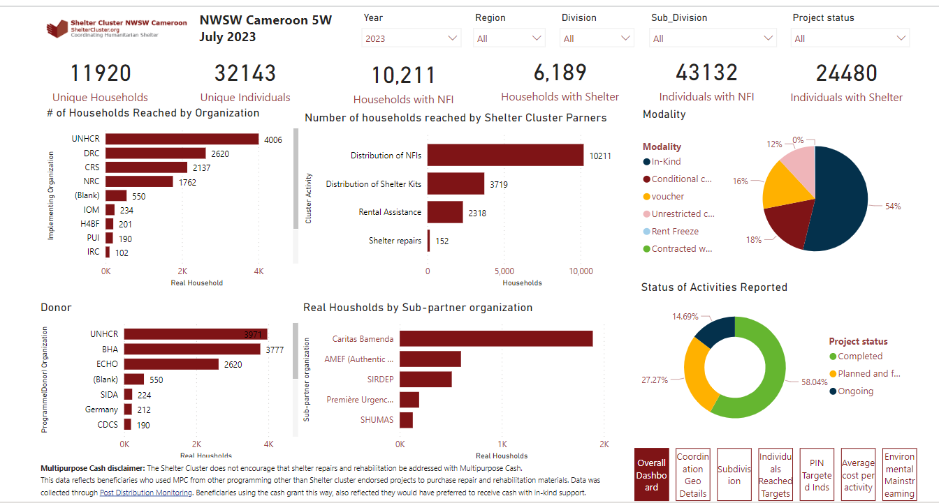
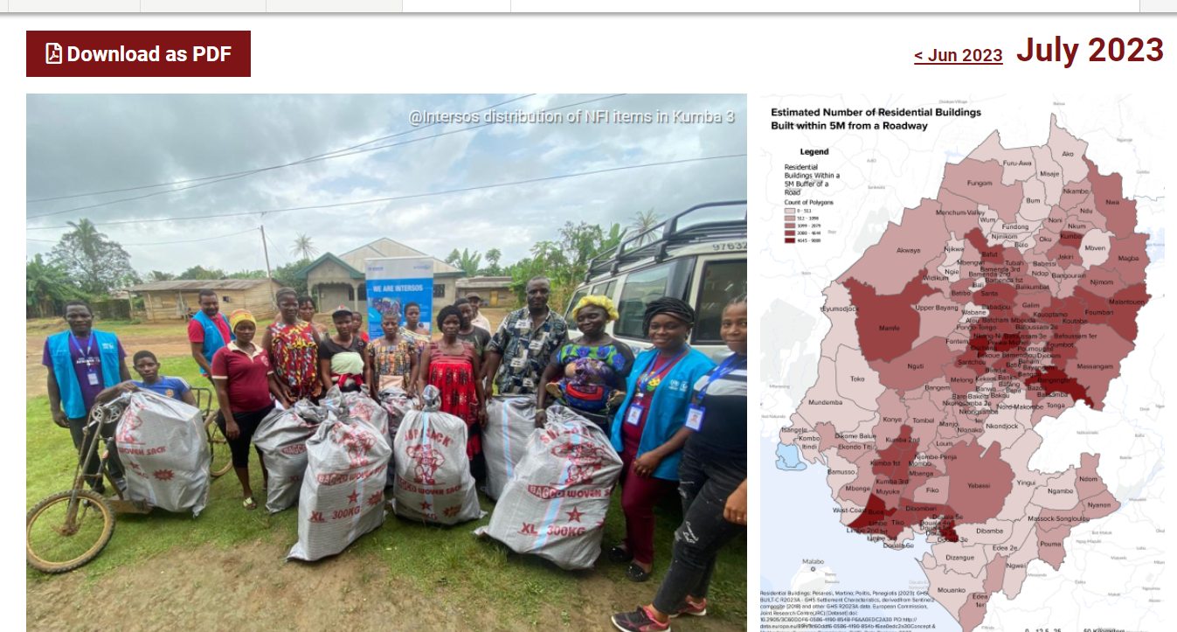
Updates on the Shelter Cluster Response presentation of online dashboard and Factsheet

Slide 6
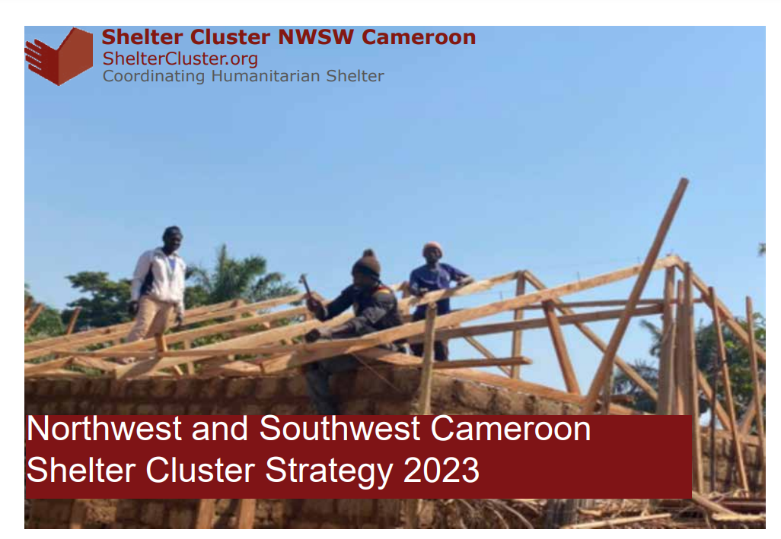
Shelter Cluster Strategy Update What Changed
Updated Needs Analysis
Updated Targets
Updated advocacy messages
Updated Toolkit
Small Table on Beneficiary Selection

Slide 7
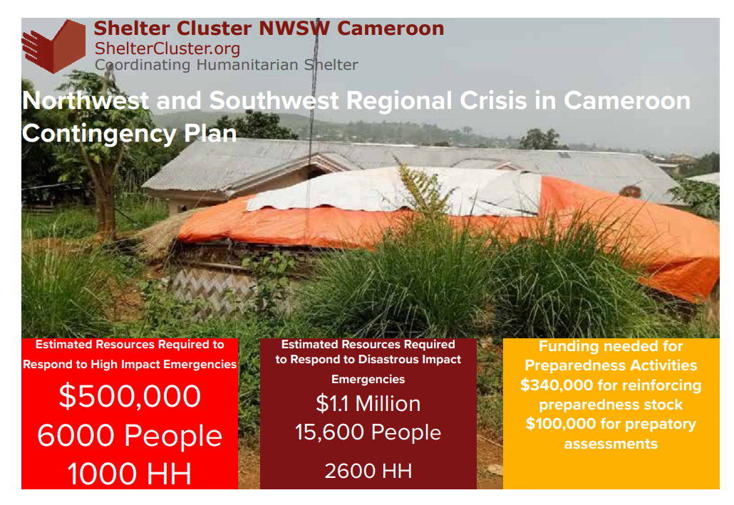
Updated Contingency Plan
Description of Scenarios and their Development
Budget Requests for High and Disastrous consequence scenarios
Maps highlighting areas at risk
Prioritization for conflict situations while advocating for better government cooperation in natural disaster cases

Slide 8
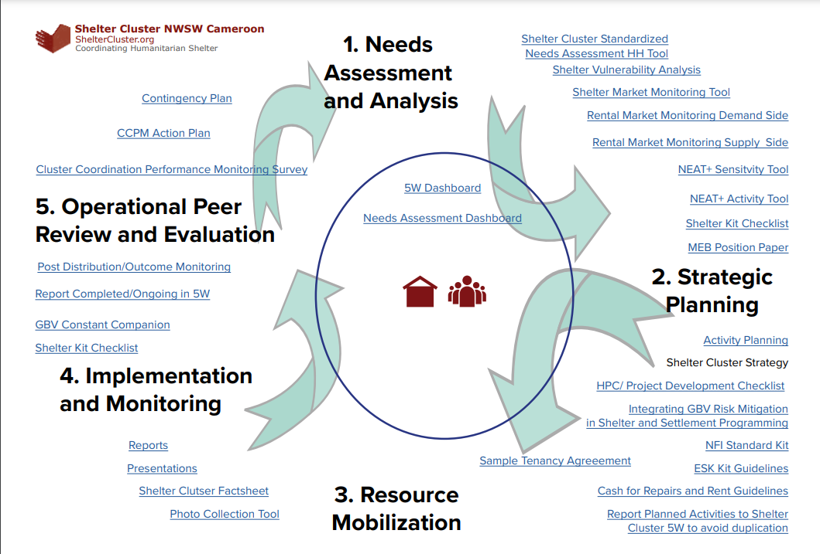
Updated one pager
2 new tools on assessing the rental market thanks to NRC
Updated strategy and contingency plan
Easier spaced out links and readability

Slide 9
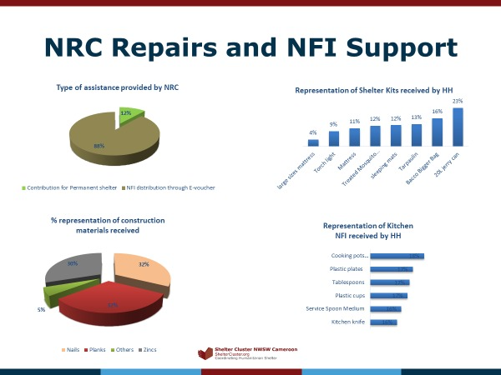
NRC PDM presentation

Slide 10
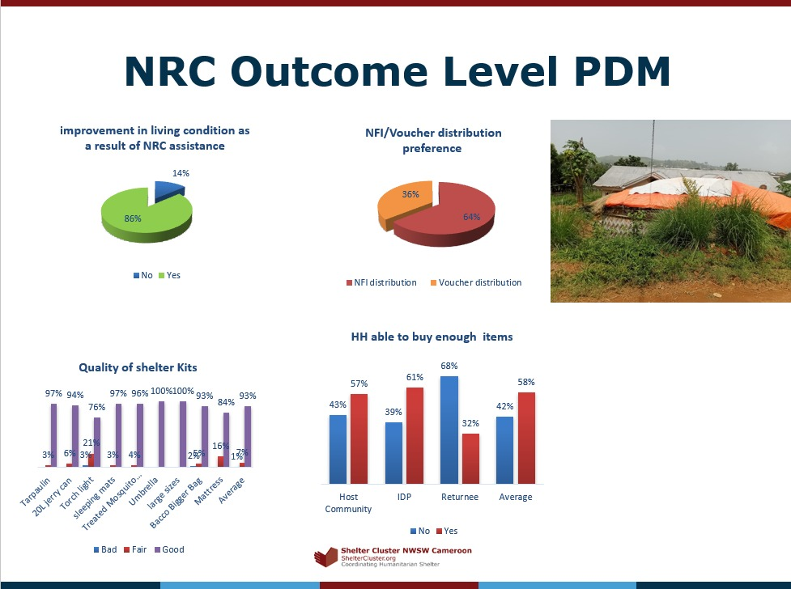
NRC PDM presentation

Slide 11
Updates from Shelter Cluster partners

