Slide 1

Cluster Strategy for Cooking Fuel Provision and Fuel Efficient Stoves
28 August 2014

Slide 2
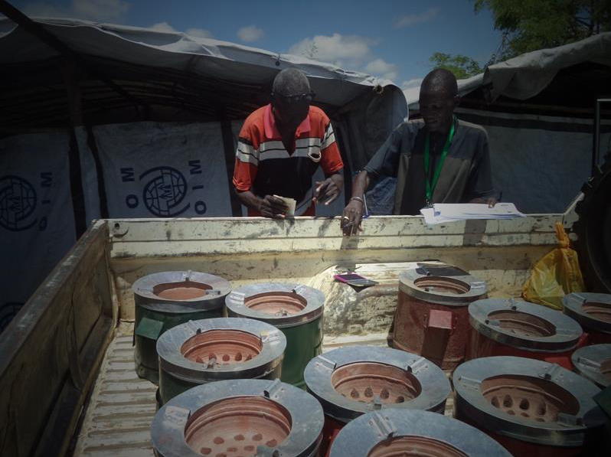
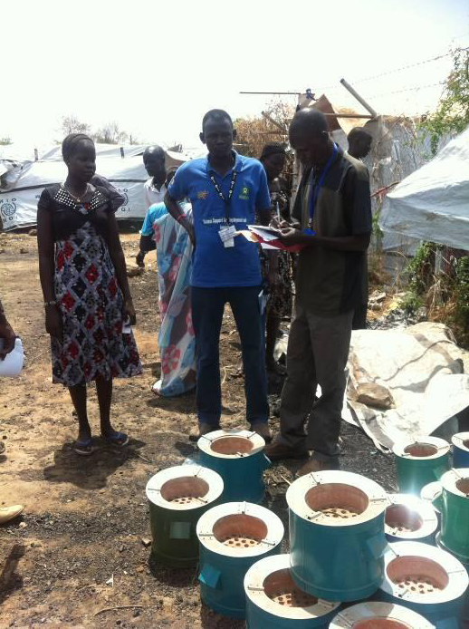
Cooking fuel and fuel efficient stoves
Prior to the December 2013 crisis, internal displacement in South Sudan did not tend to result in concentrated sites where cooking fuel became an urgent humanitarian issue.
The protection environment has changed this.
At the Crisis Response Plan review in July it was decided that the Shelter NFI Cluster should include provision of fuel and/or fuel efficient stoves within its response.
Provision of fuel and fuel efficient stoves has been limited and ad hoc thus far.

Slide 3
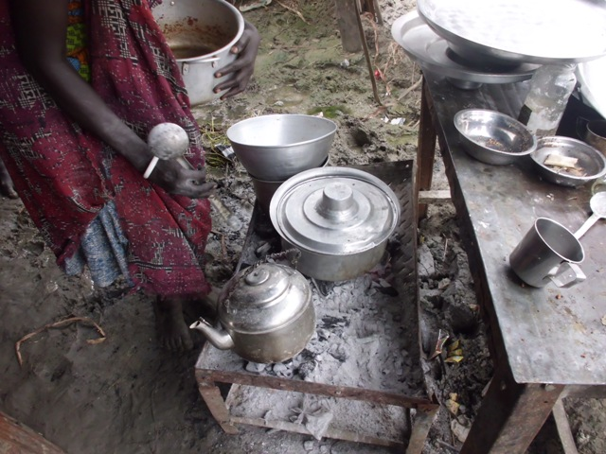
Key elements of decision-making/strategy
Availability
Access
Logistics and feasibility
Other strategies
TRACK 1: Enhanced protective measures
TRACK 2: Provision of fuel and/or fuel efficient stoves

Slide 4
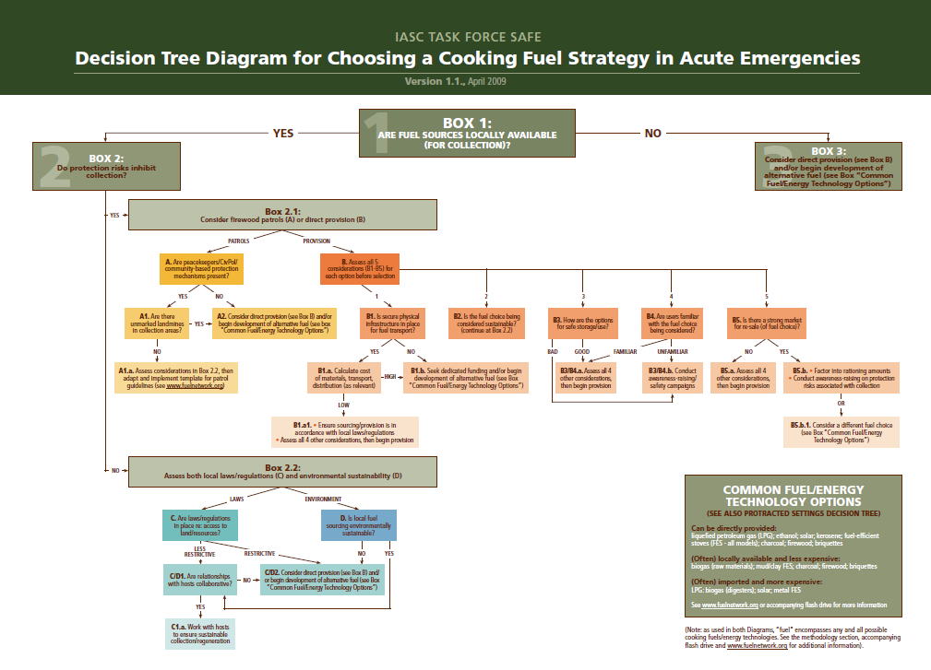

Slide 5
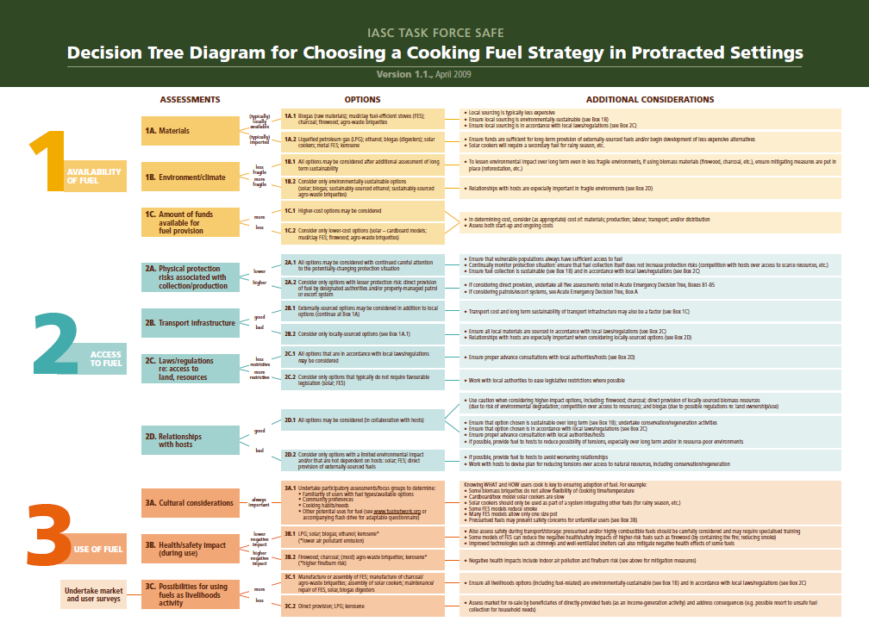

Slide 6
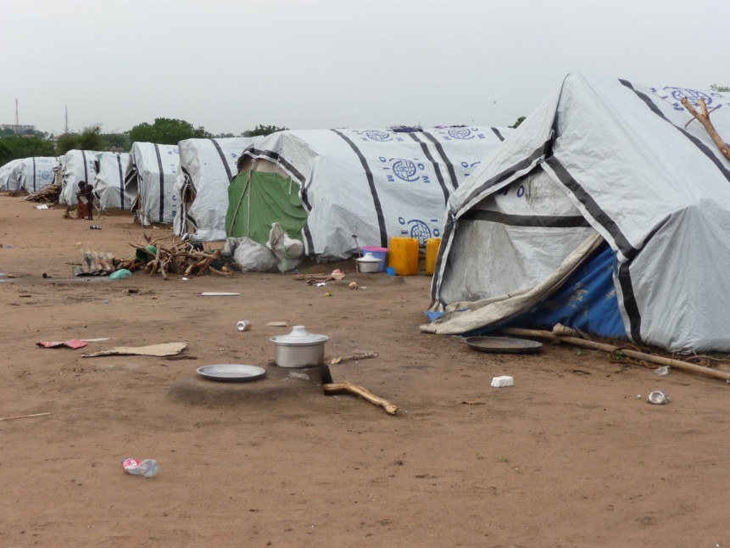
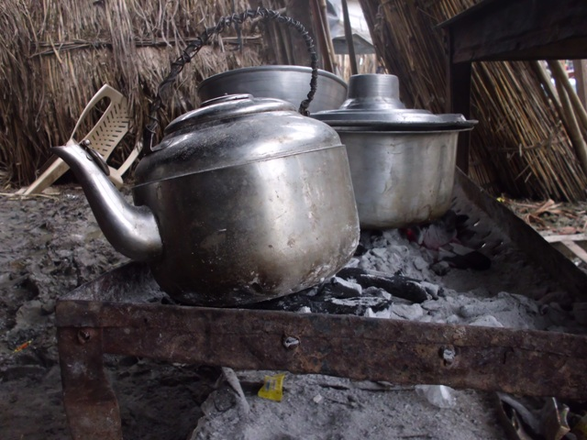
When to provide direct fuel/FES intervention
Fuel Efficient Stoves will be considered where fuel is available for gathering or purchase, but where there are some barriers to access.
Regular provision of charcoal will be considered in addition where fuel is not available, and/or where there are very high barriers to access for the majority of the population.

Slide 7
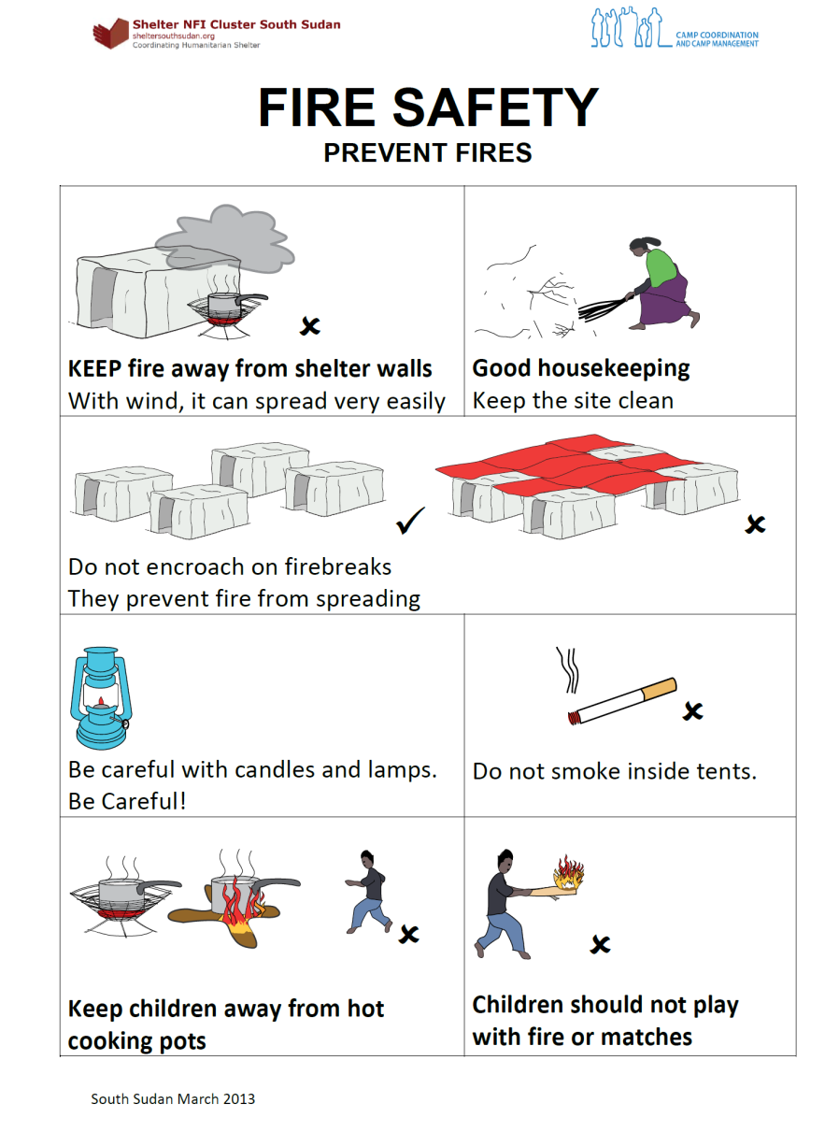
What type of fuel/FES intervention?
Choice of stove type should take logistics considerations into account.
For both provision of FES and fuel rations, a targeted approach is preferable.
All interventions should be accompanied by fire safety awareness raising.

Slide 8
Analysis
Site | Fuel availability | Access (protection considerations) | Logistics | Cost
Bentiu | Charcoal; market inside POC; 10 SSP for small bag | Some movement in and out of base for water/fuel collection; high number of protection incidents reported outside base. Protective accompaniment not possible. | Air | Fuel and FES cost, tanspor t (road + air), stoage, labour (includign offloading)
Bor | Charcoal; market inside POC; 67 SSP for large back; wood for gathering outside | Very limited movement; perception of huge security risk, citing April incident. Suspended firewood patrols. | Road
Malakal | Market inside POC and in Wau Shilluk; 5 SSP for 0.5Kg | A lot of movement in and out of base for gathering, markets, employment; medium number of protection incidents outside. Limited patrolling. | Air
TP | Market available; 100 SSP per large bag | A lot of movement in and out for work; number of protection incidents fallen. Gates monitored. | Road
UN House | Market available; 100 SSP per large bag | Some movement in and out, mainly for food and work; high level of protection incidents. | Road
Mingkaman | Wood available for gathering (environmental concerns) | Low number of protection incidents reported? Tensions btwn IDP and host. | Road

Slide 9
Proposed strategy by site
Site | TRACK 1: Enhanced Protective Measures | TRACK 2: Provision of cooking fuel and/or FES | Potential ES/NFI partner
Bentiu | UNMISS patrols outside. Removal of SPLA block to expand collection area. | Consider flatpack FES; targeting | GAA/DRC
Bor | UNMISS patrols outside. | FES; blanket monthly provision of charcoal ration underway. | Oxfam/Intersos/ Acted
Malakal | UNMISS patrols outside. | Consider flatpack FES | DRC?
Tongping (Juba) | UNMISS patrols outside. | No intervention until relocation complete; then decision based on assessment at that time | N/A until December , then Intersos?
UN House (Juba) | UNMISS patrols outside. Removal of SPLA block to expand collection area. | Charcoal provision + FES underway since Feb. Possibly targeted from Jan, but to be based on protection assessment at that time. | Oxfam (until Dec), then Concern?
Mingkaman |  | Consider FES (local materials) | Oxfam?

Slide 10
Next Steps
Urgent funding gap for Bor (charcoal provision at USD 13,800 per month + support cost)
Combined advocacy with UNMISS and monitoring of indicators with Protection Cluster
Further analysis of stoves in use and relative efficiency; livelihoods/income and markets (FSL; ODI/Oxfam study); costing of each intervention including logs
Clarify partner commitments and funding gaps across the sites
Beyond December in the Juba sites? General exit strategy?

