Slide 1
SHELTER CLUSTER
DIGITAL PLATFORM

Slide 2


SHELTER CLUSTER AS A SERVICE PROVIDER FOR MOBILE DATA COLLECTION.
+

Slide 3
PILOT PROJECT FOR INFORMATION SHARING AND STRONGER ACCOUNTABILITY
+

Slide 4
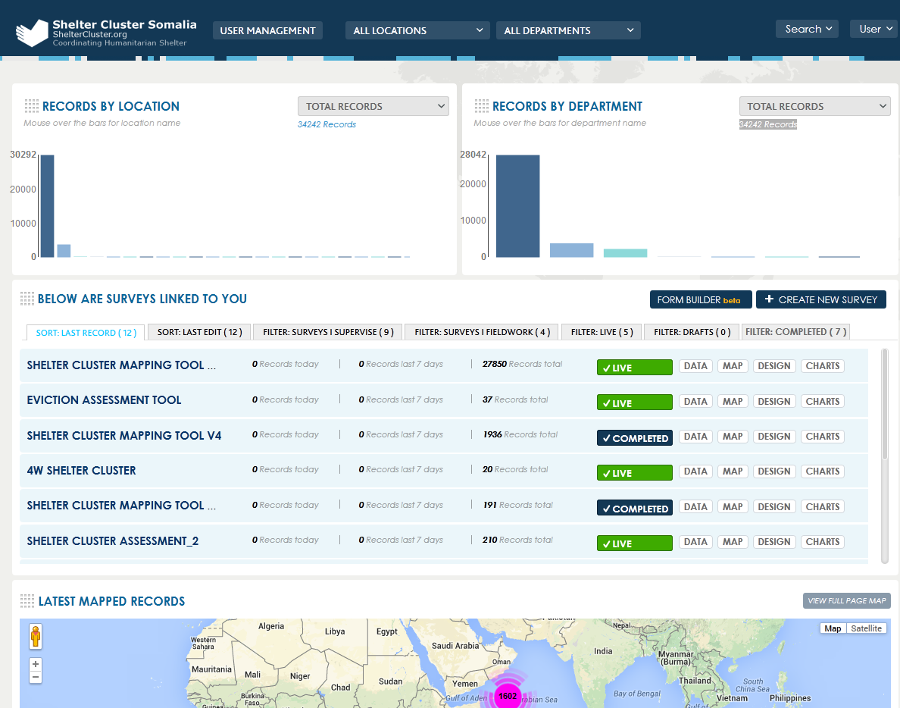
Org.Logos
Used for management roles e.g.
adding editing removing Locations
Used for management roles e.g.
adding users, removal of departments
Used for management roles e.g.
adding users, editing roles,
removing users, assigning roles
Survey tools
Live Surveys that can be seen on mobile platform
Completed survey version, not seen on the mobile platform

Slide 5

FORMER MODEL
+
Shelter cluster digital platform
Locations
SHELTER CLUSTER
Only accessible to SC
ARC
Only accessible to ARC
Needs Assessments
Departments
This would filter all needs assessment tools
Mapping/others
This would filter all mapping tools
ALL SOMALIA
Accessible to all organizations
Monitoring
This would filter all monitoring tools
Evaluation
This would filter all evaluation tools
Other organisations
Only accessible to specific organizations

Slide 6
NEW MODEL
+
SHELTER CLUSTER DIGITAL PLATFORM
DEPARMENTS
SHELTER CLUSTER
LOCATIONS
ARC
LOCATIONS
DKH
According to Geography:
*ALL SOMALIA
*NAIROBI
*BOSSASO
*BAIDOA
*MOGADISHU
This will give flexibility to all the field clusters to develop their own tools. Regional Cluster Coordinators will become department administrators
These will be cateogrized according to the project cycle management:
*NEEDS ASS.
*MONITORING
*EVALUATION
*MAPPING
DEPARMENTS
This will depend on the agency. ARC will decide to who they will want to give access.: Or geographic locations or sectoral location should be chosen.
If sectoral access is used, shelter ARC department could have their own department administrator.
This will depend on the agency. Depending if the locations will be geographical or sectoral, this will categorize the tools according to the project cycle management (see shelter cluster)
LOCATIONS
This will depend on the agency. ARC will decide to who they will want to give access.: Or geographic locations or sectoral location should be chosen.
If sectoral access is used, shelter ARC department could have their own department administrator.
DEPARMENTS
This will depend on the agency. Depending if the locations will be geographical or sectoral, this will categorize the tools according to the project cycle management (see shelter cluster)
Other organisations
LOCATIONS
This will depend on the agency. ARC will decide to who they will want to give access.: Or geographic locations or sectoral location should be chosen.
If sectoral access is used, shelter ARC department could have their own department administrator.
DEPARMENTS
This will depend on the agency. Depending if the locations will be geographical or sectoral, this will categorize the tools according to the project cycle management (see shelter cluster)

Slide 7
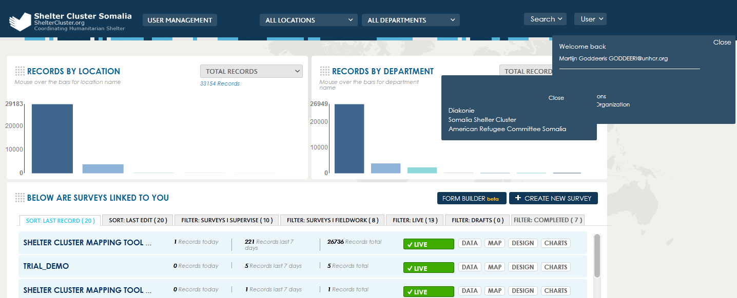
MODEL NEW LOOK
+
When Logged in as Admin (SC.Coordinator)
The SC.Account Admin sees the existing agencies and depending on the roles assigned to him, he can view the tools, locations, and departments

Slide 8
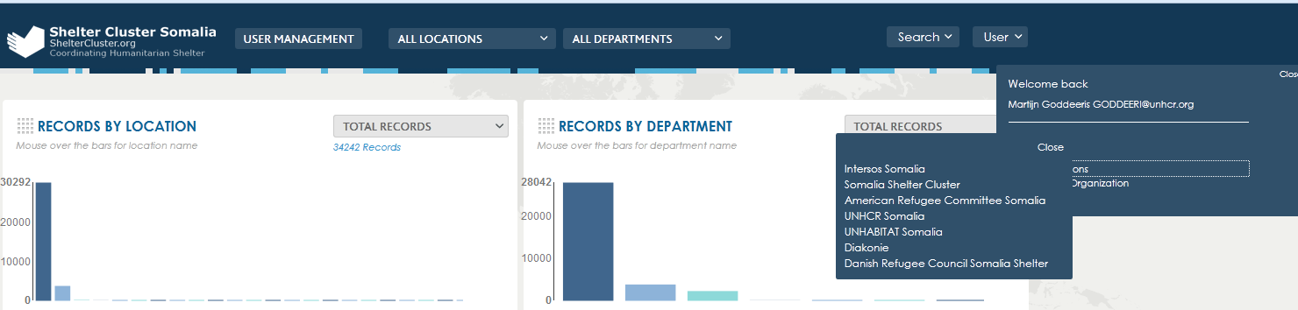
Model Latest Look
Individual organization
hosted in the digital platform (mFieldwork)

Slide 9
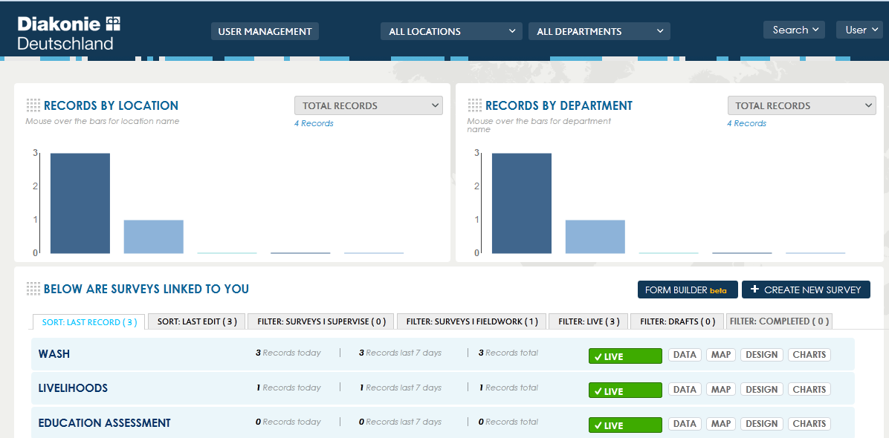
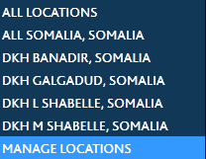
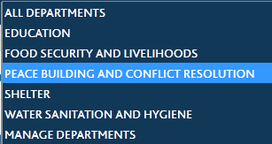
DKH Platform
+
This is DKH suggested Departments and Locations created by their account Admin in their platform
DKH Test-survey tools

Slide 10
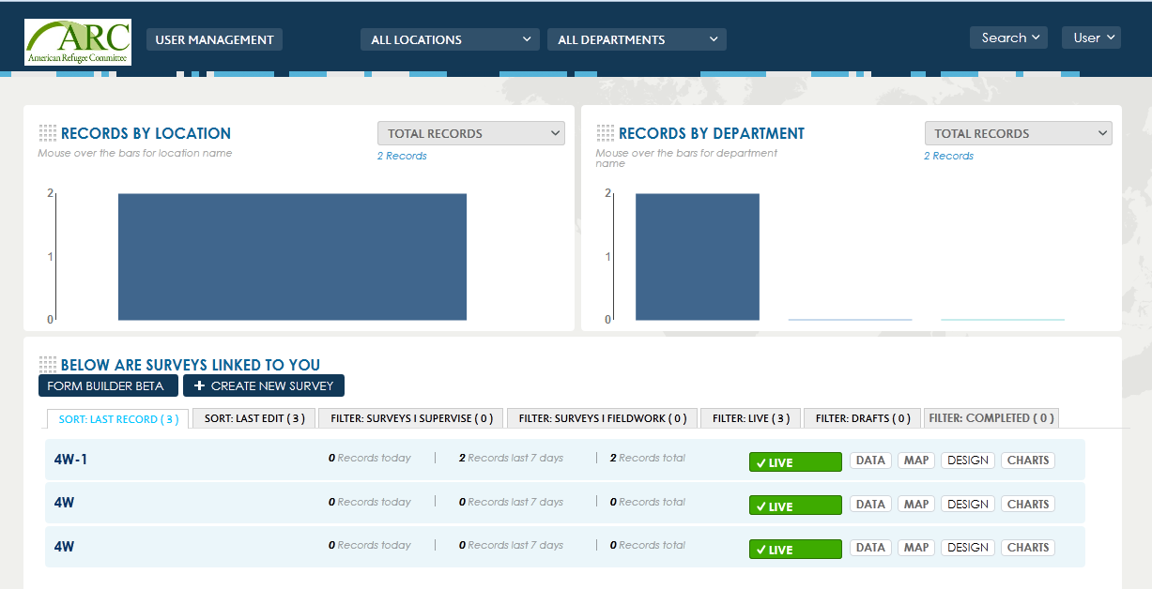


ARC Platform
ARC Account admin created 3 pilot departments which are sectoral based.
More improvements is anticipated based on their decisions
ARC Test-survey tools

Slide 11
BENEFITS
+
SHELTER CLUSTER DIGITAL PLATFORM
DEPARMENTS
SHELTER CLUSTER
LOCATIONS
DKH
According to Geography:
*ALL SOMALIA
*NAIROBI
*BOSSASO
*BAIDOA
*MOGADISHU
This will give flexibility to all the field clusters to develop their own tools. Regional Cluster Coordinators will become department administrators
These will be categorized according to the project cycle management:
*NEEDS ASS.
*MONITORING
*EVALUATION
*MAPPING
LOCATIONS
This will depend on the agency. DKH will decide who they will want to give access.: Or geographic locations or sectoral location should be chosen.
If sectoral access is used, shelter DKH department could have their own department administrator.
DEPARMENTS
This will depend on the agency.
Depending if the locations will be geographical or sectoral, this will categorize the tools according to the project cycle management (see shelter cluster)
Other organisations
LOCATIONS
This will depend on the agency. Specific organizations will decide to who they will want to give access.: Or geographic locations or sectoral location should be chosen.
If sectoral access is used, shelter ARC department could have their own department administrator.
DEPARMENTS
This will depend on the agency.
Depending if the locations will be geographical or sectoral, this will categorize the tools according to the project cycle management (see shelter cluster)
ARC
LOCATIONS
DEPARMENTS
This will depend on the agency.
ARC will decide to who they will want to give access.: Or geographic locations or sectoral location should be chosen.
If sectoral access is used, shelter ARC department could have their own department administrator.
This will depend on the agency.
Depending if the locations will be geographical or sectoral, this will categorize the tools according to the project cycle management (see shelter cluster)
ADVANTAGES:-
EASY TO SEPARATE WITHOUT DATA LOSS
IT IS AGENCY SPECIFIC; AGENCY ADMIN CAN MANAGE THEIR PLATFORM
ORGANIZATION CAN MANAGE THE LOCATIONS AND DEPARTMENTS INDEPENDLY BASED ON THEIR DECISIONS
ORGANIZATIONS CAN ADD, REMOVE AND OR MANAGE THEIR USERS BY ASSINING ROLES
INDEPENDLY

Slide 12
BENEFITS
+
EASY TO SHARE INFORMATION BETWEEN PLATFORMS THROUGH USER MANAGEMENT RIGHTS
SHELTER CLUSTER DIGITAL PLATFORM
DEPARMENTS
SHELTER CLUSTER
LOCATIONS
DKH
According to Geography:
*ALL SOMALIA
*NAIROBI
*BOSSASO
*BAIDOA
*MOGADISHU
This will give flexibility to all the field clusters to develop their own tools. Regional Cluster Coordinators will become department administrators
These will be cateogrized according to the project cycle management:
*NEEDS ASS.
*MONITORING
*EVALUATION
*MAPPING
*
LOCATIONS
This will depend on the agency. DKH will decide to who they will want to give access.: Or geographic locations or sectoral location should be chosen.
If sectoral access is used, shelter ARC department could have their own department administrator.
DEPARMENTS
This will depend on the agency. Depending if the locations will be geographical or sectoral, this will categorize the tools according to the project cycle management (see shelter cluster)
Other organisations
LOCATIONS
This will depend on the agency. Specif agencies will decide to who they will want to give access.: Or geographic locations or sectoral location should be chosen.
If sectoral access is used, shelter ARC department could have their own department administrator.
DEPARMENTS
This will depend on the agency. Depending if the locations will be geographical or sectoral, this will categorize the tools according to the project cycle management (see shelter cluster)
ARC
LOCATIONS
DEPARMENTS
This will depend on the agency. ARC will decide to who they will want to give access.: Or geographic locations or sectoral location should be chosen.
If sectoral access is used, shelter ARC department could have their own department administrator.
This will depend on the agency. Depending if the locations will be geographical or sectoral, this will categorize the tools according to the project cycle management (see shelter cluster)
ALL USERS ON MFIELDWORK (WITH DIFFERENT VIEWING RIGHTS)

Slide 13
PRINCIPLES
+
Platform provided FREE OF CHARGE by the Shelter cluster to all partners
Shelter Cluster Coordinator = Account Administrator (for the duration of this partnership)
DATA COLLECTED = owned by the partner
Shelter Cluster STANDARD TOOLS can be replicated to all other individual sites
ALL TOOLS (not data collected) WILL BE MADE AVAILABLE THROUGH THE WEBSITE: sheltercluster.org
Each agency can make their own surveys
Inter-sectoral assessments are encouraged
Annual analysis: data can be made available for annual analysis that will be done by the cluster

Slide 14
STANDARD TOOLS
+
Shelter Cluster standard needs assessment (available)
Shelter Cluster Infrastructure mapping exercise (available)
4W matrix (mainly for shelter Cluster use)
REACH tri-cluster assessment
Shelter Cluster monitoring tool for shelter (TBD)
Shelter Cluster PDM tool (TBD)
Shelter Cluster Evaluation tool for shelter (TBD)
Market analysis tool for construction (TBD)
Rapid Needs Assessment tool (TBD)
Inter-sectoral Needs Assessment tool (cfr MIRA)
Etc…

