Slide 1
TRAINING: 4 W Questionnaire

Slide 2
Agenda
Introduction
The technology
The Mobile Application for the 4 W Questionnaire
Reporting frequency
How many uploads per project
Review of questions > Step by Step
Good and bad pictures
Tips

Slide 3
1. Introduction
Objective of the training: You will learn
What is the 4W questionnaire
How to use the phone for data collection
What information is needed for reporting
The questions and how to answer effectively
How to connect to WIFI and access the application
How this information is to be used

Slide 4
1. Introduction
What is the 4W Questionnaire?

Slide 5
1. Introduction
What is the 4W Questionnaire?
4W
WHO is doing
WHAT activity
WHEN and
WHERE
The questionnaire is a simple project reporting tool that helps to identify and compare gaps.

Slide 6
1. General background: 4W
Information is gathered using mobile phones programmed with the questions.
The questionnaire has been developed by the Shelter Cluster, it is the IMPROVED version, based on existing reporting format
Mobile data collection adds credibility by linking the information with a location (pictures, GPS and visual findings).

Slide 7

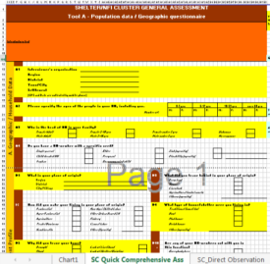
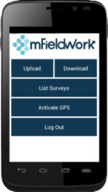
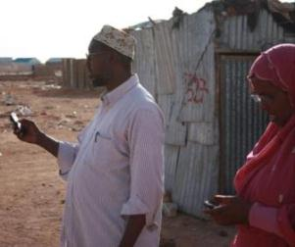
2. The Technology
Components of the 4W include:
1. The questionnaire
2. The mobile phone programmed with the questionnaire
3. Practical data collection
4. The digital platform

Slide 8
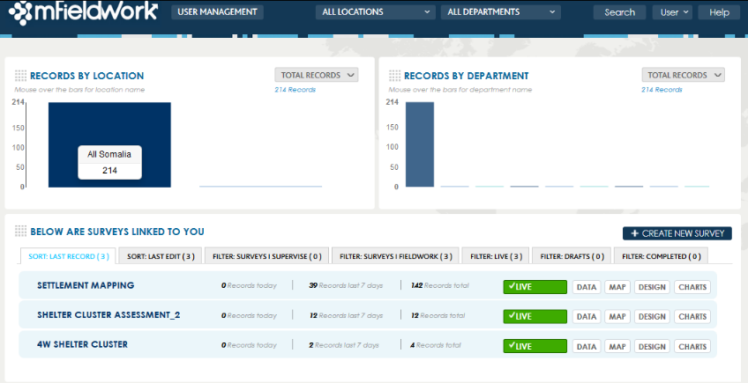
2. The Technology
The digital platform records project by location

Slide 9
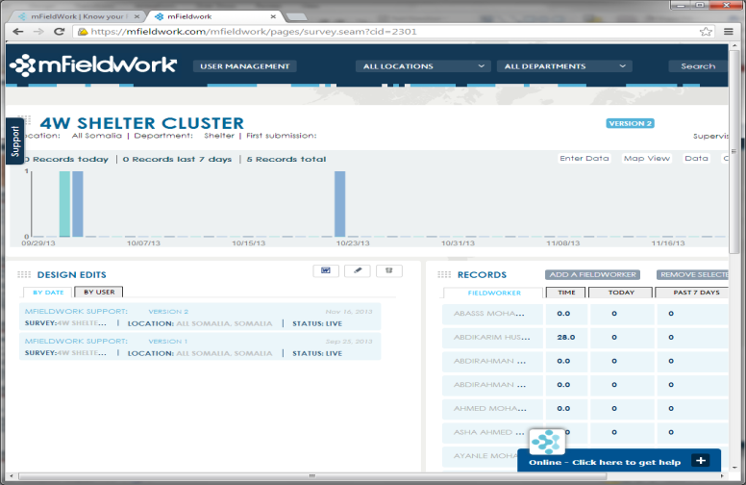
2. The Technology
The digital platform records implementing agency activity

Slide 10
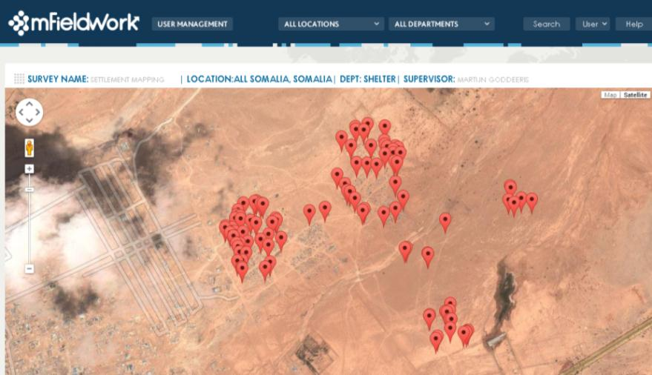
2. The Technology
The digital platform provides a map of projects

Slide 11
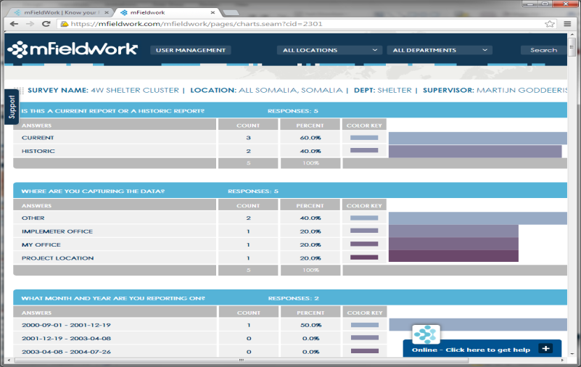
2. The Technology
The digital platform analyses the project report information

Slide 12
3. Mobile application for the 4W
The mobile application is very user friendly.
The whole 4W exercise is located in the ‘4W’ questionnaire.
You click on the questionnaire and the first thing it will do is allow you to capture the exact location through a GPS point (longitude, latitude). -> This allows for information to be gathered quickly
-> It ties all information to a GPS point insuring it is accurate
-> Adds credibility to Shelter Cluster reporting.
After the GPS point, follow the questions and answer to the best of your ability and knowledge.

Slide 13
4. Reporting frequency
Monthly reporting:
Monthly reporting on the FIRST DAY (1st) of each month to report:
1. The previous month activities for Shelter implementation (Transitional and Permanent)
2. NFI report on status of current NFI and Emergency Shelter Kit stocks
Arrange to visit the field of implementing agencies once a month to capture their activity.
Ad-hoc reporting:
NFI distribution activity should be reported on the day of distribution.
It is ideal to visit on the day of distribution to record the activity
(see guidance on how to take a good photograph)
Alternatively: if you cannot be at the distribution on the day, remote report can be submitted.

Slide 14
5. How many uploads per project?
It depends on the components of a project:
It must be split by Location, Donor, and Activity.
For example, if in a contract it says Emergency Shelter for 200 HH and NFI for 300 HH in one location, then you have to split it into two entries (records) because it is two activities.

Slide 15
5. How many uploads per project?
Example:
DRC is implementing shelter and NFI projects in two locations. They are NFI, Permanent Shelter and Transitional Shelter, funded by CHF, ECHO and DFID.
Location | Donor | Activity
Location 1 | CHF | NFI, PS
 | ECHO | NFI, TS
Location | Donor | Activity
Location 2 | CHF | NFI
 | DFID | NFI, PS

Slide 16
5. How many uploads per project?
Example:
DRC is implementing shelter/NFI projects in two locations. They are NFI, Permanent Shelter and Transitional Shelter, funded by CHF, ECHO and DFID.
Location | Donor | Activity
Location 1 | CHF | NFI, PS
 | ECHO | NFI, TS
1: NFI, CHF, Location 1
2: PS, CHF, Location 1
3: TS, ECHO, Location 1
4: NFI, ECHO, Location 1
Location | Donor | Activity
Location 2 | CHF | NFI
 | DFID | NFI, PS
5: NFI, CHF, Location 2
6: PS, ECHO, Location 2
7: NFI, ECHO, Location 2
In this case you are supposed to upload 7 entries (records) separately, one for each separate activity funded by a different donor in a different location.

Slide 17
The following topics have been made available: • Type of assistance: NFI kit / Emergency- / Transitional- / Permanent –Shelter • Size of the project • Location • Reason for displacement (insecurity, natural disaster, etc.) • Who implemented project • Technical specifics of shelter type The questions use skip logic depending on the choice that you make. i.e. some questions are ‘skipped’ or omitted. After having made a choice, you will only receive specific information regarding that choice.
6. Review of Questionnaire

Slide 18
Skip logic illustrated
Project details | Size of project (number of Households)
 | Status of project
 | Location & GPS
 | Reason for intervention
 | Photographs
 | Donor
 | Who implemented
Type of Assistance | NFI | Emergency Shelter | Transitional Shelter | Permanent Shelter
(depending on the status of the project) | Kit / package contents |  | Technical solution (construction)
 | Procurement |  | Procurement & Materials
 | Cost of kit & contents |  | Cost of materials & labour
 |  |  | Disaster Risk reduction. i.e. build safer
 |  |  | Settlement planning & services
 |  |  | Housing, land & property. i.e. tenure
 |  |  | Size of shelter & plot
 |  |  | Lifespan
 |  |  | Labour method
 |  |  | Security

Slide 19
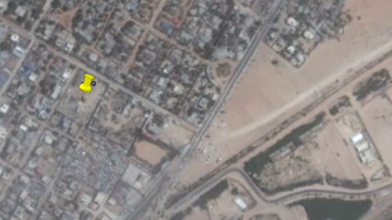
Step by Step
GPS
Everything in the 4W is linked to a Geographical location.
There should be a record for each project per agency, even if in the same settlement.

Slide 20
Basic project information
Type of activity? (select one)
NFI
Emergency Shelter
Transitional Shelter
Permanent Shelter
This is the main category question for the 4W and will define WHAT information you will be asked

Slide 21
Basic project information
NFI Kit
Emergency Shelter

Slide 22
Basic project information
NFI Kit
Reason for intervention (select one)
Emergency Shelter
PROTRACTED NEEDS
OFFENSIVE
FIRE
DROUGHT
OTHER
CLAN CONFLICT
EVICTIONS
FLOOD
NATURAL DISASTER OTHER

Slide 23
Basic project information
NFI Kit
Status of activity:
Emergency Shelter
Proposal
Funding secured
Procurement
In warehouse
distributed
stopped
to determine cluster stocks

Slide 24
Basic project information
NFI Kit
Status of activity:
Emergency Shelter
Proposal
Funding secured
Procurement
In warehouse
distributed
stopped
Region
LOCATION INFORMATION
district
city
settlement

Slide 25
Step by Step
NFI Kit
Reporting location
Emergency Shelter
Project location
implementerofficer
Own office
Warehouse
other
Ideally you will capture the project in the field to verify on site.
However, if you don’t have access, you can do it remotely by calling partners and going through the questionnaire with them while you use the mobile application.

Slide 26
Step by Step
NFI Kit
Date of report:
Emergency Shelter
Year
Month
Monthly reporting:
Date of report must be on the first day of each month reporting on the activities of the preceding month.
i.e. report date 1st February will report on activities during January , and capture status of activity and warehouse / stock on the last day of January.
OR
AD-HOC: reporting for an NFI / ESK distribution.

Slide 27
Step by Step
NFI Kit
Donor and agencies involved
Who is the direct donor?
Is UN involved?
Who is the agency reporting this activity
Do they have an implementing partner?
Emergency Shelter
Select from list
Usually you can find this in contracts, however if it is difficult to find you can skip this question
Select from list
Select from list
no
yes
Select from list

Slide 28
Step by Step
NFI Kit
How many households are you targetting?
For monthly NFI and Emergency Shelter Kit report:
Provide the number of kits in the project.
For ad-hoc reporting on NFI and Emergency Shelter distributed:
Provide the number of kits that have been distributed.
Emergency Shelter

Slide 29
Step by Step
NFI Kit
What is the type of the NFI kit?
Select from list
Standard kit
EAP (more than 5 items)
Separate items
Standard dignity kit
Return package
Solar torch
Other kit
For EAP and separate items, you will be asked more questions from a dropdown menu, please check each item you see in the kit.
You can check this information in proposals.
Plastic sheet (how many?)
Sanitary items
Soap
Wash basin
Jerry can
Kitchen set
Blanket (how many?)
Mat (how many?)

Slide 30
Step by Step
Emergency Shelter
What is the kit content of the Emergency Shelter?
Select from list
TENT
Plastic sheet only
Plastic sheet and sticks
plastic sheet, sticks and rope
plastic sheet, sticks, rope and door
Other
There is a list in a dropdown menu, please check each item you see in the kit.
You can check this information in proposals.

Slide 31
Step by Step
NFI Kit
Procurement
How were the kits items / materials procured?
Emergency Shelter
Select from list
There is a list in a dropdown menu, please select procurement details that most suits the project
Local purchase and procurement
Local purchase of imported items
International procurement
other
The same options are provided for NFI and ESK kits, and shelters

Slide 32
Step by Step
NFI Kit
Cost
What was the value of the kit?
Emergency Shelter
Insert value

Slide 33
Step by Step
NFI Kit
Distribution method
How were the NFI / Emergency Shelter kits distributed?
Emergency Shelter
Select from list
Direct by ngo
Contracted supplier
Voucher
Conditional cash
other
Please select distribution method that most suits the project

Slide 34
Step by Step
NFI Kit
Distribution speed
What was the time delay between the emergency,
and the distribution of kits?
Emergency Shelter
Select from list (in months)
This information is required to track the timeliness of the cluster response within the challenging context.

Slide 35
Step by Step
NFI Kit
Take a photo
(maximum 3)
It is ideal if the RSCC can be present on distribution day. Then you can monitor the activity, do the 4W on that day, take a picture of the NFI kit and of how people are lining up.
Emergency Shelter
Tip: Photos of Distribution for NFI / ESK
Waiting area and queue
Distribution area
Beneficiaries receiving items

Slide 36
Basic project information
Transitional Shelter
Permanent shelter

Slide 37
Basic project information
Transitional Shelter
Reason for intervention (select one)
Permanent shelter
PROTRACTED NEEDS
OFFENSIVE
FIRE
DROUGHT
OTHER
CLAN CONFLICT
EVICTIONS
FLOOD
NATURAL DISASTER OTHER

Slide 38
Basic project information
Transitional Shelter
Status of activity:
Permanent shelter
Proposal
Funding secured
Procurement
On-going
completed
stopped
If on-going: You will be prompted to answer project details related to materials, procurement, site planning and site services

Slide 39
Basic project information
Transitional Shelter
Status of activity:
Permanent shelter
Proposal
Funding secured
Procurement
On-going
completed
stopped
If planned target has been achieved answer “Project Completed”.
eg. Planned target was 1000 HH and distribution has taken place to 1000 HH

Slide 40
Basic project information
Transitional Shelter
Status of activity:
Permanent shelter
Proposal
Funding secured
Procurement
On-going
completed
stopped
If a project for some reason will not happen again, thus the agency will relocate funds elsewhere, change location, change content etc.. Answer “Stop”.

Slide 41
Step by Step
Transitional Shelter
Reporting location
Permanent shelter
Project location
implementerofficer
Own office
other
Ideally you will capture the project in the field to verify on site.

Slide 42
Step by Step
Transitional Shelter
Reporting location
Permanent shelter
Project location
implementerofficer
Own office
other
However, if you don’t have access, you can do it remotely by calling partners and going through the questionnaire with them while you use the mobile application.

Slide 43
Step by Step
Transitional Shelter
Date of report:
Permanent shelter
Year
Month
Monthly reporting:
Date of report must be on the first day of each month reporting on the activities of the preceding month.
i.e. report date 1st February will report on activities during January , and capture status of activity the last day of January.

Slide 44
Basic project information
Transitional Shelter
Location of activity:
Permanent shelter
LOCATION INFORMATION
Region
district
city
settlement

Slide 45
Step by Step
Transitional Shelter
Donor and agencies involved
Who is the direct donor?
Is UN involved?
Who is the agency reporting this activity
Do they have an implementing partner?
Permanent shelter
Select from list
Usually you can find this in contracts, however if it is difficult to find you can skip this question
Select from list
Select from list
no
yes
Select from list

Slide 46
Step by Step
Transitional Shelter
How many households are you targetting?
Provide the households targeted with this project (overall project)
Permanent shelter
you will be asked later:
How many households have received shelter to date.

Slide 47
Step by Step
Transitional Shelter
What is the shelter construction typology?
Select from list: transitional
Improvement to buul
Hybrid shelter
Cgi shelter
Wood / bamboo & grass roof
Wood / bamboo & cgi roof
Adobe block
Stabilised soil block
other
There is a list in a dropdown menu, please select the type of construction that most suits the shelter

Slide 48
Step by Step
Permanent shelter
What is the shelter construction typology?
Select from list: permanent shelter
Cement block
Adobe block
Stone house, mud mortar, traditional roof
Stone house, mud mortar, cgi roof
Stone house, cement mortar, cgi roof
Stabilised soil block
Interlocking stabilised soil block
Reinforced concrete frame, stone walls
Other
There is a list in a dropdown menu, please select the type of construction that most suits the shelter

Slide 49
Step by Step
Transitional Shelter
Technical Improvements
For Disaster Risk Reduction (DRR)
Permanent shelter
Have any structural improvements been integrated into the shelter to reduce the risk during natural disaster or to improve durability?
Select from list
select from the list any that most suits the project.
Check with the program officer or project manager to confirm these details.
Foundation included / improved
Hurricane fixing / bracing
Earthquake resistance
Flood mitigation
Stabilising agent in the block mix
Training of beneficiary
Drainage around shelter
other

Slide 50
Step by Step
Transitional Shelter
Number of Households received Shelter
How many units were completed by the time of your report.
This is provided as a cumulative amount
Permanent shelter
Example: 4 month project targeting 300 HH for Transitional Shelter.
January | February | March | April
50 completed | 100 completed | 200 completed | 300 completed
Project ‘ongoing’ | Project ‘ongoing’ | Project ‘ongoing’ | Completed

Slide 51
Step by Step
Transitional Shelter
Settlement Services
Permanent shelter
Have any services been planned in the settlement?
yes
No
Latrines
Water points
Community centre
Health facilities
Education facilities
Nutrition
Solar street light
Police unit
There is a list in a dropdown menu, please select any that apply that most suits the project.
Check with the program officer or project manager to confirm these details.

Slide 52
Step by Step
Transitional Shelter
Site Planning
Permanent shelter
Has the settlement been planned by site planner to include spacing considerations for fire, etc.?
yes
No
Are there any fire-breaks in the settlement?
yes
No
Has the community been trained in fire prevention and DRR?
yes
No

Slide 53
Step by Step
Transitional Shelter
Housing Land and Property
Permanent shelter
Has tenure and security of land agreement been included?
yes
What was the HLP activity?
Select from list
No
Settling of land tenure disputes
Access to communal services
Advocacy for land agreements
Provision of land tenure agreements
other
Check with the program officer or project manager to confirm these details.

Slide 54
Step by Step
Transitional Shelter
Housing Land and Property
Permanent shelter
Assess improvement of the tenure security before and after the project.
Land tenure before
Land tenure after
Select from list
NO land tenure
INFORMAL CLAN CONSENT
LESS THAN 5 YEAR LAND TENURE AGREEMENT
5 – 10 LAND TENURE AGREEMENT
MORE THAN 10 YEAR LAND TENURE AGREEMENT
COMMUNAL TITLE DEED
INDIVIDUAL TITLE DEED
other
Check with the program officer or project manager to confirm these details.

Slide 55
Step by Step
Transitional Shelter
Housing Land and Property
Permanent shelter
Has the land tenure situation changed during the project
Select from list
Improved
Decreased
same
Check with the program officer or project manager to confirm these details.

Slide 56
Step by Step
Transitional Shelter
Shelter Lifespan
Permanent shelter
What is the anticipated lifespan of the shelter in years?
Select from list
1 year
1-2 years
2-5 years
5-10 years
More than 10 years
Check with the program officer or project manager to confirm these details.

Slide 57
Step by Step
Transitional Shelter
Shelter Construction Labour Details
Permanent shelter
What was the labour method used?
Select from list
No paid labour
Cash for work
Food for work
Voucher for work
Community contract
Direct NGO implementation
Contractor driven
Check with the program officer or project manager to confirm these details.

Slide 58
Step by Step
Transitional Shelter
Procurement
How were the materials purchased?
Permanent shelter
Select from list
Local purchase and procurement
Local purchase of imported items
International procurement
other

Slide 59
Step by Step
Transitional Shelter
Shelter Materials
Permanent shelter
How were materials provided to beneficiary?
Select from list
Direct ngo distribution
Supplier distribution
Voucher system
Conditional cash
other
What materials were used? (maximum 3)
Check with the program officer or project manager to confirm these details.
Select from list PROVIDED

Slide 60
Step by Step
Transitional Shelter
Shelter details
Permanent shelter
Size of shelter
‘before’ applies to improved shelters, or the type of shelter beneficiaries were living in prior to the project, if known.
Shelter size new
Shelter size before
Insert value in meters squared (m2)

Slide 61
Step by Step
Transitional Shelter
Shelter details
Permanent shelter
Size of plot
Average plot size
Insert value in meters squared (m2)

Slide 62
Step by Step
Transitional Shelter
Shelter costs
Permanent shelter
Provide details if known of the costs, split for labour, materials, and total costs. (in USD)
Cost of labour and materials
Cost of labour only
Cost of materials only
Insert value in USD
Check with the program officer or project manager to confirm these details.

Slide 63
Step by Step
Transitional Shelter
Shelter details
Permanent shelter
Security
Is the shelter lockable (provided with a latch, padlock fitting?)
yes
No
Is a lock provided?
yes
No
Check with the program officer or project manager to confirm these details.

Slide 64
Step by Step
Transitional Shelter
Take a photo
(maximum 3)
If there was a fire outbreak just before your visit you can even take this picture.
Permanent shelter
Tip: Photos of Transitional Shelter / Permanent Shelter
Whole shelter (outside)
Area or plot around
Inside shelter or a detail (e.g. Lock, door)
Tip: Hold your mobile phone upright, make sure the whole structure is captured in the photo.

Slide 65
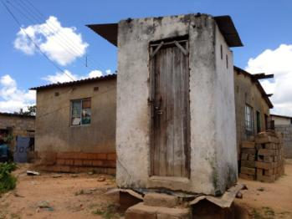

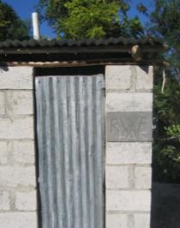

7. Good and bad pictures
Shows the structure and the context
Shows only part of the structure and no context

Slide 66




7. Good and bad pictures
Shows the full structure and the context
Shows only part of the structure and no context

Slide 67
8. Tips before going to the field
Make sure you have a log in code
Make sure you are logged in with this phone on the MFIELDWORK application before leaving the WIFI area. It is necessary to be logged in when in the field.
Make sure the latest versions of all the questionnaires have been downloaded.
Make sure that the GPS is functional on all the phones. Try this out at the office.
Make sure all the phones are properly charged.
Make sure that wifi is turned OFF while in the field to save the phone’s battery.

