Slide 1

Shelter Cluster IM update
April 29th, 2015

Slide 2
Key message - Tarpaulin distributions will eventually reach over 20,000 HH.
  We are seeing the beginning phases of monitoring, shelter repair training and shelter repair kit distribution activities.
  According to 3W submissions, there are no more planned distributions for tarpaulins outside of Efate rural or Tanna, only some ongoing. Complete distribution have reached 16,000 plus HH.
  Not all agencies are reporting every week – Deadline every Monday (please).

Slide 3
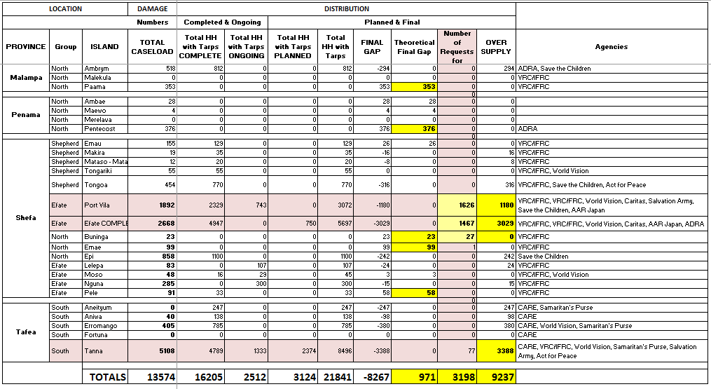
Tarpaulin distribution report

Slide 4
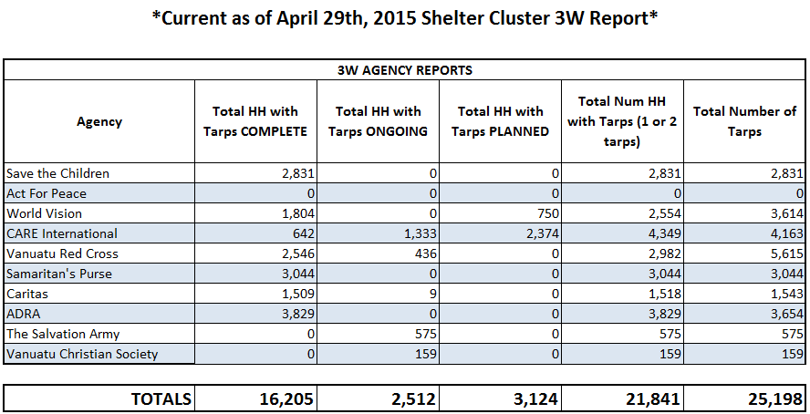
Tarp distribution report

Slide 5
Key message - Requests for shelter assistance are being recorded and analyzed for potential gaps in area coverage.
  Highlighted areas continue to include informal settlements, outer island communities in Efate, and other vulnerable groups such as the disabled.
  Areas with most requests:
  Maps have been created to identify these areas based on shelter assistance requests and will be distributed to all shelter cluster agencies.
  We can also create any maps or infographics for shelter agencies upon request, email me at: im.vanuatu@sheltercluster.org.
Teouma | Erakor
Ohlen | Etas
Blacksands | Manples

Slide 6
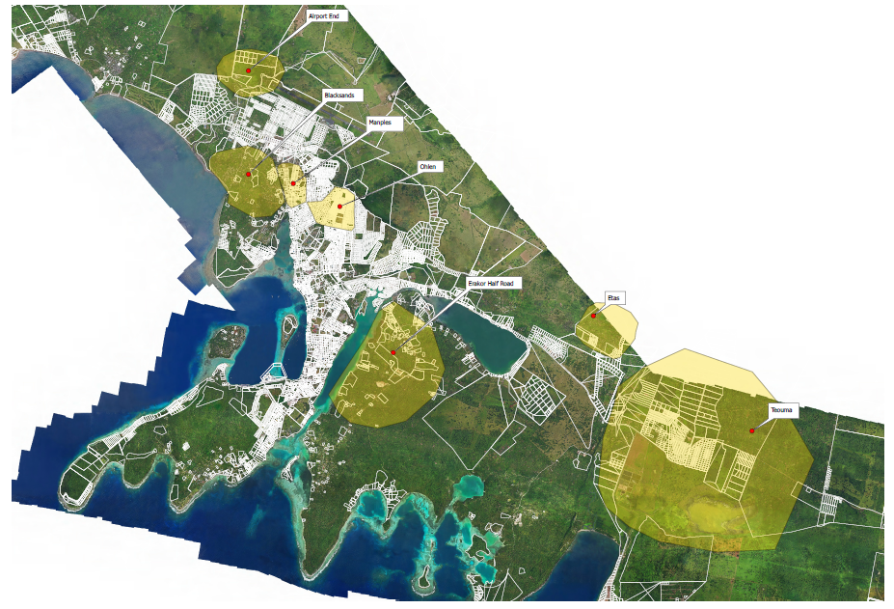
Example of the map of potential gap areas in tarp distributions based on higher numbers of request for shelter assistance. Areas highlighted in yellow below.

Slide 7

Key message - Shelter cluster website has been updated with more shelter resources, information and schedules {click image below for link}.

