Slide 1

Shelter Cluster IM update
May 15th, 2015

Slide 2
topics
The Hap and reporting
Example of Hap progress
3W reporting key points
Reporting deadlines

Slide 3
The Hap and reporting
HAP Finalized – Primary Strategic Objective (May 1st to July 31st):
Meet the remaining life-saving and protection needs of the affected people.
Supporting Shelter Cluster objectives:
Provide emergency shelter and non-food items for people whose house have been partially damaged or destroyed.
Assist affected people with repair and reconstruction of houses, water and sanitation facilities.
Investment in safer community buildings.
HAP reporting and template.

Slide 4
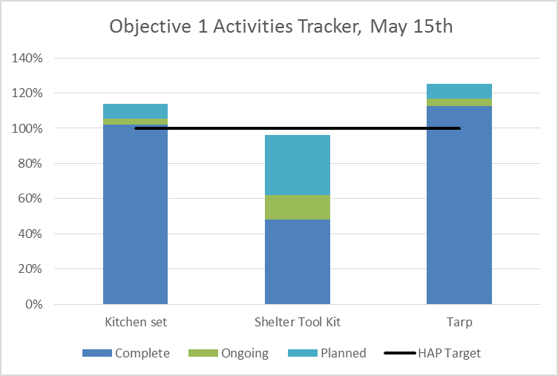
Example of hap progress
Cluster Objective 1: Provide emergency shelter and non-food items for people whose houses have been damaged (distribution of tarps, tool kits and kitchen sets).

Slide 5
3w reporting key points
Cluster objectives, and how agency activities support them, will be assessed in the coming weeks.
We will continue reporting via 3W’s, and may modify activity menus within the template to be able to track agency activities against the HAP indicators.
How we adjust our agency activity tracking against the HAP will be influenced by survey results and cluster discussions.

Slide 6
Reporting deadlines
3Ws will be due every two weeks, starting Monday May 18th (next 3W due after that will be Monday, June 1st and so on…)
HAP reporting will be due every two weeks, starting Friday, May 22nd (next HAP report due after that will be Friday, June 5th).
After 3Ws are submitted to VHT/OCHA, I use the 3W to complete the HAP report.

Slide 7

Key message - Shelter cluster website has been updated with more shelter resources, information and schedules {click image below for link}. The upcoming updates for the website include technical guidance, survey results, REACH assessment, and more….

