Slide 1
Vanuatu Shelter Cluster meeting
21st May 2015
NDMO office – VGMD conference room

Slide 2
Agenda
1. Introduction
2. IM update
3. Updates and discussion
Shelter recovery programing and incoming Intervention survey
2. Recovery framework
- Emergency shelter gaps response plans & incoming shelter material capacity
- VAT for shelter material
- Scoping for Shelter Lessons Learned workshop on Thursday 28/05
- Vanuatu Shelter Cluster long term scenario
4. Partners update and issues
5. AOB

Slide 3
2. IM update
1. Introduction
2. IM update
3. Updates and discussion
Shelter recovery programing and incoming Intervention survey
Recovery framework
Emergency shelter gaps response plans & incoming shelter material capacity
VAT for shelter material
Scoping for Shelter Lessons Learned workshop on Thursday 28/05
Vanuatu Shelter Cluster long term scenario
4. Partners update and issues
5. AOB

Slide 4
2.IM update – distribution as 20/05
INITIAL TOTAL CASELOAD (Damaged & Destroyed HH) | 13 574
HAP target | 1 800
Total HH for Tarps | 23 287
Total HH for Shelter Awareness | 1 711
Total HH for Shelter Reconstruction Activities | 1 101
Total HH for Shelter Repair Materials | 5 159
Total HH for Shelter Tool Kits | 14 709
Total HH for Kitchen Sets | 9 971
Total HH for Blankets | 17 228
Total HH for Solar Lamp | 3 271

Slide 5
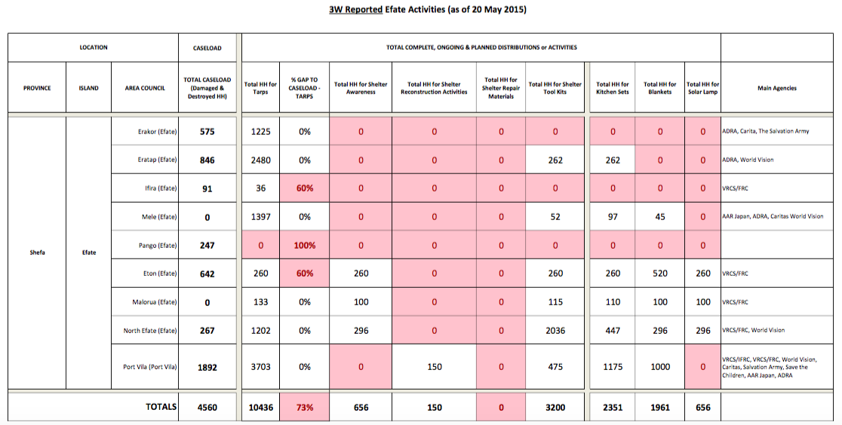
2.IM update - example Efate

Slide 6
3.1 Shelter Recovery programming and incoming intervention survey
The "PAM Shelter Intervention survey" will help to get a better overview over plans for durable shelter interventions.
It will contribute to developing the Shelter Cluster strategy further . The cluster will hold a meeting with cluster partners to discuss the findings.
This is an opportunity for self-reflection by the cluster, identifying areas that are working well and those that require attention. Individual answers will remain confidential and will not be shared outside of the team without your consent.

Slide 7
3.1 Shelter Recovery programming and incoming intervention survey
Do you feel there are still emergency shelter gaps in your area(s) of intervention?
In which islands/provinces are you working or planning to work?
Which type of shelter interventions are you planning or implementing at household level?
Which type of shelter interventions are you planning or implementing at community level?
Which “Building Back Better-Safer”- activities are you planning or implementing?
Which type of additional activities are you planning or implementing?

Slide 8
3.1 Shelter Recovery programming and incoming intervention survey
How many households are you targeting?
What is the intended timeframe of your interventions?
What is the indicative budget for you programming related to shelter programming and related activities?
Has the funding been secured to cover this target?
Have you already finalized your shelter recovery plan of action and budget, if not, when would it be available?
Are you collecting disaggregated data on beneficiaries?
Are you targeting specifically vulnerable beneficiaries?
What human resource capacity do you have in-country?
If you are an international organisation (UN, INGO), do you work in partnership with a local organisation ?

Slide 9
3.1 Shelter Recovery programming and incoming intervention survey
Where are your main operational offices?
Please select up to three critical technical issues you might face in your shelter recovery programming
Does the cluster provide you with the technical guidance you need?
Does the cluster provide you with the information management services that you need?
Is it easy to find the information you need on the Cluster website?
Related to this survey objective, is there any other issue you would like us to know about?

Slide 10
3.2 Recovery framework
The GoV cyclone recovery management framework was presented on Friday 15 to donors
On meeting would be organised in coming days to engage all partners (to be confirmed)

Slide 11
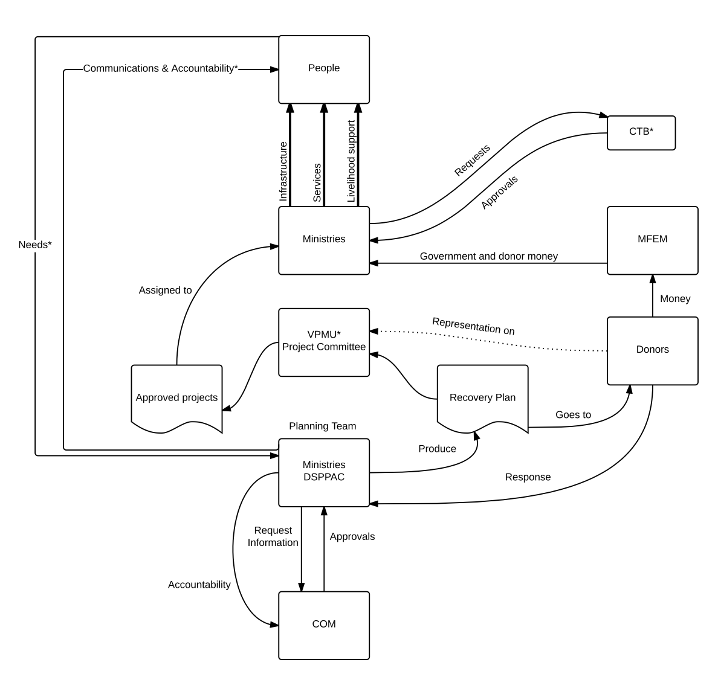

Slide 12
3.3 Emergency shelter gaps response plans & incoming shelter material capacity
Around/more than 2500 Tarps request to fill remaining emergency shelter gaps:
Care: 945 tarps
Vanuatu Red Cross 1,100 tarps – in coordination with Shefa Gov.
NDMO undefined, few hundreds to cover day to day requests
VSDP: 50 tarps
2500 tarps stocks confirmed to arrive:
2,000 from Australian Red Cross on request of Shelter Cluster (ETA 27 May)
500 from IOM part of the CERF (ETA from 10 June)

Slide 13
3.4 VAT for shelter material
Reported information (not confirmed) from Logistic cluster that VAT exemption for shelter material will end on June 12th

Slide 14
3.5 Scoping for Shelter Lessons Learned workshop on Thursday 28/05
Will help to feed on general Lessons Learned workshop to be held on June 24 & 25
Shelter LL workshop will be chair by PWD in their office next Thursday 28
3 key questions:
What we have done?
What worked well?
What we need to be improved?

Slide 15
3.6 Vanuatu Shelter Cluster long term scenario

Slide 16
4. Partners update and issues

Slide 17
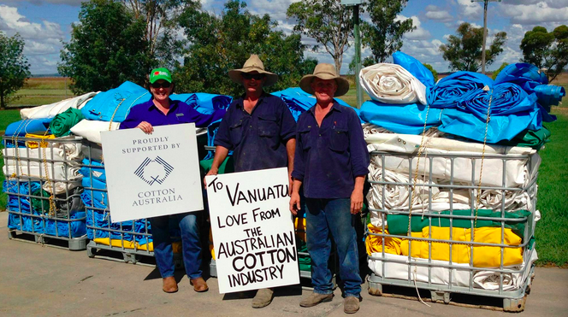
5. AOB
Does anybody could help to identify where 700+ cotton tarps have been distributed? 20ft long, blue, grey or white predominantly, with a farm or family name stencilled in big black letters along the side. They will probably have bits of old cotton rope attached to them. A full container was donated by the Australian Cotton Industry. The tarps were packed into metal crates.
Please contact Michelle Prendergast, mm.prendergast@bigpond.com

