Slide 1
Vanuatu Shelter Cluster
TWiG meeting
“Building Back Safer – awareness and training”
2nd June 2015
PWD offices – conference room

Slide 2
Agenda
1. Partners update on BBS activities (Safe shelter awareness and training)
2. Lessons learned on practical experience from BBS activities conducted so far.
3. Obstacles and opportunities
4. BBS and Shelter Cluster way forward

Slide 3
Last meeting Action points:
For the short term (till end July), need to use the same key messages around building principles and related IEC material (on Shelter Cluster website), which have been developed before PAM. Need to monitor various partners training process and feed back at cluster level for learning capitalization.
For the medium term (6 months), need to continue as for short term but looking at refining content and process and looking at adding expending on principles already prioritized.

Slide 4
Last meeting Action points:
Need to engage Vanuatu Agricultural Research and Technical Centre (VARTC) on training of trainees, and other relevant Governmental institutions.
For the long term, to see on how shelter cluster learning and strategy could contribute to the Strategic Action Plan, as awareness and training have to be core components of Building Back Better/Safer reconstruction strategy
There is an opportunity for interested donor or agency to mobilise training/knowledge specialist to support overall BBS training framework for PAM response.

Slide 5
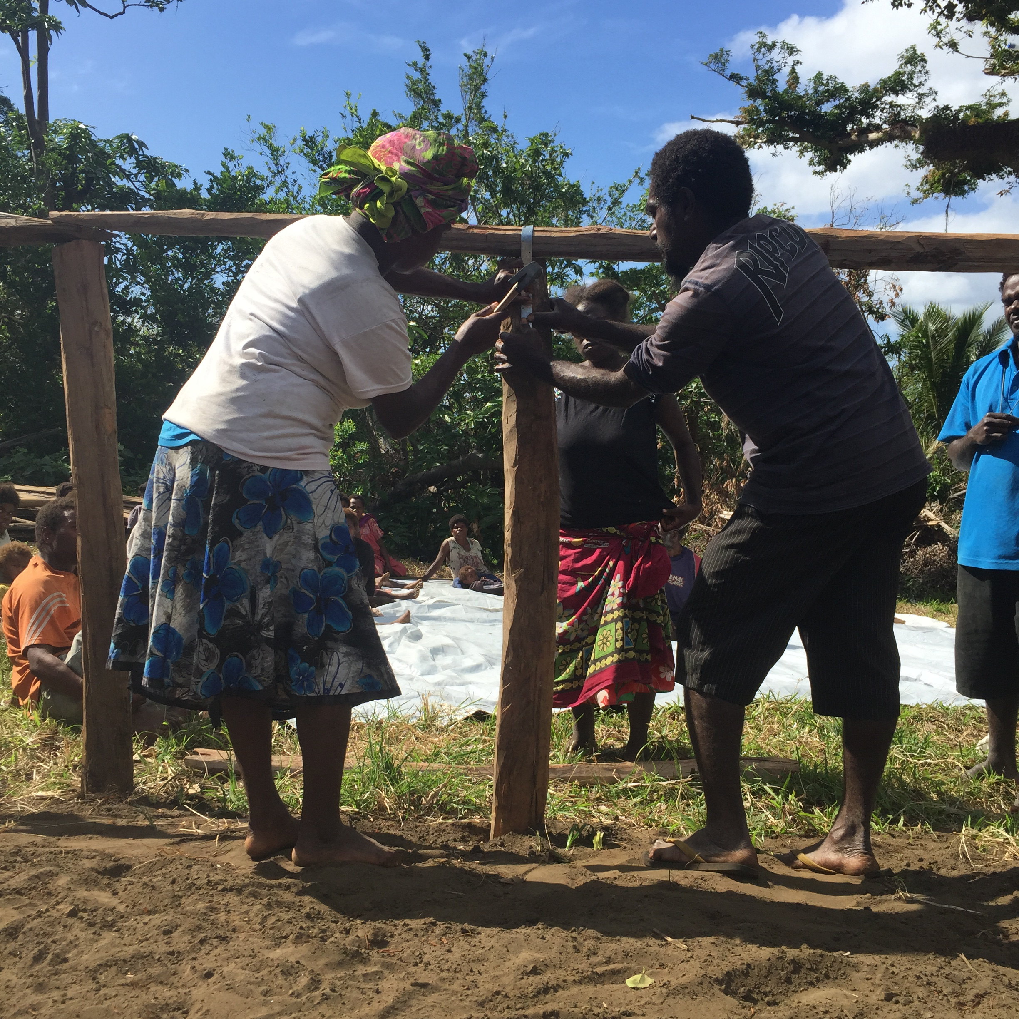
Tankyu Tumas, Thank you, Merci

