Slide 1
Vanuatu Shelter Cluster meeting
11th June 2015
PWD main office – conference room

Slide 2
Agenda
1. Introduction
2. IM update
3. Updates and discussion
Shelter Lessons Learned report
Feedback on shelter recovery in Tongoa, by Save the Children
Shelter key messages for communication with communities
Shelter Interventions survey key outputs, framing the shelter recovery strategy
Recovery Framework, how it will work.
4. Partners update and issues
5. AOB

Slide 3
2. IM update – Distribution as 10/06
INITIAL TOTAL CASELOAD (Damaged & Destroyed HH) | 13 574 | HAP Target |  | 18 000
Total HH for… | Complete | Ongoing | Planned | Total
Tarps | 21 963 | 181 | 2 535 | 24 679
Shelter Awareness | 2 130 | 3 033 | 2* | 5 165
Shelter Reconstruction Activities | 0 | 0 | 1 101** | 1 101
Shelter Repair Materials | 4 131 | 1 323 | 1 183* ** | 6 637
Shelter Tool Kits | 8 779 | 1 323 | 5 637 | 15 739
Kitchen Sets | 8 987 | 300 | 1 204 | 10 491
Blankets | 14 135 | 300 | 3 003 | 17 438
Solar Lamp | 2 620 | 0 | 656 | 3 276
Notes:
* Erro North & South whole island, unknown number of HH
** Unspecified HfH project
With IOM planned distributions not yet updated in 3W, locations TBD

Slide 4
2. IM update – Reporting
3W Reporting continues fortnightly – next 3W submission due date will be Monday, June 15th. The following submission would then be Monday, June 29th.
To your best estimation please included number of HH you’re targeting or reaching with your activities – this way we can evaluate the scope of early recovery activities like shelter awareness training, fixing kit distributions, reconstruction activities, etc.
Report on recovery and reconstruction activities as well.
Notes:
* Erro North & South whole island, unknown number of HH
** Unspecified HfH project

Slide 5
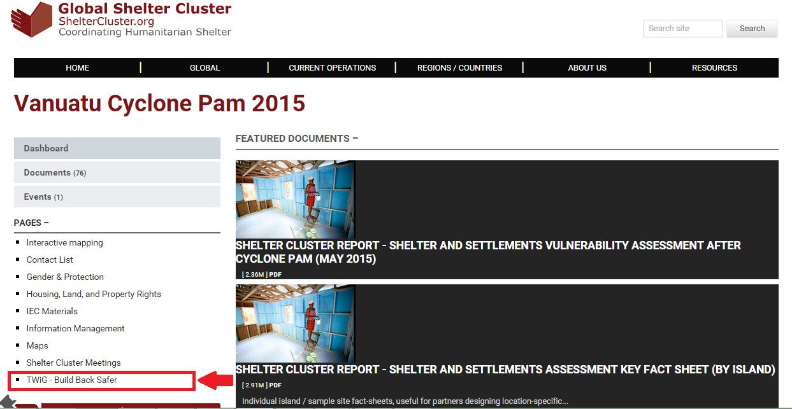
2. IM update – BBS TWiG Resources
Notes:
* Erro North & South whole island, unknown number of HH
** Unspecified HfH project

Slide 6
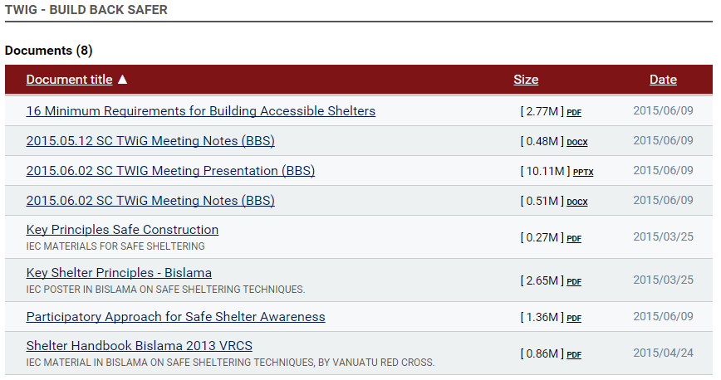
2. IM update – BBS TWiG Resources
Notes:
* Erro North & South whole island, unknown number of HH
** Unspecified HfH project

Slide 7
3.1 Shelter Lessons Learned Report
Circulated on 10/06.
Review and comments, deadline on Monday 15/06
To feed NDMO workshop on 24 & 25/06

Slide 8
3.2 Feedback on shelter recovery in Tongoa, by Save the Children

Slide 9
3.3 Shelter key messages for communication with communities
18,000 of the most vulnerable households are being targeted by relief agencies with emergency shelter items.
Relief agencies are working with communities to provide tools and materials to support longer-term recovery.
Relief agencies work closely with National, Provincial, Municipal Governments, and traditional leaders to assess and distribute shelter items to the most vulnerable people affected by Cyclone Pam. All parties coordinate closely to identify gaps and meet emergency needs.

Slide 10
3.3 Shelter key messages for communication with communities
There are precise quality guidelines, especially for tarpaulins, to ensure the items distributed meet international standards.
Relief items are only provided to people whose houses have been damaged by Cyclone Pam. If you have questions or concerns, please contact your local or Provincial Government – these messages will be passed back to relief agencies to follow up.
Do we want update existing/new messages?

Slide 11
3.3 Shelter Interventions survey key outputs
9 Shelter Cluster partners inputs:
UN Habitat
World Vision
ADRA
Vanuatu Christian Council
CARE international
IOM
CARITAS
Disability Desk; Ministry of Justice and Community Services
The Salvation Army
Save the Children Australia

Slide 12
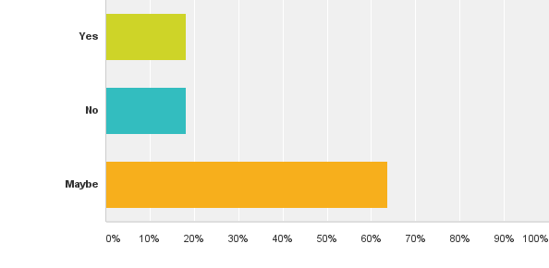
Q6.Do you feel there are still emergency shelter gaps in your area(s) of intervention?

Slide 13
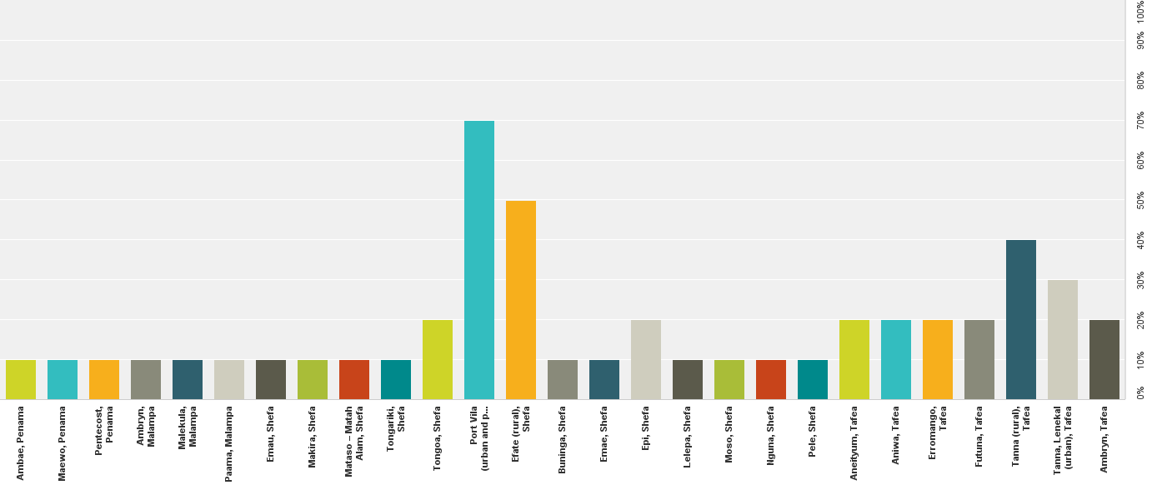
Q8: In which islands/provinces are you working or planning to work?
At least one agency in all islands
7 agencies in Port Vila (urban and peri urban) - 5 in Efate (rural)
3 agencies in Lenekal - 4 agencies in Tanna (rural)

Slide 14
Q9: Which type of shelter interventions are you planning or implementing at household level?

Slide 15
Q10: Which type of shelter interventions are you planning or implementing at community level?

Slide 16
Q11: Which type of community building will you target, if any?

Slide 17
Q12: Which “Building Back Better-Safer”- activities are you planning or implementing?

Slide 18
Q13: Which type of additional activities are you planning or implementing?

Slide 19
Q15: What is the intended timeframe of your interventions?

Slide 20
Q17: Has the funding been secured to cover this target?
Q18: Have you already finalized your shelter recovery plan of action and budget?

Slide 21
Q20: Are you targeting specifically vulnerable beneficiaries?

Slide 22
Q24: Please select up to three critical technical issues you might face in your shelter recovery programming

Slide 23
Q25: Does the cluster provide you with the coordination services you need?
Q26: Does the cluster provide you with the technical guidance you need?
Q27: Does the cluster provide you with the information management services that you need?
Q28: Is it easy to find the information you need on the Cluster website?

Slide 24

3.5 Recovery Framework, how it will work
Humanitarian assistance, HAP & actual clusters coordination will end on 31 July
Recovery framework & Sector working groups after 31 July
Need to go through line ministries
There will be a monitoring and reporting framework
Emphasis on resilience, cultural revival and preparedness

Slide 25
3.5 Recovery Framework, how it will work
If assistance/implementation after 31 July, project/proposal must be submitted to the recovery framework. It apply to projects already started.
Proposal will go through line ministries to a project committee (ministries DG and technical advisors) Need to be the most efficient to deliver the project.
If project/proposal involved more than 1 sector, must go through relevant sector analysis.
Call for proposal with format and prioritisation document to be available soon, after endorsement by cabinet.
All projects/proposal must be submitted to recovery framework before 31 July

Slide 26
DRAFT Recovery framework:1 of priorities for reconstruction and reconstruction activity is: Rebuild/repair/upgrade private housing and infrastructure.
Who will take the lead?
Ministry of Internal Affairs
Ministry of Lands and Natural Resources
Who will support?
Prime Minister’s Office
Ministry of Finance and Economic Management
Ministry of Infrastructure and Public Utilities
Provincial Government Councils
Municipal Government Councils
Malvatumauri
Island Council of Chiefs

Slide 27
4. Partners update and issues

Slide 28
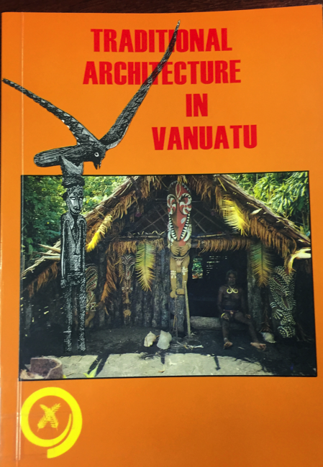
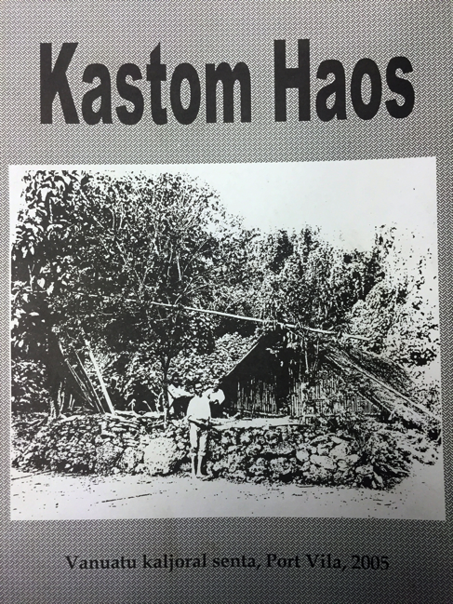
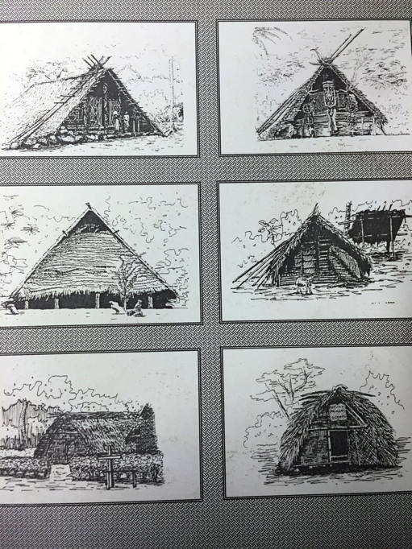
5. AOB
Visit of National library as action point from TWiG
Potential SC visit of museum, when curator back in country
Recomendation to go to Cutural Center field workers
Workshop in October

Slide 29
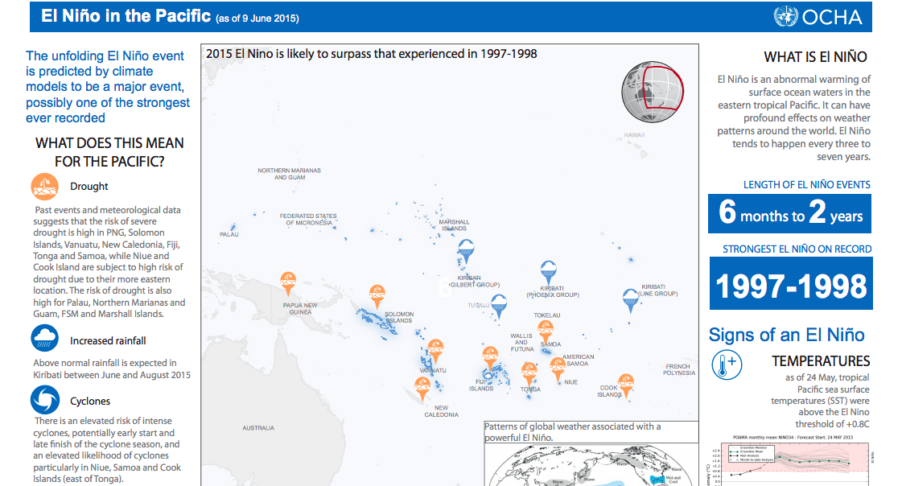
5. AOB
El Nino, The unfolding El Niño event is predicted by climate models to be a major event, possibly one of the strongest ever recorded

Slide 30
5. AOB
Some people came to World vision to get tarps, claiming that it was NDMO who told them to do so. Does anybody experience this?
Key issues to raise at ECHO level.

