Slide 1
Vanuatu Shelter Cluster meeting
18th June 2015
PWD offices– Port Vila

Slide 2
Agenda
1. Introduction
2. IM update
3. Updates and discussion
Feedback from Tanna Shelter Cluster meeting
Feedback from Tanna field visit
Shelter key messages for CwC
Improvement of water supply in Isangel
Co-delivery options for rehabilitation
4. Partners update and issues
5. AOB

Slide 3
2. IM update – National Distribution -18/06

Slide 4
IM Update

Slide 5
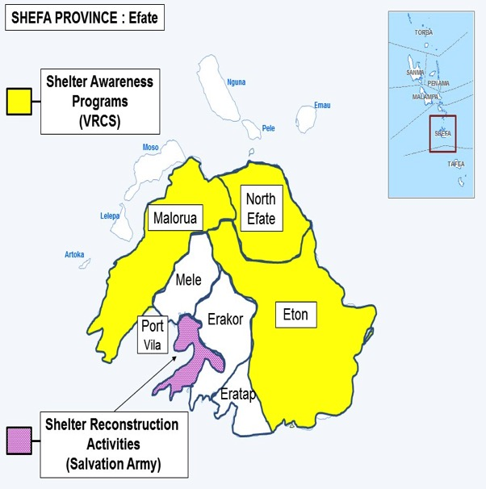
IM Update

Slide 6
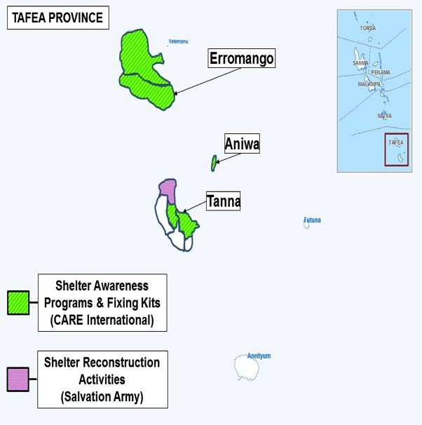
IM Update

Slide 7
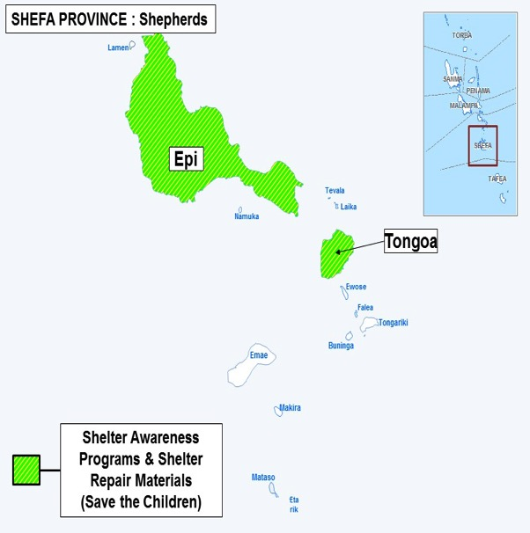
IM Update

Slide 8
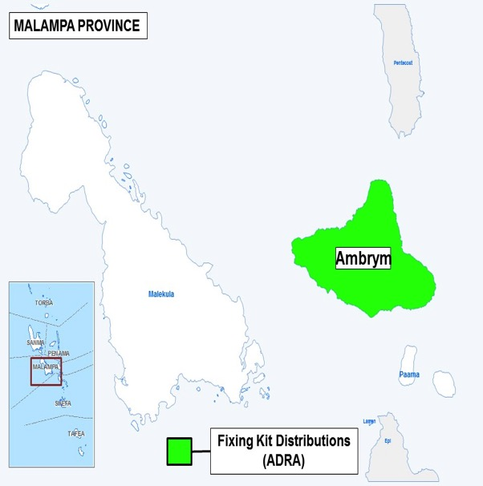
IM Update

Slide 9
IM Update
Next 3W update due Monday, 29 June
Great reporting this week, thank you!
BBS TWiG next Tuesday, 23 June at 3pm (PWD Office)
Finalizing Shelter Cluster key messages
Shelter Cluster Lessons Learned to be distributed
National Lessons Learned workshop Wednesday & Thursday next week (23 & 24 June)

Slide 10
3.1 Feedback from Tanna Shelter Cluster meeting
21 persons attending from NDMO, Vanuatu Red Cross, French Red Cross, CRATERRE, TVET Program, Education/Health/Agriculture clusters, NDMO, PDO, FM 104, Immigration, World Vision, Care, PWD, Police, PDC, Forestry department
Agenda IM update, sharing lessons learned, shelter lessons learned, partners update
Key issues: Toolkits gaps and lessons learned

Slide 11
3.1 Feedback from Tanna Shelter Cluster meeting
Toolkits gap in West Tanna.
2,877 HH received tarpaulins but no toolkits / Solar lamps / Safe shelter awareness.
In Tanna, some agencies distributed 1 toolkit by HH or 1 toolkit for 3 HH
While 1 toolkit for each HH would be better, agreement to distribute 1 toolkit for 3HH, BUT with explanation on sharing toolkit.
Care international still have up to 200 toolkits.
Need to review PAM emergency response to agree on standards for Vanuatu.

Slide 12
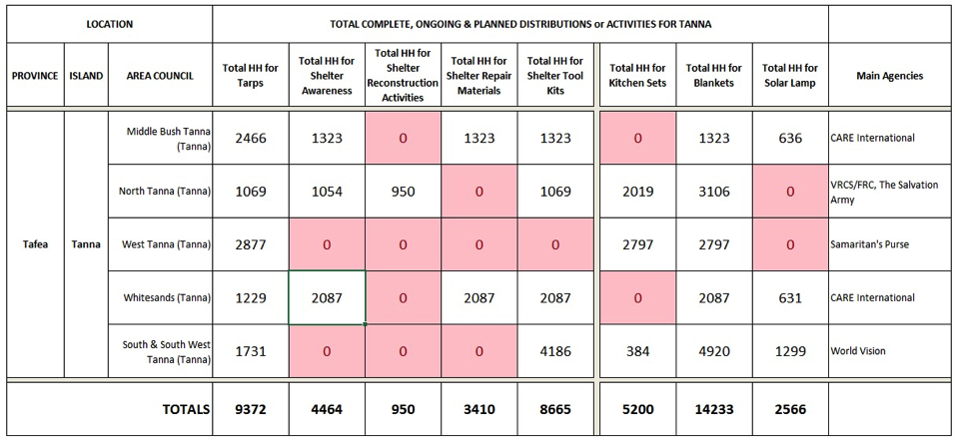
2. IM update – Tanna Distribution -10/06

Slide 13
3.1 Feedback from Tanna Shelter Cluster meeting
Community cyclone shelters.
Tafea recent lessons learned workshop shows that:
People prefer to have cyclone shelters at community level.
Need to reinforce CDC and PDC capacity building
There is not sufficient gov. building to work as cyclone shelters. CDC need to identify community building for evacuation centers.
Need to support community buildings as evacuation centers, as for traditional Nimaiten .

Slide 14
3.2 Feedback from Tanna field visit
Field visits with Vanuatu Red Cross / French Red Cross and CRATERRE.
RTC / PDO / Ministry of education / Cultural center.
Visited Yakel community
Discussion about cyclone PAM impact and how people cope with. A lot of people took refuge in traditional Nimaiten houses, with people gripping structure to help structure resistance.

Slide 15
3.2 Feedback from Tanna field visit
Field visits with Vanuatu Red Cross / French Red Cross and CRATERRE.
Discussion on emergency shelter response and items use. Seems that 1 toolkit by HH is better due to need for nails and other items, and to cope with some tools as hammer which might broke.
On top of standardize toolkit, need to look at adding axe, stone and oil to extend duration of tools.
Idea to preposition community toolkits and tarpaulins to help immediate actions.

Slide 16
3.2 Feedback from Tanna field visit
Field visits with Vanuatu Red Cross / French Red Cross and CRATERRE.
Tarpaulins are good but need to meet standards and guidance to use them.
Shelter was the first need as people feared immediate rain as experienced in cyclone.
It seems that people had 2 to 3 weeks food reserve, with market quickly open. But food support critical after this period.
Tarpaulins are used first for immediate shelter but could be re use after for kitchen, community places, etc…

Slide 17
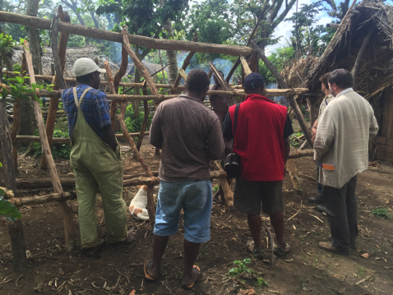
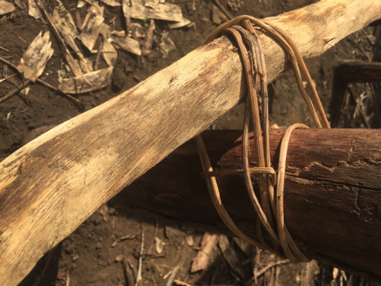
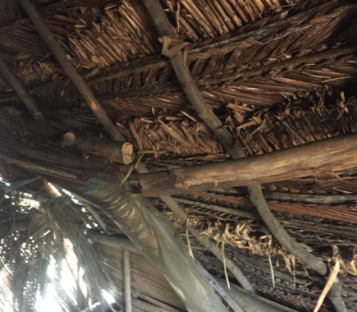
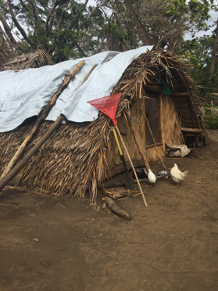
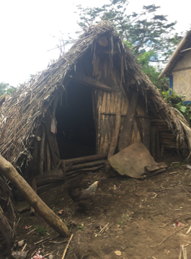

Slide 18
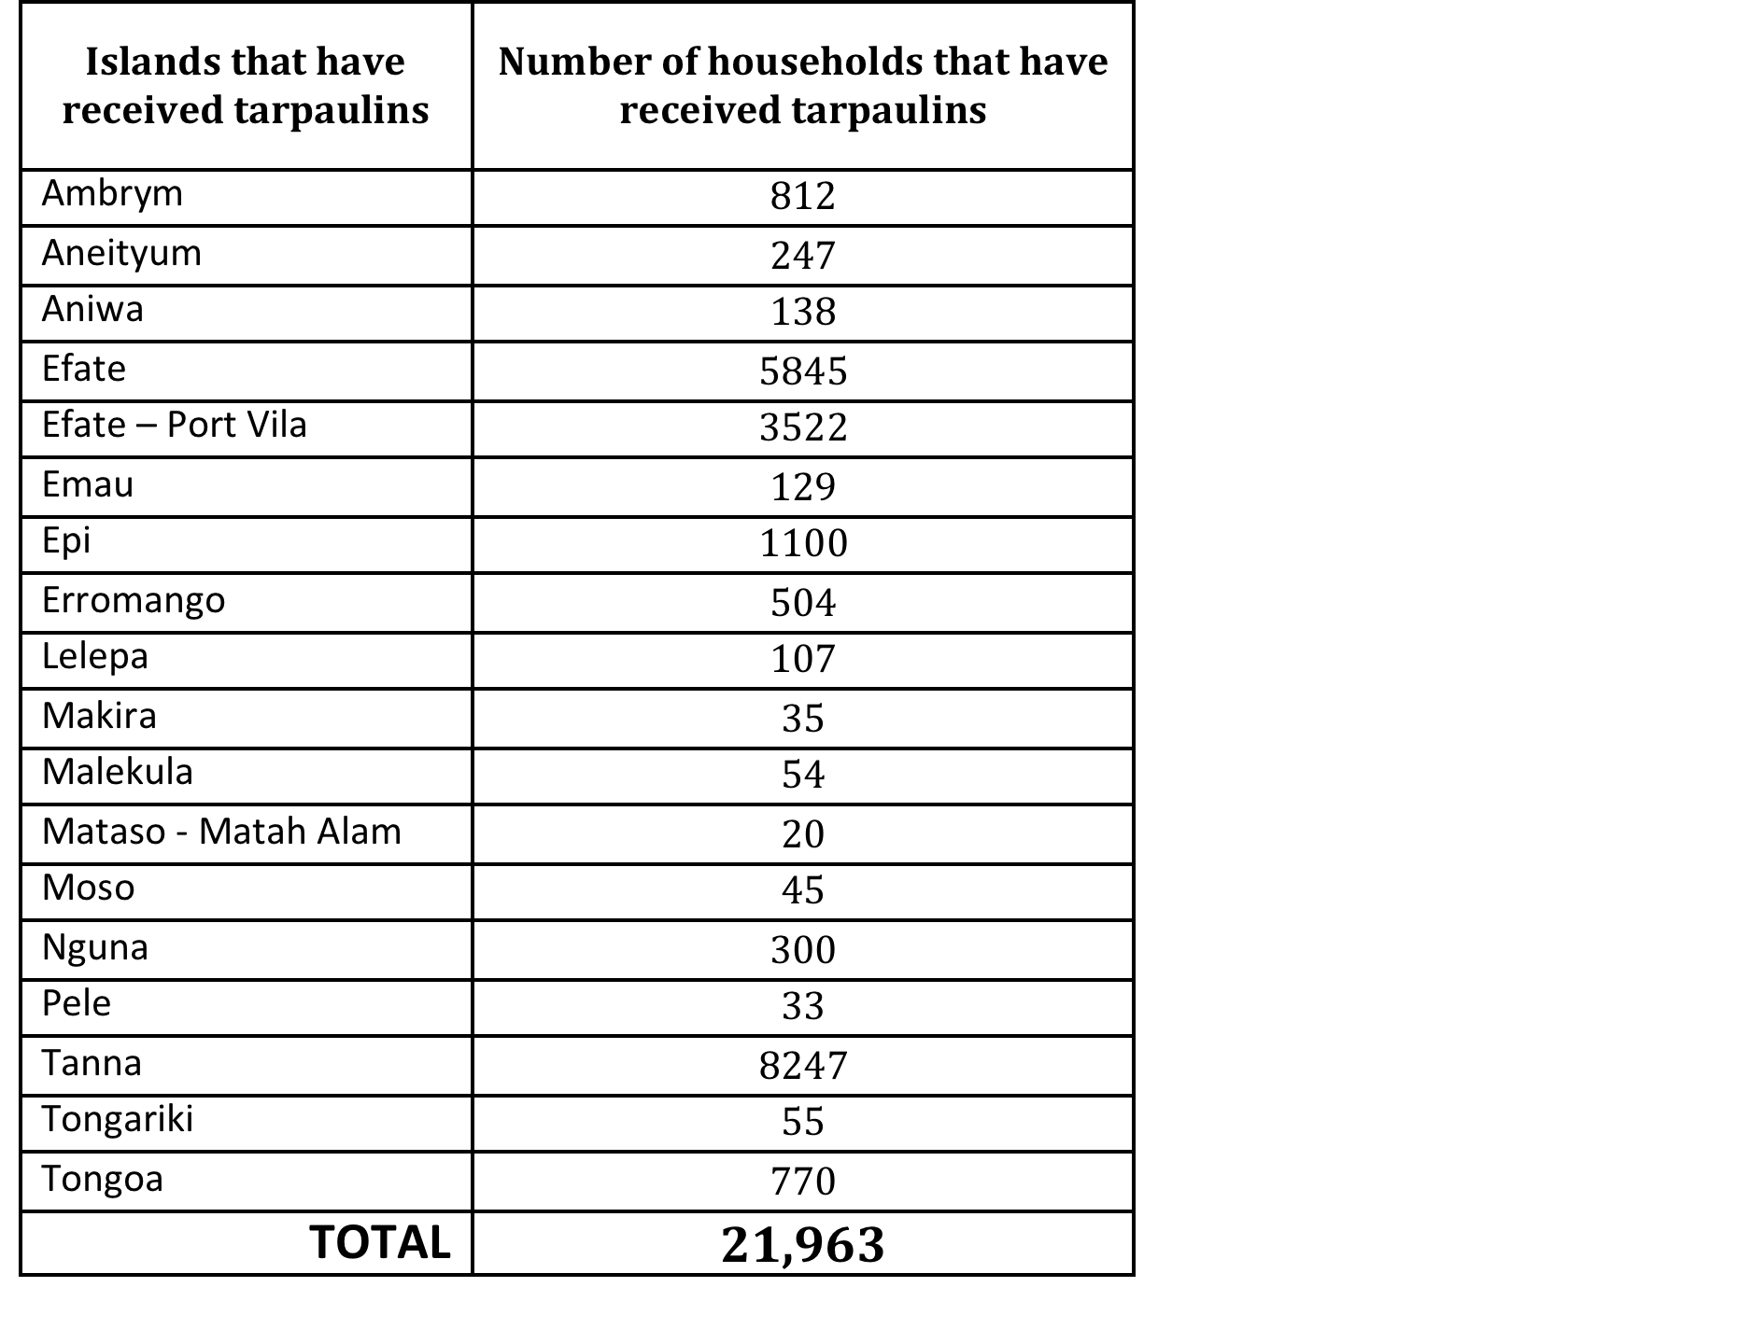
3.3 Shelter key messages for CWC
1. 21,963 of the most affected households have been supported by relief agencies with tarpaulins.

Slide 19
3.3 Shelter key messages for CwC
2. Relief items are only provided to people whose houses have been damaged by Cyclone Pam. If you have questions or concerns, please contact your local or Provincial Government.
3. Shelter agencies work closely with National, Provincial, Municipal Governments, and traditional leaders to assess and fairly distribute shelter items to the most vulnerable people affected by Cyclone Pam.
4. All parties coordinate closely to identify gaps to equitably meet shelter needs.

Slide 20
3.3 Shelter key messages for CWC
5. Shelter agencies provide community awareness on safer shelter repairing and reconstruction
6. Government and agencies encourage wherever possible community resilience and shelter self-recovery,
7. It is important to identify traditional community cyclone houses which resisted well to cyclone PAM
8. To rebuilt your house it is important to learned from traditional knowledge for buildings which resisted well to cyclone PAM

Slide 21
3.3 Shelter key messages for CWC
9. To make your house more resilient to strong winds and cyclone, it is important to:
Deeply anchor your house to the ground with strong foundations,
Ensure that you have strong connections at all joints – the roof material to the roof timbers, the roof to the walls and the walls to the foundations. Strong connections can be made with hurricane straps, rope and vines.
Brace between the corners or junctions of your house creating triangles in the walls and roof.
Site your house safely by identifying hazards in your location and build as well as you can to resist them,
These 4 principles are at the core of community engagement on safe shelter awareness

Slide 22

Shelter intervention survey
This survey was open from 1st to 9th June, with contributions of 11 agencies which represent the majority of agencies involved in shelter recovery activities.
UN Habitat - World Vision – ADRA - Vanuatu Christian Council - CARE international - IOM – CARITAS - Disability Desk; Ministry of Justice and Community Services - The Salvation Army - Save the Children Australia – Butterfly Trust
This survey will remain open till the end of the HAP on 31 July 2015 in order to feed the shelter cluster recovery strategy.
A PY Birds'D

Slide 23
Shelter intervention survey
9. Which type of shelter interventions are you planning or implementing at household level?
10 on 11 agencies are planning shelter interventions at HH level; 5 agencies in only one response modality.

Slide 24
Shelter intervention survey
10. Which type of shelter interventions are you planning or implementing at community level?
7 on 11 agencies are planning shelter interventions at community building level. 3 agencies in all response modalities.

Slide 25
Shelter intervention survey
11. Which type of community building will you target, if any?
Kindy, Community hall, Chief hall/nakamal and church buildings are equitably targeted by 2 agencies for each.

Slide 26
Shelter intervention survey
12. Which “Building Back Better-Safer”- activities are you planning or implementing?
8 on 11 agencies include Building Back Better-Safer activities in their strategies.

Slide 27
Shelter intervention survey
15. What is the intended timeframe of your interventions?
At least 7 on 11 agencies will implement activities within Recovery Framework.

Slide 28
Shelter intervention survey
16. Has the funding been secured to cover this target?
17. Have you already finalized your shelter recovery plan of action and budget?
Only 1 on 11 agencies has finalized its recovery plan, and 6 only have secured their funding.

Slide 29
Shelter intervention survey
24. Please select up to three critical technical issues you might face in your shelter recovery programming
Logistic and material delivery is first critical challenge (6), then trainings and beneficiary communication and community engagement (4).

Slide 30
4. Partners update and issues

Slide 31
5. AOB

Slide 32
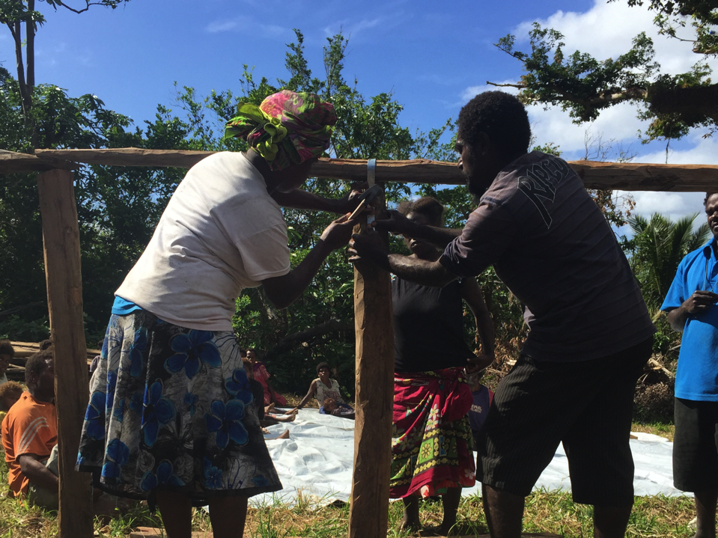
Tankyu Tumas, Thank you, Merci

