Slide 1

Shelter Cluster Vanuatu Meeting
26th June 2015
PWD Offices, Port-Vila

Slide 2
Agenda
1. Introduction
2. IM Update
3. Updates and discussion
Shelter Governance & Strategic Advisory Group, objectives and membership
Building Code current status, application and way forward
Feedback on Building Back Safer TWiG
Feedback from NDMO Lessons Learned Workshop
4. Partners update and issues
Salvation Army & Liberty for the Nations project
5. AOB

Slide 3
2. IM Update
Purpose
Response - Show the progress and coverage of Shelter Cluster partners towards achieving ‘Cluster Objective 1’, which supports the Humanitarian Action Plan’s ‘Primary Strategic Objective’ that covers all response activities of every cluster.
Early Recovery - Show the activity number and coverage of shelter tool kit & fixing kit distributions along with shelter awareness training & shelter reconstruction.
Reminder – 3Ws Due Monday 29 June!

Slide 4
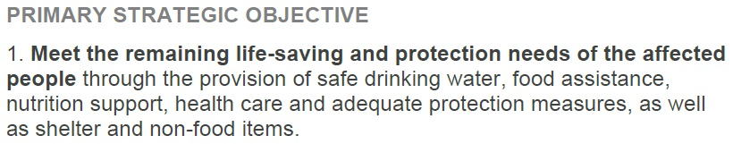
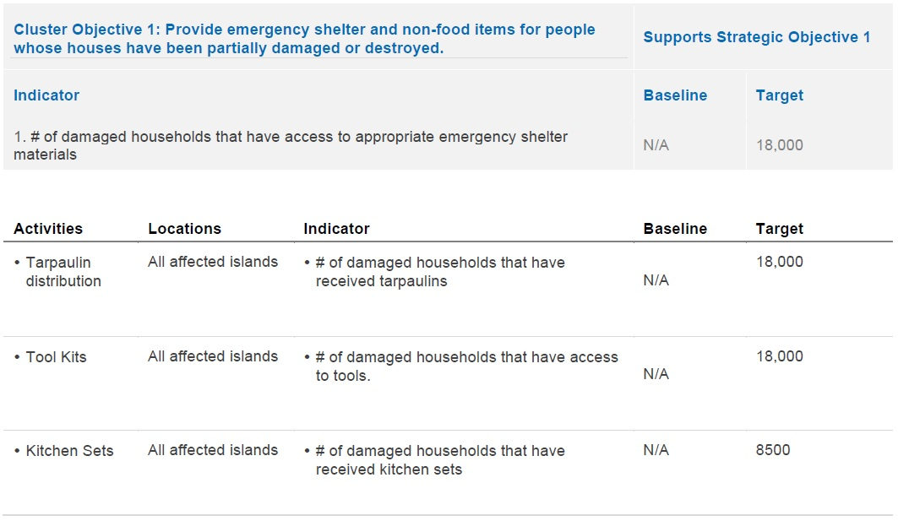
2. IM Update
Response

Slide 5
2. IM Update
SC Vanuatu Primary Strategic Objective Progress Map
SC Vanuatu Primary Strategic Objective Progress Table

Slide 6
2. IM Update
Early Recovery
Includes
Shelter Tool Kits (overlap with SC Objective 1)
Fixing Kits
Shelter Awareness Training
Shelter Reconstruction
Not yet able to identify scope of these activities because not all agencies are able to identify total number of households to be reached.

Slide 7
2. IM Update
SC Vanuatu Completed, Ongoing & Planned Early Recovery Activities Table
SC Vanuatu 3W Island Activity by HH Reached Table

Slide 8
2. IM Update
3Ws
Please check to update status of activities (planned -> ongoing, ongoing -> complete)
Update HH reached so we can understand scope of your activities
Please contact me for any IM needs – mapping, gap & needs analysis, contact lists, etc…
im.vanuatu@sheltercluster.org
Reminder – 3Ws Due Monday 29 June!

Slide 9
3.1 Strategic Advisory Group
Meeting on Wednesday 24/06: PWD, DLA, UN Habitat and IFRC SCT:
Shelter Cluster governance
Shelter Recovery Strategy
Coordination platform continuum between Shelter Cluster and Housing Sector table

Slide 10
What is the SAG (from Global Shelter Cluster guidance)
The coordination function seeks to engage many Cluster participants, representing various stakeholder groups, in decision-making through consensus management.
The process confers legitimacy only through maximising participation and inclusivity.
This small representative group of no more than fifteen people can be facilitated by the Cluster Coordinator or a representative from a cluster partner agency. Those representing larger NGO constituencies can rotate but this is up to the various NGO to decide.
Meetings should be held according to ‘Chatham House Rules’ i.e comments are incorporated but are not attributable to any particular organization

Slide 11
Objectives of the SAG
Agree composition of the Strategic Action Group (SAG);
Draw up and agree Terms of Reference
Formulate and agree the Cluster’s ‘Strategic Framework’; ensure formal ratification by Government; ensure complementarity with government policies and plans at local level;
Establish ‘Technical Working Groups’ (TWIGs) as required and hold such groups accountable to Terms of Reference agreed by the SAG;

Slide 12
Objectives of the SAG
Formulate and agree advocacy positions on behalf of the Cluster partners;
Provide strategic planning oversight for effective and efficient allocation of resources by Cluster partners;
Provide strategic oversight on integration of cross-Cluster planning and inclusion of cross-cutting issues;
Agree benchmarks and indicators;
Ensure technical standards are agreed and consistently applied;

Slide 13
Stakeholders
Cluster Lead
Cluster co-Lead
United Nations
Civil Society
Governement
Training network
Red Cross
Local NGOs
International NGOs
Protection & Gender
Evacuation Centers
Donors

Slide 14
Stakeholders | Proposed membership | 16
Cluster Lead | PWD & DLA | 2
Cluster co-Lead | IFRC (emergency & Preparedness), | 1
United Nations | UN Habitat (Recovery) | 1
Civil Society | Council of Chiefs & VCC | 2
Governement | NDMO & ministry of Land | 2
Training network | VNTC | 1
Red Cross | Vanuatu Red Cross | 1
Local NGOs | ADRA Vanuatu | 1
International NGOs | CARE International & Butterfly Trust | 2
Protection & Gender | Women voice (to be identified) | 1
Evacuation Centers | IOM | 1
Donors | To be identified | 1

Slide 15
Objectives of the SAG in Vanuatu
2 meetings planned till end of July (1. Wednesday 8/07 2PM, 2. End of July )
Objectives:
(1) Governance and framework for the Shelter Cluster in Vanuatu
(2) Coordination platform continuum from HAP (Shelter Cluster) to Recovery Framework (Housing sector)
(3) Shelter Cluster Recovery Strategy (from HAP - short term, Recovery Framework - medium term. To potentially liaise with NSDP).
(4) Standards for preparedness and emergency

Slide 16
3.2 Building Code
PWD have consultant to review/update building code as part of building act.
Building code applies in physical planning area (Port Vila and Loungainville). Not applies for peri urbain/informal settlement & rural areas
Need to look at value of traditional building construction standards, between traditional to modern; to see how to develop second building code or include in the new one with Building Back Safer principles.

Slide 17
3.2 Building Code
Need to look at value of traditional building construction standards, between traditional to modern; to see how to develop second building code or include in the new one with Building Back Safer principles.
Building code from 1990 could be used in the meantime. No soft copy, but some hard copies (3 books) available for a cost of 5,000 Vat
Need to get receipt of payment through finance department

Slide 18

3.3 Building Back Safer TWiG
Presentation of Study of local building culture in Vanuatu, North Tanna island, rural settlement, by

Slide 19
3.3 Building Back Safer TWiG
We had APTC (Asian Pacific Technical Collage), TVET (Technical Vocational Education and Training), VIT (Vanuatu Institute Technology) and The Ministry of Education attend the meeting.
APTC –Offer chance to gain Aus/NZ qualifications in Building Construction, they are waiting for funding confirmation.
This training has a strong on-the-job learning component.
So, the current cohort will need a project/job, most likely in post-pam reconstruction, to carry out on-the-job learning to gain the qualifications

Slide 20
3.3 Building Back Safer TWiG
TVET are looking at doing similar training to APTC and will be supporting RTC (Regional Training Centers) to deliver this training.
The are looking at accredited and non-accredited training. They would also be looking at having students join a construction project.
One of there standards for competency is building a small structure, like a meeting space. Others include helping with building bungalows in tourism sector.

Slide 21
3.3 Building Back Safer TWiG
VIT will be delivering some construction training for TVET.
It was discussed what the training would include and what existing modules could be used. TVET could put a non-accredited short course together but APTC would have to work to AUS/NZ standards.
Ministry of Education would like the opportunity to see what modules would be included and have input to this. They suggested that the first modules could include the Shelter Cluster four key BBS messages. This is planed to be done at the next BBS TWiG meeting.

Slide 22
3.3 Building Back Safer TWiG
Going forward it seems that the construction of kindergartens that some NGO’s are considering would be an opportunity for the construction student to get hands on training.
We need to understand what locations the vocational trainers will be targeting, what level of training will be delivered, how many students can be trained and how long the training will take.
The TWiG was informed that there is building code/handbook in Vanuatu that needs to be implemented and disseminated more.
The next BBS TWiG meeting will be held on 7 July 2pm in the PWD conference room.

Slide 23
3.4 NDMO LL Workshop
Wednesday 24 and Thursday 25
Various Shelter Cluster partners participation
IFRC 3 SCT members attending
Shelter Cluster as part of last panel with WASH,

Slide 24
4. Partners update and issues
Salvation Army & Liberty for the nation project

Slide 25
5. AOB

