Slide 1

Shelter Cluster Vanuatu Meeting
02 July 2015
PWD Offices, Port-Vila

Slide 2
Agenda
1. Introduction
2. IM Update
3. Updates and discussion
Recovery Framework, "Strengthening Ni-Vanuatu Resilience", priorities and project submissions
Shelter Cluster Strategic Framework & SAG meeting
VAT exemption for shelter material process by NDMO
CWC - Shelter Building Back Safer Radio show
Vanuatu National Statistic Office presentation
4. Partners update and issues
5. AOB

Slide 3
2. IM Update
Purpose
Response - Show the progress and coverage of Shelter Cluster partners towards achieving ‘Cluster Objective 1’, which supports the Humanitarian Action Plan’s ‘Primary Strategic Objective’ that covers all response activities of every cluster.
Early Recovery - Show the activity number and coverage of shelter tool kit & fixing kit distributions along with shelter awareness training & shelter reconstruction.
Reminder – 3Ws Due Monday 13 July!

Slide 4
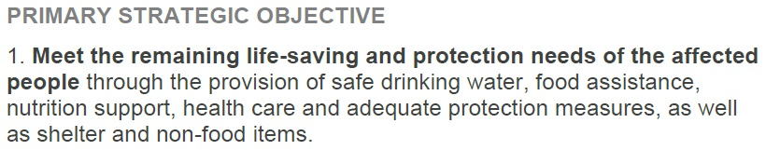
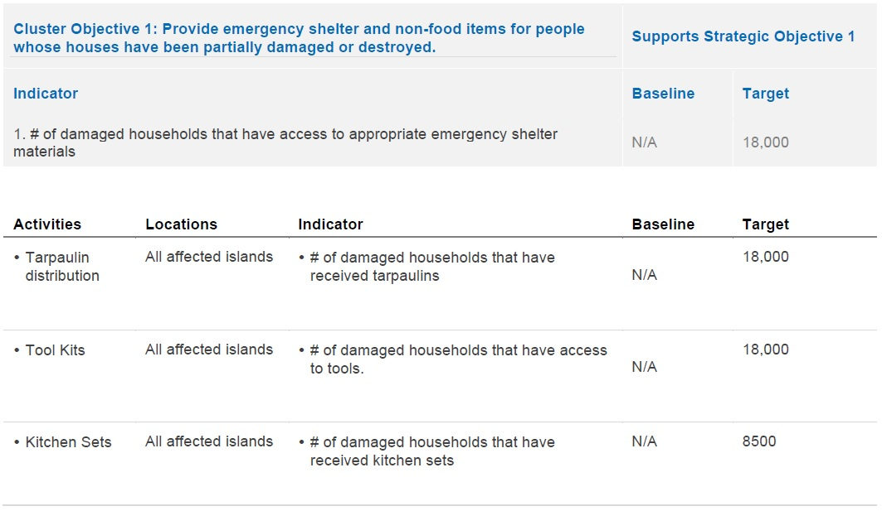
2. IM Update
Response

Slide 5
2. IM Update
SC Vanuatu Primary Strategic Objective Progress Map
SC Vanuatu Primary Strategic Objective Progress Table

Slide 6
2. IM Update
Early Recovery
Includes
Shelter Tool Kits (overlap with SC Objective 1)
Fixing Kits
Shelter Awareness Training
Shelter Reconstruction
Not yet able to identify scope of these activities because not all agencies are able to identify total number of households to be reached.

Slide 7
2. IM Update
SC Vanuatu Completed, Ongoing & Planned Early Recovery Activities Table
SC Vanuatu 3W Island Activity by HH Reached Table

Slide 8
2. IM Update
3Ws
Please check to update status of activities (planned -> ongoing, ongoing -> complete)
Update HH reached so we can understand scope of your activities
Please contact me for any IM needs – 3Ws, mapping, gap & needs analysis, contact lists, etc…
im.vanuatu@sheltercluster.org
Reminder – 3Ws Due Monday 13 July!

Slide 9
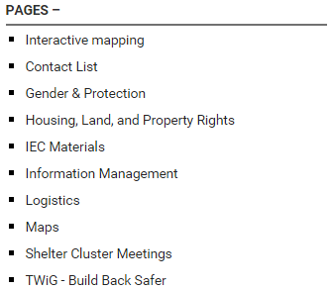
2. IM Update
Website
Our website has lots of resources, including:
https://www.sheltercluster.org/response/vanuatu-cyclone-pam-2015

Slide 10
3.1 Recovery Framework

Slide 11
3.2 Shelter Cluster Strategic Framework & SAG meeting

Slide 12
Objectives of the SAG in Vanuatu
2 meetings planned till end of July (1. Wednesday 8/07 2PM, 2. End of July )
Objectives:
(1) Governance and framework for the Shelter Cluster in Vanuatu
(2) Coordination platform continuum from HAP (Shelter Cluster) to Recovery Framework (Housing sector)
(3) Shelter Cluster Recovery Strategy (from HAP - short term, Recovery Framework - medium term. To potentially liaise with NSDP).
(4) Standards for preparedness and emergency

Slide 13
Stakeholders
Cluster Lead
Cluster co-Lead
United Nations
Civil Society
Governement
Training network
Red Cross
Local NGOs
International NGOs
Protection & Gender
Evacuation Centers
Donors

Slide 14
Stakeholders | Proposed membership | 16
Cluster Lead | PWD & DLA | 2
Cluster co-Lead | IFRC (emergency & Preparedness), | 1
United Nations | UN Habitat (Recovery) | 1
Civil Society | Council of Chiefs & VCC | 2
Governement | NDMO & ministry of Land | 2
Training network | VNTC | 1
Red Cross | Vanuatu Red Cross | 1
Local NGOs | ADRA Vanuatu | 1
International NGOs | CARE International & Butterfly Trust | 2
Protection & Gender | Women voice (to be identified) | 1
Evacuation Centers | IOM | 1
Donors | To be identified | 1

Slide 15
3.3 VAT Exemption

Slide 16
3.4 CWC - Shelter Building Back Safer Radio show

Slide 17
3.5 Vanuatu National Statistic Office presentation

Slide 18
4. Partners update and issues

Slide 19
5. AOB

