Slide 1

Shelter Cluster Vanuatu Meeting
09 July 2015
PWD Offices, Port-Vila

Slide 2
Agenda
1. Introduction
2. IM Update
3. Updates and discussion
Vanuatu Radio Talk Back on shelter and building back safer
Update on SAG 08/07 meeting with its recommendations regarding shelter cluster lead and Recovery framework submission process
Feedback on Building Back Safer TWiG
Objectives of incoming evaluation of the effectiveness of the shelter operational response following the Cyclone Pam.
4. Partners update and issues
5. AOB

Slide 3
2. IM Update
Purpose
Remaining gaps throughout all islands but especially Efate and Tanna.
Reminder – 3Ws Due Monday 13 July!

Slide 5
TANNA

Slide 6
EFATE

Slide 7
2. IM Update
3Ws
Please check to update status of activities (planned -> ongoing, ongoing -> complete)
Update HH reached so we can understand scope of your activities
Please contact me for any IM needs – 3Ws, mapping, gap & needs analysis, contact lists, etc…
im.vanuatu@sheltercluster.org
Reminder – 3Ws Due Monday 13 July!

Slide 8
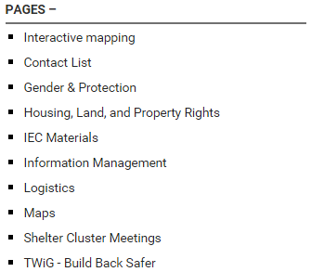
2. IM Update
Website
Our website has lots of resources, including:
https://www.sheltercluster.org/response/vanuatu-cyclone-pam-2015

Slide 9
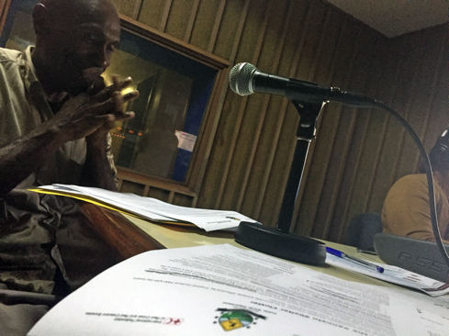
3.1 Vanuatu Radio Talk Back on shelter and building back safer
In coordination with NDMO Communication with Communities working group
1 hour talk on Vanuatu Radio, Monday 06/07
Cluster lead (PWD) and co lead (IFRC SCT)
What is the shelter cluster?
What is the response?
Building back safer and
other key messages
Show available in MP3 (58Mo)

Slide 10
3.2 Update on SAG 08/07 meeting
Attendance of DLA, PWD, NDMO, IFRC SCT, UN Habitat, DFAT, Vanuatu Red Cross, Butterfly trust, MOIA sector analyst, CARE International, IOM
Key discussions around Shelter Cluster coordination framework and recovery framework.
Consensus for 2 recommendations.

Slide 11
A. To better reflect the need to liaise humanitarian shelter and long term housing issues, and to enhance emergency shelter response and preparedness, the Department of Local Affairs (DLA) is now leading the Shelter Cluster with technical support of PWD; with IFRC (for emergency) and UN-Habitat (for recovery) humanitarian co leads. Shelter cluster will be contributing to preparedness strengthening under the MCCA/NDMO.
The SAG recommend MIPU to prepare letter to DG PMO, confirming its role in the shelter cluster from 13 March to 31 July, The letter need to confirm the transition of the Shelter Cluster lead after 31 July under MOIA as cluster lead with PWD as technical support to the shelter cluster.

Slide 12
B. The SAG would like to have further clarification on submission process regarding:
(1) Different types of projects (projects before PAM, Project already started for the on going response to PAM, Projects already funded and not started and new potential ones after 31 July), and specific template to be used (full GIP form, partial or use of the monitoring template) for submission to the recovery framework.
(2) Projects having different activities linked to different ministries and priority actions.
(3) As there is no actual action under MOIA in the recovery framework for housing, to add additional activities under MOIA related to shelter & housing.
(4) Request an extension of the deadline, due to needed clarification on above issues.
The SAG kindly requests for a workshop with DSPPAC, MOIA & MIPU and MCCA to address above issues.

Slide 13
3.2 Feedback on Building Back Safer TWiG

Slide 14
3.3 Evaluation of the effectiveness of the shelter operational response
Follow up the Shelter & Settlement vulnerability assessment.
Deployment Shelter cluster Team Assessment coordinator and GIS officer (REACH), with the current coordination team and Global Shelter Cluster team support.
3 weeks from mid August

Slide 15
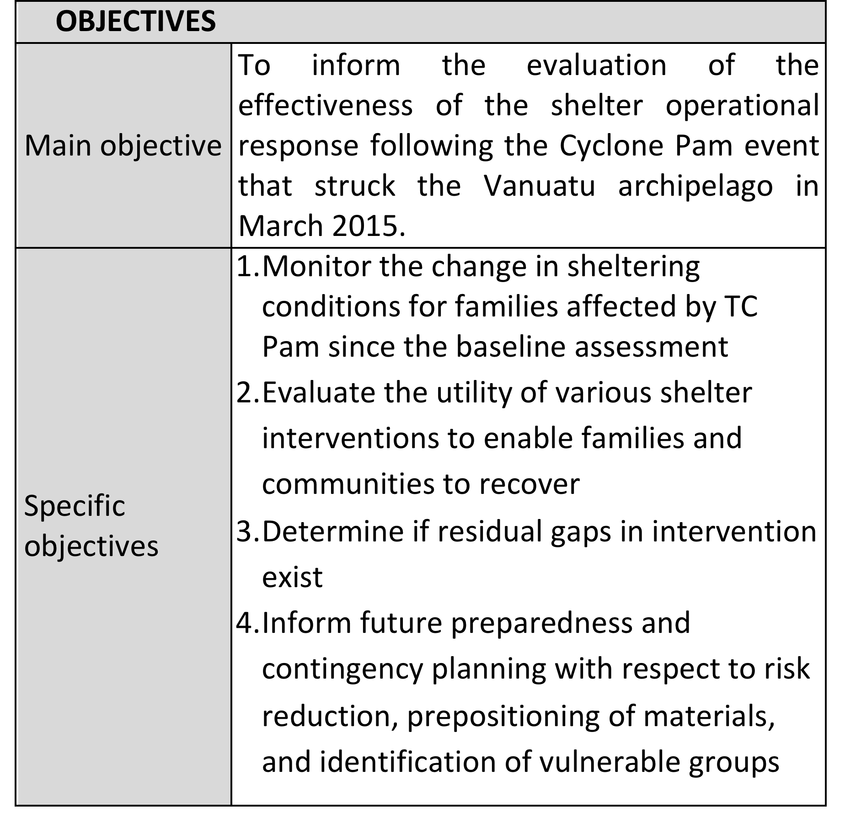

Slide 16
Questions:
1. What about these objectives?
2. What do we want to know?
3. What we want to measure?
4. What would be the key indicators?
5. How cluster partners could support this process?

Slide 17
4 Partners update

Slide 18
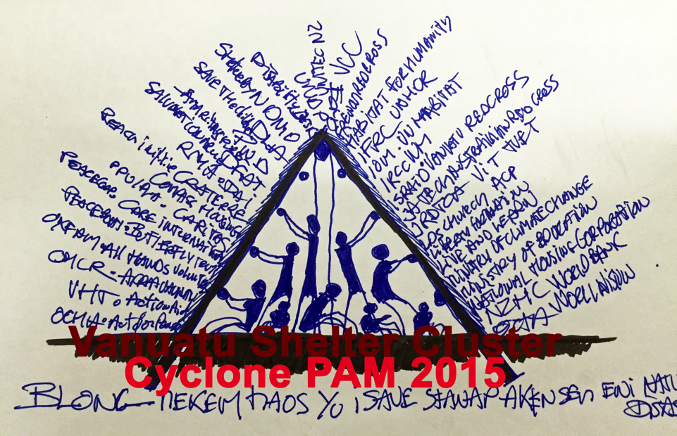
5 AOB, Tshirt DRAFT

