Slide 1

Shelter Cluster Vanuatu Meeting
16 July 2015
PWD Offices, Port-Vila

Slide 2
Agenda
1. Introduction
2. IM Update
3. Updates and discussion
Submission process of shelter/housing projects to the recovery framework
Coordination platform after 31 July for shelter/housing
4. Partners update and issues
5. AOB

Slide 3
2. IM Update
Purpose
1. HAP Update
2. Mapping & Gap Analysis
3. Website and contact
Reminder – 3Ws Due Monday 27 July!

Slide 4
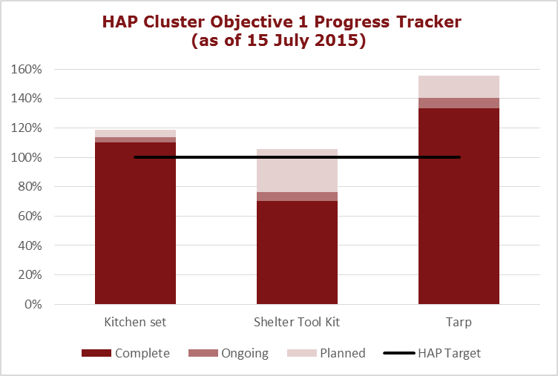
2. IM Update

Slide 5
2. IM Update
Mapping & Gap Analysis (to be distributed)
Master 3W
HAP Cluster Objective 1 – map and supporting table
Breakdown of island activities table
Breakdown of Tanna & Efate activities table

Slide 6
2. IM Update
Website
Our website has lots of resources, including:
Coordination & information management
Technical support & design
Assessment reports (i.e. Shelter & Settlements Report)
Housing, land & property issues
Gender & protection issues in shelter
Build Back Safer documents and guidelines
All Shelter Cluster meeting presentations, notes, etc.
https://www.sheltercluster.org/response/vanuatu-cyclone-pam-2015

Slide 7
2. IM Update
Contacts
If you wish to contact me directly, email:
im.vanuatu@sheltercluster.org
If you wish to email the SC group directly, send an email to:
vanuatu_sheltercluster@googlegroups.com

Slide 8
2. IM Update
3Ws
Updating these remaining 3Ws within the HAP period will be crucial in accurately recognizing shelter partners’ response!
Please check to update status of activities (planned -> ongoing, ongoing -> complete)
Update HH reached so we can understand scope of your activities
Reminder – 3Ws Due Monday 27 July!

Slide 9
3.1 Submission process to the recovery framework
On 16 June 2015, the Office of the Prime Minister released the National Recovery and Strengthening Program Plan entitled “Strengthening ni-Vanuatu Resilience”. In this document, three areas of critical recovery need have been identified:
Restore and develop essential social services
Repair and improve infrastructure
Promote and support ni-Vanuatu livelihoods and lifeways

Slide 10
under the strategy: Assist to rebuild/repair/upgrade private housing and infrastructure, especially on projects submitted to the priority action Strengthening housing & settlement community resilience activities initiated within the HAP and new planned projects aiming to
(1) assist repairing, retrofitting and reconstruction of damaged houses,
(2) households safe shelter awareness and training,
(3) assist repairing, retrofitting and reconstruction of damaged community building,
(4) Local and traditional construction knowledge and capacity strengthening,
(5) Building Back Safer knowledge dissemination, and (6) strengthening local and national capacity in post disaster shelter and housing

Slide 11
Contribution to the action:
PWD will compile, with the support of DLA and Shelter Cluster coordination team, all proposals in the GIP format for submission to MIPU DG by the end of July 2015.
Write and submit detailed UNFUNDED recovery activity proposal for inclusion in the 2 projects. Proposals need to be sent before Wednesday 22, 8PM
Write and submit summaries of PRE-EXISTING ALREADY FUNDED recovery activities for reference in this priority action. It will be done through the on-line survey which will be open from 18 to 22 June,

Slide 12
Contribution to the action:
On line survey and proposal submitted will allow:
Analyse, consolidation of the programme and priorities
Mapping of activities with potential gaps
Scoping of Housing Sector Working Group
Attendance at Housing Sector Working Group meeting, which would tentatively be held on Tuesday 28 June at PWD, is recommended wherein the project will be discussed
Continued and comprehensive submission of 3Ws to the Housing Sector Working Group will ensure that current activities are not overlooked for this priority action.

Slide 13
3.2 Coordination platform after 31 July
Building on the shelter cluster’s coordination platform, which will end on 31July 2105 and partners recovery capacity, Public Works Department (MIPU) will implement a Housing sector working group starting on 1st of August, with the support of DLA (MOIA) and NDMO (MCCA) with the aim of coordinating some of the related priority actions under the strategy: Assist to rebuild/repair/upgrade private housing and infrastructure, especially on projects submitted to the priority action Strengthening housing & settlement community resilience

Slide 14
3.3 Incoming events
Last TWiG on Building Back Safer on Tuesday 21/07 2PM, PWD offices
TWiG on REACH2 preparation next week
TWiG on emergency shelter TBC
Shelter Cluster meeting on Thursday 23/07, 3PM
Housing Working Group meeting on Tuesday 28/07 (TBC)
Shelter Cluster SAG, 5 or 6/08

Slide 15
4. Partner Updates & Issues

Slide 16
5. AOB

